Slide 1
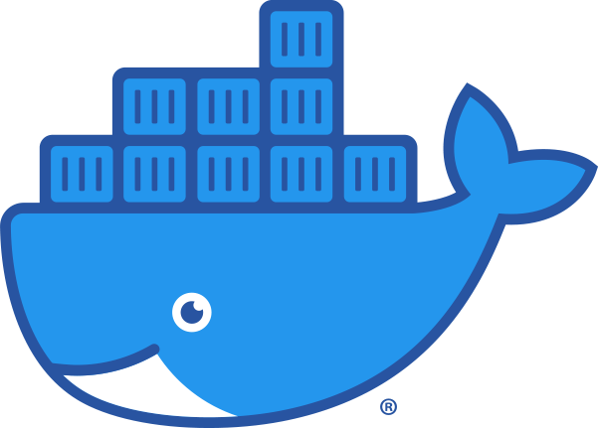
Docker
A Gentle Introduction
By: Pole

Slide 2
Motivation
Traditional developing way:
SSH into production server
Go to project directory
$ git pull
Install dependencies (curl, interpreter for our Language…)
Deploy our code

Slide 3
Motivation
Running multiple applications on the same host:
Isolation for security reasons;
Separate hosts for each application;
Run in different VMs in the host

Slide 4
Solution: Docker
Faster development;
Encapsulation is easy;
Same behavior on local machine, dev, staging and production server;
Easy to scale;
Good monitoring;
Lighter than VMs (faster boot, less space taken, not OS-dependent);
When using Docker on applications, we implicitly standardize our application (by following Docker’s guidelines), hence making our application runnable on any environment, mainly because Docker is used by 99% of cloud services;

Slide 5
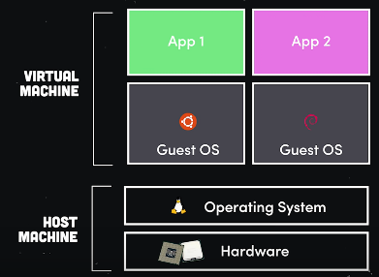
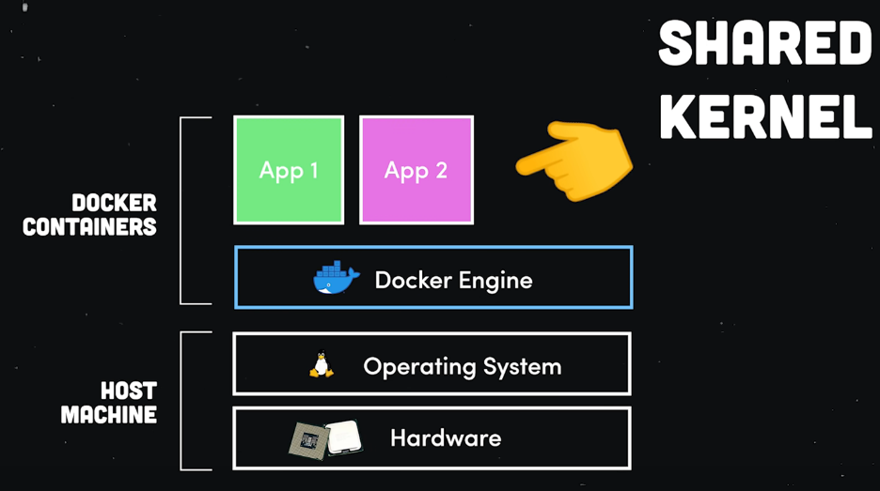
How it works?
“Docker is just a fancy way to run a process, not a virtual machine.”

Slide 6
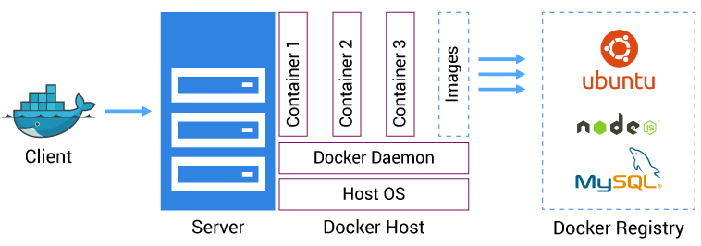
How it works?

Slide 7
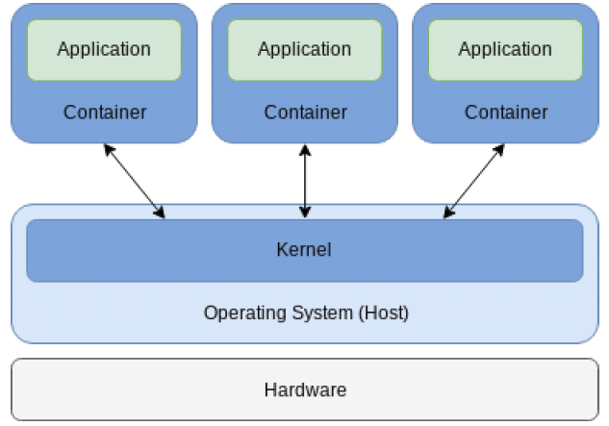
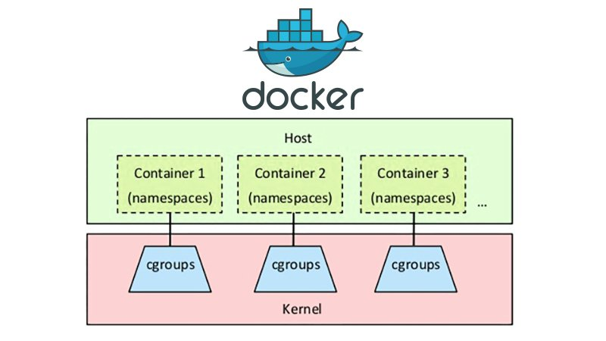
Why Docker excels?
AuFS/overlay2/bttrfs: layered filesystem;
LXC/runC (libcontainer): relies on namespaces and cgroups;
Shares resources with the Host OS;

Slide 8
Why Docker excels?
The layered filesystem is one of the factors why Docker excels;
VM case:
1GB container image -> 1 VM that needs 1GB x NumberOfVMs
Docker case: (layered filesystem)
The 1GB Image is shared throughout the whole OS kernel, 1000 containers running?

Slide 9
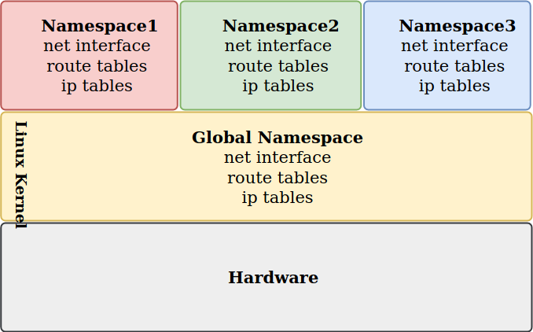
Why Docker excels?
LXC (Linux Container): namespaes

Slide 10
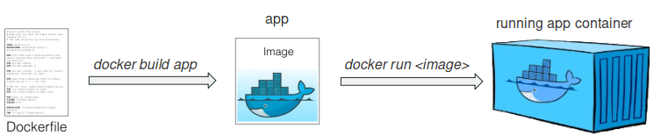
Terminology
Container: instance that encapsulates wished SW, created by images;
Image: basic element of a container;
Ports: a way to containers to talk with each other or with the Host OS
Volume: shared directory

Slide 11
BORA METER MÃO EM DOCKER

