Slide 1



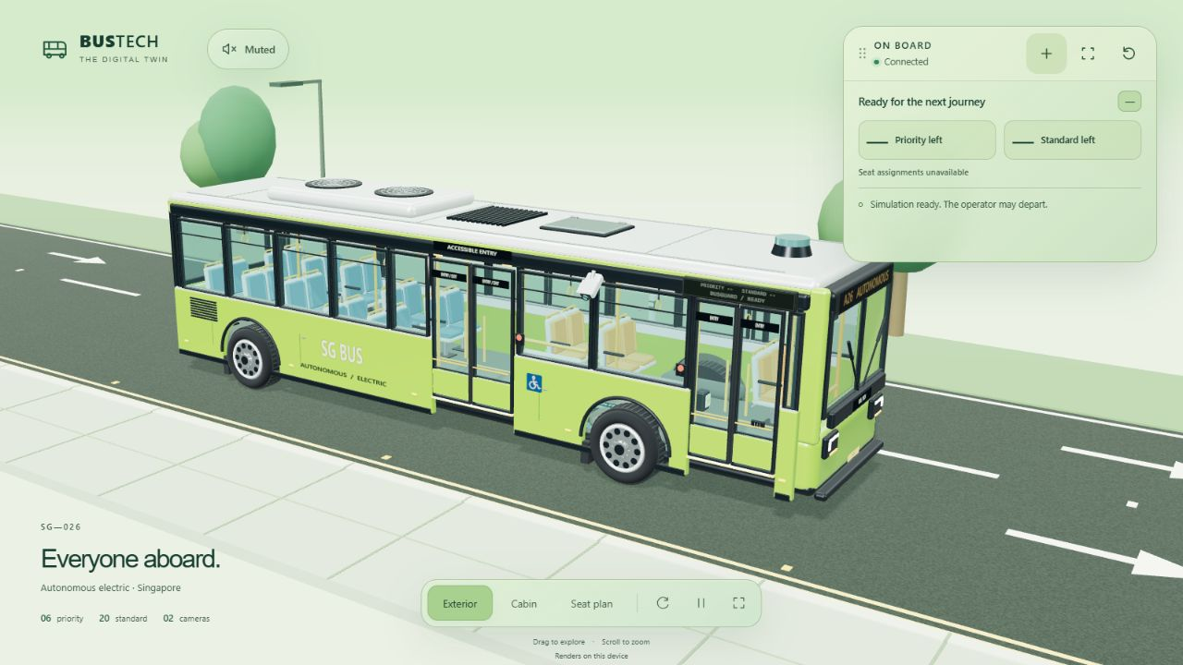


TEAM NAME: TO CONFIRM
BUSGUARD
Team members: to confirm
Connected passenger
assistance
Singapore Polytechnic
DRAFT · team details pending
Inclusive boarding, coordinated assistance
Passengers need a clear way to ask for help and enough time to board.
BusGuard connects two CCTV views, RFID profiles and passenger requests through one local controller.
3D bus visualization • vehicle outputs are simulated
One controller keeps every interface in step
Two CCTV views
RFID profiles
Passenger app
Outside activity · inside count
Known card · board / alight
Ramp · time · seat · guidance
Shared assistance controller
Detection console · 3D bus · passenger updates · clear announcements
Time for the passenger
Fresh evidence before departure
15 s quiet window. RFID: 10 s from a tap.
Ramp request: 20 s. Admission closes at
50 s; accepted time finishes in full.
After doors close: 5 s of fresh results
with no standing detected. Stale feeds
and active holds keep departure held.
Physical inputs: CCTV + ESP32 RFID. Simulated outputs: ramp, doors and bus motion.
Notes:
BusGuard / Singapore Polytechnic. Team name and member names are awaiting confirmation. Source: vision4479/README.md, docs/SYSTEM_WORKFLOW.md, docs/ARCHITECTURE.md, docs/VALIDATION_CURRENT.md (29 September 2026). Actual project screenshot supplied from an isolated demonstration backend; it is a 3D visualization, not a live-camera result or physical ramp demonstration. CCTV cameras and ESP32 + RC522 RFID reader are physical inputs. Doors, ramp, vehicle motion and mobility-position confirmation are simulated. Source verification recorded 936 backend and 307 browser tests passing and a successful 3D build; this is not measured detection accuracy or user-study evidence. No-standing is a detector result, not proof that every passenger is seated. Standing detection and camera placement require evaluation. The official template is 8001000 × 11328400 EMU (222.25 × 314.6778 mm); its filename suggests a larger poster but the intended print dimensions require confirmation. Official template background and competition branding retained. Singapore Polytechnic logo supplied by user.

