Slide 1
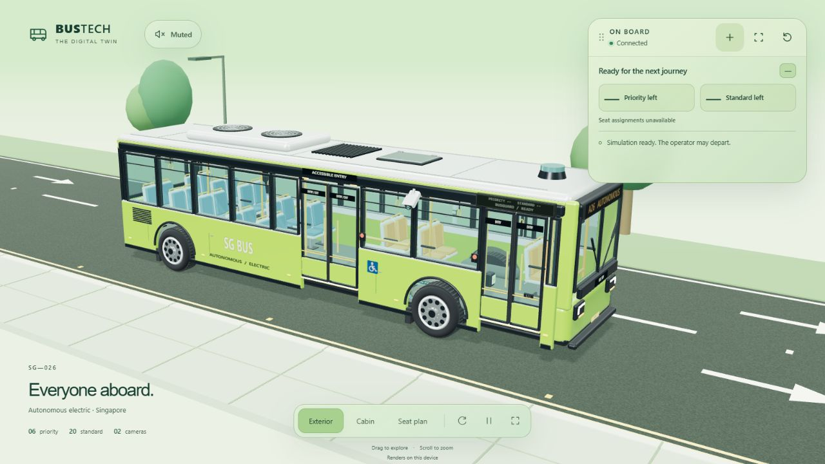
BusGuard
Autonomous
passenger assistance
Singapore BusTech Grand Challenge 2026
IHL Student Category
3D software preview
Team and institution: TBC
01
Notes:
Good morning. Our project is BusGuard, an autonomous passenger assistance prototype for the Singapore BusTech Grand Challenge. It connects camera observations, RFID taps and a passenger website to one local controller. We will show physical camera and card-reader inputs alongside a software simulation of the bus, doors and ramp. Our focus is how these parts respond together when a passenger needs help.
Sources: SGBTGC 2026 - IHL Updates 18 Aug 2026.pdf, pages 7–13 and 16. Project: vision4479/docs/SYSTEM_WORKFLOW.md and ARCHITECTURE.md. Team and institution require confirmation before submission.
Visual source: tmp/submission/assets/bus-view.png. Screenshot of the current project in an isolated fresh local demonstration environment. No CCTV or private passenger data. Software preview only, not measured sensor or physical-hardware trial evidence.

Slide 2
Assistance at the bus stop
Passengers need a clear
way to ask for help and
know what happens next.
More time to board or alight
Step-free access
Spoken and visible instructions
Passengers declare age-related or pregnancy-related needs through a request or card profile.
02
Notes:
A passenger may need extra boarding time, step-free access, or information in a form they can use. In an autonomous bus, that need still requires a clear response. Our design gives passengers an explicit way to ask and see what happens next. We use camera observations for visible objects and standing checks. We use a request or configured card profile for needs such as priority seating. We do not guess pregnancy or age from appearance. The aim is a more understandable assistance process, whose benefit still needs evaluation with users.
Sources: official challenge update, pages 8–13. Project: SYSTEM_WORKFLOW.md, passenger request API and RFID profiles. No user satisfaction measurement or demographic inference claim.

Slide 3
One shared assistance controller
Inputs
Local server
Connected websites
Outside CCTV
Detection and tracking
Assistance rules
Shared bus state
Detection console
Inside CCTV
Passenger app
ESP32 RFID
Passenger requests
3D bus display
Cameras and RFID supply physical inputs. Bus movement, ramp and doors remain simulated.
03
Notes:
The outside camera observes boarding activity while the doors are open. The inside camera continues counting throughout the journey and checks standing after door closure. The ESP32 sends RFID card events over the local network. Passengers can also send a request from their phone. One server combines these inputs and owns the timing and assistance state. The detection console, passenger app and 3D bus all show that same state. The viewer can run on another device, so it does not need to share the detection computer's graphics workload. The vehicle outputs here are simulated.
Sources: ARCHITECTURE.md, SYSTEM_WORKFLOW.md, vision/api.py, vision/viewer.py, vision/passenger_site.py and firmware/BusGuardRFID/README.md. This native diagram describes current software connections, not a deployed vehicle network.

Slide 4
Boarding time follows activity
15 seconds
Initial quiet window after doors fully open.
10 seconds per RFID tap
Accepted taps protect time from that tap.
20 seconds for ramp access
An accepted passenger request protects its full allowance.
50-second admission cutoff
New requests and taps close. Earlier accepted allowances finish.
Example: a tap accepted at 49 seconds can finish at 59 seconds.
04
Notes:
The operator's Stop button brings the simulated bus to the next station. Once the doors are fully open, a quiet stop has a fifteen-second window. Fresh outside activity can keep it open. An accepted RFID tap protects ten seconds from the tap, and a ramp request protects twenty seconds from acceptance. At fifty seconds, the controller closes new admissions. However, it honours an allowance accepted before that cutoff. A tap at forty-nine seconds can therefore finish at fifty-nine. These are deadlines from accepted events, not ten seconds stacked onto every retry. The system gives a departure warning and then closes access when the conditions allow.
Sources: SYSTEM_WORKFLOW.md and vision/scenario.py. Initial window 15 s; RFID 10 s; ramp request 20 s; new-admission cutoff 50 s. The 10-second departure notice and safety conditions can delay actual movement.

Slide 5
Standing checks and passenger counts
5 seconds
30 seconds
Before departure
Cabin count cross-check
Doors closed. Fresh valid checks
must report no standing person.
Standing or missing evidence
restarts confirmation.
RFID updates the count immediately.
The rounded mean of 30 one-second
camera samples corrects it.
Seat distribution remains estimated.
Inside counting stays active. Outside detection runs only with doors fully open.
05
Notes:
Standing confirmation and occupancy correction serve different purposes. After the doors close, the standing gate requires five continuous seconds of fresh successful checks with no standing person detected. A standing result or missing evidence resets that confirmation. Other holds still apply. During travel, standing produces a reminder rather than an abrupt stop. Occupancy changes immediately when an accepted card tap boards or alights someone. The inside camera then cross-checks that baseline using the rounded mean of thirty one-second samples. The camera does not add a second count on top of RFID. Neither zero standing detections nor a stable mean proves perfect perception.
Sources: SYSTEM_WORKFLOW.md, STANDING_DEPARTURE.md, vision/departure.py and vision/cabin_count.py. A standing-only negative inference is not proof every passenger is seated. Full-cabin coverage and complete fresh samples are required for correction.

Slide 6
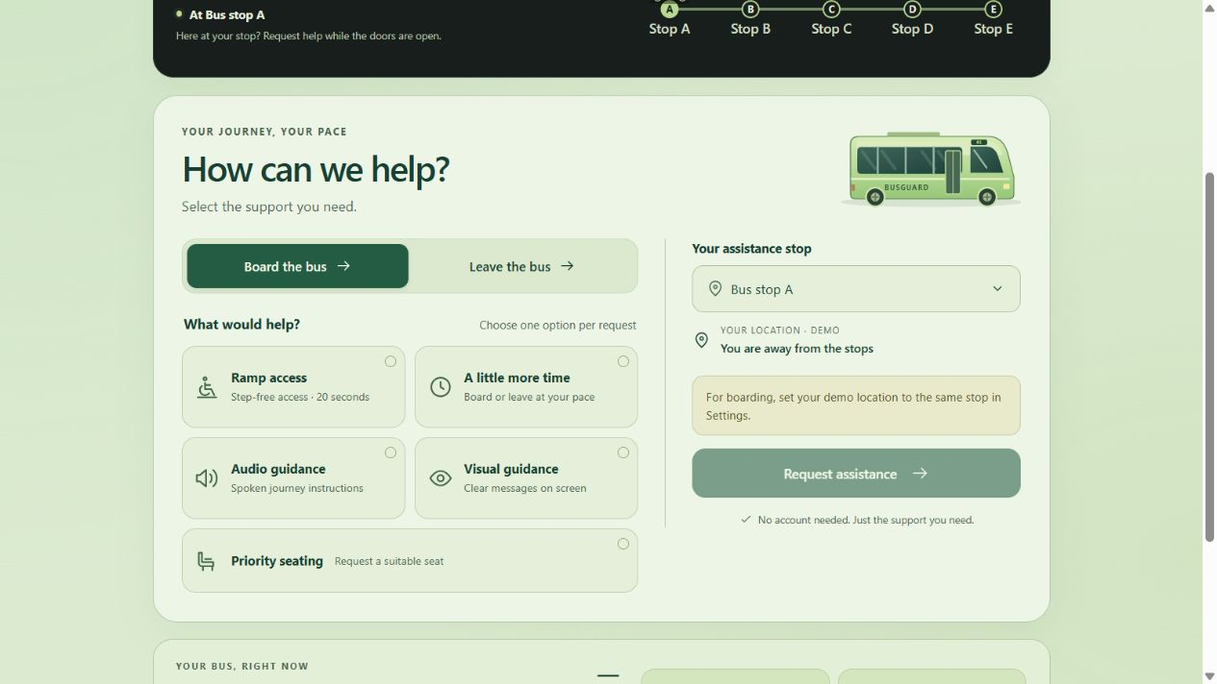
A passenger chooses one request
Ramp access, more time, priority seating,
spoken guidance or visual guidance.
A shared countdown explains the accepted allowance.
“Hey BusGuard” activates brief voice help.
The reply finishes before listening resumes.
Arrival alerts offer visible messages, optional speech and supported vibration.
Passenger app software preview
06
Notes:
The passenger app puts assistance commands first. A passenger chooses one option and receives a shared status and countdown. New assistance requests require an eligible stop and location in the demonstration. Voice offers another route to those same controls: Hey BusGuard activates it, and the assistant checks current state before answering. Replies are brief and finish before listening resumes. Arrival alerts can show a message, speak it, and vibrate when the device supports that feature. We retain text controls because internet access, microphone permissions and browser support can differ between passengers' devices.
Sources: SYSTEM_WORKFLOW.md, VOICE_SETUP.md, static/passenger and vision/voice.py. Voice uses OpenAI and trusted HTTPS on phones. Vibration and foreground/background delivery are browser-dependent.
Visual source: tmp/submission/assets/passenger-commands.png. Screenshot of the current project in an isolated fresh local demonstration environment. No CCTV or private passenger data. Software preview only, not measured sensor or physical-hardware trial evidence.

Slide 7
Engineering contribution
One authoritative state
The phone, console and bus display share the same decision.
Controlled event handling
Fresh camera evidence, repeat-safe RFID taps and bounded request allowances.
Visible reasons for holds
Standing, missing input and access conditions remain distinct.
YOLOE and OpenAI supply model capabilities. The project integrates the assistance workflow.
07
Notes:
Our contribution is the connected workflow around the models. One state keeps the three websites consistent. Event handling separates fresh evidence from old frames and repeat card deliveries. The controller keeps accepted allowances and admission cutoffs explicit. It also displays why departure is held, so a missing camera is not confused with a standing passenger. YOLOE provides detection and OpenAI provides optional voice capabilities. We credit those components and identify our work as the integration, controller logic and passenger experience, rather than claiming a new foundation model.
Sources: ARCHITECTURE.md, SYSTEM_WORKFLOW.md, THIRD_PARTY_NOTICES.md and current source. Official judging originality criterion: update PDF page 16. No claim that third-party models are original team inventions.

Slide 8
Evidence and next validation
Implemented software
Next evaluation
Shared controller and three websites
Timing, ownership and retry checks
Camera and RFID integration paths
Standing errors on labelled cabin scenes
Physical reader and Wi-Fi recovery
Usability with accessibility users
The demonstration uses simulated doors, ramp and motion.
We have not established real-bus accuracy or passenger satisfaction.
08
Notes:
The implemented software provides a connected controller and repeatable cases for timing, ownership, retries and recovery. The next evidence we need is a labelled cabin evaluation of standing errors, a physical reader and Wi-Fi recovery trial, and usability testing with people who use these accessibility features. We have not established real-bus accuracy or measured passenger satisfaction. Doors, ramp and motion remain simulated. The video and demonstration will show the current prototype, including a hold and recovery case, so you can judge both the intended response and the limits of the evidence. Thank you.
Sources: DEMONSTRATION_GUIDE.md and SYSTEM_WORKFLOW.md. Official success criteria require reliable recognition, appropriate responses and measurable accessibility/passenger satisfaction improvement (update PDF pages 8 and 13). These improvements remain evaluation targets, not completed findings.

