Slide 1

TinyMLjs
Training an ML microcontroller model using a static webpage

Slide 2

Demo on Cell phone or laptop https://hpssjellis.github.io/tinyMLjs/public/acceleration/a00-best-acceleration-rak2270-sticker-tracker.html

Slide 3
Why use Javascript to train ML for microcontrollers?
1. Reduce deprecation issues
2. Reduce cloud costs
3. Full control of everything
4. True data privacy
5. No need for an internet connection
6. Huge WebML community
7. Ease of use for beginners and students

Slide 4
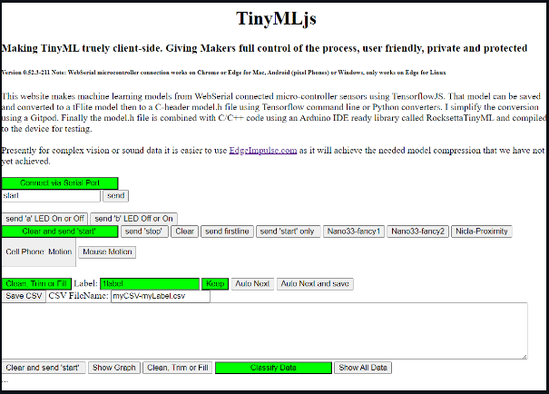
Start the SPA (single page application)

Slide 5
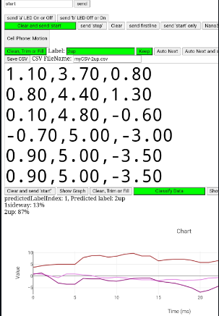
Collect Data

Slide 6
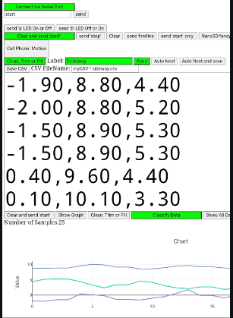
I do 3 moving sideways and 3 moving up. Change the label!

Slide 7
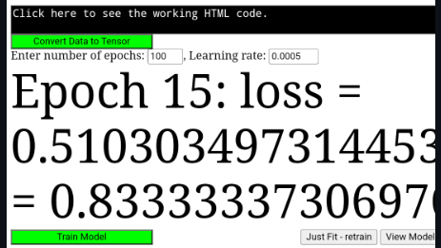
Clean, Trim and Fill, then convert to tensor, then train

Slide 8
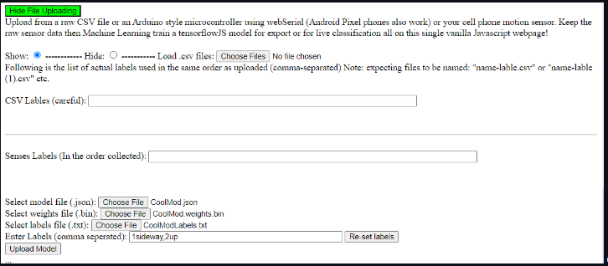
Possible to both save and upload saved CSV file data

Slide 9
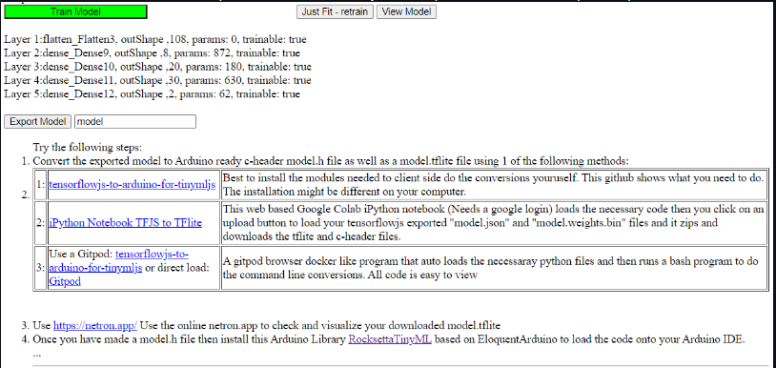
Now the hard part, converting tfjs to tflite then a c-header file

Slide 10
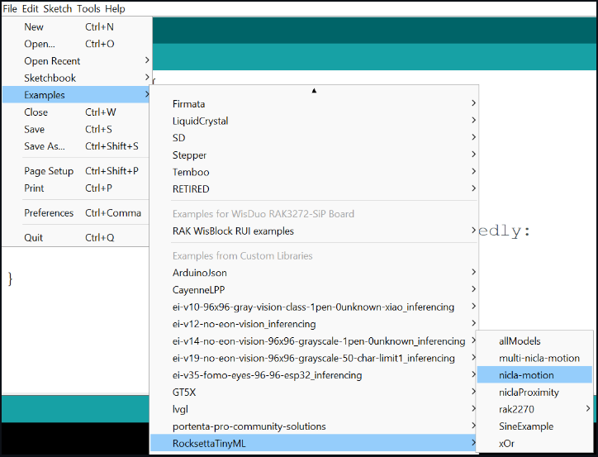
Once RocksettaTinyML installed on the Arduino IDE, load an example and…

Slide 11
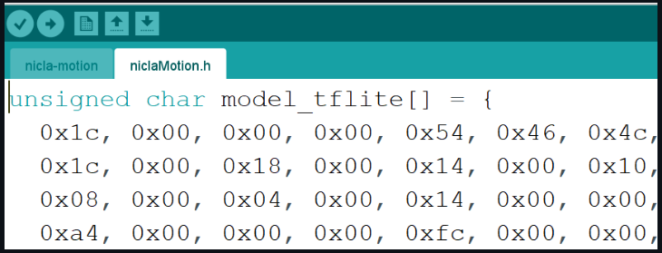
Replace the c-header file with your new c-header file

Slide 12
Why use Javascript to train ML for microcontrollers?
1. Reduce deprecation issues
2. Reduce cloud costs
3. Full control of everything
4. True data privacy
5. No need for an internet connection
6. Huge WebML community
7. Ease of use for beginners and students

Slide 13
TinyMLjs Demo
A new possibility for Educators teaching Machine Learning for Microcontrollers

