Slide 1
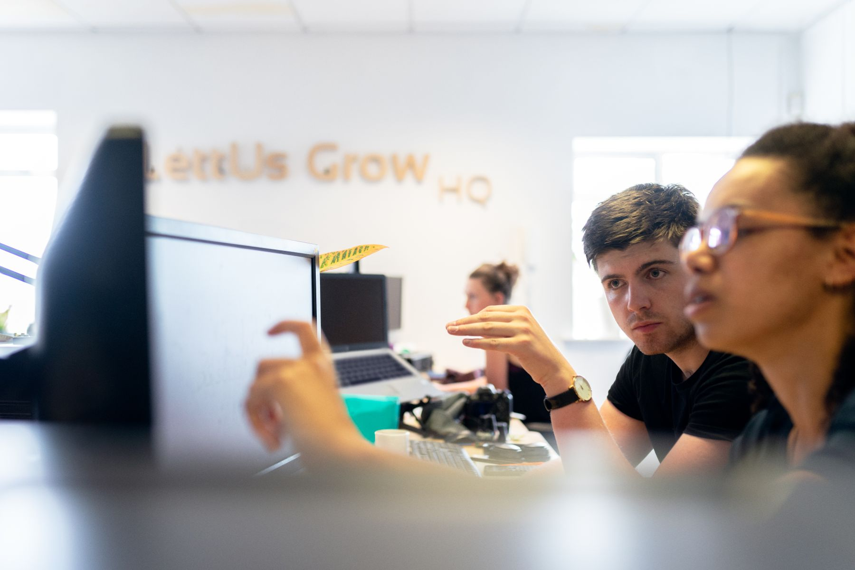
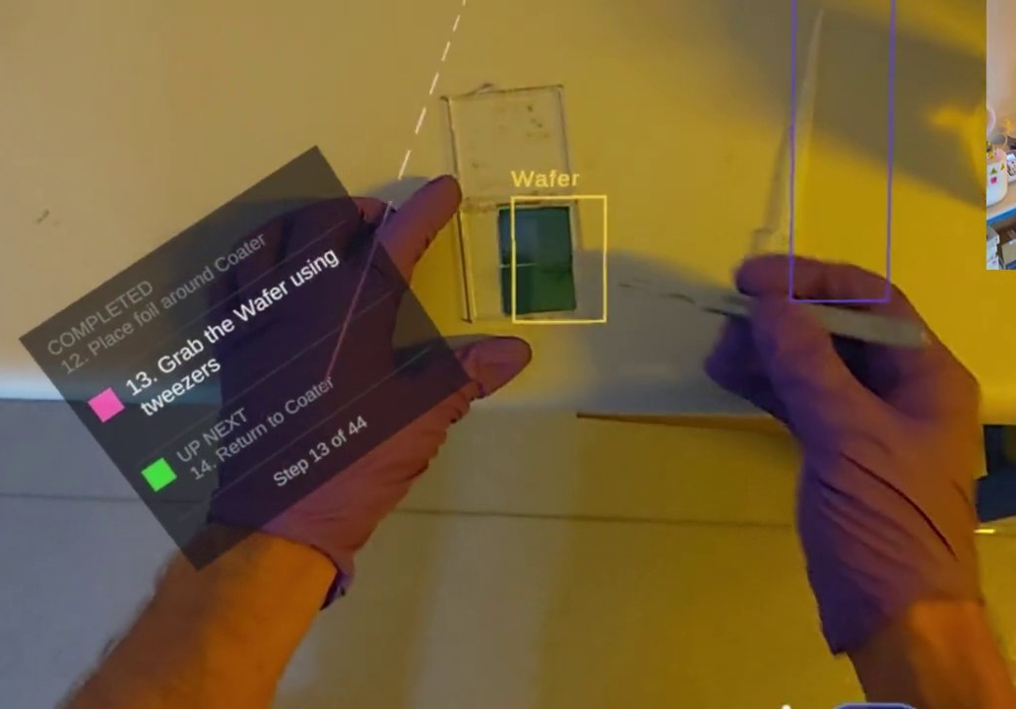
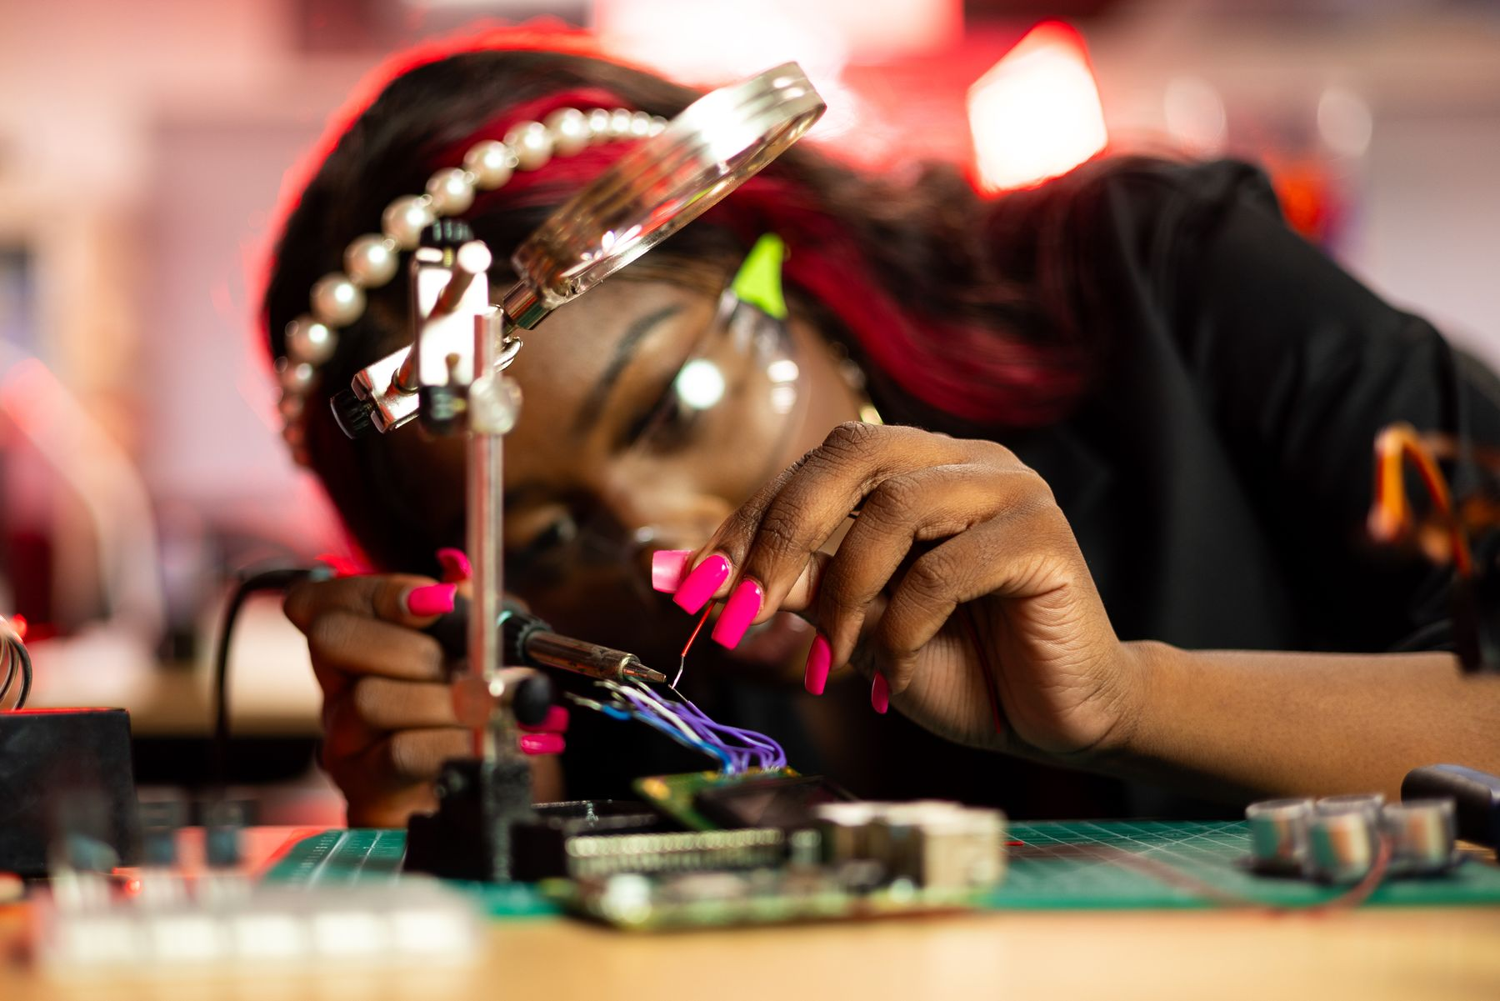
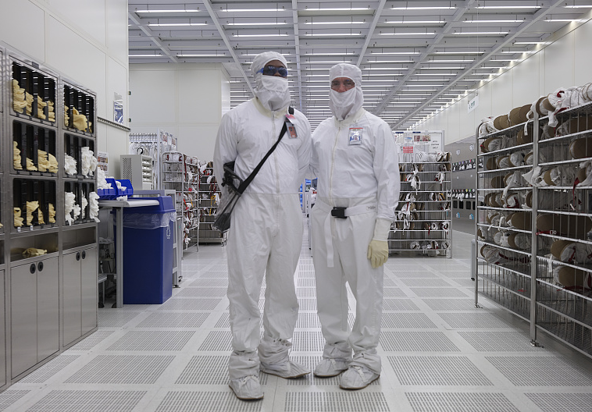
CoRTEX / COLORADO SCHOOL OF MINES
Certificate of Experience on Semiconductor Training Readiness Through Experiential Learning
EXPERIENTIAL LEARNING
PROGRAM GOAL
01
02
03
04
Coursework
Hands-on learning
Industry capstone
Industry placement
Build a foundation in devices, materials, physics, and computing.
Practice microelectronics processing with laboratory work and SMILE tools.
Design, build, and test a project with a semiconductor industry partner.
Bring course, lab, and project experience into an engineering role.
3 credits
3 credits
6 credits
Semiconductor manufacturing
Notes:
Photo sources and intended use:
1. Coursework: ThisIsEngineering, Engineers Working in Office. https://www.pexels.com/photo/engineers-working-in-office-3912378/ — Pexels License https://www.pexels.com/license/ . Representative engineering collaboration, not a photo of Mines students.
2. Hands-on: ARCA spin-coating demonstration from supplied SMILE material. Retained project image.
3. Industry capstone: ThisIsEngineering, Woman Working on Computer Hardware. https://www.pexels.com/photo/woman-working-on-computer-hardware-19895718/ — Pexels License. Representative electronics project work, not a photo of a Mines capstone team.
4. Industry placement: Carol M. Highsmith, Kenneth Rudolph and John Hojnacki at Intel's wafer fabrication facility, Chandler, Arizona, 14 November 2018. Library of Congress, https://www.loc.gov/item/2018703083/ . Rights advisory: No known restrictions on publication. Cropped for layout. This image illustrates semiconductor employment; it does not identify a program partner or placed graduate.
The final stage is the program goal. Course credits remain 3 + 3 + 6.

