Slide 1
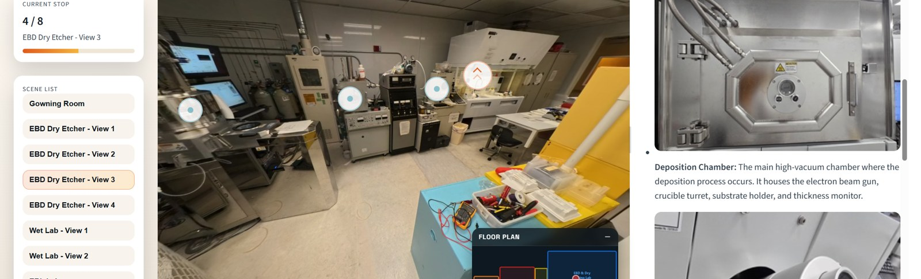
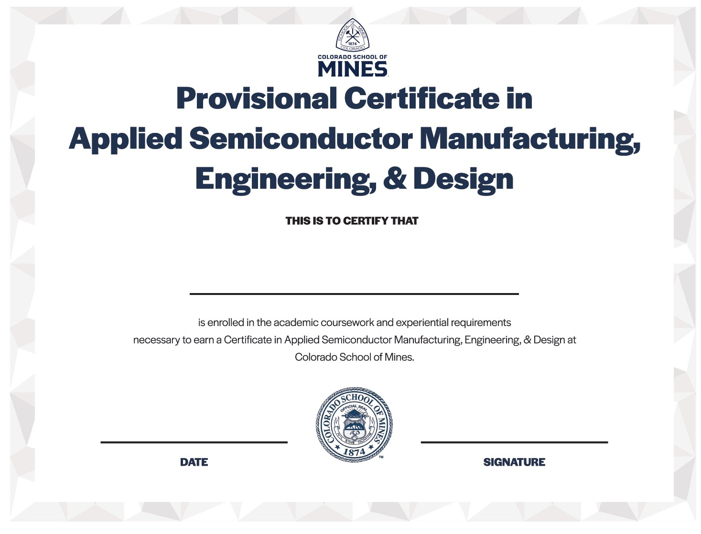
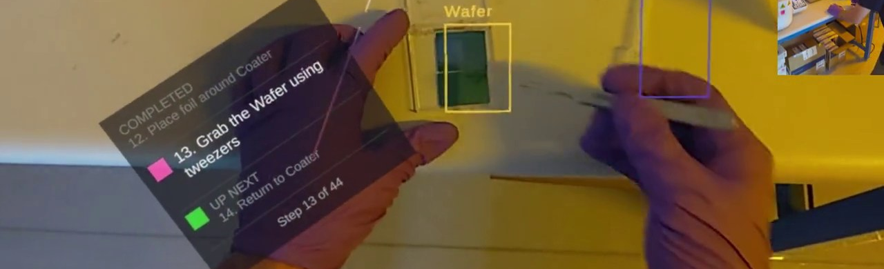
COLORADO SCHOOL OF MINES / CERTIFICATE OF EXPERIENCE
Learn semiconductor engineering through experience
Course concepts → laboratory practice → an industry project
EXPERIENTIAL LEARNING
12 CREDITS TOTAL
01
Coursework
02
Hands-on learning
03
Capstone & industry
Devices
Materials
Industry problem
EXPLORE THE CLEANROOM
Design & build
Physics
Computing
Test & deliver
Certificate sample
PRACTICE WITH AR GUIDANCE
Connect devices, materials, physics, and computing through an approved elective.
Practice microelectronics processing with laboratory work and SMILE tools.
Apply your skills to a project with a semiconductor industry partner.
3 credits · Approved elective
3 credits · Hands-on component
6 credits · Industry experience
Applied Semiconductor Manufacturing, Engineering & Design
NNME Southwest

