Slide 1
MicroFrontends workshop Sprint 3
NashTech – Line DotNet
From April 13 to April 27

Slide 2
What were done in Sprint 2?
Next tasks in Sprint 3
Retrospective
Q&As

Slide 3
What were done in Sprint 2?

Slide 4
What were done in Sprint 2?
MicroFrontends pros and cons
Integration approaches: Routing
Communication patterns: User interface (Custom Event), Global Context
Select framework for demo project: single-spa.js
Select template for demo project: GreenMarket NashTech
Select HTML template for demo project: organi-master

Slide 5
What were done in Sprint 2?
Create github for demo project
Apply main page organi-master to demo project
Split all components/fragments from main page to modules which will written by Angular/React/Vue

Slide 6
02
Next tasks in Sprint 3

Slide 7
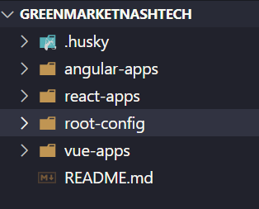
Source code structure

Slide 8
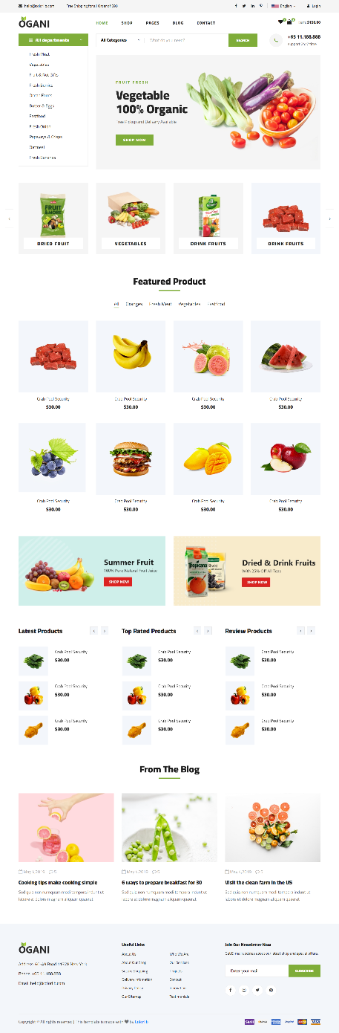
Home page
Header - Angular
Categories - Angular
Hero-main - React
Featured Product - React
From-blog - React
Latest-product - Angular
Footer - React

Slide 9
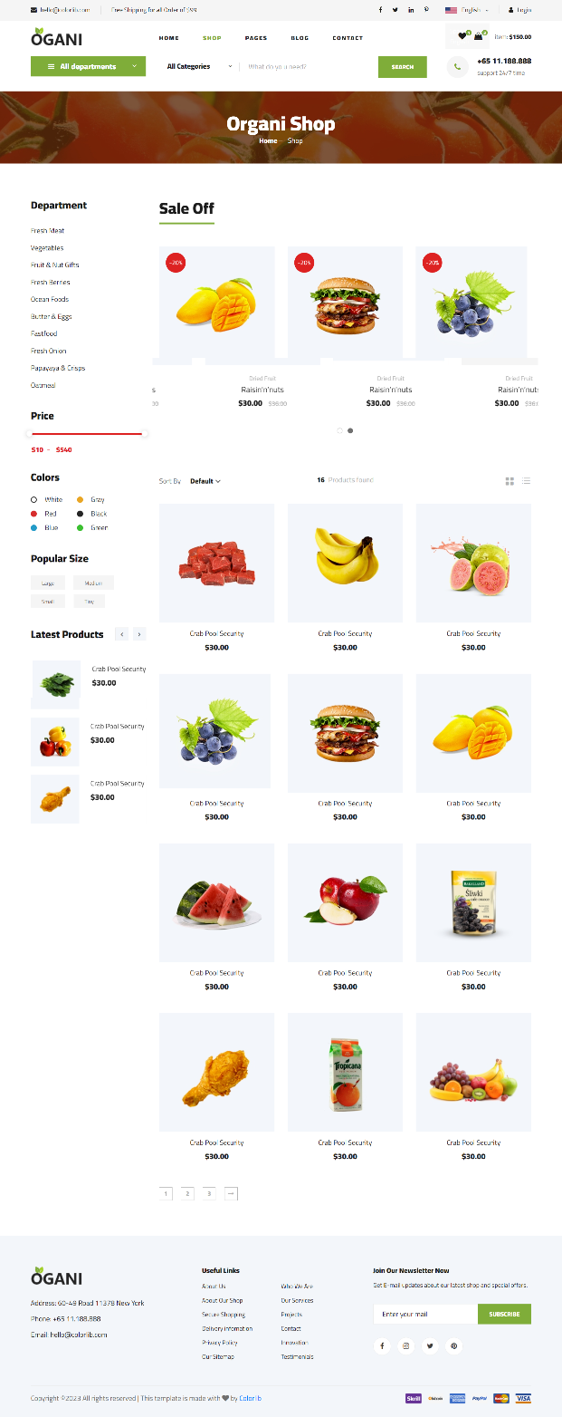
Shop grid page
Hero - React
Header - Angular
Breadcrumb - Angular
Product - Vue
Footer - React

Slide 10

Shop details page
Hero - React
Header - Angular
Breadcrumb - Angular
Product details - React
Related product - Vue
Footer - React

Slide 11
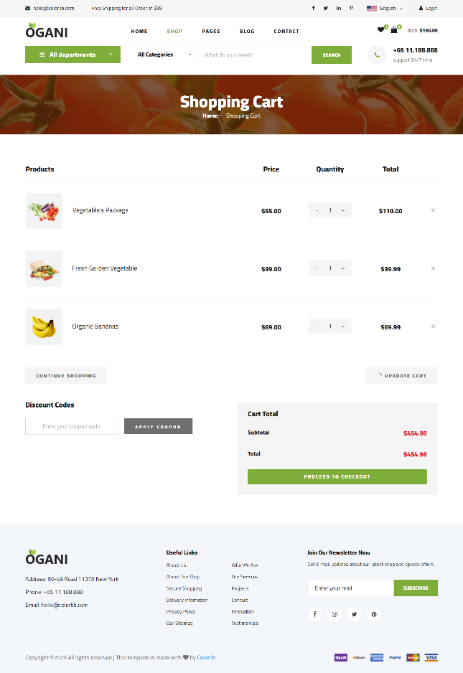
Shopping cart page
Hero - React
Header - Angular
Breadcrumb - Angular
Shopping cart - Vue
Footer - React

Slide 12
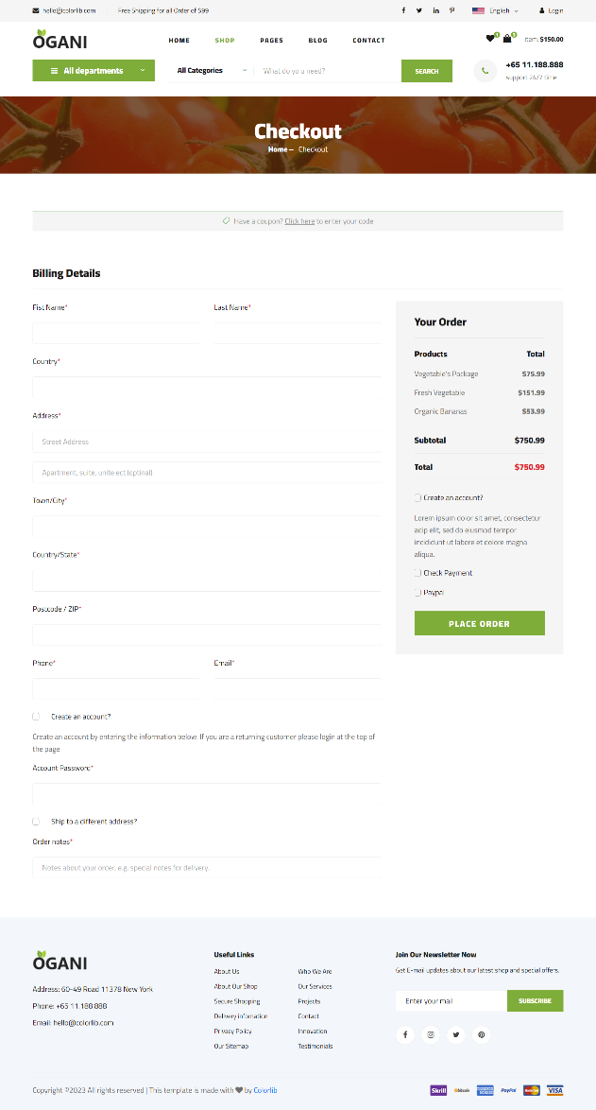
Check out page
Hero - React
Header - Angular
Breadcrumb - Angular
Checkout - Angular
Footer - React

Slide 13
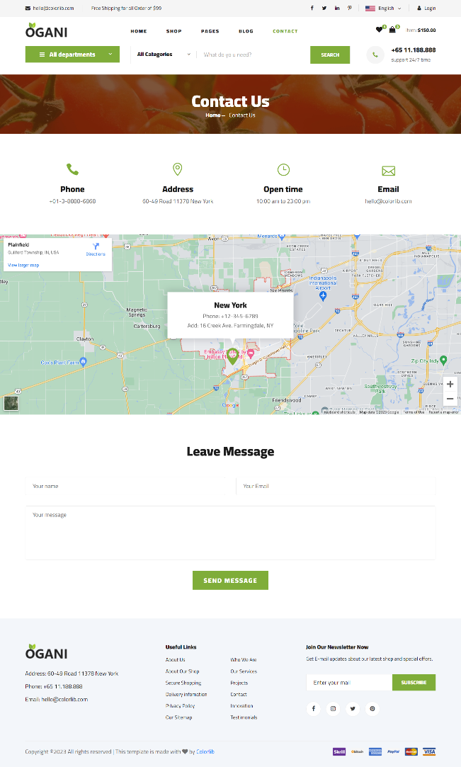
Contact page
Hero - React
Header - Angular
Breadcrumb - Angular
Map - Vue
Contact - React
Contact form - Angular
Footer - React

Slide 14
03
Retrospective

Slide 15
03
Q&As

