Slide 1
MicroFrontends workshop Sprint 2
NashTech – Line DotNet
Mar - 2023

Slide 2
MicroFrontends pros and cons
Integration approaches
Communication patterns
Select framework for demo project
Select template for demo project
Q&As

Slide 3
MicroFrontends pros & cons

Slide 4
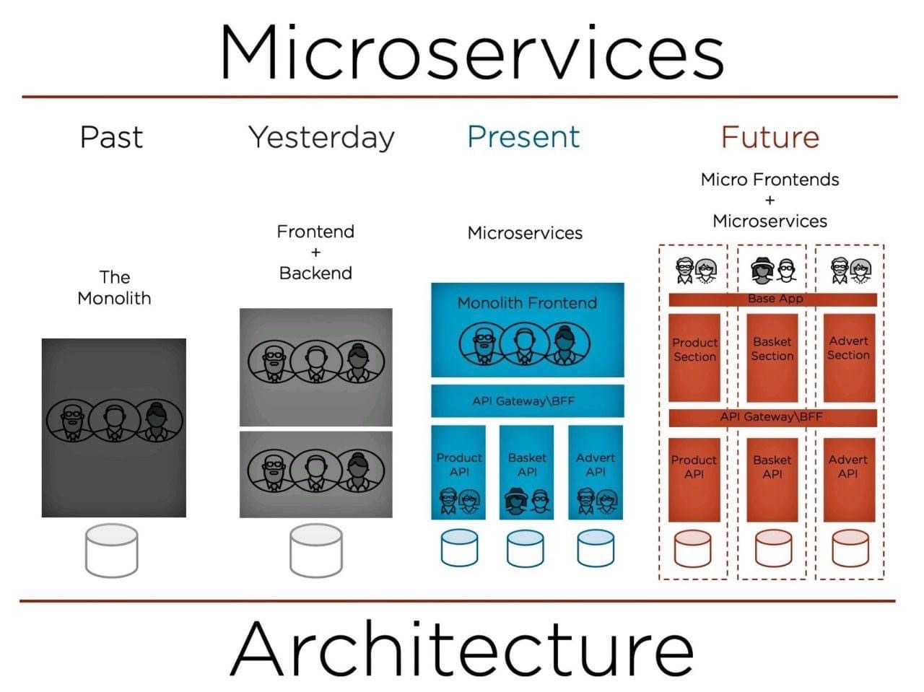
MicroFrontends pros & cons

Slide 5
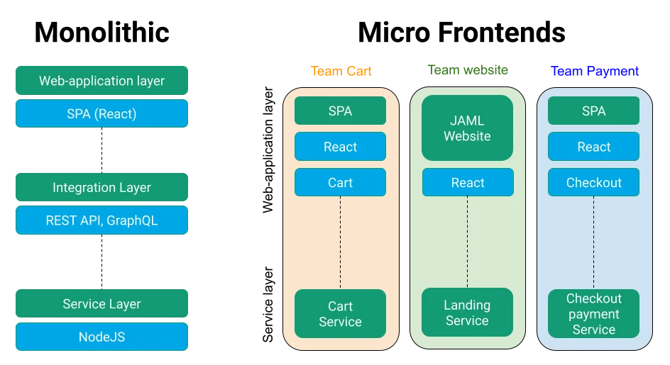
MicroFrontends pros & cons

Slide 6
MicroFrontends pros
Accelerated Development with Autonomous Teams
Higher App Stability Due to Loose Coupling
Cleaner Code Due to Smaller Codebases of Individual Micro Frontends
Faster Feature Roll-out Due to Independent Deployments
Easier Testing of Individual Features
Less Risky Implementation of Major Changes
Faster Page Load Due to a Smaller Bundle
No Technology Lock-in

Slide 7
MicroFrontends cons
Complicated Testing of a Web Solution As a Whole
Development and Deployment Complexity
Inconsistency of Chosen Technologies
Difficulty of Keeping the UX Cohesive
High Initial Investments

Slide 8
02
Integration approaches

Slide 9
Integration approaches
Routing
Build-time integration
Run-time integration

Slide 10
03
Communication patterns

Slide 11
Integration approaches
User interface
Parent to fragment
Fragment to parent
Fragment to fragment
Publish/Subscribe with Broadcast Channel API
Global context (HTTP headers or cookies or local storage)
Managing state
Frontend-backend communication

Slide 12
04
Choose framework for demo project

Slide 13
Choose framework for demo project
Bit.dev
Single-spa
StencilJS
Module Federation

Slide 14
05
Select template for demo project

Slide 15
Select template for demo project

Slide 16
06
Q&As

