Slide 1
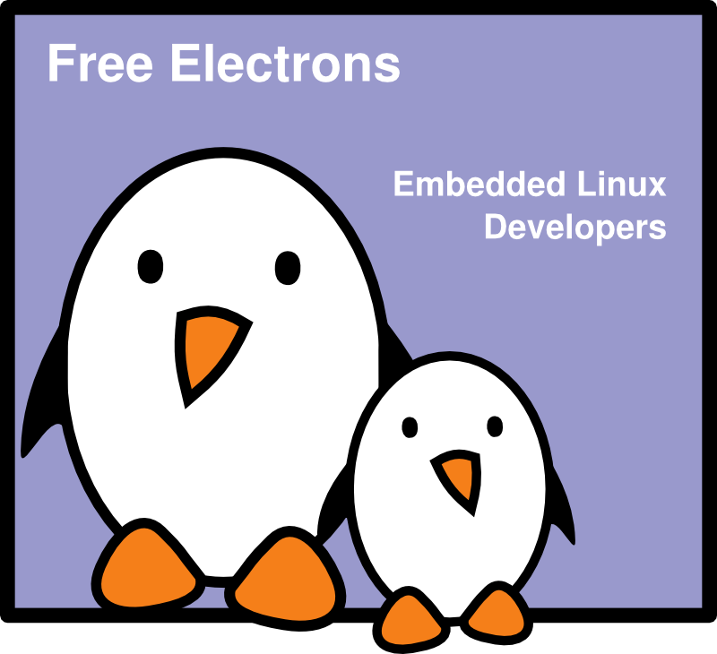
Embedded Linux optimizations
Embedded Linux optimizations
Size, RAM, speed,
power, cost
Michael Opdenacker
Thomas Petazzoni
Free Electrons
© Copyright 2004-2009, Free Electrons.
Creative Commons BY-SA 3.0 license
Latest update: Sep 28, 2010,
Document sources, updates and translations:
http://free-electrons.com/docs/optimizations
Corrections, suggestions, contributions and translations are welcome!

Slide 2


Penguin weight watchers
Make your penguin slimmer, faster, and reduce its consumption of fish!
Before
2 weeks after

Slide 3

CE Linux Forum
http://celinuxforum.org/
Non profit organization, whose members are embedded Linux companies and Consumer Electronics (CE) devices makers.
Mission: develop the use of Linux in CE devices
Hosts many projects to improve the suitability of Linux for CE devices and embedded systems. All patches are meant to be included in the mainline Linux kernel.
Most of the ideas introduced in this presentation have been gathered or even implemented by CE Linux Forum projects!

Slide 4
Contents
Ideas for optimizing the Linux kernel and executables
Increasing speed
Reducing size: disk footprint and RAM
Reducing power consumption
Global perspective: cost and combined optimization effects
The ultimate optimization tool!

Slide 5
Embedded Linux Optimizations
Increasing speed
Reducing kernel boot time

Slide 6

Measuring kernel boot time
CONFIG_PRINTK_TIME
Configure it in the Kernel Hacking section.
Adds timing information to kernel messages. Simple and robust.
Not accurate enough on some platforms (1 jiffy = 10 ms on arm!)
See http://elinux.org/Printk_Times
...
[42949372.970000] Memory: 64MB = 64MB total
[42949372.970000] Memory: 54784KB available (1404K code, 296K data, 72K init)
[42949373.180000] Mount-cache hash table entries: 512
[42949373.180000] CPU: Testing write buffer coherency: ok
[42949373.180000] checking if image is initramfs...it isn't (bad gzip magic numb
ers); looks like an initrd
[42949373.200000] Freeing initrd memory: 8192K
[42949373.210000] NET: Registered protocol family 16
...

Slide 7
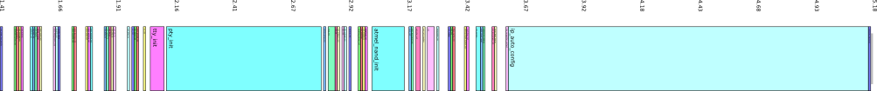
Boot tracer
CONFIG_BOOT_TRACER in kernel configuration
Introduced in Linux 2.6.28
Based on the ftrace tracing infrastructure
Allows to record the timings of initcalls
Boot with the initcall_debug and printk.time=1 parameters,
run dmesg > boot.log and on your workstation, run
cat boot.log | perl scripts/bootgraph.pl > boot.svg
to generate a graphical representation
Example on a board with at Atmel AT91 CPU:
0
5s
tty_init
pty_init
atmel_nand_init
ip_auto_config

Slide 8
Grabserial
From Tim Bird
http://elinux.org/Grabserial
A simple script to add timestamps to messages coming from a serial console.
Key advantage: starts counting very early (bootloader),
and doesn't just start when the kernel initializes.
Another advantage: no overhead on the target, because run on the host machine.

Slide 9

Disable IP auto config
Stopped initializing the IP address on the kernel command line
(old remains from NFS booting, was convenient not to hardcode the IP address in the root filesystem.)
Instead, did it in the /etc/init.d/rcS script.
This saved 1.56 s on our AT91 board.
You will save even more if you had other related options in your kernel (DHCP, BOOP, RARP)

Slide 10
Reducing the number of PTYs
PTYs are needed for remote terminals (through SSH)
They are not needed in our dedicated system!
The number of PTYs can be reduced through the CONFIG_LEGACY_PTY_COUNT kernel parameter.
If this number is set to 4, we save 0.63 s on our Atmel board.
As we're not using PTYs at all in our production system,
we disabled them with completely with CONFIG_LEGACY_PTYS. We saved 0.64 s.
Note that this can also be achieved without recompiling the kernel, using the pty.legacy_count kernel parameter.

Slide 11

Disable console output
The output of kernel bootup messages to the console takes time! Even worse: scrolling up in framebuffer consoles!
Console output not needed in production systems.
Console output can be disabled with the quiet
argument in the Linux kernel command line (bootloader settings)
Example:
root=/dev/ram0 rw init=/startup.sh quiet
Benchmarks: can reduce boot time by 30 or even 50%!
See http://elinux.org/Disable_Console

Slide 12
Preset loops_per_jiffy
At each boot, the Linux kernel calibrates a delay loop (for the udelay function). This measures a loops_per_jiffy (lpj) value. This takes about 25 jiffies (1 jiffy = time between 2 timer interrupts).
In embedded systems, it can be about 250 ms!
You just need to measure this once! Find the lpj value in kernel boot messages (if you don't get it in the console, boot Linux with the loglevel=8 parameter). Example:
Calibrating using timer specific routine... 187.59 BogoMIPS (lpj=937984)
At the next boots, start Linux with the below option:
lpj=<value>

Slide 13

LZO kernel decompression
LZO is a compression algorithm that is much faster than gzip,
at the cost of a slightly degrade compression ratio (+10%).
It was already in use in the kernel code (JFFS2, UBIFS...)
Albin Tonnerre from Free Electrons added support for LZO compressed kernels. His patches are waiting for inclusion in mainstream Linux. Get them from http://lwn.net/Articles/350985/

Slide 14
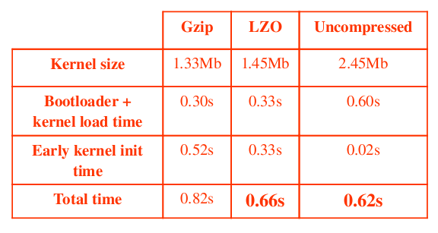
LZO decompression results
Saves approximately 0.25 s of boot time
See http://free-electrons.com/blog/lzo-kernel-compression/
Our patch also allows LZO to be used for initramfs decompression (CONFIG_INITRAMFS_COMPRESSION_LZO=y)
Another solution is to use an uncompressed kernel
(another patch will be sent), in which case kernel execution is just marginally faster than with LZO, at the expense of a double size.

Slide 15
Directly boot Linux from bootstrap code
Idea: make a slight change to at91bootstrap to directly load and execute the Linux kernel image instead of the U-boot one.
Rather straightforward when boot U-boot and the kernel are loaded from NAND flash.
Requires to hardcode the kernel command line in the kernel image (CONFIG_CMDLINE)
Requires more development work when U-boot is loaded from a different type of storage (SPI dataflash, for example).
In this case, you can keep U-boot, but remove all the features not needed in production (USB, Ethernet, tftp...)
Time savings: about 2 s
See http://free-electrons.com/blog/at91bootstrap-linux/

Slide 16
Reduce the kernel size
Through the CONFIG_EMBEDDED option
Remove things that are not needed in your dedicated system
(features, debugging facilities and messages)
Make sure you have no unused kernel drivers
Disable support for loadable kernel modules and make all your drivers static (unless there are multiple drivers than can be loaded later).
A smaller kernel is faster to load
A simpler kernel executes faster
At least, compile drivers as modules for devices not used at boot time. This reduces time spent initializing drivers.

Slide 17
Faster rebooting (1)
kexec system call: executes a new kernel from a running one.
Must faster rebooting: doesn't go through bootstrap / bootloader code.
Great solution for rebooting after system (“firmware”) upgrades.
Useful for automatic rebooting after kernel panics.
See http://developer.osdl.org/andyp/kexec/whitepaper/kexec.pdf
and Documentation/kdump/kdump.txt in kernel sources.

Slide 18
Faster rebooting (2)
Another option: use reboot=soft in the kernel command line
When you reboot, the firmware will be skipped.
Drawback: unlike kexec, cannot be chosen from userspace.
Supported platforms: i386, x86_64, arm, arm26 (Aug. 2006)
See Documentation/kernel-parameters.txt
in the kernel sources for details. Not supported on all platforms.

Slide 19
Skip memory allocation
Idea: spare memory at boot time and manage it by yourself!
Assume you have 32 MB of RAM
Boot your kernel with mem=30
The kernel will just manage the first 30 MB of RAM.
Driver code can now reclaim the 2 MB left:
buf = ioremap (
0x1e00000, /* Start: 30 MB */
0x200000 /* Size: 2 MB */
);
This saves time allocating memory.
Critical drivers are also sure to always have the RAM they need.

Slide 20
Kernel boot time - Other ideas
Copy kernel and initramfs from flash to RAM using DMA
(Used by MontaVista in Dell Latitude ON)
Fast boot, asynchronous initcalls: http://lwn.net/Articles/314808/
Mainlined, but API still used by very few drivers.
Mostly useful when your CPU has idle time in the boot process.
Use deferred initcalls
See http://elinux.org/Deferred_Initcalls
NAND: just check for bad blocks once
Atmel: see http://patchwork.ozlabs.org/patch/27652/
See http://elinux.org/Boot_Time for more resources

Slide 21


Embedded Linux Optimizations
Increasing speed
System startup time and application speed

Slide 22
Starting system services
SysV init:
Starts services sequentially. Waits for the current startup script to be complete to start the next one! While dependencies exist, some tasks can be run in parallel!
Initng: http://initng.org
New alternative to SysV init, which can start services in parallel, as soon as their preconditions are met.

Slide 23
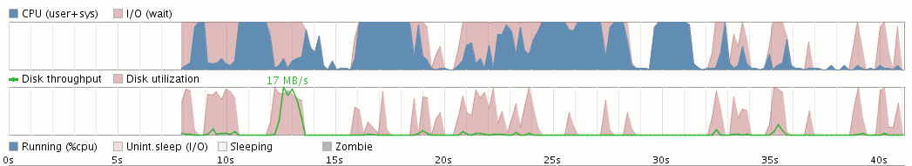
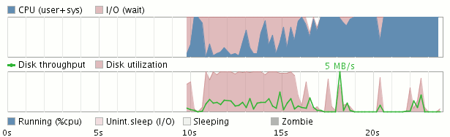
Initng vs. SysV init: bootcharts
Initng wins!
System utilization is much better.
You can hunt system startup trouble by using the Bootchart program
(http://www.bootchart.org/).
Bootchart is slow (Java) and not very accurate.
See http://elinux.org/Bootchart for solutions for embedded systems.

Slide 24
Reading ahead
Linux keeps the contents of all the files it reads in RAM (in the page cache), as long as it doesn't need the RAM pages for something else.
Idea: load files (programs and libraries in particular) in RAM cache before using them. Best done when the system is not doing any I/O.
Thanks to this, programs are not stuck waiting for I/O.
Used the Knoppix distribution to achieve very nice boot speed-ups.
Also planned to be used by Initng.
Not very useful for systems with very little RAM:
cached pages are recycled before the files are accessed.

Slide 25
Implementing readahead
You can use the sys_readahead() system call
in your C programs. See man readahead for details.
You can also use the readahead-list utility, which reads a file containing the list of files to load in cache.
Available on: http://freshmeat.net/projects/readahead-list/.
In embedded systems using Busybox, you can use the readahead command (implemented by Free Electrons).

Slide 26
Compiler speed optimizations
By default, most tools are compiled with compiler optimizations.
Make sure you use them for your own programs!
-O2 is the most common optimization switch of gcc.
Lots of optimization techniques are available.
See http://en.wikipedia.org/wiki/Compiler_optimization
-O3 can be also be used for speed critical executables.
However, there is done at the expense of code size (for example “inlining”: replacing function calls by the function code itself).

Slide 27
Using processor acceleration instructions
liboil - http://liboil.freedesktop.org/
Library of functions optimized for special instructions
from several processors (Altivec, MMX, SSE, etc.)
Mainly functions implementing loops on data arrays:
type conversion, copying, simple arithmetics, direct cosine transform, random number generation...
Transparent: keeps your application portable!
So far mainly supports desktop processors
License: BSD type

Slide 28
Prelinking (1)
Applies to executables using shared libraries
To load and start an executable, the dynamic linker has a significant amount of work to do (mainly address relocation)
It can take a lot of time for executables using many shared libraries!
In many systems in which executables and shared libraries never change, the same job is done every time the executable is started.

Slide 29
Prelinking (2)
prelink
http://people.redhat.com/jakub/prelink/
prelink modifies executables and shared libraries to simplify the dynamic linker relocation work.
This can greatly reduce startup time for big applications (50% less for KDE!). This also saves memory consumed by relocations.
Can be used to reduce the startup time of a Linux system.
Just needs to be run again when libraries or executables are updated.
Details on http://elinux.org/Pre_Linking

Slide 30

Use simpler Unix executables
Big, feature rich executables take time to load.
Particularly true for shell scripts calling the bash shell!
Idea: replace standard Unix / GNU executables by lightweight, simplified implementations by busybox (http://busybox.net).
Implemented by Ubuntu 6.10 to reduce boot time, replacing bash (649 K) by dash (79 K, see http://en.wikipedia.org/wiki/Debian_Almquist_shell). This broke various shell scripts which used bash specific features (“bashisms”).
In non-embedded Linux systems
where feature-rich executables are still needed,
should at least use busybox ash for system scripts.

Slide 31
Shells: reducing forking
fork / exec system calls are very heavy.
Because of this, calls to executables from shells are slow.
Even executing echo in busybox shells results in a fork syscall!
Select Shells -> Standalone shell in busybox configuration to make the busybox shell call applets whenever possible.
Pipes and back-quotes are also implemented by fork / exec.
You can reduce their usage in scripts. Example:
cat /proc/cpuinfo | grep model
Replace it with: grep model /proc/cpuinfo
See http://elinux.org/Optimize_RC_Scripts

Slide 32
Use faster filesystems
Run faster by using the most appropriate filesystems!
Compressed read-only filesystem (block device):
use SquashFS (http://squashfs.sourceforge.net)
instead of CramFS (much slower, getting obsolete).
NAND flash storage: you should try UBIFS
(http://www.linux-mtd.infradead.org/doc/ubifs.html), the successor of JFFS2. It is much faster. You could also use SquashFS. See our Choosing filesystems presentation
(http://free-electrons.com/docs/filesystems).

Slide 33
Use faster filesystems (2)
Use RAM filesystems for temporary, speed critical files with no need for permanent storage. Details in the kernel sources: Documentation/filesystems/tmpfs.txt
Benchmark your system and application on competing filesystems! Reiser4 is more innovative and benchmarks found it faster than ext3.
Good to benchmark your system with JFS or XFS too. XFS is reported to be the fastest to mount (good for startup time), and JFS to have the lowest CPU utilization.
See http://www.debian-administration.org/articles/388
ext4 is also ready to be used now.

Slide 34
Speed up applications with tmpfs
When enough RAM is available, the OS keeps recently accessed files and applications in RAM (page cache). This significantly speeds up any new usage. However, depending on system activity, this may not last long.
For programs that need fast startup even if they haven't been run for a long time: copy them to a tmpfs filesystem at system startup! This makes sure they are always accessed from the file cache in RAM (provided you do not have a swap partition).
See Documentation/filesystems/tmpfs.txt in kernel sources for details about tmpfs.
Caution: don't use ramdisks instead!
Ramdisks duplicate files in RAM and unused space cannot be reclaimed.
Caution: use with care. May impact overall performance.
Not needed if there's enough RAM to cache all files and programs.

Slide 35
Boot from a hibernate image
The ultimate technique for instant boot!
In development: start the system, required applications and the user interface. Hibernate the system to disk / flash in this state.
In production: boot the kernel and restore the system state from with this predefined hibernation image.
This way, you don't have to initialize the programs one by one. You just get the back to a valid state.
Used in Sony cameras to achieve instant power on time.
Unlike Suspend to RAM, still allows to remove batteries!

Slide 36


Use a profiler
Using a profiler can help to identify unexpected behavior degrading application performance.
For example, a profiler can tell you in which functions most of the time is spent.
Possible to start with strace and ltrace
Advanced profiling with Valgrind: http://valgrind.org/
  Compile your application for x86 architecture
  You can then profile it with the whole Valgrind toolsuite:
  Cachegrind: sources of cache misses and function statistics.
  Massif: sources of memory allocation.
See our Software Development presentation for details:
http://free-electrons.com/docs/swdev/

Slide 37
Embedded Linux Optimizations
Reducing size
Kernel size and RAM usage

Slide 38
Linux-Tiny
Goal: reduce the disk footprint and RAM size of the Linux kernel
http://elinux.org/Linux_Tiny
Set of patches against the mainstream Linux kernel.
Mergeability in mainstream is a priority.
Many changes have already been merged in recent kernels.
All features can be selected in kernel configuration (CONFIG_EMBEDDED).
Also ships utilities or patches for tracking sources
of memory usage or code size.

Slide 39
Linux-Tiny ideas (1)
Remove kernel messages (printk, BUG, panic...)
Hunt excess inlining (speed vs. size tradeoff)
2.6.26: can allow gcc to uninline functions marked as inline:
(CONFIG_OPTIMIZE_INLINING=y). Only used by x86 so far.
Hunt excess memory allocations
Memory (slob instead of slab) allocator more space efficient for small systems.
Reduce the size of kernel data structures (may impact performance)
Simpler alternative implementations of kernel functionalities with less features, or not supporting special cases.

Slide 40
Linux-Tiny ideas (2)
Remove some features which may not be needed
in some systems.
Compiling optimizations for size.
A smaller kernel executable also saves RAM
(unless executed in place from storage).

Slide 41
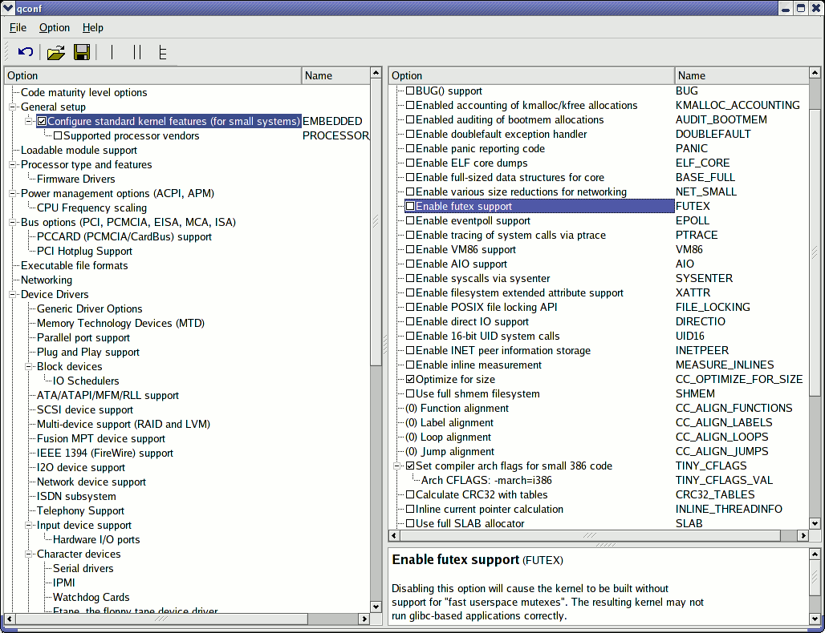
Linux-Tiny: kernel configuration screenshot
Many features
configured out

Slide 42
With and without CONFIG_EMBEDDED
Tests on Linux 2.6.29, on a minimalistic but working x86 kernel
Raw: -272 KB (-17%), Compressed: -136 KB (-20%)

Slide 43
Replace initrd by initramfs
Replace init ramdisks (initrd) with initramfs:
much less overhead and ram waste!
Access
to file
Regular
block device
Access
to file
Ramdisk
block device
Access
to file
ramfs
Virtual File
System
Virtual File
System
Virtual File
System
Filesystem
driver
File
cache
File
cache
File
cache
Filesystem
driver
Block
driver
Copy
Block
driver
Block storage
Copy
Block storage
RAM
RAM
RAM

Slide 44
ramfs advantages over ramdisks
No block and filesystem overhead.
No duplication in RAM.
Files can be removed (reclaiming RAM) after use.
Initramfs: ramfs archive embedded in the Linux kernel file.

Slide 45
Embedded Linux Optimizations
Reducing size
Application size and RAM usage

Slide 46

Static or dynamic linking? (1)
Static linking
All shared library code duplicated in the executables
Allows not to copy the C library in the filesystem.
Simpler and smaller when very few executables (busybox)
Library code duplication: bad for systems with more executables (code size and RAM)
Best for small systems (< 1-2 MB) with few executables!

Slide 47
Static or dynamic linking? (2)
Dynamic linking
Shared library code not duplicated in the executables
Makes much smaller executables
Saves space in RAM (bigger executables take more RAM)
Requires the library to the copied to the filesystem
Best for medium to big systems (> 500 KB - 1 MB)

Slide 48
Using a lighter C library
glibc (GNU C library): http://www.gnu.org/software/libc/
Found on most computer type GNU/Linux machines
Size on arm: approx 1.7 MB
uClibc: http://www.uclibc.org/
Found in more and more embedded Linux systems!
Size on arm: approx 400 KB (you save 1.2 MB!)
Executables are slightly smaller too:

Slide 49
How to use uClibc?
Need to compile all your executables with a uClibc toolchain.
Ready-to-use toolchains can be found on
http://free-electrons.com/community/tools/uclibc
You can very easily build your own with buildroot:
http://buildroot.uclibc.org/
You also have to copy the uClibc files from the toolchain to the /lib directory in the target root filesystem.
Ready-to-use filesystems can also be generated by buildroot.
You just need to add your specific stuff then.

Slide 50
Need for stripping
Compiled executables and libraries contain extra information which can be used to investigate problems in a debugger.
This was useful for the tool developer, but not for the final user.
To remove debugging information, use the strip command.
This can save a very significant amount of space!
gcc -o hello hello.c (output size: 4635 bytes)
strip hello (output size: 2852 bytes, -38.5%)
Don't forget to strip libraries too!

Slide 51
Are my executables stripped?
You can use the file command to get the answer
gcc -o hello hello.c
file hello
hello: ELF 32-bit LSB executable, Intel 80386, version 1 (SYSV), for GNU/Linux 2.2.5, dynamically linked (uses shared libs), not stripped
strip hello
hello: ELF 32-bit LSB executable, Intel 80386, version 1 (SYSV), for GNU/Linux 2.2.5, dynamically linked (uses shared libs), stripped
You can use findstrip (http://packages.debian.org/stable/source/perforate)
to find all executables and libraries that need stripping in your system.

Slide 52
How to strip
Some lightweight tools, like busybox, are automatically stripped when you build them.
Makefiles for many standard tools offer a special command:
make install-strip
Caution: stripping is architecture dependent.
Use the strip command from your cross-compiling toolchain:
arm-linux-strip potato

Slide 53
sstrip: “super strip”
http://muppetlabs.com/~breadbox/software/elfkickers.html
Goes beyond strip and can strip out a few more bits that are not used by Linux to start an executable.
Can be used on libraries too. Minor limitation: processed libraries can no longer be used to compile new executables.
Can also be found in toolchains made by Buildroot (optional)
Best for tiny
executables!

Slide 54
Library Optimizer
http://libraryopt.sourceforge.net/
Contributed by MontaVista
Examines the complete target file system, resolves all shared library symbol references, and rebuilds the shared libraries with only the object files required to satisfy the symbol references.
Can also take care of stripping executables and libraries.
However, requires to rebuild all the components from source. Would be nicer to achieve this only with ELF manipulations.

Slide 55
Compiler space optimizations
Regular compiler optimizations simplifying code also reduce size
You can also reduce the size of executables by asking gcc to optimize generated code size:
gcc -Os -o husband husband.c
-Os corresponds to -O2 optimizations except the ones increasing size, plus extra size-specific ones.
-Os is already used by default to build busybox.
Possible to further reduce the size by compiling and optimizing all sources at once, with the -fwhole-program --combine gcc options.
See http://gcc.gnu.org/onlinedocs/gcc/Optimize-Options.html
for all gcc optimization options.

Slide 56
Simple gcc optimization benchmark

Slide 57
Restartable applications
When RAM is scarce, can be useful to abort applications that are not in use (for example hidden graphical interfaces).
Better to do it before the Linux Kernel OOM
(Out Of Memory) killer comes and makes bad decisions.
You can use the “Linux Checkpoint / Restart” project to have the Linux kernel save the state of a running application so that it can later resume its execution from the time at which it was checkpointed.
See http://www.linux-cr.org/ for details.

Slide 58
Compressing filesystems
Can significantly increase your storage capacity
MTD (flash or ROM) storage: use UBIFS
or JFFS2 for small partitions.
Block storage: use SquashFS (http://squashfs.sourceforge.net) instead of CramFS for read-only partitions. It compresses much better and is much faster too.

Slide 59
Merging duplicate files
Software compiling and installing often create duplicate files...
Check that your root filesystem doesn’t contain any!
dupmerge2: http://sourceforge.net/projects/dupmerge
Replaces duplicate files by hard links.
clink: http://free-electrons.com/community/tools/utils/clink
Replaces duplicate files by symbolic links.
Example: saves 4% of total space in Fedora Core 5.
finddup: http://www.shelldorado.com/scripts/cmds/finddup
Finds duplicate files.

Slide 60
Embedded Linux Optimizations
Reducing power consumption

Slide 61

Tickless kernel
Kernel configuration: NO_HZ setting in Processor type and features
To implement multitasking, the processor receives a timer interrupt
at a given frequency (every 4 ms by default on Linux 2.6). On idle systems, this wakes up the processor all the time, just to realize there is nothing to do!
Idea: when all processors are idle, disable the timer interrupt, and re-enable it when something happens (a real interrupt). This saves power in laptops, in embedded systems and with virtual servers!
2.6.24: supports x86, arm, mips and powerpc

Slide 62
PowerTOP
http://www.lesswatts.org/projects/powertop/
A very nice utility showing the top 10 sources of power consumption.
Requirements: a tickless kernel (> 2.6.21), and a “mobile” (x86) CPU.
Best run on laptops running on battery (to estimate battery savings).
PowerTOP measures the number of wake-ups,
and counts the time spent in low-power modes.
It detects issues in both kernel space (drivers) and user space.
It already uncovered several bugs in today's distributions.
Embedded systems: non Intel processors probably not supported yet.
You can still run your apps on a PC to check their behavior.
See also http://www.lesswatts.org for other useful resources.

Slide 63
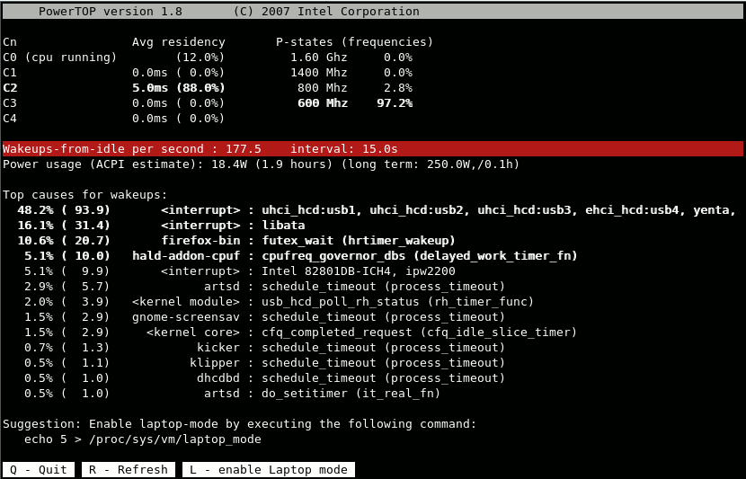
PowerTOP in action

Slide 64
cpufreq
Configuration: CPU_FREQ in Power management options
Allows to change the CPU frequency on the fly
Supported architectures (2.6.20):
i386, sh, ia64, sparc64, x86_64, powerpc, arm (i.MX only).
Usually controlled from userspace through /sys by a user configurable governor process, according to CPU load, heat, battery status... The most common is cpuspeed: http://carlthompson.net/software/cpuspeed/
Saves a significant amount of battery life in notebooks.

Slide 65
Suspend hidden GUIs
Idea: suspend hidden user interfaces to save CPU and power.
Send a suspend (stop) signal:
kill -SIGTSTP <pid>
Send a continue signal:
kill -SIGCONT <pid>

Slide 66
Software suspend
http://www.suspend2.net/
Lots of great features for notebook users, such as RAM suspend or hibernate to disk.
Unfortunately, restricted on some Intel compatible processors and targeting only machines with APM or ACPI (rarely found in non PC embedded systems!).
Not addressing the requirements of embedded systems (support for other CPUs, voltage reduction...).

Slide 67
Embedded Linux Optimizations
Global perspective
Cost and combined optimization effects

Slide 68
Combined benefits

Slide 69

The ultimate optimization tool!
We have seen many ways to optimize
an existing system.
However, nothing replaces a good design!
So, first carefully design and implement
your system and applications with their requirements
in mind.
Then, use the optimization techniques to further improve your system and the parts that you reused (kernel and applications).

