Slide 1
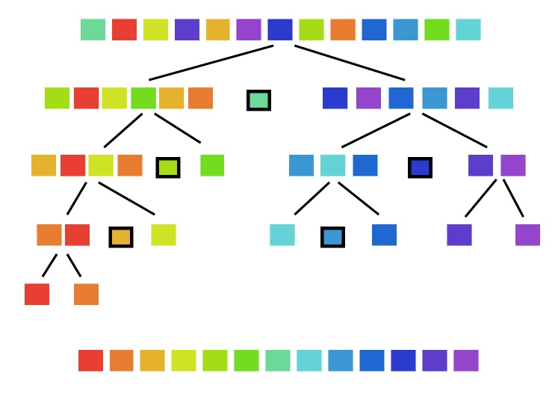
Lab 10 - Quicksort

Slide 2
Lab 10 - Quicksort
"Quicksort is a sorting algorithm developed by Tony Hoare that, on average, makes O(n log n) comparisons to sort n items. It is also known as partition-exchange sort.
In the worst case, Quicksort makes O(n²) comparisons, though this behavior is rare. Quicksort is typically faster in practice than other O(n log n) algorithms.
Additionally, quicksort's sequential and localized memory references work well with a cache. Quicksort can be implemented as an in-place partitioning algorithm."

Slide 3
Quicksort Commands
COMMAND | DESCRIPTION | OUTPUT
QuickSort <capacity> | Dynamically allocate a QuickSort array of size capacity. Set current number of elements (Size) to 0. | OK Error
AddToArray <data1> <data2>... | Add data element(s) to QuickSort array. Duplicates are allowed. Dynamically increase array size as needed (double array capacity for each increase.) | OK Error
Capacity | Return the size of the QuickSort array. | size
Clear | Delete all nodes from the QuickSort array. | OK
Size | Return the number of elements currently in the QuickSort array. | elements
Sort <left> <right> | QuickSort the elements in the QuickSort array from index <left> to index <right> (where <right> is one past last element) using median and partition functions. | OK Error
SortAll | QuickSort all the elements in the QuickSort array using median and partition functions. | OK Error
MedianOfThree <left> <right> | 1) Calculate the middle index (middle = (left + right)/2), then 2) bubble-sort the values at the left, middle, and right indices. (<right> is one past last element.) | Pivot Index -1 error
Partition <left> <right> <pivot> | Using the revised pivot algorithm, partition the QuickSort array (<left>, <right> and <pivot> indexes) around the pivot value. Values smaller than the pivot should be placed to the left of the pivot while values larger than the pivot should be placed to the right of the pivot. (<right> is one past last element.) | Pivot Index -1 error
PrintArray | Print the contents of the QuickSort array as comma separated values (using a friend insertion (<<) operator and toString() function.) | Array values. Empty
Stats (Bonus) | Output the number of comparisons and exchanges used by the SortAll command. | Comparisons,Exchanges

Slide 4
Quicksort Example
QuickSort 2
AddToArray 1 6 5 4 2 8
PrintArray
Capacity
Size
Sort 0 3
PrintArray
AddToArray 6 -5 -1 -3 -2 -4
PrintArray
MedianOfThree 0 12
PrintArray
Partition 0 12 4
PrintArray
Size
SortAll
PrintArray
Stats
Clear
PrintArray
QuickSort 2 OK
AddToArray 1,6,5,4,2,8 OK
PrintArray 1,6,5,4,2,8
Capacity 8
Size 6
Sort 0,3 OK
PrintArray 1,5,6,4,2,8
AddToArray 6,-5,-1,-3,-2,-4 OK
PrintArray 1,5,6,4,2,8,6,-5,-1,-3,-2,-4
MedianOfThree 0,12 = 6
PrintArray -4,5,6,4,2,8,1,-5,-1,-3,-2,6
Partition 0,12,4 = 6
PrintArray 1,-2,-3,-1,-4,-5,2,8,4,6,5,6
Size 12
SortAll OK
PrintArray -5,-4,-3,-2,-1,1,2,4,5,6,6,8
Stats 53,22
Clear OK
PrintArray Empty

Slide 5
Steps to Success
Step 1 - Begin with a main function.
As with most labs this semester, you will need to write your own main function.
The main needs to be able to parse a given input file.
Step 2 - Begin the QuickSort class.
The templated QuickSort class is derived from the abstract template interface class QSInterface.
Your QuickSort class should contain a dynamically-allocated array. Before you focus too much on the actual sorting algorithm, make sure the logistics of the class work correctly. Focus on createArray(), addToArray(), clear(), getSize(), and toString() member functions.
Step 3 - Write your medianOfThree() function in the QuickSort class.
The Median of Three function should take a left index and right index as parameters. It should then calculate the index in the middle of the left and right indexes (rounding down if necessary).
Sort the left, middle, and right numbers from smallest to largest in the array.
Finally, return the index of the middle value. This will be your pivot value in the sortAll() function.
Note that medianOfThree() is not used in your partition() function. The pivot value will be supplied by the input files.

Slide 6
Steps to Success
Step 4 - Write your partition() function in the QuickSort class.
The partition() function should begin by swapping the leftmost element from the array with whatever value is contained at the pivot index.
Now, follow the revised pivot algorithm presented in the textbook (pg. 611) to arrange the array such that all elements lower than the given pivot are at its left and all elements higher are at its right.
The partition() function should return the location of the pivot index.
Step 5 - Write the sortAll() function, using your medianOfThree() and partition() functions.
Note that this function will be recursive. Most people use sortAll() as a recursive starter function that then calls another function to do the sorting.
To sort, you should first call your medianOfThree() function and sort the first, middle, and last elements. This function returns the pivot index.
Now, call your partition() function, using the number returned from medianOfThree() as the pivot index. This function will return a pivot index, or the index where your array is split.
Finally, you will recursively call your sort() function on two halves of your array, with one half from the left until the pivot, and the other half from the pivot to the right.

Slide 7
Requirements
Points | Requirement (40 Points)
5 | argv[1] and argv[2] used for input / output streams respectively. No execution user interaction (i.e. system("pause"); or getchr();).
5 | Your template QuickSort class contains a dynamically-allocated element array and implements the abstract interface QSInterface class. The QuickSort command deletes the current array (if any) and then dynamically allocates a new element array. The Capacity and Clear commands execute as described above. No STL container is used anywhere in your QuickSort class. (lab10_in_01.txt).
5 | Items are added to the QuickSort array using the AddToArray command. Duplicate/multiple items can be added with one command. The QuickSort array dynamically grows (by doubling) as the number of items added exceeds the current array capacity. The PrintArray command outputs a comma-separated string representation of the array using an insertion (<<) friend operator and the toString() method. The Size command outputs the number of elements in the QuickSort array. (lab10_in_02.txt).
5 | Your MedianOfThree command (medianOfThree() function) properly sorts the first, middle, and last elements (as described above.) (lab10_in_03.txt).
5 | Your Partition command (partition() function) arranges the array such that all elements less than the given pivot are to the left and all elements greater than the given pivot are to the right (using the revised pivot algorithm.) (lab10_in_04.txt).
5 | The SortAll command (sortAll() function) utilizes your medianOfThree() and partition() functions to recursively sort the entire array. (lab10_in_05.txt).
5 | The Sort command (sort() function) utilizes your medianOfThree() and partition() functions to recursively sort a QuickSort subarray. (lab10_in_06.txt).
5 | BONUS: The Stats command outputs the number of comparisons and exchanges used by the sort commands (Sort and SortAll.) (lab10_in_07.txt).
5 | VS_MEM_CHECK macro is included in main to detect memory leaks. No Memory leaks are reported.

Slide 8
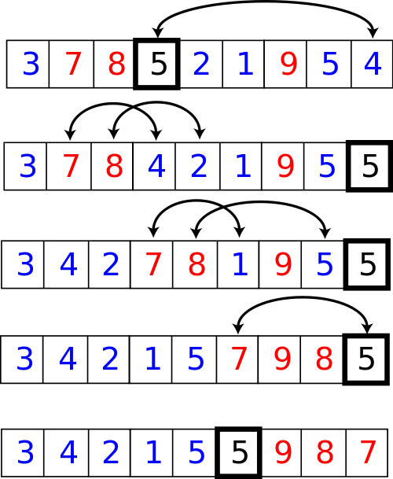
10.9 Quicksort
Algorithm for Quicksort
Code for Quicksort
Algorithm for Partitioning
Code for partition
A Revised Partition Algorithm
Code for Revised partition Function
10.9, pgs. 604-614

Slide 9
A Revised Partition Algorithm
Quicksort is O(n²) when each split yields one empty subarray, which is the case when the array is presorted.
The worst possible performance occurs for a sorted array, which is not very desirable.
A better solution is to pick the pivot value in a way that is less likely to lead to a bad split.
Use three references: first, middle, last.
Select the median of the these items as the pivot.
Revised Partition Algorithm
1. Sort table[first], table[middle], and table[last-1].
2. Move median value to first position (pivot value) by exchanging table[first] and table[middle].
3. Initialize up to first + 1 and down to last - 1.
…

Slide 10
Finding a Pivot
0 | 1 | 2 | 3 | 4 | 5 | 6 | 7 | 8 | 9 | 10
50 | 25 | 80 | 35 | 60 | 90 | 70 | 40 | 12 | 90 | 85
Up
Pivot
Up
Down
Down
50 | 25 | 12 | 35 | 60 | 90 | 70 | 40 | 80 | 90 | 85
Pivot
Up
Down
50 | 25 | 12 | 35 | 40 | 90 | 70 | 60 | 80 | 90 | 85
Pivot
Down
Up
40 | 25 | 12 | 35 | 50 | 90 | 70 | 60 | 80 | 90 | 85
Pivot

Slide 11
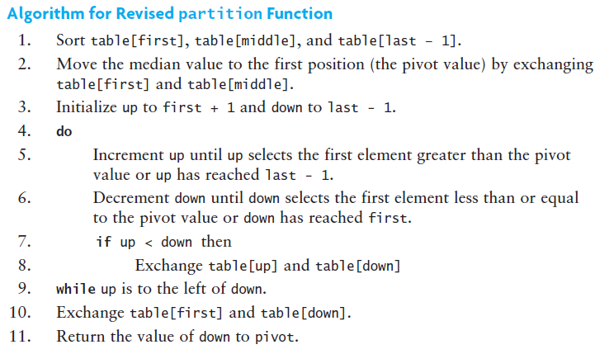
A Revised Partition Algorithm

Slide 12
Median of Three
first
middle
last
44
75
23
43
55
12
64
77
33
middle = (last – first) / 2
= (8 – 0) / 2 = 4

Slide 13
Median of Three
first
middle
last
33
75
23
43
44
12
64
77
55
Sort these values

Slide 14
Revised Partitioning
first
middle
44
75
23
43
33
12
64
77
55
Exchange middle and first

Slide 15
Revised Partitioning
up
down
44
75
23
43
33
12
64
77
55
Run the partition algorithm using the first element as the pivot

Slide 16
Revised Partitioning
up
down
44
75
23
43
33
12
64
77
55
up moves right until > 44
down move left until <= 44

Slide 17
Revised Partitioning
up
down
44
12
23
43
33
75
64
77
55
then exchange and
continue until down <= up

Slide 18
Revised Partitioning
down
up
44
12
23
43
33
75
64
77
55
When down and up cross…

Slide 19
Revised Partitioning
down
up
33
12
23
43
44
75
64
77
55
Exchange first with down
down becomes pivot

Slide 20
Code for Revised partition
/** Partition the table so that left values are less than pivot and right are greater
then or equal to pivot.
@return The position of the pivot value (originally at first) */
template<typename RI>
RI partition(RI first, RI last)
{
/* Put the median of table[first], table[middle], table[last - 1]
into table[first], and use this value as the pivot. */
bubble_sort3(first, last);
// Swap first element with middle element.
std::iter_swap(first, first + (last - first) / 2);
// Start up and down at either end of the sequence with first as pivot
RI up = first + 1;
RI down = last - 1;
do
{
/* Invariant: All items in table[first] through table[up - 1] <= table[first]
All items in table[down + 1] through table[last - 1] > table[first] */
while ((up != last - 1) && !(*first < *up)) ++up;
// Assert: up equals last - 1 or table[up] > table[first].
while (*first < *down) --down;
// Assert: down equals first or table[down] <= table[first].
// if up is to the left of down, exchange table[up] and table[down].
if (up < down) std::iter_swap(up, down);
} while (up < down); // Repeat while up is left of down.
// Exchange table[first] and table[down] thus putting the pivot value where it belongs.
std::iter_swap(first, down);
return down; // Return position of pivot.
}

Slide 21


