Slide 1

Introduction to R
Daniel Vaulot

Slide 2
Why use R ?
Script vs. Menu driven software
Can be re-rerun with new data
R works with vectors and tables
Z <- X + Y where X and Y are vectors
"Tidy" worflow
Select(Tara_table, fraction="0.2-5")
Tidy "universe" : tidyverse
Incredible graphics and plots
ggplot2 family
Work environment
R studio
Document your data processing
R markdown
Share your data and workflow
GitHub

Slide 3
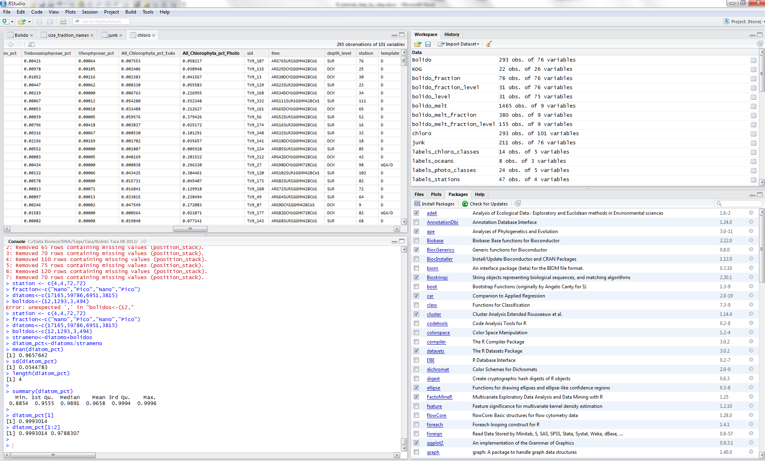
R studio

Slide 4
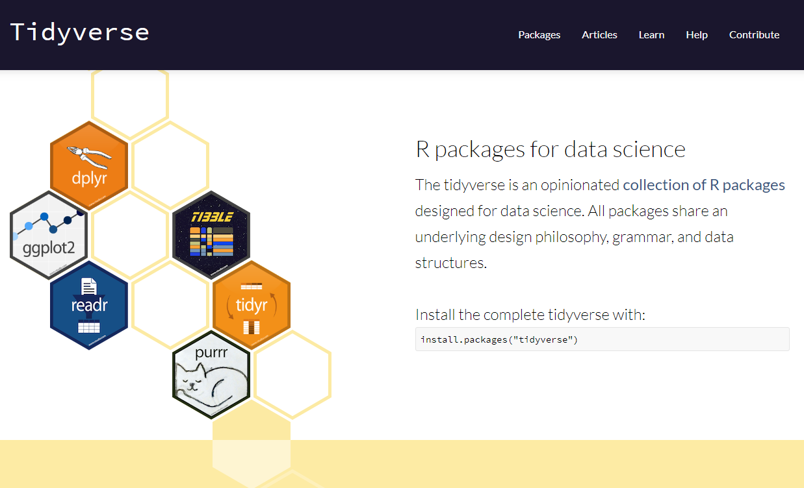
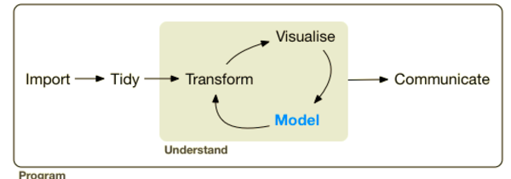
Tidyverse

Slide 5
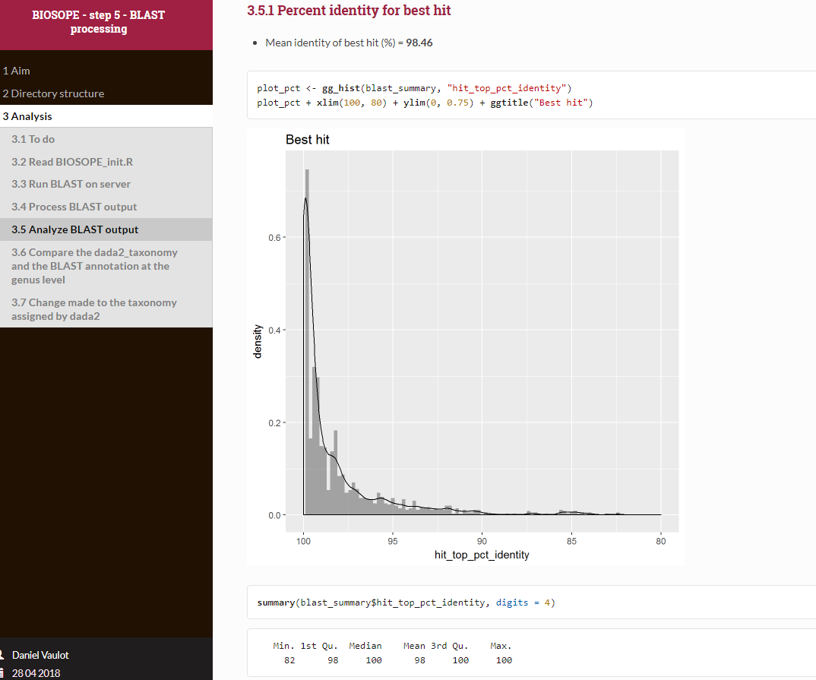
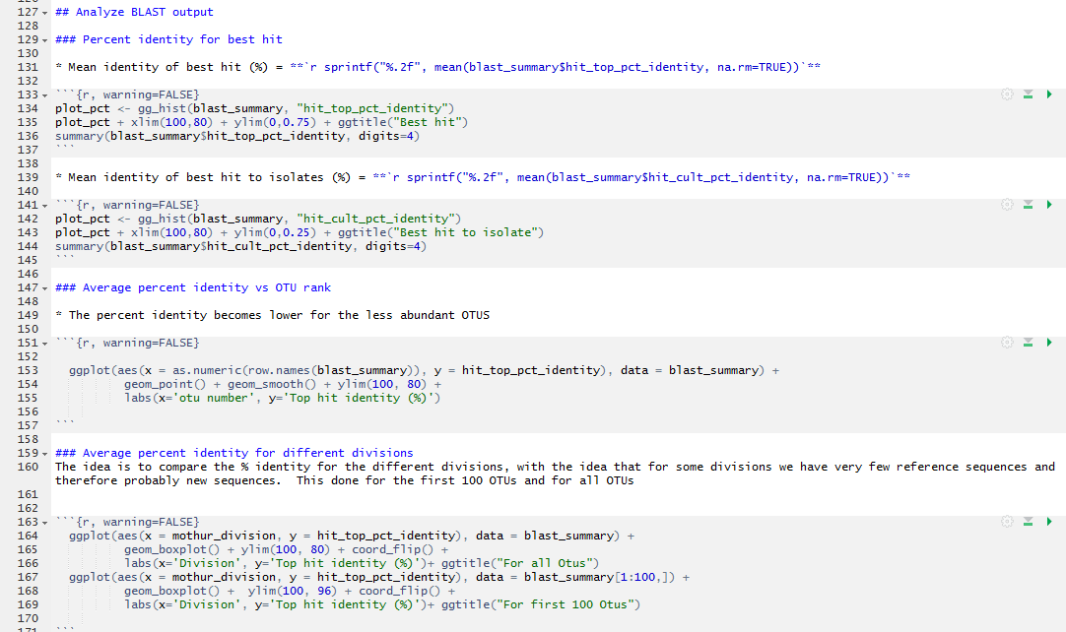
Document your work and recycle

Slide 6

R objects
You are manipulating vectors everyday….
Data structures
Vector (can be one line)
List
Matrix
Data frames
Function
Data types
Numeric : 1,2.5, 1e-10
Character (Strings) : "Surface","12"
No data "NA"

Slide 7
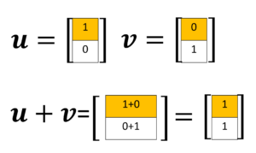
Vector mathematics - 1
station | fraction | diatoms | bolidos | stramenos | diatoms_pct
4 | Nano | 17165 | 12 | 17177 | 0.999
4 | Pico | 59786 | 1293 | 61079 | 0.979
72 | Nano | 6951 | 3 | 6954 | 1.000
72 | Pico | 3815 | 494 | 4309 | 0.885
Concept of data frame
Each column correspond to a vector
Some columns can be numeric, characters, dates
Creating new vectors
strameno<-diatoms+bolidos
diatoms_pct<-diatoms/strameno

Slide 8

Vector mathematics - 2
Small data set
Each column correspond to a vector
Enter data with vector operator c()
station <- c(4,4,72,72)
fraction<-c("Nano","Pico","Nano","Pico")
diatoms<-c(17165,59786,6951,3815)
bolidos<-c(12,1293,3,494)
Creating new vectors
strameno<-diatoms+bolidos
diatoms_pct<-diatoms/strameno
R is case sensitive
Diatoms ≠ diatoms
station | fraction | diatoms | bolidos | stramenos | diatoms_pct
4 | Nano | 17165 | 12 | 17177 | 0.999
4 | Pico | 59786 | 1293 | 61079 | 0.979
72 | Nano | 6951 | 3 | 6954 | 1.000
72 | Pico | 3815 | 494 | 4309 | 0.885

Slide 9
Vector mathematics - 3
Compute statistics
mean(diatom_pct)
sd(diatom_pct)
length(diatom_pct)
summary(diatom_pct)
Accessing subsets
diatom_pct[1]
diatom_pct[1:2]
station | fraction | diatoms | bolidos | stramenos | diatoms_pct
4 | Nano | 17165 | 12 | 17177 | 0.999
4 | Pico | 59786 | 1293 | 61079 | 0.979
72 | Nano | 6951 | 3 | 6954 | 1.000
72 | Pico | 3815 | 494 | 4309 | 0.885

Slide 10
Data frame - 1
You are manipulating data frame everyday….
Association of vectors of different types
Exactly like the columns of an Excel worksheet
tara<-data.frame(station, fraction, diatoms, bolidos,stramenos, diatoms_pct)
tara
Access individual columns
tara$diatoms
tara[,3:5]
Access specific lines
tara$diatoms[tara$station==4]
tara[3:4,]
station | fraction | diatoms | bolidos | stramenos | diatoms_pct
4 | Nano | 17165 | 12 | 17177 | 0.999
4 | Pico | 59786 | 1293 | 61079 | 0.979
72 | Nano | 6951 | 3 | 6954 | 1.000
72 | Pico | 3815 | 494 | 4309 | 0.885
tara[row, column]
tara[2,3]

Slide 11
Data frame - 2
Computing statistics according to factor
tapply(tara$diatoms, tara$station, mean)
Importing data frames
Format your worksheet very precisely
Data are in columns
One line only for title of each column (no space in title !!)
All data in a column should be of the same type
Do not mix in the same column numeric and strings
Copy and save to text file
Import into R
Even better : Use the readxl library

Slide 12
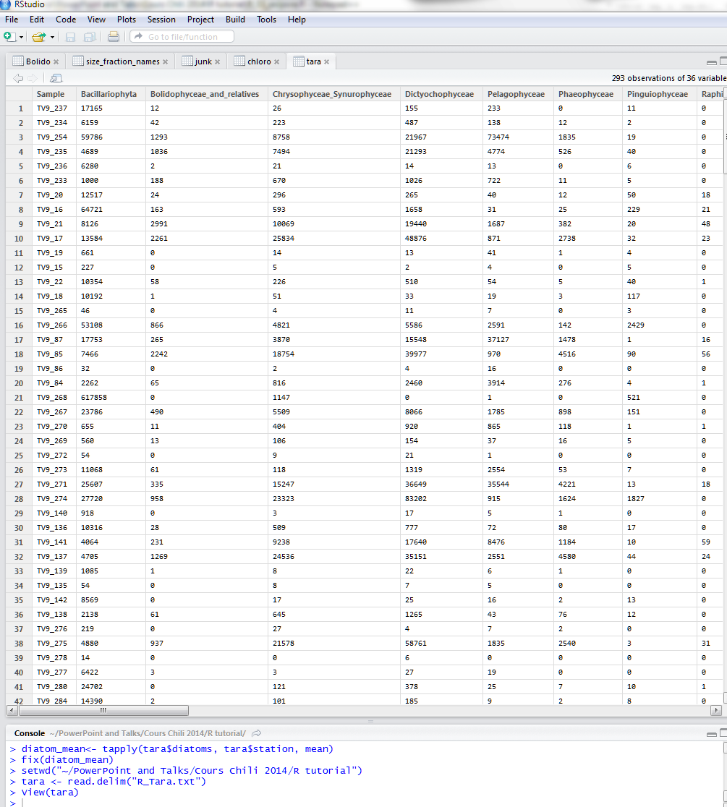
Data exploration – Statistics and Plots

Slide 13
Statistics
 | Group.1 | Group.2 | Bacillariophyta_pct | Bolidophyceae_and_relatives_pct | Chrysophyceae_Synurophyceae_pct | Dictyochophyceae_pct
1 | 0.8-5 | DCM | 28% | 1% | 13% | 18%
2 | 180-2000 | DCM | 78% | 0% | 4% | 4%
3 | 20-180 | DCM | 95% | 0% | 1% | 1%
4 | 5-20 | DCM | 87% | 0% | 4% | 6%
5 | 0.8-5 | SUR | 24% | 2% | 20% | 33%
6 | 180-2000 | SUR | 75% | 0% | 5% | 7%
7 | 20-180 | SUR | 94% | 0% | 1% | 3%
8 | 5-20 | SUR | 88% | 0% | 3% | 5%

Slide 14
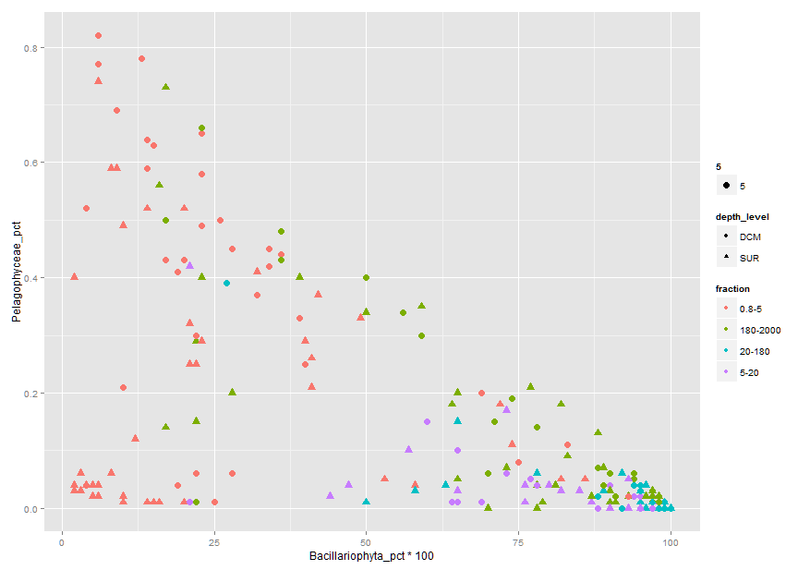
Graphics

Slide 15
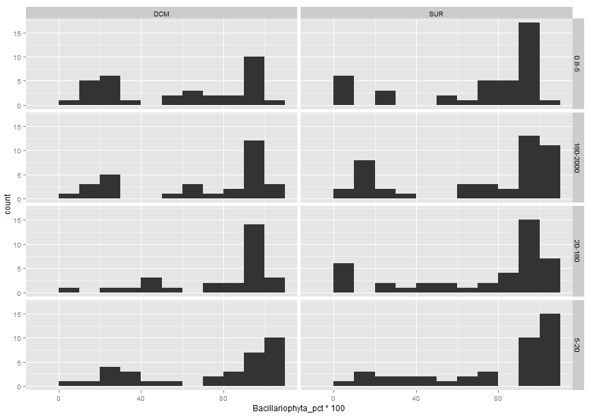
Graphics

Slide 16
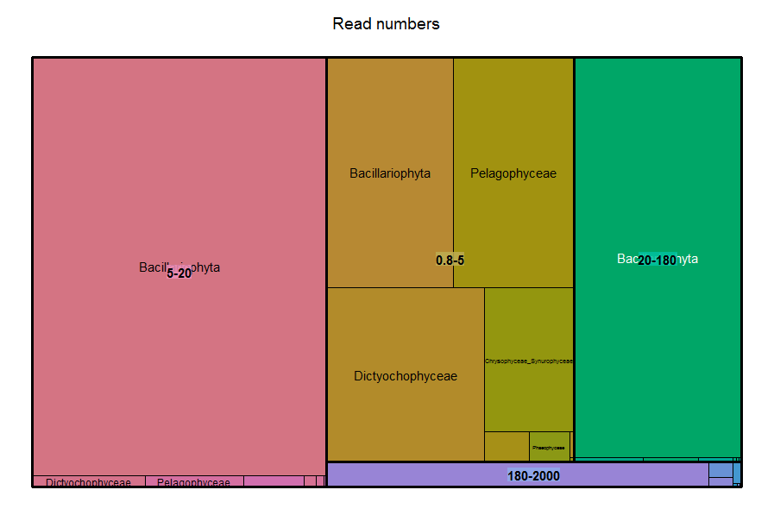
Treemaps

Slide 17
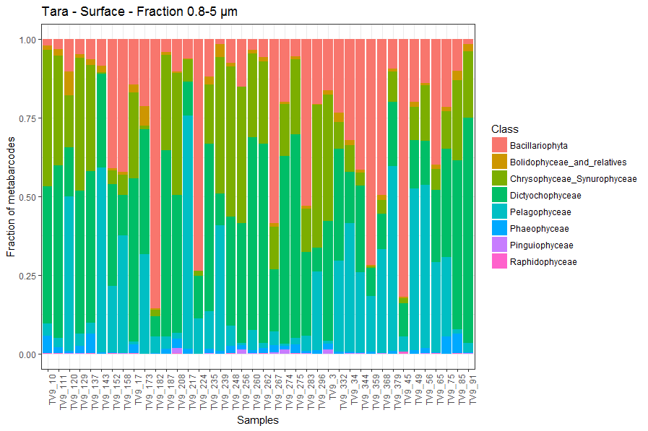
Bar graphs

Slide 18
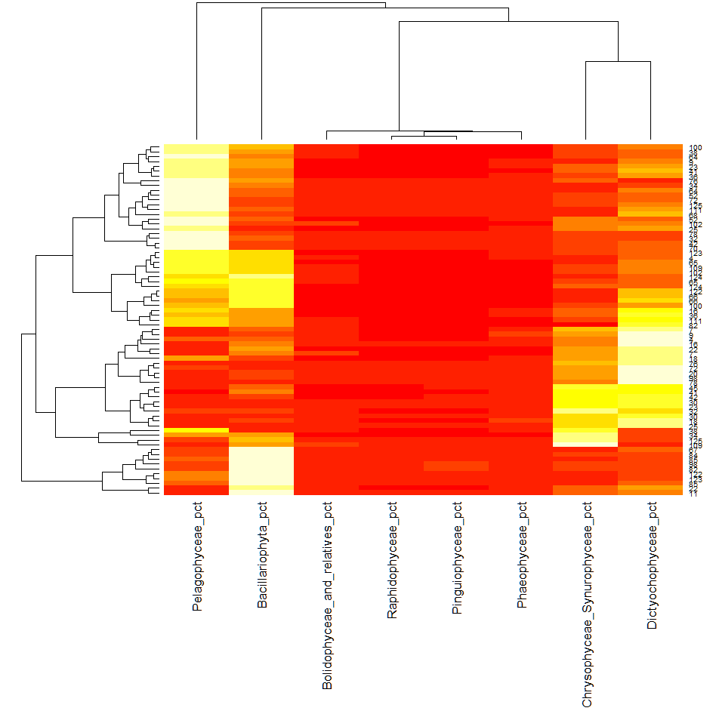
Heatmaps

Slide 19
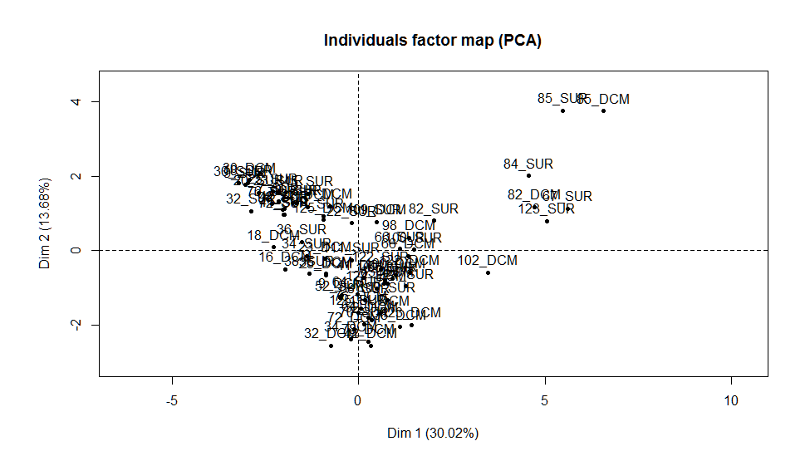
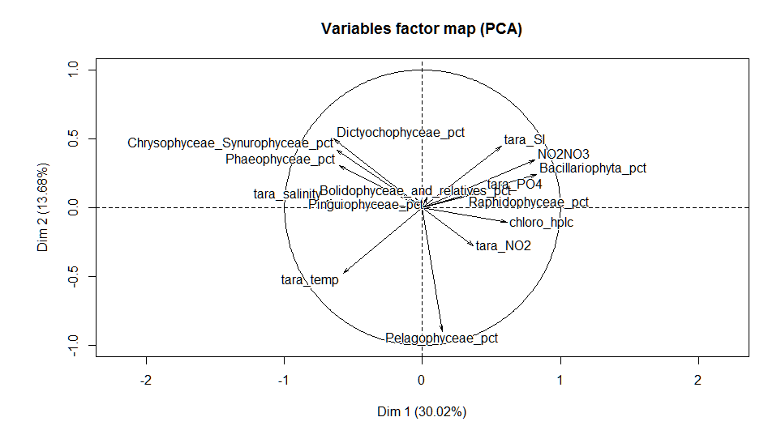
Multivariate analysis

Slide 20
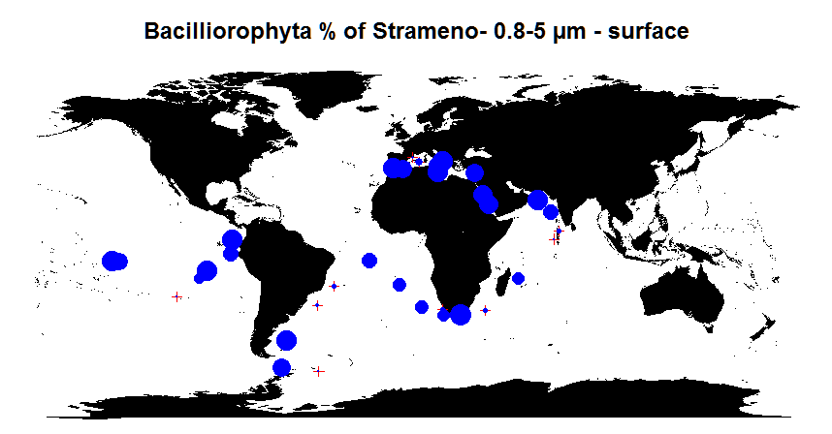
Maps

Slide 21
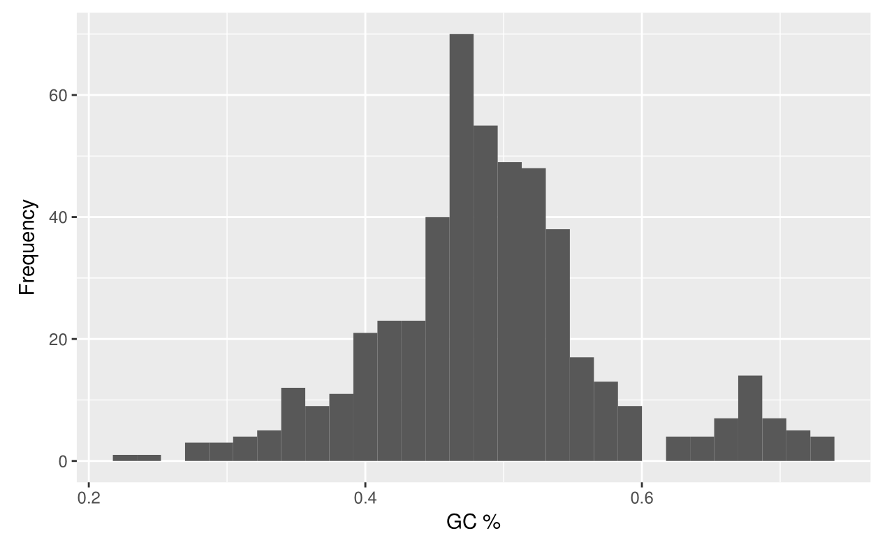
Bioinformatics – Sequence analysis

