Slide 1







WGBS
RRBS
Genome
RRBS

Slide 2


Slide 3
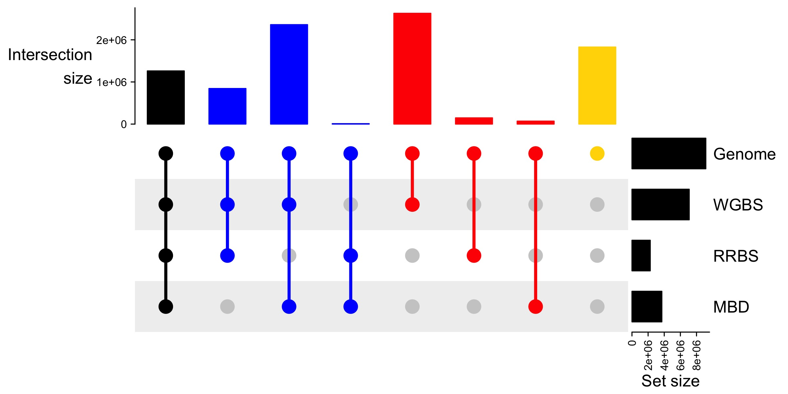
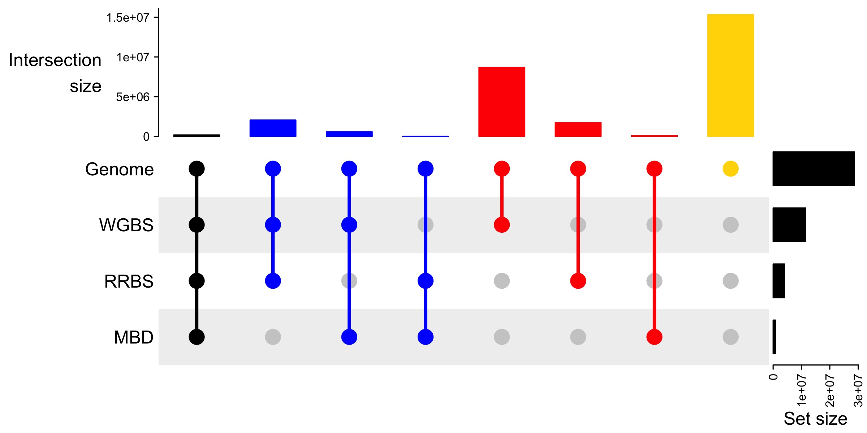
a
color key
number of unique CpGs between sets
b
set size (number of CpGs)
number of unique CpGs between sets
set size (number of CpGs)

Slide 4
a
color key
number of unique CpGs between sets
b
set size (number of CpGs)
number of unique CpGs between sets
set size (number of CpGs)

Slide 5
A
color key
number of unique CpGs between sets
M. capitata
MBDBS
B
set size (number of CpGs)
number of unique CpGs between sets
P. acuta
MBDBS
set size (number of CpGs)

Slide 6
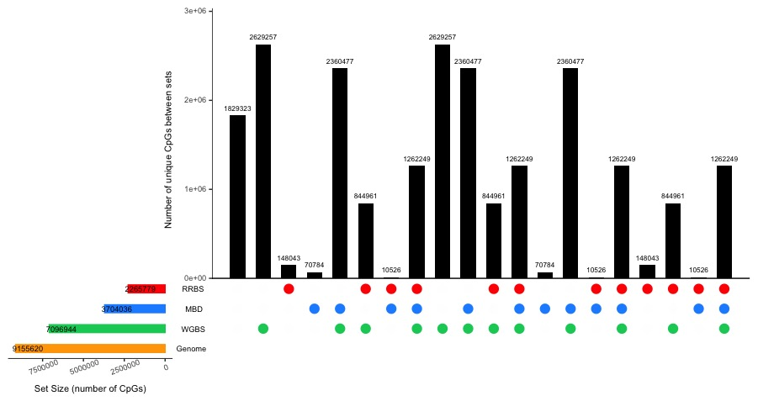
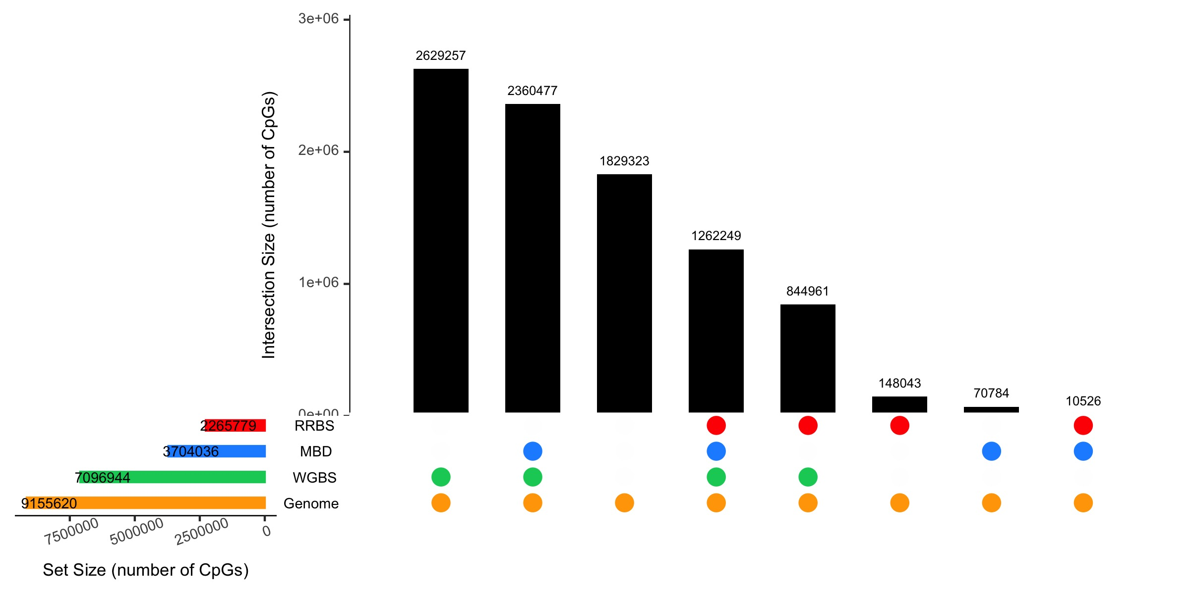
CpGs covered by MBD
CpGs not covered by any method
CpGs covered by RRBS
Number of unique CpGs between sets

Slide 7
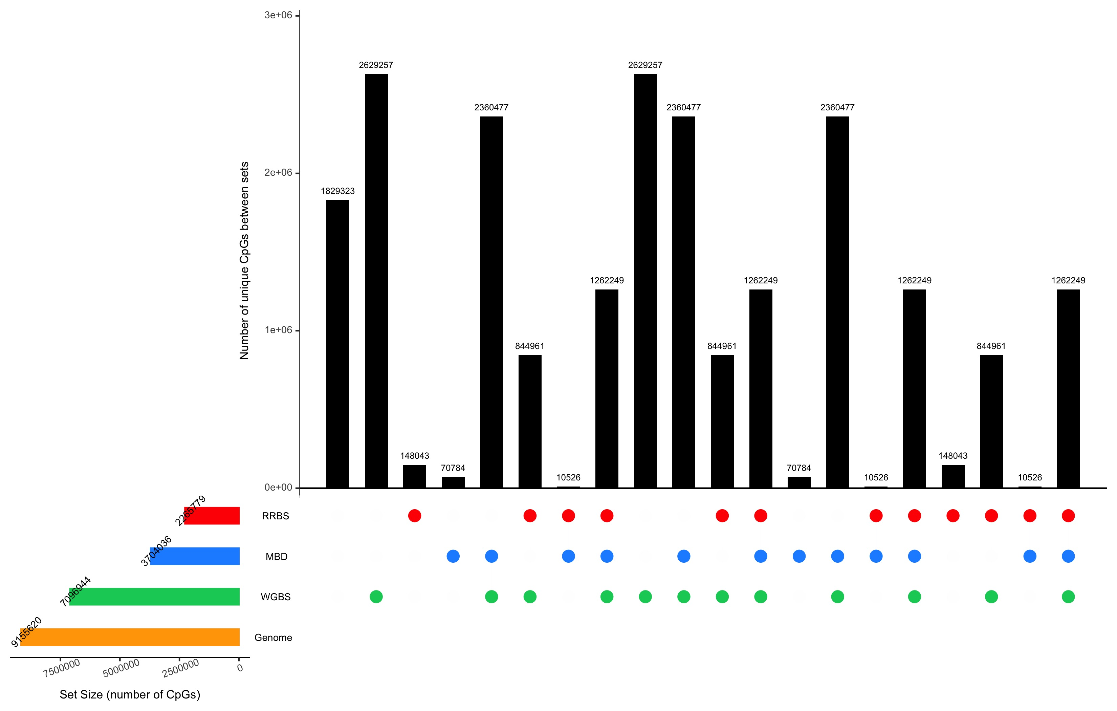
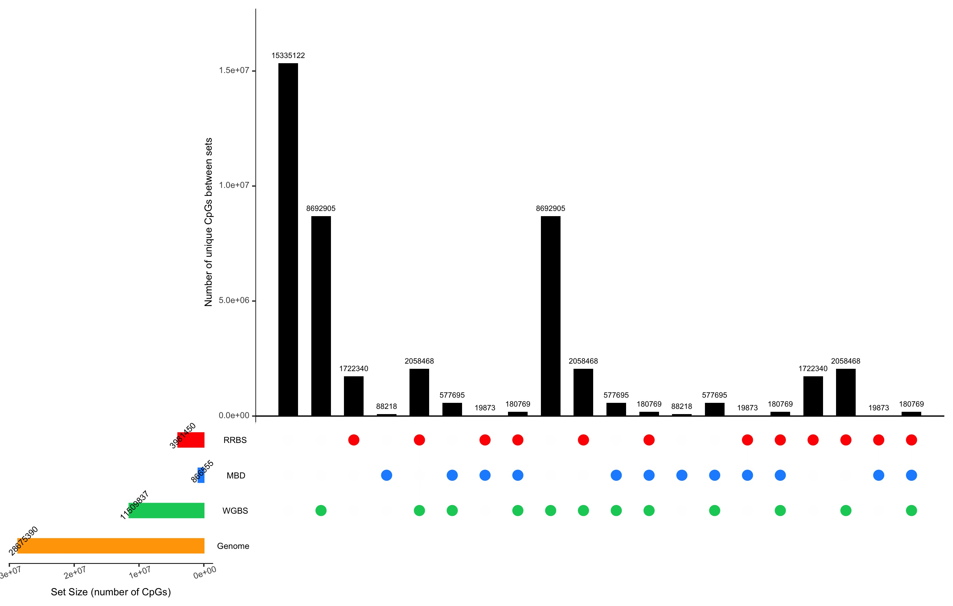
a
b

Slide 8
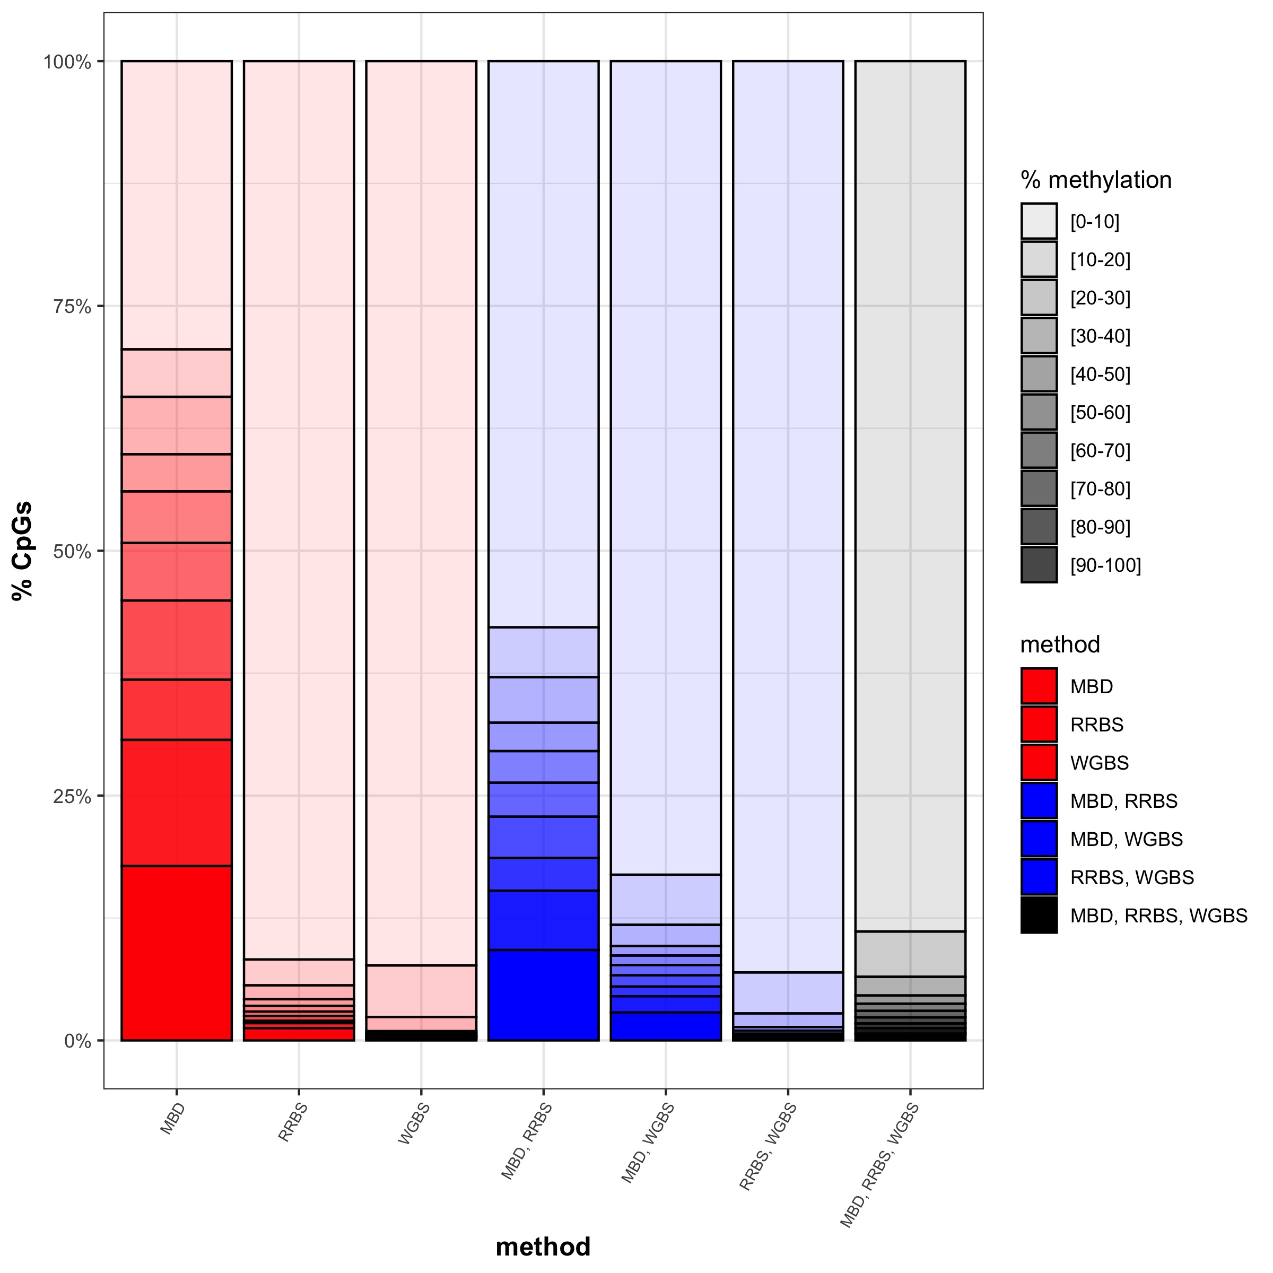
N=115,072
N=282,608
N=5,673,483
N=37,659
N=10,190,116
N=3,711,951
N=8,477,058

