Slide 1
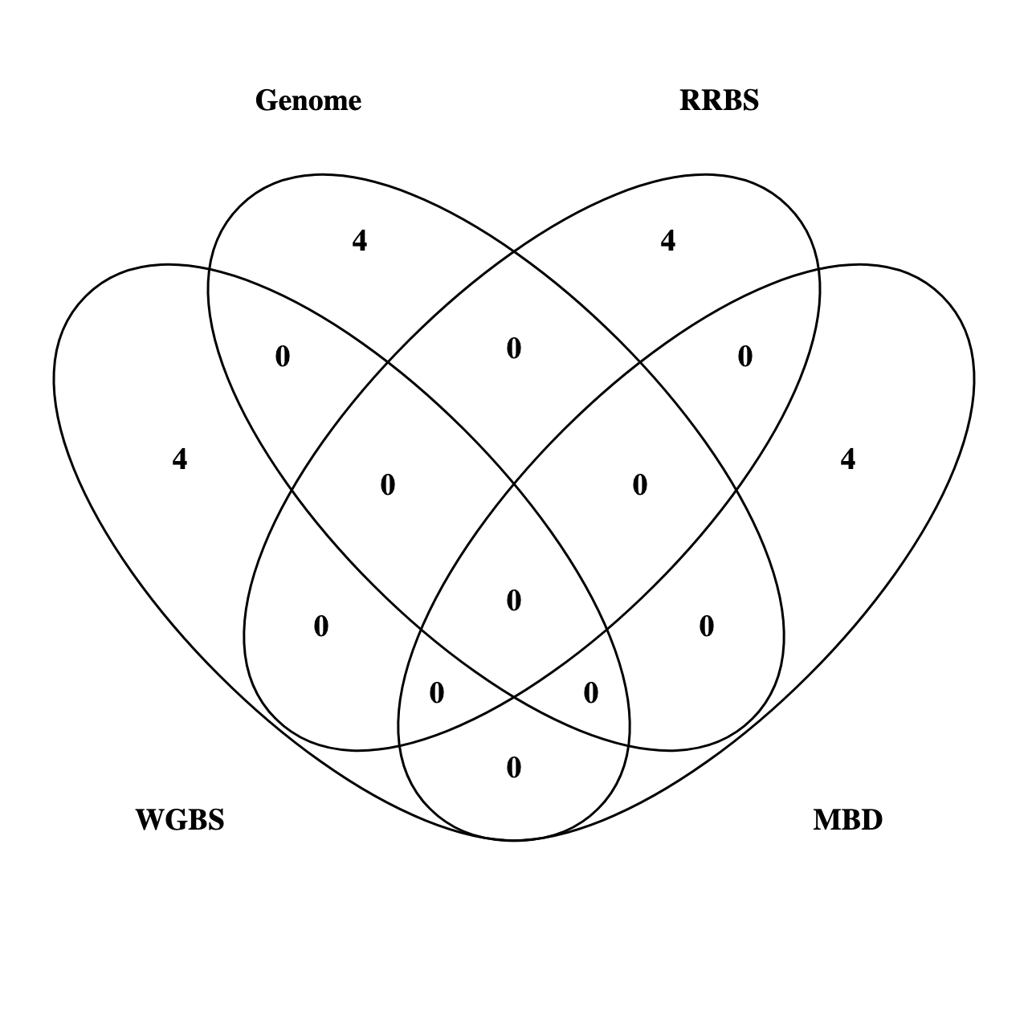









Slide 2







WGBS
RRBS
Genome
RRBS

Slide 4

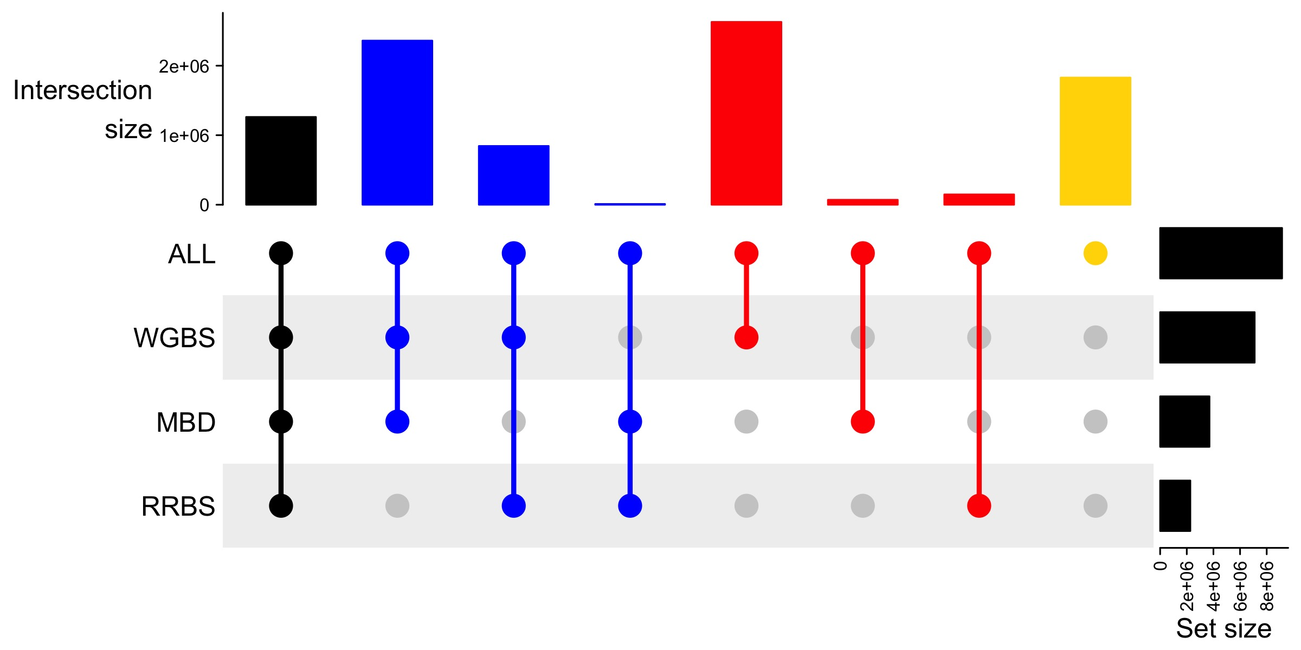
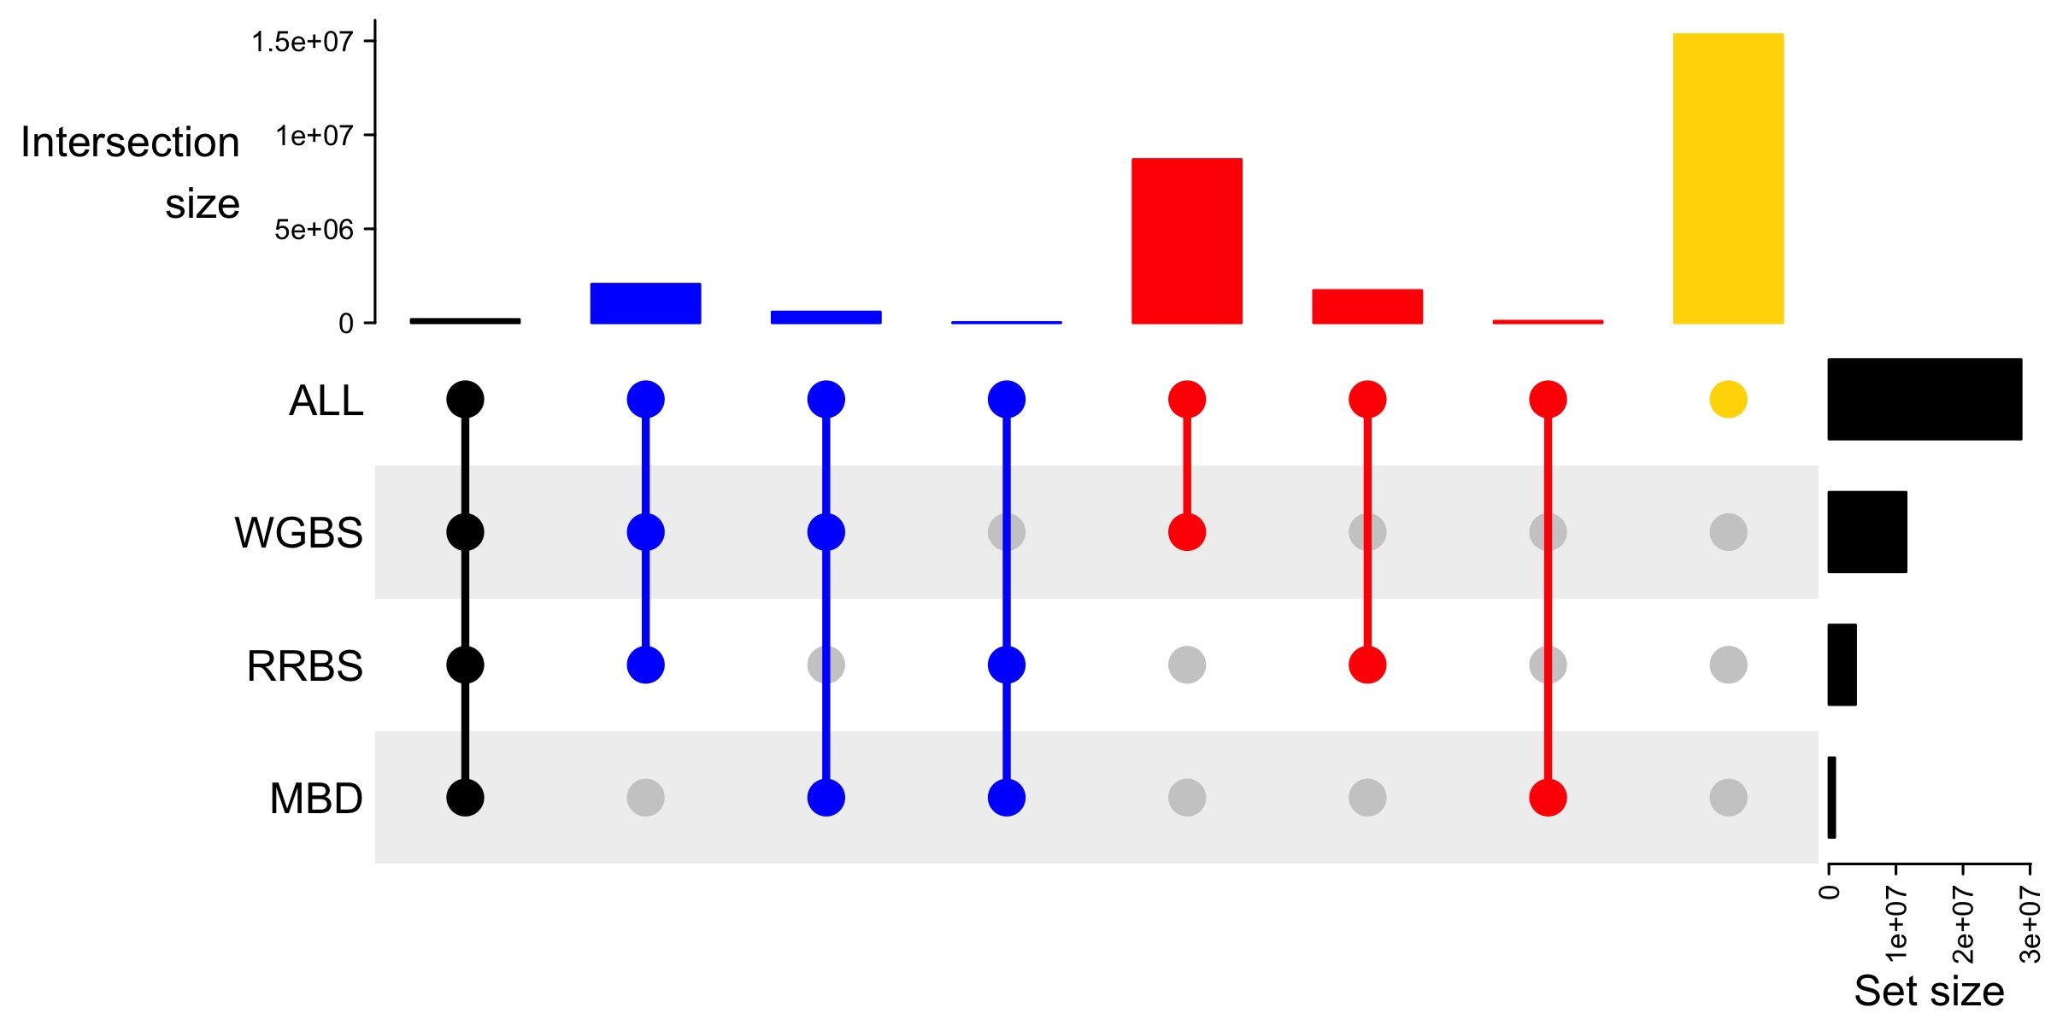

Slide 5


Slide 6
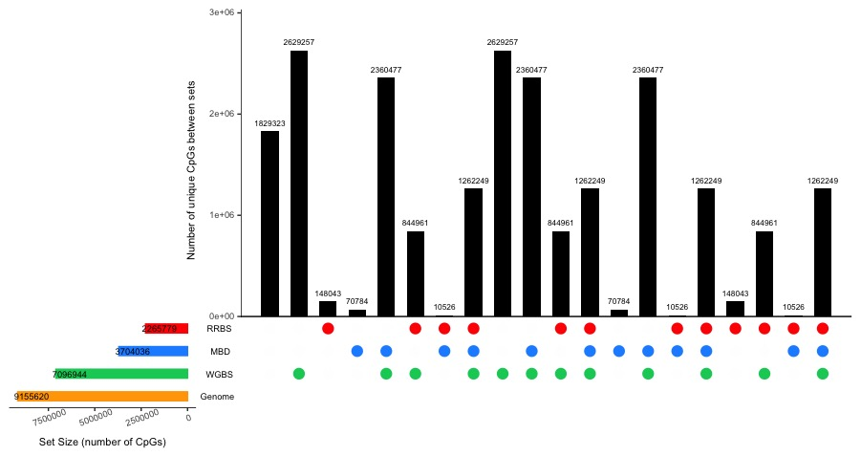
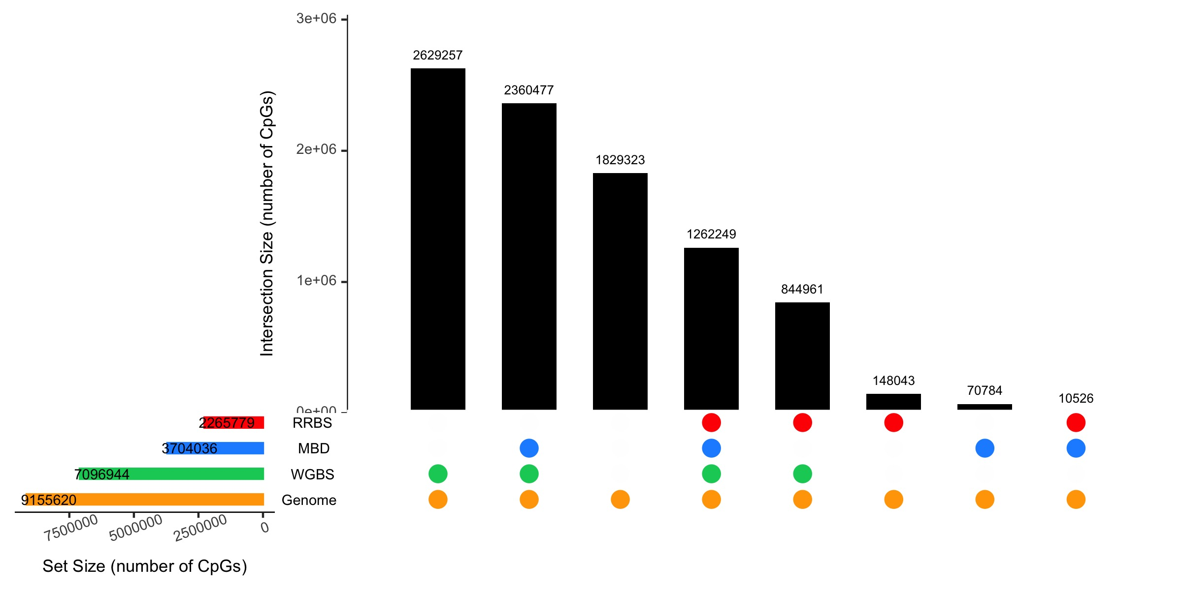
CpGs covered by MBD
CpGs not covered by any method
CpGs covered by RRBS
Number of unique CpGs between sets

Slide 7
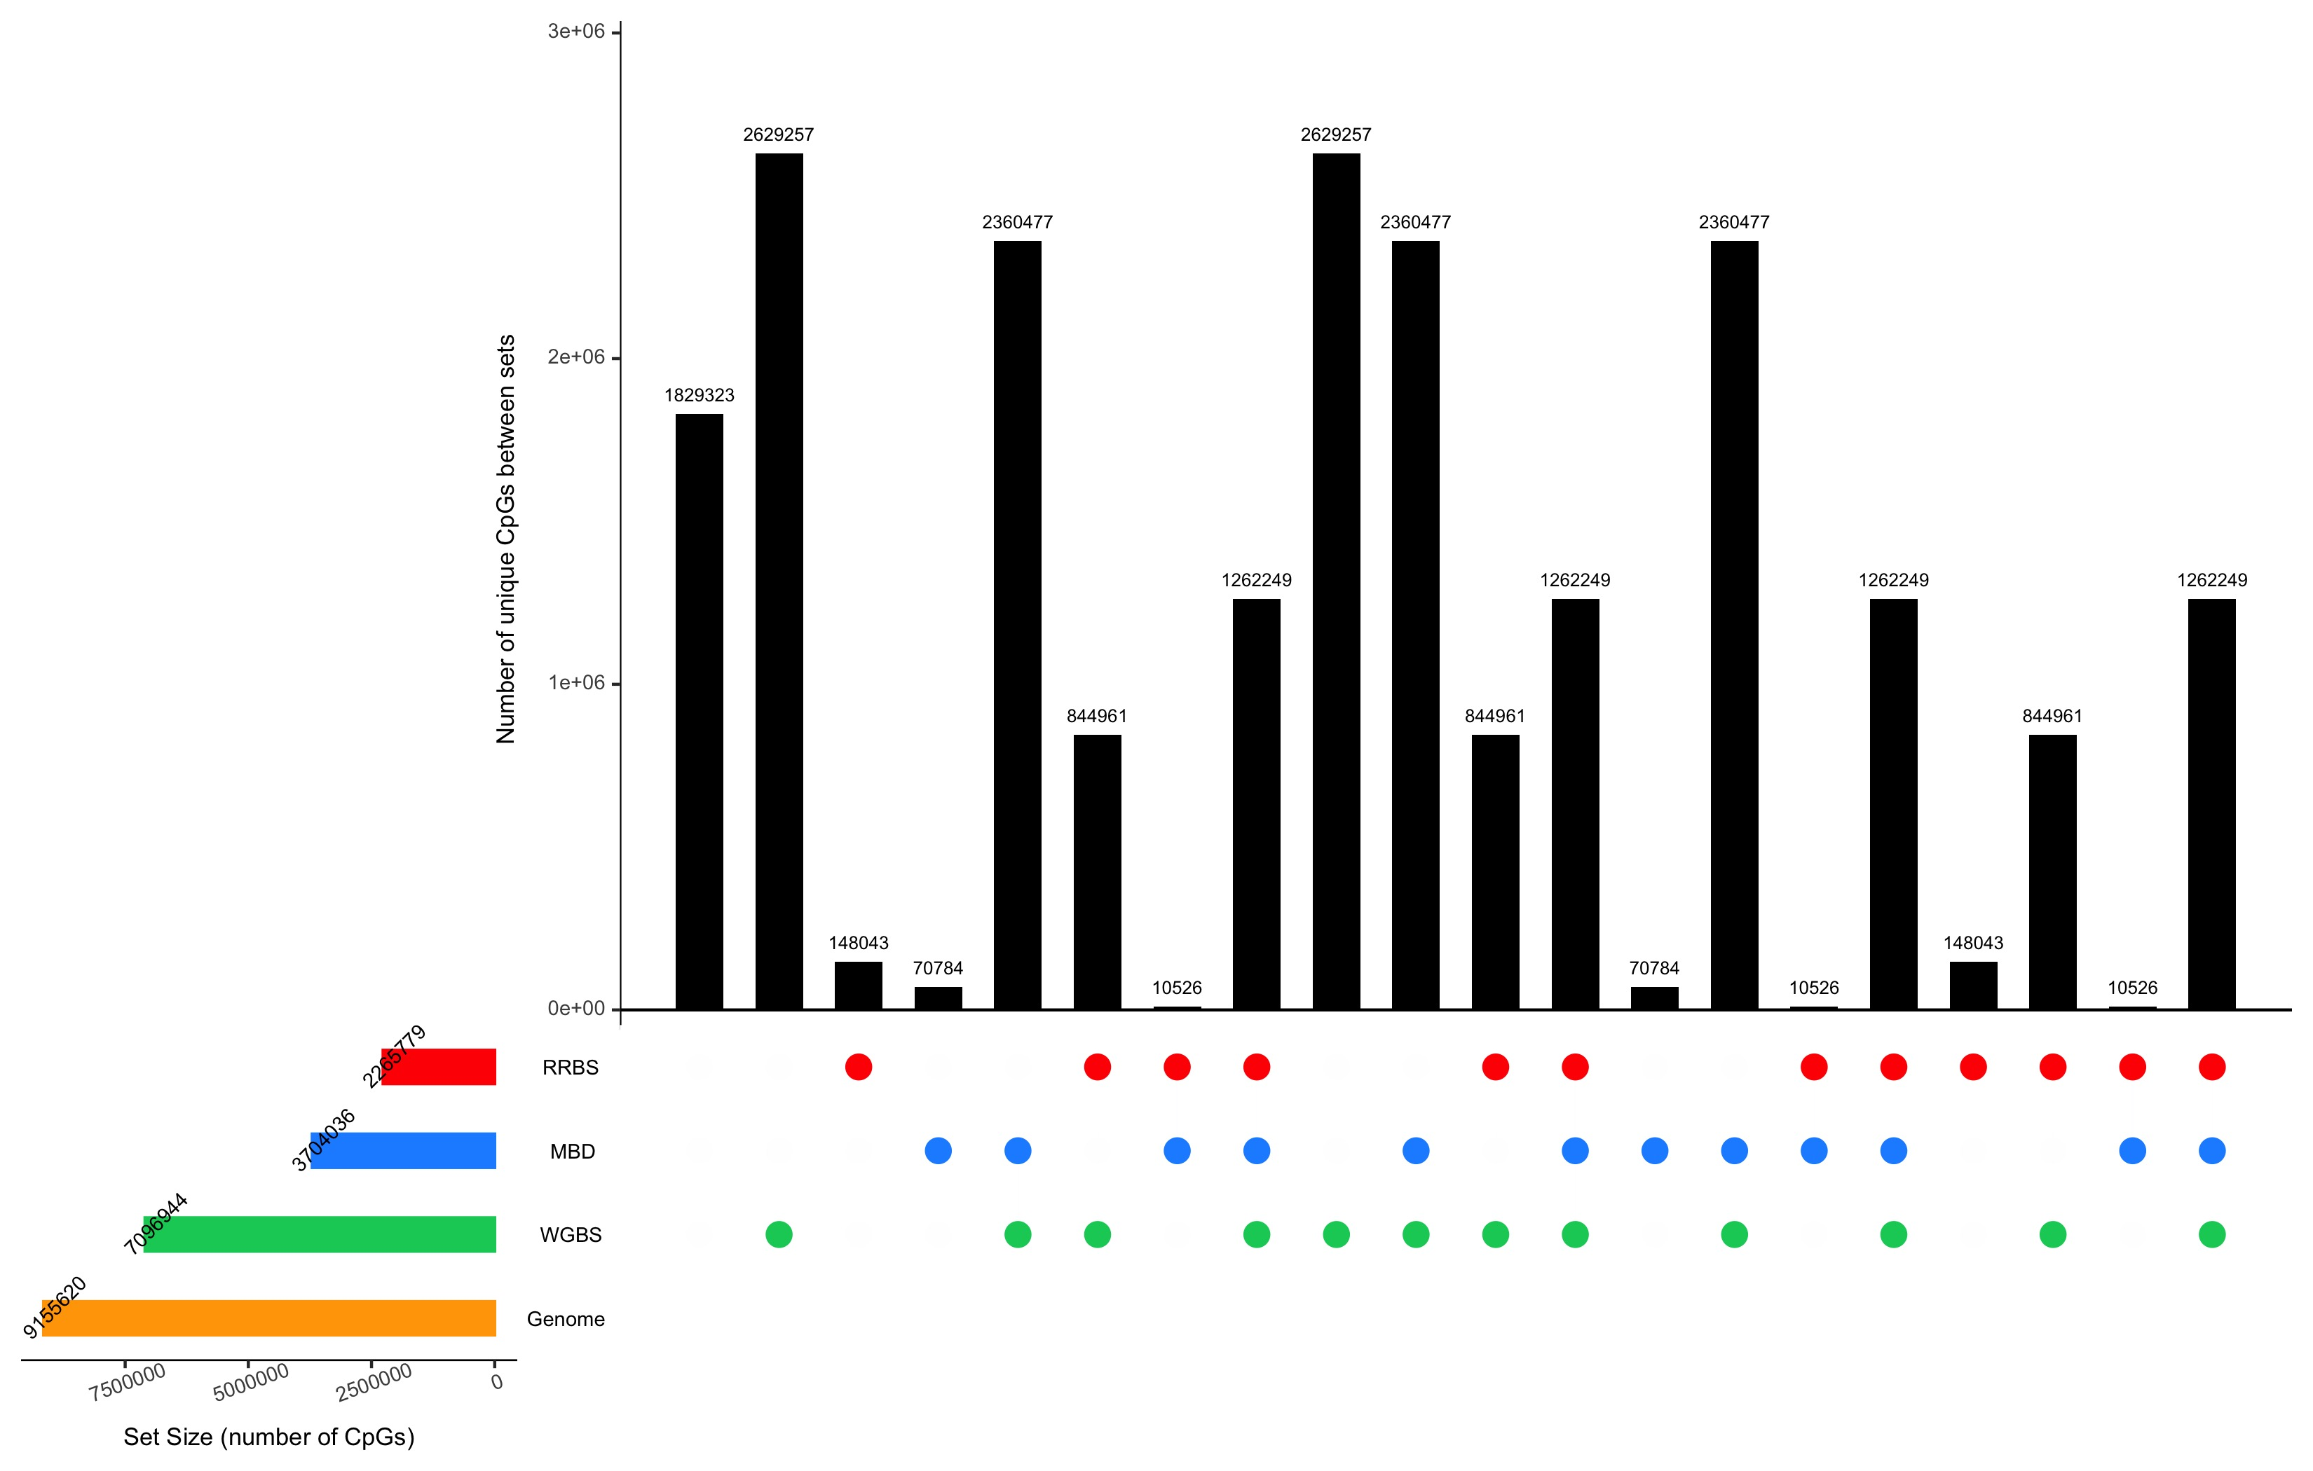
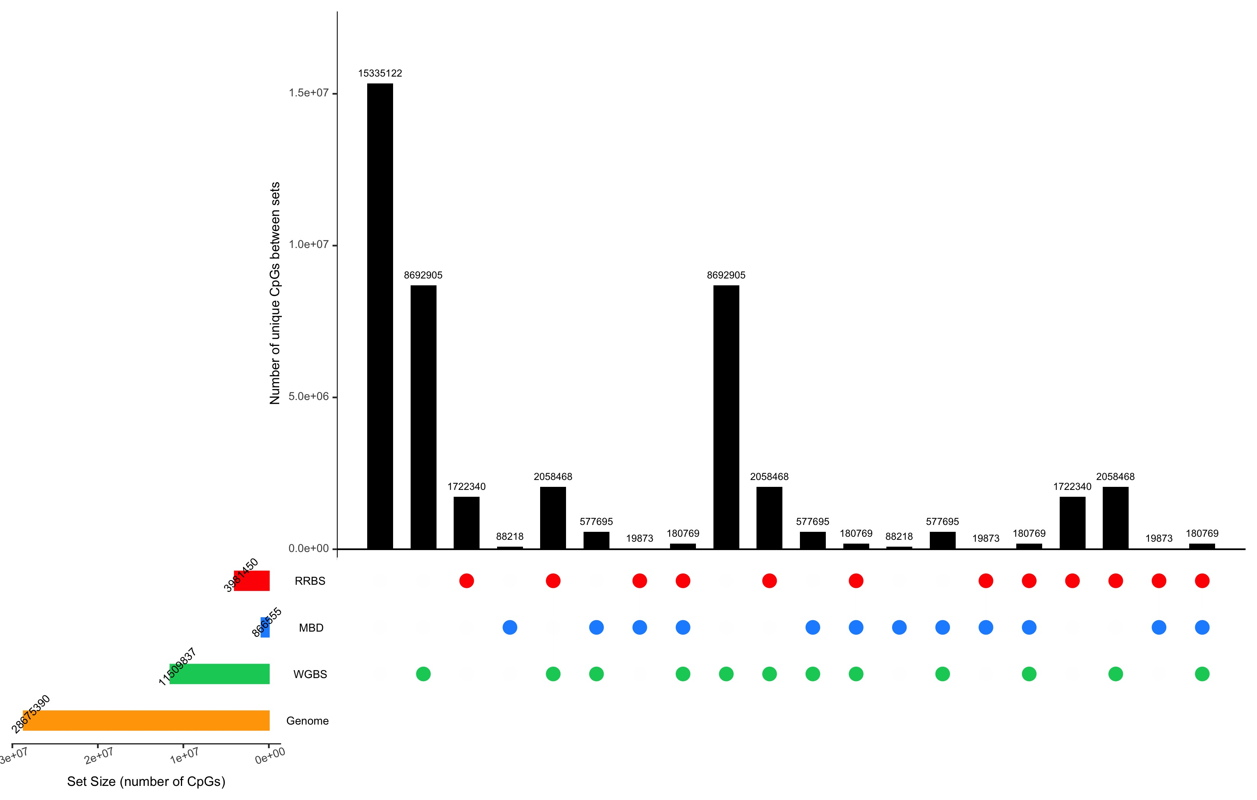
a
b

