Slide 1


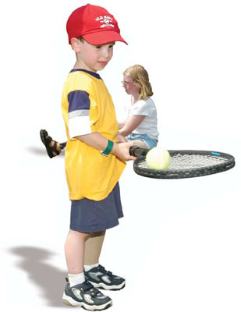

Introducing Metaworks3 –
You are the mother, How about your Object ?
Mother cares All the things?
Do that by himself ?

Slide 2
Introducing Metaworks3 –
Metaworks is ‘metadata-oriented framework’
Centralizing metadata and behaviors – it’s Object-Oriented Manner itself!
Concurrent Web-based (and mobile) Applications are degrading the Object’s own property – Cohesion of metadata.
For example, you need to keep the properties’ type as same value in DHTML scripts, Server Object, Data Object(Hibernate), and the DDL script as well.
Metaworks automatically synchronizes(or hides the operation) …
Stubs for calling Javascript to the server function (using DWR)
DAO object and relational query (not completely, SQL is still good)
Keeps intuitive and Sophisticated Programming Model… Don’t be a dog!
By managing the metadata

Slide 3
Introducing Metaworks3
– Lifecycle of metadata
General Approach:
Spring MVC, JSON, jQuery, Hibernate
Using Metaworks3:
metadata
Controller
Controller
Domain class (java version)
View
DAO
View
You have to
Synchronize the gap
metadata
DAO
metadata
Metaworks
Synchronizes the Proxy
metadata
Metaworks
Synchronizes the Proxy
Domain class (JS version)
Domain class (Hibernate version)
Domain Class
(Java)

Slide 4


No more words, Seeing is believing:
#Posting.java
@org.metaworks.Metadata(tableName = “fb_posting”)
public class Posting extends MetaworksObject<IPosting> implements IPosting{
String document;
@org.metaworks.Metadata(isKey = true)
public String getDocument() {
return document;
}
public void setDocument(String document) {
this.document = document;
}
public void post() throws Exception{
createDatabaseMe();
}
}
#Posting.ejs
<%
if(mw3.when == mw3.WHEN_EDIT){
value.document = 'Share your status...';
}
%>
<%=mw3.locateObject(value.document, 'java.lang.String')%>
<%
if(mw3.when == mw3.WHEN_EDIT){
%>
<input type="button" value="SHARE" onclick="mw3.call(<%=objectId%>, 'post')">
<%
}
%>
#application.html
<script>
mw3.setContextWhen(mw3.WHEN_EDIT);
mw3.locateObject(
{ document:"",
__className: "org.metaworks.example.Posting”
},
null,
'newEntry’
);
</script>
...
<div id=‘newEntry’></div>
#Result

Slide 5
FaceBook example
Steps:
Recognizing what is (was) ‘Object’ in your application
Modeling the Objects
Face making and Context-awaring for the Objects
Creating Application with highly-abstracted programming Model – almost natural language!
→ Humanity-Recovery !

Slide 6

Step 1.
Recognizing what is (was) ‘Object’ in your application

Slide 7
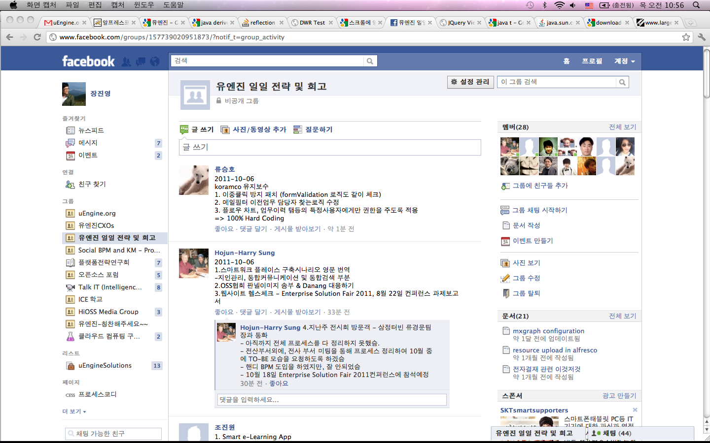
1. Recognizing Objects in facebook
Person object
Posting object
Doc object
Group object

Slide 8
1. Recognizing Objects in facebook 1.1. Person objects in different ‘Context’
Where: NORMAL
Where: MINIMISED
Where: MEDIUM

Slide 9
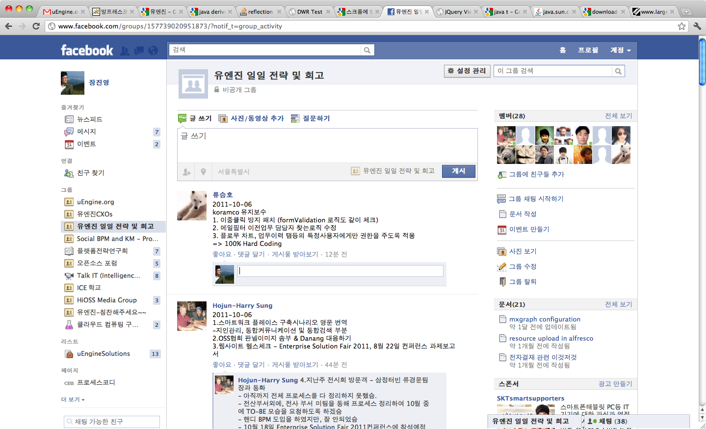
1. Recognizing Objects in facebook 1.2. Posting objects in different ‘Context’
Where: NORMAL
When: EDIT
Where: NORMAL
When: VIEW
Where: MINIMISED
When: EDIT

Slide 10
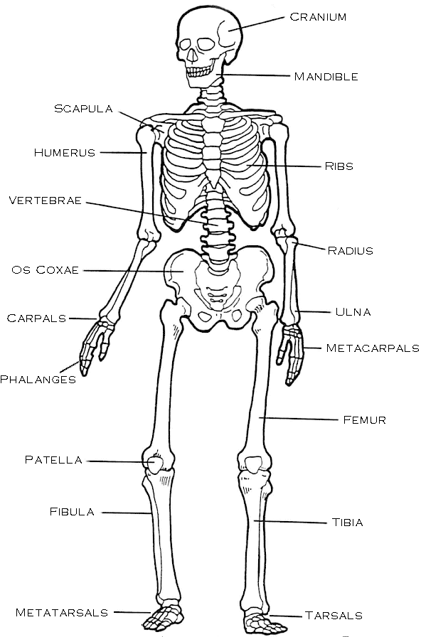
Step 2.
Modeling the ‘Cohesive’ Objects

Slide 11
2. Modeling Objects - Posting object Design –
2.1. create interface
import org.metaworks.dao.IDAO;
public interface IPosting extends IDAO{
public Person getWriter(); // 작성자
public void setWriter(Person writer);
public String getDocument(); // 글
public void setDocument(String document);
public boolean isLikeIt(); // 좋아요 여부
public void setLikeIt(boolean likeIt);
}

Slide 12
2. Modeling Objects - Posting object Design –
2.2. add metadata
import org.metaworks.dao.IDAO;
@Table(name="Posting")
public interface IPosting extends IDAO{
public Person getWriter();
public void setWriter(Person writer);
@Id
public String getDocument();
public void setDocument(String document);
public boolean isLikeIt();
public void setLikeIt(boolean likeIt);
}

Slide 13
2. Modeling Objects – Posting object
2.3. create implementation object
public class Posting extends MetaworksObject<IPosting> implements IPosting{
Person writer;
public Person getWriter() {
return writer;
}
public void setWriter(Person writer) {
this.writer = writer;
}
String document;
public String getDocument() {
return document;
}
public void setDocument(String document) {
this.document = document;
}
boolean likeIt;
public boolean isLikeIt() {
return likeIt;
}
public void setLikeIt(boolean likeIt) {
this.likeIt = likeIt;
}
}

Slide 14
2. Modeling Objects - Posting object
2.4. add behaviors
public class Posting extends MetaworksObject<IPosting> implements IPosting{
Person writer;
public Person getWriter() {
return writer;
}
public void setWriter(Person writer) {
this.writer = writer;
}
String document;
public String getDocument() {
return document;
}
public void setDocument(String document) {
this.document = document;
}
boolean likeIt;
public boolean isLikeIt() {
return likeIt;
}
public void setLikeIt(boolean likeIt) {
this.likeIt = likeIt;
}
public void post() throws Exception{
createDatabaseMe();
}
public void like() throws Exception{
databaseMe().setLikeIt(true); //will automatically synchronize the value
}
}

Slide 15

Step 3
Face making and Context-awaring for the Objects

Slide 16
3. Face Making
3.1. creating ‘Face’ – Posting.ejs
<table>
<tr>
<td><%=fields.writer.here() %></td>
<td><%=fields.document.here() %>
<%
if(value.likeIt){
%>
You like this
<% }else{%>
<a onclick=<%=methods.like.caller()%>>좋아요</a>
<%}%>
</td>
</tr>
</table>

Slide 17
3. Face Making
3.1. considering the Contexts – WHEN_EDIT
<%
if(mw3.when == mw3.WHEN_EDIT){
value.document = 'Share your status...';
}
%>
<table>
<tr>
<td><%=mw3.locateObject(value.writer, 'org.metaworks.example.Person')%></td>
<td><%=mw3.locateObject(value.document, 'java.lang.String')%>
<%
if(mw3.when == mw3.WHEN_EDIT){
%>
<input type="button" value="SHARE" onclick="mw3.call(<%=objectId%>, 'post')">
<%
}
if(value.likeIt){
%>
You like this
<% }else{%>
<input type=button onclick="mw3.call(<%=objectId%>, 'like')" value="like”>
<%}%>
<%
if(mw3.when == mw3.WHEN_EDIT){
%>
<input type=button value="save">
<%
}else{
%>
<input type=button onclick="<%=editFunction%>" value="edit"a>
<%
}
%>
</td>
</tr>
</table>

Slide 18
Next, Do 1~3 for Person object – Person.java & Person.ejs
#Person.java
public interface Person extends IDAO{
@org.metaworks.Metadata(isKey = true)
public String getName();
public void setName(String name);
public int getAge();
public void setAge(int age);
@org.metaworks.Metadata(face="faces/image.ejs”)
public String getPortraitURL();
public void setPortraitURL(String portraitURL);
public boolean isMyFried();
public void setMyFried(boolean isMyFried);
}
#Person.ejs
<%if (!value){%>
Writer is not specified
<%}else{%>
<img src="<%=value.portraitURL%>" width=50><br>
<b><%=value.name%></b>
<%if(!value.myFried){%>
<br> [<a onclick='addFriend("<%=objectId%>")'> add to friend </a>]
<%}%>
<%}%>

Slide 19
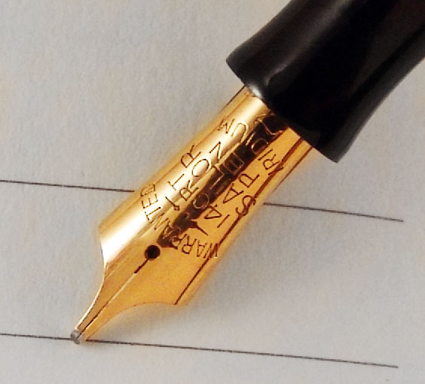
Step 4
Creating Application with highly-abstracted programming Model –
Write a Novel or Poet, not the alien language

Slide 20
4. Now, create the Application
<script type="text/javascript">
var loginUser = //some how you can access the loginUser, metaworks don’t touch
$(document).ready(function() {
dwr.engine.setActiveReverseAjax(true); // let the long-polling based chatting enabled
FaceBook.getNewsFeed(
function(newsFeed){
mw3.showObject(newsFeed, 'org.metaworks.example.Posting[]', 'foo');
newEntry();
}
);
});
var lastEntryId = 0;
function newEntry(){
mw3.setContextWhen(mw3.WHEN_EDIT);
lastEntryId = mw3.locateObject(
{document:"", writer: loginUser, __className: "org.metaworks.example.Posting"},
null,
'newEntry'
);
}
</script>
<div id="foo">LOADING...</div>
<div id="newEntry"></div>

Slide 21
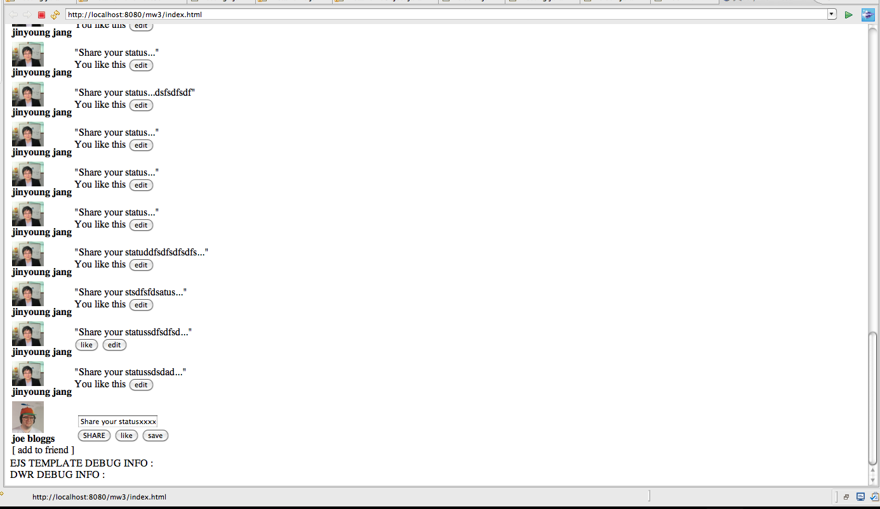
Result

Slide 22
Conclusion
No duplicated metadata mapping e.g. JSON object mapping in Spring Controller and DAO mapping for Hibernate.
→ No errors from duplicated metadata source.
Cohesive User Interface management by EJS-object mapping.
Intuitive Programming Model – model and metadata-driven, not implementation-driven.
Only thing you have to do is… just forgetting the old manners!

Slide 23
All the Source Code available here:
http://www.largedocument.com/2/99c863a7/mw3_facebook_example_MetaworksObject.zip
it’s very early stage now! You are welcomed to participate this Open Source Project. E-mail me: jyjang at uengine.org

