Slide 1
Procurement Design & Activation
NorthStar Aviation | August 31, 2026 | Harrison Pizzi

Slide 2
What we’re solving
Approval speed
Audit readiness
Approvals bottleneck.
Parts miss need-by dates.
No clean trail from request to payment. Everything lives in email, Slack, and spreadsheets.
Recommended launch path
One controlled program for aircraft parts first — request through payment.
Notes:
NorthStar’s regional expansion will multiply both challenges if procurement stays informal.

Slide 3
Recommended path — request to payment
Request
Approve
PO
Receive
Match & pay
qty × price · need-by · vendor · part #
Your thresholds · Inventory? (TBD)
On approval
→ NetSuite
NetSuite or Ramp
Order + receipt + invoice → pay
Confirm with me
Why is Inventory Manager in approval path? – visibility, accountability, or both? _____________
Approval thresholds – who / at what $ _____________
Receiving – where it lives and who does it? Central receiving or requesters? _____________
Required fields beyond quantity, unit price, need by date _____________

Slide 4
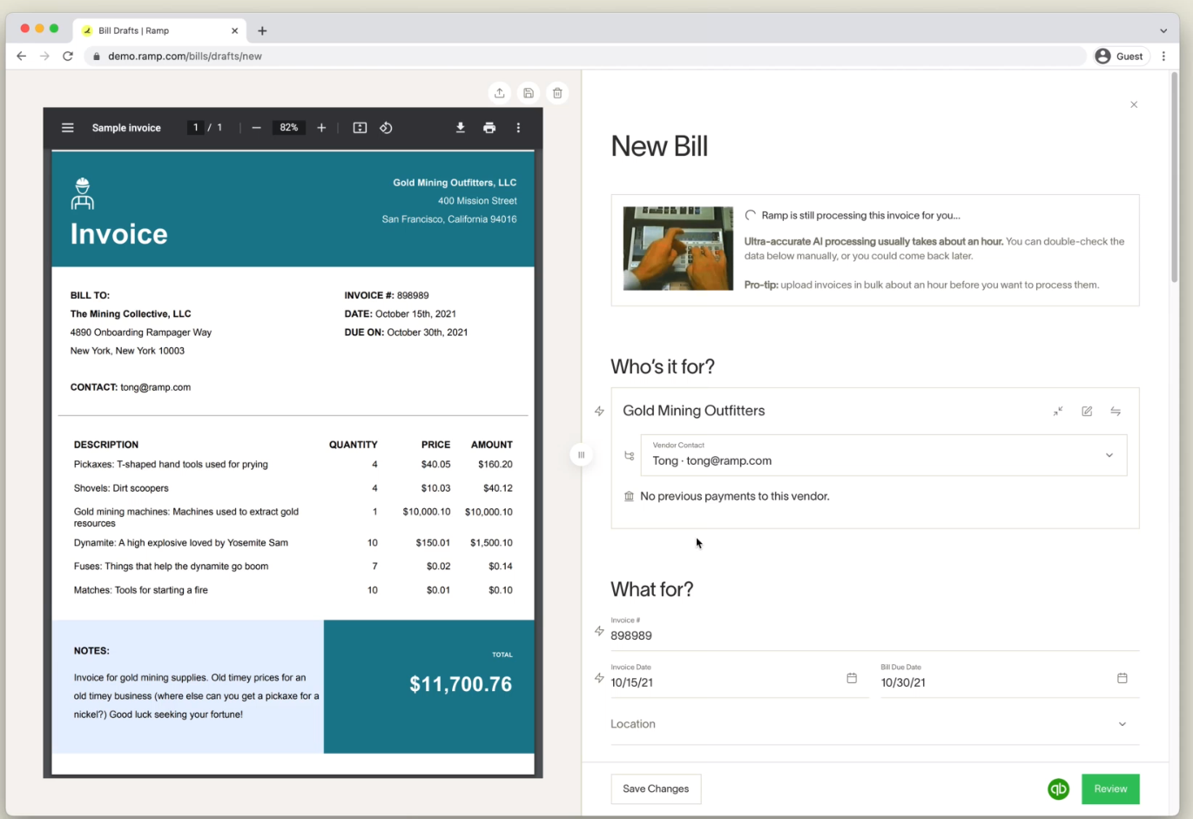
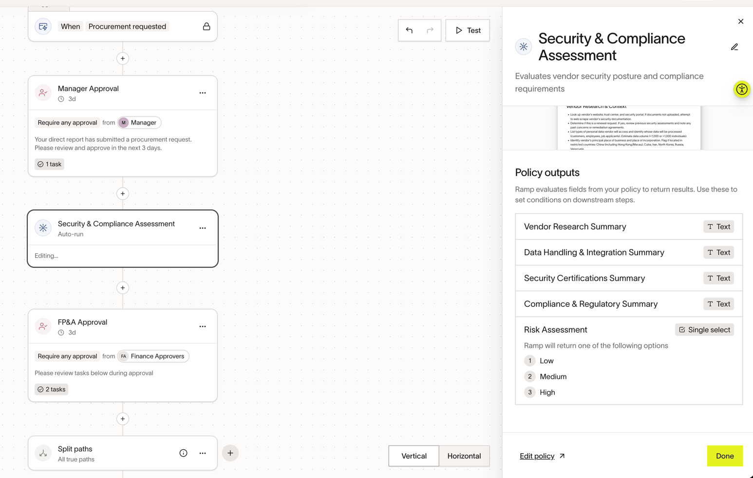
After the path is live
Ramp extensions
Bill Pay
AI Procurement Agents
Matched invoices paid in Ramp
Due dates leave the spreadsheet.
Full request-to-payment trail in one place.
Embedded in approval workflow for research & structured reports
Web + document analysis; risk tiering; conditional routing
Does not approve — prepares context for humans
Best for: new vendors, security/legal review, duplicate detection

Slide 5
This week
Build & publish
Run first request together
Review what broke
Stand up Aircraft Parts Program
Lock before we leave
Schedule working session
Pilot group confirmed
Any open items from today (thresholds, receiving, Inventory)

