Slide 1
Data Wrangling and Data Analysis
How to do R practicals
Department of Methodology & Statistics
Utrecht University

Slide 2
Schedule for the R practicals
Three practical sessions per week: Monday, Tuesday, Wednesday
Attendance is mandatory
In each session:
Q&A time for the lecture, short intro time for practical
Working on today’s practical (working together is allowed / encouraged)
~20 minutes discussion
Answers will be online during discussion

Slide 3
How to do R practicals
R practicals are on https://infomdwr.nl (like always!)
Sometimes they need some additional data
What steps to take?

Slide 4
Step 1: Create a folder with R project
Our suggestion: either
One folder for the course with an R project (.Rproj file)
Subfolder for each practical with .Rmd, .qmd, or .R file (depending on your preference)
Data folder with all data for all practicals
OR
One folder with .Rproj file per practical
Data folder per practical if needed

Slide 5
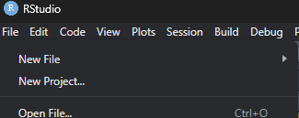
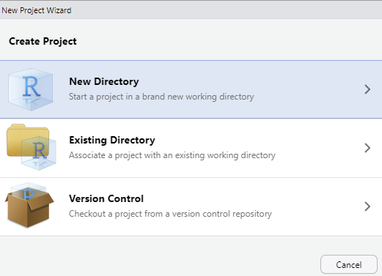
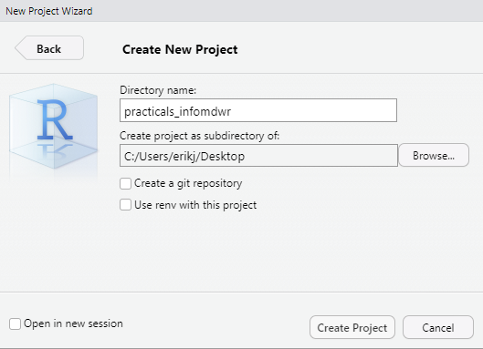
Step 1

Slide 6
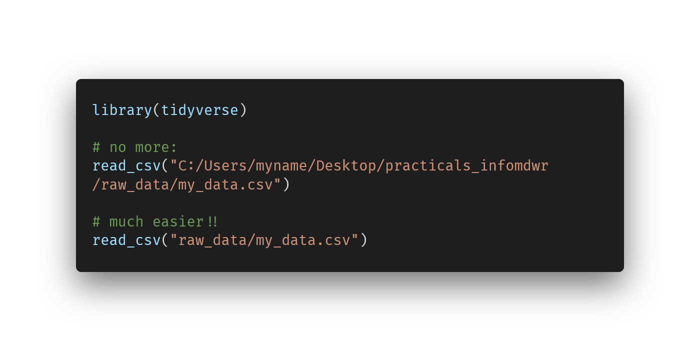
Now all file paths are relative!
For more info see R4DS chapter 7 https://r4ds.hadley.nz/workflow-scripts

Slide 7
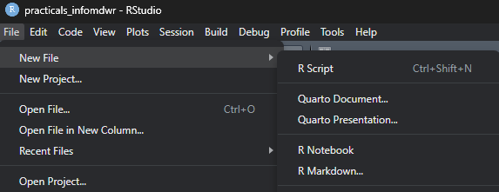
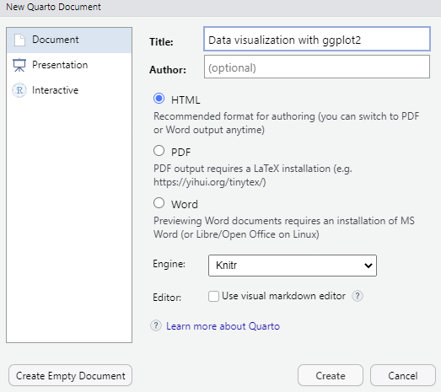
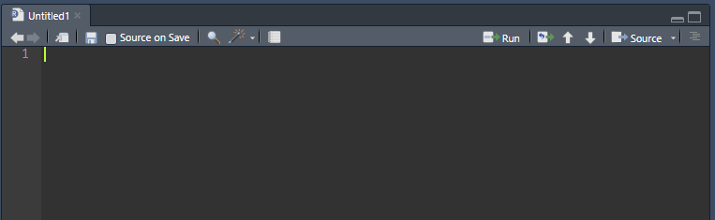


Step 2: qmd or .R file (or .rmd)
Notes:
Recommend an R script or a qmd file. Rmd only if they already know how to work with that (and then still qmd is better because it’s the successor).

Slide 8
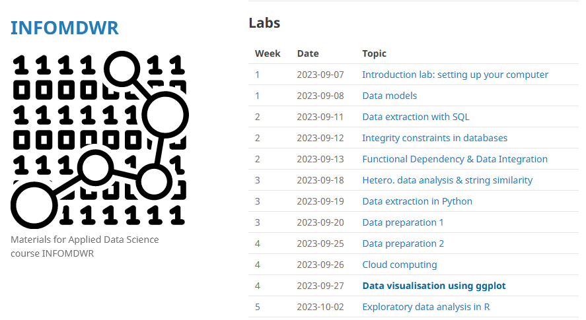

Step 3: Open the practical
Click on the url in the browser
Follow along and type your answers in your chosen file type

Slide 9
Any questions?

