Slide 1
Data Wrangling and Data Analysis
Missing Data Example
Department of Methodology & Statistics
Utrecht University

Slide 2
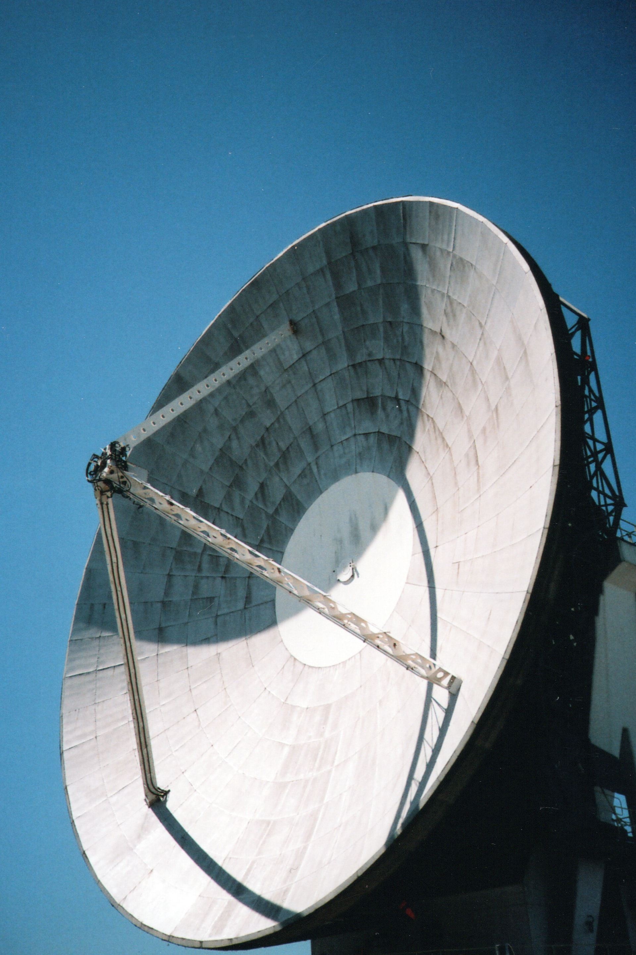
Small missing data example
A satellite orbits the sun, measuring each 5 minutes the intensity of solar flares Y and sending it to earth.
Y = [.5, 0, 0, .1, 0, 20, 25, 19, 8, .3, 0, ...]
Researchers want to make use of this data but they notice something strange…

Slide 3
Small missing data example
A bug in the software of the satellite has created a wrongly measured 24-hour spike in solar flare activity each 2^32 milliseconds (about 50 days).
Those values have to be thrown away.
What is the missingness mechanism?

Slide 4
Small missing data example
Discuss!
NDD? SDD? UDD?

