Slide 1
Data Wrangling and Data Analysis
Data Extraction 1
Hakim Qahtan
Department of Information and Computing Sciences
Utrecht University

Slide 2
Outlines
So Far
Data types
Structured, semi-structured and unstructured
Data Models
Relational model and entity-relationship model
Graphs and trees
Objects
Data model components
Data, structure, semantics, and operations
Databases vs file systems
DDL and DML
Creating and modifying tables (relations) in SQL

Slide 3
Outlines
Today
Reminder
OAC members
Volunteers for the social event (only one week left)
Office hours only by appointment (send email)
Operations on databases
Relational algebra
Data Extraction with SQL

Slide 4
Reading Material for Today
Database System Concepts (7th Edition)
CH 2.6, 3.3 – 3.8.

Slide 5
Relational Algebra

Slide 6
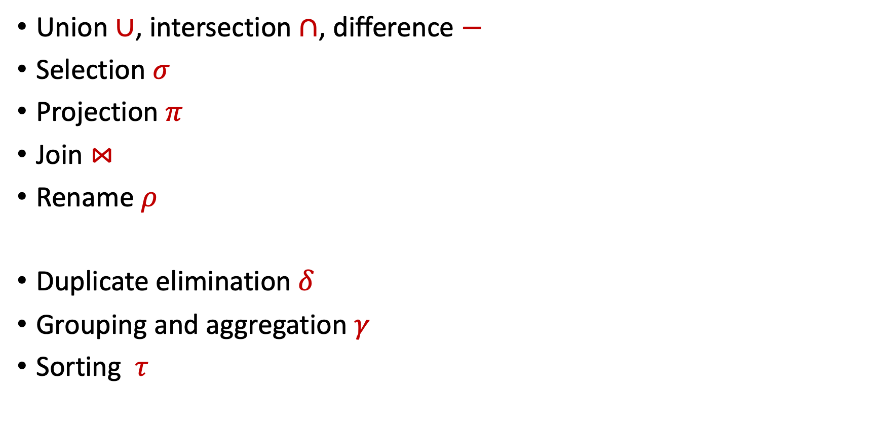
Relational Algebra Operators
Remember: a relation is a set of records
Union $∪$, intersection $∩$, difference $−$
Selection $σ$
Projection $π$
Join $⋈$
Rename $ρ$
Duplicate elimination $δ$
Grouping and aggregation $γ$
Sorting $τ$
RA
Extended RA

Slide 7

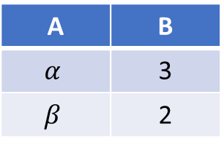
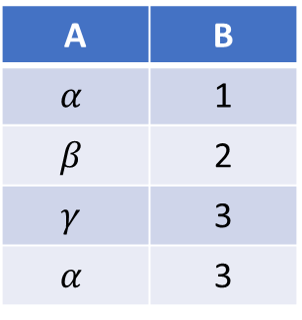

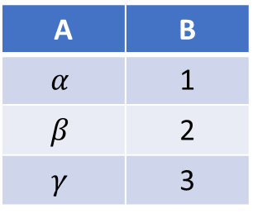

Union
$$r∪s$$
$$r$$
$$s$$
$$r∪s$$
A | B
$$α$$ | 3
$$β$$ | 2
A | B
$$α$$ | 1
$$β$$ | 2
$$γ$$ | 3
A | B
$$α$$ | 1
$$β$$ | 2
$$γ$$ | 3
$$α$$ | 3

Slide 8
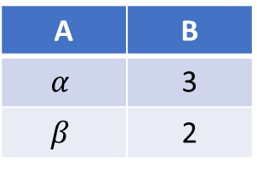


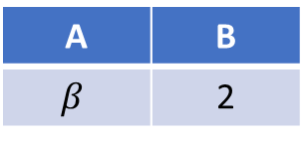

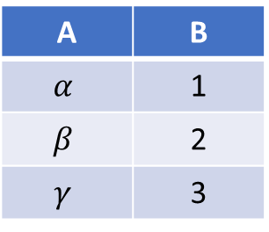
Intersection
$$r∩s$$
$$r$$
$$s$$
$$r∩s$$
A | B
$$α$$ | 3
$$β$$ | 2
A | B
$$α$$ | 1
$$β$$ | 2
$$γ$$ | 3
A | B
$$β$$ | 2

Slide 9
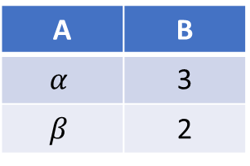


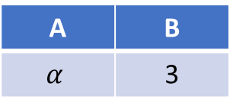

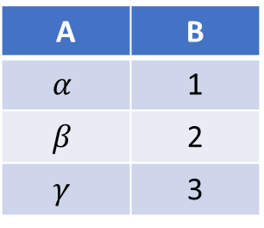

Difference
$$r−s$$
$$r$$
$$s$$
$$r−s$$
A | B
$$α$$ | 3
$$β$$ | 2
A | B
$$α$$ | 1
$$β$$ | 2
$$γ$$ | 3
A | B
$$α$$ | 3
Can you find an expression that is equivalent to $r−s$ using the operators $∩$ and $\sim$?

Slide 10

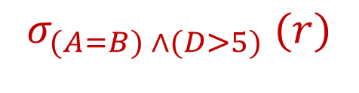
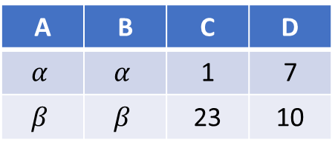
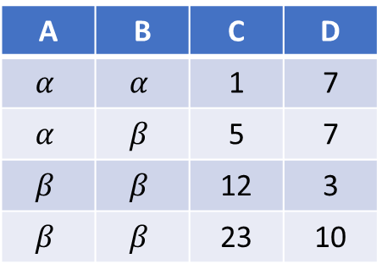
Selection
$$r$$
$$σ_{(A=B) ∧(D>5)} (r)$$
A | B | C | D
$$α$$ | $$α$$ | 1 | 7
$$α$$ | $$β$$ | 5 | 7
$$β$$ | $$β$$ | 12 | 3
$$β$$ | $$β$$ | 23 | 10
A | B | C | D
$$α$$ | $$α$$ | 1 | 7
$$β$$ | $$β$$ | 23 | 10

Slide 11


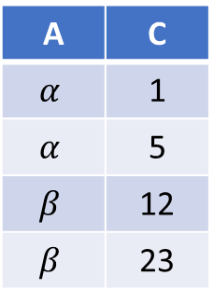
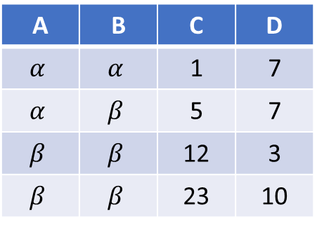
Projection
$$r$$
$$π_{A,C}(r)$$
A | B | C | D
$$α$$ | $$α$$ | 1 | 7
$$α$$ | $$β$$ | 5 | 7
$$β$$ | $$β$$ | 12 | 3
$$β$$ | $$β$$ | 23 | 10
A | C
$$α$$ | 1
$$α$$ | 5
$$β$$ | 12
$$β$$ | 23

Slide 12
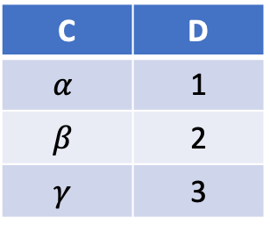

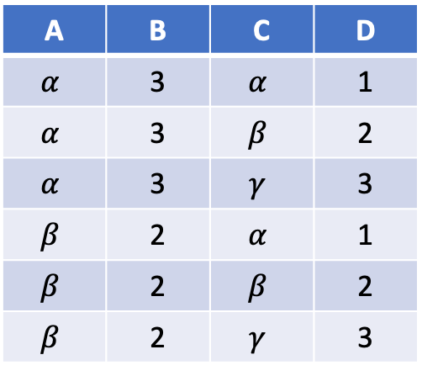
Join
Cartesian Product
$$r$$
$$s$$
$$r×s$$
A | B
$$α$$ | 3
$$β$$ | 2
C | D
$$α$$ | 1
$$β$$ | 2
$$γ$$ | 3
A | B | C | D
$$α$$ | 3 | $$α$$ | 1
$$α$$ | 3 | $$β$$ | 2
$$α$$ | 3 | $$γ$$ | 3
$$β$$ | 2 | $$α$$ | 1
$$β$$ | 2 | $$β$$ | 2
$$β$$ | 2 | $$γ$$ | 3

Slide 13
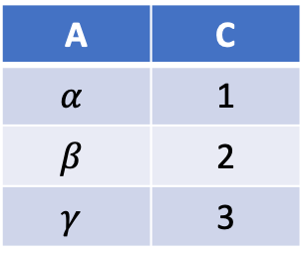
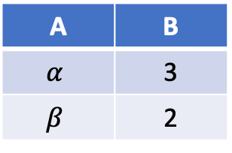


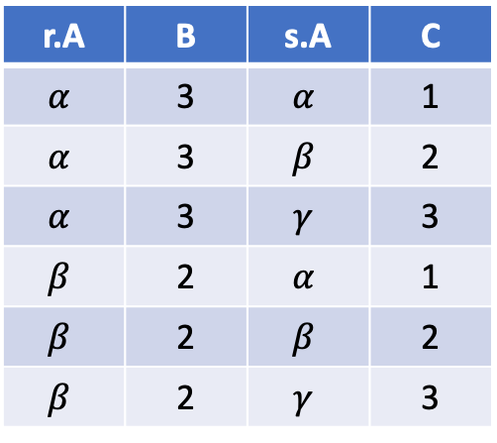

Join
Cartesian Product
$$r$$
$$s$$
$$r×s$$
A | B
$$α$$ | 3
$$β$$ | 2
A | C
$$α$$ | 1
$$β$$ | 2
$$γ$$ | 3
r.A | B | s.A | C
$$α$$ | 3 | $$α$$ | 1
$$α$$ | 3 | $$β$$ | 2
$$α$$ | 3 | $$γ$$ | 3
$$β$$ | 2 | $$α$$ | 1
$$β$$ | 2 | $$β$$ | 2
$$β$$ | 2 | $$γ$$ | 3

Slide 14

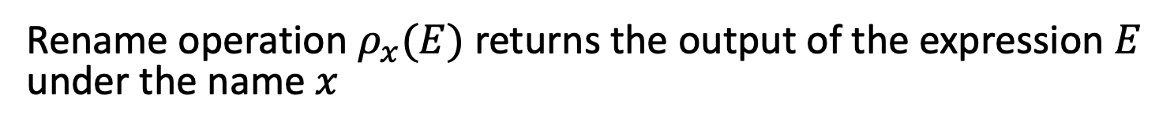
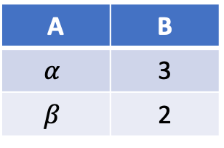
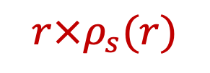
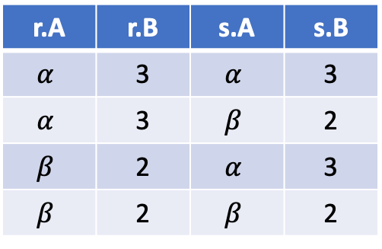
Rename
Rename operation $ρ_{x}(E)$ returns the output of the expression $E$ under the name $x$
$$r$$
$$r×ρ_{s}(r)$$
A | B
$$α$$ | 3
$$β$$ | 2
r.A | r.B | s.A | s.B
$$α$$ | 3 | $$α$$ | 3
$$α$$ | 3 | $$β$$ | 2
$$β$$ | 2 | $$α$$ | 3
$$β$$ | 2 | $$β$$ | 2

Slide 15
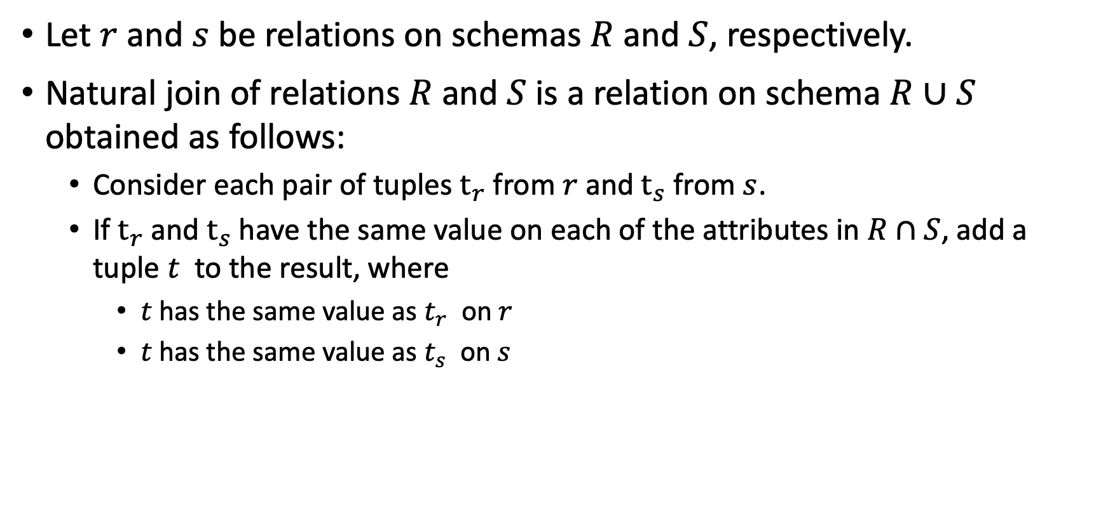
Natural Join
Let $r$ and $s$ be relations on schemas $R$ and $S$, respectively.
Natural join of relations $R$and $S$is a relation on schema $R∪S$ obtained as follows:
Consider each pair of tuples $t_{r}$from $r$ and $t_{s}$ from $s$.
If $t_{r}$and $t_{s}$ have the same value on each of the attributes in $R∩S$, add a tuple $t$ to the result, where
$t$ has the same value as $t_{r}$ on $r$
$t$ has the same value as $t_{s}$ on $s$

Slide 16
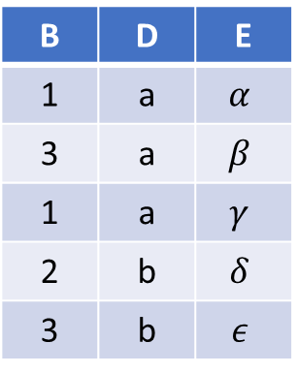
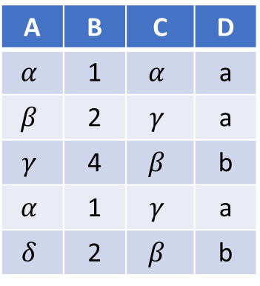


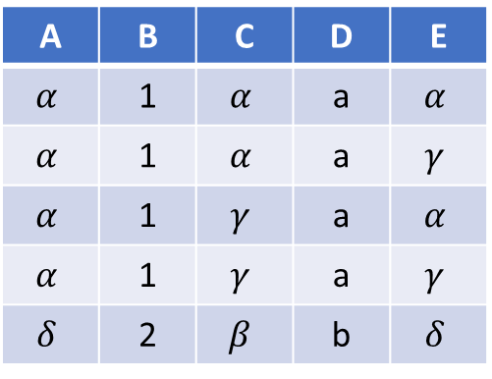

Natural Join – Example
$$r$$
$$s$$
$$r⋈s$$
A | B | C | D
$$α$$ | 1 | $$α$$ | a
$$β$$ | 2 | $$γ$$ | a
$$γ$$ | 4 | $$β$$ | b
$$α$$ | 1 | $$γ$$ | a
$$δ$$ | 2 | $$β$$ | b
B | D | E
1 | a | $$α$$
3 | a | $$β$$
1 | a | $$γ$$
2 | b | $$δ$$
3 | b | $$ε$$
A | B | C | D | E
$$α$$ | 1 | $$α$$ | a | $$α$$
$$α$$ | 1 | $$α$$ | a | $$γ$$
$$α$$ | 1 | $$γ$$ | a | $$α$$
$$α$$ | 1 | $$γ$$ | a | $$γ$$
$$δ$$ | 2 | $$β$$ | b | $$δ$$
$r⋈s≡π_{A,r.B, C, r.D, E}(σ_{r.B=s.B∧r.D=s.D }(r×s))$

Slide 17
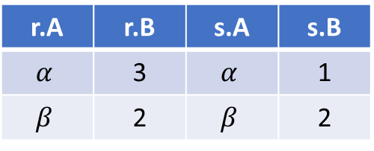
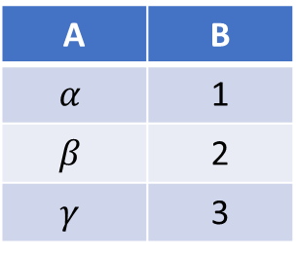



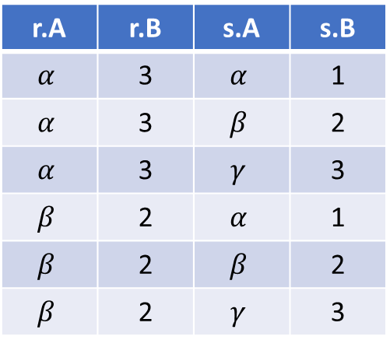


Composition of Operations
$$σ_{r.A=s.A }(r×s)$$
$$r$$
$$s$$
$$r×s$$
A | B
$$α$$ | 3
$$β$$ | 2
A | B
$$α$$ | 1
$$β$$ | 2
$$γ$$ | 3
r.A | r.B | s.A | s.B
$$α$$ | 3 | $$α$$ | 1
$$α$$ | 3 | $$β$$ | 2
$$α$$ | 3 | $$γ$$ | 3
$$β$$ | 2 | $$α$$ | 1
$$β$$ | 2 | $$β$$ | 2
$$β$$ | 2 | $$γ$$ | 3
r.A | r.B | s.A | s.B
$$α$$ | 3 | $$α$$ | 1
$$β$$ | 2 | $$β$$ | 2

Slide 18
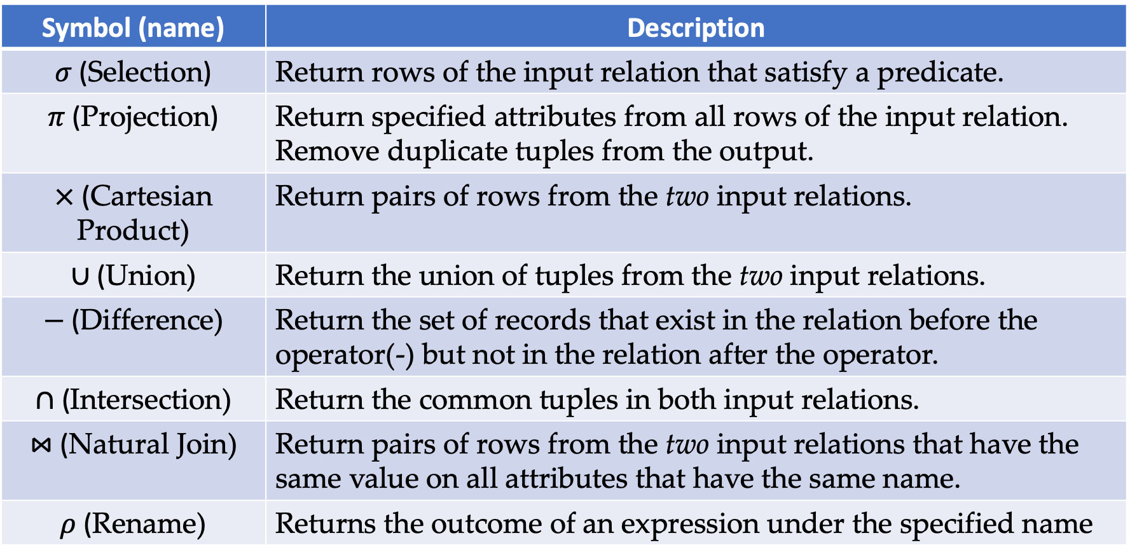
Summary of Relational Algebra Operators
Symbol (name) | Description
$σ$ (Selection) | Return rows of the input relation that satisfy a predicate.
$π$ (Projection) | Return specified attributes from all rows of the input relation. Remove duplicate tuples from the output.
$×$ (Cartesian Product) | Return pairs of rows from the two input relations.
$∪$ (Union) | Return the union of tuples from the two input relations.
$−$ (Difference) | Return the set of records that exist in the relation before the operator(-) but not in the relation after the operator.
$∩$ (Intersection) | Return the common tuples in both input relations.
$⋈$ (Natural Join) | Return pairs of rows from the two input relations that have the same value on all attributes that have the same name.
$ρ$ (Rename) | Returns the outcome of an expression under the specified name

Slide 19
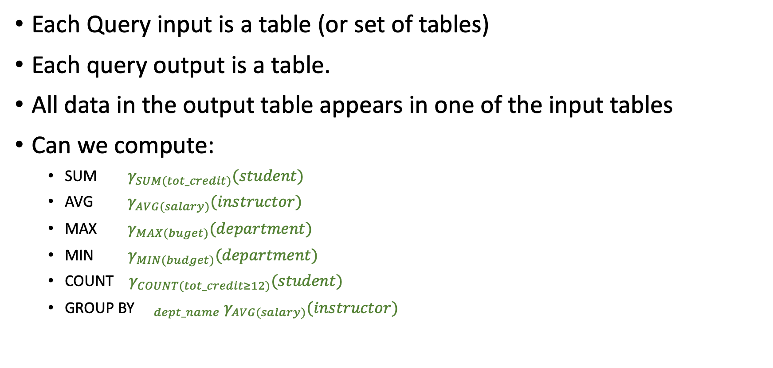
Remarks on RA
Each Query input is a table (or set of tables)
Each query output is a table.
All data in the output table appears in one of the input tables
Can we compute:
SUM $γ_{SUM(tot_credit)}(student)$
AVG $γ_{AVG(salary)}(instructor)$
MAX $γ_{MAX(buget)}(department)$
MIN $γ_{MIN(budget)}(department)$
COUNT $γ_{COUNT(tot_credit≥12)}(student)$
GROUP BY ${{}_{dept_name} γ}_{AVG(salary)}(instructor)$

Slide 20
Data Extraction Using Structured Query Language (SQL)

Slide 21
SELECT-FROM-WHERE Statements
SELECT desired attributes
FROM one or more tables
WHERE condition about tuples of the tables

Slide 22
Remember Our Main Database?

Slide 23
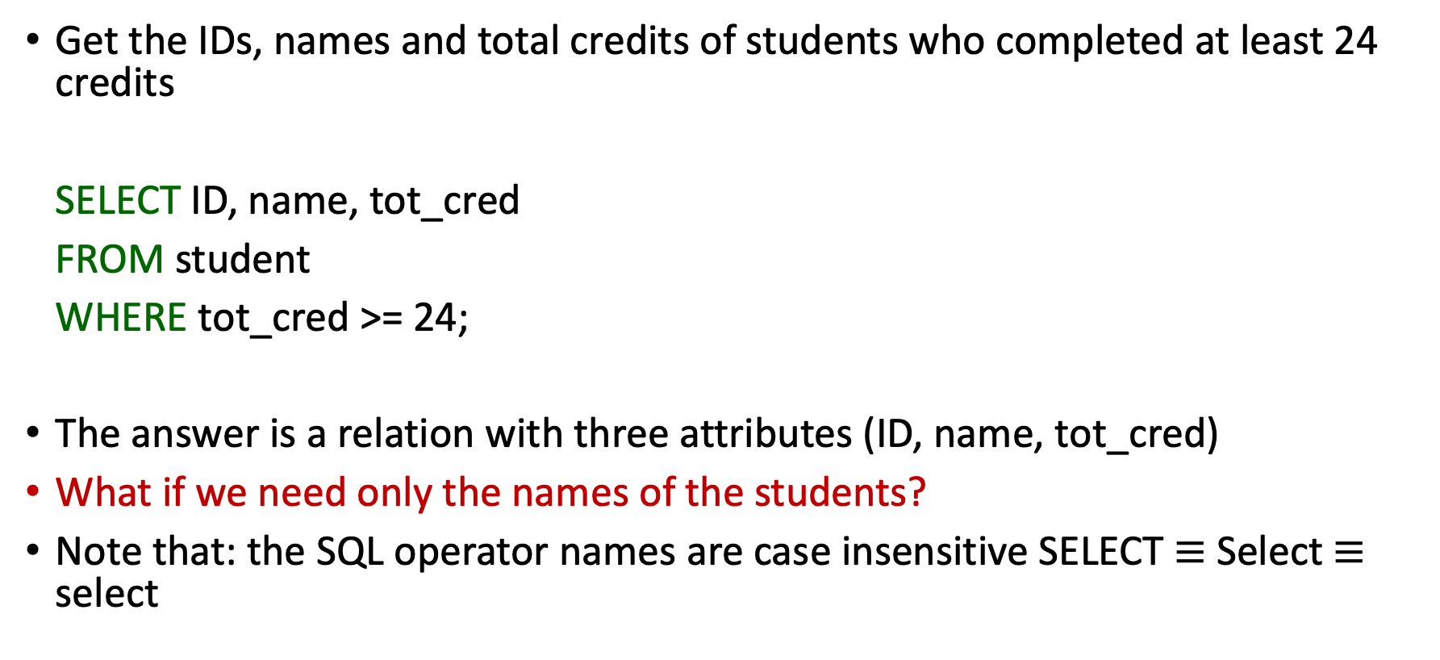
Example: The SELECT Clause
Get the IDs, names and total credits of students who completed at least 24 credits
SELECT ID, name, tot_cred
FROM student
WHERE tot_cred >= 24;
The answer is a relation with three attributes (ID, name, tot_cred)
What if we need only the names of the students?
Note that: the SQL operator names are case insensitive SELECT $≡$ Select $≡$ select

Slide 24
The SELECT Clause
Lists the desired attributes in the result of the query
Corresponds to the projection operator of the relational algebra
SQL allows duplicates in relations as well as in query results
To force the elimination of duplicates, use the keyword DISTINCT after select
Example: find the department names of all instructors whose salary is strictly greater than 60000 without showing the department name more than once
SELECT DISTINCT dept_name
FROM instructor
WHERE salary > 60000

Slide 25
The SELECT Clause (Cont.)
The keyword ALL specifies that duplicates should not be removed
SELECT ALL dept_name
FROM instructor
WHERE salary > 60000
An asterisk in the SELECT clause denotes “all attributes”
SELECT * FROM instructor
will return all the records from table “instructor”

Slide 26
The SELECT Clause (Cont.)
An attribute could be literal with no FROM clause
SELECT ’542’
Results in a relation with one column and one row with value ‘’542’
We can also give the column a name using
SELECT ’542’ AS V1
An attribute could be a literal with FROM clause
SELECT ‘A’ FROM instructor
will return a relation with one column and N rows (the number of tuples in the ‘instructor ’ relation) where each row will contain the value “A”

Slide 27
The SELECT Clause (Cont.)
SELECT clause can contain arithmetic expressions involving the operators *, +, -, and /.
SELECT ID, name, salary/12.0
FROM instructor
This query would return a relation with the same number of records as the ‘instructor’ relation and the (ID, name, salary/12.0) where the yearly salary is replaced by the monthly salary
We can rename the “salary/12.0” using the AS clause
SELECT ID, name, salary/12.0 as monthly_salary
FROM instructor

Slide 28
The WHERE Clause
Specifies conditions that the result must satisfy
Corresponds to the selection predicate of the relational algebra
To find all students enrolled in the ‘Math.’ department
SELECT ID, name FROM student
WHERE dept_name = ‘Math.’
Conditions can be also combined using logical operators (AND, OR, NOT)
Find all students in the ‘Math.’ department who completed a minimum of 24 credits
SELECT ID, name FROM student
WHERE dept_name = ‘Math.’ AND tot_cred >= 24
Comparisons =, <>, <, >, <=, >=

Slide 29
The FROM Clause
Lists the relations involved in the query
Corresponds to the Cartesian product operation of the relational algebra
Find the Cartesian product ’ instructor’ X ’ teaches’
SELECT * FROM instructor, teaches
Generates every possible instructor – teaches pairs, with all attributes from both relations.
For common attributes (e.g., ID), the attributes in the resulting table are renamed using the relation name (e.g., instructor.ID)
Similar to the cartesian product in RA
Cartesian product not very useful directly, but useful when combined with where-clause condition.

Slide 30
SELECT-FROM-WHERE Examples
SELECT name, course_id
FROM instructor, teaches
WHERE instructor.ID = teaches.ID
Returns the names of all instructors who have taught any courses and the course_id
SELECT name, course_id
FROM instructor, teaches
WHERE instructor.ID = teaches.ID AND instructor.dept_name = ‘Art’
Returns the names of all instructors in the Art department who have taught any courses and the course_id

Slide 31
The Rename Operation
SQL allows renaming relations and attributes using the AS clause:
old-name AS new-name
Find the names of all instructors who have a higher salary than some instructor in ‘Comp. Sci’.
SELECT DISTINCT T.name FROM instructor AS T, instructor AS S WHERE T.salary >= 75000 AND S.dept_name = ‘Comp. Sci.’
Returns the names of instructors in the ‘Comp. Sci.’ department joined with whose salary is greater than or equal 75000
Keyword AS is optional and may be omitted instructor AS T ≡ instructor T

Slide 32
Renaming Example: Self-Join
Sometimes, a query needs to use two copies of the same relation.
Distinguish copies by renaming the relations.
Example self-Join
SELECT T.name AS N1, S.name AS N2 FROM instructor T, instructor S WHERE T.salary = S.salary AND T.name < S.name
Returns the names of instructors who has the same salary
Do not produce pairs like (Miller, Miller)
Produces pairs in alphabetic order, e.g. (Adison, Miller), not (Miller, Adison)
Note that we omit AS when renaming the relations

Slide 33

Let us try:
Running a few SQL queries on different platforms (SQLite3 command line, Google Colab, and w3school)

Slide 34
What have we learnt?
Let us spend 2 minutes to look at what we have studied so far

Slide 35
Join Operation
JOIN operations take two relations and return as a result another relation.
A join operation is a Cartesian product which requires that tuples in the two relations match (under some condition). It also specifies the attributes that are present in the result of the join
The join operations are typically used as subquery expressions in the FROM clause

Slide 36
Join Operation (Cont.)
We will consider the following relations in the few coming slides
Relation course
course_id | title | dept_name | credits
BIO-301 | Genetics | Biology | 4
CS-490 | Game Design | Comp. Sci. | 4
CS-315 | Boolean Algebra | Comp. Sci. | 3
Relation prereq
Note that:
prereq information is missing for course CS-315
course information is missing for course CS-347
course_id | prereq_id
BIO-301 | BIO-101
CS-490 | CS-101
CS-347 | CS-201

Slide 37
Outer Join
An extension of the join operation that avoids loss of information.
Computes the join and then adds tuples form one relation that does not match tuples in the other relation to the result of the join.
Uses null values.

Slide 38
Left Outer Join
SELECT * FROM course
LEFT OUTER JOIN prereq
ON course.course_id = prereq.course_id
course_id | title | dept_name | credits | prereq_id
BIO-301 | Genetics | Biology | 4 | BIO-101
CS-490 | Game Design | Comp. Sci. | 4 | CS-101
CS-315 | Boolean Algebra | Comp. Sci. | 3 | null

Slide 39
Right Outer Join
SELECT * FROM course
RIGHT OUTER JOIN prereq
ON course.course_id = prereq.course_id
course_id | prereq_id | title | dept_name | credits
BIO-301 | BIO-101 | Genetics | Biology | 4
CS-490 | CS-101 | Game Design | Comp. Sci. | 4
CS-347 | CS-201 | null | null | null
Remember:
The order of the attributes in a relation has no meaning

Slide 40
Full Outer Join
SELECT * FROM course
FULL OUTER JOIN prereq
ON course.course_id = prereq.course_id
course_id | prereq_id | title | dept_name | credits
BIO-301 | BIO-101 | Genetics | Biology | 4
CS-490 | CS-101 | Game Design | Comp. Sci. | 4
CS-347 | CS-201 | null | null | null
CS-315 | null | Boolean Algebra | Comp. Sci. | 3

Slide 41
Inner Join
SELECT * FROM course
INNER JOIN prereq
ON course.course_id = prereq.course_id
course_id | prereq_id | title | dept_name | credits
BIO-301 | BIO-101 | Genetics | Biology | 4
CS-490 | CS-101 | Game Design | Comp. Sci. | 4
An SQL INNER JOIN is same as JOIN clause
Question:
What is the difference between the above JOIN and
the right/left outer join

Slide 42
String Operations
SQL includes a string-matching operator for comparisons on character strings.
The operator LIKE uses patterns that are described using two special characters
Percent ( % ). The % character matches any substring.
Underscore ( _ ). The _ character matches any character.
Example: find the names of all instructors whose name includes the substring “Van der”
SELECT DISTINCT name FROM instructor WHERE name LIKE ‘%Van der%’

Slide 43
String Operations (Cont.)
Match the string “100%”
LIKE ‘100 \%’ ESCAPE '\'
in that above we use backslash (\) as the escape character
Patterns are case sensitive.
Pattern matching examples:
‘Intro%’ matches any string beginning with “Intro”.
‘%Comp%’ matches any string containing “Comp” as a substring.
‘_ _ _’ matches any string of exactly three characters.
‘_ _ _ %’ matches any string of at least three characters.

Slide 44
Range Queries
SQL includes a BETWEEN comparison operator
Example: Find the names of all instructors with salary between $90,000 and $100,000 (that is, ≥ $90,000 and ≤ $100,000)
SELECT name FROM instructor WHERE salary BETWEEN 90000 AND 100000

Slide 45
Tuple Comparison
SELECT name, course_id FROM instructor, teaches WHERE (instructor.ID, dept_name) = (teaches.ID, ‘Biology’)

Slide 46
Set Operations
Find courses that ran in Fall 2009 or in Spring 2010
SELECT course_id FROM section WHERE sem = ‘Fall’ AND year = 2009
UNION
SELECT course_id FROM section WHERE sem = ‘Spring’ AND year = 2010
Find courses that ran in Fall 2009 and in Spring 2010
SELECT course_id FROM section WHERE sem = ‘Fall’ AND year = 2009
INTERSECT
SELECT course_id FROM section WHERE sem = ‘Spring’ AND year = 2010
Find courses that ran in Fall 2009 but not in Spring 2010
SELECT course_id FROM section WHERE sem = ‘Fall’ AND year = 2009
EXCEPT
SELECT course_id FROM section WHERE sem = ‘Spring’ AND year = 2010

Slide 47
Null Values
It is possible for tuples to have a null value, denoted by NULL, for some of their attributes
null signifies an unknown value or that a value does not exist.
The result of any arithmetic expression involving NULL is NULL
Example: 5 + NULL returns NULL
The predicate IS NULL can be used to check for null values.
Example: Find all instructors whose salary is null.
SELECT name FROM instructor WHERE salary IS NULL

Slide 48
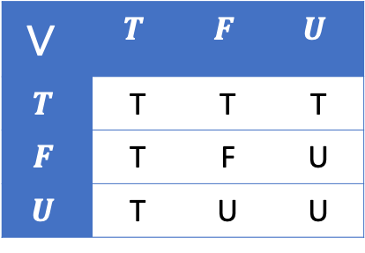
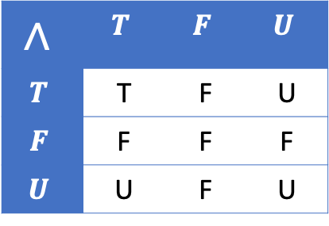
Null Values and Three Valued Logic
$$∧$$ | $$T$$ | $$F$$ | $$U$$
$$T$$ | T | F | U
$$F$$ | F | F | F
$$U$$ | U | F | U
Three values – true, false, unknown
Any comparison with null returns unknown
Example: 5 < null or null <> null or null = null
Three-valued logic using the value unknown:
OR: (unknown OR true) = true, (unknown OR false) = unknown (unknown OR unknown) = unknown
AND: (true AND unknown) = unknown, (false AND unknown) = false, (unknown AND unknown) = unknown
NOT: (NOT unknown) = unknown
“P is unknown” evaluates to true if predicate P evaluates to unknown
Result of WHERE clause predicate is treated as false if it evaluates to unknown
$$∨$$ | $$T$$ | $$F$$ | $$U$$
$$T$$ | T | T | T
$$F$$ | T | F | U
$$U$$ | T | U | U

Slide 49
The IN Operator
<v> IN <S> evaluates to true if the value v matches one of the values in S.
It can be used to replace a sequence of conditions connected by OR
Example:
SELECT name FROM instructor WHERE dept_name IN (’Comp. Sci.’, ’Math.’, ’Chem.’);
This Query is equivalent to:
SELECT name FROM instructor WHERE dept_name = ’Comp. Sci.’ OR dept_name = ’Math.’ OR dept_name = ’Chem.’

Slide 50

Wrap-Up
Summarize what you learned today in 2-minutes

Slide 51
Next lecture
Process Discovery
Conformance Checking

Slide 52
Boolean Operators – Revision

Slide 53


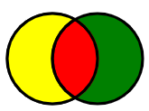

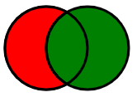





Boolean Operators
Searching through a database or search engine can often be frustrating
Boolean Operators create relationships between concepts and terms for better search results
Most popular Boolean operators are AND, OR and NOT
The red areas represent the results of the operators
$$A$$
$$B$$
$$A AND B$$
$$A OR B$$
$$A AND NOT(B)$$

Slide 54
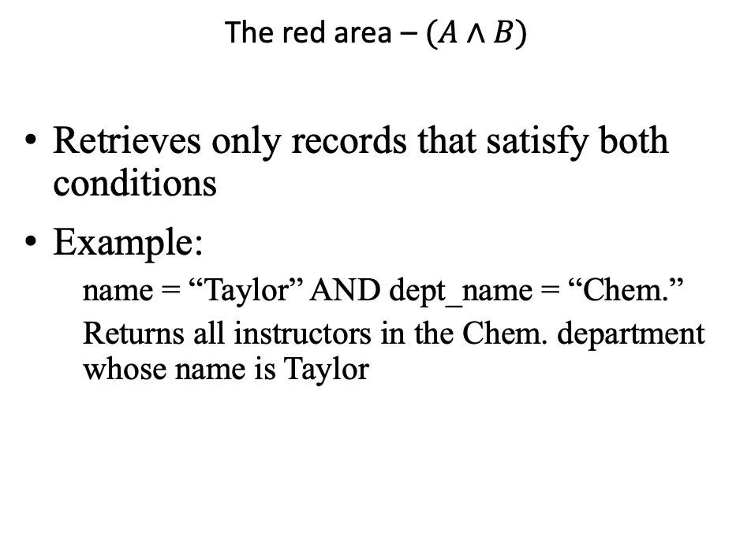

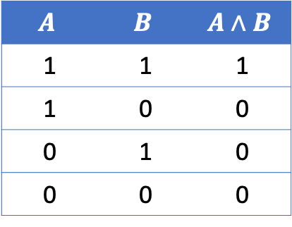
AND ($∧$)
A
B
$$A$$ | $$B$$ | $$A∧B$$
1 | 1 | 1
1 | 0 | 0
0 | 1 | 0
0 | 0 | 0
The red area – $(A∧B)$
Retrieves only records that satisfy both conditions
Example:
name = “Taylor” AND dept_name = “Chem.”
Returns all instructors in the Chem. department whose name is Taylor

Slide 55
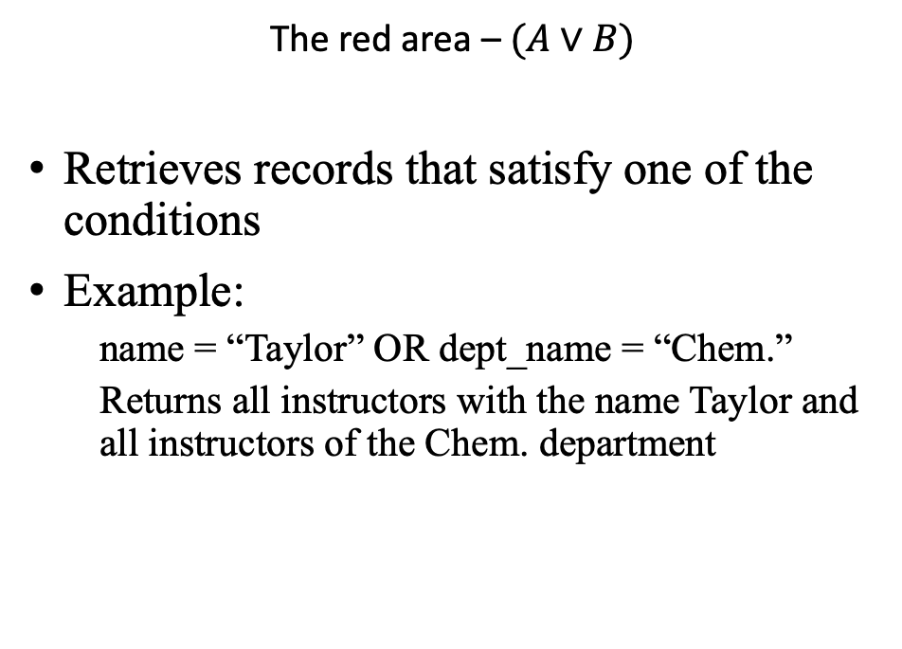
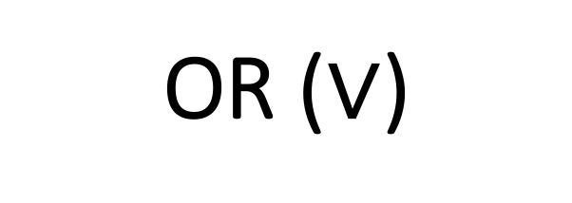
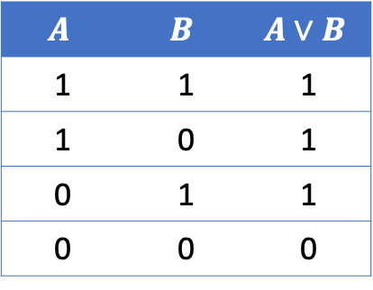
OR ($∨$)
A
B
$$A$$ | $$B$$ | $$A∨B$$
1 | 1 | 1
1 | 0 | 1
0 | 1 | 1
0 | 0 | 0
The red area – $(A∨B)$
Retrieves records that satisfy one of the conditions
Example:
name = “Taylor” OR dept_name = “Chem.”
Returns all instructors with the name Taylor and all instructors of the Chem. department

Slide 56
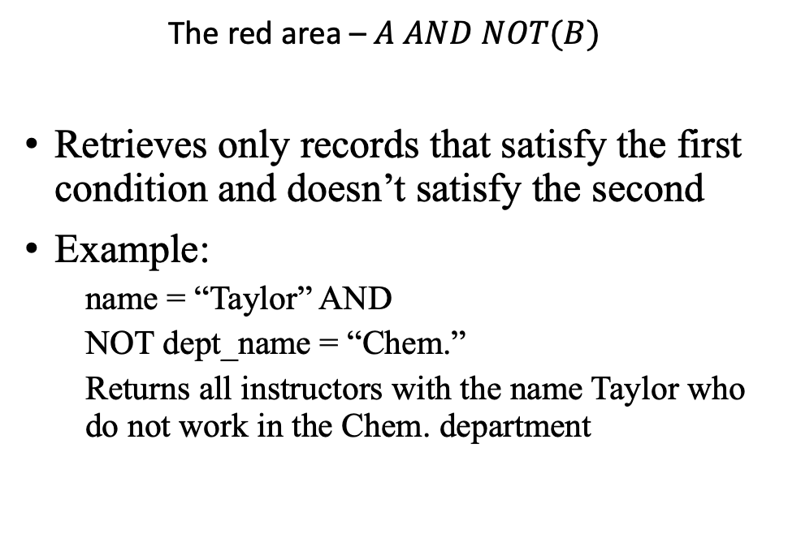

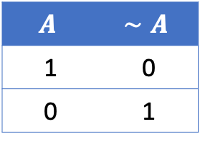
NOT ($∼$)
A
B
$$A$$ | $$∼A$$
1 | 0
0 | 1
The red area – $A AND NOT(B)$
Retrieves only records that satisfy the first condition and doesn’t satisfy the second
Example:
name = “Taylor” AND
NOT dept_name = “Chem.”
Returns all instructors with the name Taylor who do not work in the Chem. department

Slide 57
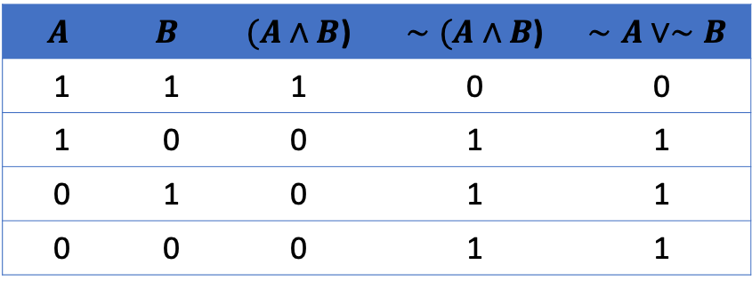
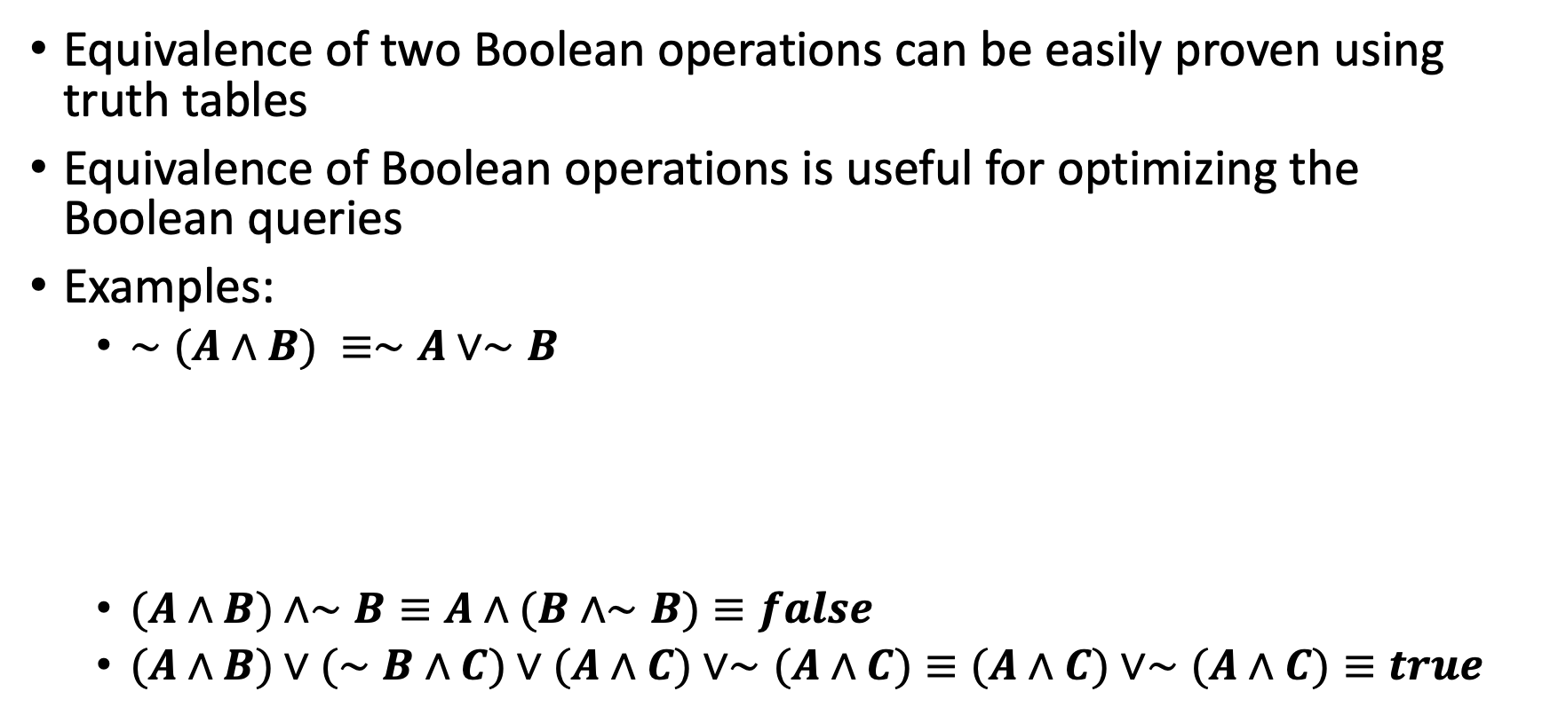

Boolean Equivalence
Equivalence of two Boolean operations can be easily proven using truth tables
Equivalence of Boolean operations is useful for optimizing the Boolean queries
Examples:
$∼(A∧B) ≡∼A∨∼B$
$(A∧B)∧∼B≡A∧(B∧∼B)≡false$
$(A∧B)∨(∼B∧C)∨(A∧C)∨∼(A∧C)≡(A∧C)∨∼(A∧C)≡true$
$$A$$ | $$B$$ | $(A∧B$) | $∼(A∧B$) | $$∼A∨∼B$$
1 | 1 | 1 | 0 | 0
1 | 0 | 0 | 1 | 1
0 | 1 | 0 | 1 | 1
0 | 0 | 0 | 1 | 1
$$≡$$

Slide 58
Proving Boolean Equivalence
Truth Table: Helpful when the number of statements in the Boolean expression is small
Proof by contradiction: assume the expression is false/true and proof that it leads to contradiction
Using the Boolean axioms.

Slide 59
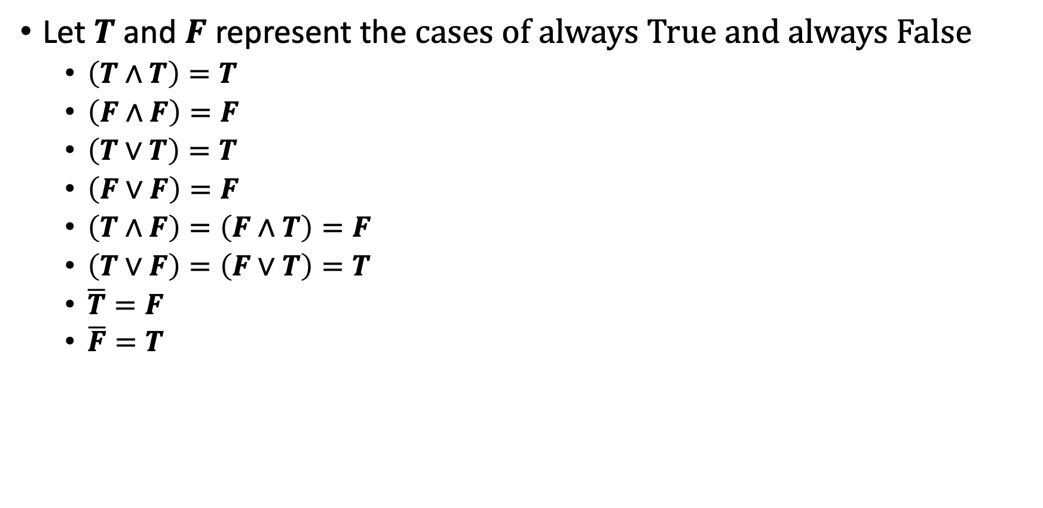
Boolean Axioms
Let $T$ and $F$ represent the cases of always True and always False
$\left(T∧T\right)=T$
$\left(F∧F\right)=F$
$\left(T∨T\right)=T$
$\left(F∨F\right)=F$
$\left(T∧F\right)=\left(F∧T\right)=F$
$\left(T∨F\right)=\left(F∨T\right)=T$
$\overline{T}=F$
$\overline{F}=T$

Slide 60

Boolean Axioms
Commutativity
$\left(A∧B\right)=\left(B∧A\right)$
$\left(A∨B\right)=\left(B∨A\right)$
Identity
$\left(A∧T\right)=A$
$\left(A∨T\right)=T$
$\left(A∧F\right)=F$
$\left(A∨F\right)=A$

Slide 61

Boolean Axioms
Idempotent
$\left(A∧A\right)=A$
$\left(A∨A\right)=A$
Involution
$\overline{\overline{A}}=A$
Complement
$\left(A∧\overline{A}\right)=F$
$\left(A∨\overline{A}\right)=T$

Slide 62

Boolean Axioms
Associativity
$\left(A∧B\right)∧C=A∧\left(B∧C\right)$
$\left(A∨B\right)∨C=A∨\left(B∨C\right)$
Distributivity
$A∧\left(B∨C\right)=\left(A∧B\right)∨\left(A∧C\right)$
$A∨\left(B∧C\right)=\left(A∨B\right)∧\left(A∨C\right)$

Slide 63

Proving Boolean Equivalence
Using the Boolean axioms (Example):
prove that:
LHS = $\left(A∧B\right)∨\left(∼A∧C\right)∨\left(B∧C\right)=\left(A∧B\right)∨\left(∼A∧C\right)∨[\left(B∧C\right)∧T$]
$$=\left(A∧B\right)∨\left(∼A∧C\right)∨[\left(B∧C\right)∧\left(A∨\sim A\right)]$$
$=\left(A∧B\right)∨\left(∼A∧C\right)∨[\left(B∧C∧A\right)∨\left(B∧C∧\sim A\right)$]
$$=\left[\left(A∧B\right)∨\left(B∧C∧A\right)\right]∨\left[\left(∼A∧C\right)∨\left(B∧C∧\sim A\right)\right]$$
$$=\left[\left(A∧B\right)∧\left(T∨C\right)\right]∨\left[\left(∼A∧C\right)∧\left(T∨B\right)\right]$$
$=\left[\left(A∧B\right)\right]∨\left[\left(∼A∧C\right)\right]$= RHS
$T$ means always TRUE.
$(A∧B)∨(∼A∧C)∨(B∧C) =(A∧B)∨(∼A∧C$)

Slide 64
Read more FROM
John Kelly, The Essence of Logic (Prentice Hall, 1997)
Chapter 1 is good enough

