Slide 1
Data Wrangling and Data Analysis
Data Extraction 2
Hakim Qahtan
Department of Information and Computing Sciences
Utrecht University

Slide 2
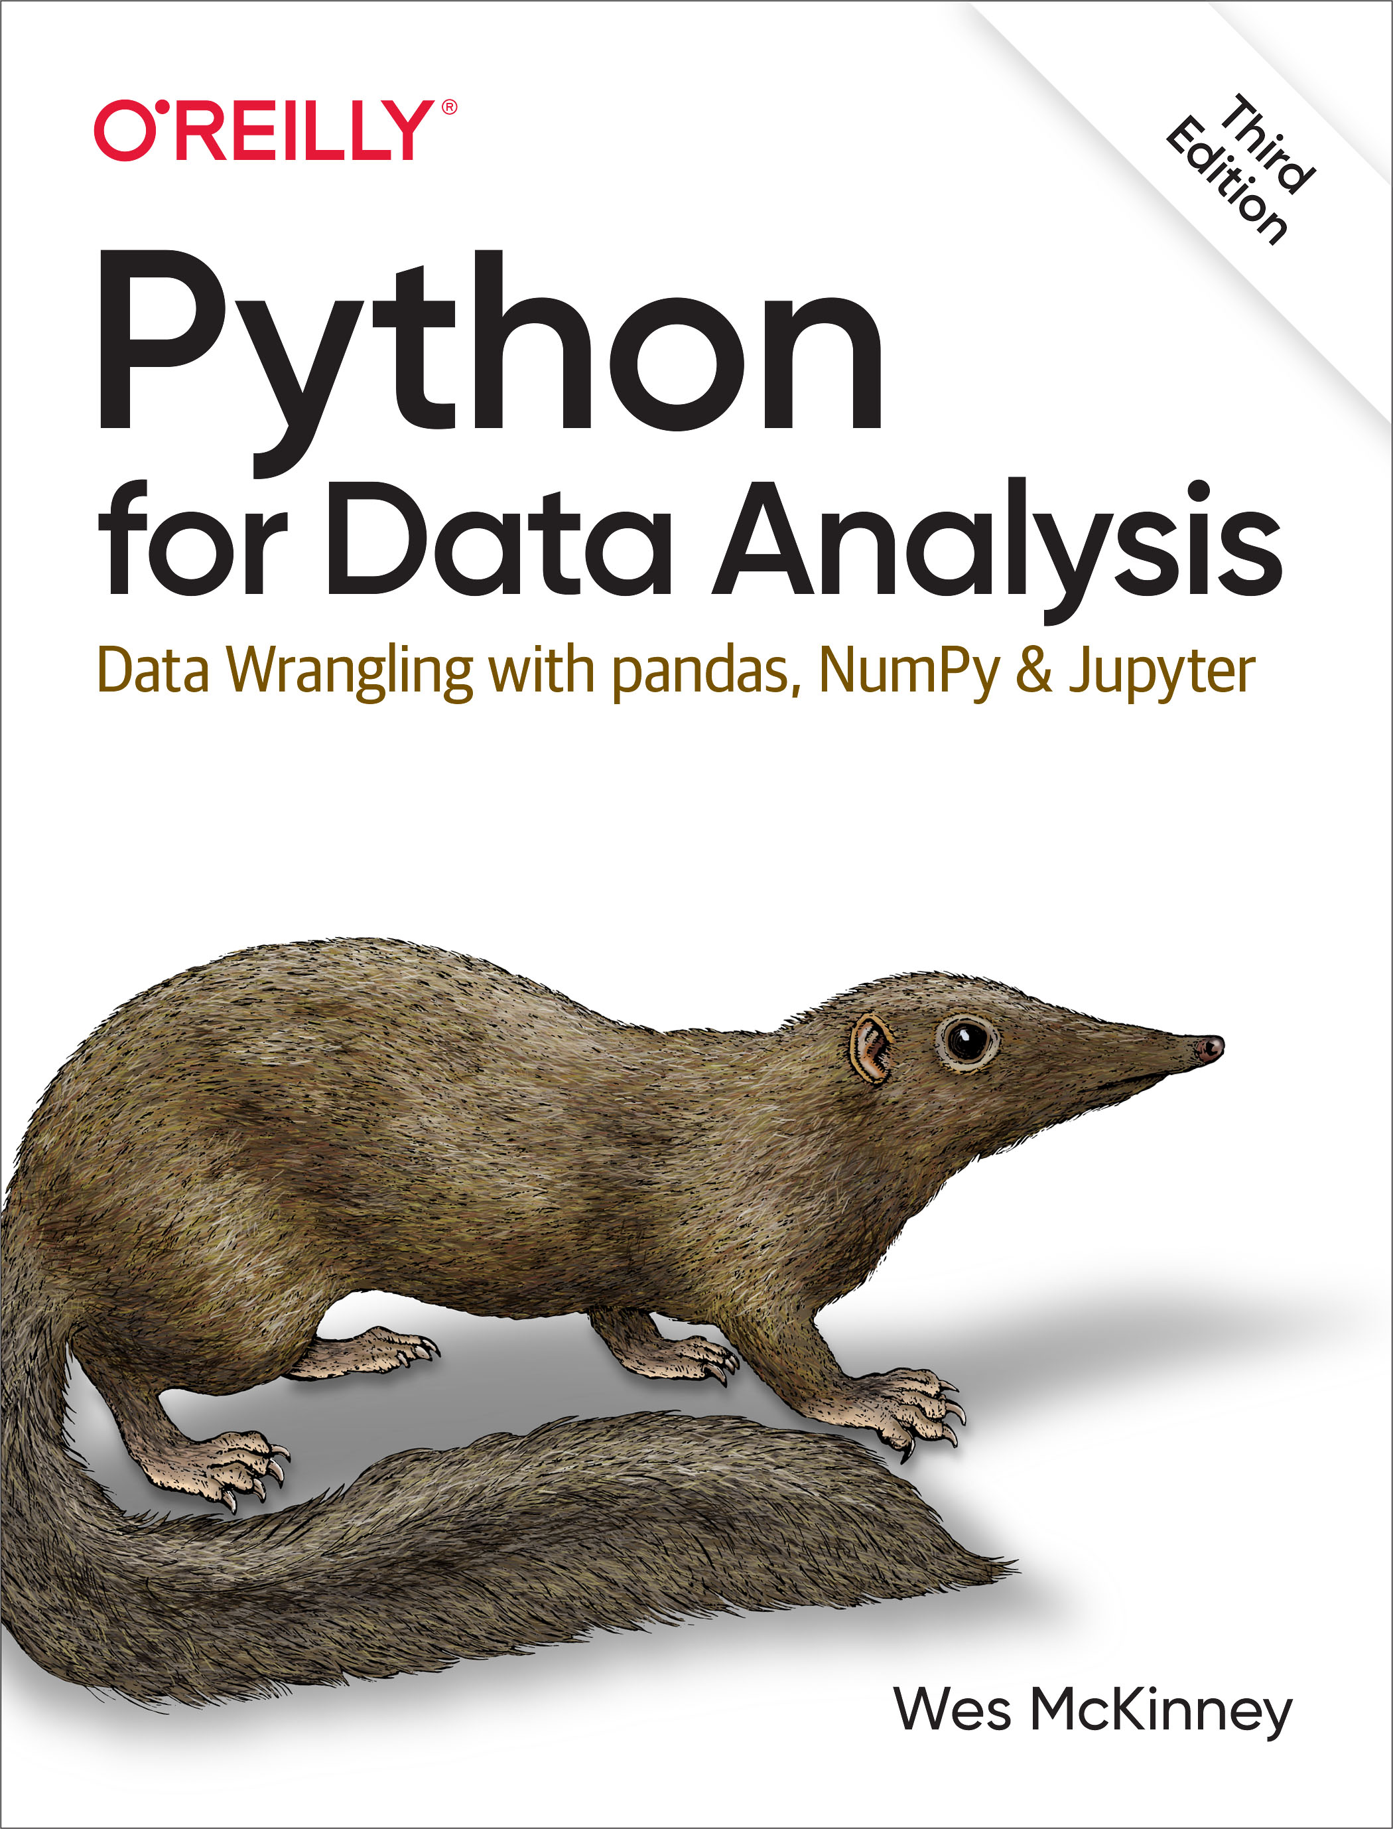
Reading Material for Today
Python for Data Analysis, 3E
CH 5, and 6.1.

Slide 3
So Far
Data models and focused on the relational model
Creating and querying databases
Today
Querying Databases to obtain aggregated values
Data manipulation in Python
Dataframes
Connecting to databases
Data profiling

Slide 4
Aggregate Functions
These functions operate on the multiset of values of a column of a relation, and return a value
avg: average value min: minimum value max: maximum value sum: sum of values count: number of values

Slide 5
Aggregate Functions (Cont.)
Find the average salary of instructors in the Computer Science department
SELECT AVG (salary) FROM instructor WHERE dept_name= ’Comp. Sci.’;
Find the total number of instructors who taught a course in the Spring 2010 semester
SELECT COUNT (DISTINCT ID) FROM teaches WHERE semester = ’Spring’ AND year = 2010;
Find the number of tuples in the course relation
SELECT COUNT (*) FROM course;

Slide 6
Aggregate Functions (Cont.)
Find the average salary of instructors in each department
SELECT dept_name, AVG (salary) AS avg_salary FROM instructor GROUP BY dept_name;
ID | name | dept_name | salary
22322 | Einstein | Physics | 95000
33452 | Gold | Physics | 87000
21212 | Wu | Finance | 90000
10101 | Brandt | Comp. Sci. | 82000
43521 | Katz | Comp. Sci. | 75000
98531 | Kim | Biology | 78000
58763 | Crick | Elec. Eng. | 80000
52187 | Mozart | History | 65000
32343 | El Said | History | 86000
The query result
dept_name | avg_salary
Physics | 91000
Finance | 90000
Comp. Sci. | 78500
Biology | 78000
Elec. Eng. | 80000
History | 75500

Slide 7
Aggregate Functions (Cont.)
Find the average salary of instructors in each department which has average salary greater than 80000 – use HAVING because WHERE cannot be used with aggregate functions
SELECT dept_name, AVG (salary) AS avg_salary FROM instructor GROUP BY dept_name
HAVING avg_salary > 80000;
ID | name | dept_name | salary
22322 | Einstein | Physics | 95000
33452 | Gold | Physics | 87000
21212 | Wu | Finance | 90000
10101 | Brandt | Comp. Sci. | 82000
43521 | Katz | Comp. Sci. | 75000
98531 | Kim | Biology | 78000
58763 | Crick | Elec. Eng. | 80000
52187 | Mozart | History | 65000
32343 | El Said | History | 86000
The query result
dept_name | avg_salary
Physics | 91000
Finance | 90000

Slide 8
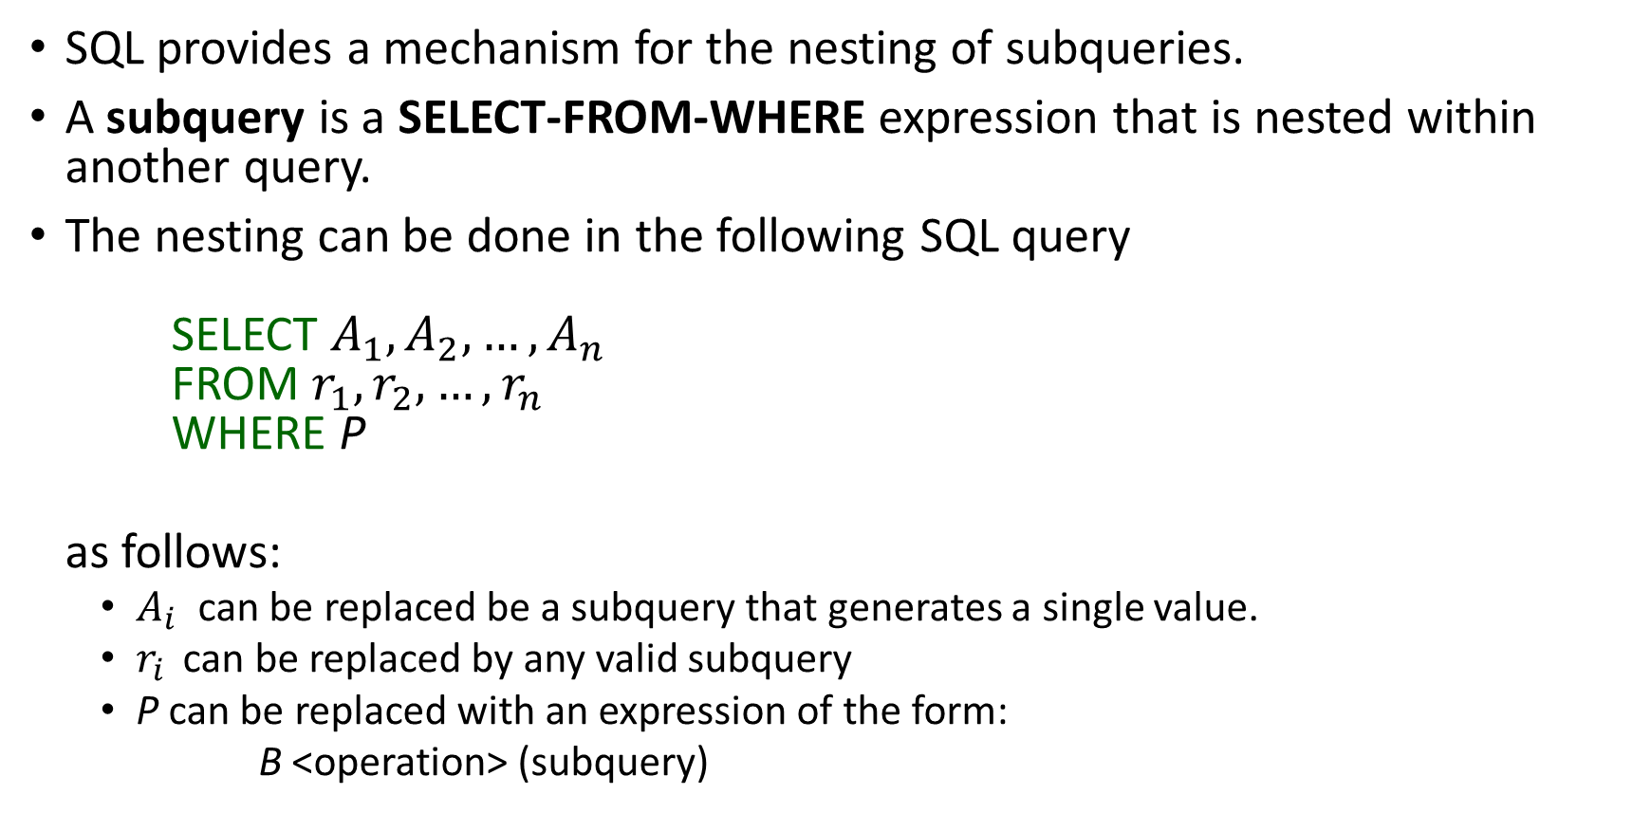
Subqueries
SQL provides a mechanism for the nesting of subqueries.
A subquery is a SELECT-FROM-WHERE expression that is nested within another query.
The nesting can be done in the following SQL query SELECT $A_{1}, A_{2}, …,A_{n}$ FROM $r_{1}, r_{2}, …,r_{n}$ WHERE P
as follows:
$A_{i}$ can be replaced be a subquery that generates a single value.
$r_{i}$ can be replaced by any valid subquery
P can be replaced with an expression of the form:
B <operation> (subquery)

Slide 9
Subqueries – Examples (Subquery in the WHERE clause)
Find courses offered in Fall 2009 and in Spring 2010 SELECT DISTINCT course_id FROM section WHERE semester = ’Fall’ AND year = 2009 AND course_id IN (SELECT course_id
FROM section
WHERE semester = ’Spring’ AND year= 2010);

Slide 10
Subqueries – Examples (Subquery in the FROM clause)
Find the average instructors’ salaries of those departments where the average salary is greater than $42,000.”
SELECT dept_name, avg_salary
FROM (SELECT dept_name, AVG (salary) AS avg_salary FROM instructor GROUP BY dept_name)
WHERE avg_salary > 42000;

Slide 11
Subqueries – Examples (Subquery in the SELECT clause)
List all departments along with the number of instructors in each department
SELECT dept_name, (SELECT COUNT(*) FROM instructor WHERE department.dept_name = instructor.dept_name) AS num_instructors FROM department;
Runtime error if subquery returns more than one result tuple
Note that: subqueries are parenthesized SELECT-FROM-WHERE statements

Slide 12
Data Extraction with Python

Slide 13
Aren’t DBMSs Enough?
DBMSs provides effective and efficient access for the data
Performing data analysis is limited
Programming languages (such as Python) provides libraries for wide range of data analysis techniques including different ML models

Slide 14
Pandas Dataframes
The most popular way to handle data tables in Python is using Pandas dataframes
DataFrame: a rectangular table of data and contains an ordered collection of columns, each of which can be a different value type (numeric, string, boolean, etc.)
Has columns and rows indexes
Columns are made up of Pandas series
Column index (df.columns)
Row index
(df.index)
Series of data
Series of data
Series of data
…
Series of data

Slide 15
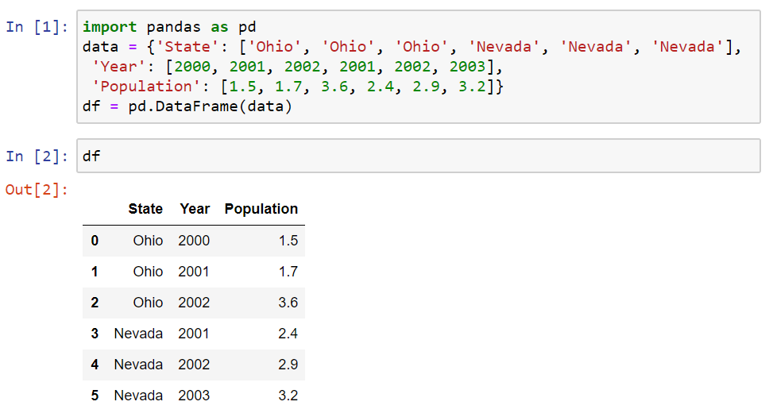
Creating DataFrame
Similarly: you can use the following code
import pandas as pd
data = [['Ohio', 2000, 1.5], ['Ohio', 2001, 1.7],
['Ohio', 2002, 3.6], ['Nevada', 2001, 2.4],
['Nevada', 2002, 2.9], ['Nevada', 2003, 3.2]]
cols = ['State', 'Year', 'Population']
df = pd.DataFrame(data, columns = cols)

Slide 16
Load DataFrame from CSV Files
The simplest way is:
More options can be added when loading a csv file into a dataframe
More options can be found in Pandas documentation
Remeber to import the Pandas library as pd
df = pd.read_csv('file.csv’) # often works
df = pd.read_csv('movies.csv', header=0,
index_col=0, quotechar='"',sep=",",
na_values = ['na', '-', '.', ‘’])

Slide 17
Load DataFrame from EXCEL Files
Each Excel sheet in a Python dictionary
The parse() method takes many arguments like read_csv().
Refer to the Pandas documentation for more options
workbook = pd.ExcelFile('file.xlsx')
dictionary = {}
for sheet_name in workbook.sheet_names:
df = workbook.parse(sheet_name)
dictionary[sheet_name] = df

Slide 18



Python DB API
Connection request
DBMSX.connector.connect()
Python Application
DBMS Connector
(Python)
connection.cursor()
Connected
Cursor.execute()
Results

Slide 19
Load DataFrame from MySQL Database
Create Connector/Python to MySQL
Create SQL query as a string and send the query to the DBMS
Process the results of the query and close the connection
from mysql.connector import connection
cnx = connection.MySQLConnection(user=‘user_name’, password='password', host='127.0.0.1', database=‘university’)
cursor = cnx.cursor()
query = ("SELECT ID, name, tot_cred FROM student WHERE tot_cred > 24")
cursor.execute(query)
df = pd.DataFrame(cursor, columns = ["ID", "name", "tot_cred"])
cursor.close()
cnx.close()

Slide 20
Load DataFrame from PostgreSQL Database
Create Connector/Python to PostgreSQL using psycopg2 library
Create SQL query as a string and send the query to the DBMS
Process the results of the query and close the connection
import psycopg2
conn = psycopg2.connect(database='db_name', user='user_name’,
password='password', host='127.0.0.1', port=5432)
cursor = conn.cursor()
query = ("SELECT ID, name, tot_cred FROM student WHERE tot_cred > 24")
cursor.execute(query)
df = pd.DataFrame(cursor, columns = ["ID", "name", "tot_cred"])
cursor.close()
cnx.close()

Slide 21
Load DataFrame from SQLite Database
Create Connector/Python to SQLite using sqlite3 library
Create SQL query as a string and send the query to the DBMS
Process the results of the query and close the connection
Example
import sqlite3
conn = sqlite3.connect(db_file)
cursor = conn.cursor()
query = ``SELECT * FROM” + table
cur.execute(query)
rows = cur.fetchall()
for row in rows:
print(row)
import sqlite3
conn = sqlite3.connect(``chinook.db”)
cursor = conn.cursor()
table = ``albums”

Slide 22
Working with Dataframes
Consider the movies dataset extracted from imdb dataset
Start by reading the csv file
Extract sub-table of the dataframe
df = pd.read_csv(filepath_or_buffer = 'movies.csv', delimiter=',',
doublequote=True, quotechar='"',na_values = ['na', '-', '.', ''],
quoting=csv.QUOTE_ALL, encoding = "ISO-8859-1")
df.info() # index & data types
n = 4
dfh = df.head(n) # get first n rows
dft = df.tail(n) # get last n rows
dfs = df.describe() # summary stats cols
top_left_corner_df = df.iloc[:5, :5]

Slide 23
Extracting Data from Dataframes
Extarct row number 0
Extract the column with the names of directors
row1 = df.iloc[0,:] #You may ignore adding the :
row1 = df.iloc[0]
df.director_name # OR
df["director_name"]

Slide 24
Extracting Data from Dataframes (Cont.)
Extract set of rows (corresponds to selection in relational algebra)
Extract set of columns (corresponds to projection in relational algebra)
Note that: df.columns is a vector that contains the attributes’ names
Rows_set1 = df.iloc[[5:10], ] # Extracts rows 5,6,7,8, and 9
Rows_set2 = df.iloc[[5,6,8,10], ] # Extracts rows 5,6,8, and 10
cols_set1 = df[df.columns[5:10]][:] # Extracts columns 5,6,7,8, and 9
cols_set2 = df[df.columns[[5,7,9]]][:] # Extracts rows 5,7, and 9
col_set3 = df[['actor_3_facebook_likes', 'actor_1_facebook_likes', 'content_rating']]

Slide 25
Extracting Data from Dataframes (Cont.)
Extract set of rows with a condition
You can do the same thing using iloc
Note that: iloc requires numerical values for the indexes
df.loc[df['content_rating'] == 'PG-13', ['actor_1_facebook_likes',
'actor_3_facebook_likes', 'budget']]
df.iloc[(df['content_rating'] == 'PG-13').values, [1, 3]]

Slide 26
Profiling the Dataframes
Display number of columns
Display number of rows
Find the number of non-null values in each column (attribute)
print(len(df.columns))
print(len(df)) # OR print(len(df[df.columns[0]])
df.count()

Slide 27
Profiling the Dataframes
Display number of distinct values in an attribute
Display the data type of each attribute
for col in df.columns:
print(col, ' has (', len(df[col].unique()), ') unique values')
dataTypeSeries = df.dtypes
for col_idx in range(len(df.columns)):
print(df.columns[col_idx], 'has type (', dataTypeSeries[col_idx], ')')

Slide 28
Profiling the Dataframes – Aggregate Queries
Find max, min, and average of numerical attributes
dataTypeSeries = df.dtypes
for col_idx in range(len(df.columns)):
if (not (dataTypeSeries[col_idx] == 'object')):
print(df.columns[col_idx], 'has Min = ', df[df.columns[col_idx]].min(),
'Max = ', df[df.columns[col_idx]].max(),
'Average = ', df[df.columns[col_idx]].mean())

Slide 29
Set Operations on Dataframes
Assume the following dataframes
The concat function concatenates the dataframes allowing repetition
dd1 = pd.DataFrame( { 'id': ['1', '2', '3', '4', '5'], 'Feature1': ['A', 'C', 'E', 'G', 'I’],
'Feature2': ['B', 'D', 'F', 'H', 'J’]})
dd2 = pd.DataFrame( { 'id': ['1', '2', '6', '7', '8'], 'Feature1': [‘A', ‘C', 'O', 'Q', 'S’],
'Feature2': [‘B', ‘D', 'P', 'R', 'T’]})
union_df = pd.concat([dd1, dd2]) # concatenate row-wise (default)
union_df = pd.concat([dd1, dd2], axis = 1) # concatenate column-wise

Slide 30
Join Operation on Dataframes
The merge function joins dataframes on selected attribute
If the joining attribute has different names in both dataframes
df_merge_col = pd.merge(dd1, dd2, on='id')
df_merge_col = pd.merge(dd1, dd2, left_on='att_dd1’, right_on = 'att_dd2')

Slide 31

Summarize what you learned today in 2-minutes

Slide 32
Next lecture
Process Discovery
Conformance Checking

