Slide 1
Data Wrangling and Data Analysis
Functional Dependencies
Hakim Qahtan
Department of Information and Computing Sciences
Utrecht University

Slide 2
Reading Material for Today
Database System Concepts (7th Edition)
CH 7.1 - 7.4.1

Slide 3
Designing Good Databases

Slide 4
The Database Design Problem
How do we know when a design is good?
A DB schema seems to be good if it helps us to avoid redundancy and inconsistency, but are there more quality issues?
This question can be answered using the normalization theory
Basic rules for good DB design
1 table for each entity
1 table for each relationship
Each cell contains a single value
If you have BIG relations, decompose them
This could result in a serious problem

Slide 5

Decomposing Big Relations
Definition:
Let $R$ be a relation schema (with constraints).
A decomposition of $R$ is a set of relation schemas $R_{1},R_{2}, …,R_{n}$ such that
each $R_{i}$ consists of attributes in $R$ and
each attribute of $R$ occurs in at least one $R_{j}$

Slide 6
Example
Sales
id | name | carId | brand | color
A | John | 2 | VW | black
B | Nick | 3 | VW | Red
C | Mary | null | null | null
A | John | 3 | VW | Red

Slide 7
Consider the two representations of the data
Person
id | name | carId
A | John | 2
B | Nick | 3
C | Mary | null
A | John | 3
Option 1:
Car
carId | brand | color
2 | VW | black
3 | VW | Red
Sales
id | name | carId | brand | color
A | John | 2 | VW | black
B | Nick | 3 | VW | Red
C | Mary | null | null | null
A | John | 3 | VW | Red
Option 2:
Which one do you like?

Slide 8
Person
id | name | carId
A | John | 2
B | Nick | 3
C | Mary | null
A | John | 3
Car
carId | brand | color
2 | VW | black
3 | VW | Red
PERSON JOIN CAR
Sales
id | name | carId | brand | color
A | John | 2 | VW | black
B | Nick | 3 | VW | Red
C | Mary | null | null | null
A | John | 3 | VW | Red
Join followed by decompose
Projection on id, name, carId
Person
id | name | carId
A | John | 2
B | Nick | 3
C | Mary | null
A | John | 3
Projection on carId, brand, color
Car
carId | brand | color
2 | VW | black
3 | VW | Red

Slide 9
Sales
id | name | carId | brand | color
A | John | 2 | VW | black
B | Nick | 3 | VW | Red
C | Mary | null | null | null
A | John | 3 | VW | Red
Decompose followed by join
Projection on id, name, carId
Person
id | name | carId
A | John | 2
B | Nick | 3
C | Mary | null
A | John | 3
Projection on carId, brand, color
Car
carId | brand | color
2 | VW | black
3 | VW | Red
PERSON JOIN CAR
Sales
id | name | carId | brand | color
A | John | 2 | VW | black
B | Nick | 3 | VW | Red
C | Mary | null | null | null
A | John | 3 | VW | Red

Slide 10
Sales
id | name | carId | brand | color
A | John | 2 | VW | black
B | Nick | 3 | VW | Red
C | Mary | null | null | null
A | John | 3 | VW | Red
Improper decompose followed by join
Projection on id, name, carId, brand
Projection on brand, color
Person
id | name | carId | brand
A | John | 2 | VW
B | Nick | 3 | VW
C | Mary | null | null
A | John | 3 | VW
Car
brand | color
VW | black
VW | Red
PERSON JOIN CAR
Sales
id | name | carId | brand | color
A | John | 2 | VW | black
B | Nick | 3 | VW | black
C | Mary | null | null | null
A | John | 3 | VW | black
A | John | 2 | VW | Red
B | Nick | 3 | VW | Red
A | John | 3 | VW | Red
There is clearly
a problem here !!
Records in red are called
spurious tuples

Slide 11
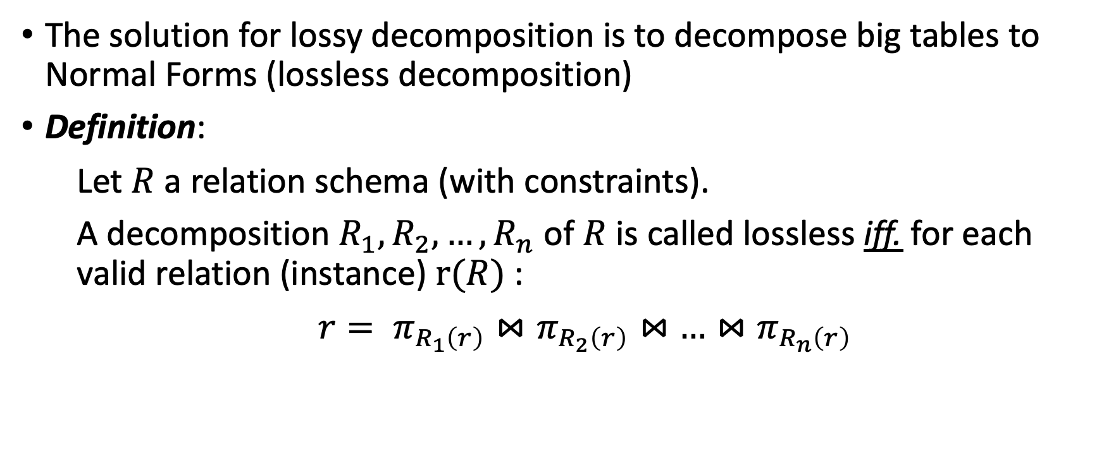
Dependencies
The solution for lossy decomposition is to decompose big tables to Normal Forms (lossless decomposition)
Definition:
Let $R$ a relation schema (with constraints).
A decomposition $R_{1}, R_{2}, …, R_{n}$ of $R$ is called lossless iff. for each valid relation (instance) $r(R)$:
$r= π_{R_{1}\left(r\right)}⋈π_{R_{2}\left(r\right)}⋈$ $…⋈π_{R_{n}\left(r\right)}$

Slide 12
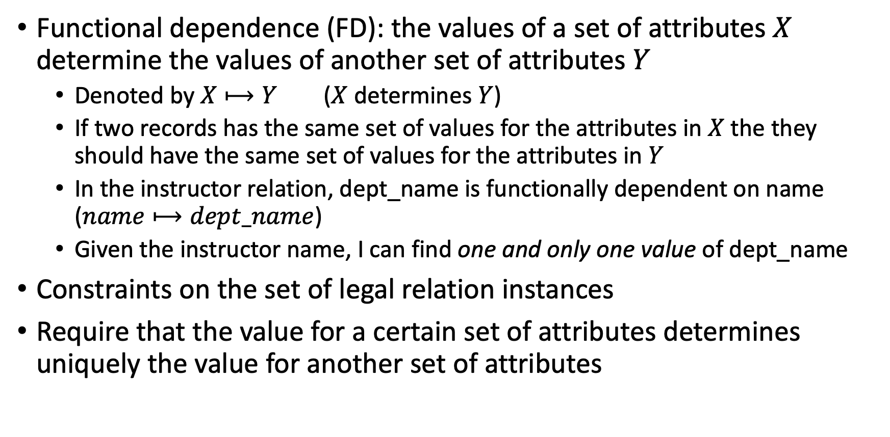
Functional Dependence (FD)
Functional dependence (FD): the values of a set of attributes $X$ determine the values of another set of attributes $Y$
Denoted by $X⟼Y$ ($X$ determines $Y$)
If two records has the same set of values for the attributes in $X$ the they should have the same set of values for the attributes in $Y$
In the instructor relation, dept_name is functionally dependent on name ($name⟼dept_name$)
Given the instructor name, I can find one and only one value of dept_name
Constraints on the set of legal relation instances
Require that the value for a certain set of attributes determines uniquely the value for another set of attributes

Slide 13
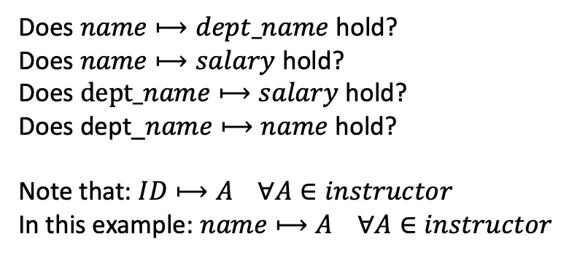
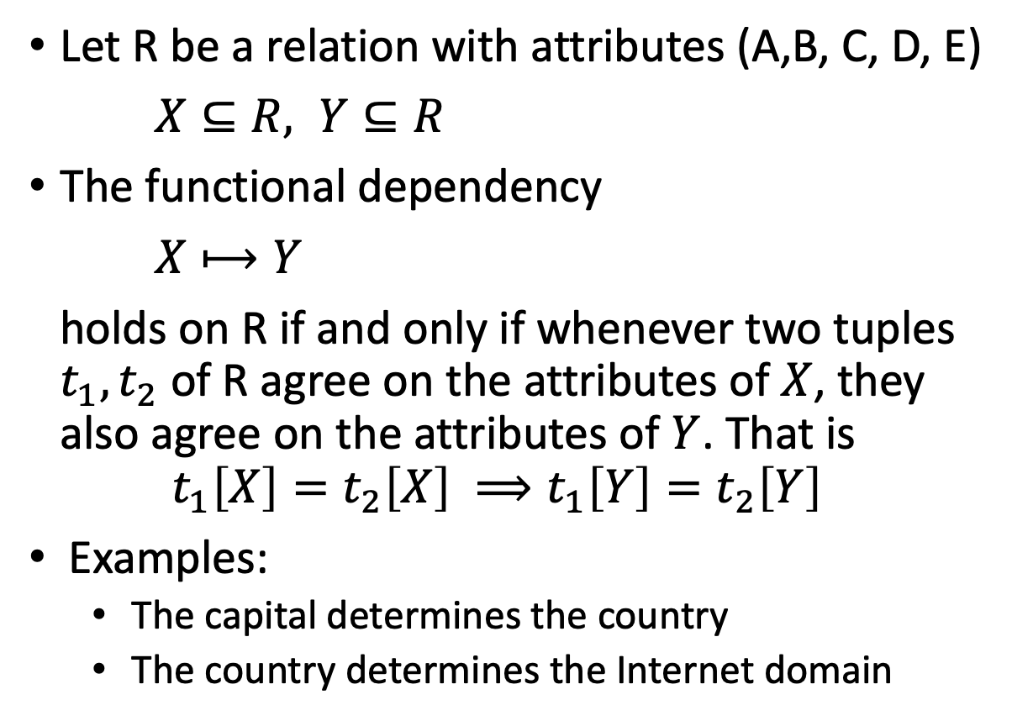
Functional Dependence
instructor table
ID | name | dept_name | salary
22322 | Einstein | Physics | 95000
33452 | Gold | Physics | 87000
21212 | Wu | Finance | 90000
10101 | Brandt | Comp. Sci. | 82000
43521 | Katz | Comp. Sci. | 75000
98531 | Kim | Biology | 78000
58763 | Crick | Elec. Eng. | 80000
52187 | Mozart | History | 65000
32343 | El Said | History | 86000
Let R be a relation with attributes (A,B, C, D, E)
$X⊆R, Y⊆R$
The functional dependency
$X⟼Y$
holds on R if and only if whenever two tuples $t_{1},t_{2}$ of R agree on the attributes of $X$, they also agree on the attributes of $Y$. That is
$$t_{1}\left[X\right]=t_{2}\left[X\right] ⟹t_{1}\left[Y\right]=t_{2}\left[Y\right]$$
Examples:
The capital determines the country
The country determines the Internet domain
Does $name⟼dept_name$ hold?
Does $name⟼salary$ hold?
Does $dept_name⟼salary$ hold?
Does dept_$name⟼name$ hold?
Note that: $ID⟼A ∀A∈instructor$
In this example: $name⟼A ∀A∈instructor$

Slide 14
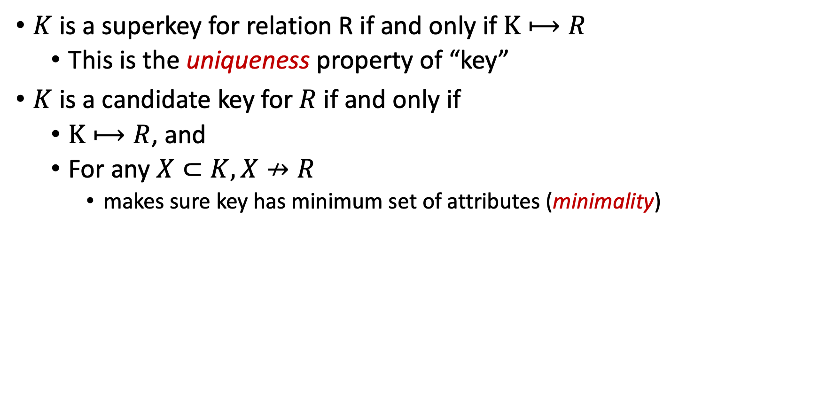
Alternative Definition of the Keys
$K$ is a superkey for relation R if and only if $K⟼R$
This is the uniqueness property of “key”
$K$ is a candidate key for $R$ if and only if
$K⟼R$, and
For any $X⊂K, X↛R$
makes sure key has minimum set of attributes (minimality)

Slide 15
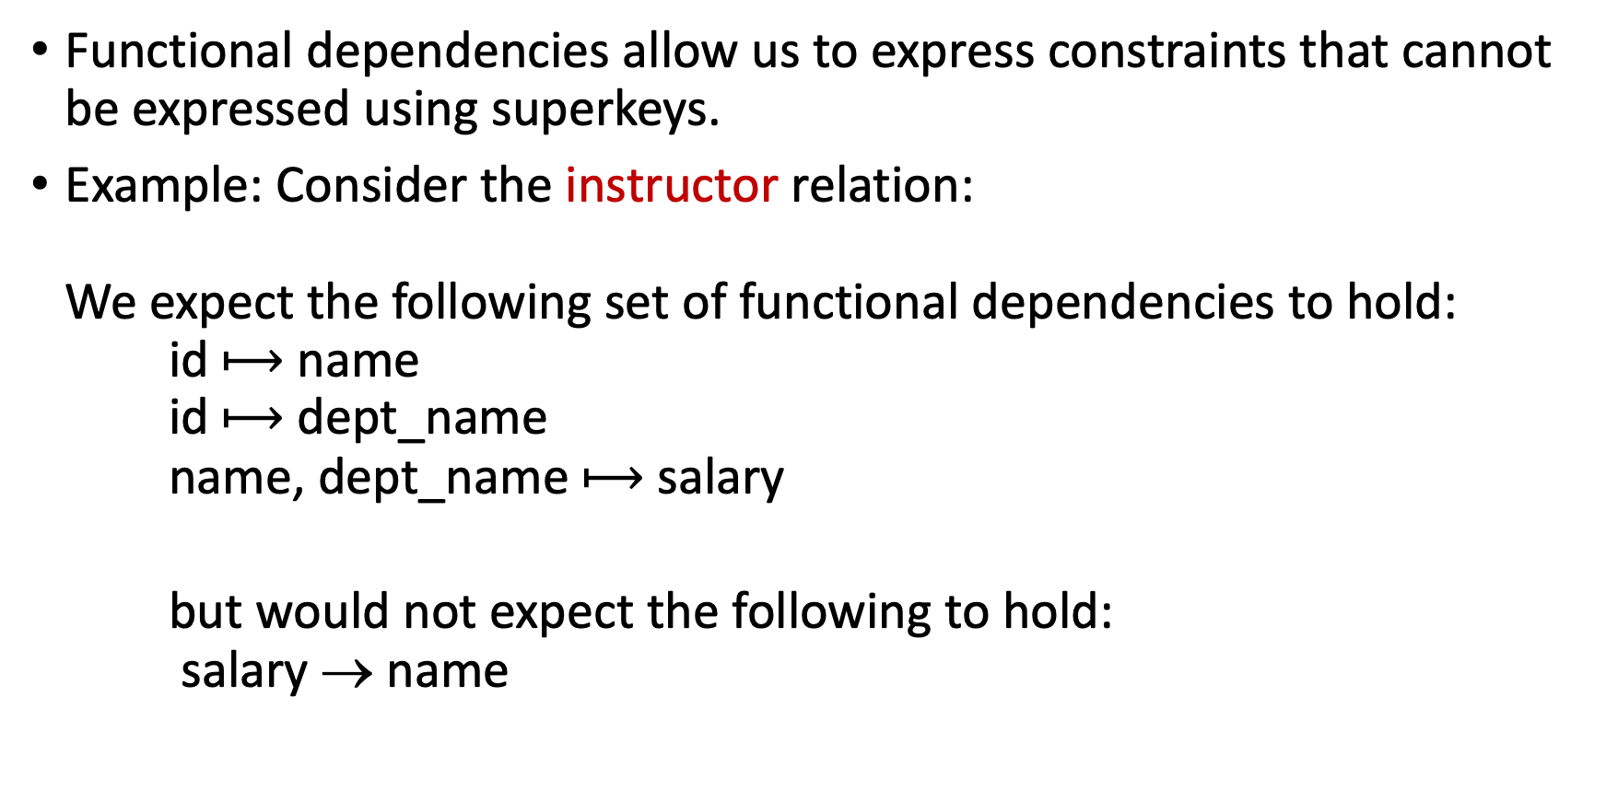
Functional Dependencies
Functional dependencies allow us to express constraints that cannot be expressed using superkeys.
Example: Consider the instructor relation: We expect the following set of functional dependencies to hold: id $⟼$ name id $⟼$ dept_name name, dept_name $⟼$ salary
but would not expect the following to hold: salary → name

Slide 16
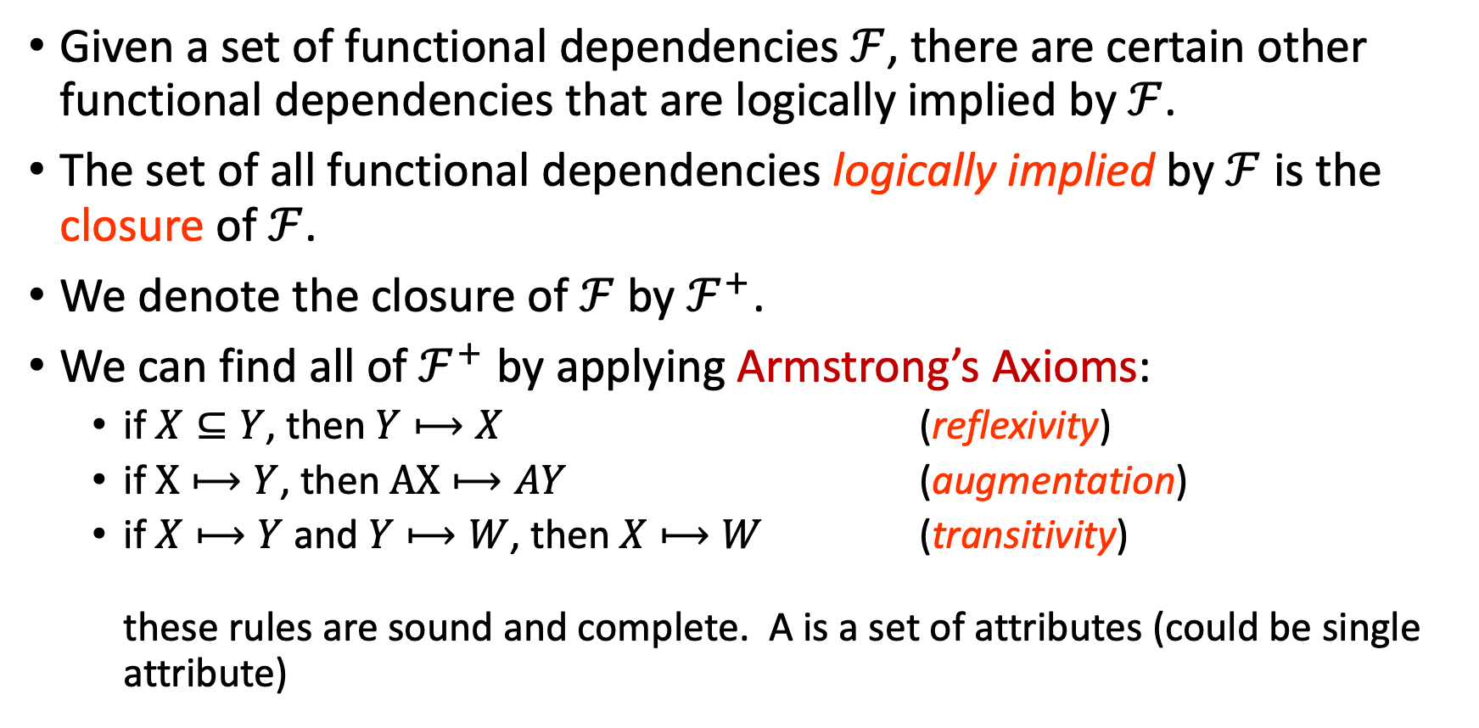
Closure of a Set of Functional Dependencies
Given a set of functional dependencies $ℱ$, there are certain other functional dependencies that are logically implied by $ℱ$.
The set of all functional dependencies logically implied by $ℱ$ is the closure of $ℱ$.
We denote the closure of $ℱ$ by $ℱ^{+}$.
We can find all of $ℱ^{+}$ by applying Armstrong’s Axioms:
if $X⊆Y$, then $Y⟼X$ (reflexivity)
if $X⟼Y$, then $AX⟼AY$ (augmentation)
if $X⟼Y$ and $Y⟼W$, then $X⟼W$ (transitivity) these rules are sound and complete. A is a set of attributes (could be single attribute)

Slide 17
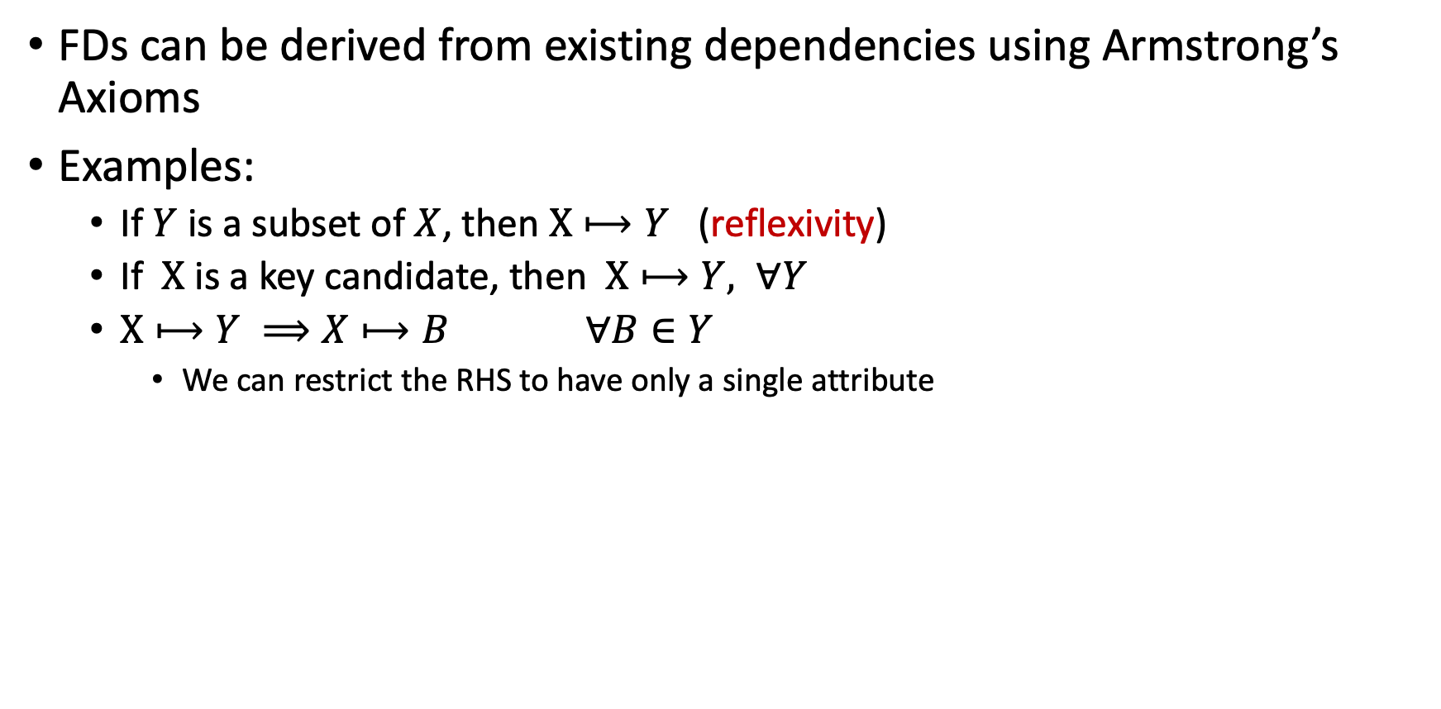
Functional Dependencies
FDs can be derived from existing dependencies using Armstrong’s Axioms
Examples:
If $Y$ is a subset of $X$, then $X⟼Y$ (reflexivity)
If $X$ is a key candidate, then $X⟼Y, ∀Y$
$X⟼Y ⟹X⟼B ∀B∈Y$
We can restrict the RHS to have only a single attribute

Slide 18
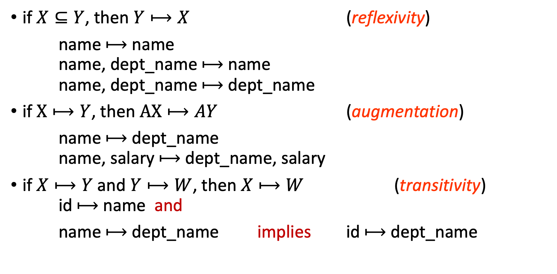
Examples of Armstrong’s Axioms
if $X⊆Y$, then $Y⟼X$ (reflexivity)
name $⟼$ name name, dept_name $⟼$ name name, dept_name $⟼$ dept_name
if $X⟼Y$, then $AX⟼AY$ (augmentation)
name $⟼$ dept_name name, salary $⟼$ dept_name, salary
if $X⟼Y$ and $Y⟼W$, then $X⟼W$ (transitivity) id $⟼$ name and
name $⟼$ dept_name implies id $⟼$ dept_name

Slide 19
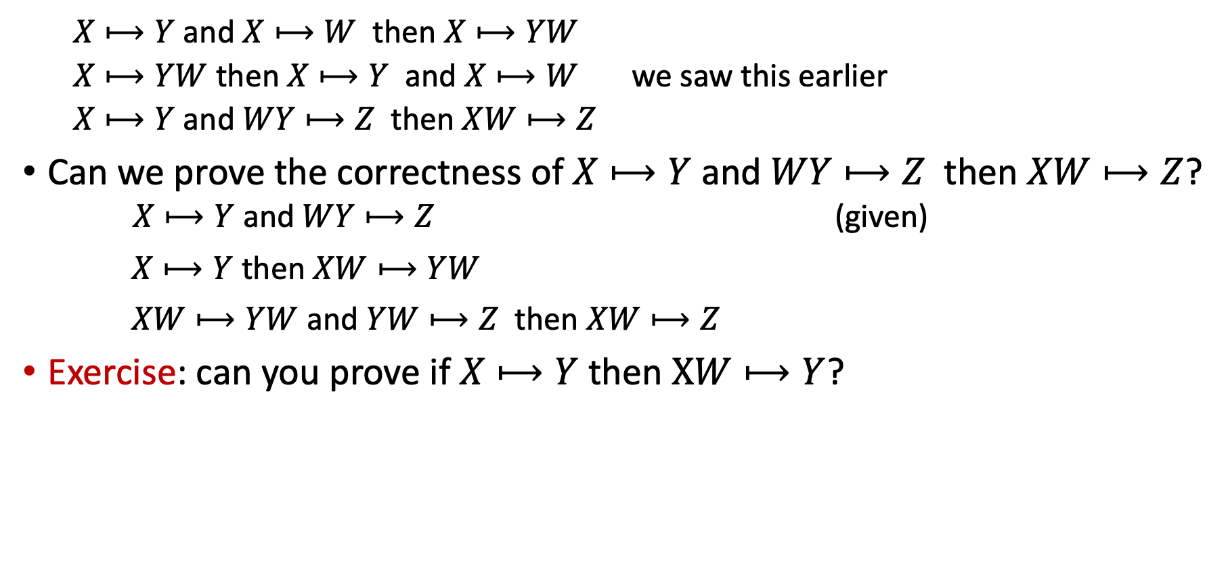
More Derived FDs
$X⟼Y$ and $X⟼W$ then $X⟼YW$
$X⟼YW$ then $X⟼Y$ and $X⟼W$ we saw this earlier
$X⟼Y$ and $WY⟼Z$ then $XW⟼Z$
Can we prove the correctness of $X⟼Y$ and $WY⟼Z$ then $XW⟼Z$? $X⟼Y$ and $WY⟼Z$ (given)
$X⟼Y$ then $XW⟼YW$
$XW⟼YW$ and $YW⟼Z$ then $XW⟼Z$
Exercise: can you prove if $X⟼Y$ then $XW⟼Y$?

Slide 20
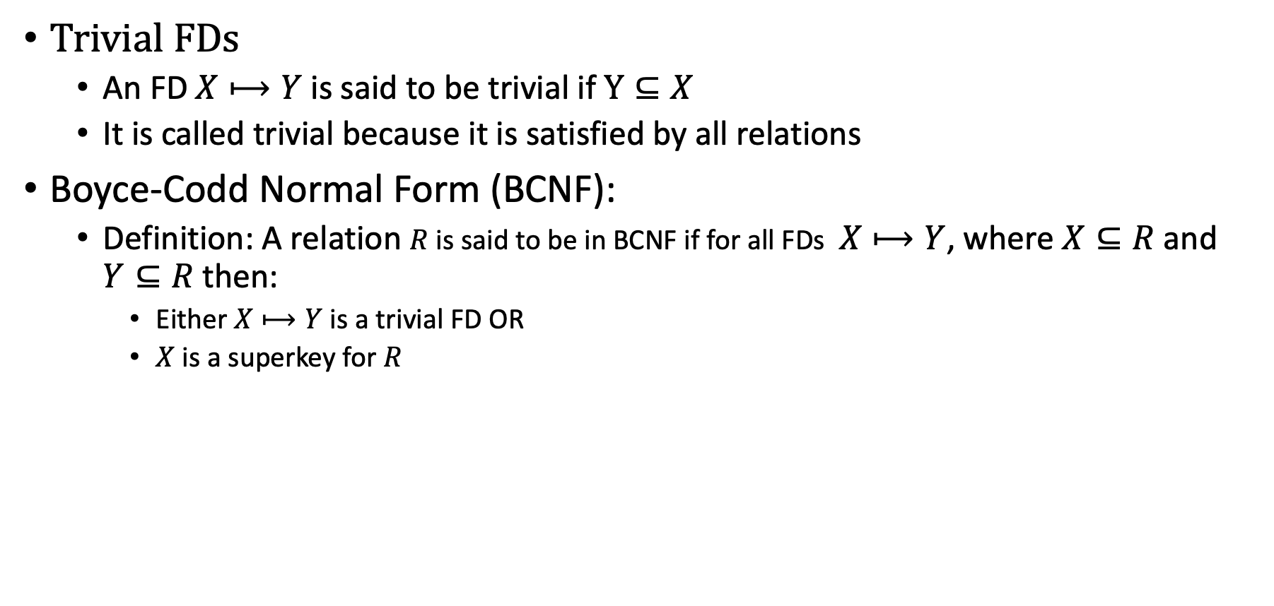
Boyce-Codd Normal Form
Trivial FDs
An FD $X⟼Y$ is said to be trivial if $Y⊆X$
It is called trivial because it is satisfied by all relations
Boyce-Codd Normal Form (BCNF):
Definition: A relation $R$ is said to be in BCNF if for all FDs $X⟼Y$, where $X⊆R$ and $Y⊆R$ then:
Either $X⟼Y$ is a trivial FD OR
$X$ is a superkey for $R$

Slide 21
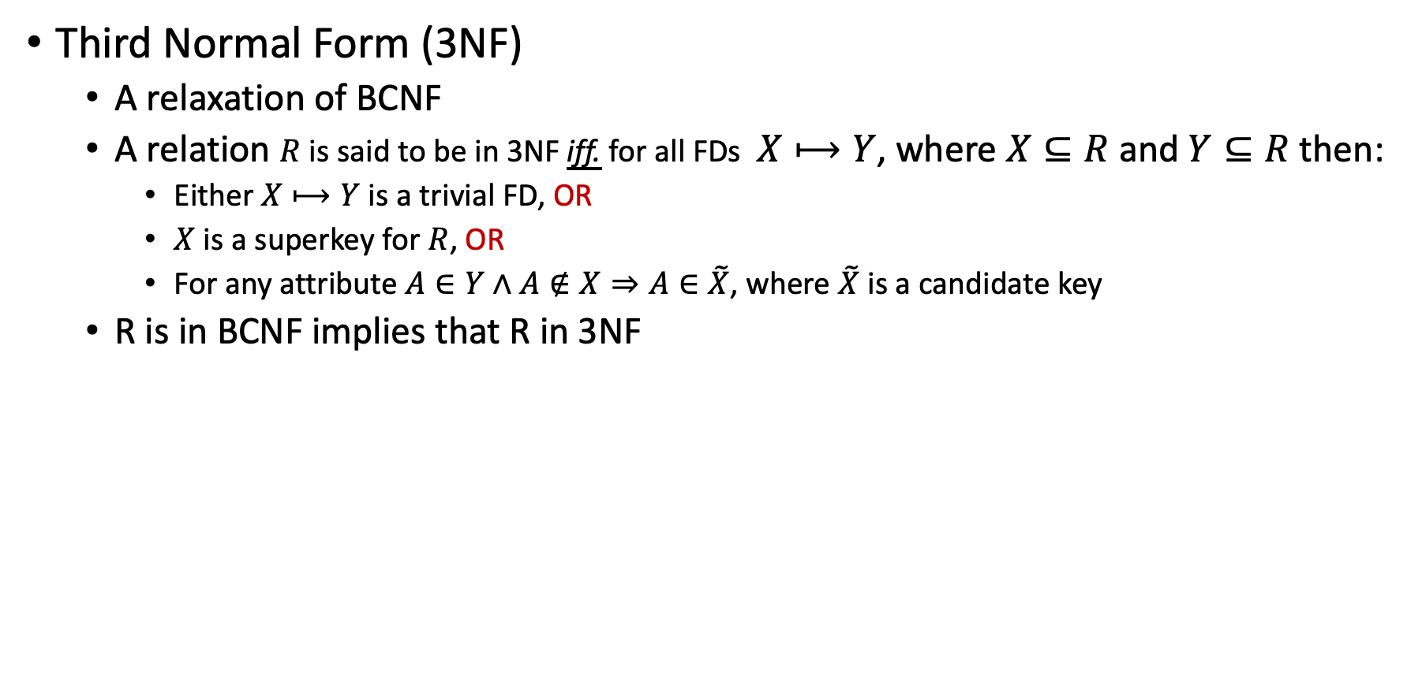
Other Normal Forms
Third Normal Form (3NF)
A relaxation of BCNF
A relation $R$ is said to be in 3NF iff. for all FDs $X⟼Y$, where $X⊆R$ and $Y⊆R$ then:
Either $X⟼Y$ is a trivial FD, OR
$X$ is a superkey for $R$, OR
For any attribute $A∈Y∧A∉X⇒A∈\tilde{X}$, where $\tilde{X}$ is a candidate key
R is in BCNF implies that R in 3NF

Slide 22
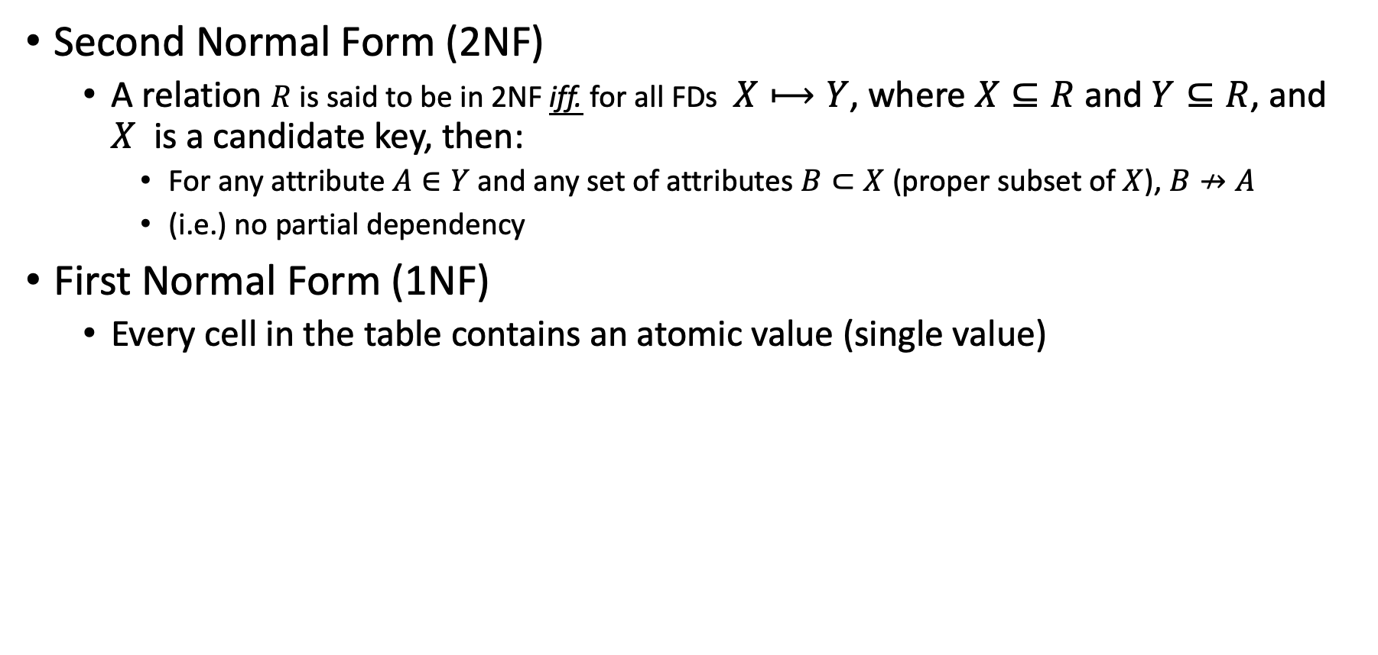
Other Normal Forms
Second Normal Form (2NF)
A relation $R$ is said to be in 2NF iff. for all FDs $X⟼Y$, where $X⊆R$ and $Y⊆R$, and $X$ is a candidate key, then:
For any attribute $A∈Y$ and any set of attributes $B⊂X$ (proper subset of $X$), $B↛A$
(i.e.) no partial dependency
First Normal Form (1NF)
Every cell in the table contains an atomic value (single value)

Slide 23
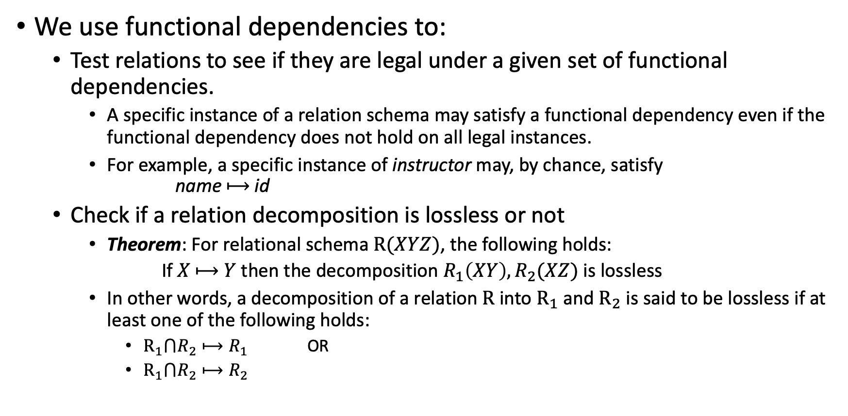
Use of FDs
We use functional dependencies to:
Test relations to see if they are legal under a given set of functional dependencies.
A specific instance of a relation schema may satisfy a functional dependency even if the functional dependency does not hold on all legal instances.
For example, a specific instance of instructor may, by chance, satisfy name $⟼$ id
Check if a relation decomposition is lossless or not
Theorem: For relational schema $R(XYZ)$, the following holds:
If $X$ $⟼$ $Y$ then the decomposition $R_{1}\left(XY\right), R_{2}(XZ)$ is lossless
In other words, a decomposition of a relation $R$ into $R_{1}$ and $R_{2}$ is said to be lossless if at least one of the following holds:
$R_{1}⋂R_{2}⟼R_{1}$ OR
$R_{1}⋂R_{2}⟼R_{2}$

Slide 24
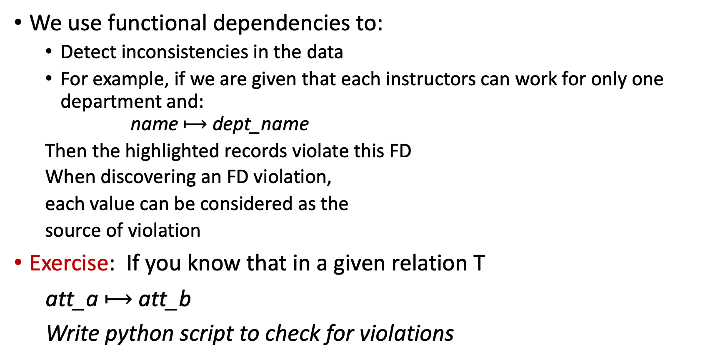
Use of FDs (Cont.)
We use functional dependencies to:
Detect inconsistencies in the data
For example, if we are given that each instructors can work for only one department and: name $⟼$ dept_name
Then the highlighted records violate this FD
When discovering an FD violation,
each value can be considered as the
source of violation
Exercise: If you know that in a given relation T
att_a $⟼$ att_b
Write python script to check for violations
id | name | dept_name | salary
22322 | Einstein | Physics | 95000
33452 | Gold | Physics | 87000
21212 | Wu | Finance | 90000
10101 | Einstein | Comp. Sci. | 82000
43521 | Katz | Comp. Sci. | 75000
98531 | Kim | Biology | 78000
58763 | Crick | Elec. Eng. | 80000
The highlighted cells reflect violations of the FD name → dept_name.

Slide 25
Conditional Functional Dependencies (CFDs)
In the UK, zip code uniquely determines the street
The constraint may not hold for other countries
This constraints can be expressed as follows
([country = 44, zip] → street)
It expresses a fundamental part of the semantics of the data
It can NOT be expressed as an FD
It does not hold on the entire relation; instead, it holds on tuples representing UK customers only
country | area-code | phone | street | city | zip
44 | 131 | 1234567 | Mayfield | Liverpool | EH4 8LE
44 | 131 | 3456789 | Crichton | Manchester | EH4 8LE
01 | 908 | 3456789 | Mountain Ave | NYC | 07974
The highlighted cells reflect violations of the CFD ([country = 44, zip] → street).

Slide 26

Summarize what you learned today in 2-minutes

Slide 27
Next lecture
Process Discovery
Conformance Checking

