Slide 1
Data Wrangling and Data Analysis
Data Preparation
Hakim Qahtan
Department of Information and Computing Sciences
Utrecht University

Slide 2
Topics for Today
Data preparation: motivation and overview
Quality of data
Data cleaning
Incomplete data
Noisy data
Outliers

Slide 3

Reading Material for Today
Data Mining: Concepts and Techniques Book
CH 3.1, 3.2, 12.1 - 12.4
Python for Data Analysis, 3E
CH 7.1

Slide 4
For Exercise
https://sqlzoo.net/wiki/SQL_Tutorial

Slide 5
Data Science Process
O
P
E
M
I
Obtain
Prepare
Explore
Model
Interpret
Gather Data from relevant sources
Clean data to formats that machine understands
Find significant patterns and trends using statistical methods
Construct models to predict and forecast
Put the results into good use

Slide 6
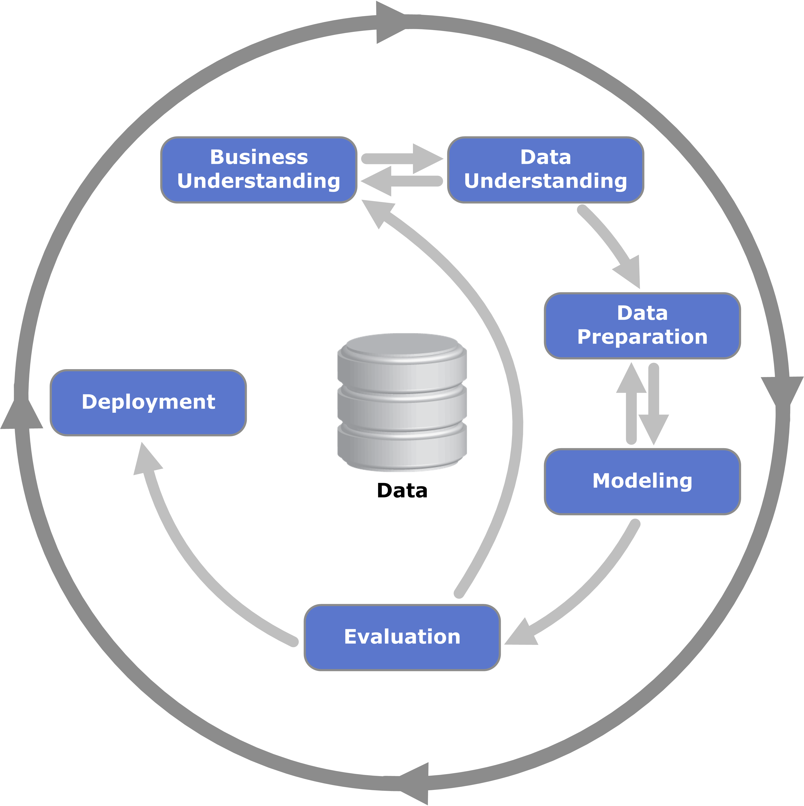
CRISP-DM

Slide 7
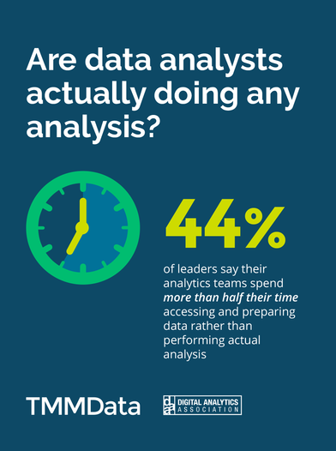
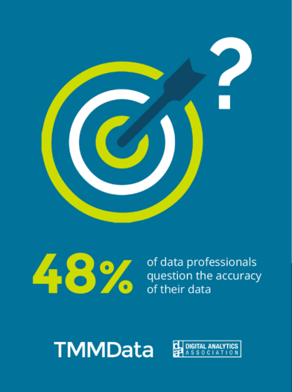
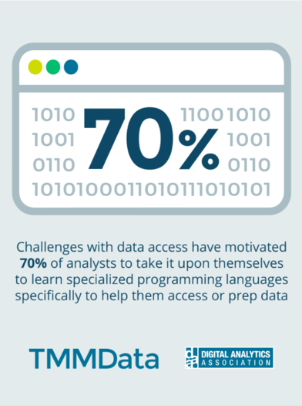
Why data preparation?

Slide 8
Why data preparation?
What data scientists spend the most of their time doing?
60%
19%
9%
4%
5%
3%

Slide 9
Data preparation: An Overview
Data preparation: the process of cleaning and transforming raw data prior to processing and analysis.
Involves the following tasks:
Checking the data quality and applying correction techniques
Reformatting data
Combining datasets for the purpose of enrichment

Slide 10
Data Quality

Slide 11

Data Quality Issues
Noise
Missing Values
Duplicate Data
Outdated Values
Outliers
Inconsistent Values
Unreliable sources
For any data retrieval or data analytic task,
it is critically important to know the quality of your data
For the US alone, poor data quality costs around US economy $3 trillions a year (2016).

Slide 12
Data Quality
Data quality: checking the data from multiple perspectives
Accuracy
The data was recorded correctly.
Completeness
All relevant data was recorded.
Uniqueness
Entities are recorded once.
Timeliness
The data is kept up to date.
Special problems in federated data: time consistency.
Consistency
The data agrees with itself.

Slide 13
Data Quality (Cont.)
Problems in previous definition of data quality:
Unmeasurable
Accuracy and completeness are extremely difficult, perhaps impossible to measure.
Context independent
No accounting for what is important. E.g., if you are computing aggregates, you can tolerate a lot of inaccuracies.
Incomplete
What about interpretability, accessibility, metadata, analysis, etc.
Vague
The previous definition provide no guidance towards practical improvements of the data.

Slide 14
Example
T. Das|97336o8237|24.95|Y|-|0.0|1000
Ted J.|973-360-8997|2000|N|M|NY|1000
Can we interpret the data?
What do the fields mean?
What is the key? The measures?
Data glitches
Typos, multiple formats, missing / default values
Metadata and domain expertise
Field three is Revenue. In dollars or cents?

Slide 15
Data Quality (Cont.)
Sources of problems:
Manual entry
No uniform standards for content and formats
Parallel data entry (duplicates)
Approximations, surrogates – SW/HW constraints
Measurement errors.
We need a definition of data quality which
Reflects the use of the data
Leads to improvements in processes
Measurable (we can define metrics)

Slide 16
Examples of Data Quality metrics
Conformance to schema
Evaluate constraints on a snapshot.
Conformance to business rules
Evaluate constraints on changes in the database.
Accuracy
Perform inventory (expensive), or use proxy (track complaints). Audit samples?
Glitches in analysis
Successful completion of end-to-end process

Slide 17
Data Cleaning

Slide 18
Data Cleaning
Data in the Real World is Dirty: lots of potentially incorrect data, e.g., instrument faulty, human or computer error, transmission error
Incomplete: lacking attribute values, lacking certain attributes of interest, or containing only aggregate data
e.g., Occupation=“ ” (missing data)
Noisy: containing noise, errors, or outliers
e.g., Salary=“−10” (an error)

Slide 19
Data Cleaning (Cont.)
Data in the real world is dirty
Inconsistent: containing discrepancies in codes or names, e.g.,
Age=“42”, Birthday=“03/07/2010”
Was rating “1, 2, 3”, now rating “A, B, C”
Discrepancy between duplicate records
Intentional (e.g., disguised missing data)
Jan. 1 as everyone’s birthday?

Slide 20
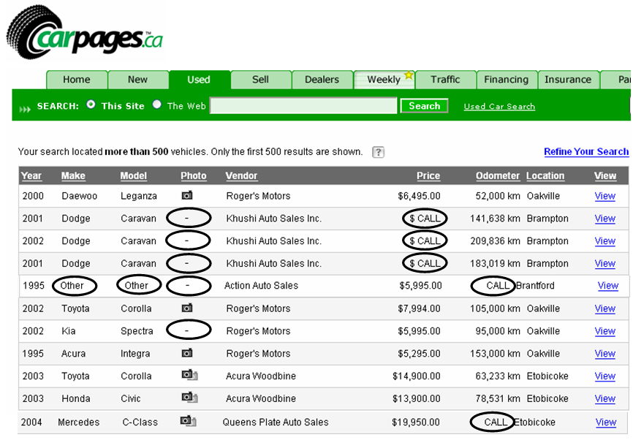
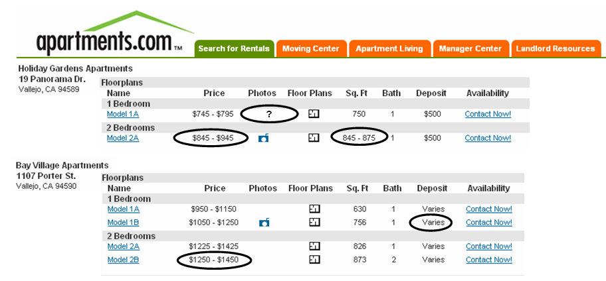
Real data is full of N/A or nulls, special values (99999) etc.

Slide 21
Data Cleaning
1- Incomplete Data

Slide 22
Incomplete (Missing) Data
Data is not always available
E.g., many tuples have no recorded value for several attributes, such as customer income in sales data
Missing data may be due to
Equipment malfunction
Inconsistent with other recorded data and thus deleted
Data not entered due to misunderstanding
Certain data values may not be considered important at the time of entry
Missing data may need to be inferred

Slide 23
Handling the Missing Data
Ignore the tuple: usually done when class label is missing (for classification problem) – not effective when the % of missing values is large
Fill in the missing value:
Manually: tedious + infeasible?
Automatically (data imputation) with
A global constant : e.g., “unknown”, a new class?!
The attribute mean
The attribute mean for all samples belonging to the same class: smarter
More sophisticated data imputation techniques will be discussed in more details in the upcoming weeks

Slide 24
Data Cleaning
2- Noisy Data

Slide 25
Noisy Data
Noise: random error or variance in a measured variable
Incorrect attribute values may be due to
Faulty data collection instruments
Data entry problems
Data transmission problems
Technology limitation
Inconsistency in naming convention

Slide 26
Handling the Noisy Data
Binning
First sort data and partition into (equal-frequency) bins
Then one can smooth by bin means, smooth by bin median, smooth by bin boundaries, etc.
Smoothing by bin means : In smoothing by bin means, each value in a bin is replaced by the mean value of the bin.
Smoothing by bin median : In this method each bin value is replaced by its bin median value.
Smoothing by bin boundary: In smoothing by bin boundaries, the minimum and maximum values in a given bin are identified as the bin boundaries. Each bin value is then replaced by the closest boundary value.

Slide 27
Handling the Noisy Data (Cont.)
Regression
Smooth by fitting the data into regression functions
Clustering
Detect and remove outliers that do not belong to any of the clusters
Combined computer and human inspection
Detect suspicious values and check by human (e.g., deal with possible outliers)

Slide 28
Binning methods for data smoothing
Sorted data for grades (out of 50):
4, 8, 9, 11, 15, 21, 21, 24, 24, 25,26, 28, 29, 34, 48
Partition into equal-frequency (equidepth) bins:
- Bin 1: 4, 8, 9, 11, 15
- Bin 2: 21, 21, 24, 24, 25
- Bin 3: 26, 28, 29, 34, 48
Smoothing by bin means:
- Bin 1: 9.4, 9.4, 9.4, 9.4, 9.4
- Bin 2: 23, 23, 23, 23, 23
- Bin 3: 33, 33, 33, 33, 33
Smoothing by bin boundaries:
- Bin 1: 4, 4, 4, 15, 15
- Bin 2: 21, 21, 25, 25, 25
- Bin 3: 26, 26, 26, 26, 48

Slide 29
Data Cleaning
3- Outliers

Slide 30
Outliers
Consider the data points
3, 4, 7, 4, 8, 3, 9, 5, 7, 6, 92
“92” is suspicious - an outlier
Outliers are data or model glitches
Definition of Hawkins [Hawkins 1980]:
“An outlier is an observation which deviates so much from the other observations as to arouse suspicions that it was generated by a different mechanism”

Slide 31

Outliers (Cont.)
Outliers are interesting: they violate the mechanism that generates the normal data
Outlier detection vs. novelty detection: early stage, outlier; but later merged into the model
Applications:
Credit card fraud detection
Telecom fraud detection
Customer segmentation
Medical analysis
$$O$$

Slide 32


Types of Outliers
Three kinds: global, contextual and collective outliers
Global outlier (or point anomaly)
Object is a global outlier ($o_{g}$) if it significantly deviates from the rest of the data set
Ex. Intrusion detection in computer networks
Issue: Find an appropriate measurement of deviation
Global Outliers
$$O$$

Slide 33
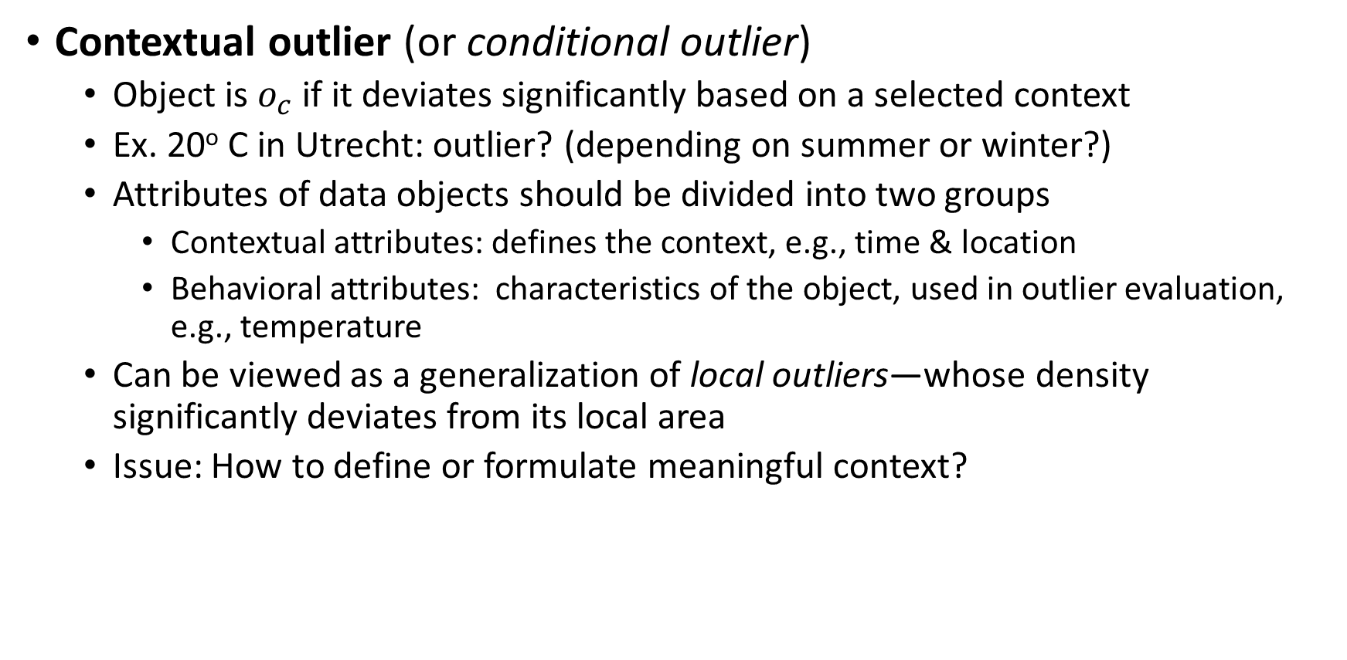
Types of Outliers (Cont.)
Contextual outlier (or conditional outlier)
Object is $o_{c}$ if it deviates significantly based on a selected context
Ex. 20º C in Utrecht: outlier? (depending on summer or winter?)
Attributes of data objects should be divided into two groups
Contextual attributes: defines the context, e.g., time & location
Behavioral attributes: characteristics of the object, used in outlier evaluation, e.g., temperature
Can be viewed as a generalization of local outliers—whose density significantly deviates from its local area
Issue: How to define or formulate meaningful context?

Slide 34
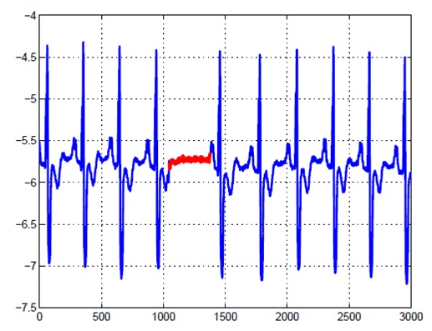
Types of Outliers (Cont.)
Collective Outliers
A subset of data objects collectively deviate significantly from the whole data set, even if the individual data objects may not be outliers
Applications: E.g., intrusion detection:
When a number of computers keep sending denial-of-service packages to each other
Detection of collective outliers
Consider not only behavior of individual objects, but also that of groups of objects
Need to have the background knowledge on the relationship among data objects, such as a distance or similarity measure on objects

Slide 35
Challenges of Outlier Detection
Modeling normal objects and outliers properly
Hard to enumerate all possible normal behaviors in an application
The border between normal and outlier objects is often a gray area
Application-specific outlier detection
Choice of distance measure among objects and the model of relationship among objects are often application-dependent
E.g., clinical data: a small deviation could be an outlier; while in marketing analysis, larger fluctuations
Handling noise in outlier detection
Noise may distort the normal objects and blur the distinction between normal objects and outliers. It may help hide outliers and reduce the effectiveness of outlier detection

Slide 36
Challenges of Outlier Detection (Cont.)
Understandability
Understand why these are outliers: Justification of the detection
Specify the degree of an outlier: the unlikelihood of the object being generated by a normal mechanism
A data set may have multiple types of outlier
One object may belong to more than one type of outlier

Slide 37
Outlier Detection Techniques for Single Points
Local vs global approaches
Scoring vs labeling
Many approaches, for example:
Statistical methods
Distance based methods
Density based methods
Methods based on model fitting

Slide 38
Outlier Detection Techniques (Cont.)
Global versus local approaches
Considers the resolution of the reference set w.r.t. which the “outlierness” of a particular data object is determined – Global approaches
Global approaches
The reference set contains all other data objects
Basic problem: other outliers are also in the reference set and may falsify the results
Local approaches
The reference contains a (small) subset of data objects
No assumption on the number of normal mechanisms
Basic problem: how to choose a proper reference set
Some approaches are somewhat in between

Slide 39
Outlier Detection Techniques (Cont.)
Labeling versus scoring: considers the output of an outlier detection algorithm
Labeling approaches
Binary output
Data objects are labeled either as normal or outlier
Scoring approaches
Continuous output
For each object an outlier score is computed (e.g. the probability for being an outlier)
Data objects can be sorted according to their scores

Slide 40
Outlier Detection – Statistical Approaches
Statistical approaches assume that the objects in a data set are generated by a stochastic process (a generative model)
Idea: learn a generative model fitting the given data set, and then identify the objects in low probability regions of the model as outliers
Model Estimation: Methods are divided into two categories
parametric vs. non-parametric

Slide 41
Outlier Detection – Statistical Approaches (Cont.)
Parametric method
Assumes that the normal data is generated by a specific distribution with parameter θ
The probability density function of the parametric distribution f(x, θ) gives the probability that object x is generated by the distribution
The smaller this value, the more likely x is an outlier
Non-parametric method
Not assume an a-priori statistical model and determine the model from the input data
Not completely parameter free but consider the number and nature of the parameters are flexible and not fixed in advance
Examples: histogram and kernel density estimation

Slide 42
Outlier Detection – Parametric Statistical Approaches
Detection of univariate outliers based on Normal distribution
Univariate data: A data set involving only one attribute or variable
Often assume that data are generated from a normal distribution, learn the parameters from the input data, and identify the points with low probability as outliers

Slide 43
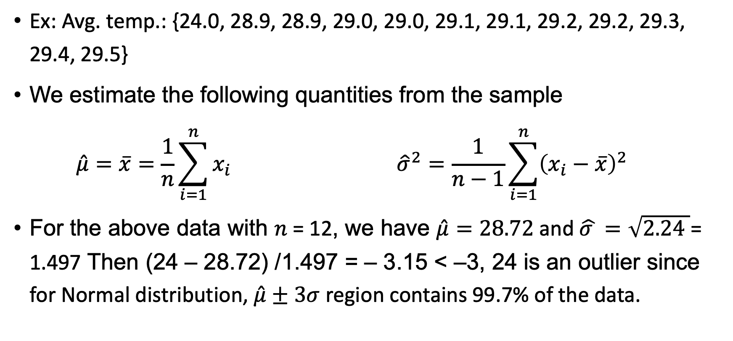
Outlier Detection – Parametric Statistical Approaches
Ex: Avg. temp.: {24.0, 28.9, 28.9, 29.0, 29.0, 29.1, 29.1, 29.2, 29.2, 29.3, 29.4, 29.5}
We estimate the following quantities from the sample
$$\hat{μ}=\overline{x}=\frac{1}{n}\sum_{i=1}^{n}{x_{i}} {\hat{σ}}^{2}=\frac{1}{n−1}\sum_{i=1}^{n}{{\left(x_{i}−\overline{x}\right)}^{2} }$$
For the above data with $n \text{=}\text{ 12}$, we have $\hat{μ}=28.72$ and $\hat{σ }=\sqrt{2.24 }\text{= 1.}\text{4}\text{97}$ Then $\text{(24 – 28.}\text{72}\text{) /1.}\text{4}\text{97}\text{ = – 3.}\text{15}\text{ < –3}$, 24 is an outlier since for Normal distribution, $\hat{μ}±3σ$ region contains 99.7% of the data.

Slide 44
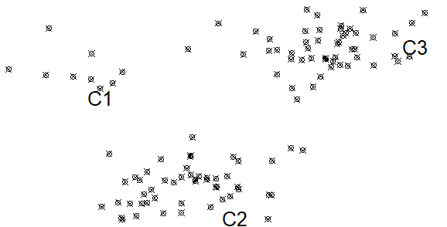
Outlier Detection – Parametric Statistical Approaches
Assuming data generated by a normal distribution could be sometimes overly simplified
Example (data in the figure): The objects between the two clusters cannot be captured as outliers since they are close to the estimated mean
To overcome this problem, assume the normal data is generated by mixture of Normal distributions.

Slide 45
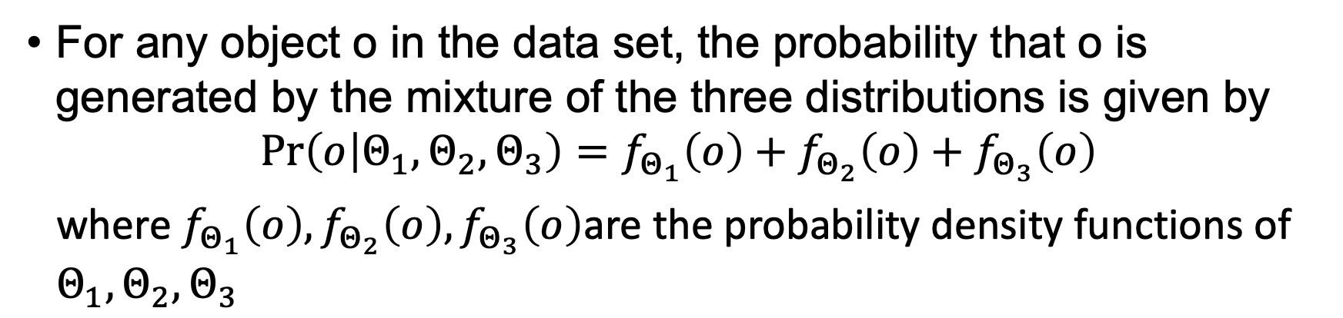
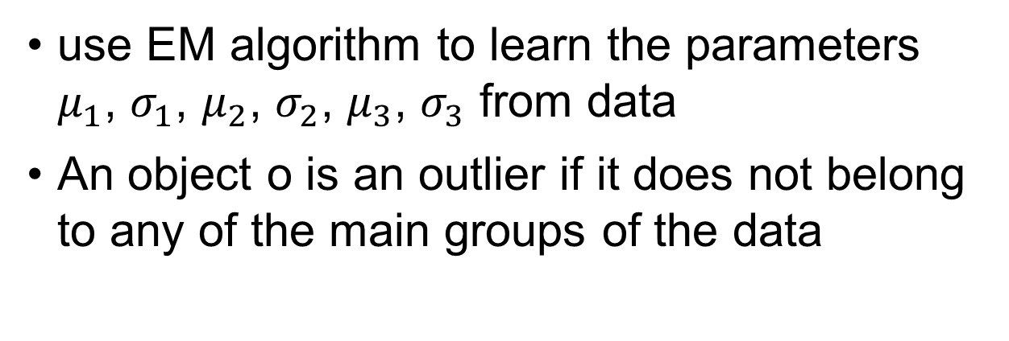
Outlier Detection – Parametric Statistical Approaches
For any object o in the data set, the probability that o is generated by the mixture of the three distributions is given by
$$\operatorname{Pr}\left(o | Θ_{1}, Θ_{2},Θ_{3}\right)=f_{Θ_{1}}\left(o\right)+f_{Θ_{2}}\left(o\right)+f_{Θ_{3}}\left(o\right)$$
where $f_{Θ_{1}}\left(o\right),f_{Θ_{2}}\left(o\right),f_{Θ_{3}}\left(o\right)$are the probability density functions of $Θ_{1},Θ_{2},Θ_{3}$
use EM algorithm to learn the parameters $μ_{1}$, $σ_{1}$, $μ_{2}$, $σ_{2}$, $μ_{3}$, $σ_{3}$ from data
An object o is an outlier if it does not belong to any of the main groups of the data

Slide 46
Outlier Detection – Non-Parametric Statistical Approaches
The model of normal data is learned from the input data without any a priori structure.
Often makes fewer assumptions about the data, and thus can be applicable in more scenarios
Outlier detection using histogram:
Figure shows the histogram of purchase amounts in transactions
A transaction in the amount of $7,500 is an outlier, since only 0.2% transactions have an amount higher than $5,000
Problem: Hard to choose an appropriate bin size for histogram

Slide 47
Outlier Detection – Non-Parametric Statistical Approaches
Problem: Hard to choose an appropriate bin size for histogram
Too small bin size → normal objects in empty/rare bins, false positive
Too big bin size → outliers in some frequent bins, false negative
Solution: Adopt kernel density estimation to estimate the probability density distribution of the data. If the estimated density function is high, the object is likely normal. Otherwise, it is likely an outlier.

Slide 48
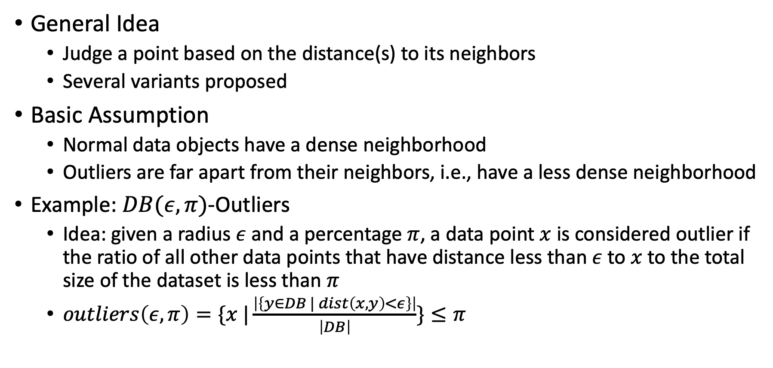
Outlier Detection – Distance-Based Approaches
General Idea
Judge a point based on the distance(s) to its neighbors
Several variants proposed
Basic Assumption
Normal data objects have a dense neighborhood
Outliers are far apart from their neighbors, i.e., have a less dense neighborhood
Example: $DB(ε, π)$-Outliers
Idea: given a radius $ε$ and a percentage $π$, a data point $x$ is considered outlier if the ratio of all other data points that have distance less than $ε$ to $x$ to the total size of the dataset is less than $π$
$outliers\left(ε, π\right)=\{x |\frac{\left|\left\{y∈DB | dist\left(x,y\right)<ε\right\}\right|}{\left|DB\right|}\}≤π$

Slide 49
Outlier Detection – Density-Based Approaches
General Idea
Compare the density around a point with the density around its local neighbors
The relative density of a point compared to its neighbors is computed as an outlier score
Approaches essentially differ in how to estimate density
Basic Assumption
The density around a normal data object is similar to the density around its neighbors
The density around an outlier is considerably different to the density around its neighbors

Slide 50
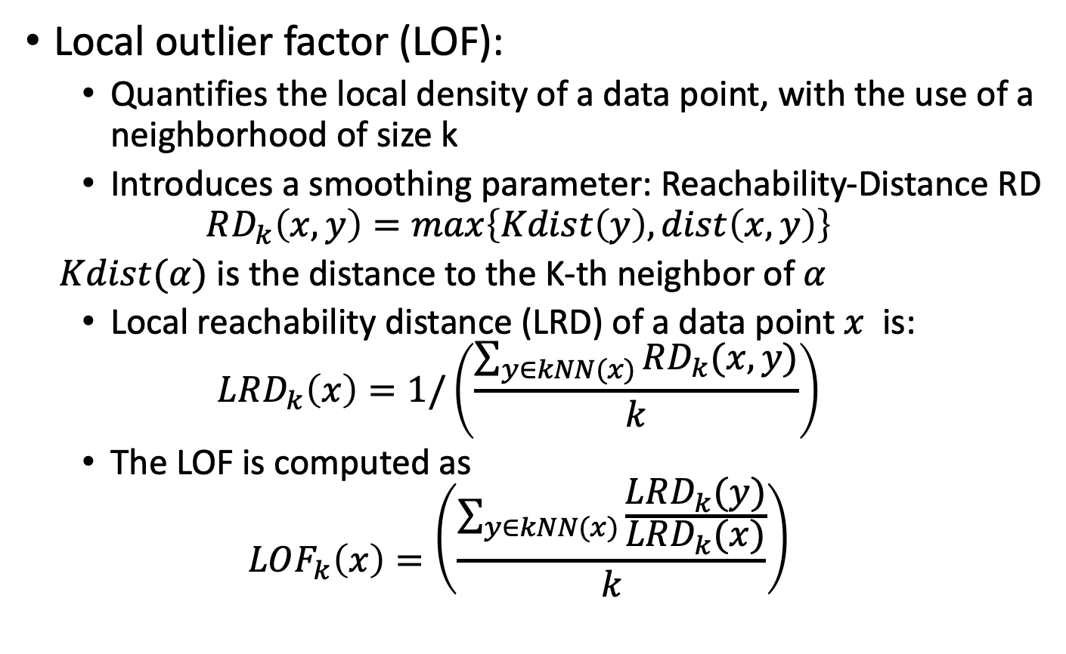
Outlier Detection – Density-Based Approaches (Cont.)
Local outlier factor (LOF):
Quantifies the local density of a data point, with the use of a neighborhood of size k
Introduces a smoothing parameter: Reachability-Distance RD
$$RD_{k}\left(x,y\right)=max\left\{Kdist\left(y\right), dist\left(x,y\right)\right\}$$
$Kdist(α)$ is the distance to the K-th neighbor of $α$
Local reachability distance (LRD) of a data point $x$ is:
$$LRD_{k}\left(x\right)=1/\left(\frac{\sum_{y∈kNN(x)}{RD_{k}(x,y)}}{k}\right)$$
The LOF is computed as
$$LOF_{k}\left(x\right)=\left(\frac{\sum_{y∈kNN(x)}{\frac{LRD_{k}(y)}{LRD_{k}(x)}}}{k}\right)$$

Slide 51
Outlier Detection – Model-Based Approaches
Models summarize general trends in data
More complex than simple aggregates
E.g. linear regression, logistic regression
Data points that do not conform to the fitting model are potential outliers
Goodness of fit tests
Check suitableness of model to data
Verify validity of assumptions
Data rich enough to answer analysis/business question?

Slide 52

Summarize what you learned today in 2-minutes

Slide 53
Next lecture
Process Discovery
Conformance Checking

