Slide 1
Data Wrangling and Data Analysis
Data Preparation (2)
Hakim Qahtan
Department of Information and Computing Sciences
Utrecht University

Slide 2
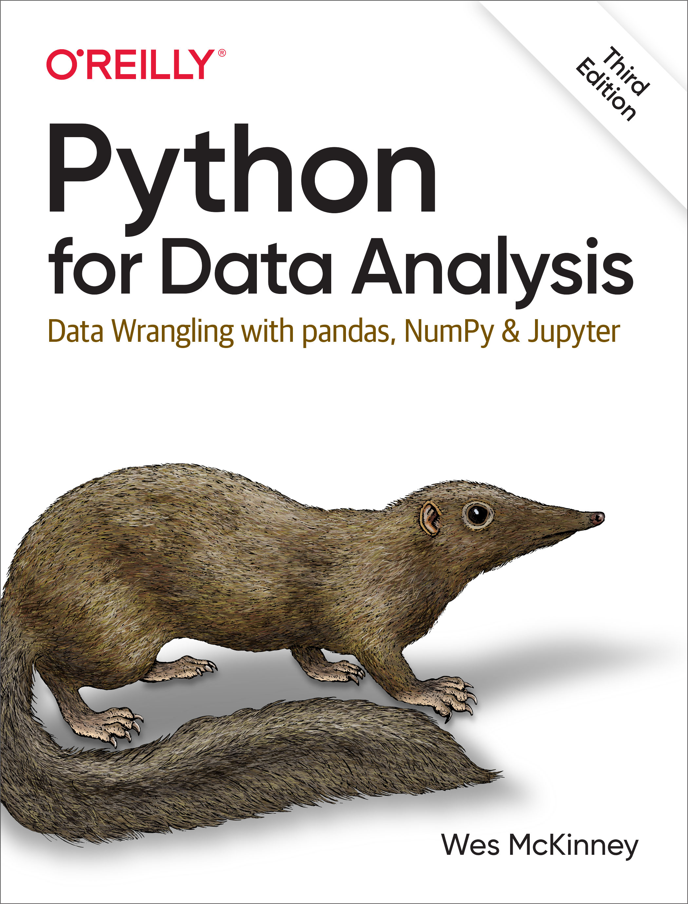
Reading Material for Today
Data Mining: Concepts and Techniques Book
CH 3.3 – 3.5
Python for Data Analysis, 3E
CH 7.2

Slide 3
Topics for Today
Data transformation
Data Integration
Data reduction
Data discretization

Slide 4
Data Transformation

Slide 5
Data Transformation
A function that maps the entire set of values of a given attribute to a new set of replacement values s.t. each old value can be identified with one of the new values
Methods for data transformation
Smoothing: Remove noise from data
Attribute/feature construction
New attributes constructed from the given ones
Aggregation: Summarization, data cube construction

Slide 6
Data Transformation (Cont.)
Methods for data transformation
Normalization: Scaled to fall within a smaller, specified range
Min-max normalization
Z-score normalization
Normalization by decimal scaling
Data reformatting:
E.g. Jack Wilsher ➔ Wilsher, J.
Use the same unit:
Records in inches and cm
Records with prices in Euros and Dollars

Slide 7
Data Normalization (Standardization)
The goal of standardization or normalization is to make an entire set of values have a particular property.

Slide 8
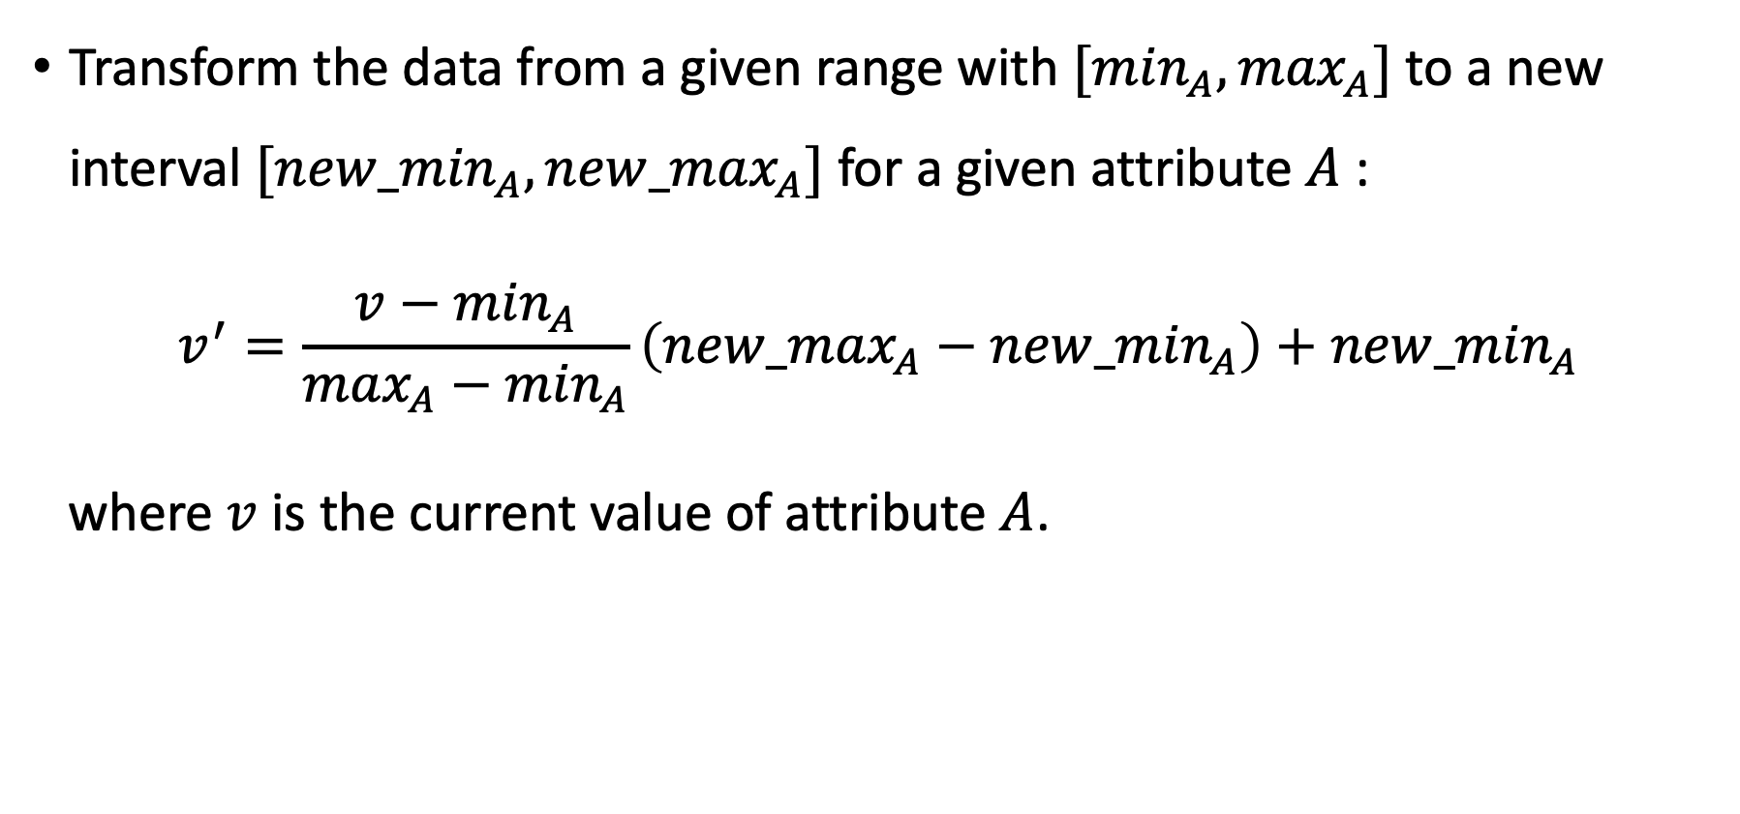
Data Normalization – Min-Max Normalization
Transform the data from a given range with $[\min_{A}, \max_{A}]$ to a new interval $[{new_min}_{A}, {new_max}_{A}]$ for a given attribute $A$ :
$$v^{′}=\frac{v−\min_{A}}{\max_{A}−\min_{A}}\left({new_max}_{A}−{new_min}_{A}\right)+{new_min}_{A}$$
where $v$ is the current value of attribute $A$.

Slide 9
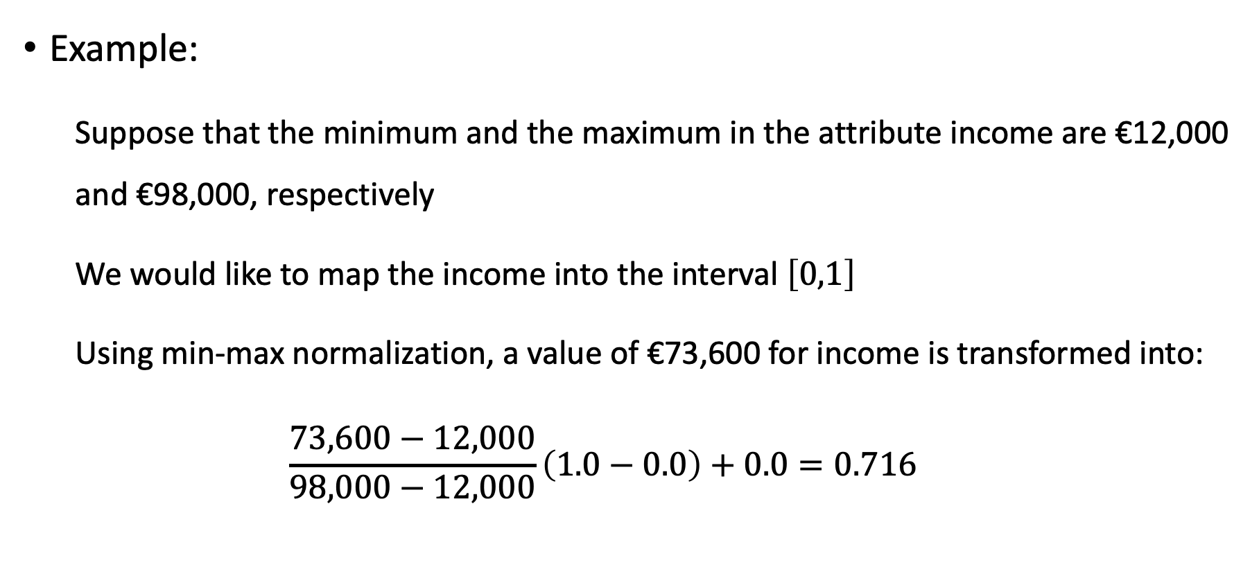
Data Normalization – Min-Max Normalization
Example:
Suppose that the minimum and the maximum in the attribute income are €12,000 and €98,000, respectively
We would like to map the income into the interval $\left[0,1\right]$
Using min-max normalization, a value of €73,600 for income is transformed into:
$$\frac{73,600−12,000}{98,000−12,000}\left(1.0−0.0\right)+0.0=0.716$$

Slide 10
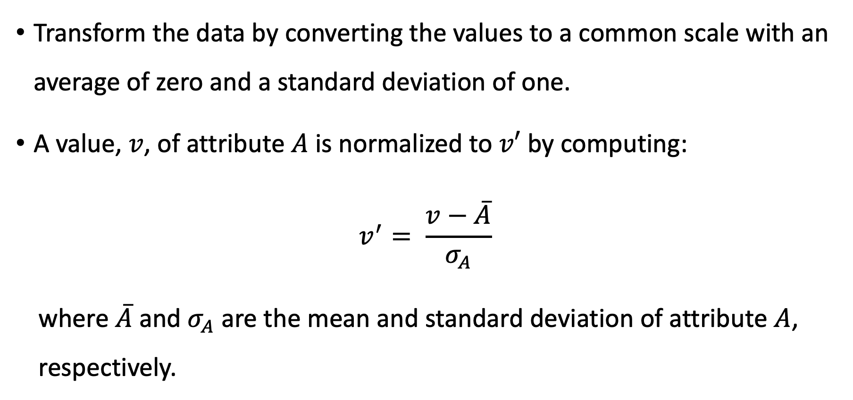
Data Normalization – Z-Score Normalization
Transform the data by converting the values to a common scale with an average of zero and a standard deviation of one.
A value, $v$, of attribute $A$ is normalized to $v′$ by computing:
$$v^{′}= \frac{v−\overline{A}}{σ_{A}}$$
where $\overline{A}$ and $σ_{A}$ are the mean and standard deviation of attribute $A$, respectively.

Slide 11
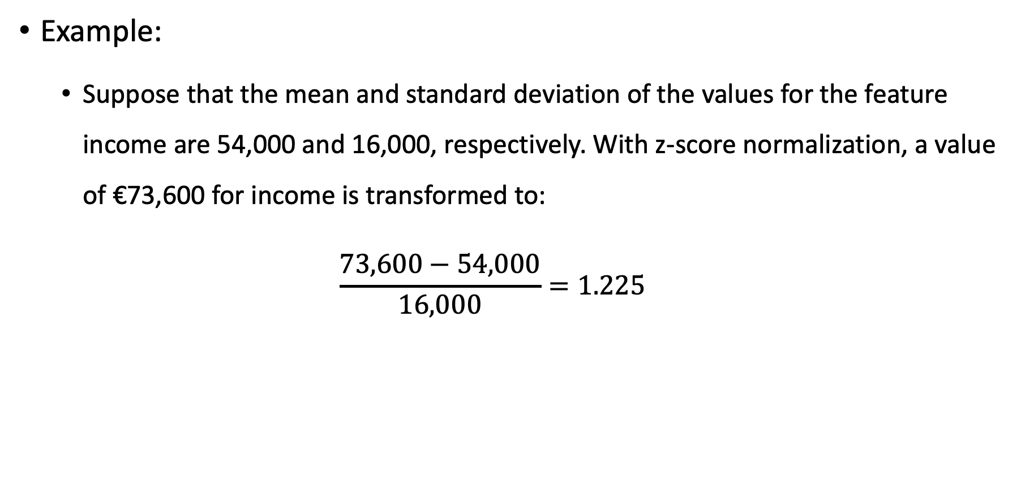
Data Normalization – Z-Score Normalization
Example:
Suppose that the mean and standard deviation of the values for the feature income are 54,000 and 16,000, respectively. With z-score normalization, a value of €73,600 for income is transformed to:
$$\frac{73,600−54,000}{16,000}=1.225$$

Slide 12
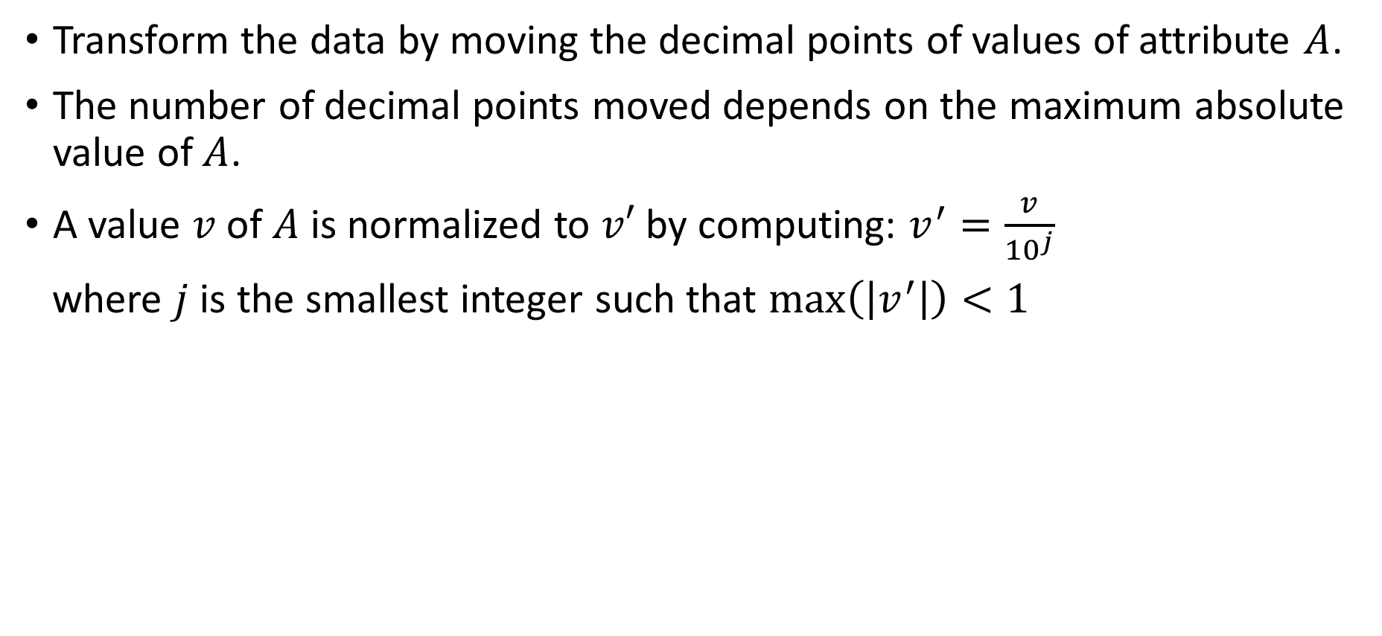
Data Normalization – Decimal Scaling Normalization
Transform the data by moving the decimal points of values of attribute $A$.
The number of decimal points moved depends on the maximum absolute value of $A$.
A value $v$ of $A$ is normalized to $v′$ by computing: $v^{′}=\frac{v}{{10}^{j}}$
where $j$ is the smallest integer such that $\max\left(\left|v^{′}\right|\right)<1$

Slide 13
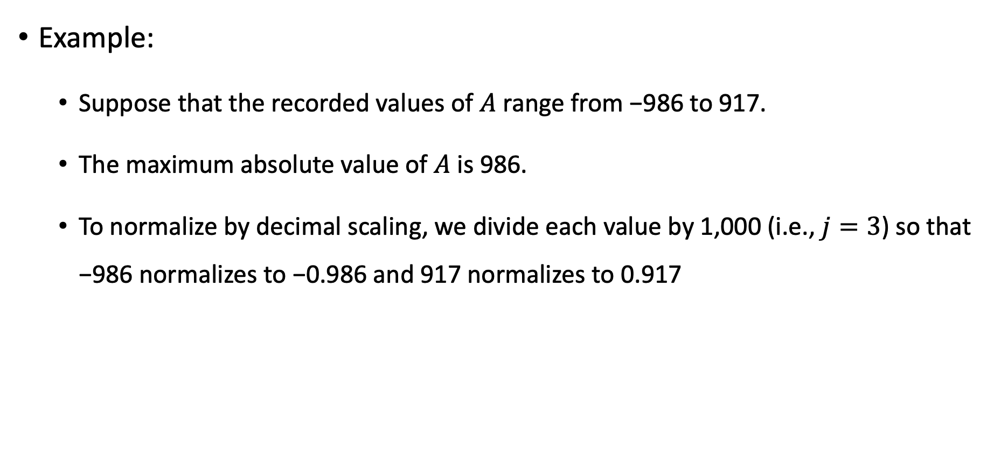
Data Normalization – Decimal Scaling Normalization
Example:
Suppose that the recorded values of $A$ range from −986 to 917.
The maximum absolute value of $A$ is 986.
To normalize by decimal scaling, we divide each value by 1,000 (i.e., $j=3$) so that −986 normalizes to −0.986 and 917 normalizes to 0.917

Slide 14
Data Transformation (Cont.)
Exercise
Use flash fill of Microsoft Excel to convert set of names from the format Family_name, First_name middle_initial. to First_name Family_name
E.g. Wilsher, John K. to John Wilsher

Slide 15
Data Integration (Revisited)

Slide 16
Data Integration
Combines data from multiple sources into a coherent store
Schema integration: e.g., A.cust-id ≡ B.cust-No
Integrate metadata from different sources
Entity identification problem:
Identify real world entities from multiple data sources, e.g., Bill Clinton = William Clinton
Detecting and resolving data value conflicts
For the same real-world entity, attribute values from different sources are different
Possible reasons: different representations, different scales, e.g., metric vs. British units

Slide 17
Handling Redundancy when Integrating Data
Handling data redundancy is an important task of the data integration
Duplicate records can be identified by applying entity resolution techniques
Redundant attributes can be detected by correlation and covariance analysis
Careful integration of the data from multiple sources may help reduce/avoid redundancies and inconsistencies and improve mining quality

Slide 18
Entity Resolution
Problem of identifying and linking/grouping different representations of the same real-world object.
Examples:
Different ways of addressing (names, email addresses, FaceBook accounts) the same person in text.
Web pages with differing descriptions of the same business.
Different photos of the same object.
…

Slide 19
Ironically, Entity Resolution has Many Duplicate Names
Reference reconciliation
Record linkage
Duplicate detection
Fuzzy match
Object identification
Object consolidation
Deduplication
Entity clustering
Identity uncertainty
Approximate match
Household matching
Doubles
Reference matching
Hardening soft databases

Slide 20
Entity Resolution – Normalization
Schema Normalization
Schema matching: e.g., Contact No. vs. Phone
Compound attributes: e.g., address vs. (street, city, zip)
Data Normalization
Capitalization, white-space normalization
Correcting typos, replacing abbreviations, variations, nick names
Usually done by employing dictionaries

Slide 21
Entity Resolution – Matching Features
Given two records, compute a vector of similarity scores for corresponding features
E.g., to match two bibliographical references, compute:
First author match score
Title match score
Venue match score
Year match score
…
Score can be Boolean (match/mismatch) or a continuous value based on specific similarity measure (distance function).

Slide 22
Entity Resolution – Similarity Measures
Atomic similarity measures
Difference between numerical values
Jaro for comparing names
Edit distance for typos
Phonetic-based
Soundex
Set similarity
Jaccard similarity
Vector-based
Cosine similarity

Slide 23
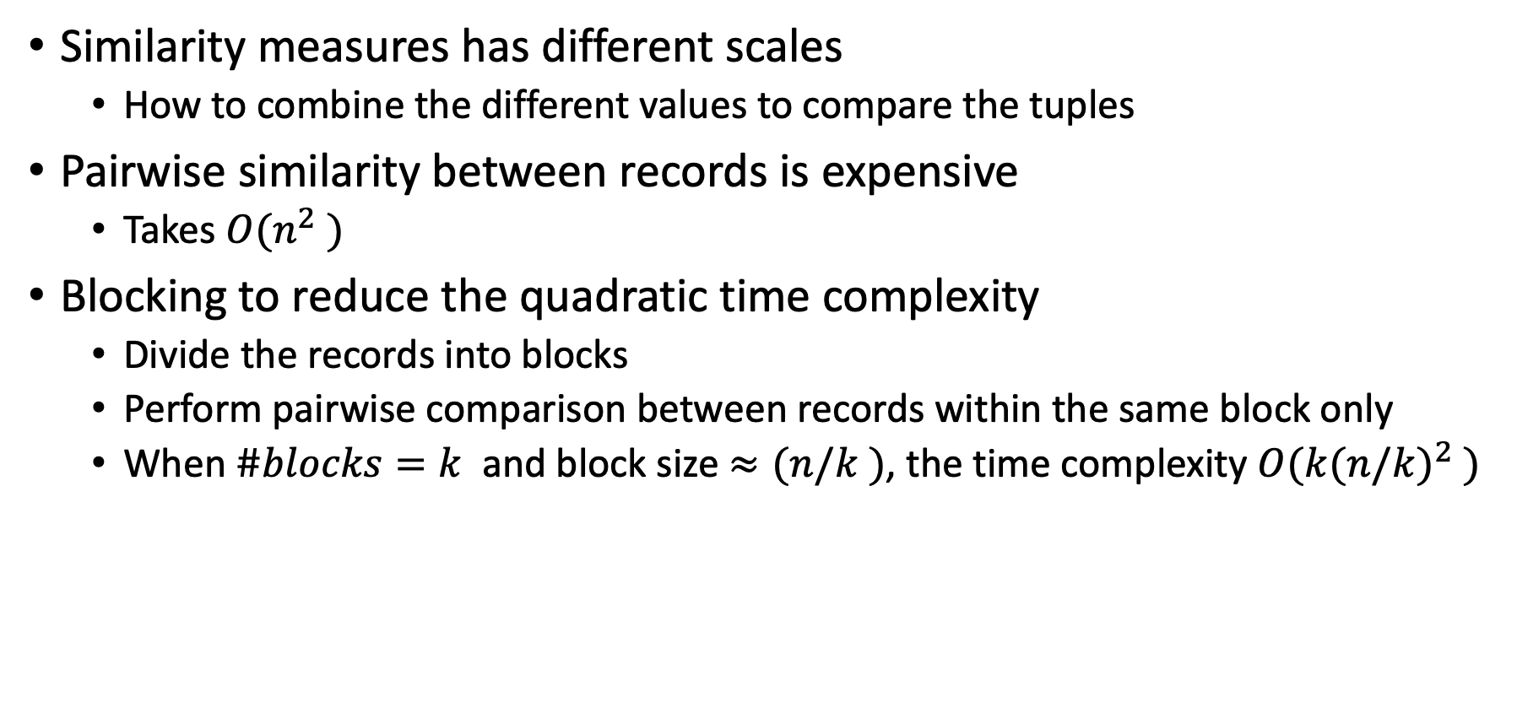
Entity Resolution – Issues
Similarity measures has different scales
How to combine the different values to compare the tuples
Pairwise similarity between records is expensive
Takes $O(n^{2} )$
Blocking to reduce the quadratic time complexity
Divide the records into blocks
Perform pairwise comparison between records within the same block only
When $\#blocks=k$ and block size $≈(n/k )$, the time complexity $O({k(n/k)}^{2} )$

Slide 24
Data Reduction

Slide 25
Data Reduction
Data reduction: obtain a reduced representation of the dataset
Much smaller in volume but yet produces the same (or almost the same) analytical results
Why data reduction?
A dataset could be extremely large – Complex data analysis may take a very long time to run on the complete dataset.
Data reduction strategies (attribute level)
Dimensionality reduction, e.g., remove unimportant attributes
Principal Components Analysis (PCA)
Singular Value Decomposition (SVD)
Feature subset selection, feature creation

Slide 26
Dimensionality Reduction
Curse of dimensionality
When dimensionality increases, data becomes increasingly sparse
Density and distance between points, which is critical to clustering, outlier analysis, becomes less meaningful
The possible combinations of subspaces will grow exponentially
Dimensionality reduction
Avoid the curse of dimensionality
Help eliminate irrelevant features and reduce noise
Reduce time and space required in data mining
Allow easier visualization

Slide 27
Principal Component Analysis (PCA)
Find a projection that captures the largest amount of variation in data
The original data are projected onto a much smaller space, resulting in dimensionality reduction.
We find the eigenvectors of the covariance matrix, and these eigenvectors define the new space

Slide 28
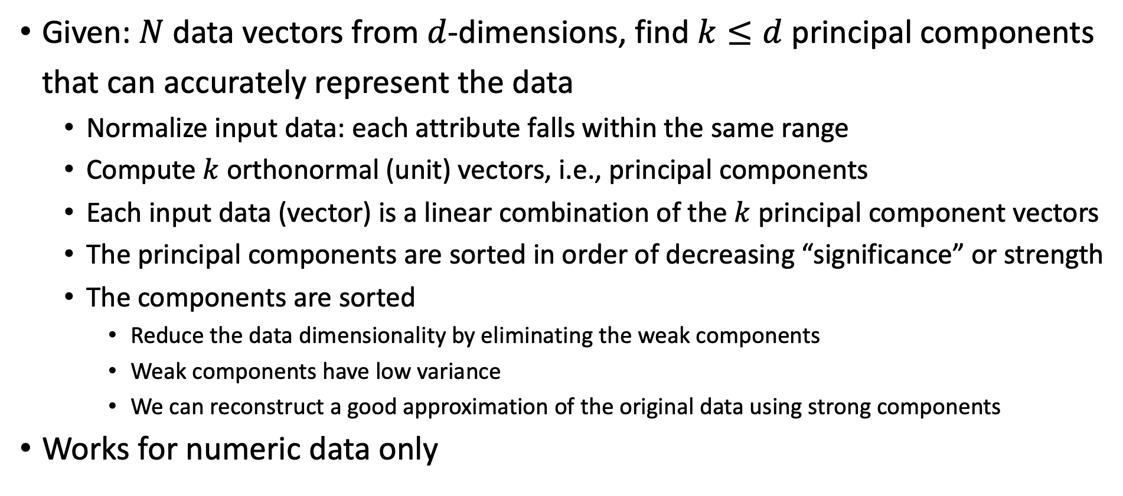
Principal Component Analysis (Steps)
Given: $N$ data vectors from $d$-dimensions, find $k≤d$ principal components that can accurately represent the data
Normalize input data: each attribute falls within the same range
Compute $k$ orthonormal (unit) vectors, i.e., principal components
Each input data (vector) is a linear combination of the $k$ principal component vectors
The principal components are sorted in order of decreasing “significance” or strength
The components are sorted
Reduce the data dimensionality by eliminating the weak components
Weak components have low variance
We can reconstruct a good approximation of the original data using strong components
Works for numeric data only

Slide 29
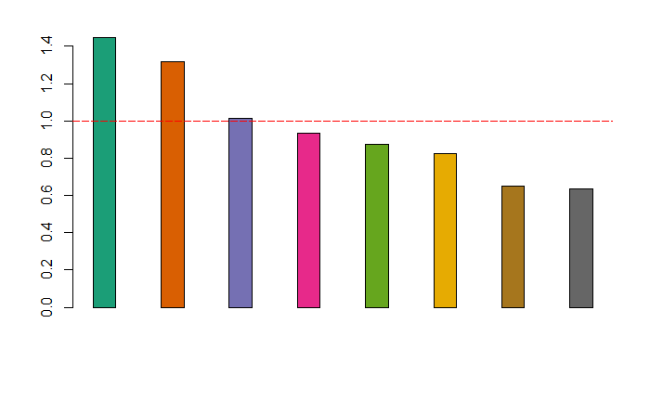
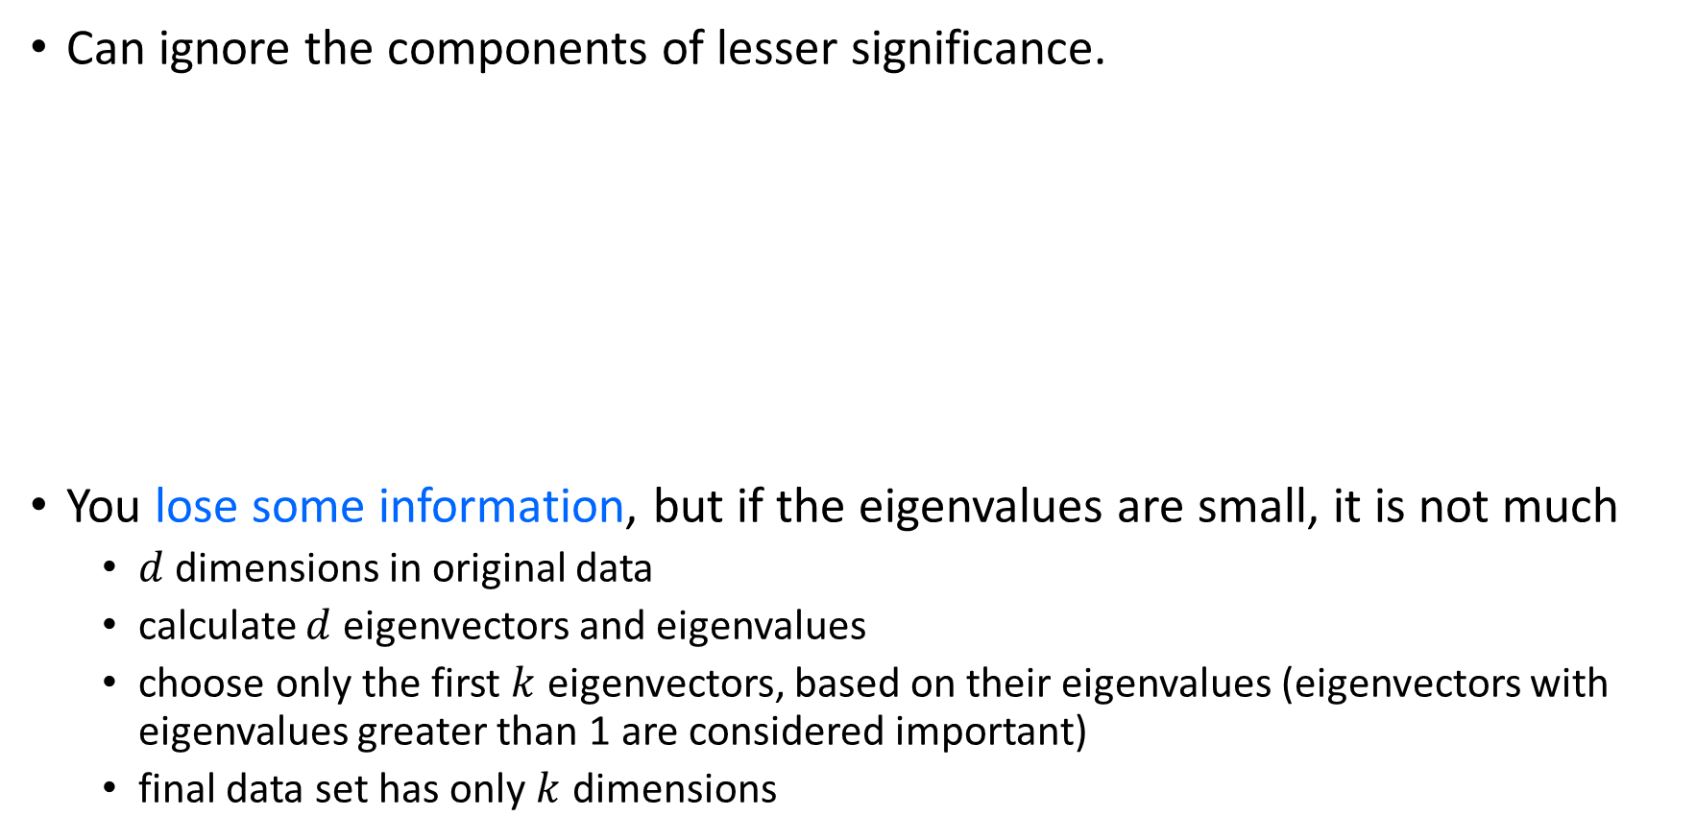
PCA for Dimensionality Reduction
Can ignore the components of lesser significance.
You lose some information, but if the eigenvalues are small, it is not much
$d$ dimensions in original data
calculate $d$ eigenvectors and eigenvalues
choose only the first $k$ eigenvectors, based on their eigenvalues (eigenvectors with eigenvalues greater than 1 are considered important)
final data set has only $k$ dimensions

Slide 30
Attribute Subset Selection for Data Reduction
Another way to reduce dimensionality of data
Redundant attributes
Duplicate much or all of the information contained in one or more other attributes
E.g., purchase price of a product and the amount of sales tax paid
Irrelevant attributes
Contain no information that is useful for the data mining task at hand
E.g., students' ID is often irrelevant to the task of predicting students' GPA

Slide 31
Data Reduction (instances or examples level)
Linear regression
Data modeled to fit a straight line
Often uses the least-square method to fit the line
Multiple regression
Allows a response variable Y to be modeled as a linear function of multidimensional feature vector
Log-linear model
Approximate data by a function whose logarithm is linear

Slide 32
Histograms for Instance Level Data Reduction
Divide data into buckets and store average (sum) for each bucket
Partitioning rules:
Equal-width: equal bucket range
Equal-frequency (or equal-depth)

Slide 33
Clustering-Based Data Reduction
Partition data set into clusters based on similarity, and store cluster representation (e.g., centroid and diameter) only
Can be very effective if data is clustered but not if data is “smeared”
There are many choices of clustering definitions and clustering algorithms
Clustering will be studied in more details in weeks 7 & 8

Slide 34
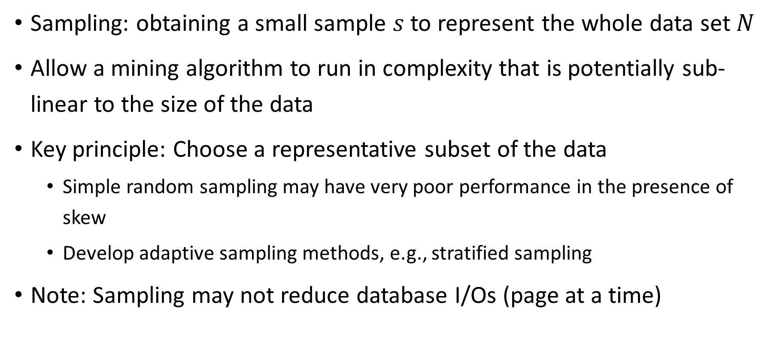
Sampling-Based Data Reduction
Sampling: obtaining a small sample $s$ to represent the whole data set $N$
Allow a mining algorithm to run in complexity that is potentially sub-linear to the size of the data
Key principle: Choose a representative subset of the data
Simple random sampling may have very poor performance in the presence of skew
Develop adaptive sampling methods, e.g., stratified sampling
Note: Sampling may not reduce database I/Os (page at a time)

Slide 35
Types of Sampling
Simple random sampling
There is an equal probability of selecting any particular item
Sampling without replacement
Once an object is selected, it is removed from the population
Sampling with replacement
A selected object is not removed from the population
Stratified sampling:
Partition the data set, and draw samples from each partition (proportionally, i.e., approximately the same percentage of the data)
Used in conjunction with skewed data

Slide 36
Sampling – with or without Replacement
SRSWOR
(simple random
sample without
replacement)
SRSWR
Raw Data

Slide 37
Sampling – Cluster or Stratified Sampling
Raw Data
Cluster/Stratified Sample

Slide 38
Concept Hierarchy Generation
Some hierarchies can be automatically generated based on the analysis of the number of distinct values per attribute in the data set
The attribute with the most distinct values is placed at the lowest level of the hierarchy
country
15 distinct values
province_or_state
365 distinct values
city
3567 distinct values
street
674,339 distinct values

Slide 39
Data Discretization

Slide 40
Data Discretization
Three types of attributes
Nominal: values from an unordered set, e.g., color, profession
Ordinal: values from an ordered set, e.g., military or academic rank
Numeric: real numbers, e.g., integer or real numbers
Discretization: Divide the range of a continuous attribute into intervals
Interval labels can be used to replace actual data values
Supervised vs. unsupervised
Split (top-down) vs. merge (bottom-up)

Slide 41
Discretization Methods
Typical methods: All the methods can be applied recursively
Binning – Histograms
Clustering
Classification (e.g. Decision-trees)
Correlation

Slide 42
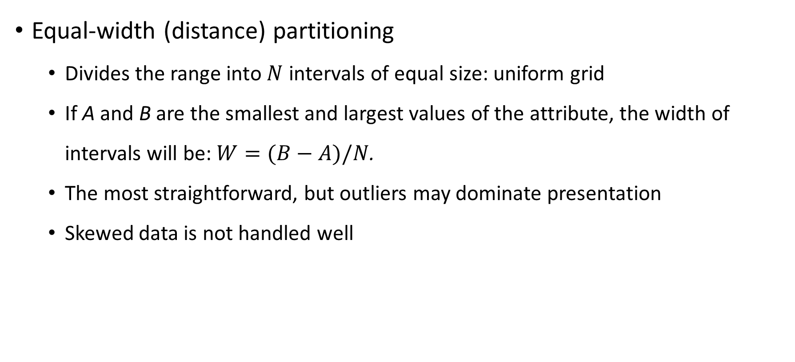
Discretization Methods – Binning
Equal-width (distance) partitioning
Divides the range into $N$ intervals of equal size: uniform grid
If A and B are the smallest and largest values of the attribute, the width of intervals will be: $W=(B−A)/N$.
The most straightforward, but outliers may dominate presentation
Skewed data is not handled well

Slide 43
Discretization Methods – Binning (Cont.)
Equal-depth (frequency) partitioning
Divides the range into N intervals, each containing approximately same number of samples
Good data scaling
Managing categorical attributes can be tricky

Slide 44
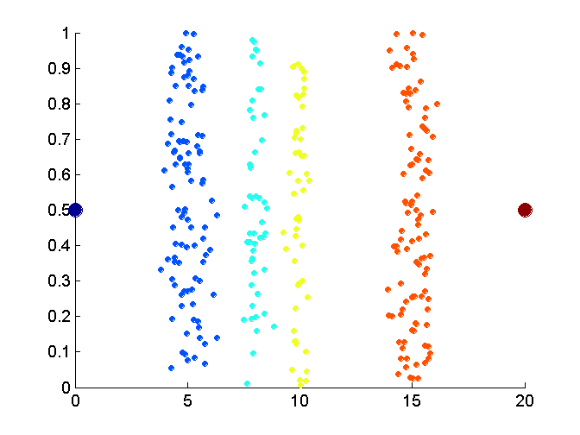
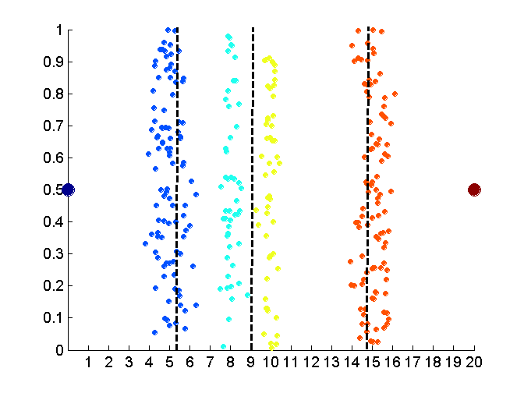
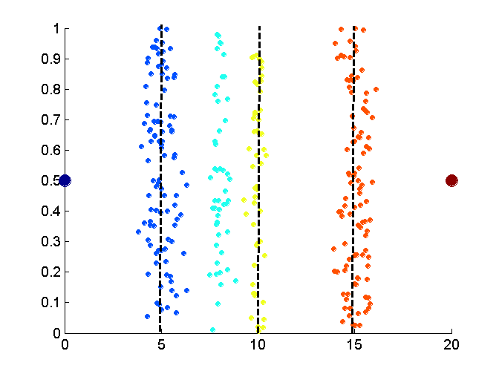
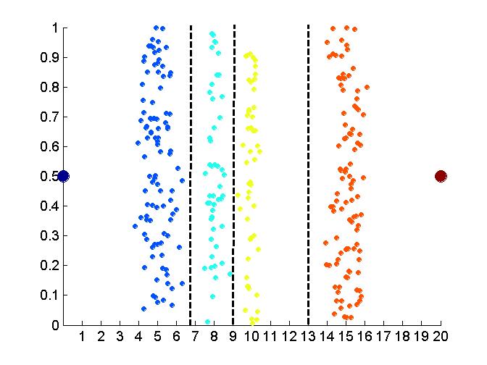
Discretization Methods – Binning (Cont.)
Data
Equal frequency (binning)
Equal width (binning)
Clustering-based discretization leads to better results (for this dataset)

Slide 45
Discretization Methods – Classification & Correlation
Classification (e.g., decision tree analysis)
Supervised: Given class labels, e.g., cancerous vs. benign
Using entropy to determine split point (discretization point)
Top-down, recursive split
Correlation analysis
Supervised: use class information
Bottom-up merge: find the best neighboring intervals (those having similar distributions of classes) to merge
Merge performed recursively, until a predefined stopping condition is satisfied

Slide 46
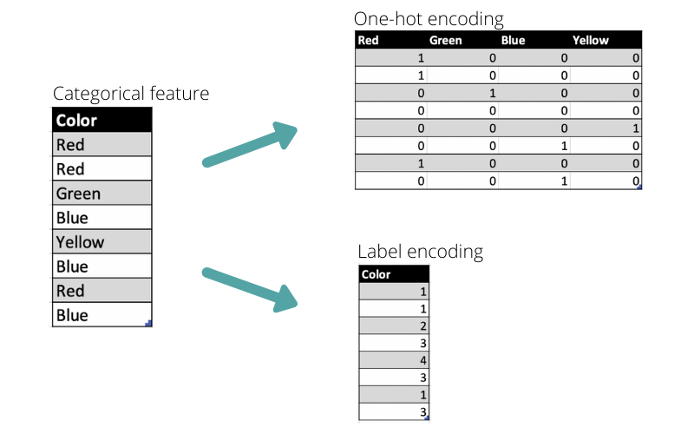
Other Data Preparation Techniques
Transforming categorical data into numerical data (See the Figure)
Label encoding
One-hot encoding
Data Enrichment
Augmentation
Join & Union
Data Validation
Check Permitted Characters
Find Type-Mismatched Data

Slide 47

Wrap-Up
Summarize what you learned
today in 2-minutes

Slide 48
Next lecture
Process Discovery
Conformance Checking

