Slide 1
Data Wrangling and Data Analysis
Data Visualization
Daniel L. Oberski & Erik-Jan van Kesteren
Department of Methodology & Statistics
Utrecht University
VERSION: 2025-09-23

Slide 2
Weekly schedule for M&S weeks (4—8)
Day | Time | What
Monday | 11:00 – 12:45 | Lecture
Monday | 13:15 – 15:00 | R Practical
Tuesday | 11:00 – 12:45 | Lecture
Tuesday | 13:15 – 15:00 | R Practical
Thursday | 11:00 – 12:45 | Lecture
Thursday | 13:15 – 15:00 | R Practical
Friday | 11:00 – 11:20 | Weekly exam

Slide 3










Social & Behavioural Science team
Erik-Jan
e.vankesteren1@uu.nl
Ayoub
a.bagheri@uu.nl
Daniel
d.l.oberski@uu.nl
Timo
timo_kuil@hotmail.com
Hanne
h.i.oberman@uu.nl
Elena
e.candellone@uu.nl
Jelle
j.j.teijema@uu.nl
Özgür
o.togay@uu.nl
Mahdi
m.shafieekamalabad@uu.nl
Thom
t.b.volker@uu.nl

Slide 4
This week
Data preparation 1
Data preparation 2
Data visualization principles & Grammar of graphics

Slide 5

Reading materials for this week
Chapters from R for Data Science (R4DS), open access book at:
https://r4ds.had.co.nz
Chapters: 1,3,9,10.

Slide 6
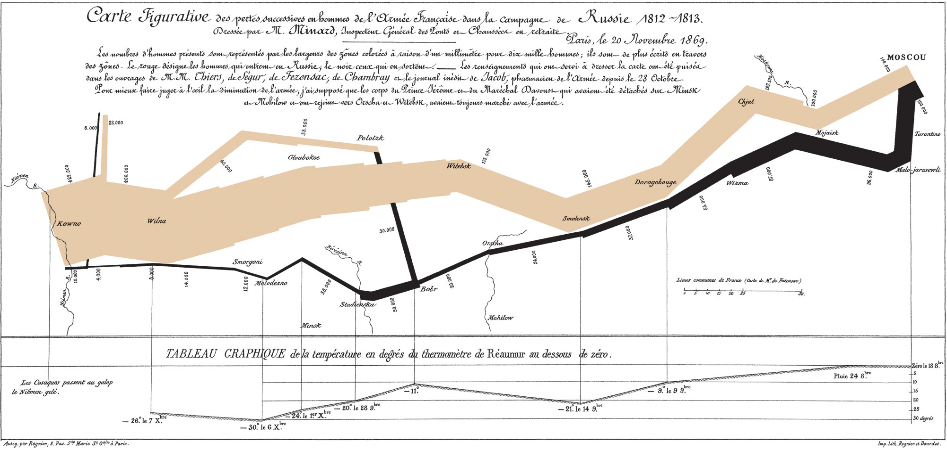

Slide 7
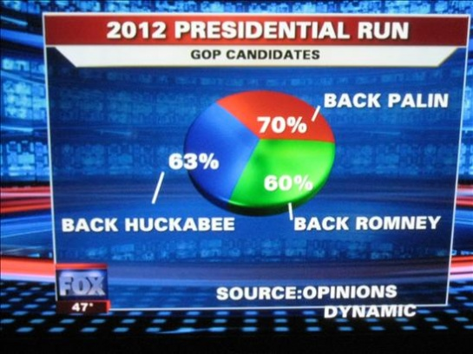

Slide 8
Today: visualization principles

Slide 9
Data visualization
For exploration, data analysis ←
For communication
For entertainment

Slide 10
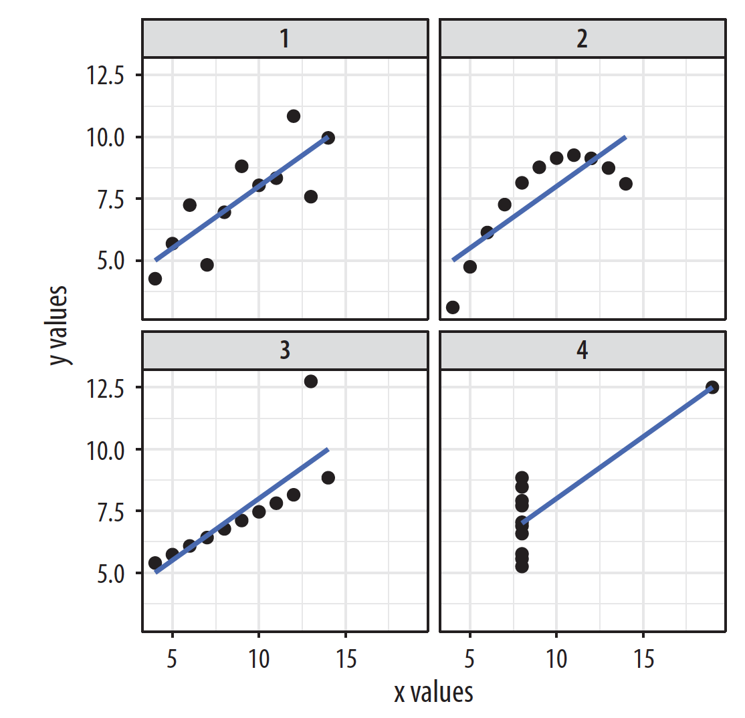
Anscombe’s quartet
Source: Healy (2019)

Slide 11
Source: Healy (2019)

Slide 12
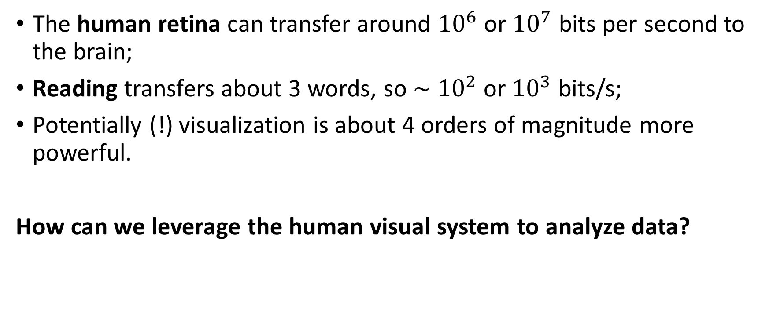
Graphics for data analysis
The human retina can transfer around ${10}^{6}$ or ${10}^{7}$ bits per second to the brain;
Reading transfers about 3 words, so ∼ ${10}^{2}$ or ${10}^{3}$ bits/s;
Potentially (!) visualization is about 4 orders of magnitude more powerful.
How can we leverage the human visual system to analyze data?

Slide 13
Plotting the right thing
Most common problems:
(Accidentally) misrepresenting what is being plotted
Omitting baselines

Slide 14
Source: Healy (2019)

Slide 15
Source: Healy (2019)

Slide 16
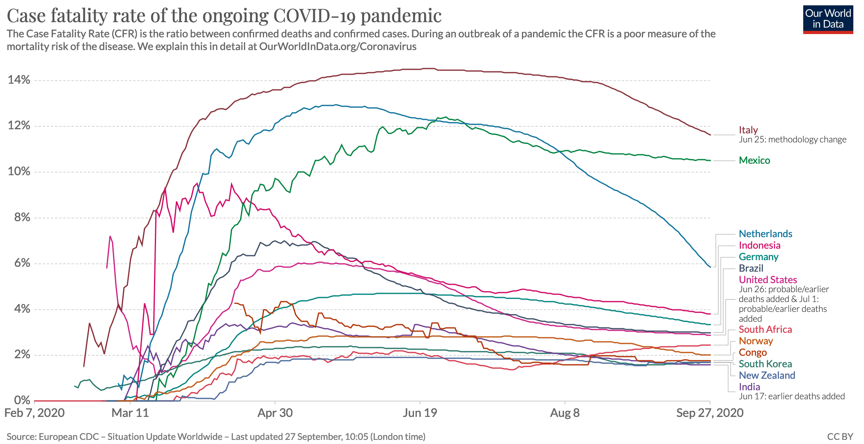

Slide 17
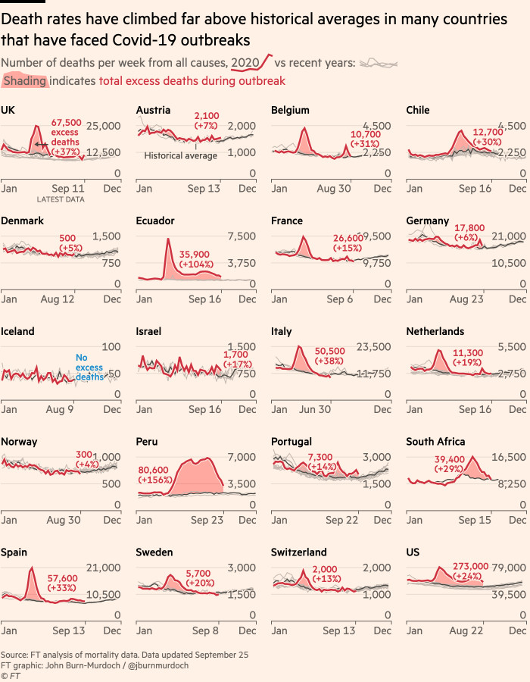
Good example (FT)
https://www.ft.com/content/a2901ce8-5eb7-4633-b89c-cbdf5b386938

Slide 18
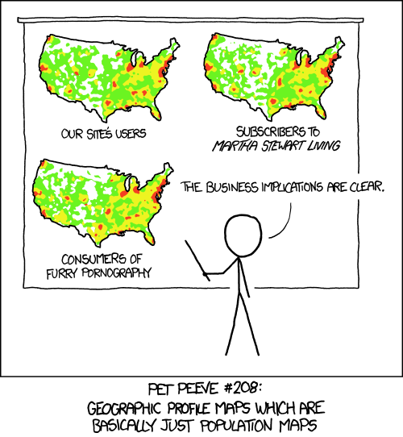

Slide 19
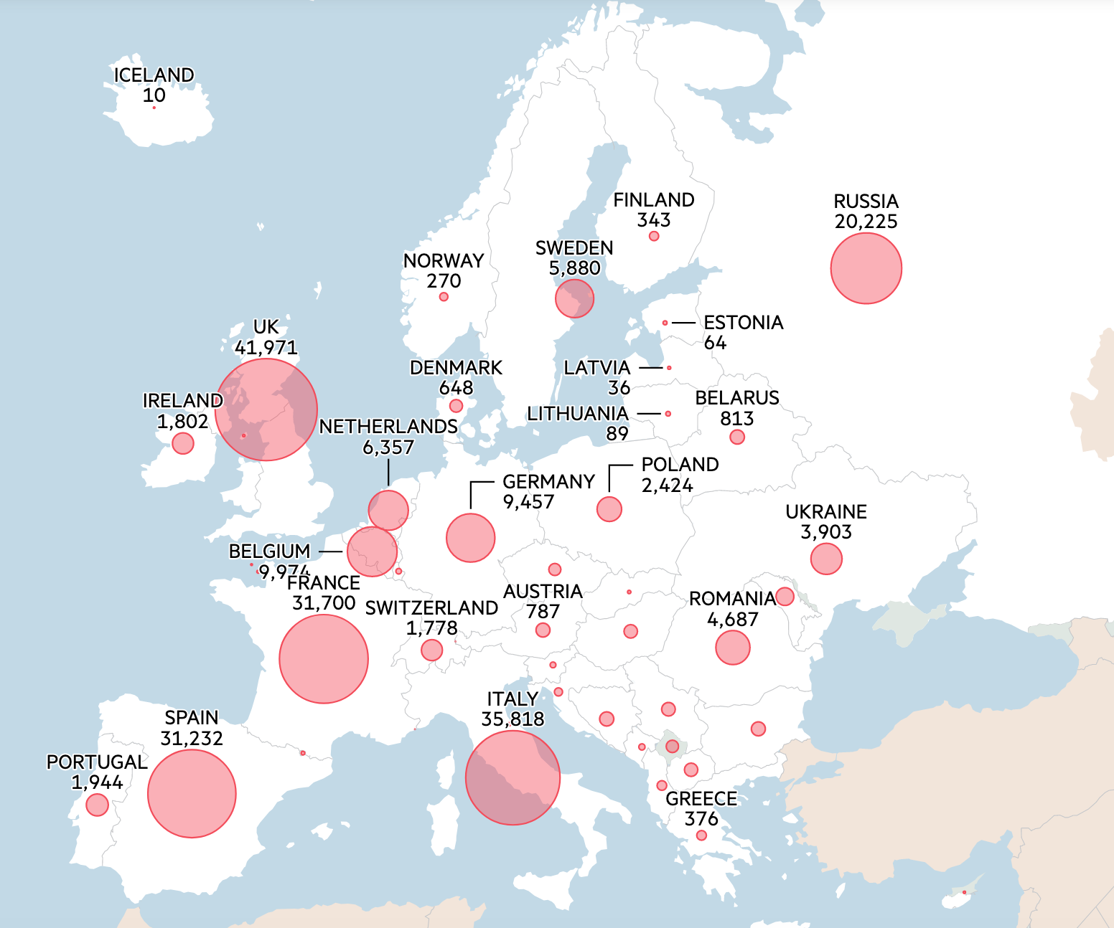
Missing a baseline…?
https://www.ft.com/content/a2901ce8-5eb7-4633-b89c-cbdf5b386938

Slide 20

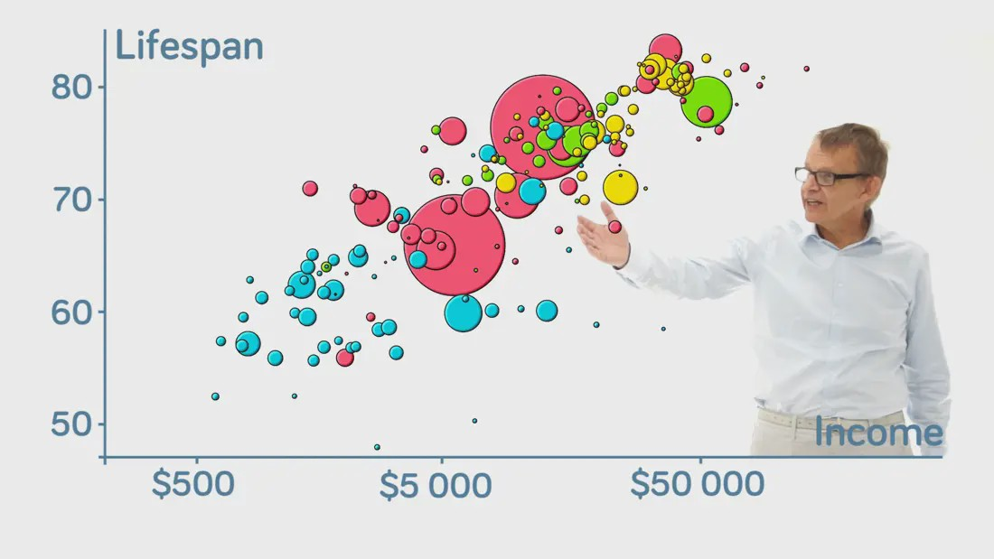

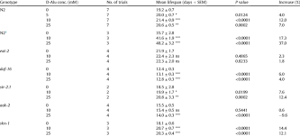
Data
Picture
Brain

Slide 21
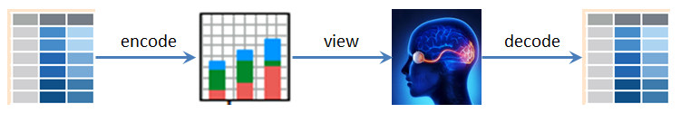
Source: Michael Friendly, http://euclid.psych.yorku.ca/www/psy6135/#Graphical_Perception

Slide 22
Making pictures that help analyze data
We’d like to make, not just any kind of picture or graph, but one that transfers some part of the data to our brain
How do we make sure that the graphs we make transfer:
The right part of the data, and;
As much of it as possible?
This is where the “grammar of graphics” comes in.
Goal is to specify how data map to picture, so the correct type and largest amount possible is transferred

Slide 23
Grammar of graphics (Wickham version)
http://r4ds.had.co.nz/visualize.html
Map raw data to following elements:
Aesthetics (position, shape, color, ...)
Geometric objects (points, lines, bars, ...)
Scales (continuous, discrete, ...)
Facets (small multiples)
Additionally, can apply:
Statistical transformation (identity, binning, median, ...)
Coordinate system (Cartesian, polar, parallel, ...

Slide 24
Grammar of graphics (Wickham version)
In R, grammar of graphics is implemented in ggplot, a function in the ggplot2 package.

Slide 25
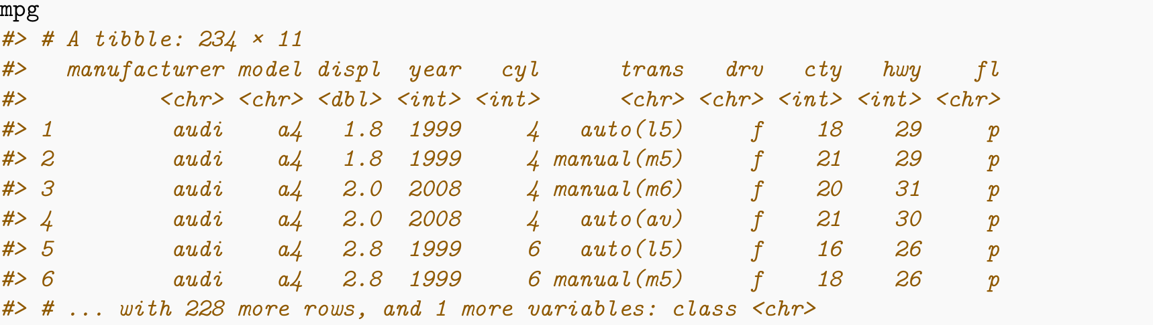
Example data set: cars

Slide 26
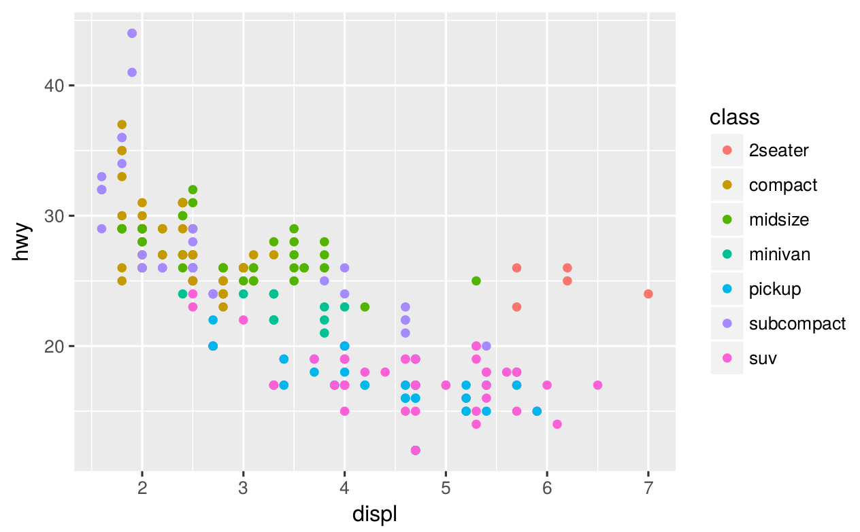
ggplot(data = mpg) + geom_point(mapping = aes(x = displ, y = hwy, color = class))

Slide 27
ggplot(data = mpg) + geom_point(mapping = aes(x = displ, y = hwy, color = class))
Aesthetics:
x-position mapped to engine size
y-position mapped to fuel efficiency
color mapped to car type
Geometric objects: points
Transformation: identity
Scales: continuous, cartesian coordinates
No facets

Slide 28
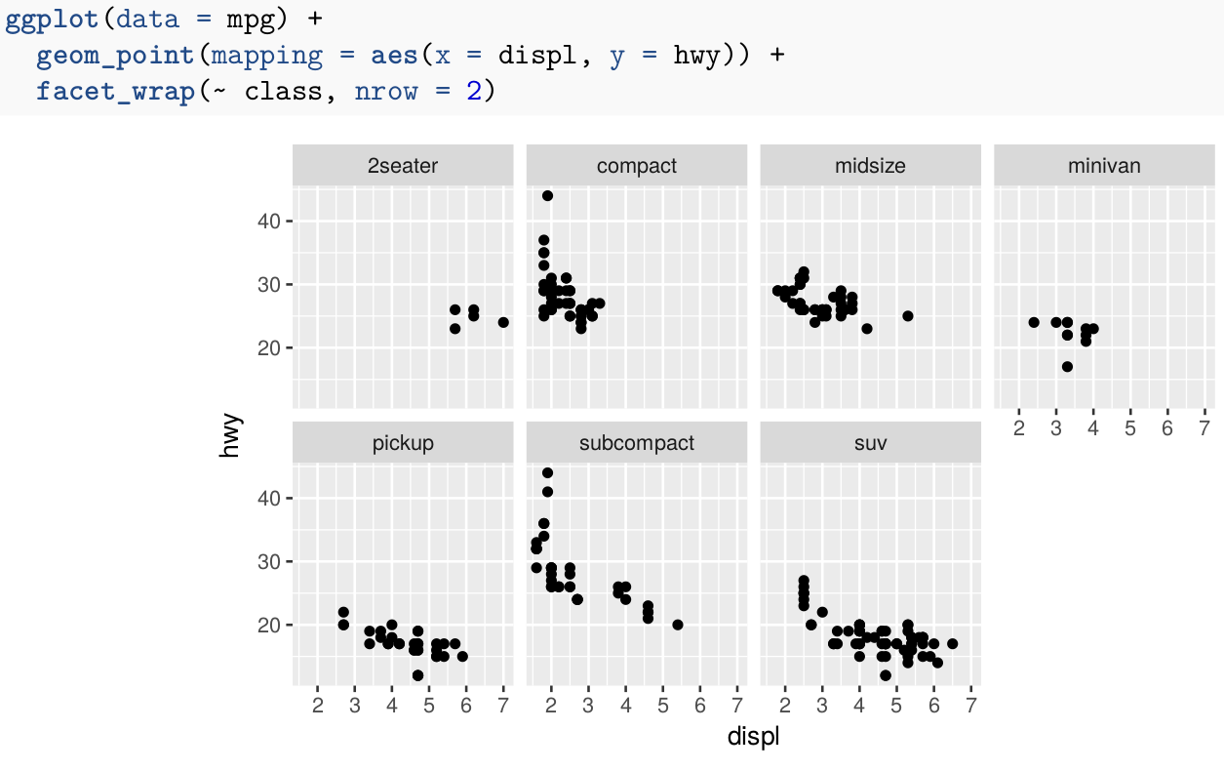
Facets

Slide 29
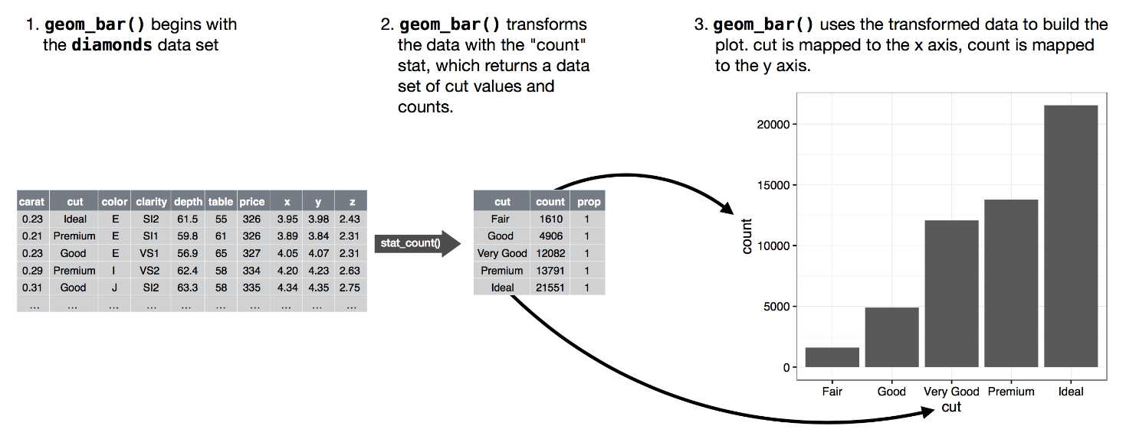
Transformation (stats)

Slide 30
What should I choose?

Slide 31
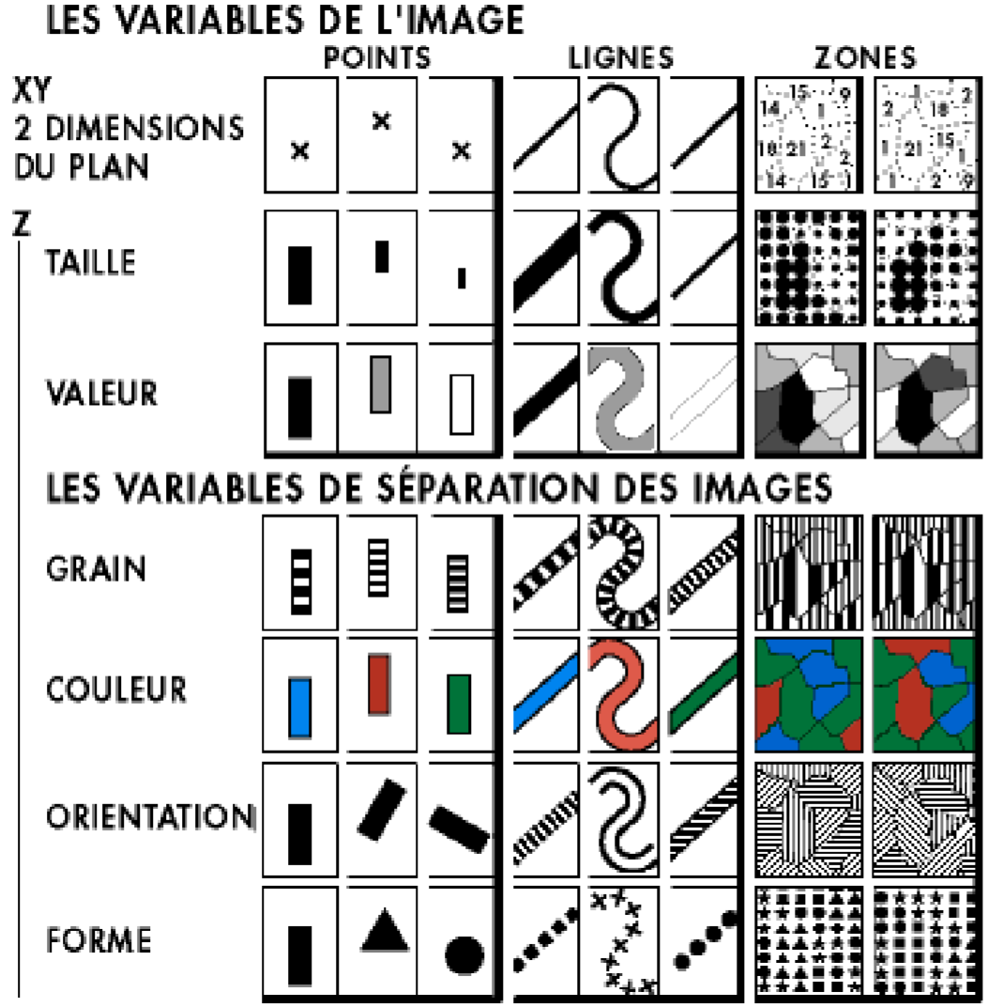

Slide 32
Mackinlay’s ranking of encodings
Quantitative | Ordinal | Nominal
Position | Position | Position
Length | Density | Color hue
Angle | Color saturation | Texture
Slope | Color Hue | Connection
Area | Texture | Containment
Volume | Connection | Density
Density | Containment | Color saturation
Color saturation | Length | Shape
Color hue | Angle | Length
Texture | Slope | Angle
Connection | Area | Slope
Containment | Volume | Area
Shape | Shape | Volume

Slide 33
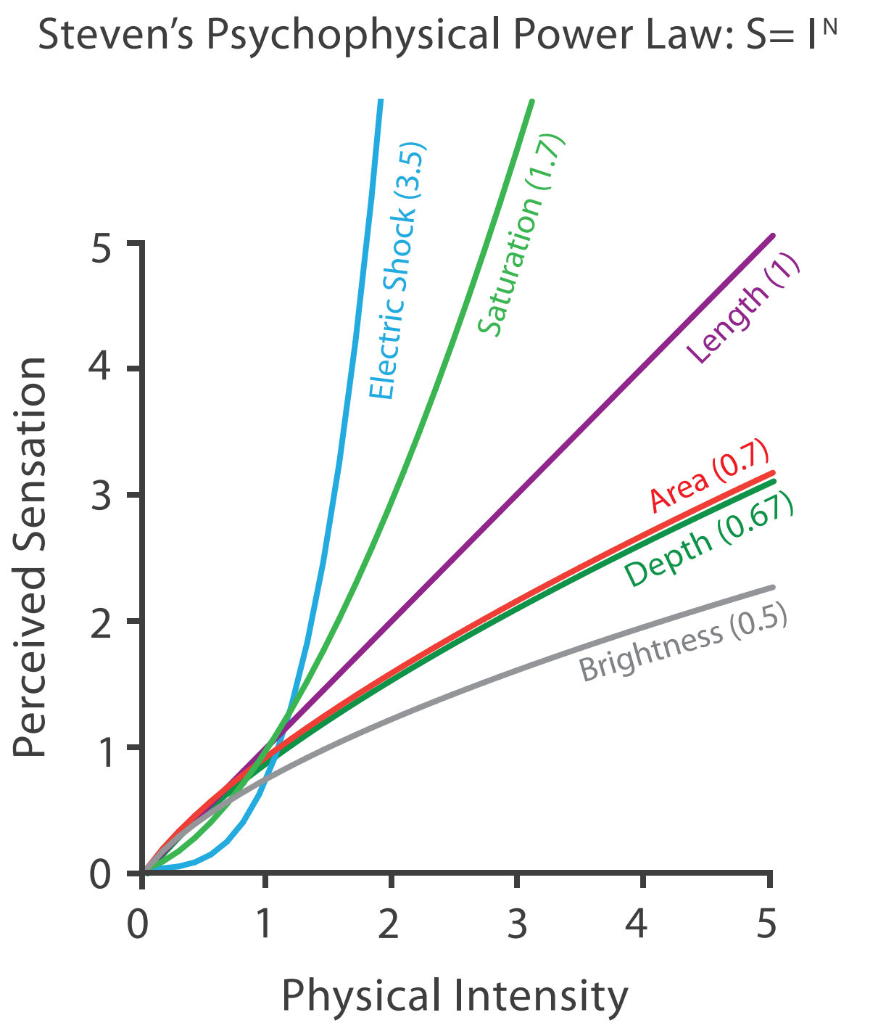
Source: Tamara Munzer (2014). Visualization Analysis and Design.

Slide 34
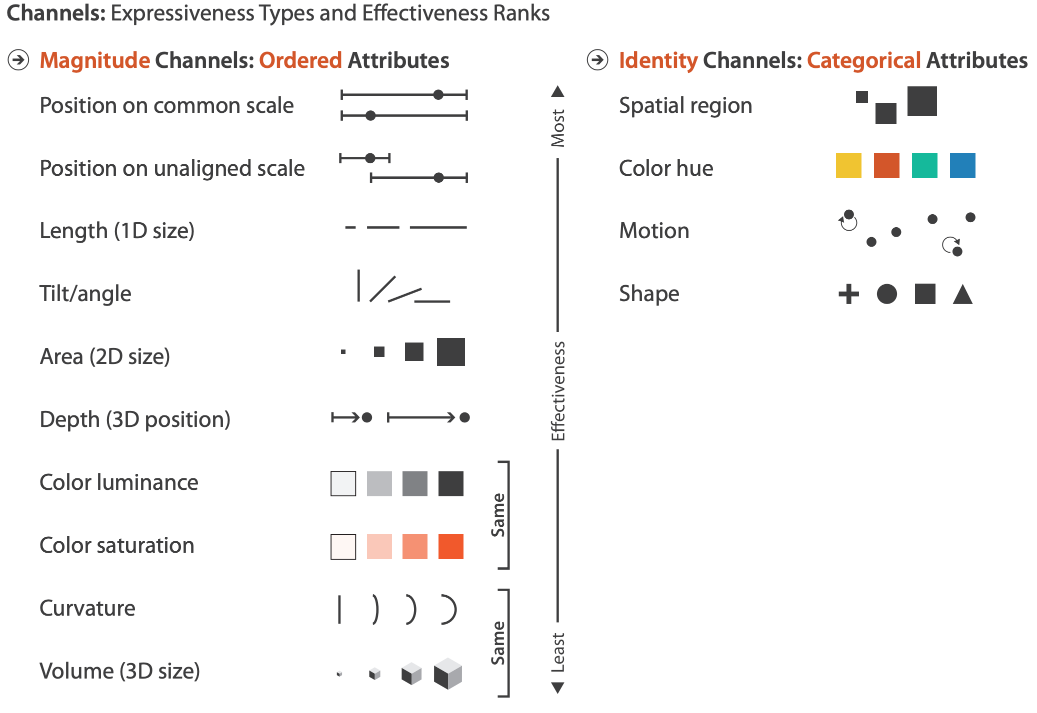
Source: Tamara Munzer (2014).
Visualization Analysis and Design.

Slide 35
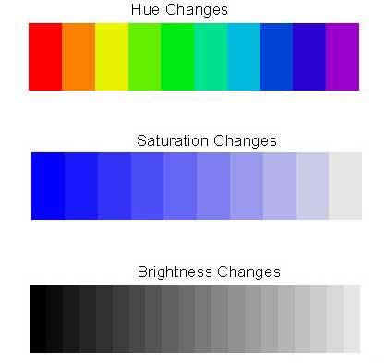
Color: hue-saturation-brightness (HSB)

Slide 36
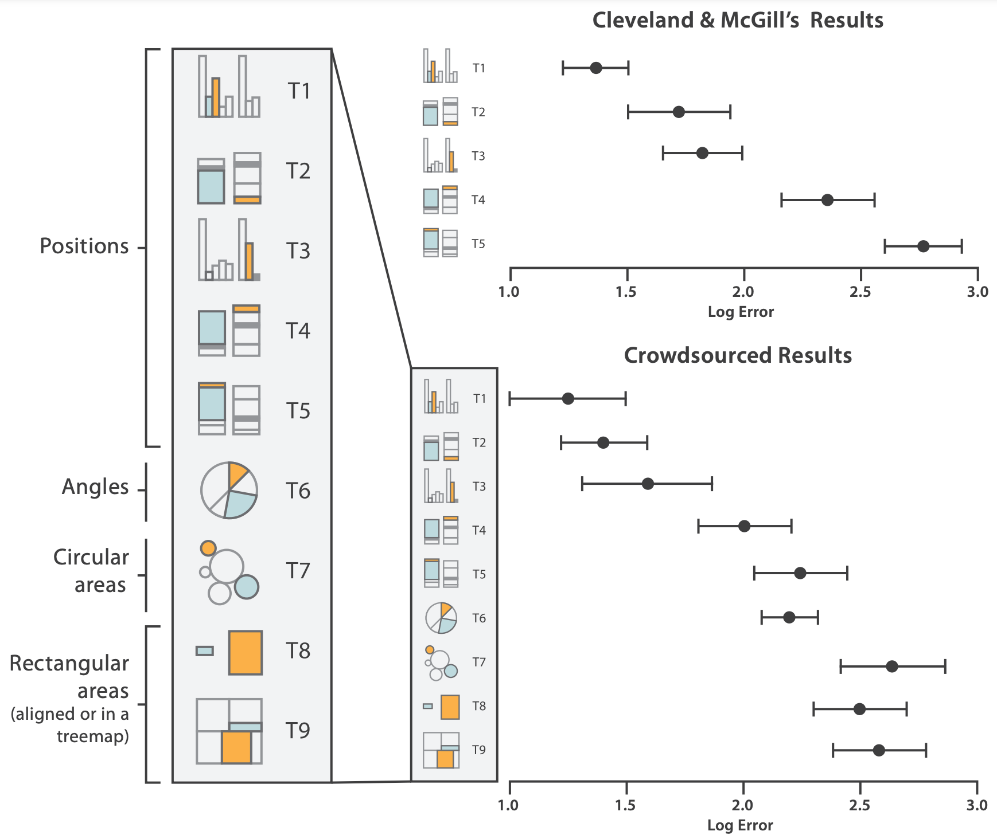
Source: Tamara Munzer (2014).
Visualization Analysis and Design.

Slide 37
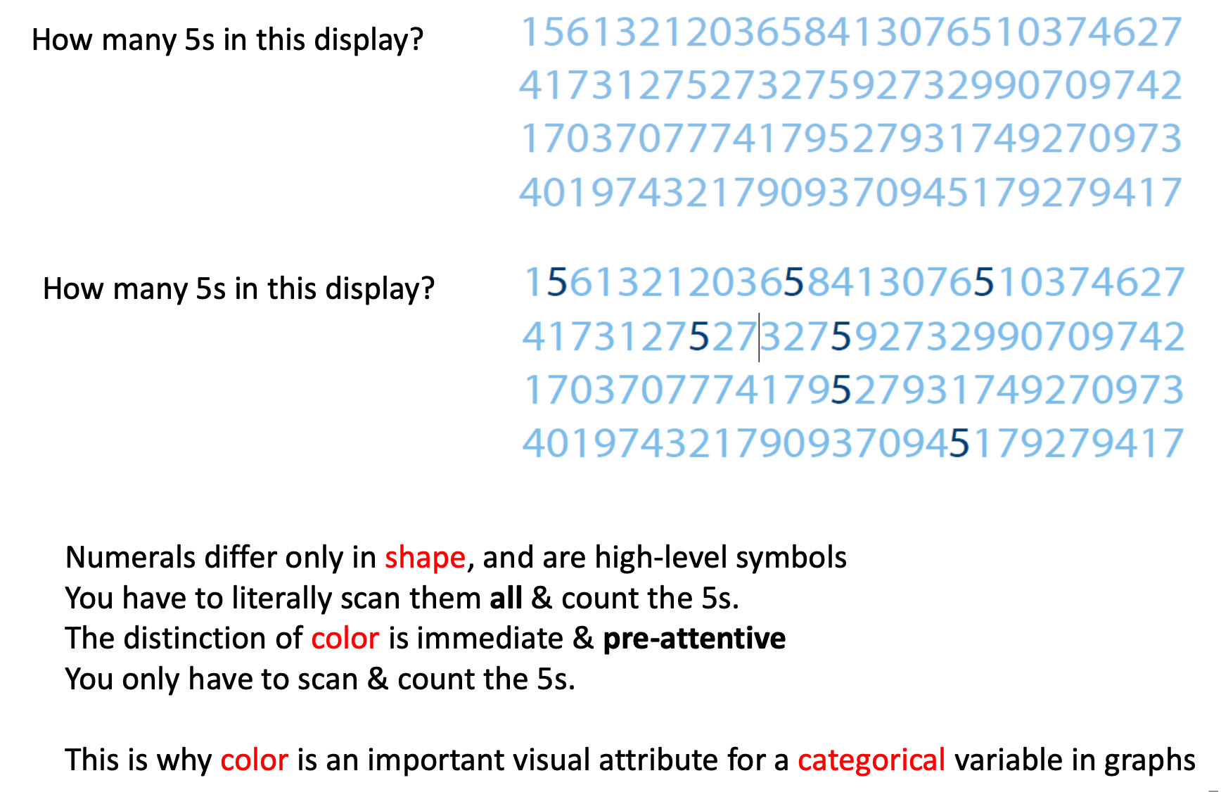
Source: Michael Friendly, http://euclid.psych.yorku.ca/www/psy6135/#Graphical_Perception

Slide 38
Gestalt principles of relatedness
Proximity: Things that are spatially near to one another seem to be related.
Similarity: Things that look alike seem to be related.
Connection: Things that are visually tied to one another seem to be related.
Continuity: Partially hidden objects are completed into familiar shapes.
Closure: Incomplete shapes are perceived as complete.
Figure and ground: Visual elements are taken to be either in the foreground or in the background.
Common fate: Elements sharing a direction of movement are perceived as a unit.

Slide 39
Source: Healy (2019)

Slide 40

Some (distilled) principles from Tufte
Ask how data maps to perception
Ask which comparisons you want, guide eye to those
Maximize data-to-ink ratio
Present more data (without losing interpretability)
Use levels of detail
(Remember narrative)

Slide 41
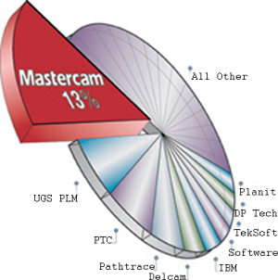

Slide 42
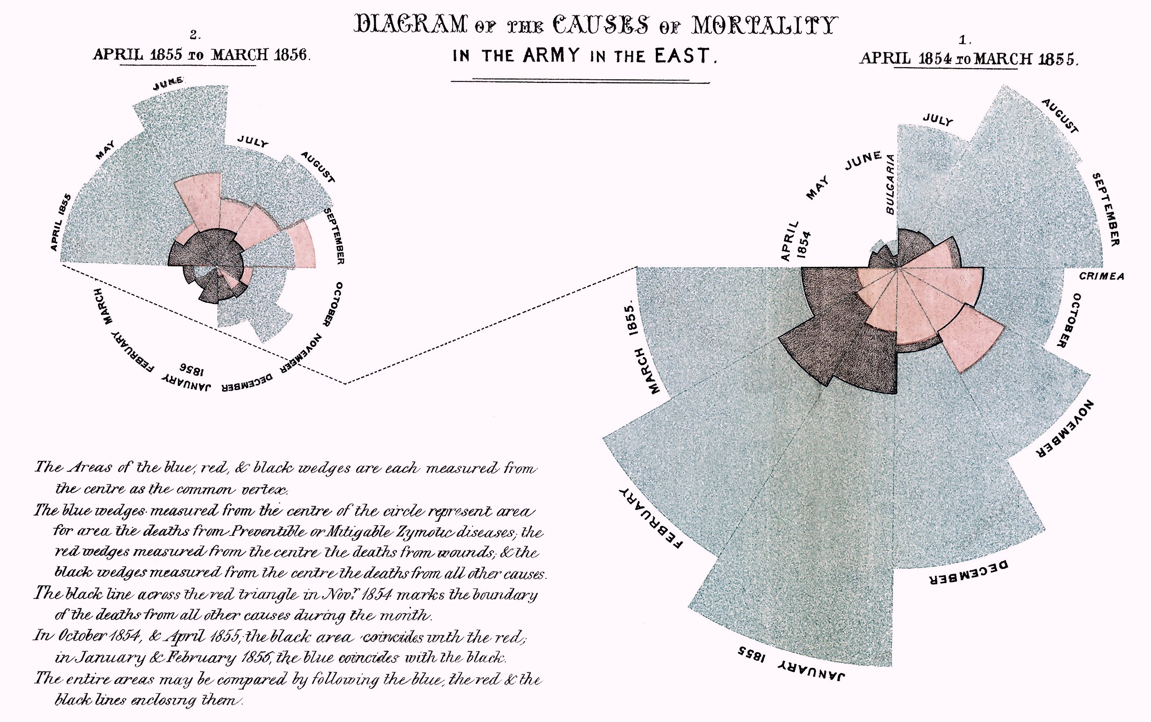
Nightingale Rose / Coxcomb chart

Slide 43
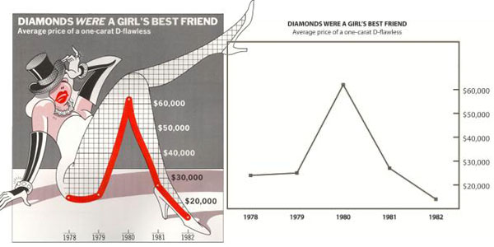

Slide 44
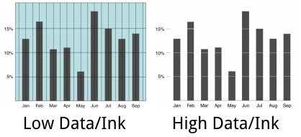

Slide 45
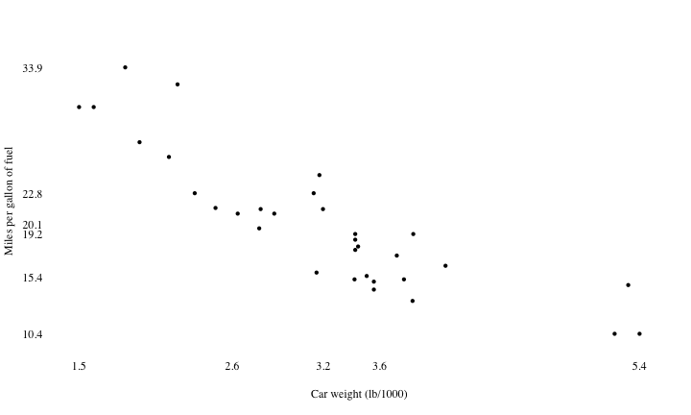

Slide 46
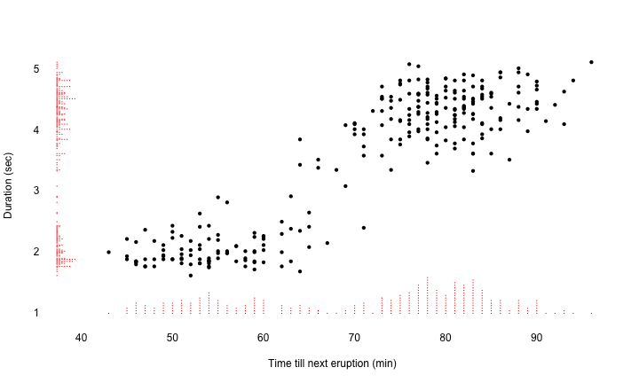

Slide 47
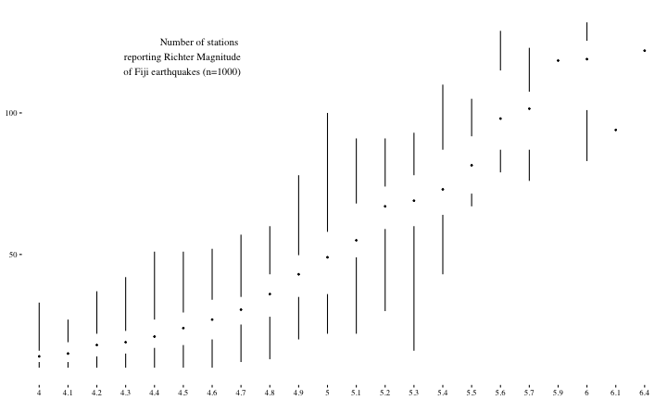
ggplot(quakes, aes(factor(mag), stations)) + theme_tufte() + geom_tufteboxplot(outlier.colour = "transparent") + theme(axis.title = element_blank())

Slide 48
Tufte wisdom
Tufte’s principles are more oriented to communication and can be taken too far
Better data/ink → display more information without overload;
Thinking about perception can help you choose better geoms, aesthetics.

Slide 49
Some practice

Slide 50
Answer these questions:
Are we plotting the right thing?
What are: aesthetics, geom, scale, facets, transformation, coordinate system
How is data/ink?
Is perception considered optimally?
Can you think of questions you can’t answer from this plot which are in the data?

Slide 51
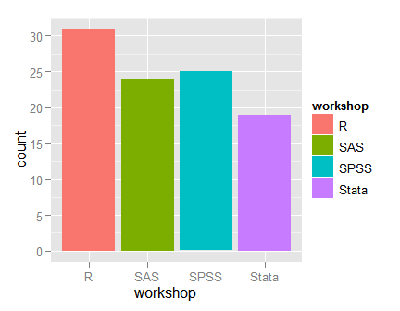

Slide 52
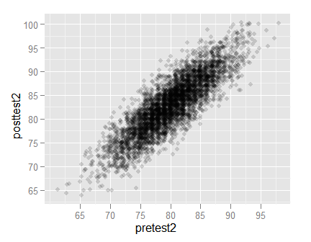

Slide 53
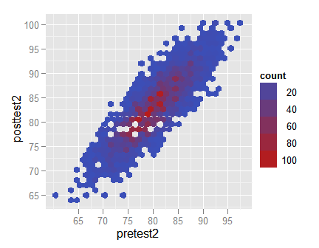

Slide 54
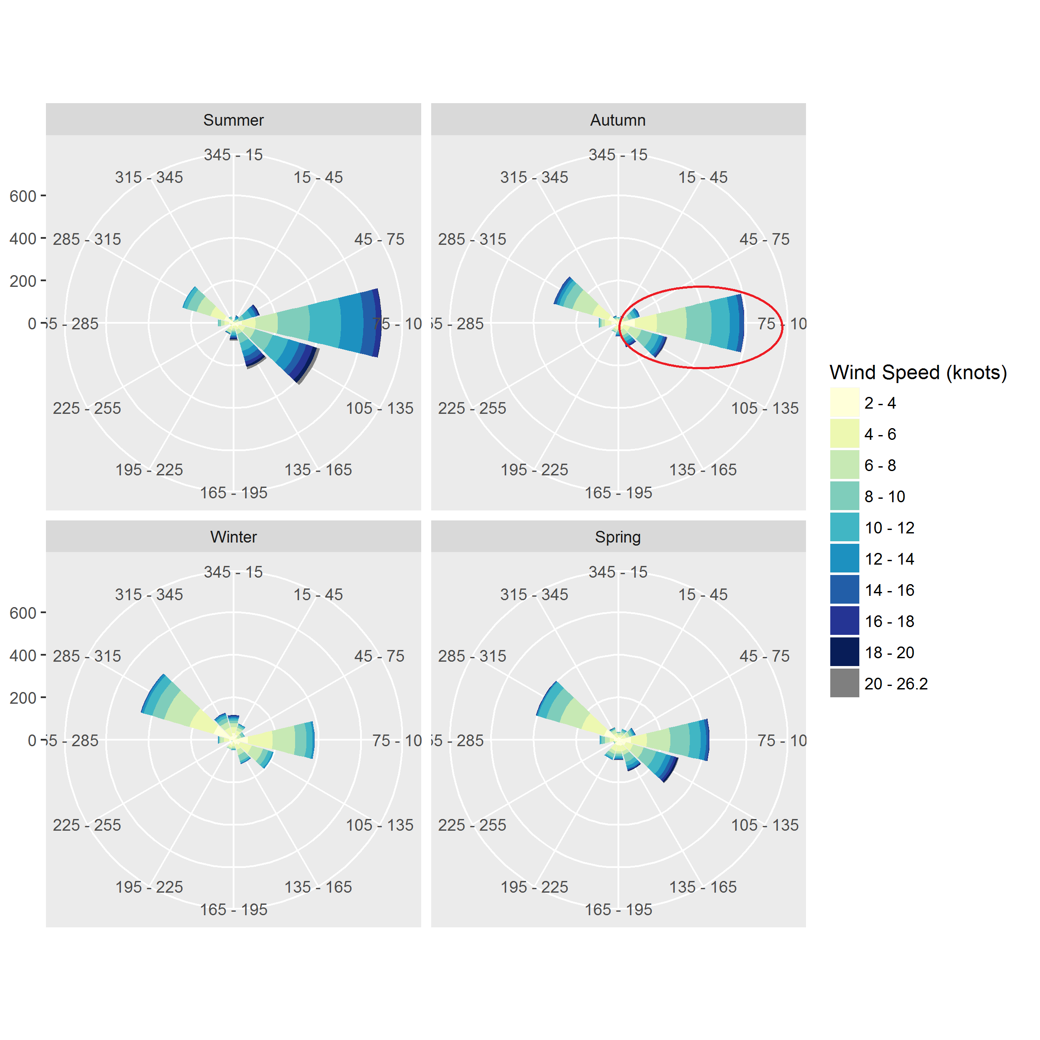

Slide 55
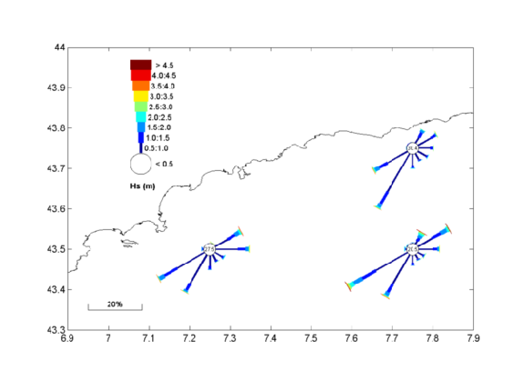

Slide 56
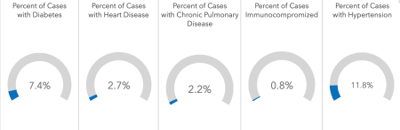
Arkansas COVID-19 dashboard

Slide 57
Conclusion

Slide 58
Conclusion
Data visualization is data analysis + psychology;
Sticking to basic principles helps:
Map data to aesthetics, geoms, scales, facets;
Perception research guides choices;
Which comparisons do I want?
Maximize data-ink (within reason).
Some standard recipes (e.g. “barplot”, “histogram”, “line graph”), but pros do not need the cookbook…
Don’t believe everything you hear (“do’s and don’ts”)

