Slide 1
Data Science & Society
Data Preparation
Hakim Qahtan
Department of Information and Computing Sciences
Utrecht University

Slide 2
Topics for Today
Introduction
Quality of data
Data cleaning
Data transformation
Data Integration
Data reduction

Slide 3
Reading Material
Chapters 3, 12 of the Data Mining: Concepts and Techniques Book

Slide 4

© Yannis Velegrakis, UU

Slide 5
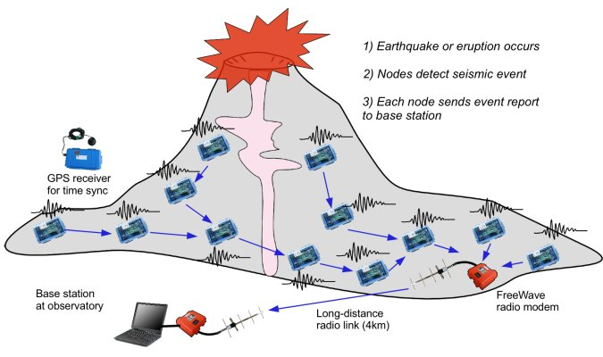
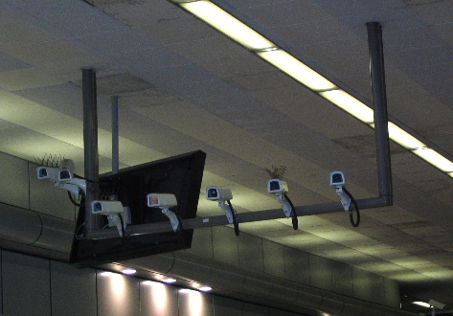
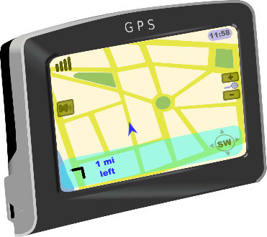
We Collect Huge Amount of Data
Data Streams
Merck (a pharma company) has:
~ 4000 Oracle databases
Plus a data lake
Plus untold files
Plus untold spreadsheets
Plus they are interested in public data from the web
Static Data

Slide 6
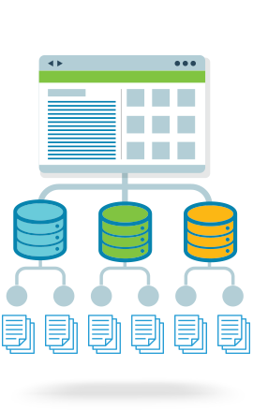

Extracting Value from the Data
Analytics

Slide 7
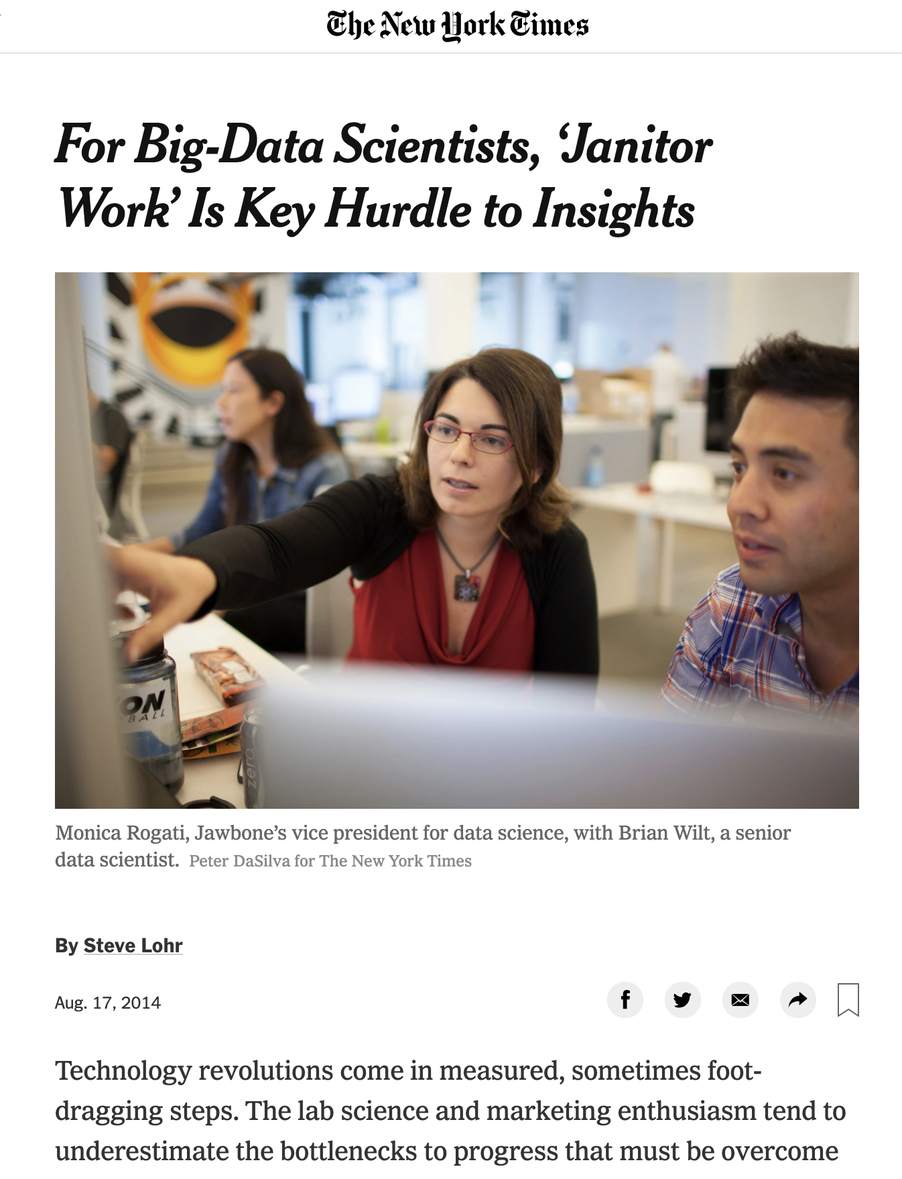
© Yannis Velegrakis, UU

Slide 8










The Data Processing Pipeline
Acquisition
&
Storage
Aggregation
Data
Analysis
Integration
Exploration
Querying
Modeling &
Annotation
&
Cleaning
Data Curation
Data scientists, according to interviews and expert estimates, spend 50% to 80% of their time mired in the mundane labor of collecting and preparing unruly digital data, before it can be explored for useful nuggets
(New York Times)
© Yannis Velegrakis, UU

Slide 9
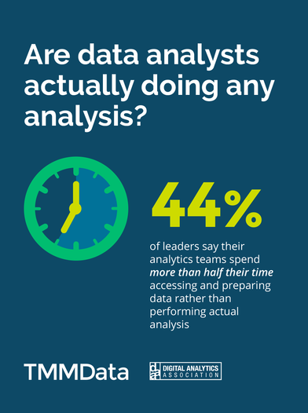
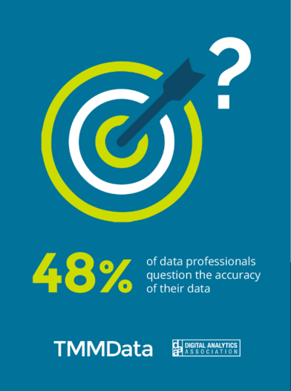
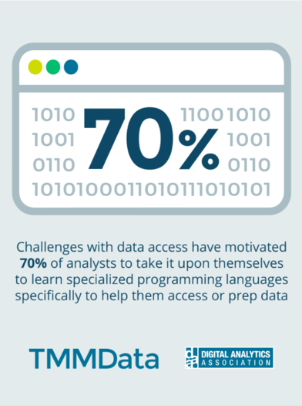
Why data preparation?

Slide 10
Why data preparation?
What data scientists spend the most of their time doing?
60%
19%
9%
4%
5%
3%

Slide 11
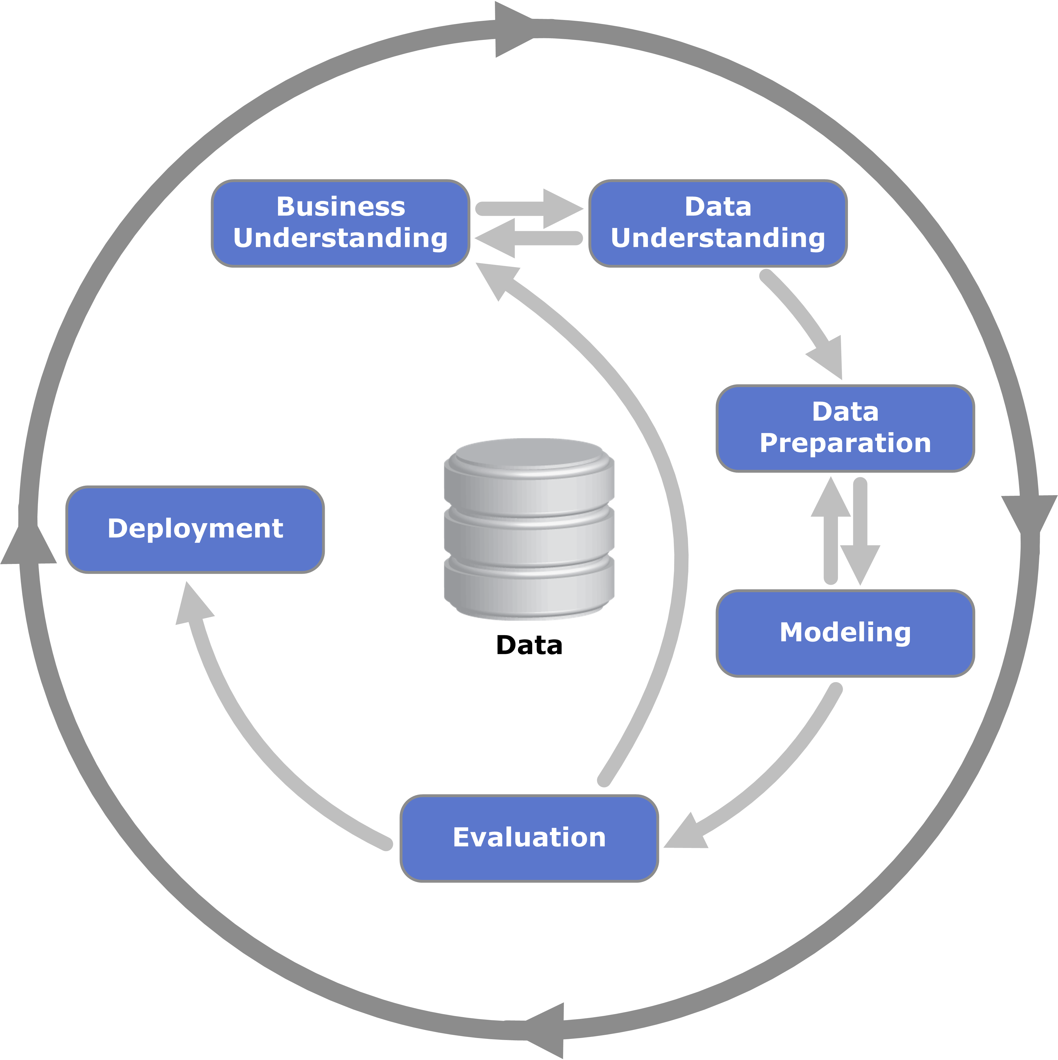
CRISP-DM

Slide 12
Data preparation: An Overview
Data preparation: the process of cleaning and transforming raw data prior to processing and analysis.
Involves the following tasks:
Checking the data quality and applying correction techniques
Reformatting data
Combining datasets for the purpose of enrichment

Slide 13
Data Quality

Slide 14
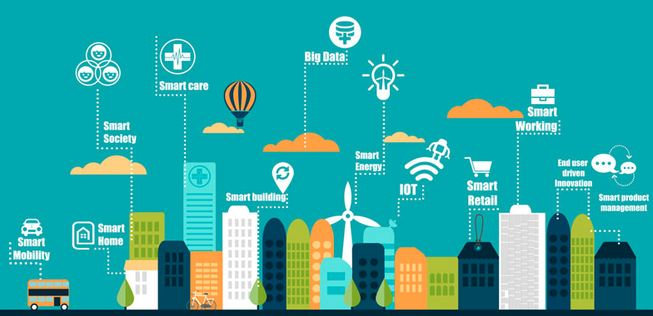
Data Quality Issues
Noise
Missing Values
Duplicate Data
Outdated Values
Outliers
Inconsistent Values
Unreliable sources
For any data retrieval or data analytic task,
it is critically important to know the quality of your data
For the US alone, poor data quality costs around US economy $3 trillions a year (2016).

Slide 15
Data Quality
Data quality: checking the data from multiple perspectives
Accuracy
The data was recorded correctly.
Completeness
All relevant data was recorded.
Uniqueness
Entities are recorded once.
Timeliness
The data is kept up to date.
Special problems in federated data: time consistency.
Consistency
The data agrees with itself.

Slide 16
Example
T. Das|97336o8237|24.95|Y|-|0.0|1000
Ted J.|973-360-8997|2000|N|M|NY|1000
Can we interpret the data?
What do the fields mean?
What is the key? The measures?
Data glitches
Typos, multiple formats, missing / default values
Metadata and domain expertise
Field three is Revenue. In dollars or cents?

Slide 17
Data Quality (Cont.)
Problems in previous definition of data quality:
Unmeasurable
Accuracy and completeness are extremely difficult, perhaps impossible to measure.
Context independent
No accounting for what is important. E.g., if you are computing aggregates, you can tolerate a lot of inaccuracies.
Incomplete
What about interpretability, accessibility, metadata, analysis, etc.
Vague
The previous definition provide no guidance towards practical improvements of the data.

Slide 18
Data Quality (Cont.)
Sources of problems:
Manual entry
No uniform standards for content and formats
Parallel data entry (duplicates)
Approximations, surrogates – SW/HW constraints
Measurement errors.
We need a definition of data quality which
Reflects the use of the data
Leads to improvements in processes
Measurable (we can define metrics)

Slide 19
Examples of Data Quality metrics
Conformance to schema
Evaluate constraints on a snapshot.
Conformance to business rules
Evaluate constraints on changes in the database.
Accuracy
Perform inventory (expensive) or use proxy (track complaints). Audit samples?
Glitches in analysis
Successful completion of end-to-end process

Slide 20
Data Cleaning

Slide 21
Data Cleaning
Data in the Real World Is Dirty: Lots of potentially incorrect data, e.g., instrument faulty, human or computer error, transmission error
Incomplete: lacking attribute values, lacking certain attributes of interest, or containing only aggregate data
e.g., Occupation=“ ” (missing data)
Noisy: containing noise, errors, or outliers
e.g., Salary=“−10” (an error)

Slide 22
Data Cleaning (Cont.)
Data in the real world is dirty
Inconsistent: containing discrepancies in codes or names, e.g.,
Age=“42”, Birthday=“03/07/2010”
Was rating “1, 2, 3”, now rating “A, B, C”
Discrepancy between duplicate records
Intentional (e.g., disguised missing data)
Jan. 1 as everyone’s birthday?

Slide 23
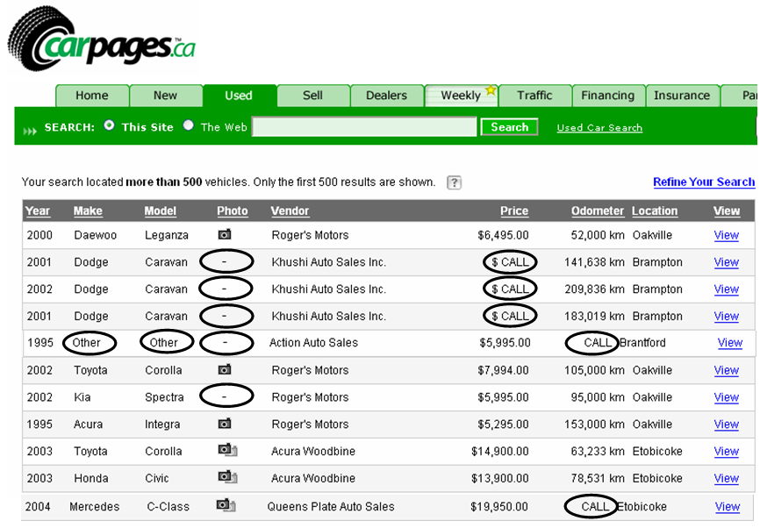
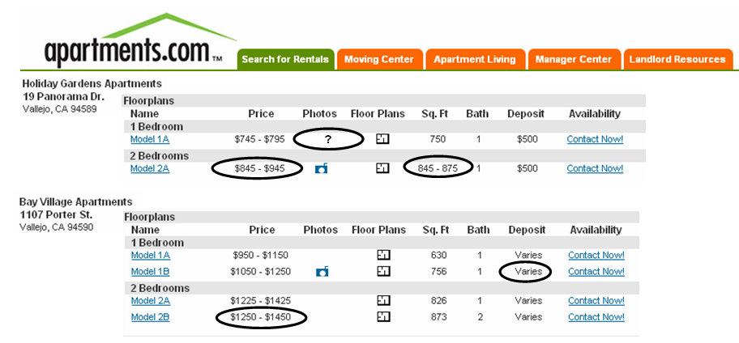
Real data is full of N/A or nulls, special values (99999) etc.

Slide 24
Data Cleaning
1- Incomplete Data

Slide 25
Incomplete (Missing) Data
Data is not always available
E.g., many tuples have no recorded value for several attributes, such as customer income in sales data
Missing data may be due to
Equipment malfunction
Inconsistent with other recorded data and thus deleted
Data not entered due to misunderstanding
Certain data values may not be considered important at the time of entry
Missing data may need to be inferred

Slide 26
Handling the Missing Data
Ignore the tuple: usually done when class label is missing (for classification problem) – not effective when the % of missing values is large
Fill in the missing value:
Manually: tedious + infeasible?
Automatically (data imputation) with
A global constant : e.g., “unknown”, a new class?!
The attribute mean
The attribute mean for all samples belonging to the same class: smarter
For time series, we may use the value arrived before/after the missing value

Slide 27
Data Cleaning
2- Noisy Data

Slide 28
Noisy Data
Noise: random error or variance in a measured variable
Incorrect attribute values may be due to
Faulty data collection instruments
Data entry problems
Data transmission problems
Technology limitation
Inconsistency in naming convention

Slide 29
Handling the Noisy Data
Binning
First sort data and partition into (equal-frequency) bins
Then one can smooth by bin means, smooth by bin median, smooth by bin boundaries, etc.
Smoothing by bin means : In smoothing by bin means, each value in a bin is replaced by the mean value of the bin.
Smoothing by bin median : In this method each bin value is replaced by its bin median value.
Smoothing by bin boundary: In smoothing by bin boundaries, the minimum and maximum values in a given bin are identified as the bin boundaries. Each bin value is then replaced by the closest boundary value.

Slide 30
Handling the Noisy Data (Cont.)
Regression
Smooth by fitting the data into regression functions
Clustering
Detect and remove values that do not belong to any of the clusters
Combined computer and human inspection
Detect suspicious values and check by human (e.g., deal with possible outliers)

Slide 31
Binning methods for data smoothing
Sorted data for grades (out of 50):
4, 8, 9, 11, 15, 21, 21, 24, 24, 25,26, 28, 29, 34, 48
Partition into equal-frequency (equidepth) bins:
- Bin 1: 4, 8, 9, 11, 15
- Bin 2: 21, 21, 24, 24, 25
- Bin 3: 26, 28, 29, 34, 48
Smoothing by bin means:
- Bin 1: 9.4, 9.4, 9.4, 9.4, 9.4
- Bin 2: 23, 23, 23, 23, 23
- Bin 3: 33, 33, 33, 33, 33
Smoothing by bin boundaries:
- Bin 1: 4, 4, 4, 15, 15
- Bin 2: 21, 21, 25, 25, 25
- Bin 3: 26, 26, 26, 26, 48

Slide 32
Data Cleaning
3- Outliers

Slide 33
Outliers
Consider the data points
3, 4, 7, 4, 8, 3, 9, 5, 7, 6, 92
“92” is suspicious - an outlier
Outliers are data or model glitches
Definition of Hawkins [Hawkins 1980]:
“An outlier is an observation which deviates so much from the other observations as to arouse suspicions that it was generated by a different mechanism”

Slide 34

Outliers (Cont.)
Outliers are interesting: they violate the mechanism that generates the normal data
Outlier detection vs. novelty detection: early stage, outlier; but later merged into the model
Applications:
Credit card fraud detection
Telecom fraud detection
Customer segmentation
Medical analysis
$$O$$

Slide 35


Types of Outliers
Three kinds: global, contextual and collective outliers
Global outlier (or point anomaly)
Object is a global outlier ($o_{g}$) if it significantly deviates from the rest of the data set
Ex. Intrusion detection in computer networks
Issue: Find an appropriate measurement of deviation
Global Outliers
$$O$$

Slide 36
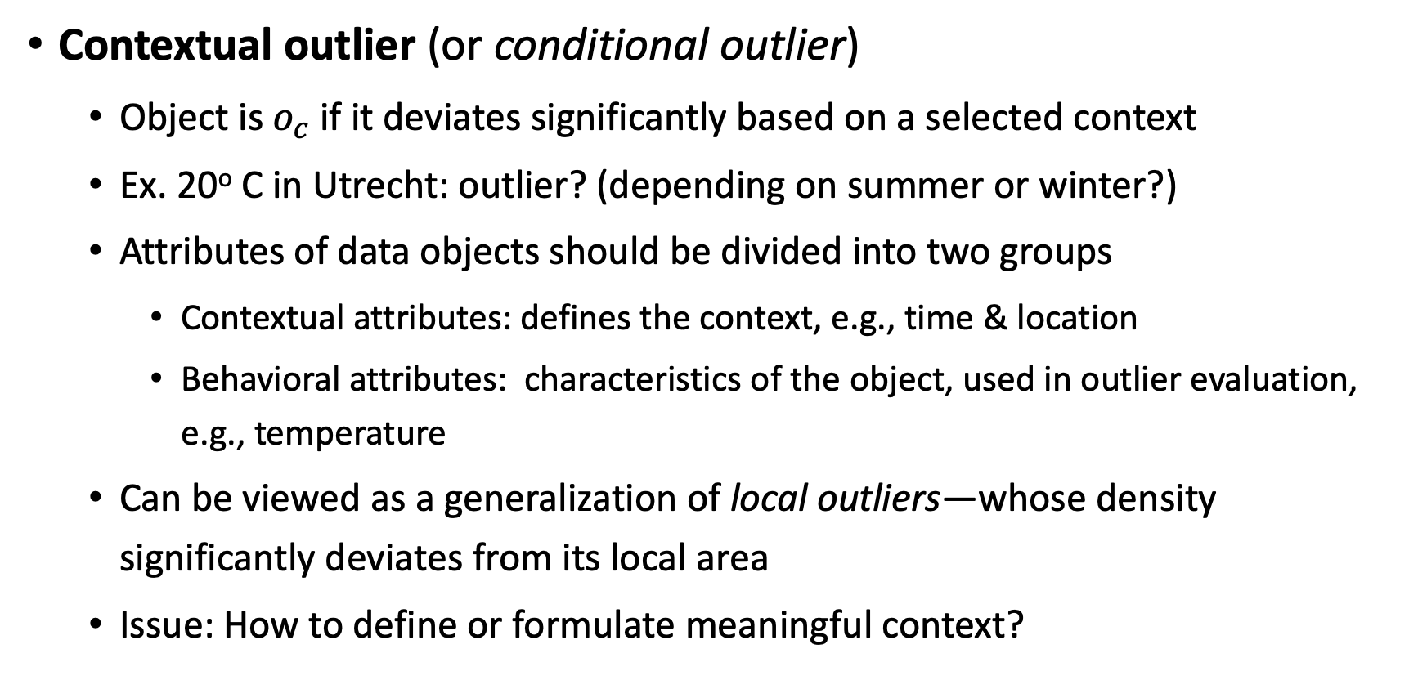
Types of Outliers (Cont.)
Contextual outlier (or conditional outlier)
Object is $o_{c}$ if it deviates significantly based on a selected context
Ex. 20º C in Utrecht: outlier? (depending on summer or winter?)
Attributes of data objects should be divided into two groups
Contextual attributes: defines the context, e.g., time & location
Behavioral attributes: characteristics of the object, used in outlier evaluation, e.g., temperature
Can be viewed as a generalization of local outliers—whose density significantly deviates from its local area
Issue: How to define or formulate meaningful context?

Slide 37
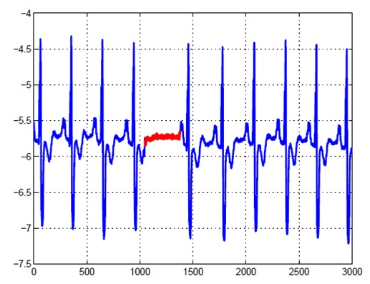
Types of Outliers (Cont.)
Collective Outliers
A subset of data objects collectively deviate significantly from the whole data set, even if the individual data objects may not be outliers
Applications: E.g., intrusion detection:
When a number of computers keep sending denial-of-service packages to each other
Detection of collective outliers
Consider not only behavior of individual objects, but also that of groups of objects
Need to have the background knowledge on the relationship among data objects, such as a distance or similarity measure on objects

Slide 38
Challenges of Outlier Detection
Modeling normal objects and outliers properly
Hard to enumerate all possible normal behaviors in an application
The border between normal and outlier objects is often a gray area
Application-specific outlier detection
Choice of distance measure among objects and the model of relationship among objects are often application-dependent
E.g., clinical data: a small deviation could be an outlier; while in marketing analysis, we observe large fluctuations as normal behavior

Slide 39
Challenges of Outlier Detection (Cont.)
Handling noise in outlier detection
Noise may distort the normal objects and blur the distinction between normal objects and outliers. It may help hide outliers and reduce the effectiveness of outlier detection
Understandability
Understand why these are outliers: Justification of the detection
Specify the degree of an outlier: the unlikelihood of the object being generated by a normal mechanism
A data set may have multiple types of outlier
One object may belong to more than one type of outlier

Slide 40
Outlier Detection Techniques
Many approaches, for example:
Statistical methods
Distance based methods
Density based methods
Methods based on model fitting
Local vs global approaches
Scoring vs labeling

Slide 41
Outlier Detection Techniques (Cont.)
Global versus local approaches
Considers the resolution of the reference set w.r.t. which the “outlierness” of a particular data object is determined – Global approaches
Global approaches
The reference set contains all other data objects
Basic problem: other outliers are also in the reference set and may falsify the results
Local approaches
The reference contains a (small) subset of data objects
No assumption on the number of normal mechanisms
Basic problem: how to choose a proper reference set
Some approaches are somewhat in between

Slide 42
Outlier Detection Techniques (Cont.)
Labeling versus scoring: considers the output of an outlier detection algorithm
Labeling approaches
Binary output
Data objects are labeled either as normal or outlier
Scoring approaches
Continuous output
For each object an outlier score is computed (e.g. the probability for being an outlier)
Data objects can be sorted according to their scores

Slide 43
Outlier Detection – Statistical Approaches
Statistical approaches assume that the objects in a data set are generated by a stochastic process (a generative model)
Idea: learn a generative model fitting the given data set, and then identify the objects in low probability regions of the model as outliers
Methods are divided into two categories: parametric vs. non-parametric

Slide 44
Outlier Detection – Statistical Approaches (Cont.)
Parametric method
Assumes that the normal data is generated by a distribution with parameter θ
The probability density function of the distribution f(x, θ) gives the probability that object x is generated by the distribution
The smaller this value, the more likely x is an outlier
Non-parametric method
No assumptions on a-priori statistical model and determine the model from the input data
Not completely parameter free but consider the number and nature of the parameters are flexible and not fixed in advance
Examples: histogram and kernel density estimation

Slide 45
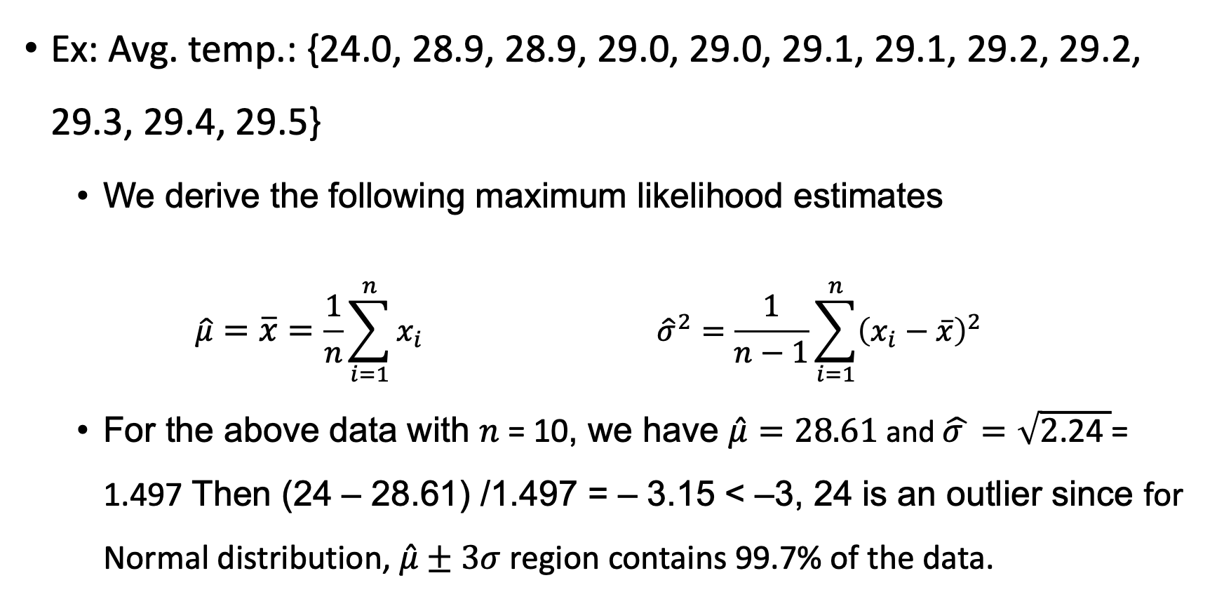
Outlier Detection – Statistical Approaches (Cont.)
Ex: Avg. temp.: {24.0, 28.9, 28.9, 29.0, 29.0, 29.1, 29.1, 29.2, 29.2, 29.3, 29.4, 29.5}
We derive the following maximum likelihood estimates
$$\hat{μ}=\overline{x}=\frac{1}{n}\sum_{i=1}^{n}{x_{i}} {\hat{σ}}^{2}=\frac{1}{n−1}\sum_{i=1}^{n}{{\left(x_{i}−\overline{x}\right)}^{2} }$$
For the above data with $n \text{=}\text{ 10}$, we have $\hat{μ}=28.61$ and $\hat{σ }=\sqrt{2\text{.2}\text{4} }\text{= 1.}\text{497}$ Then $\text{(24 – 28.61) /1.}\text{497}\text{ = – 3.}\text{15}\text{ < –3}$, 24 is an outlier since for Normal distribution, $\hat{μ}±3σ$ region contains 99.7% of the data.

Slide 46
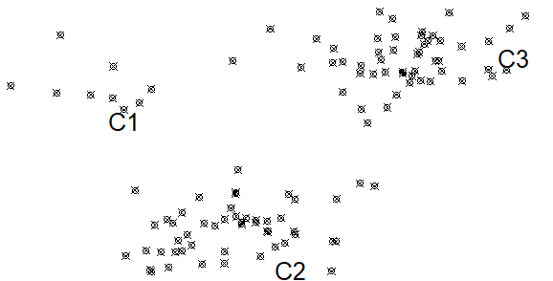
Outlier Detection – Statistical Approaches (Cont.)
Assuming data generated by a normal distribution could be sometimes overly simplified
Example (data in the figure): The objects between the two clusters cannot be captured as outliers since they are close to the estimated mean
To overcome this problem, assume the normal data is generated by mixture of Normal distributions.

Slide 47
Data Transformation

Slide 48
Data Transformation
A function that maps the entire set of values of a given attribute to a new set of replacement values s.t. each old value can be identified with one of the new values
Methods for data transformation
Smoothing: Remove noise from data
Attribute/feature construction
New attributes constructed from the given ones
Aggregation: Summarization, data cube construction

Slide 49
Data Transformation (Cont.)
Methods for data transformation
Normalization (standardization): Scaling the data to fall within a specified range
Min-max normalization
Z-score normalization
Normalization by decimal scaling
Data reformatting:
E.g. Jack Wilsher ➔ Wilsher, J.
Use the same unit:
Records in inches and cm
Records with prices in Euros and Dollars

Slide 50
Data Normalization (Standardization)
The goal of standardization or normalization is to make an entire set of values have a particular property.

Slide 51
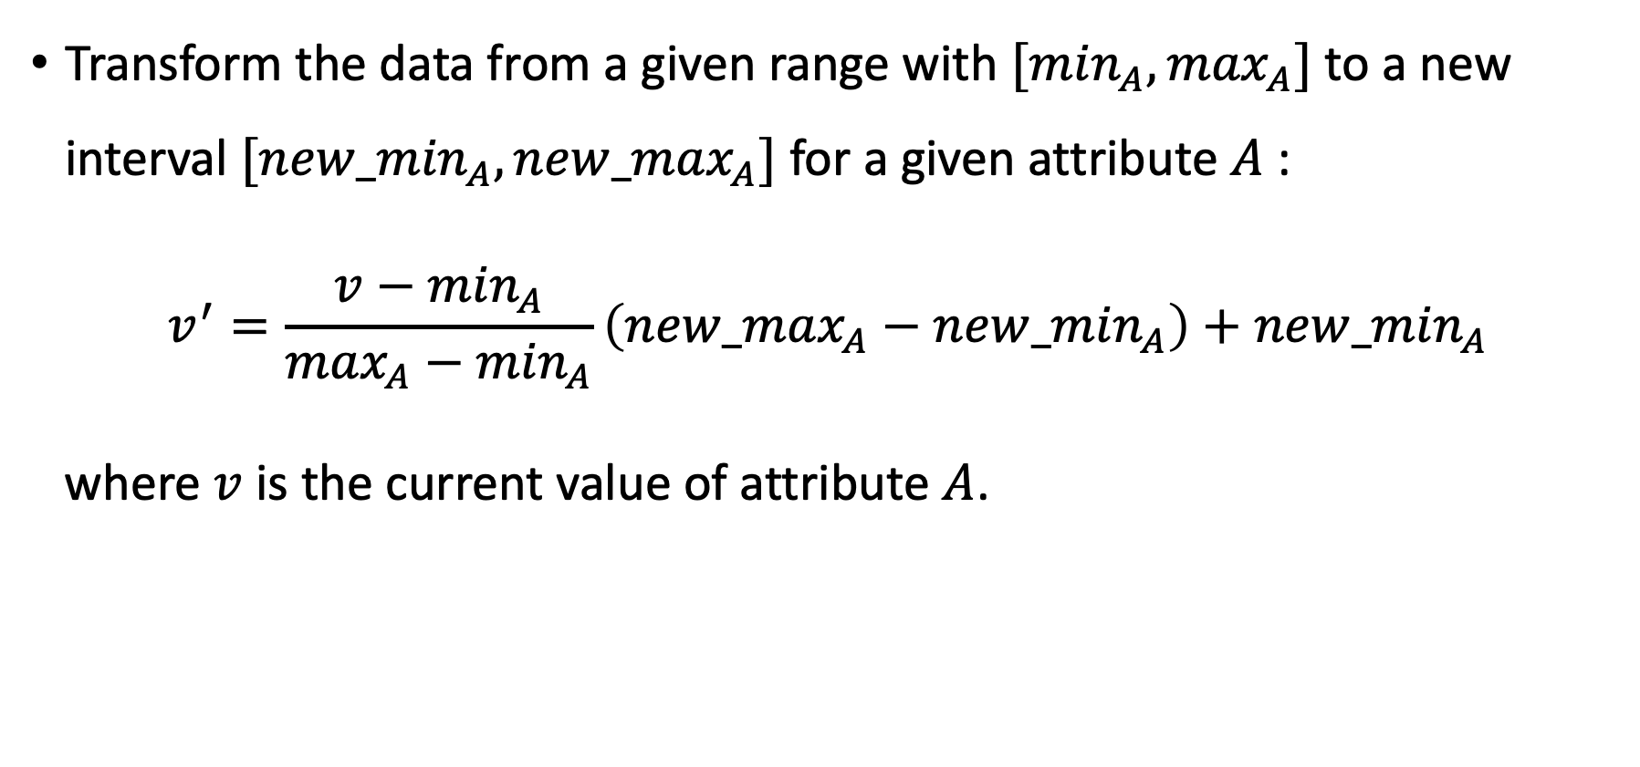
Data Normalization – Min-Max Normalization
Transform the data from a given range with $[\min_{A}, \max_{A}]$ to a new interval $[{new_min}_{A}, {new_max}_{A}]$ for a given attribute $A$ :
$$v^{′}=\frac{v−\min_{A}}{\max_{A}−\min_{A}}\left({new_max}_{A}−{new_min}_{A}\right)+{new_min}_{A}$$
where $v$ is the current value of attribute $A$.

Slide 52
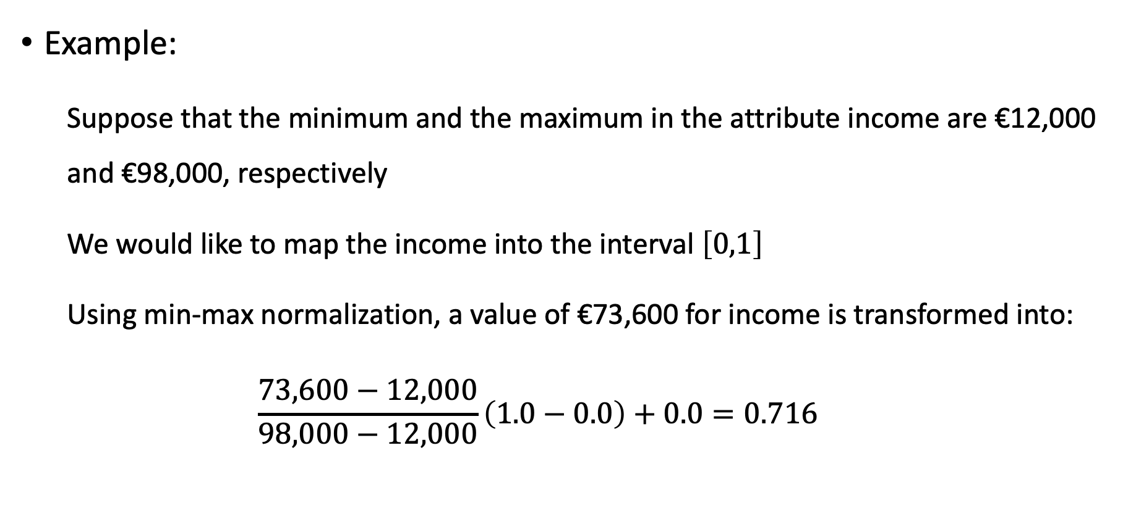
Data Normalization – Min-Max Normalization
Example:
Suppose that the minimum and the maximum in the attribute income are €12,000 and €98,000, respectively
We would like to map the income into the interval $\left[0,1\right]$
Using min-max normalization, a value of €73,600 for income is transformed into:
$$\frac{73,600−12,000}{98,000−12,000}\left(1.0−0.0\right)+0.0=0.716$$

Slide 53
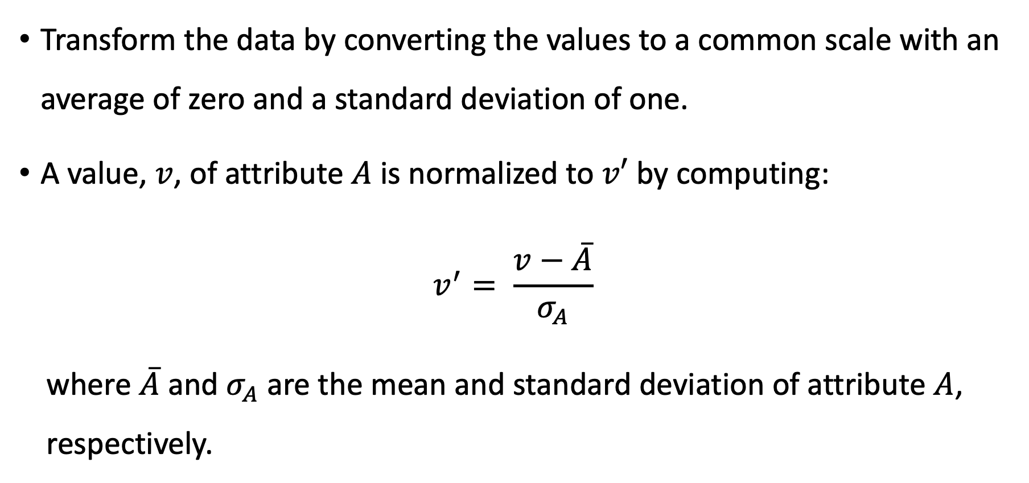
Data Normalization – Z-Score Normalization
Transform the data by converting the values to a common scale with an average of zero and a standard deviation of one.
A value, $v$, of attribute $A$ is normalized to $v′$ by computing:
$$v^{′}= \frac{v−\overline{A}}{σ_{A}}$$
where $\overline{A}$ and $σ_{A}$ are the mean and standard deviation of attribute $A$, respectively.

Slide 54
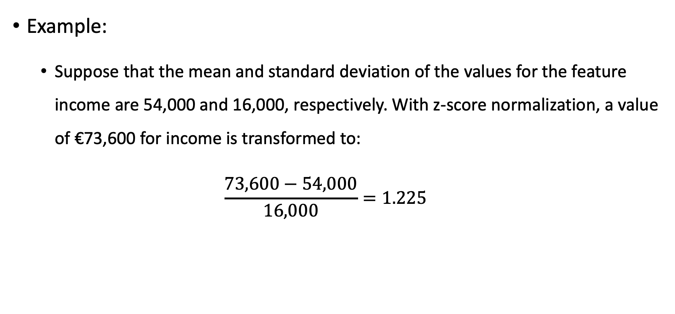
Data Normalization – Z-Score Normalization
Example:
Suppose that the mean and standard deviation of the values for the feature income are 54,000 and 16,000, respectively. With z-score normalization, a value of €73,600 for income is transformed to:
$$\frac{73,600−54,000}{16,000}=1.225$$

Slide 55
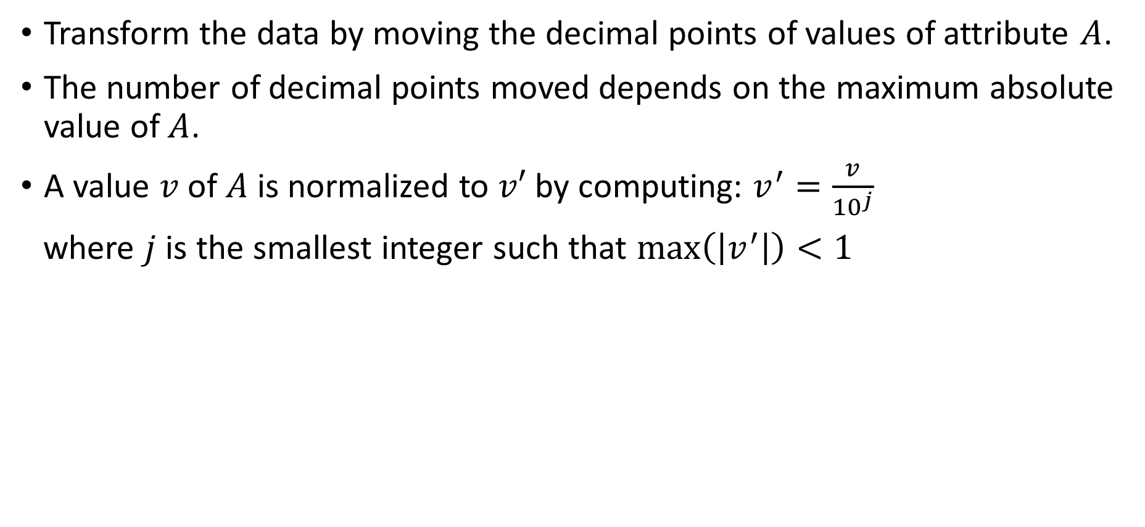
Data Normalization – Decimal Scaling Normalization
Transform the data by moving the decimal points of values of attribute $A$.
The number of decimal points moved depends on the maximum absolute value of $A$.
A value $v$ of $A$ is normalized to $v′$ by computing: $v^{′}=\frac{v}{{10}^{j}}$
where $j$ is the smallest integer such that $\max\left(\left|v^{′}\right|\right)<1$

Slide 56

Data Normalization – Decimal Scaling Normalization
Example:
Suppose that the recorded values of $A$ range from −986 to 917.
The maximum absolute value of $A$ is 986.
To normalize by decimal scaling, we divide each value by 1,000 (i.e., $j=3$) so that −986 normalizes to −0.986 and 917 normalizes to 0.917

Slide 57
Data Integration

Slide 58
Data Integration
Combines data from multiple sources into a coherent store
Schema integration: e.g., A.cust-id ≡ B.cust-No
Integrate metadata from different sources
Entity identification problem:
Identify real world entities from multiple data sources, e.g., Bill Clinton = William Clinton
Detecting and resolving data value conflicts
For the same real-world entity, attribute values from different sources are different
Possible reasons: different representations, different scales, e.g., metric vs. British units

Slide 59
Handling Redundancy when Integrating Data
Handling data redundancy is an important task of the data integration
Duplicate records can be identified by applying entity resolution techniques
Redundant attributes can be detected by correlation and covariance analysis
Careful integration of the data from multiple sources may help reduce/avoid redundancies and inconsistencies and improve mining quality

Slide 60
Entity Resolution
Problem of identifying and linking/grouping different representations of the same real-world object.
Examples:
Different ways of addressing (names, email addresses, FaceBook accounts) the same person in text.
Web pages with differing descriptions of the same business.
Different photos of the same object.
…

Slide 61
Ironically, Entity Resolution has many duplicate names
Record linkage
Duplicate detection
Reference reconciliation
Fuzzy match
Object consolidation
Object identification
Deduplication
Entity clustering
Approximate match
Identity uncertainty
Household matching
Doubles
Hardening soft databases
Reference matching

Slide 62
Entity Resolution – Normalization
Schema Normalization
Schema matching: e.g., Contact No. vs. Phone
Compound attributes: e.g., address vs. (street, city, zip)
Data Normalization
Capitalization, white-space normalization
Correcting typos, replacing abbreviations, variations, nick names
Usually done by employing dictionaries

Slide 63
Entity Resolution – Matching Features
Given two records, compute a vector of similarity scores for corresponding features
E.g., to match two bibliographical references, compute:
First author match score
Title match score
Venue match score
Year match score
…
Score can be Boolean (match/mismatch) or a continuous value based on specific similarity measure (distance function).

Slide 64
Entity Resolution – Similarity Measures
Atomic similarity measures
Difference between numerical values
Jaro for comparing names
Edit distance for typos
Phonetic-based
Soundex
Set similarity
Jaccard similarity
Vector-based
Cosine similarity

Slide 65
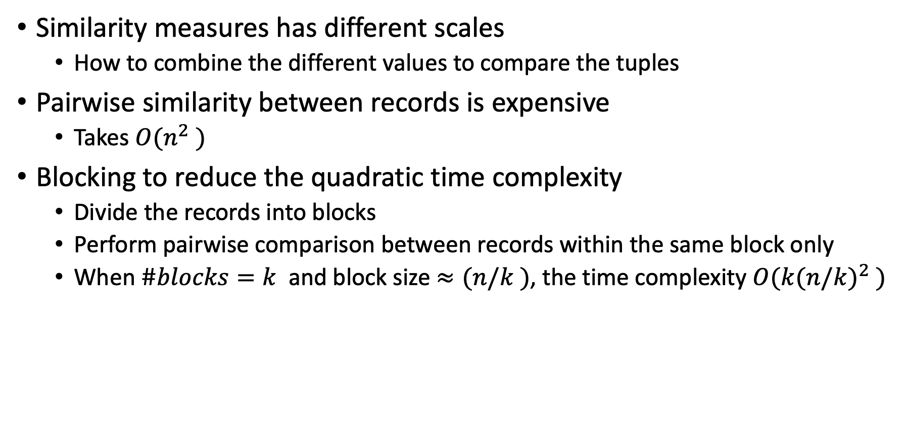
Entity Resolution – Issues
Similarity measures has different scales
How to combine the different values to compare the tuples
Pairwise similarity between records is expensive
Takes $O(n^{2} )$
Blocking to reduce the quadratic time complexity
Divide the records into blocks
Perform pairwise comparison between records within the same block only
When $\#blocks=k$ and block size $≈(n/k )$, the time complexity $O({k(n/k)}^{2} )$

Slide 66
Data Reduction

Slide 67
Data Reduction
Data reduction: obtain a reduced representation of the dataset
Much smaller in volume but yet produces the same (or almost the same) analytical results
Why data reduction?
A dataset could be extremely large – Complex data analysis may take a very long time to run on the complete dataset.
Data reduction strategies
Dimensionality reduction, e.g., remove unimportant attributes
Principal Components Analysis (PCA)
Singular Value Decomposition (SVD)
Feature subset selection, feature creation

Slide 68
Dimensionality Reduction
Curse of dimensionality
When dimensionality increases, data becomes increasingly sparse
Density and distance between points, which is critical to clustering, outlier analysis, becomes less meaningful
The possible combinations of subspaces will grow exponentially
Dimensionality reduction
Avoid the curse of dimensionality
Help eliminate irrelevant features and reduce noise
Reduce time and space required in data mining
Allow easier visualization

Slide 69
Principal Component Analysis (PCA)
Find a projection that captures the largest amount of variation in data
The original data are projected onto a much smaller space, resulting in dimensionality reduction.
We find the eigenvectors of the covariance matrix, and these eigenvectors define the new space

Slide 70
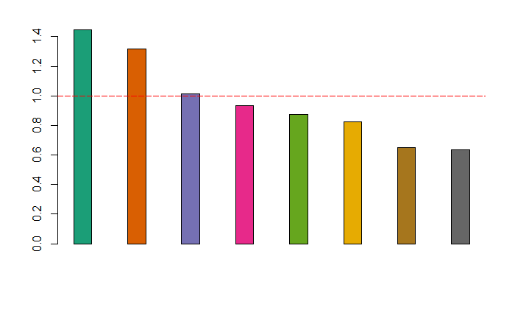
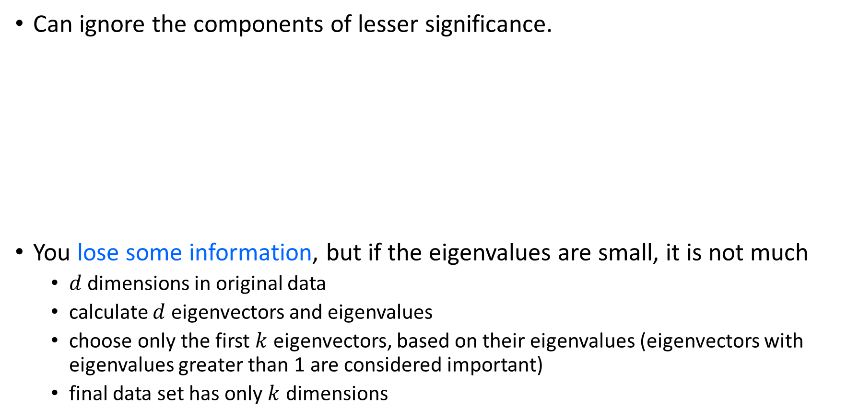
PCA for Dimensionality Reduction
Can ignore the components of lesser significance.
You lose some information, but if the eigenvalues are small, it is not much
$d$ dimensions in original data
calculate $d$ eigenvectors and eigenvalues
choose only the first $k$ eigenvectors, based on their eigenvalues (eigenvectors with eigenvalues greater than 1 are considered important)
final data set has only $k$ dimensions

Slide 71
Attribute Subset Selection for Data Reduction
Another way to reduce dimensionality of data
Redundant attributes
Duplicate much or all of the information contained in one or more other attributes
E.g., purchase price of a product and the amount of sales tax paid
Irrelevant attributes
Contain no information that is useful for the data mining task at hand
E.g., students' ID is often irrelevant to the task of predicting students' GPA

Slide 72
Model-Based Data Reduction
Linear regression
Data modeled to fit a straight line
Often uses the least-square method to fit the line
Multiple regression
Allows a response variable Y to be modeled as a linear function of multidimensional feature vector
Log-linear model
Approximate data by a function whose logarithm is linear

Slide 73
Histograms for Data Reduction
Divide data into buckets and store average (sum) for each bucket
Partitioning rules:
Equal-width: equal bucket range
Equal-frequency (or equal-depth)

Slide 74
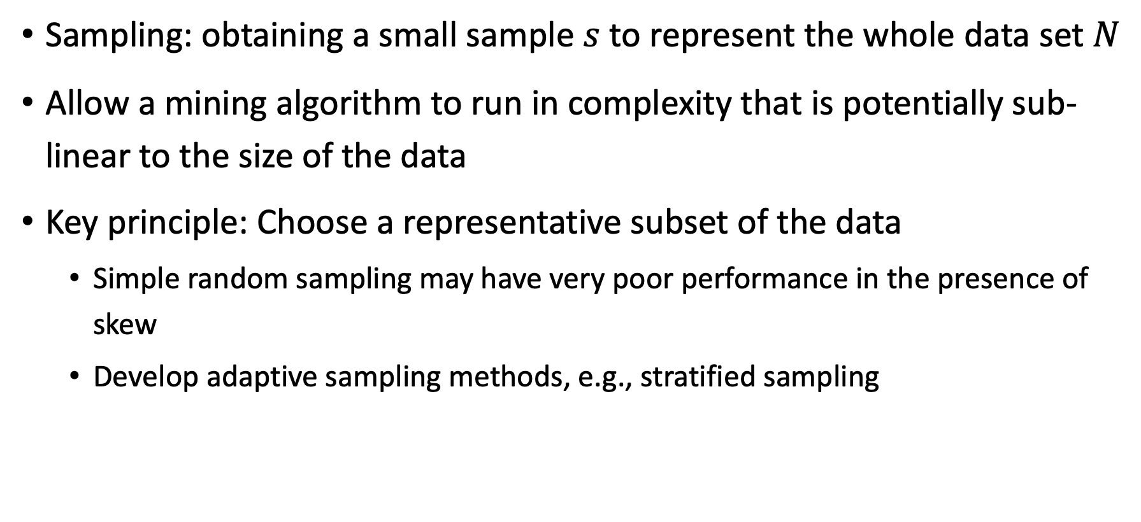
Sampling-Based Data Reduction
Sampling: obtaining a small sample $s$ to represent the whole data set $N$
Allow a mining algorithm to run in complexity that is potentially sub-linear to the size of the data
Key principle: Choose a representative subset of the data
Simple random sampling may have very poor performance in the presence of skew
Develop adaptive sampling methods, e.g., stratified sampling

Slide 75
Types of Sampling
Simple random sampling
There is an equal probability of selecting any particular item
Sampling without replacement
Once an object is selected, it is removed from the population
Sampling with replacement
A selected object is not removed from the population
Stratified sampling:
Partition the data set, and draw samples from each partition (proportionally, i.e., approximately the same percentage of the data)
Used in conjunction with skewed data

Slide 76
Sampling – with or without Replacement
SRSWOR
(simple random
sample without
replacement)
SRSWR
Raw Data

Slide 77
Sampling – Cluster or Stratified Sampling
Raw Data
Cluster/Stratified Sample

Slide 78
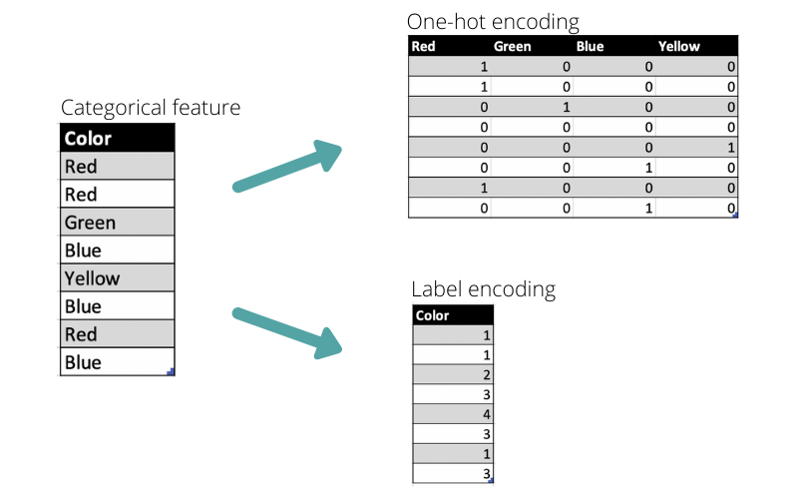
Other Data Preparation Techniques
Discretization
Transforming categorical data into numerical data
Label encoding
One-hot encoding
Data Enrichment
Augmentation
Join & Union
Data Validation
Check Permitted Characters
Find Type-Mismatched Data

Slide 79
Thank You

Slide 80
Next lecture
Process Discovery
Conformance Checking

