Slide 1
Data Wrangling and Data Analysis
Exploratory Data Analysis
Daniel L. Oberski & Erik-Jan van Kesteren
Department of Methodology & Statistics
Utrecht University

Slide 2
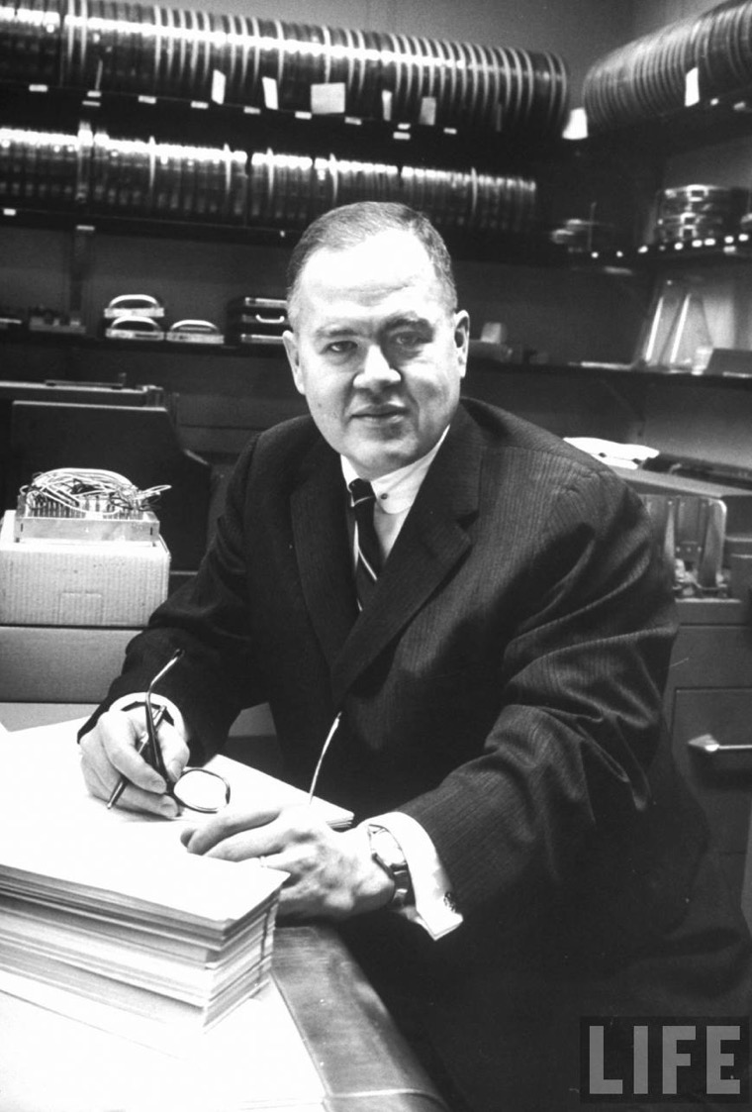
John Tukey (1915 – 2000)
Data Scientist patient zero
Inventor of:
The boxplot
The term “exploratory data analysis”
The Fast Fourier Transform
“Tukey’s test”
The word “bit”
So, so much more (Wikipedia)

Slide 3
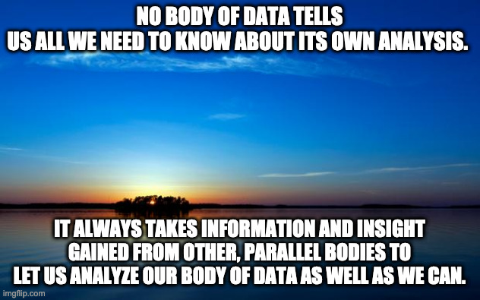
“NO BODY OF DATA TELLS US ALL we need to know ABOUT ITS OWN ANALYSIS. It always takes information and insight gained from other, parallel bodies to let us analyze our body of data as well as we can. (If we don't have it, we do as well as we can.)” – EDA p. 115
- John Tukey 1970, EDA

Slide 4
Where it fits in
Data visualization principles
The grammar of graphics
Exploratory data analysis (EDA)
Goal: know how to create and improve data visualizations, and know how to use them for exploration

Slide 5
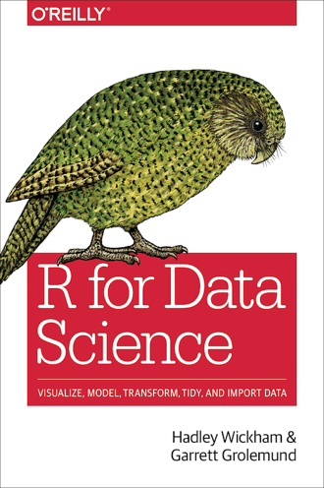
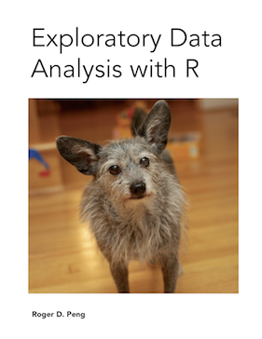
Reading materials for this week
R for Data Science (R4DS)
(Wickham & Grolemund 2017(ish) )
https://r4ds.had.co.nz
Chapters 1, 3, 9, 10
Optional:
Exploratory Data Analysis with R (Peng 2020)
https://bookdown.org/rdpeng/exdata/

Slide 6
Exploratory vs. confirmatory

Slide 7
Exploratory vs confirmatory
Exploratory analysis
Generate new insights
Create new hypotheses
Analysis may depend on data
Confirmatory analysis
Test theory
A priori hypothesis
Analysis predefined
Example: registered report

Slide 8
Exploratory vs confirmatory
You work at Google and your colleague has implemented a new search algorithm for German searches. Your task is to check whether this algorithm performs better than the existing one.
Confirmatory.
Theory testing, hypothesis: new works better than old
Analysis can be defined in advance: which outcome variables, how to sample from the population, which method?
Full analysis script could be written before the data even exists

Slide 9
Exploratory vs confirmatory
You have obtained access to your company’s customer relations database. Your task is to find data-driven ways in which your company can improve customer retainment.
Exploratory.
Generate new insights - at which touchpoint do customers drop out?
Create new hypotheses - there may be two types of customers who drop out
Analysis cannot be defined in advance, task is to explore associations between features

Slide 10
Exploratory vs confirmatory
Both are necessary and complementary
Typical scientific questions: exploratory -> confirmatory
Then build on the tested theories to generate new insights: confirmatory -> exploratory?
This lecture: exploratory analysis

Slide 11
Some good advice on data exploration
Tukey’s approach
Peng’s EDA checklist

Slide 12
1. Tukey’s approach to EDA
Look at center and spread
Find comparisons
“Straightening and flattening”:
Use logarithms and other transforms
Use models and residuals

Slide 13
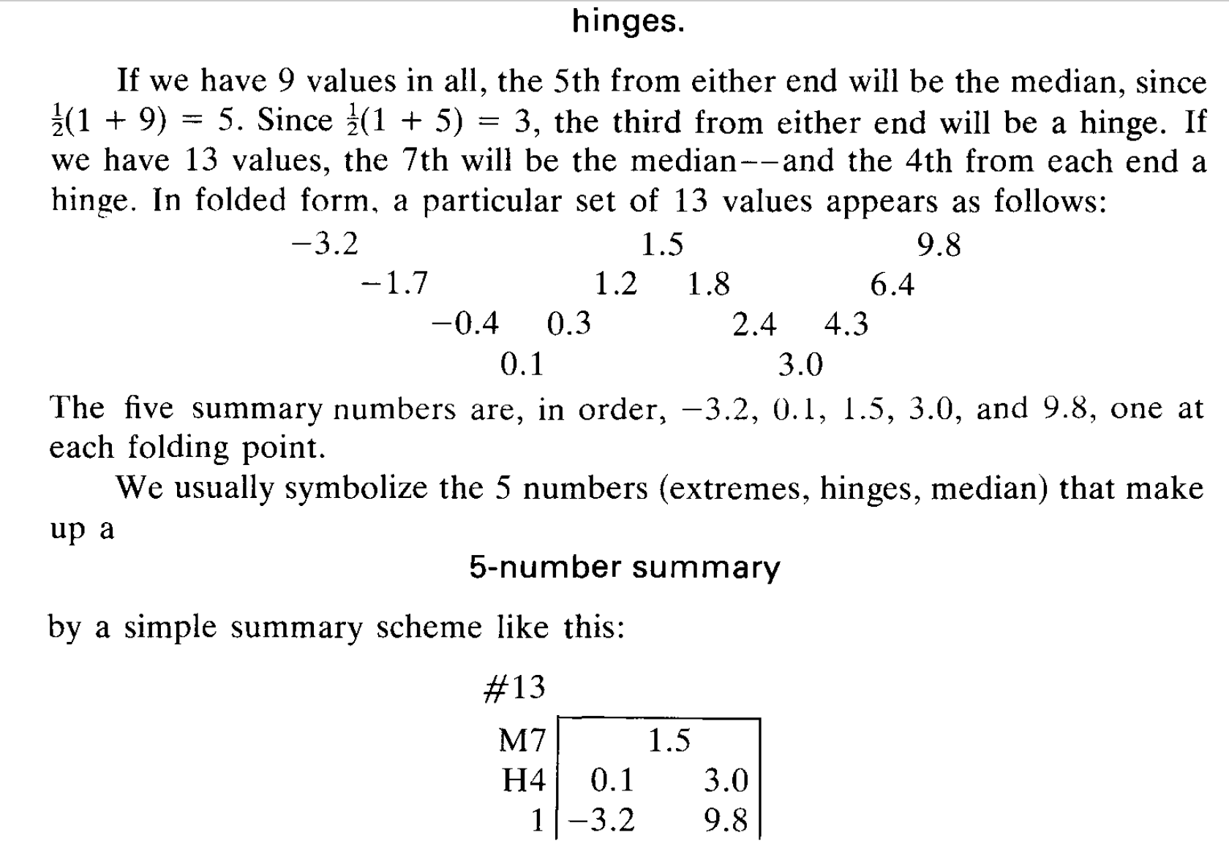
(Tukey 1970)

Slide 14
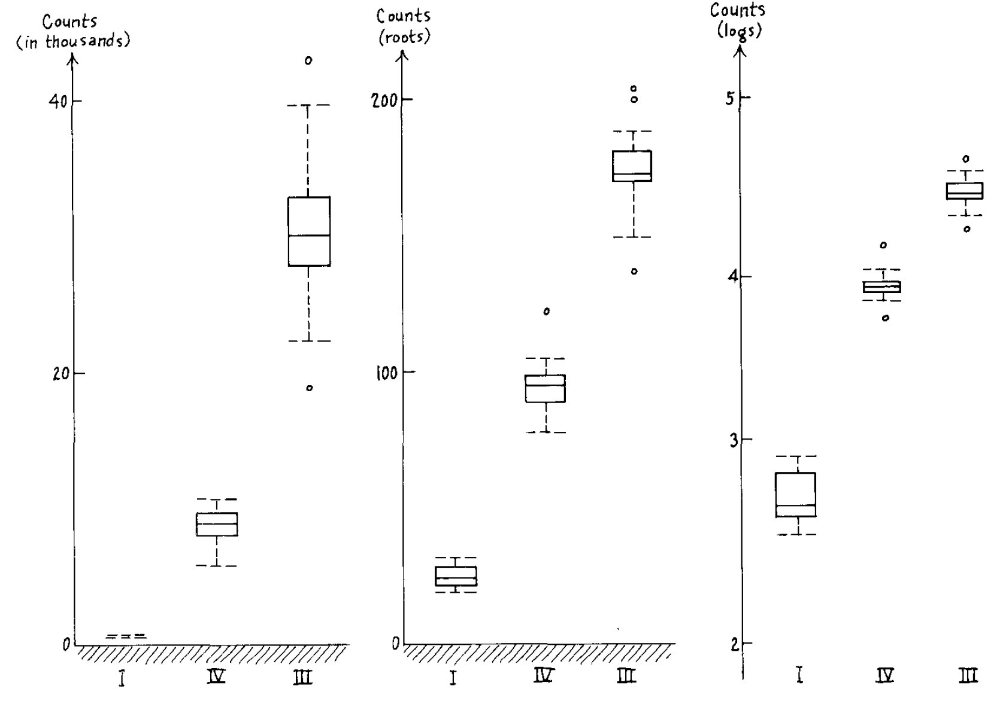
Spread vs. location
(Tukey 1970)

Slide 15
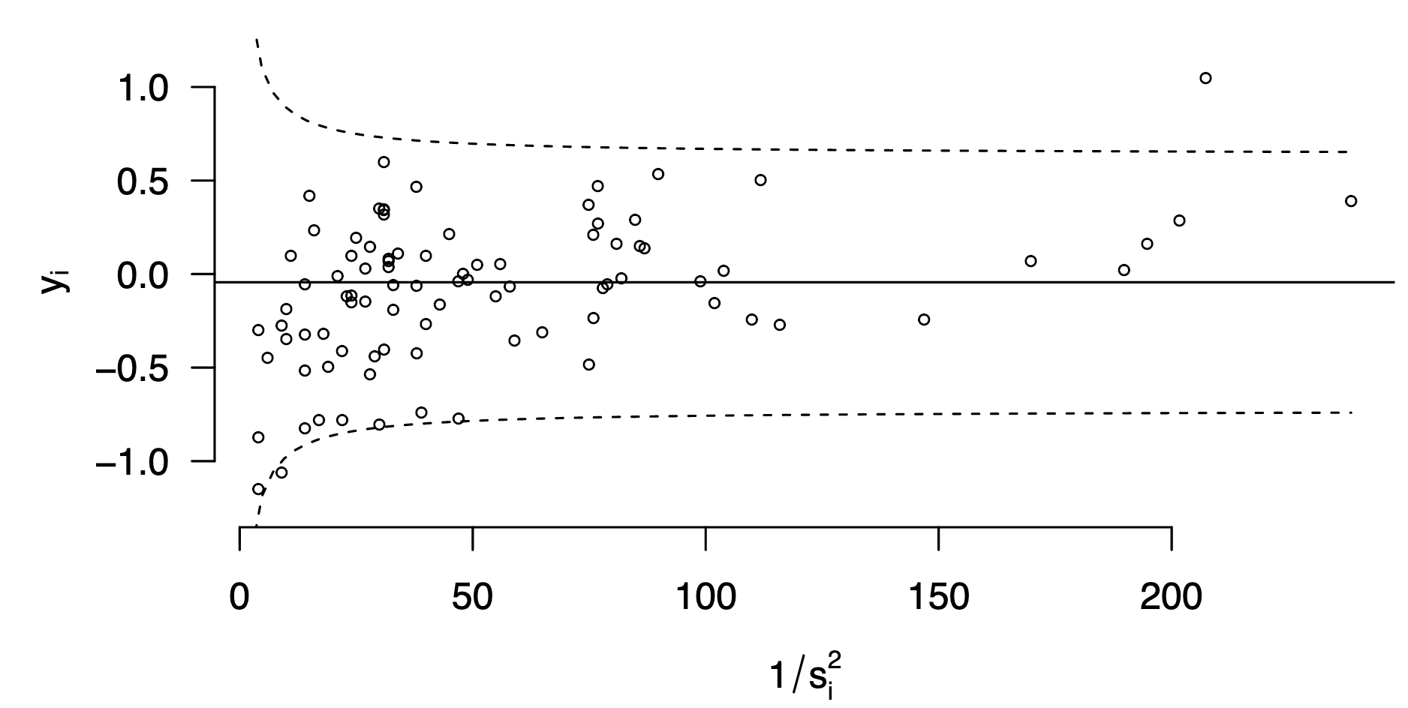
Adverse events in Dutch hospitals

Slide 16
2. Peng’s EDA checklist
Formulate your question
Read in your data
Check the packaging, (run str())
Look at the top and the bottom of your data
Check your “n”s
Validate with at least one external data source
Try the easy solution first
Challenge your solution
Follow up

Slide 17
Example exploration of current corona cases in the Netherlands

Slide 18
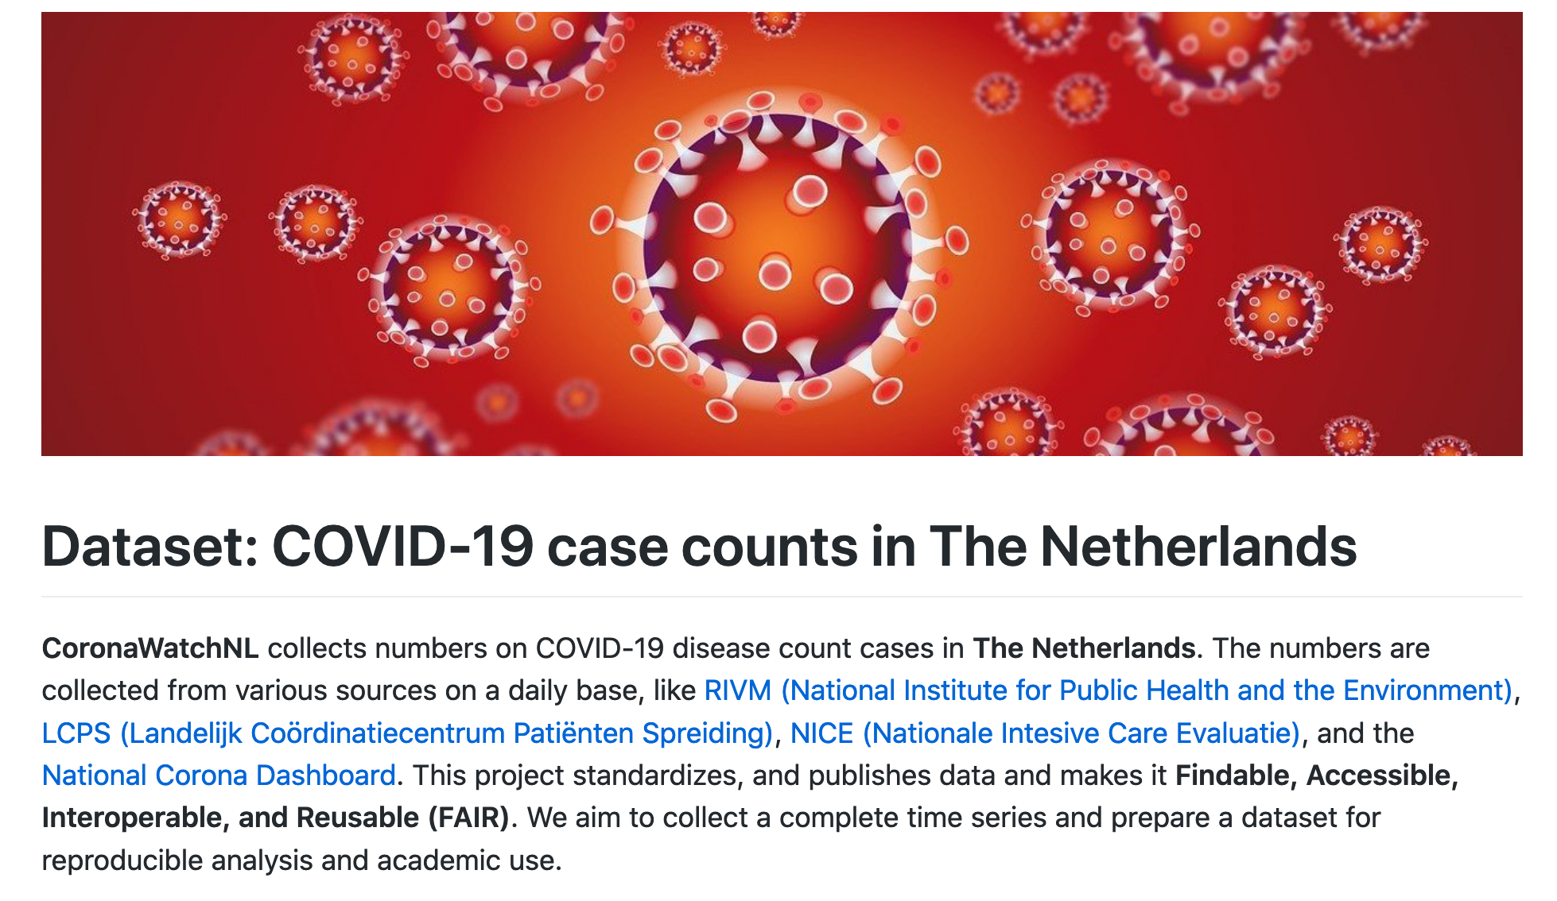
https://github.com/J535D165/CoronaWatchNL

Slide 19
Read data, check packaging
url_icu <- "https://raw.githubusercontent.com/J535D165/CoronaWatchNL/master/data-ic/data-nice/NICE_IC_long_latest.csv"
icu <- read_csv(url_icu)
> dim(icu)
[1] 1935 3

Slide 20
Look at top and bottom
> icu %>% tail
# A tibble: 6 x 3
Datum Type Aantal
<date> <chr> <dbl>
1 2020-09-28 Toename ontslag (ziekenhuis) 0
2 2020-09-28 Totaal opnamen (IC) 144
3 2020-09-28 Toename opnamen (IC) 7
4 2020-09-28 Totaal ontslag (IC) 56
5 2020-09-28 Cumulatief opnamen (IC) 3261
6 2020-09-28 Toename ontslag (overleden) 0

Slide 21
Look at top and bottom
> icu %>% head
# A tibble: 6 x 3
Datum Type Aantal
<date> <chr> <dbl>
1 2020-02-27 Totaal ingezette IC's 5
2 2020-02-27 Cumulatief opnamen (IC) 7
3 2020-02-27 Totaal ontslag (IC) 0
4 2020-02-27 Cumulatief ontslag (ziekenhuis) 0
5 2020-02-27 Cumulatief ontslag (overleden) 0
6 2020-02-27 Toename ontslag (overleden) 0

Slide 22
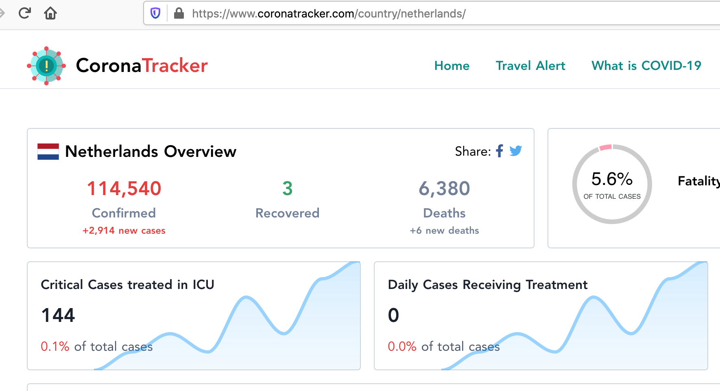
Validate with external source

Slide 23
Check n’s
> icu %>% group_by(Type) %>% summarize(n())
# A tibble: 9 x 2
Type `n()`
<chr> <int>
1 Cumulatief ontslag (overleden) 215
2 Cumulatief ontslag (ziekenhuis) 215
3 Cumulatief opnamen (IC) 215
4 Toename ontslag (overleden) 215
5 Toename ontslag (ziekenhuis) 215
6 Toename opnamen (IC) 215
7 Totaal ingezette IC's 215
8 Totaal ontslag (IC) 215
9 Totaal opnamen (IC) 215

Slide 24
icu %>%
filter(Type == "Totaal opnamen (IC)") %>%
ggplot(aes(Datum, Aantal)) + geom_line() +
theme_fira()

Slide 25
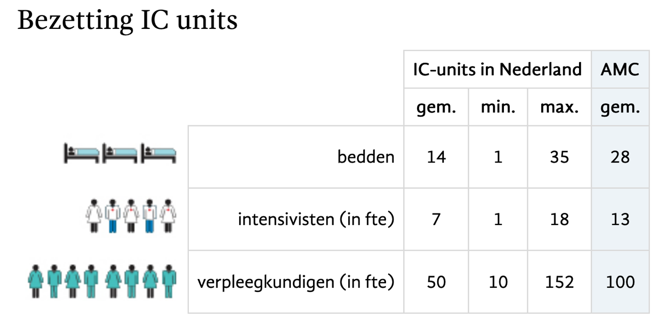
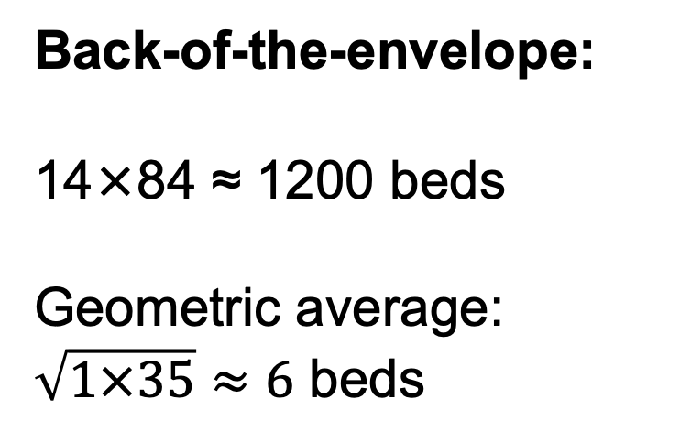
Understand what you’re looking at
(84 ICUs)
Back-of-the-envelope:
14×84 ≈ 1200 beds
Geometric average:
$\sqrt{1×35}≈6$ beds

Slide 26
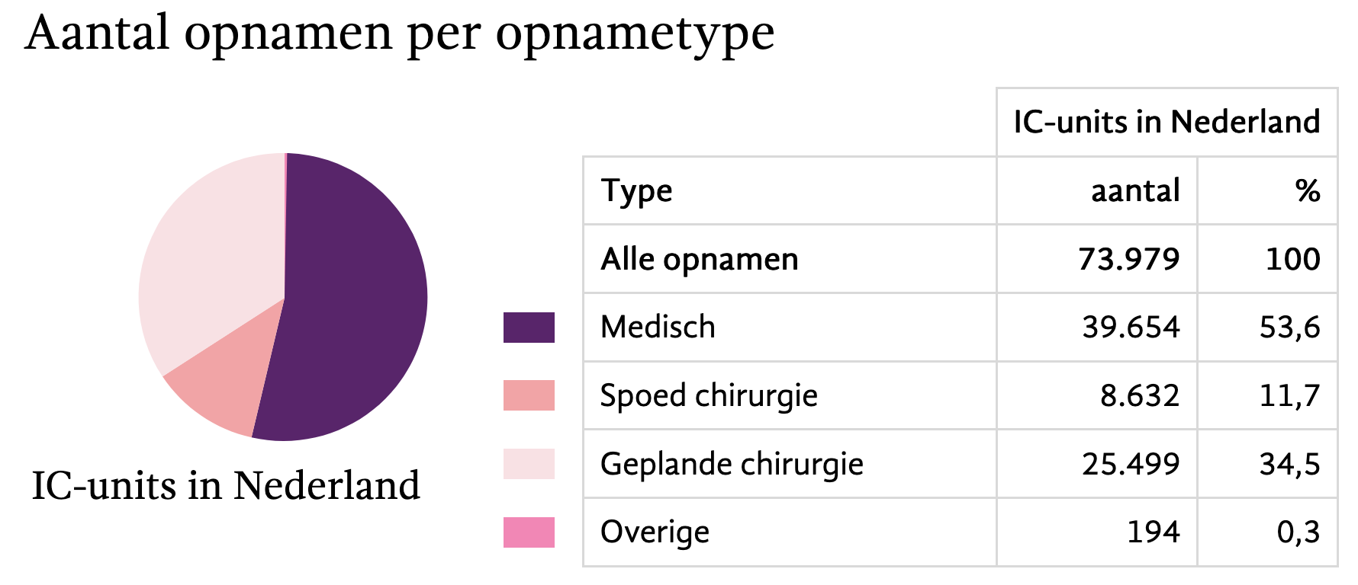
Understand what you’re looking at

Slide 27
icu %>%
filter(Type == "Totaal opnamen (IC)") %>%
ggplot(aes(Datum, Aantal)) + geom_line() +
theme_fira() + scale_y_log10()

Slide 28
url_sewage <- "https://raw.githubusercontent.com/J535D165/CoronaWatchNL/master/data-dashboard/data-sewage/RIVM_NL_sewage_counts.csv"
sewage <- read_csv(url_sewage)
joined <- bind_rows(sewage, icu)

Slide 29
joined %>%
filter(Type == "Totaal opnamen (IC)" |
Type == "Virusdeeltjes per ml rioolwater") %>%
ggplot(aes(Datum, Aantal, color = Type)) + geom_line() +
scale_y_log10() +
theme_fira() + scale_color_brewer(type = "qual")

Slide 30
joined_wide <- joined %>%
filter(Type == "Totaal opnamen (IC)" |
Type == "Virusdeeltjes per ml rioolwater") %>%
pivot_wider(names_from = Type, values_from = Aantal)

Slide 31
joined_wide %>%
ggplot(aes(`Virusdeeltjes per ml rioolwater`, `Totaal opnamen (IC)`)) +
geom_point() + theme_fira()

Slide 32
joined_wide %>%
ggplot(aes(`Virusdeeltjes per ml rioolwater`, `Totaal opnamen (IC)`)) +
geom_point() + scale_y_log10() + scale_x_log10() + theme_fira()
“straightening”
Notes:
“straightening”

Slide 33
joined_wide %>%
ggplot(aes(`Virusdeeltjes per ml rioolwater`, `Totaal opnamen (IC)`)) +
geom_point() + geom_smooth() +
scale_y_log10() + scale_x_log10() + theme_fira()

Slide 34
joined_wide %>%
ggplot(aes(`Virusdeeltjes per ml rioolwater`, `Totaal opnamen (IC)`)) +
geom_point() + geom_smooth(method = “lm”) +
scale_y_log10() + scale_x_log10() + theme_fira()

Slide 35
Looking at residuals
joined_wide <- joined_wide %>%
mutate(
log_icu = log(`Totaal opnamen (IC)` + 1),
log_sewage = log(`Virusdeeltjes per ml rioolwater` + 1))
fit_lm <- lm(log_icu ~ log_sewage, data = joined_wide)
joined_wide <- joined_wide %>%
mutate(log_icu_predicted = predict(fit_lm, newdata = .),
log_icu_residual = log_icu - log_icu_predicted)

Slide 36
joined_wide %>%
filter(!is.na(log_icu_residual)) %>%
ggplot(aes(Datum, log_icu_residual)) +
geom_line() + theme_fira()
“flattening”

Slide 37
joined_wide %>%
filter(!is.na(log_icu_residual)) %>%
ggplot(aes(Datum, log_icu_residual)) +
geom_line() + geom_smooth() + theme_fira()
“flattening”

Slide 38
Some standard plots to explore data

Slide 39
Visual EDA
Variation: How are the features distributed?
Univariate
Specific: among people, among time, among flights
General: among the unit of measurement, among examples
In tabular data, generally one example/unit per row
Association: What type of covariation occurs in the data?
Which features covary? When A is high, is B high?
Multidimensional, multivariate.

Slide 40
Example dataset: accidental deaths in the Netherlands 1950-2024
(You can find these data online yourself at: https://opendata.cbs.nl/statline)
> accidents %>% sample_n(10) %>% arrange(age_group, year)
# A tibble: 10 × 5
year age_group fall drown poison
<dbl> <fct> <dbl> <dbl> <dbl>
1 2009 0 jaar 1 0 0
2 1973 5 tot 10 jaar 5 44 2
3 1999 5 tot 10 jaar 3 5 0
4 2000 15 tot 20 jaar 0 0 1
5 1979 30 tot 35 jaar 2 3 7
6 2012 35 tot 40 jaar 7 3 14
7 1951 55 tot 60 jaar 25 12 4
8 1971 60 tot 65 jaar 55 10 3
9 2000 85 tot 90 jaar 414 3 0
10 1999 Totaal alle leeftijden 1736 91 95

Slide 41
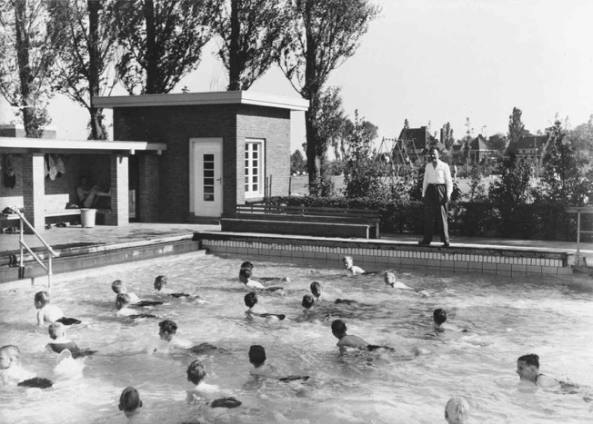

Background: school swimming
In The Netherlands, you are never far from water;
All Dutch children used to learn to swim at school;
But mandatory school swimming abolished starting from 1985.

Slide 42
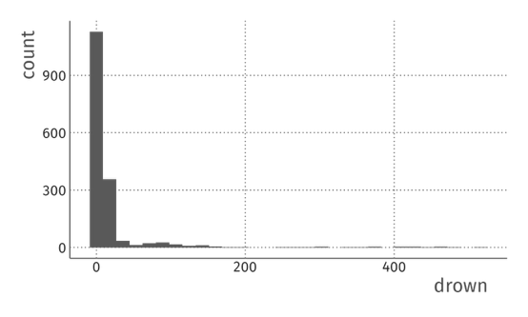
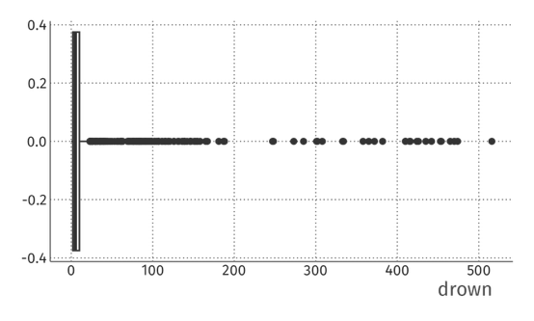
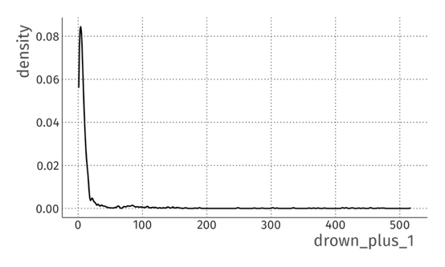
Univariate: accidental drownings
Histogram
Boxplot
Density plot

Slide 43
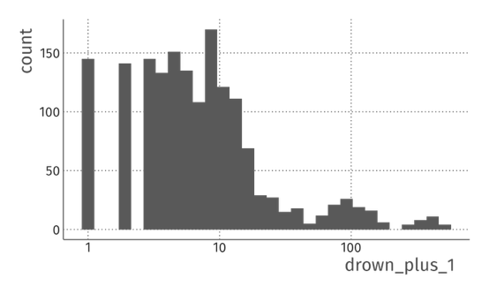
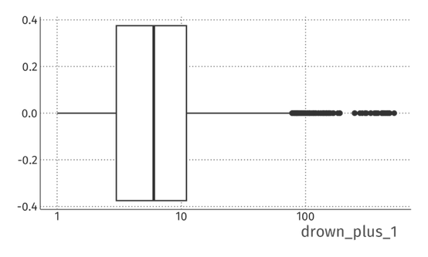
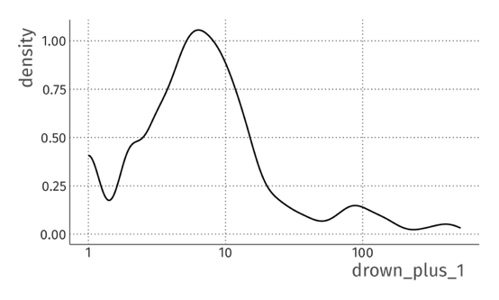
Univariate: accidental drownings (log)
Histogram
Boxplot
Density plot

Slide 44
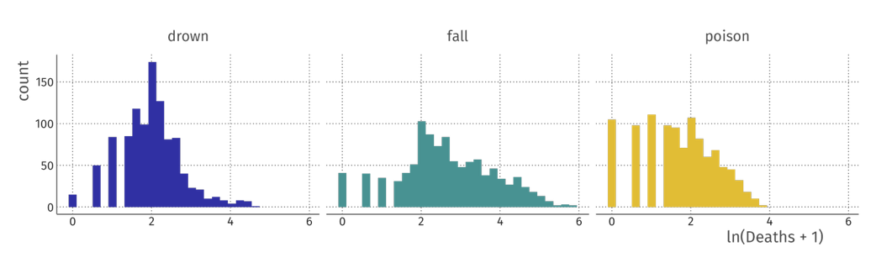
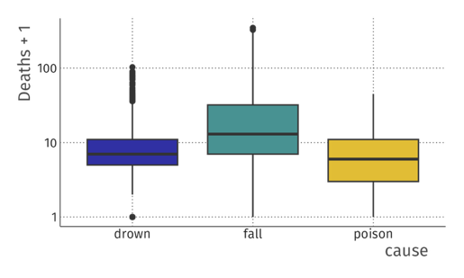
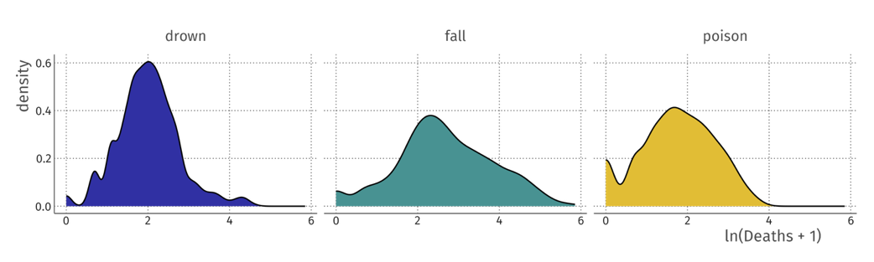
Comparisons (univariate vs. categorical)
Histograms
Boxplots
Density plots

Slide 45
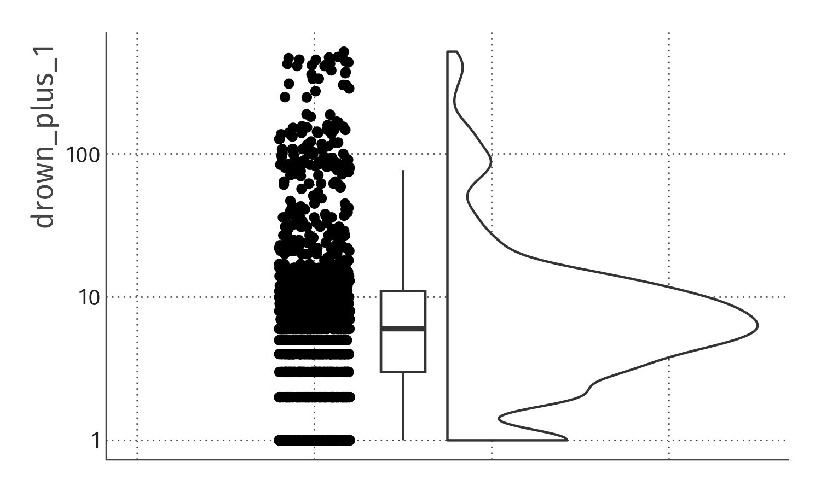
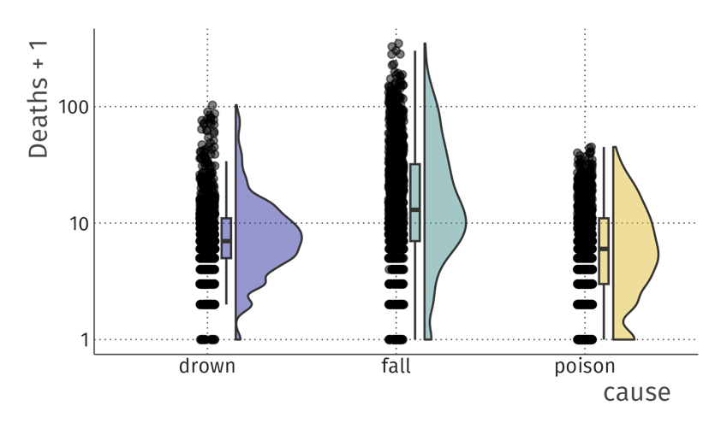
Rainplot combines plots

Slide 46
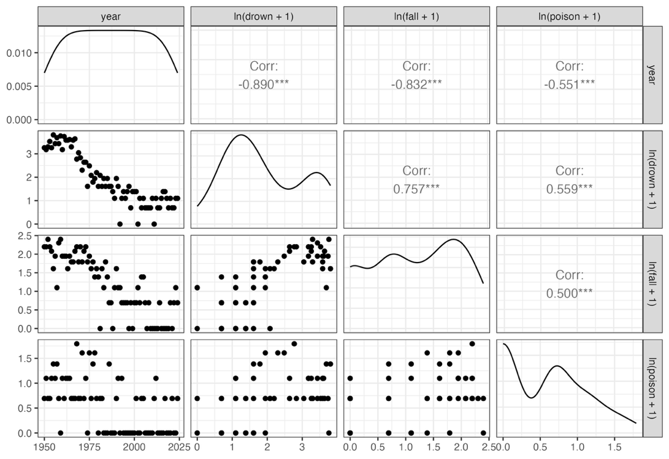
Pairs plot = small multiple scatter plots

Slide 47
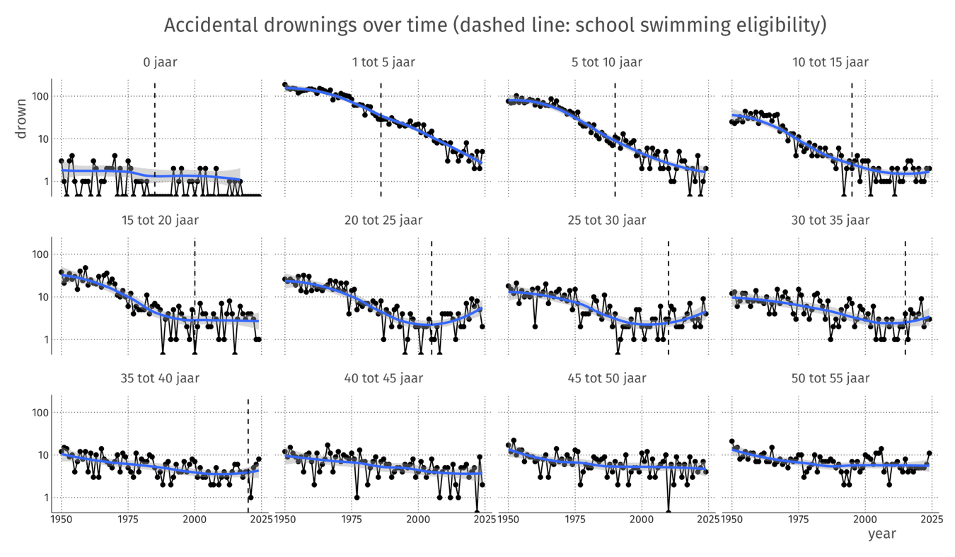
Uptick in accidental drownings?

Slide 48
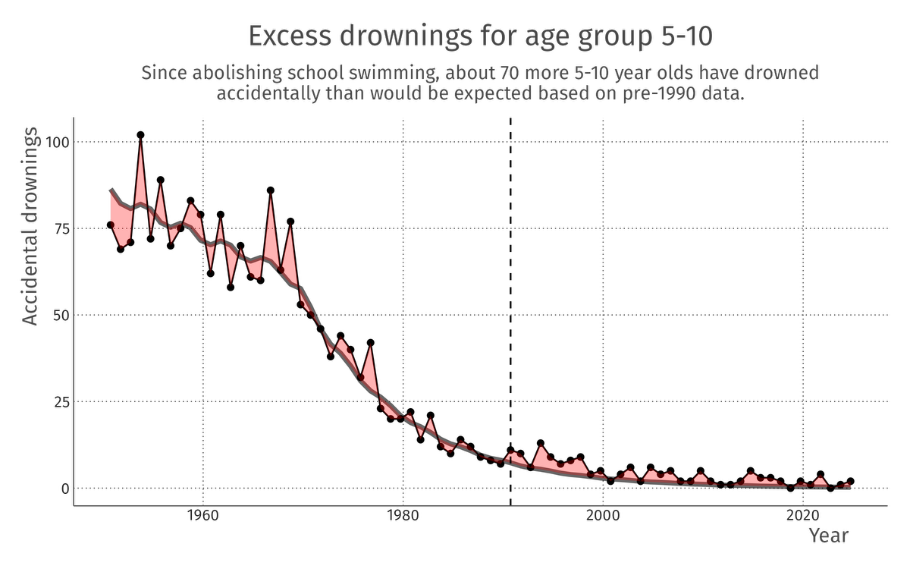
Time series model as a baseline
What about other age groups?
“Negative control”: What about age groups that should be unaffected?
“Negative control”: What about poison and falls?
Sensitive to the model?

Slide 49
Conclusion
Exploration is key to understanding things you did not know already
EDA walks a fine line between seeing useful and less useful things (overfitting, if you like)
Some useful principles are:
Peng’s checklist
Understanding what you’re seeing
Finding interesting comparisons
“Straightening and flattening” (using models and residuals)
Standard graphs to look at variation and association

