Slide 1
Data Wrangling and Data Analysis
Machine learning!
Daniel Oberski
Department of Methodology & Statistics
Utrecht University
VERSION: 2025-09-28

Slide 2
This week: supervised machine learning
Regression (predicting continuous outcomes)
More regression
Classification (predicting discrete outcomes)

Slide 3
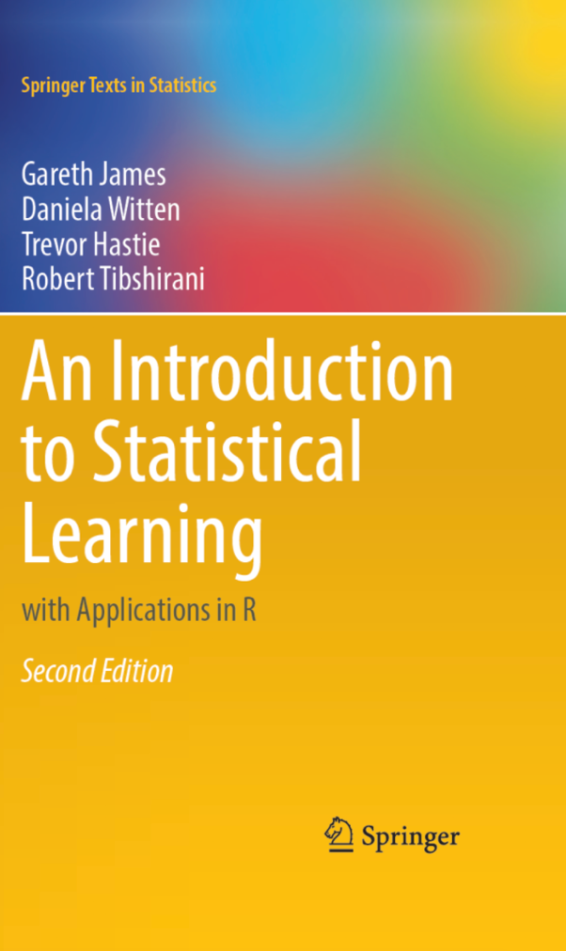
Online free version:
https://www.statlearning.com/

Slide 4
Bird’s eye (high-level) view of machine learning

Slide 5
ML definition (Samuel/Mitchell, 1959)
”A computer program is said to learn from experience E with respect to some class of tasks T and performance measure P if its performance at tasks in T, as measured by P, improves with experience E.”

Slide 6
Some translation
”A computer program is said to learn from experience E with respect to some class of tasks T and performance measure P if its performance at tasks in T, as measured by P, improves with experience E.”
 | (Loose) translations
Experience | Data; Example; Observation
Task | (Analysis) Purpose; Goal; Aim; Reason; Inference
Performance measure | Error; Loss; Cost; Risk;

Slide 7
Example tasks
Identifying customer segments and demographics to help build targeted advertising campaigns
Understanding sentiment of Twitter comments as either "positive" or "negative"
Identifying financial transactions that are potentially fraudulent
Ranking hotels you might like on hotel booking website
Recommending a book you might want to buy
Detecting brain lesions on an MRI
Predicting house prices based on house attributes such as number of bedrooms, location, and size
What could be the experience and the performance measure for each of these?

Slide 8
Machine learning definition revisited
What it says :
Define your goal (task), and let me know when you think I’m doing well at that goal (performance metric). Then give me some data (experience) and I will figure out how to get you closer to your goal (learn)
What it does not say :
You must always do/have <unattainable ideal> when analyzing data. Otherwise your analysis is worthless.

Slide 9
input
output
Testing data
Task
Training
data
Model
Perfor-mance
good model. /gʊd ˈmɒdl/ concept. 1 (statistics) a model with perfect input. 2 (machine learning) a model with good output, as measured by the performance metric.

Slide 10
Types of machine learning
We often distinguish 3 types of machine learning:
Supervised Learning: learn a model from labeled training data, then make predictions
Unsupervised Learning: explore the structure of the data to extract meaningful information
Reinforcement Learning: develop an agent that improves its performance based on interactions with the environment

Slide 11
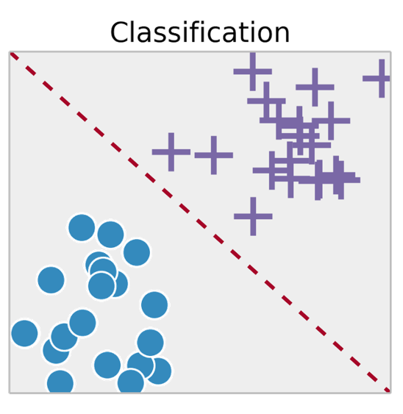
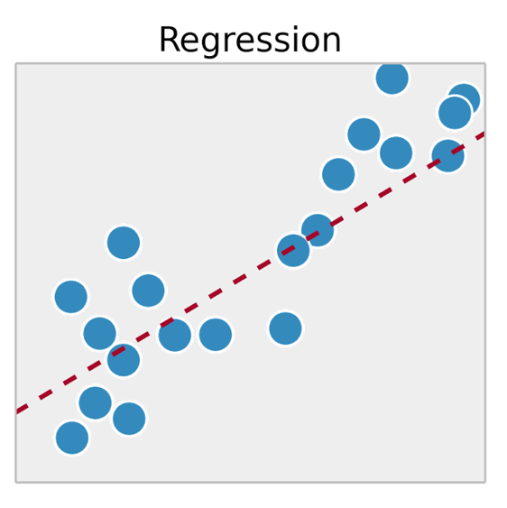
Supervised classification vs. regression
Classification: predict a class label (discrete category)
Regression:
predict a continuous value
Notes:
Many standard algoritms can do both
Uncertainty quant

Slide 12

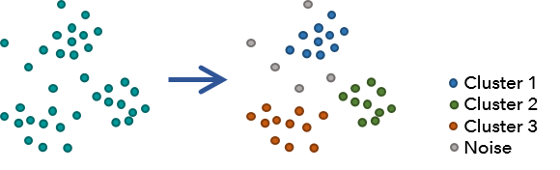
Unsupervised learning
Learn a model from unlabeled training data
Predict “labels” from unlabeled data, or predict new data
E.g.: PCA, clustering, VAE, GANs, …
Generate a photo of students in the Master Applied Data Science at Utrecht University.
Notes:
Many standard algoritms can do both
Uncertainty quant

Slide 13
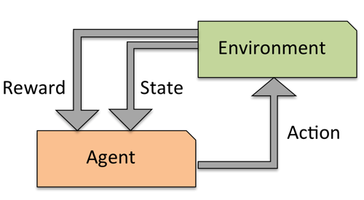
Reinforcement learning (not in this course)
Develop agent that improves performance based on interactions with environment
Example: Chess, Go, ¿healthcare?…
Reward function defines how well actions work
Learn actions that maximize reward through exploration

Slide 14
Regression

Slide 15
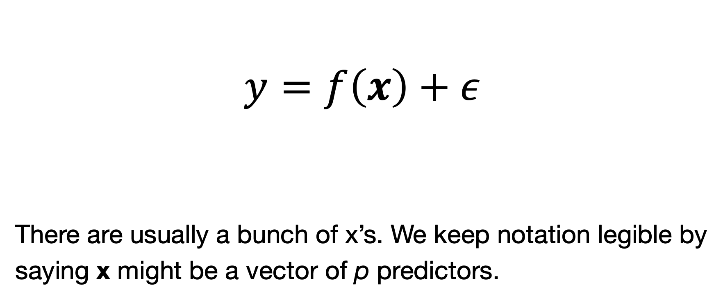
Regression
$$y=f\left(x\right)+ε$$
There are usually a bunch of x’s. We keep notation legible by
saying x might be a vector of p predictors.

Slide 16
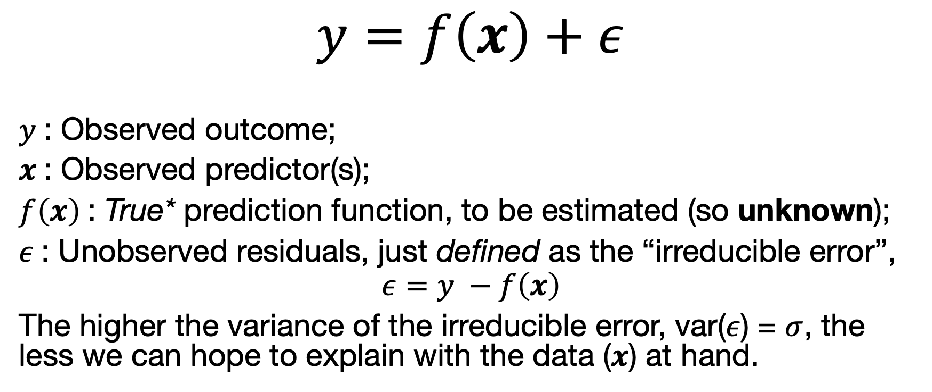
Regression
$$y=f\left(x\right)+ε$$
$y$: Observed outcome;
$x$: Observed predictor(s);
$f\left(x\right)$: True* prediction function, to be estimated (so unknown);
$ε$: Unobserved residuals, just defined as the “irreducible error”,
$$ε=y −f\left(x\right)$$
The higher the variance of the irreducible error, var($ε$) = $σ$, the less we can hope to explain with the data ($x$) at hand.

Slide 17
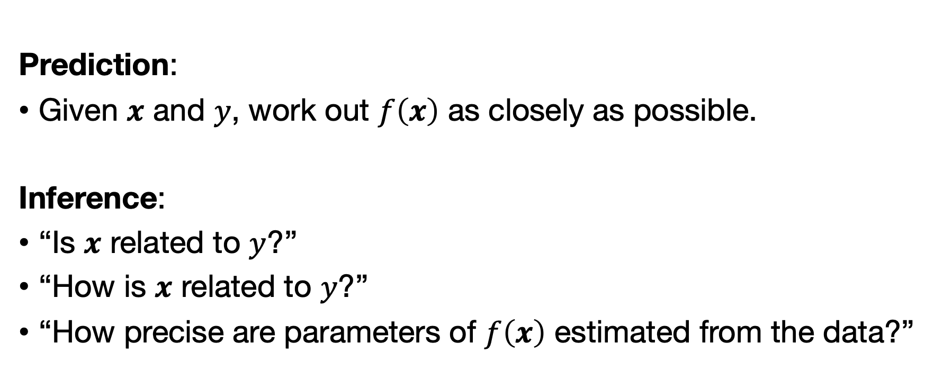
Different goals of regression
Prediction:
Given $x$ and $y$, work out $f\left(x\right)$ as closely as possible.
Inference:
“Is $x$ related to $y$?”
“How is $x$ related to $y$?”
“How precise are parameters of $f\left(x\right)$ estimated from the data?”
Galit Schmueli (2010). To Explain or to Predict?. Statistical Science.

Slide 18



Example regression techniques
Least-squares based:
Linear regression
Polynomial regression
Basis functions, Splines
Tree-based:
Regression trees
Random forests
Gradient boosting
Other:
Neural networks, deep learning, k-NN
$$f\left(x_{i}\right)=b_{0}+b_{1}x_{i}$$
$$f\left(x_{i}\right)=b_{0}+b_{1}x_{i}+b_{2}x_{i}^{2}+b_{3}x_{i}^{3}$$
$$f\left(x_{i}\right)=b_{0}+b_{1}x_{i}+b_{2}x_{i}^{2}+b_{3}x_{i}^{3}+{b_{4}\left(x−ξ\right)}_{+}^{3}$$

Slide 19
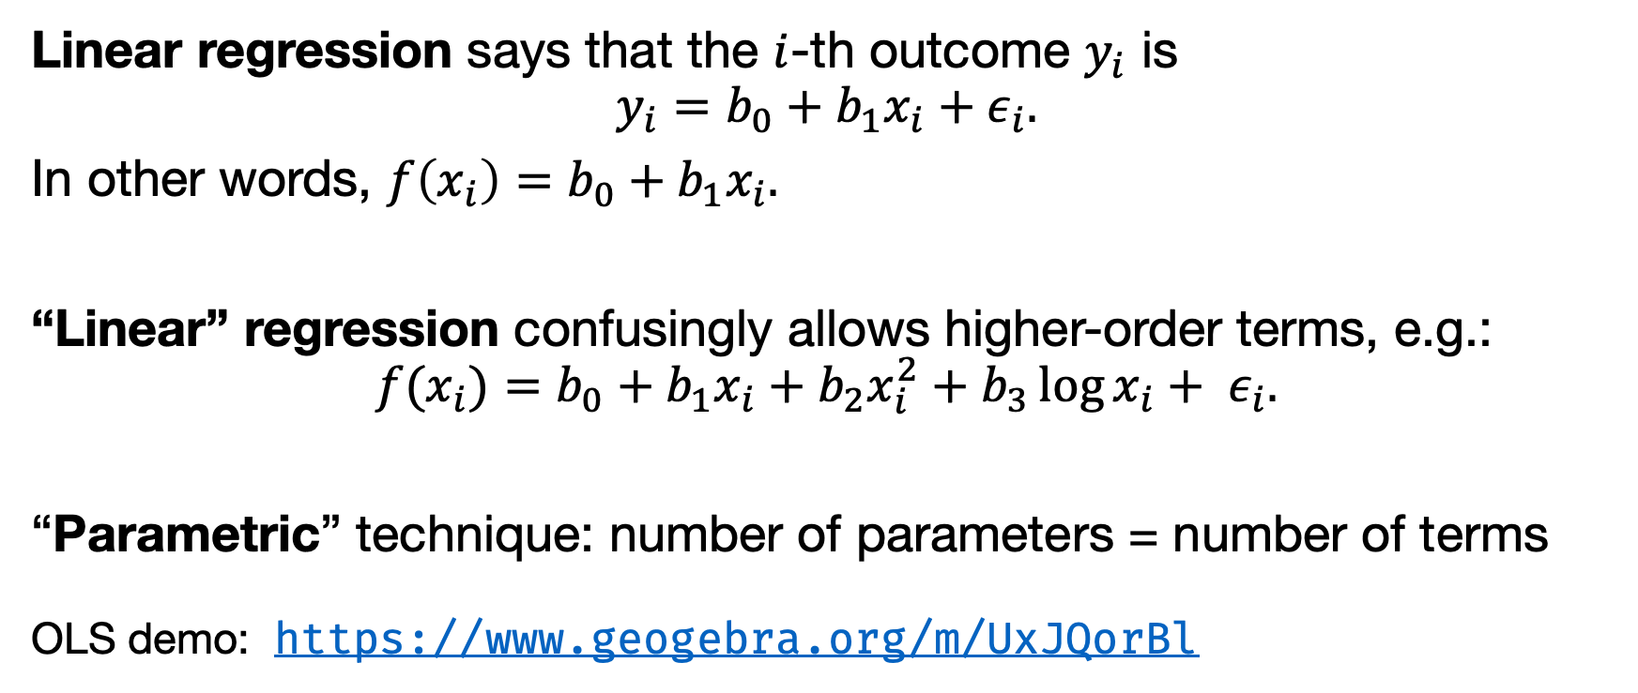
Linear regression reminder
Linear regression says that the $i$-th outcome $y_{i}$ is
$$y_{i}=b_{0}+b_{1}x_{i}+ε_{i}.$$
In other words, $f\left(x_{i}\right)=b_{0}+b_{1}x_{i}.$
“Linear” regression confusingly allows higher-order terms, e.g.:
$$f(x_{i})=b_{0}+b_{1}x_{i}+b_{2}x_{i}^{2}+b_{3}\log{x_{i}}+ ε_{i}.$$
“Parametric” technique: number of parameters = number of terms
OLS demo: https://www.geogebra.org/m/UxJQorBl

Slide 20
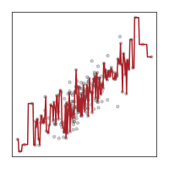
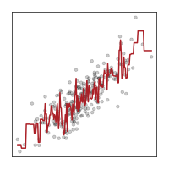
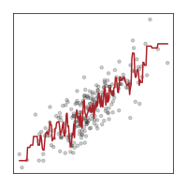
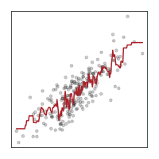
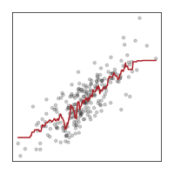
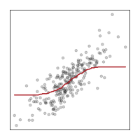
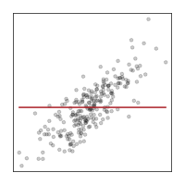

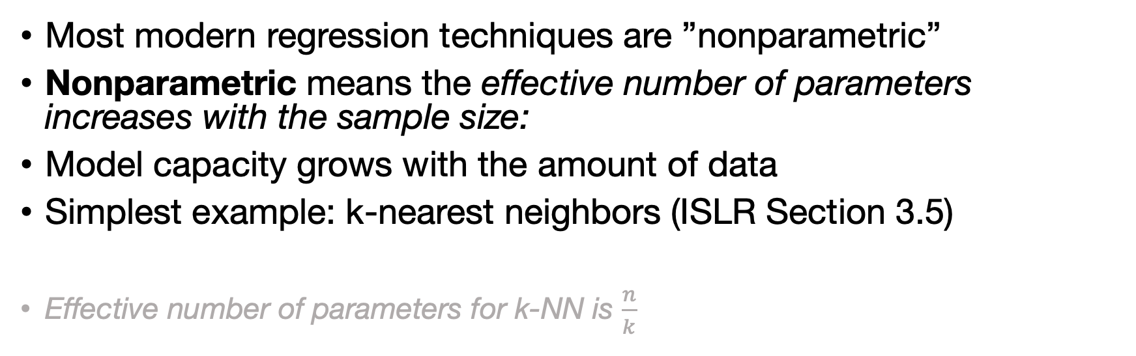






“Nonparametric” regression
Most modern regression techniques are ”nonparametric”
Nonparametric means the effective number of parameters increases with the sample size:
Model capacity grows with the amount of data
Simplest example: k-nearest neighbors (ISLR Section 3.5)
Effective number of parameters for k-NN is $\frac{n}{k}$
$$k=1$$
$$k=2$$
$$k=3$$
$$k=5$$
$$k=10$$
$$k=100$$
$$k=n$$

Slide 21
More nonparametrics.
k-NN is not so great at controlling complexity when the number of features is more than ~5.
Hence the rest of machine learning.
“Bottom-up”: complexity increases with data | “Top-down”: complexity decreases down to data
K-nearest neighbors | Random forests
Kernel regression | Deep learning / Neural nets / Transformers
Support vector regression
Boosting
Gaussian process regression

Slide 22
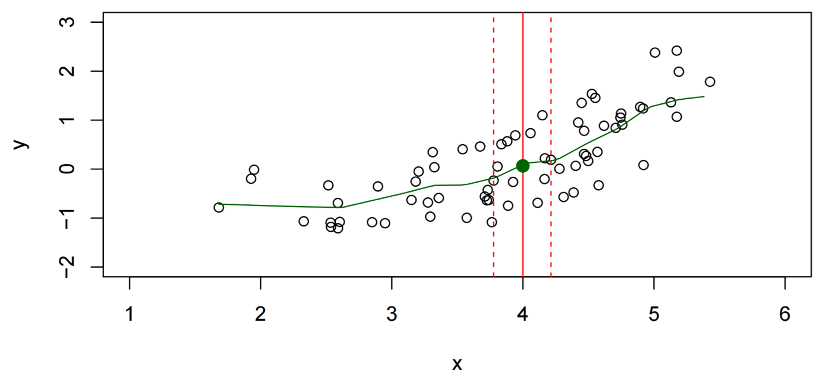
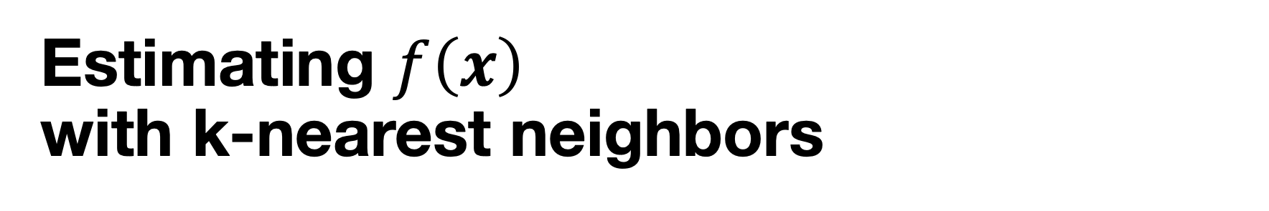
Estimating $f\left(x\right)$ with k-nearest neighbors
Typically we have no data points with x = 4 exactly.
Take “neighborhood” of points around 4 and predict average:

Slide 23
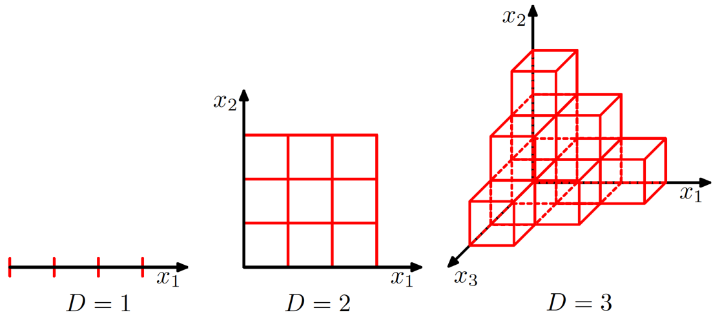
Why not kNN: “Curse of dimensionality”
kNN is intuitive and can work well with few predictors;
With “many” (say, 5 or more) predictors, kNN breaks down:
Closest points on many predictors simultaneously are actually far away!
Source: Bishop (2006).
Pattern recognition and
machine learning.

Slide 24

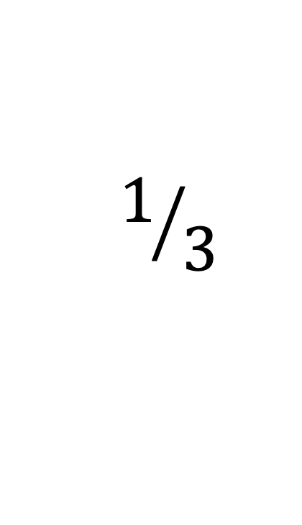
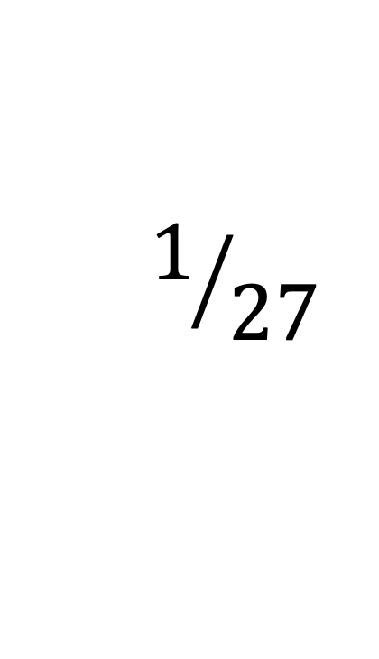
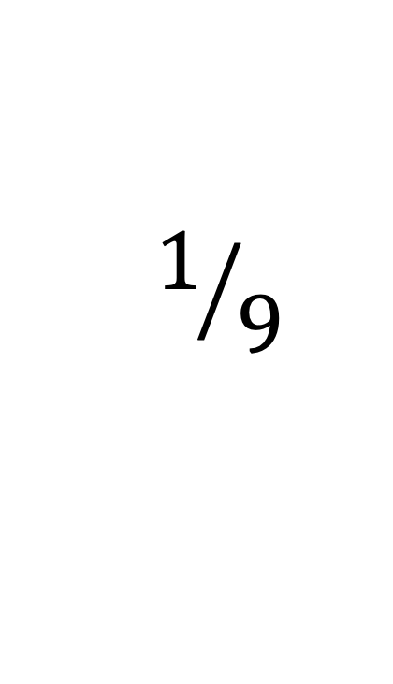
$$1/{27}$$
$$1/9$$
$$1/3$$

Slide 25
An exercise in prediction

Slide 26
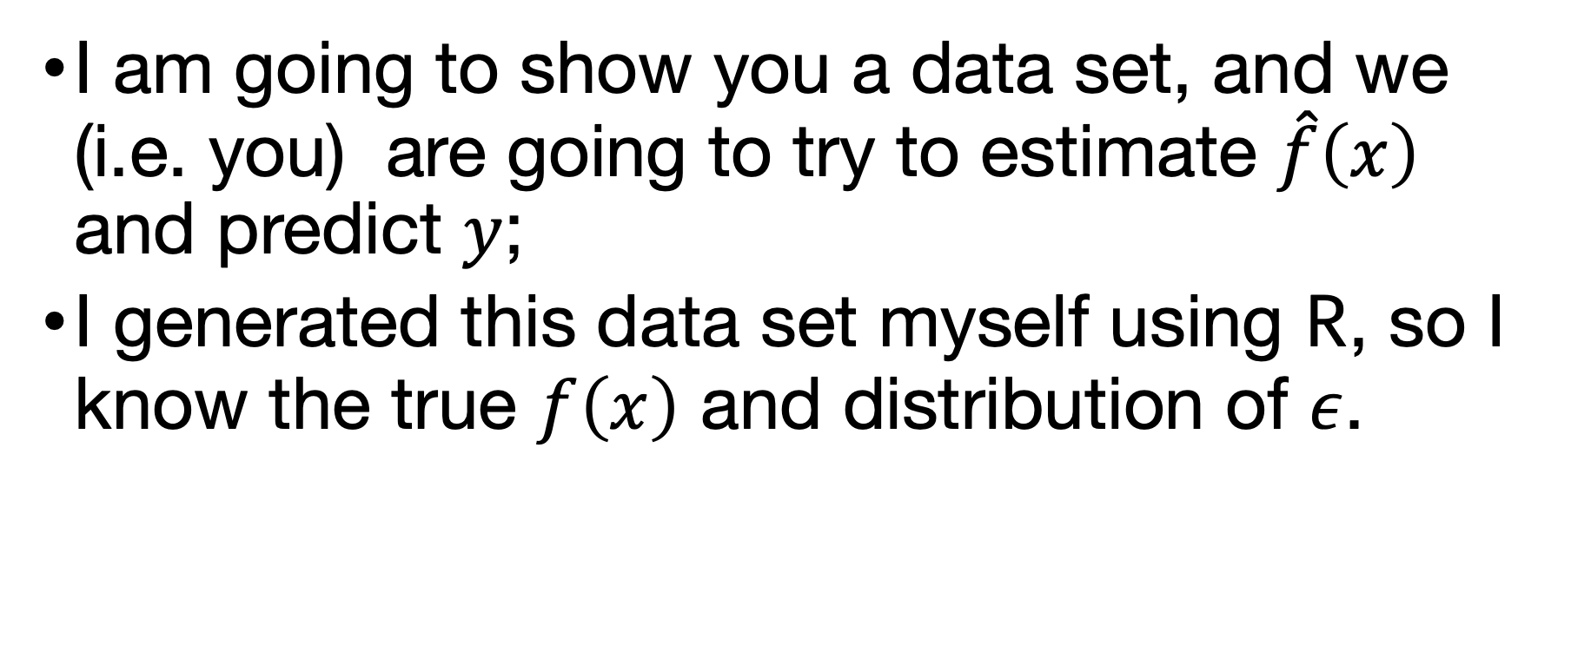
I am going to show you a data set, and we (i.e. you) are going to try to estimate $\hat{f}\left(x\right)$ and predict $y$;
I generated this data set myself using R, so I know the true $f\left(x\right)$ and distribution of $ε$.

Slide 27
Task: predict (however you want): $\hat{y}$ for $x=0.6, 1.6, 2.0$.

Slide 28
Task: predict (however you want): $\hat{y}$ for $x=0.6, 1.6, 2.0$.

Slide 29
Task: predict (however you want): $\hat{y}$ for $x=0.6, 1.6, 2.0$.

Slide 30
Task: predict (however you want): $\hat{y}$ for $x=0.6, 1.6, 2.0$.

Slide 31
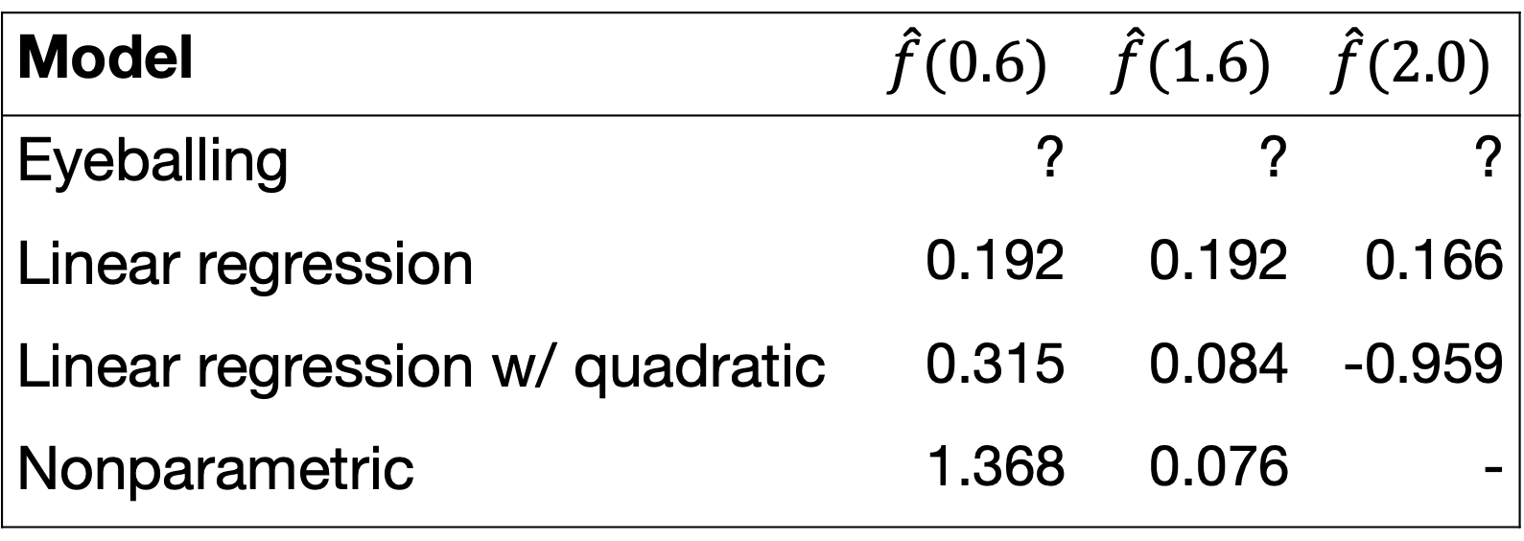
Model | $$\hat{f}(0.6)$$ | $$\hat{f}(1.6)$$ | $$\hat{f}(2.0)$$
Eyeballing | ? | ? | ?
Linear regression | 0.192 | 0.192 | 0.166
Linear regression w/ quadratic | 0.315 | 0.084 | -0.959
Nonparametric | 1.368 | 0.076 | -

Slide 32
The truth (normally we don’t know this!)

Slide 33
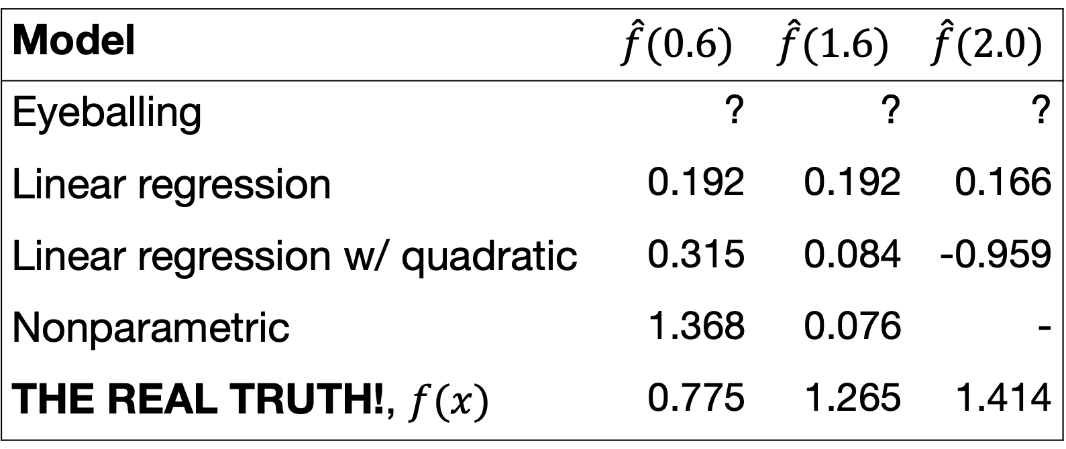
Model | $$\hat{f}(0.6)$$ | $$\hat{f}(1.6)$$ | $$\hat{f}(2.0)$$
Eyeballing | ? | ? | ?
Linear regression | 0.192 | 0.192 | 0.166
Linear regression w/ quadratic | 0.315 | 0.084 | -0.959
Nonparametric | 1.368 | 0.076 | -
THE REAL TRUTH!, $f(x)$ | 0.775 | 1.265 | 1.414

Slide 34
Model performance

Slide 35

Model performance
The predictions $\hat{y}=\hat{f}(x)$ differ from the true $f (x)$;
We can evaluate how much this happens “on average”.

Slide 36
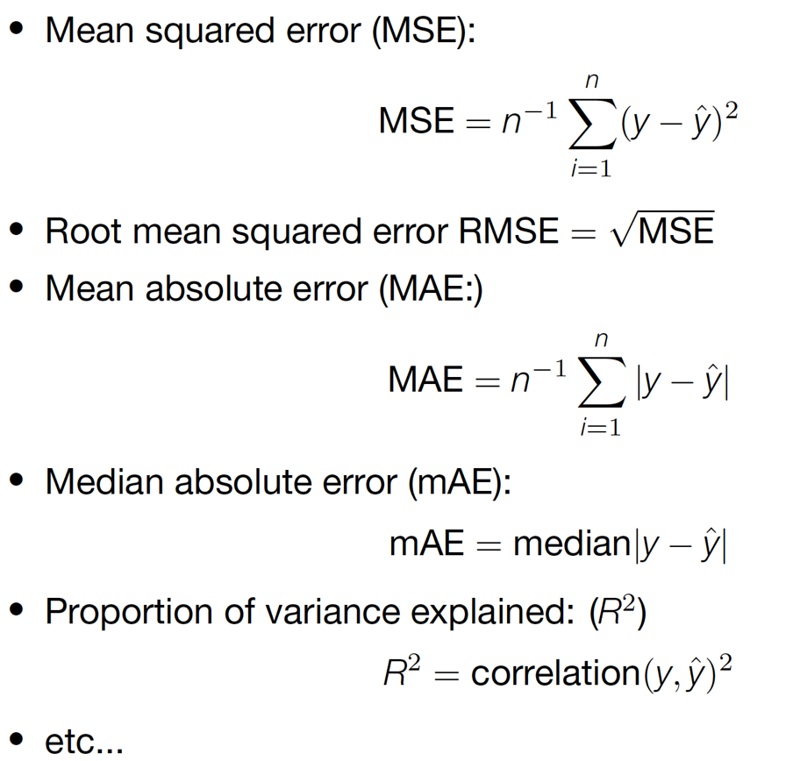
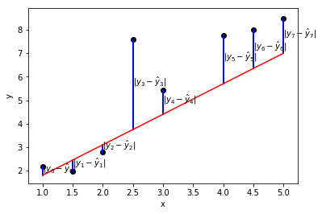
A few model evaluation metrics

Slide 37
Thinking about loss functions

Slide 38
So, who won…?
Which model appears to fit best to the training data?
Calculate MSE for one model, relative to truth.
Which is the best model in terms of MSE?

Slide 39
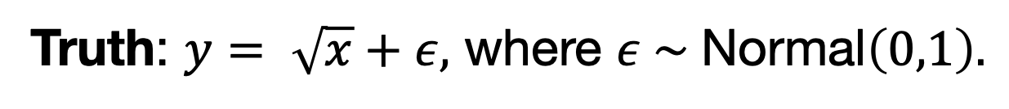
And the winner is…
Model | MSE | MSE (interpolation)
Eyeballing | ? | ?
Linear regression | 0.992 | 0.709
Linear regression w/ quadratic | 2.410 | 0.883
Nonparametric | - | 0.883
Truth: $y= \sqrt{x}+ε,$ where $ε \sim \text{Normal}\left(0,1\right).$

Slide 40
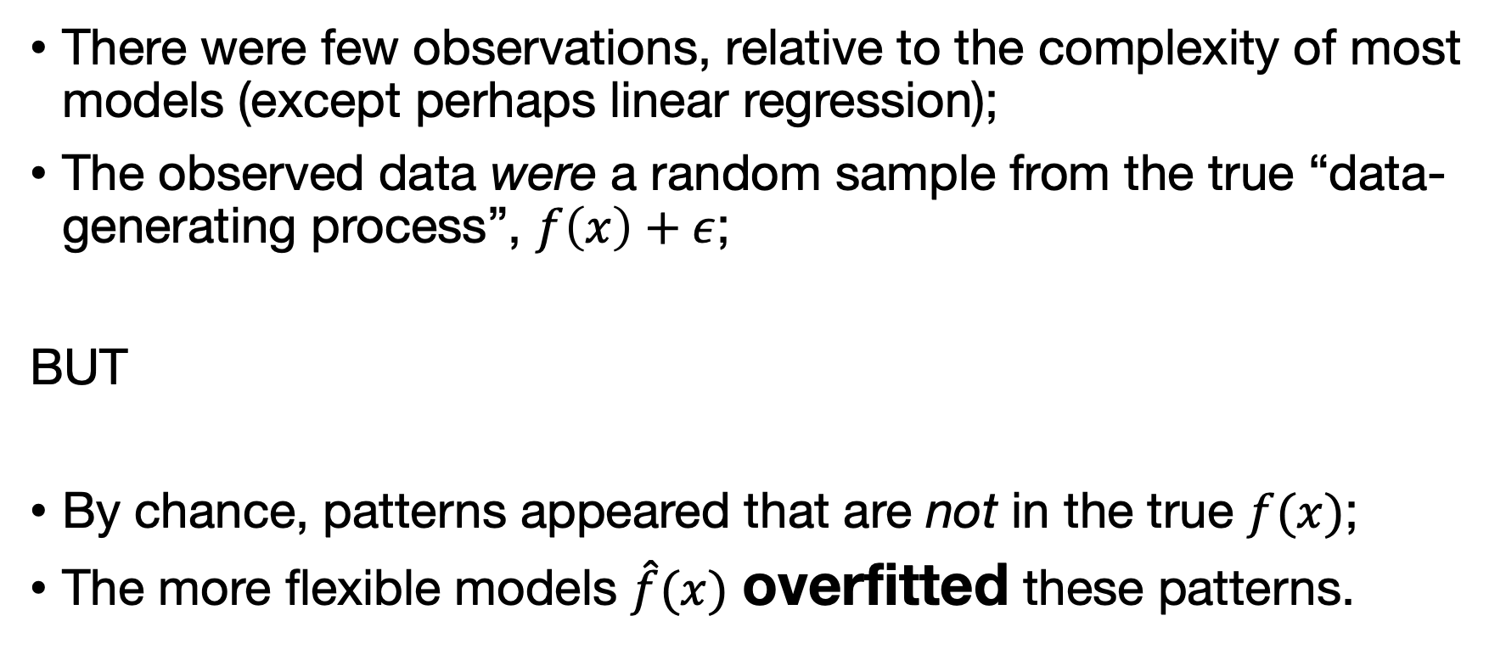
What happened?
There were few observations, relative to the complexity of most models (except perhaps linear regression);
The observed data were a random sample from the true “data-generating process”, $f\left(x\right)+ε$;
BUT
By chance, patterns appeared that are not in the true $f(x)$;
The more flexible models $\hat{f}(x)$ overfitted these patterns.

Slide 42
Thought experiment
Imagine we had sampled another 5 observations, re-trained all of our models, and predicted again.
Each time we remember the predictions given.
We do this a large number of (say, 1,000,000,000) times, and then take the average for the predictions over all samples
Questions
Which model(s) would give the right prediction on average?
Which model(s) would give wildly varying predictions?
Which model(s) would you guess have the lowest MSE overall?

Slide 43
Unbiased
Model that gives the correct prediction, on average over samples from the target population
Unbiased in our example: nonparametric, square-root
Biased in our example: all others
High variance:
Model that easily overfits accidental patterns.
High variance in our example: nonparam., quadratic, sq-root
Low variance in our example: linear regression

Slide 44
Bias and variance in our example
Some, possibly surprising, conclusions:
The best model in one sense is the worst model in the other!
The “correct” model is not the best model!

Slide 45
Bias-variance tradeoff
Flexibility ➞ less bias
Flexibility ➞ more variance
Bias and variance are implicitly linked because they are both affected by model complexity (“flexibility”, “capacity”, “effective number of parameters”)

Slide 46
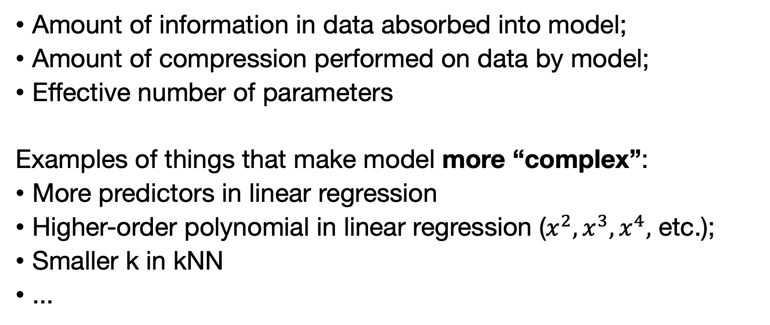
What do you mean by “complexity”?
Amount of information in data absorbed into model;
Amount of compression performed on data by model;
Effective number of parameters
Examples of things that make model more “complex”:
More predictors in linear regression
Higher-order polynomial in linear regression ($x^{2}, x^{3},x^{4},$ etc.);
Smaller k in kNN
...

Slide 47
Question:
Does the bias-variance tradeoff occur with n = 5?
Does the bias-variance tradeoff occur with n = 5,000,000,000?

Slide 48
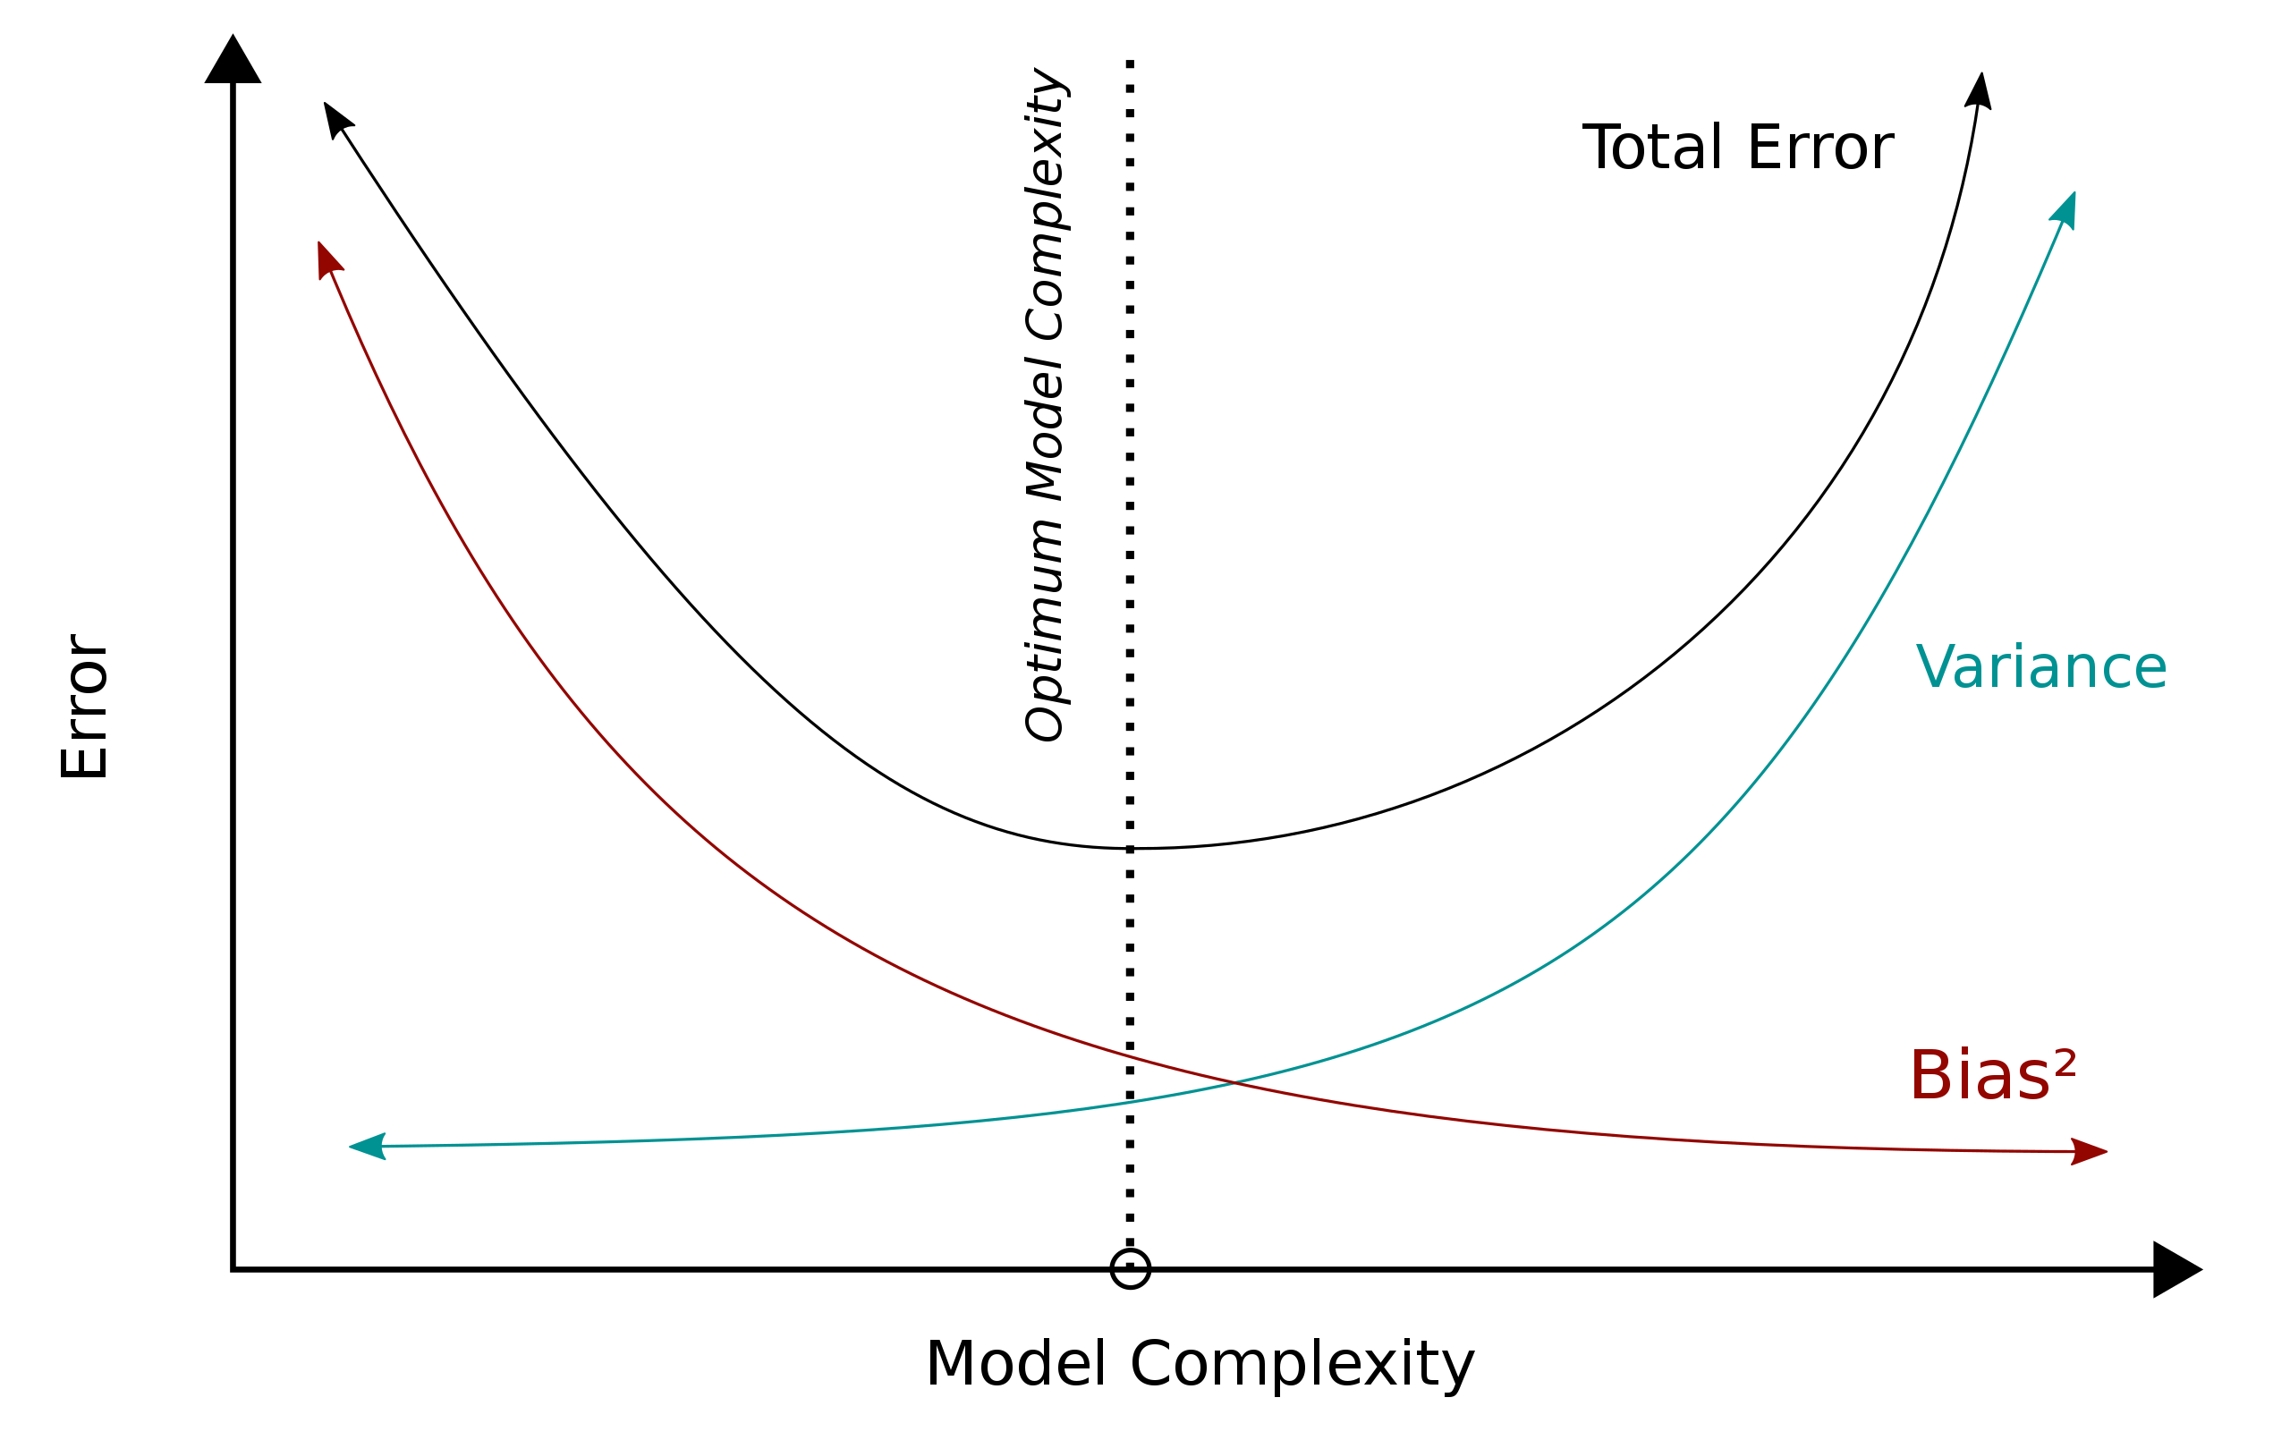

Slide 49
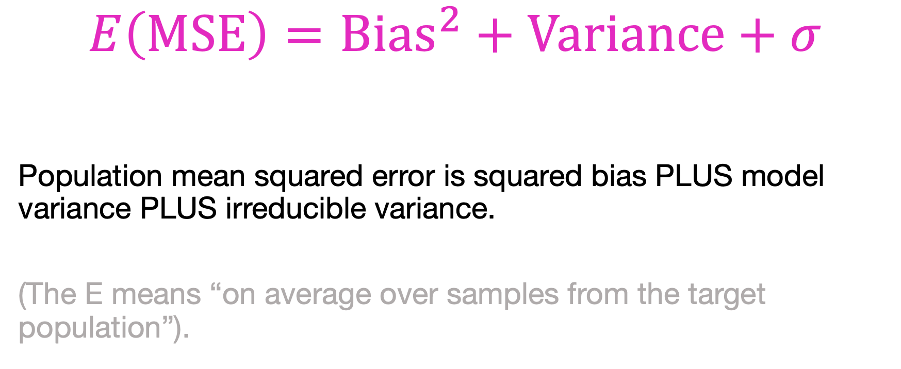
$$E\left(\text{MSE}\right)={\text{Bias}}^{2}+\text{Variance}+σ$$
Population mean squared error is squared bias PLUS model variance PLUS irreducible variance.
(The E means “on average over samples from the target population”).

Slide 51
In thought experiment-land, I knew the true f(x) so you could calculate exactly what E(MSE) was;
This is sometimes called the “Bayes error”.
In practice we do not know the truth;
How can we estimate E(MSE)?

Slide 52
Back to reality!
Problem:
Wait, we don’t actually have the population!
And our training data were already used to train the model…
Solution:
Instead, we will take a new, pristine, sample from population:
The test data

Slide 53
The train-val-test paradigm

Slide 54
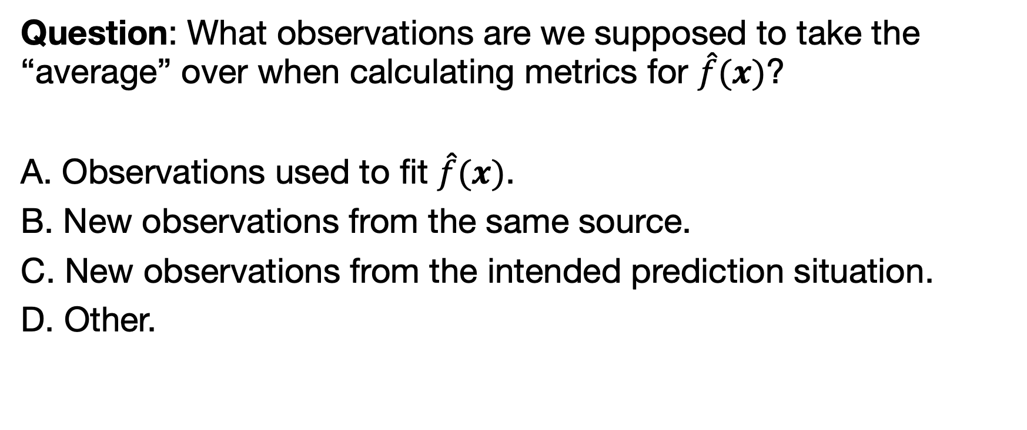
Question: What observations are we supposed to take the “average” over when calculating metrics for $\hat{f}(x)$?
A. Observations used to fit $\hat{f}(x)$.
B. New observations from the same source.
C. New observations from the intended prediction situation.
D. Other.

Slide 55
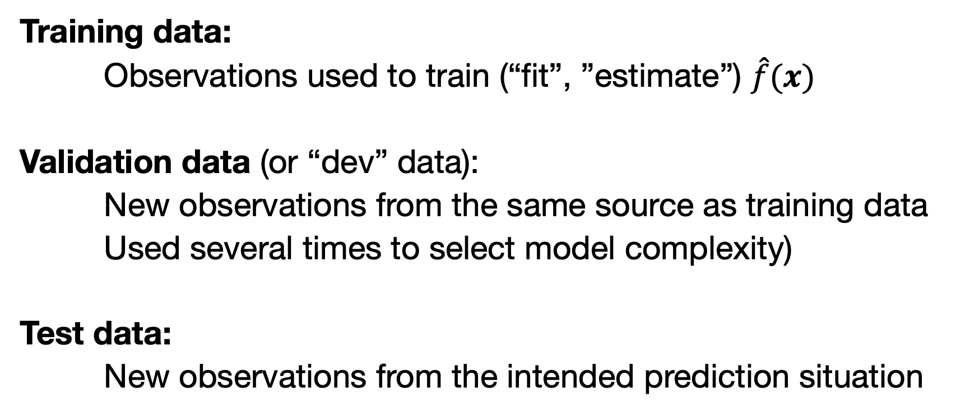
Train/dev/test
Training data:
Observations used to train (“fit”, ”estimate”) $\hat{f}(x)$
Validation data (or “dev” data):
New observations from the same source as training data
Used several times to select model complexity)
Test data:
New observations from the intended prediction situation
Question: Why don’t these give the same average MSE?

Slide 56
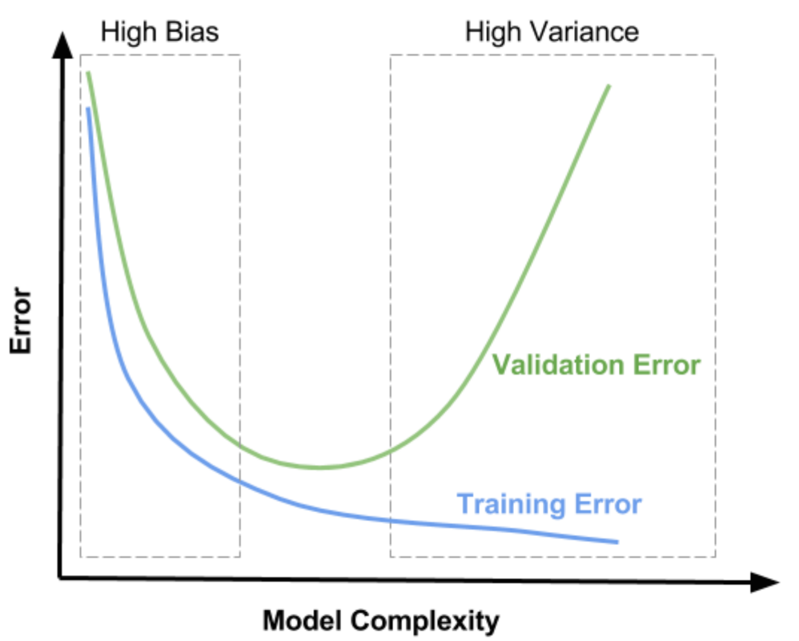
REDACTED
REDACTED

Slide 57
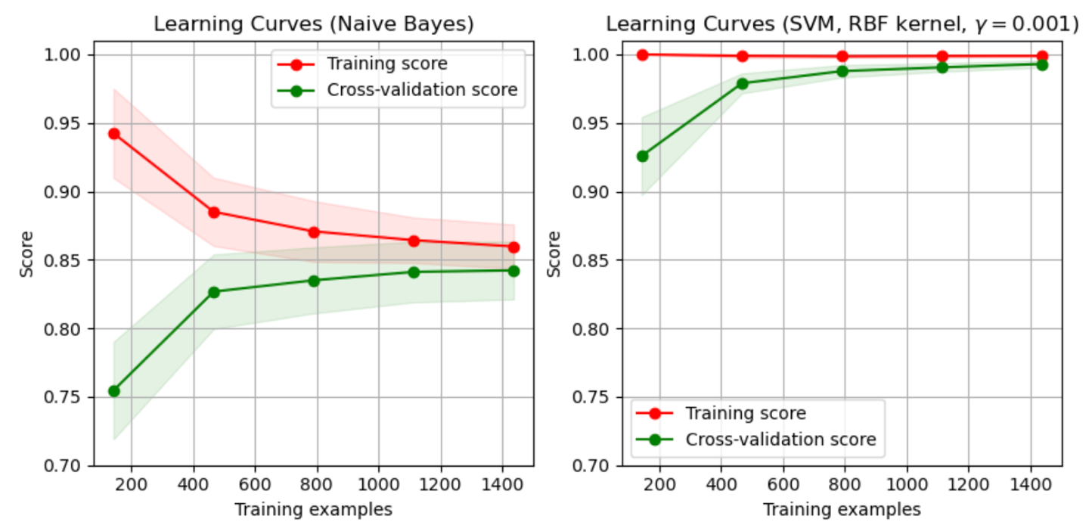
Learning curves: n vs. performance

Slide 58
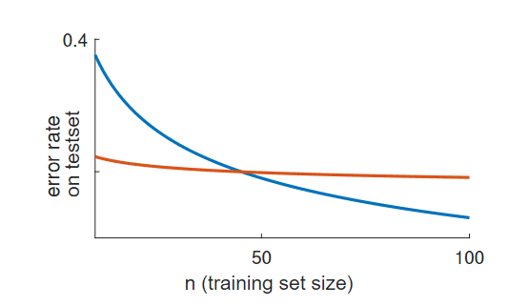
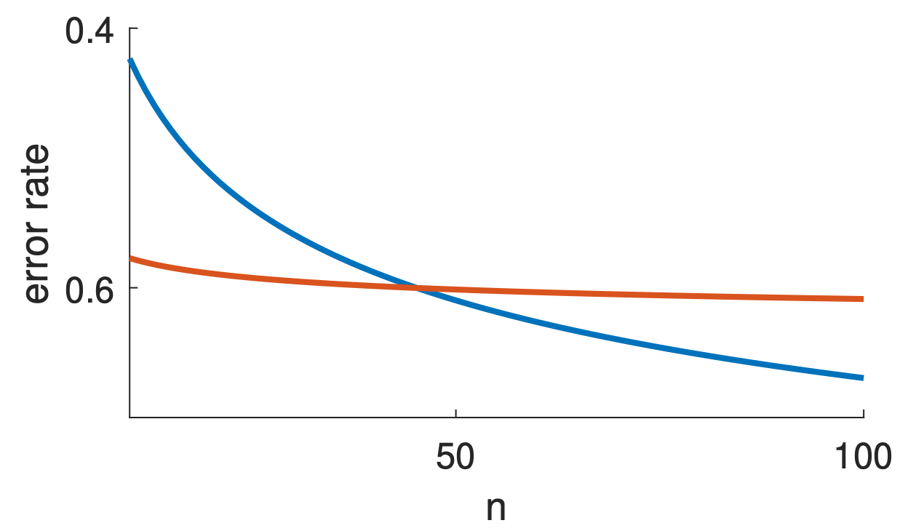
Learning curves
Linear regression
Deep learning
Viering & Loog (2021). The Shape of Learning Curves: a Review. https://arxiv.org/pdf/2103.10948.pdf

Slide 59
Conclusion
Choose your data, goal, and performance metric with care
Bias and variance trade off, in theory and practice;
We try to estimate this using train/dev/test paradigm;
Getting good test data is difficult problem;
Cross-validation is a useful alternative to separate dev set;
Beware that any procedure that makes decisions based on the data requires validation!
Machine learning is not (only) about models/algorithms. It is just as much about data, the reality of your task, etc.

