Slide 1
Data Wrangling and Data Analysis
Machine learning!
#2
Daniel Oberski
Department of Methodology & Statistics
Utrecht University
VERSION: 2025-10-06

Slide 2
Supervised machine learning
Regression (predicting continuous outcomes)
Regression: evaluation
Classification (predicting discrete outcomes)

Slide 3
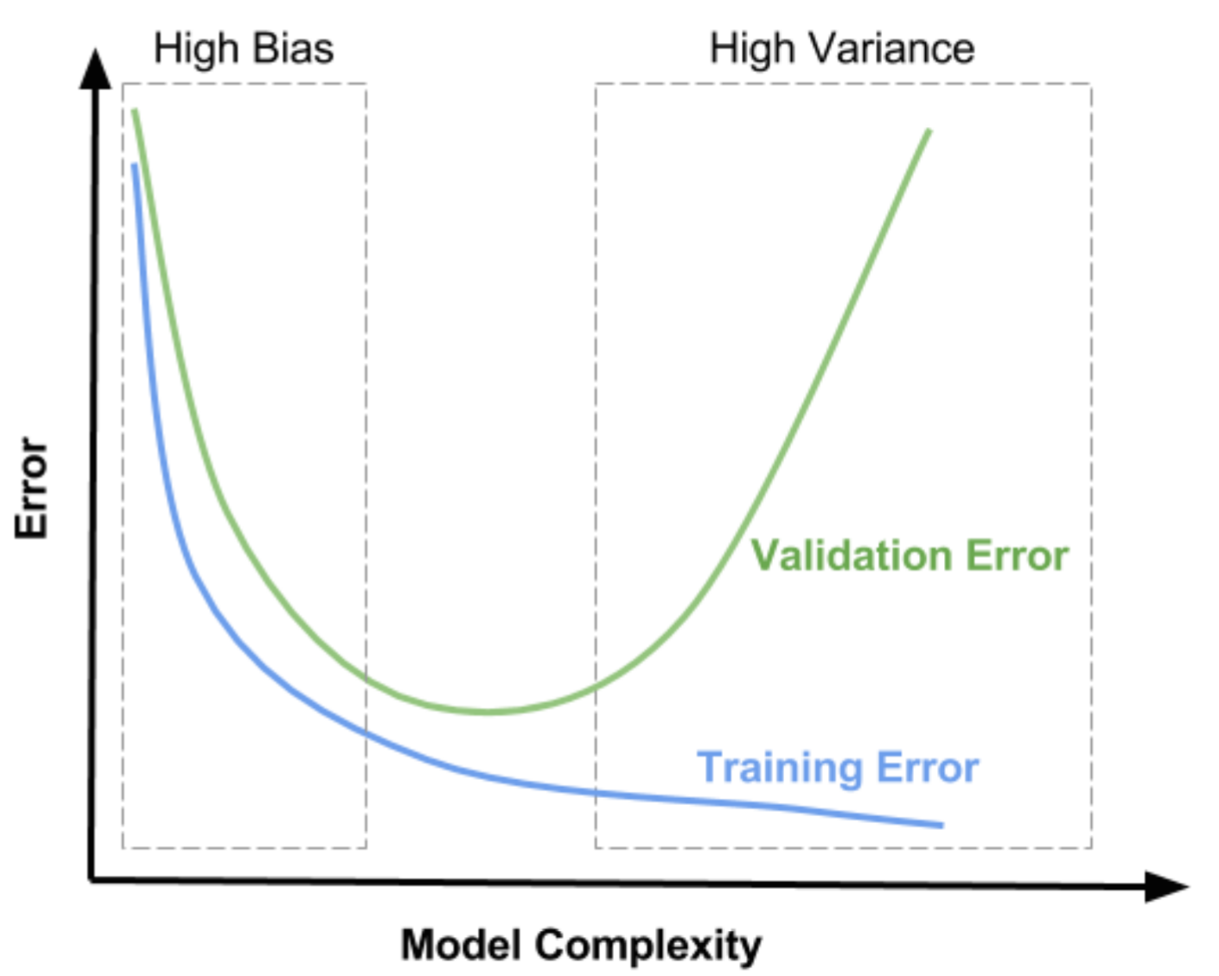
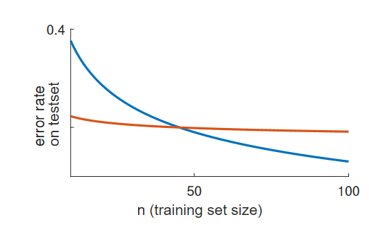

Recap: regression
$$y=f\left(x\right)+ε$$
Linear regression
Deep learning

Slide 4
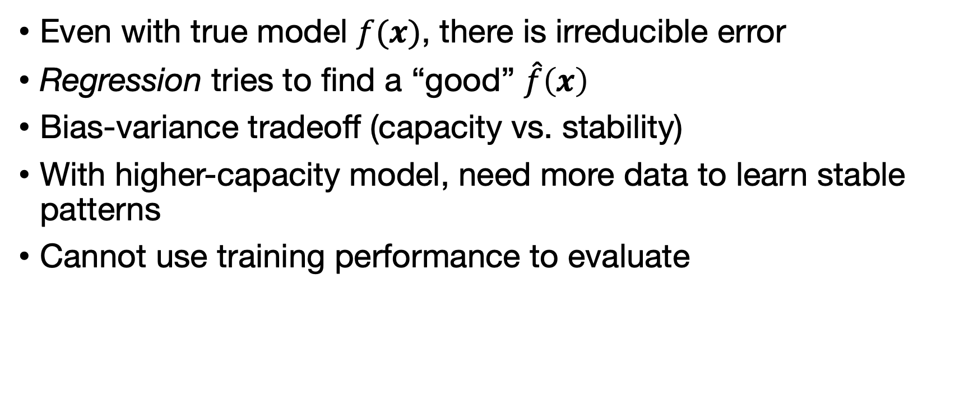
Recap: regression
Even with true model $f(x)$, there is irreducible error
Regression tries to find a “good” $\hat{f}\left(x\right)$
Bias-variance tradeoff (capacity vs. stability)
With higher-capacity model, need more data to learn stable patterns
Cannot use training performance to evaluate
Notes:
How could you go about attacking one?

Slide 5
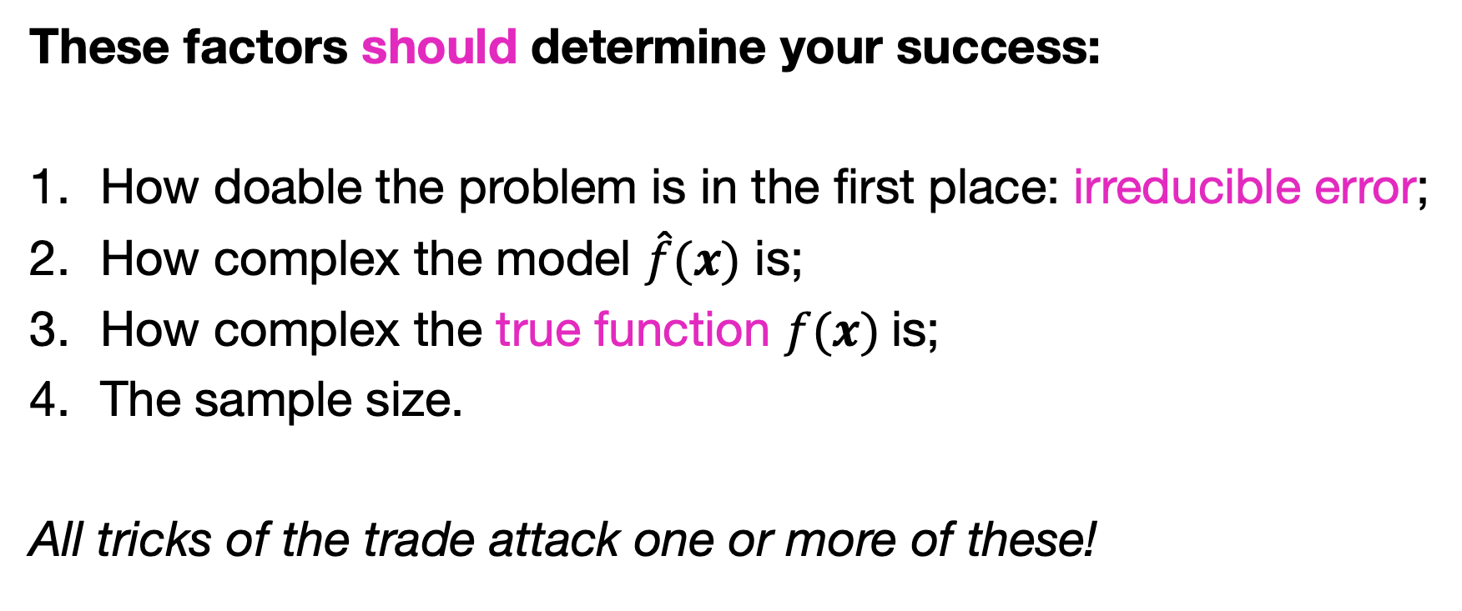
Will my model succeed?
These factors should determine your success:
How doable the problem is in the first place: irreducible error;
How complex the model $\hat{f}(x)$ is;
How complex the true function $f(x)$is;
The sample size.
All tricks of the trade attack one or more of these!
Notes:
How could you go about attacking one?

Slide 6
Problem | Some ideas for plan of attack | Example
Irreducible error | Get more features; Reduce measurement error | LIDAR on car; Multiple rating radiologists
Model capacity | Try models with range of capacities; Include prior knowledge in the model | Download pretrained model and use that as starting point
Task complexity | Choose something easier; Influence the process | Paint road signs for self-driving
Sample size | Get more examples | Illegally download all digital books and pay fine later.

Slide 7
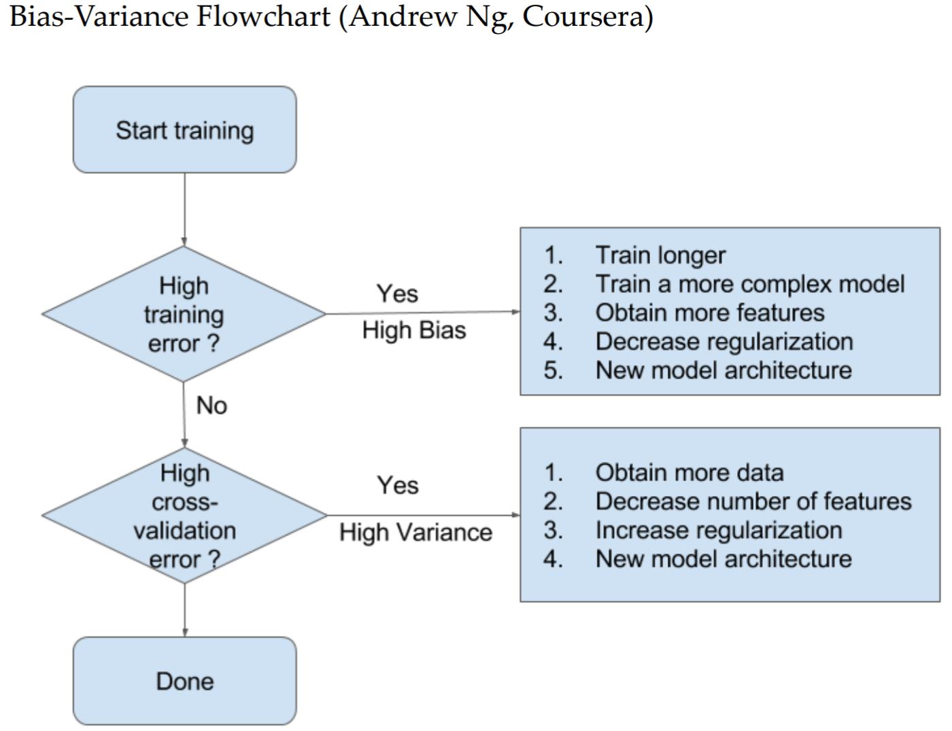

Slide 8
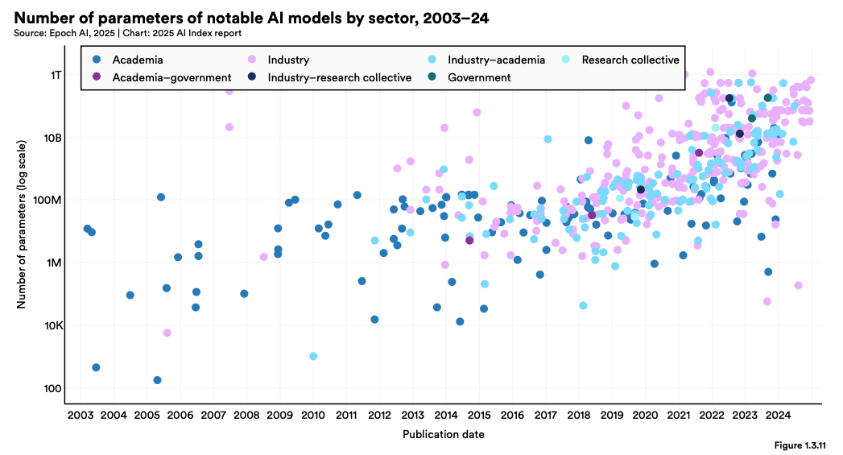
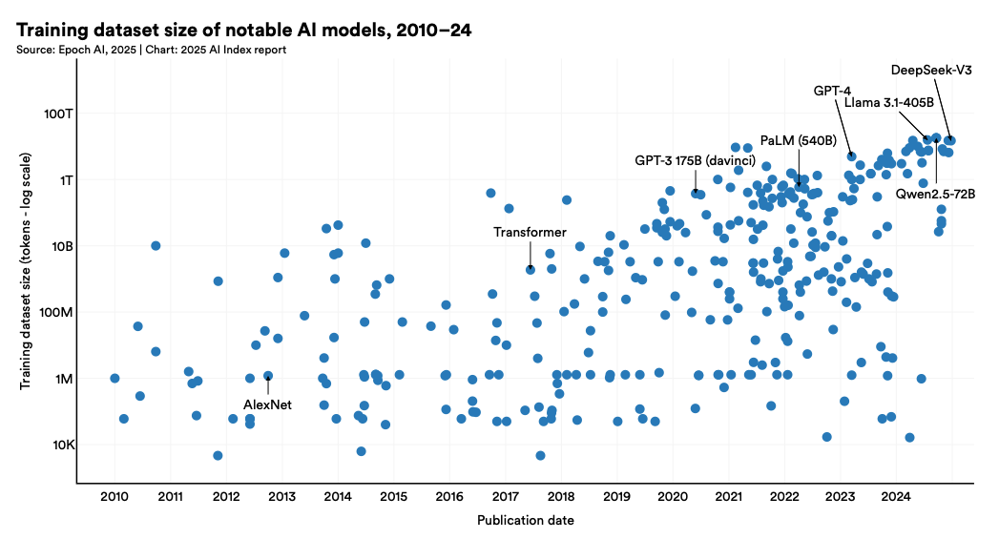
LLM #parameters and dataset size

Slide 9
Model evaluation

Slide 10
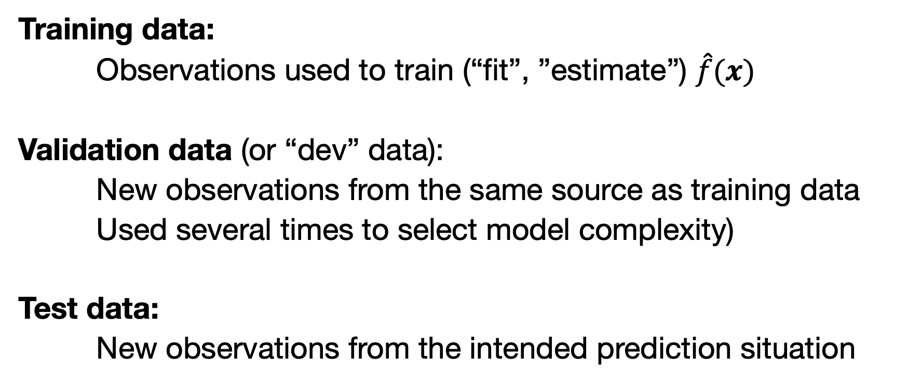
Reminder: Train/dev/test
Training data:
Observations used to train (“fit”, ”estimate”) $\hat{f}(x)$
Validation data (or “dev” data):
New observations from the same source as training data
Used several times to select model complexity)
Test data:
New observations from the intended prediction situation
Question: Why don’t these give the same average MSE?

Slide 11
Drawbacks of train/dev/test
The validation estimate of the test error is based on a single sample and can therefore be highly variable
Only a subset of observations are used to train the model (model could have learned more)
This suggests that the validation set error may tend to overestimate the test error for the model fit on the entire data set.

Slide 12
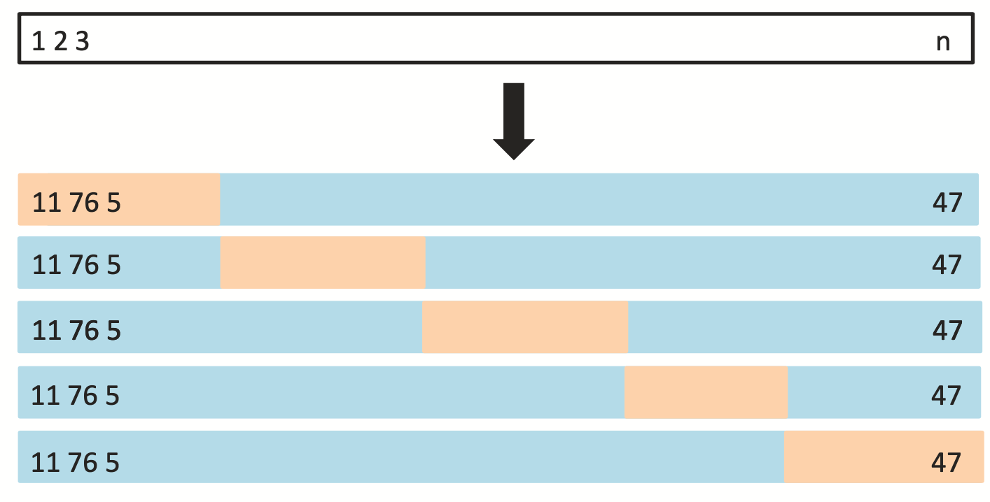
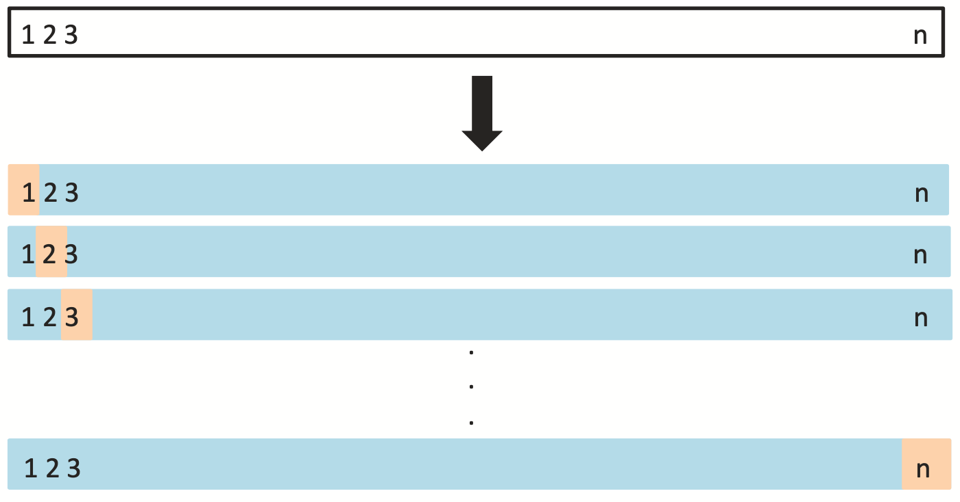
K-fold crossvalidation
“Cross-validation” replaces single dev set approach;
Perform the train/dev split several times, average the result.
Usually K = 5 or K = 10
Here, K = 5 as is more usual
When K = n, “leave-one-out”

Slide 13


Slide 14
Consider a simple regression used to predict an outcome:
Starting with 5000 predictors and 500 cases, find the 100 predictors having the largest correlation with the outcome;
We then fit a linear regression, using only these 100 predictors.
Class exercise:
How do we estimate the test set performance of this classifier?
Can we apply cross-validation in step 2, forgetting about step 1?

Slide 15
Answer: In Step 1, the procedure has already seen the labels of the training data, and made use of them. This is a form of training and must be included in the validation process!

Slide 16
Common task framework (CTF)
a.k.a. “benchmarking”

Slide 17
The Common Task Framework
(a) A publicly available training dataset
(b) A set of enrolled competitors whose common task is to infer a class prediction rule from the training data.
(c) A scoring referee, to which competitors can submit their prediction rule.
The referee runs the prediction rule against a testing dataset, which is sequestered behind a Chinese wall.
The referee objectively and automatically reports the score achieved by the submitted rule.
Donoho (2017). 50 years of data science. J Comp Graphical Stat.

Slide 18
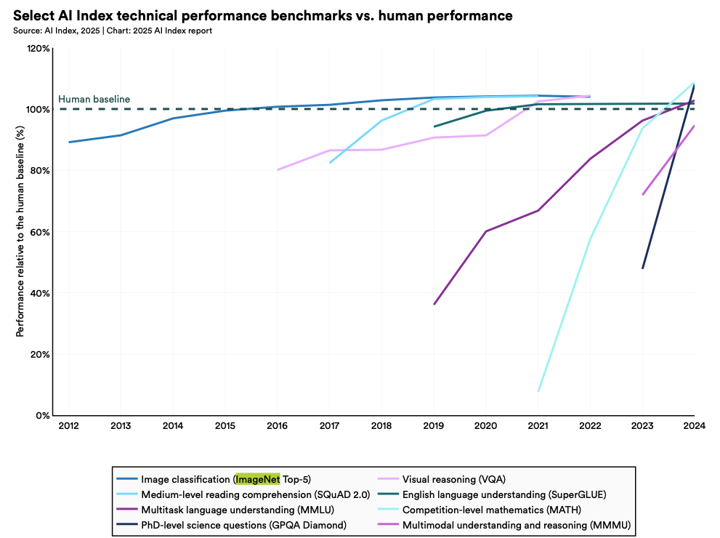
CTF/benchmarking advantages
1. Error rates decline by a fixed percentage each year, to an asymptote depending on task and data quality.
2. Progress usually comes from many small improvements; a change of 1% can be a reason to break out the champagne.
3. Shared data plays a crucial role.

Slide 19

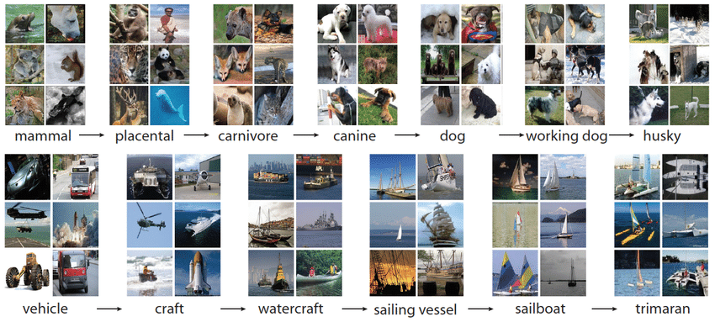
Imagenet
Future Nobel (?) Fei-Fei Li
Notes:
x

Slide 20
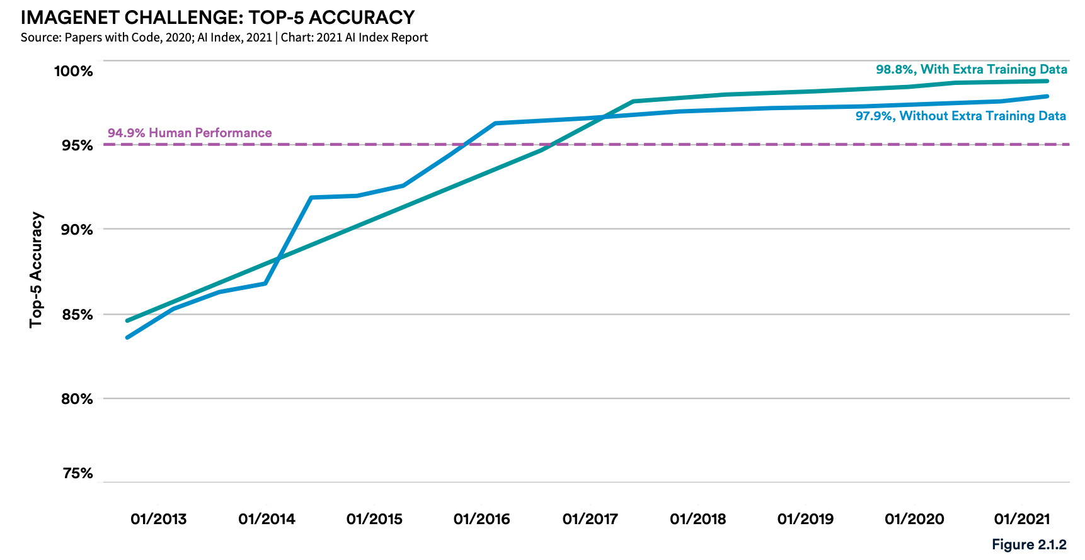
https://aiindex.stanford.edu/wp-content/uploads/2021/03/2021-AI-Index-Report_Master.pdf

Slide 21
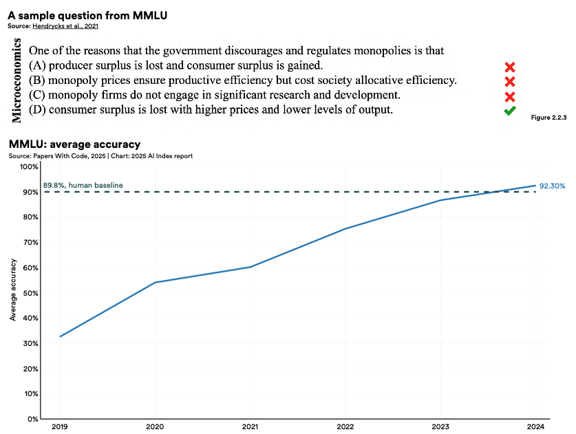

Slide 23
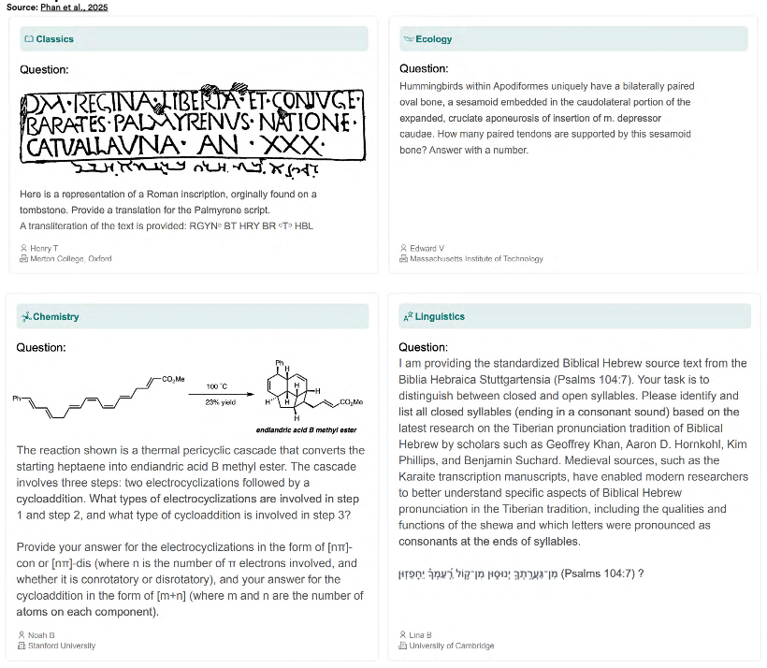
“Humanity’s last exam”

Slide 24
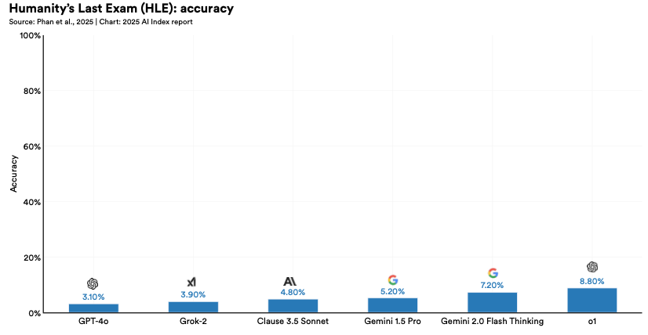

Slide 25

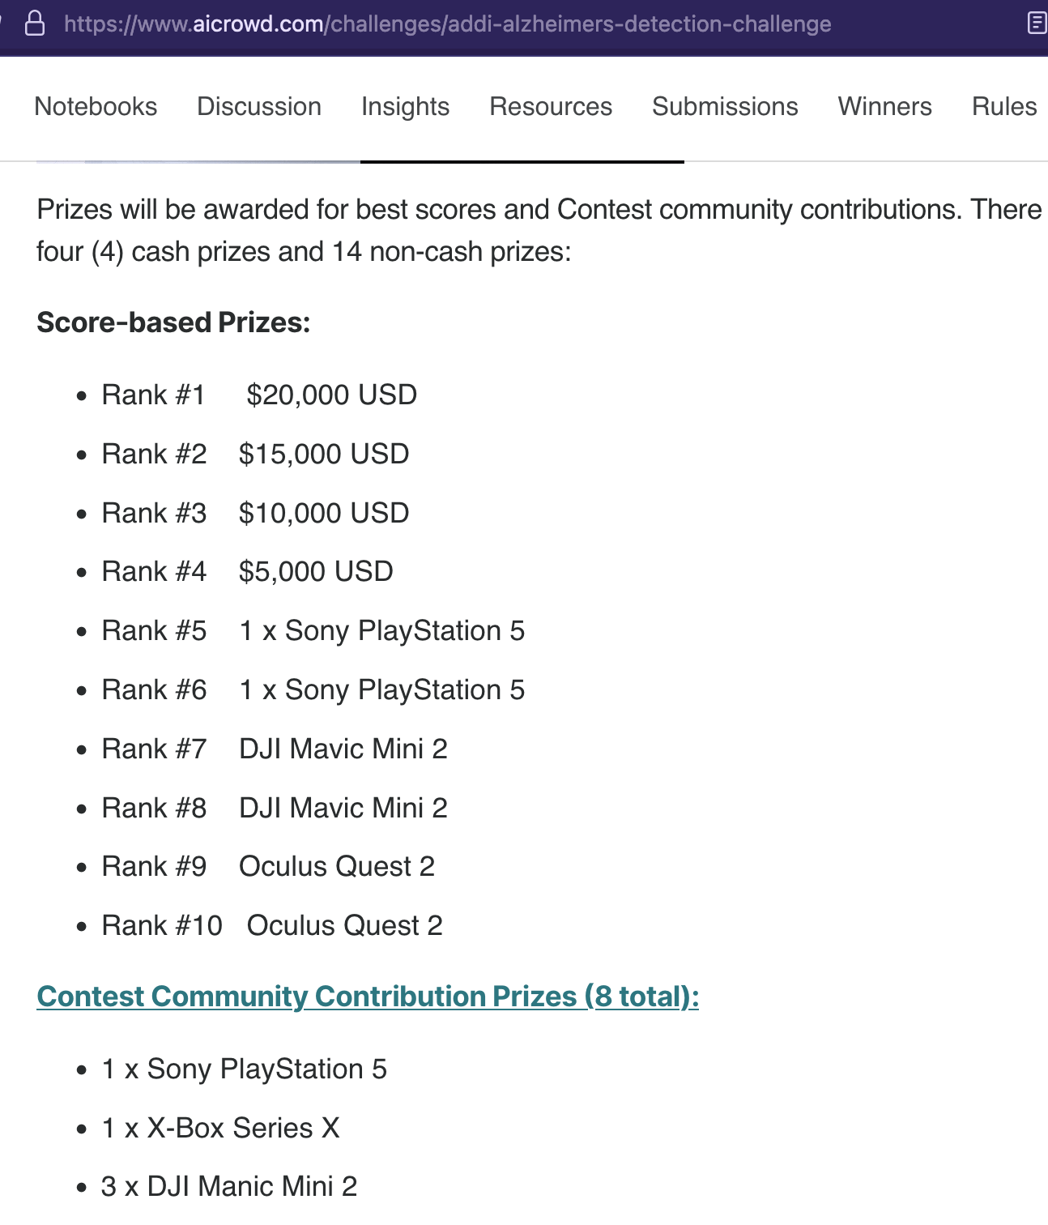

Slide 26
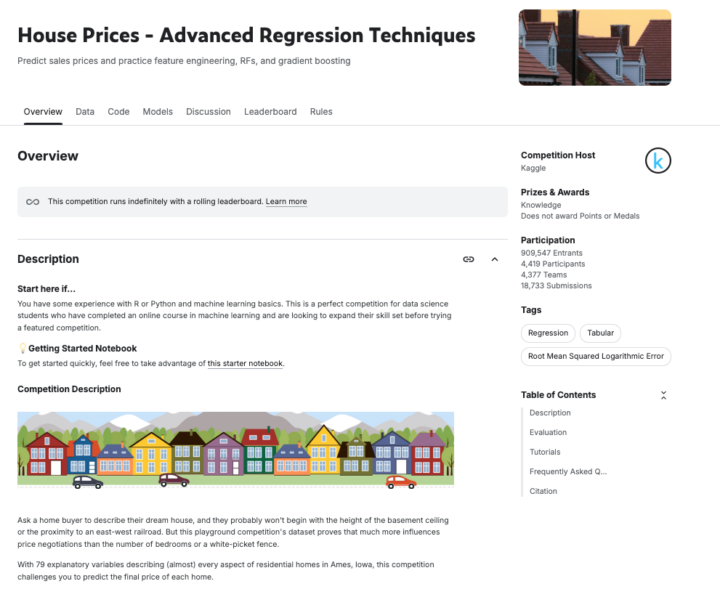

Slide 27
Some models

Slide 28
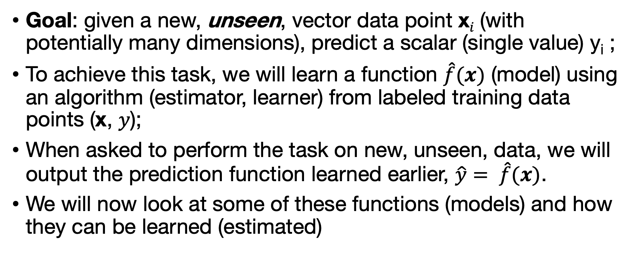
Reminder
Goal: given a new, unseen, vector data point x_{𝑖} (with potentially many dimensions), predict a scalar (single value) y_{i} ;
To achieve this task, we will learn a function $\hat{f}(x)$ (model) using an algorithm (estimator, learner) from labeled training data points (x, 𝑦);
When asked to perform the task on new, unseen, data, we will output the prediction function learned earlier, $\hat{y}= \hat{f}(x)$.
We will now look at some of these functions (models) and how they can be learned (estimated)

Slide 29
Some models
Linear regression
kNN
Trees
Random forests
Boosting (e.g. xgboost)
Support vector regression (SVR)
Neural networks / Deep learning

Slide 30
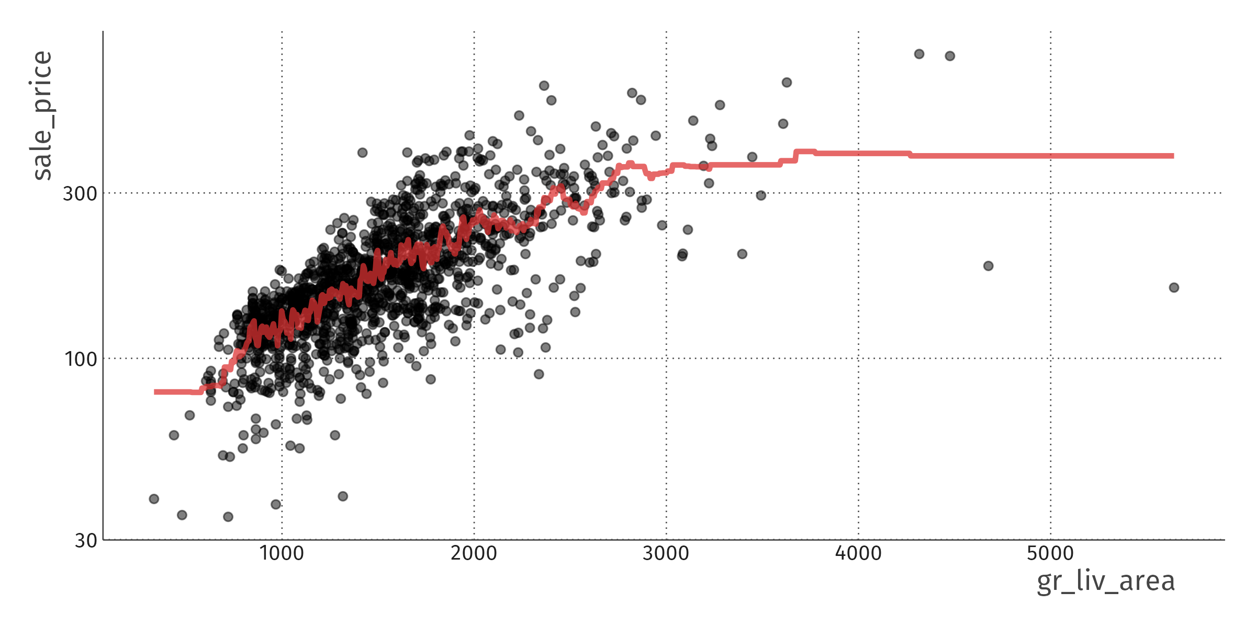
kNN regression (k = 30)

Slide 31
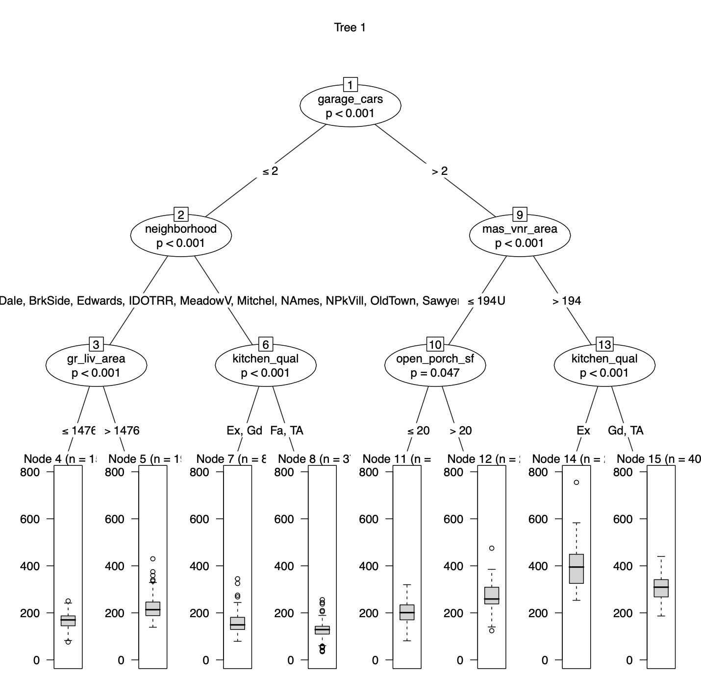
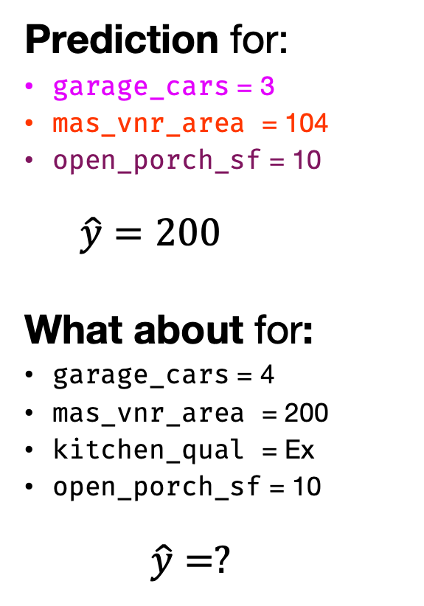
Regression tree
Prediction for:
garage_cars = 3
mas_vnr_area = 104
open_porch_sf = 10
$$\hat{y}=200$$
What about for:
garage_cars = 4
mas_vnr_area = 200
kitchen_qual = Ex
open_porch_sf = 10
$$\hat{y}=?$$

Slide 32
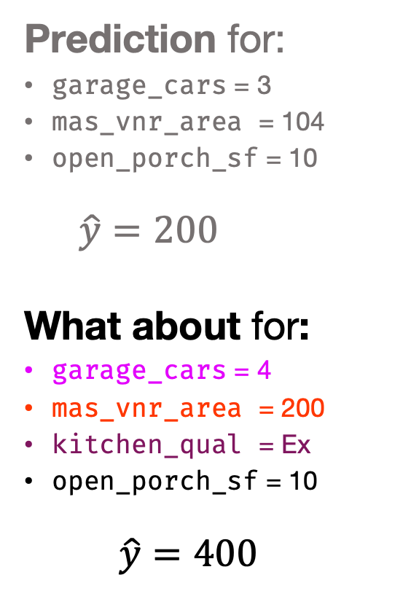
Regression tree
Prediction for:
garage_cars = 3
mas_vnr_area = 104
open_porch_sf = 10
$$\hat{y}=200$$
What about for:
garage_cars = 4
mas_vnr_area = 200
kitchen_qual = Ex
open_porch_sf = 10
$$\hat{y}=400$$

Slide 33
The problem with trees
Trees are not a bad idea, but in practice they tend to overfit
→ Use them as basic building block for ensembles
Random forests: “bagged trees with feature sampling”
Make trees that are too complex (low bias, high variance);
Average over bootstrapped samples to cancel out the overfitting parts.
Boosting: “ensemble of weak learners”
Make trees that are too simple (high bias, low variance);
Make more of them for observations with big residuals;
Average them.
More about random forests and boosting next time!

Slide 34
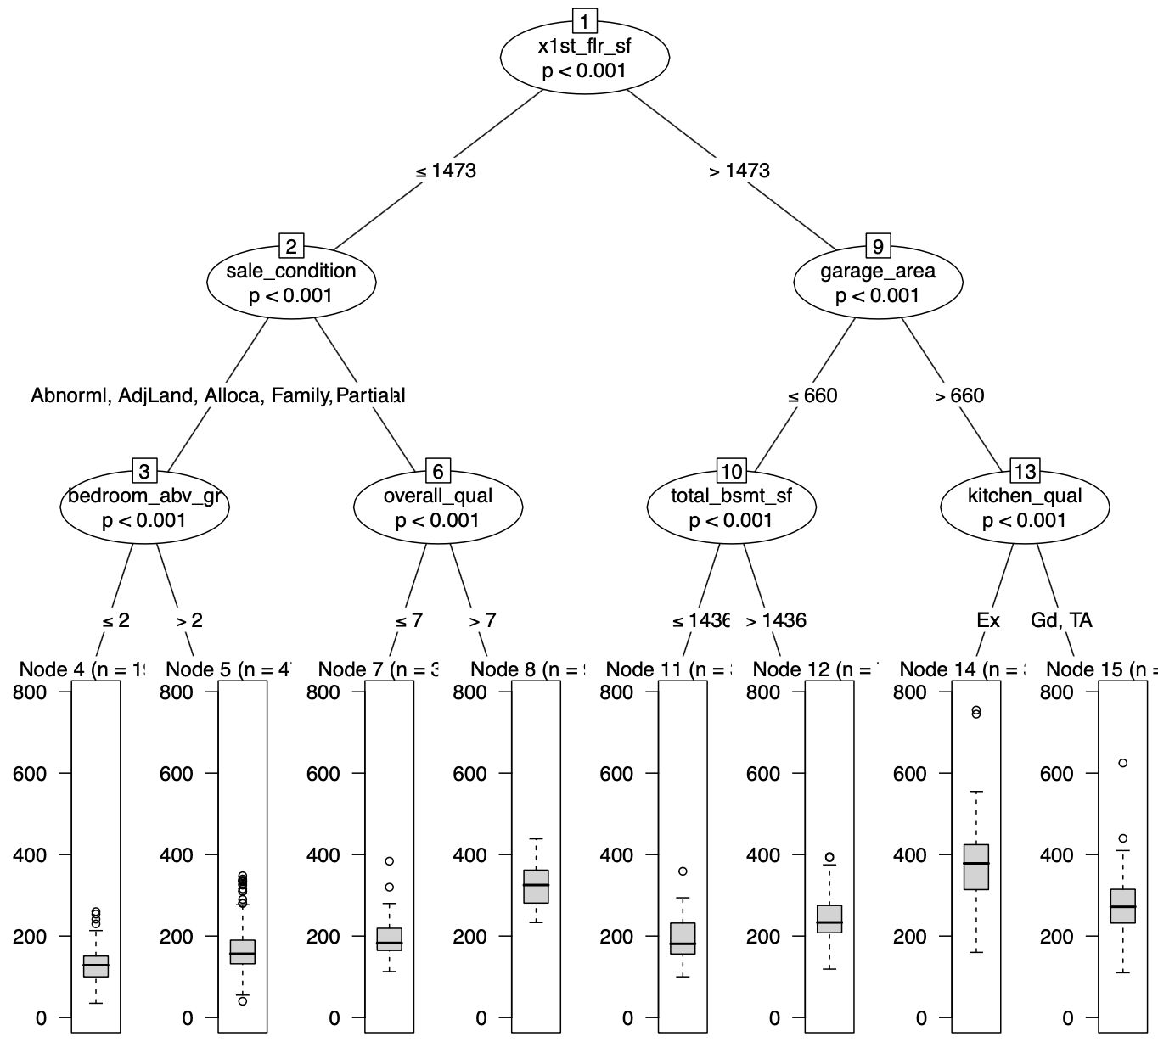
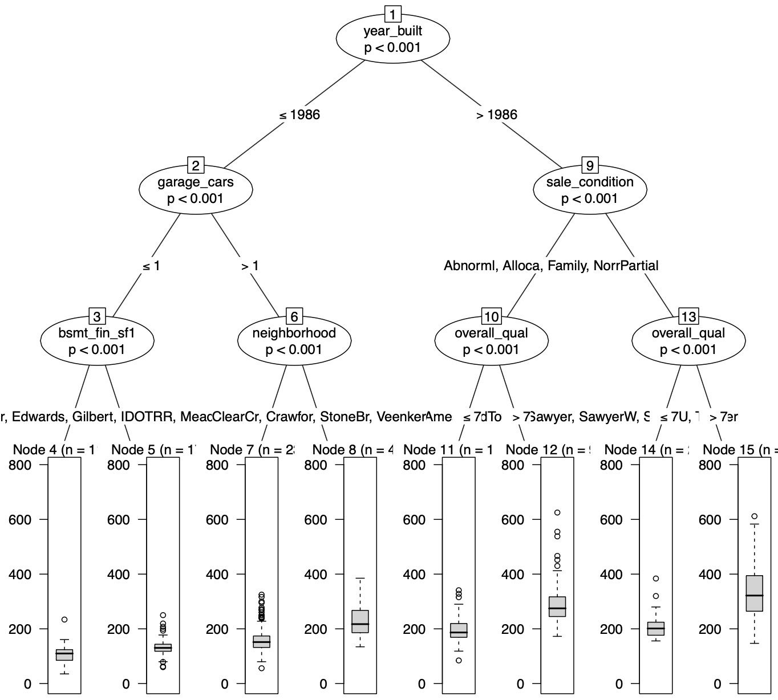
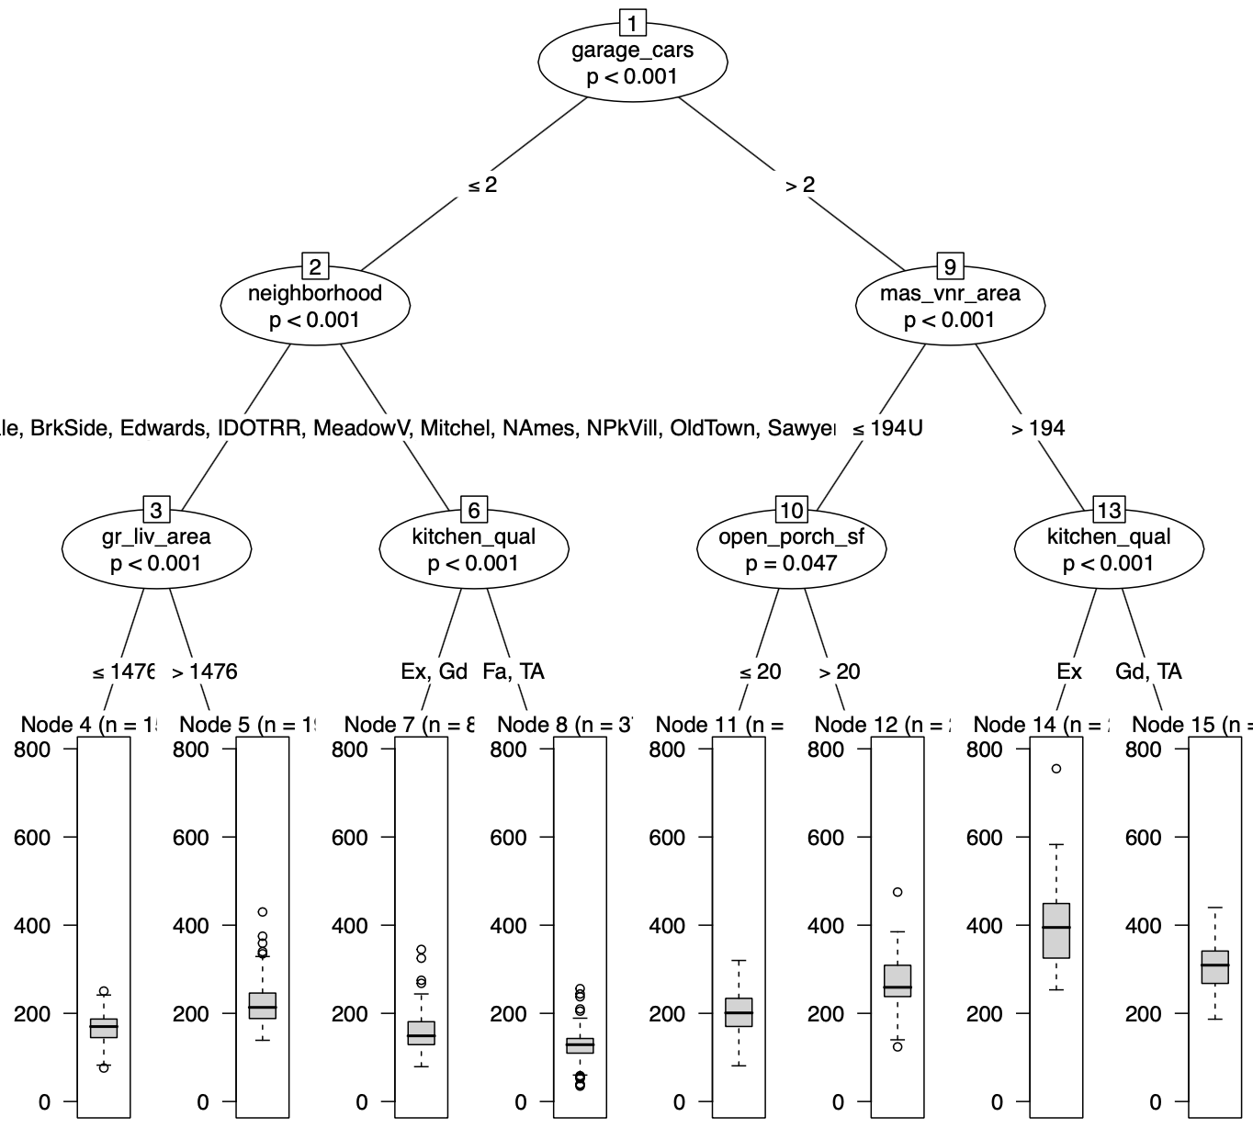
Random forests
Fit many trees, each to a different random sample of the training data,
and randomly sampling a small set of features at each node.
The final random forest prediction is the average of the individual tree predictions.

Slide 35
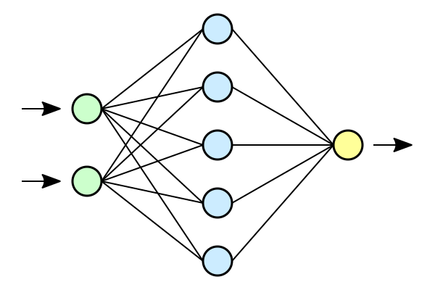
Neural network

Slide 36
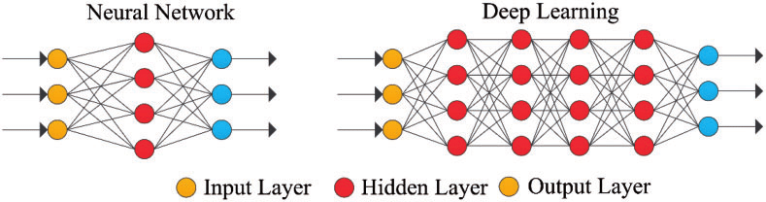
What makes a neural net “deep”?

Slide 37
Deep learning
Output of each hidden layer is input to subsequent one
Allow representation learning by building complex features out of simpler ones
Aggressive parameterization + aggressive regularization
(“top-down” nonparametric approach)
Compositional: efficient parametrization
Learn relevant features: “End-to-end”
More about deep learning later!

Slide 38
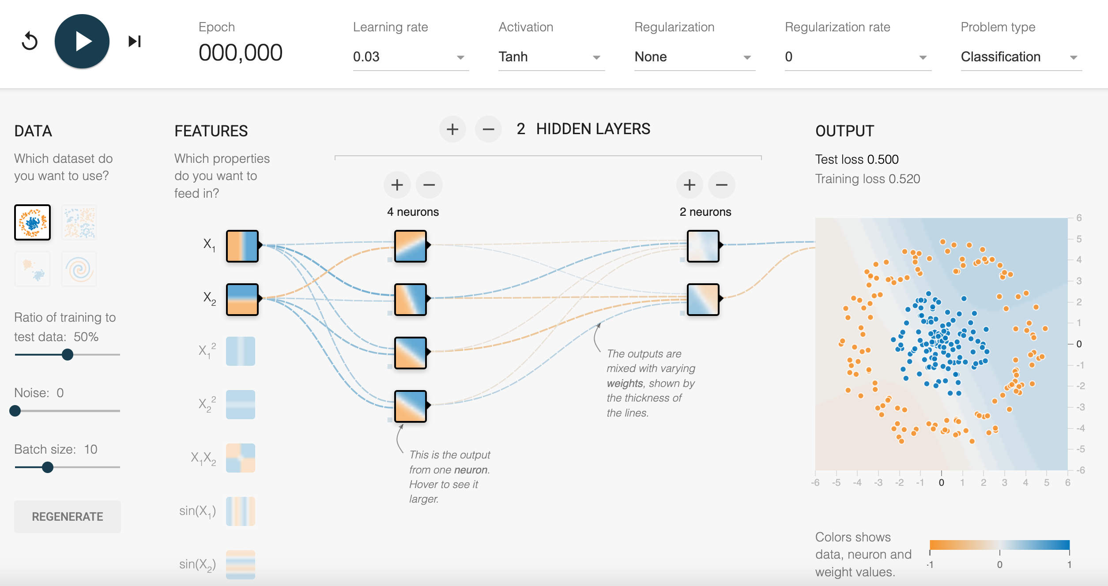
https://playground.tensorflow.org

Slide 39
No free lunch
”Any two optimization algorithms are equivalent when their performance is averaged across all possible problems”
(Wolpert & MacReady)

Slide 40
Our housing example

Slide 41
Tuning
Learners (models) have “hyperparameters”
Example: number of trees in RF, depth of neural network
General idea is to use cross-validation to select hyperparameters
Some models more sensitive to good choice of hyperparamters
Examples are boosting and neural nets

Slide 42
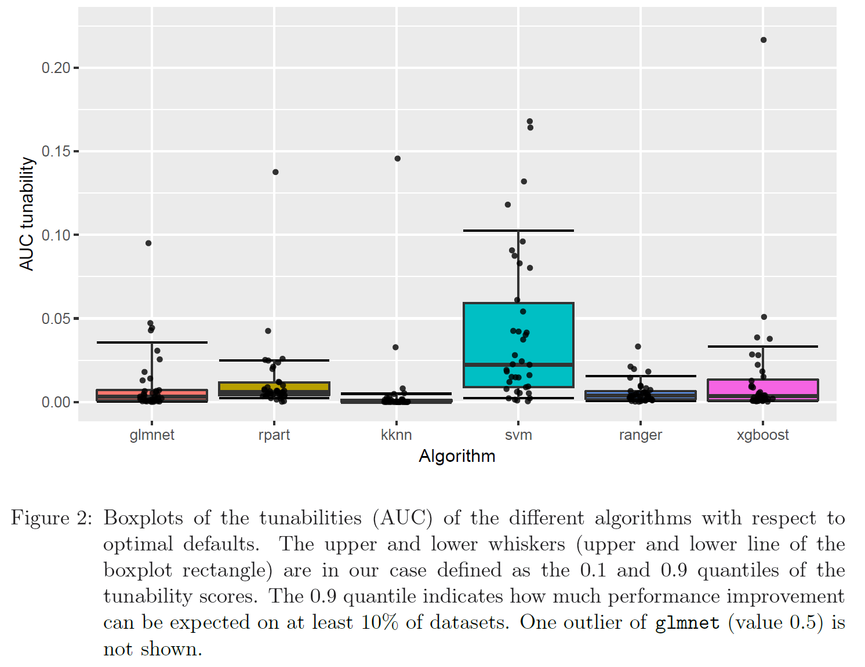
Probst et al. JMLR

Slide 43
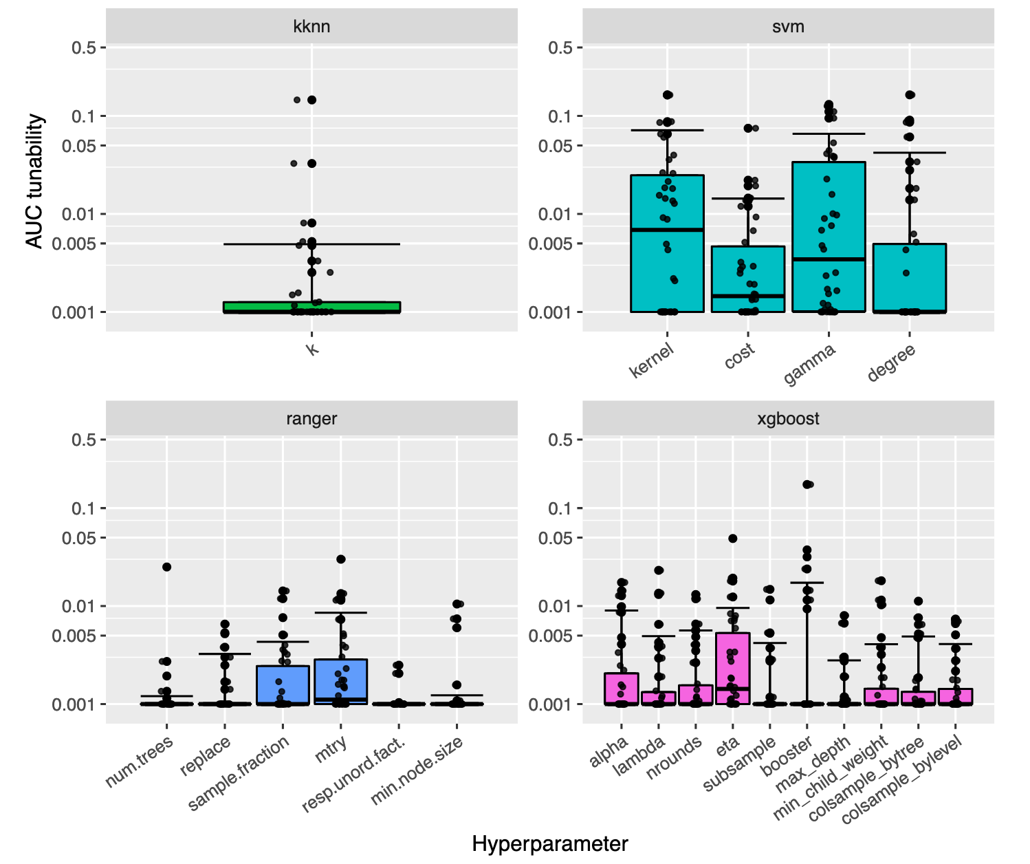
Probst et al. (2019). JMLR

Slide 44
AutoML
The idea is to perform all the steps of comparing different models using cross-validation, choosing hyperparameters etc automatically.
Very “black box”
Many cloud platforms offer some autoML option nowadays

Slide 45
AutoML for our example using h2o
fit_aml <- h2o.automl(
y = "SalePrice",
training_frame = dat_h2o_train)
Achieves about 18,000 on held out test data, better than RF
Selects very highly tuned boosting model

Slide 46
Conclusion
A new model is being invented, literally every day
The most important skill you should practice these weeks is
How to learn about a model you did not know about yet
The practical should help you do this

