Slide 1
Data Wrangling and Data Analysis
Machine learning!
#3 mostly classification
Daniel Oberski, Ayoub Bagheri
Department of Methodology & Statistics
Utrecht University
VERSION: 2025-10-08

Slide 2
Supervised machine learning
Regression (predicting continuous outcomes)
Regression evaluation
Classification (predicting discrete outcomes)

Slide 3
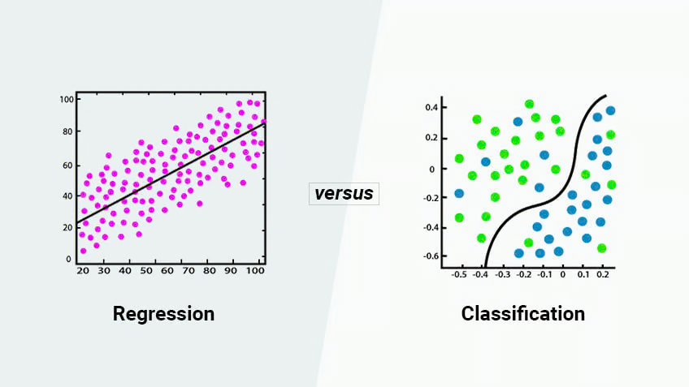
Classification
Supervised learning: Learning a function that maps an input to an output based on example input-output pairs.
infer a function from labeled training data
use the inferred function to label new instances

Slide 4
Classification
The thing you’re trying to predict is discrete:
Titanic: Survival/Nonsurvival
Banking data: Default on/payment of debt
GPS/Accelerometer data: Work/Home/Friend/Parking/Other
Imagenet: gazelle/tank/pirate/sea lion/tandem bicycle/: : :
Etc.

Slide 5
Classification types
Binary classification:
Definition: Involves two categories or classes.
Examples: True/False, Yes/No, Spam/Not Spam, Positive/Negative sentiment.
Multiclass classification:
Definition: Involves more than two categories or classes.
Examples: Classifying animal images into Cats/Dogs/Birds, predicting the genre of a book (e.g., Fiction/Non-fiction/Science/History).
Multilabel classification:
Definition: Each instance can belong to multiple classes simultaneously.
Examples: Tagging a research article with multiple topics like "Machine Learning," "Natural Language Processing," and "Healthcare.”, Assigning multiple genres to a book.

Slide 6

From Data collection to K-fold cross validation
https://scikit-learn.org/stable/modules/cross_validation.html

Slide 7
How to classify?
?
Sports
Politics
Finance

Slide 8
Classification: definition
Input:
a sample d
a fixed set of classes C = {c₁, c₂,…, c_{J}}
Output: a predicted class c ∈ C

Slide 9
Common algorithms
K-nearest neighbors
Classification trees (decision trees)
Logistic regression
Support vector machines
Neural networks
Deep learning
And …

Slide 10
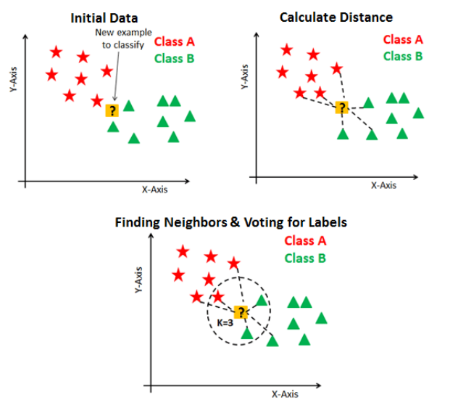
K-nearest neighbors
K-Nearest Neighbors (KNN) is a simple, non-parametric algorithm that classifies data points based on the majority class of their K nearest neighbors in feature space, using a distance metric such as Euclidean distance.
Non-parametric methods: make no strong assumptions about the data's underlying distribution.

Slide 11
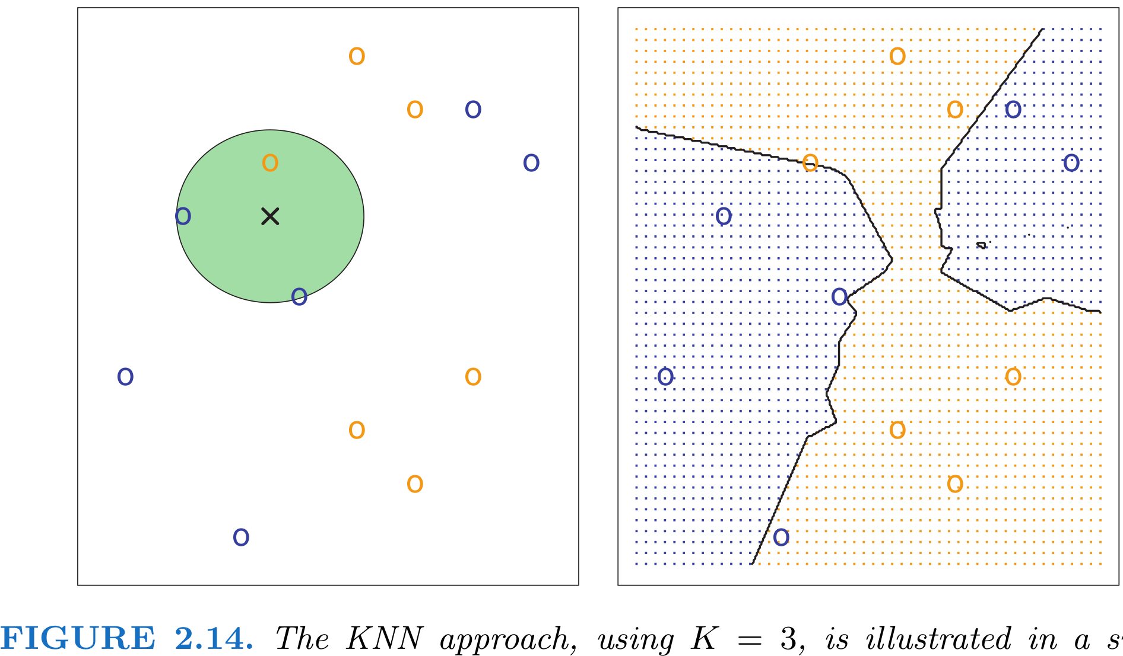
Example from the book: ISLR

Slide 12
Classification trees

Slide 13


Slide 14
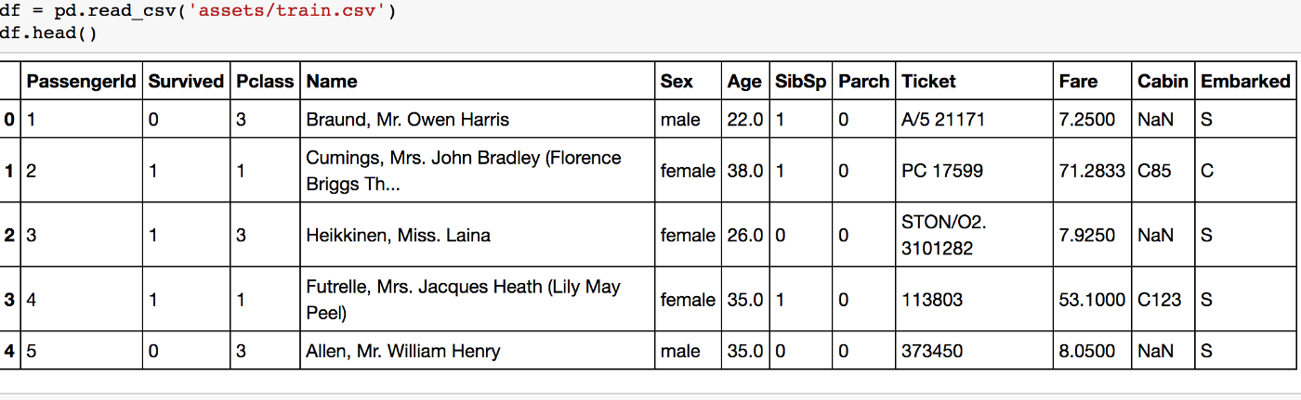
Titanic data

Slide 16
Predicted class: most males did not survive
Class probability: 81% died, 19% survived
Proportion of dataset: 65% were male

Slide 17
set.seed(73) # To make your tree reproducible

Slide 18
Learning algorithm
Recursive partitioning
Find the split that makes observations (data points) as similar as possible on the outcome within that split;
Within each resulting group, do (1).

Slide 19
Recursive partitioning
Find the split that makes observations as similar as possible on the outcome within that split;
Within each resulting group, do (1).
Criteria for “as similar as possible”: Purity, MSE reduction, ...
Early stopping: add after (2):
“unless fewer than nmin observations in the group” (typically 10);
“unless improvement less than cp” (typically 0.05);

Slide 27
These are the same!

Slide 28
Ensemble learners based on trees
ensemble methods use multiple learning algorithms to obtain better predictive performance (Wikipedia)

Slide 29
The problem with trees
Trees are not a bad idea, but in practice they tend to overfit
→ Use them as basic building block for ensembles
Random forests: “bagged trees with feature sampling”
Make trees that are too complex (low bias, high variance);
Average over bootstrapped samples to cancel out the overfitting parts.
Boosting: “ensemble of weak learners”
Make trees that are too simple (high bias, low variance);
Make more of them for observations with big residuals;
Average them.

Slide 30
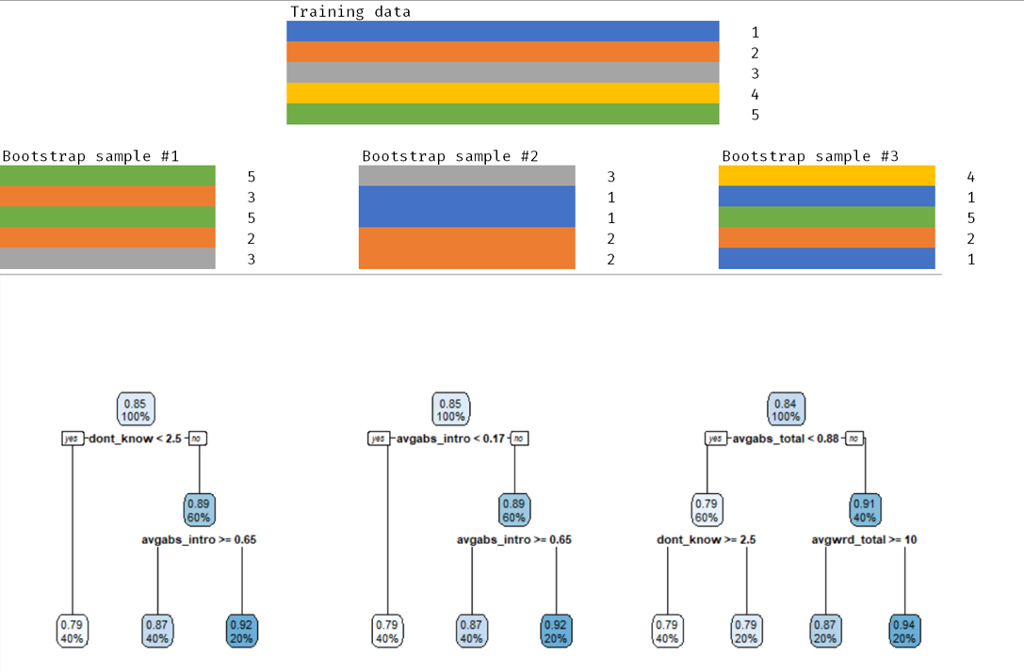
“Bagged” trees

Slide 31
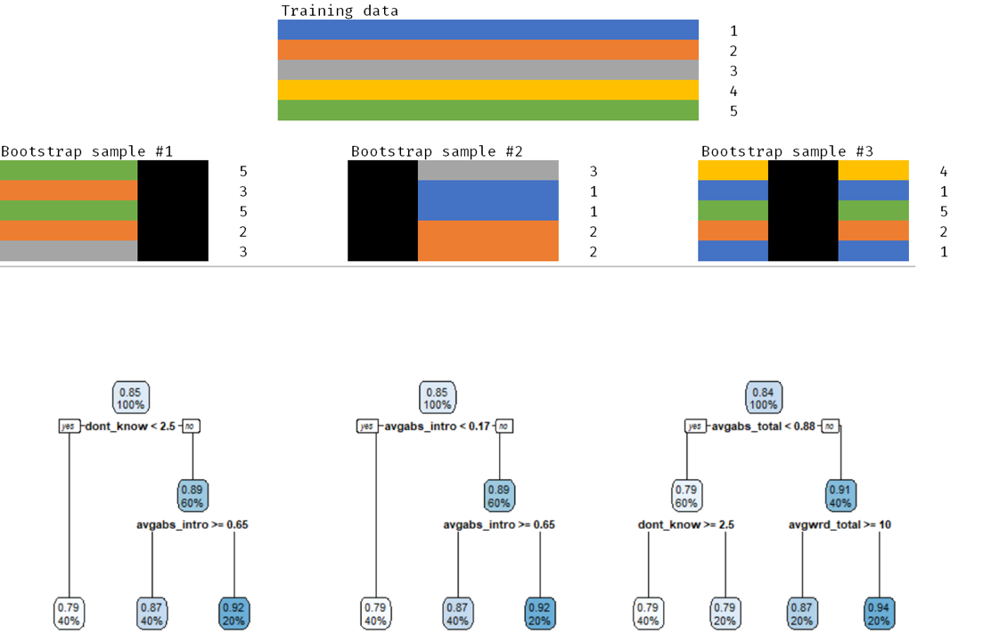
“Bagged” trees with feature sampling
Note: features are sampled at each node

Slide 32
Boosting
Start with “weak learner” (e.g. tree stump)
Repeat for nrounds “rounds”:
↑ Upweight the mistakes, ↓ Downweight the correct classifications
Train another weak learner on the mistake-upweighted data
Back to step 1
Final prediction is weighted sum of the weak learners
By combining many “weak learners”, a strong learner is created

Slide 33
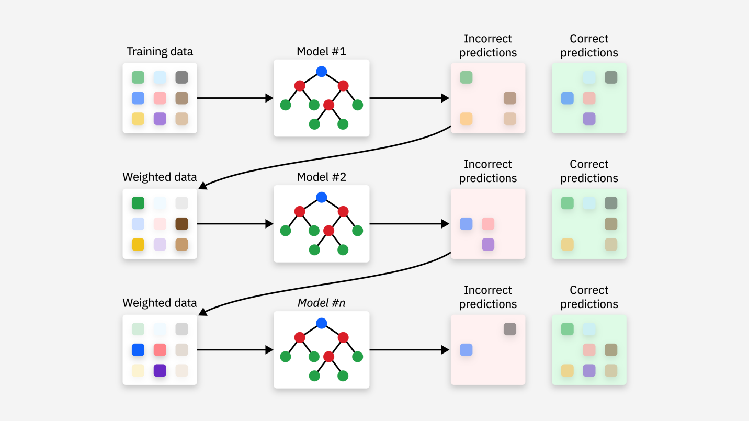
Source: https://www.ibm.com/think/topics/gradient-boosting

Slide 34
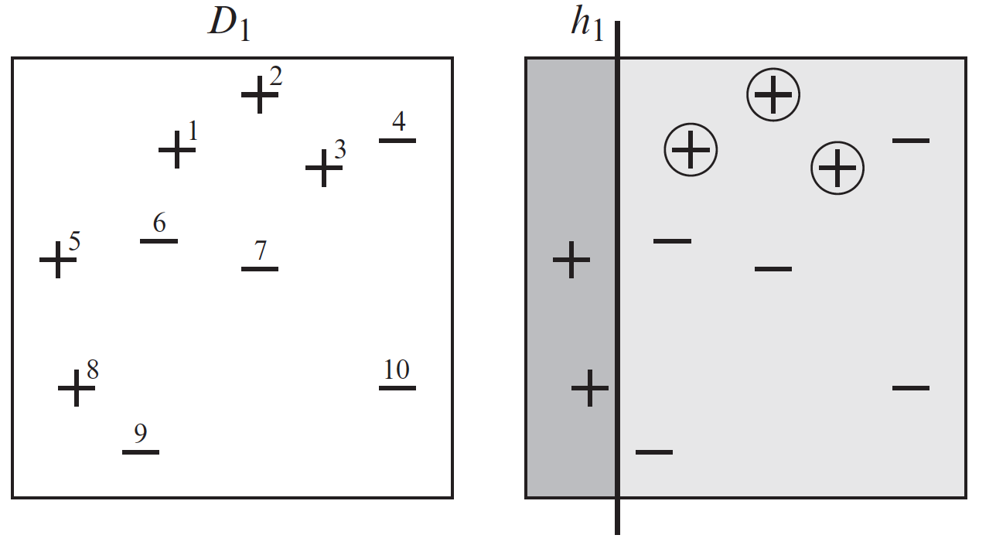
Source: Schapire & Freund (2012). Boosting: Foundations and Algorithms.

Slide 35
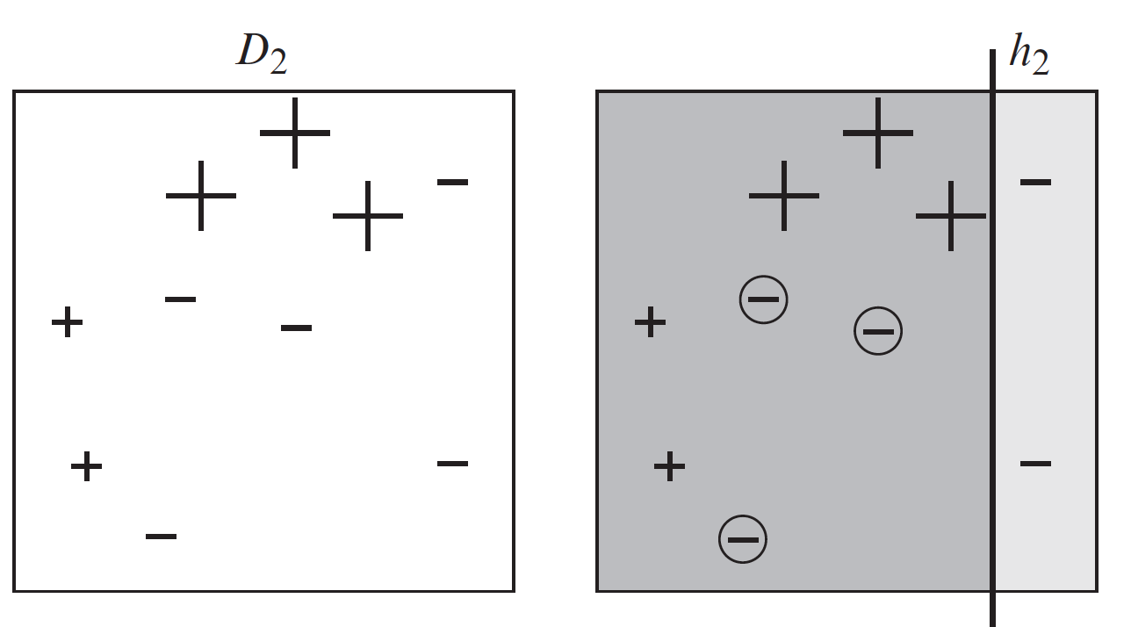
Source: Schapire & Freund (2012). Boosting: Foundations and Algorithms.

Slide 36
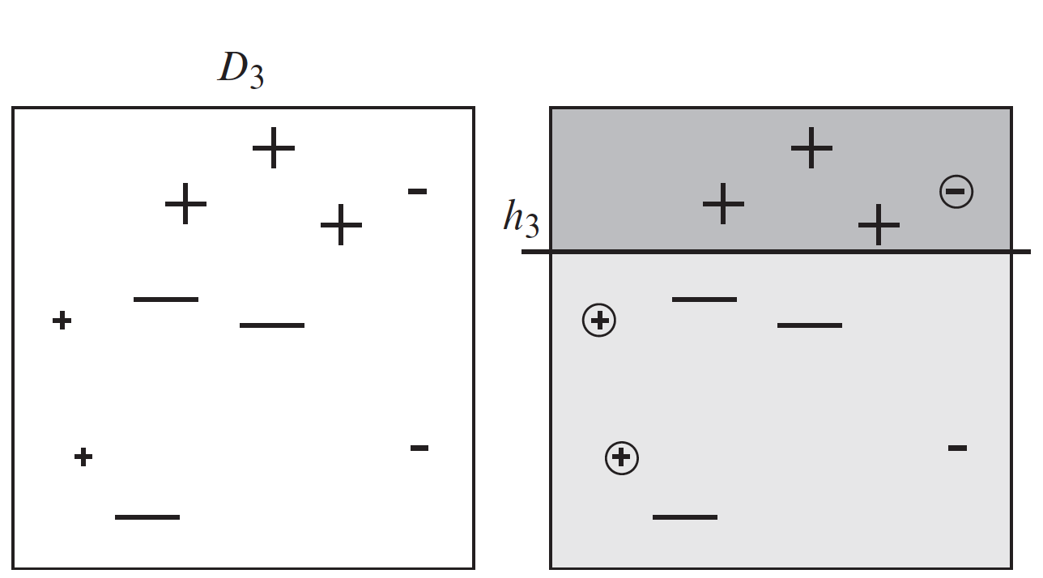
Source: Schapire & Freund (2012). Boosting: Foundations and Algorithms.

Slide 37
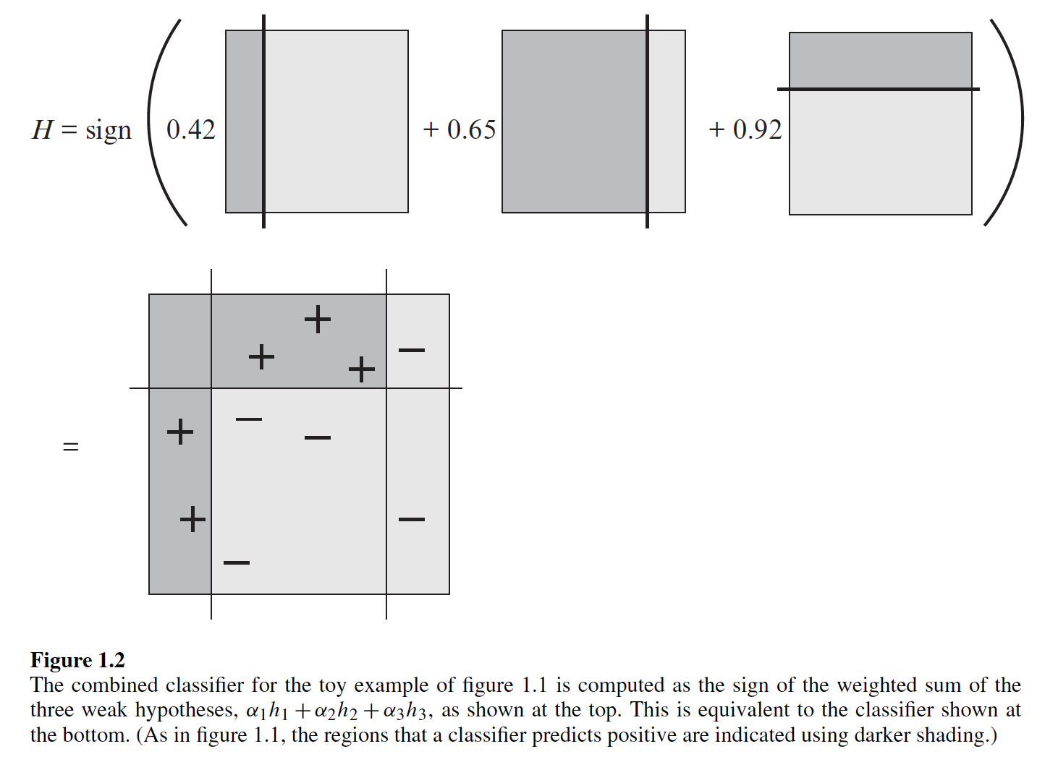
The final prediction model (classifier)

Slide 38
Boosting
Current go-to implementation is xgboost
Very powerful idea and easy to apply to other things than classification trees
Regression boosting, Survival boosting, etc.
Often SotA in tabular data challenges, …
… after extensive hyperparameter tuning

Slide 39
Neural networks

Slide 40
Neural networks, “deep learning”
Compositional approach to curve-fitting;
“Biologically inspired”
(but don’t take that too seriously);
Sound cool.

Slide 41
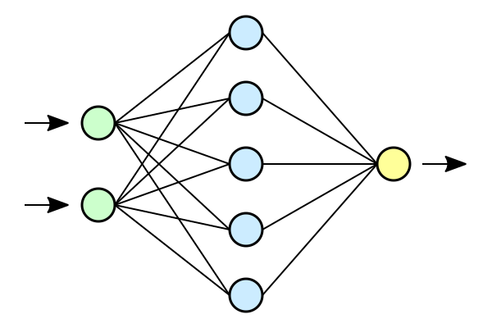
Neural network

Slide 42
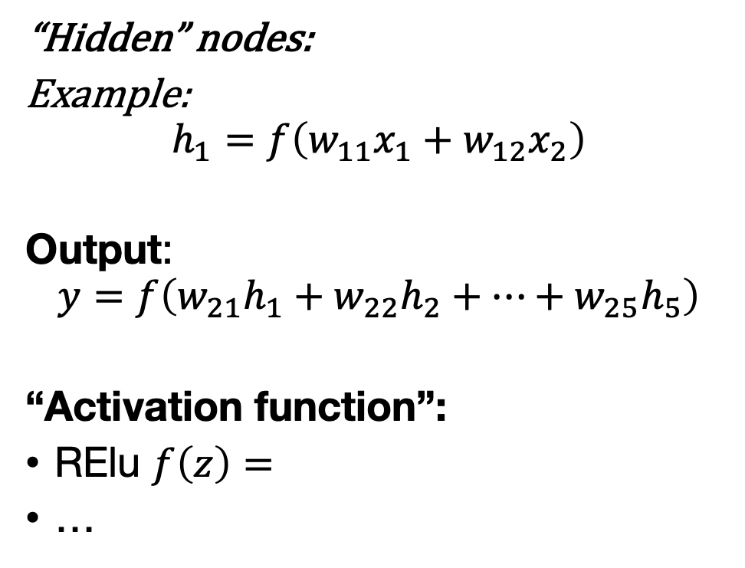
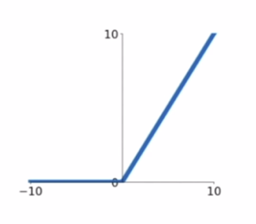
Neural network (topic of tomorrow) Deep learning
“Hidden” nodes:
Example:
$$h_{1}=f\left(w_{11}x_{1}+w_{12}x_{2}\right)$$
Output:
$$y=f\left(w_{21}h_{1}+w_{22}h_{2}+…+w_{25}h_{5}\right)$$
“Activation function”:
RElu $f\left(z\right)=$
…

Slide 43
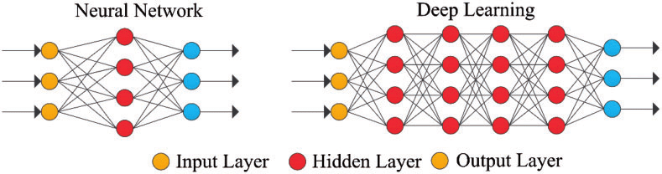
What makes a neural net “deep”?

Slide 44
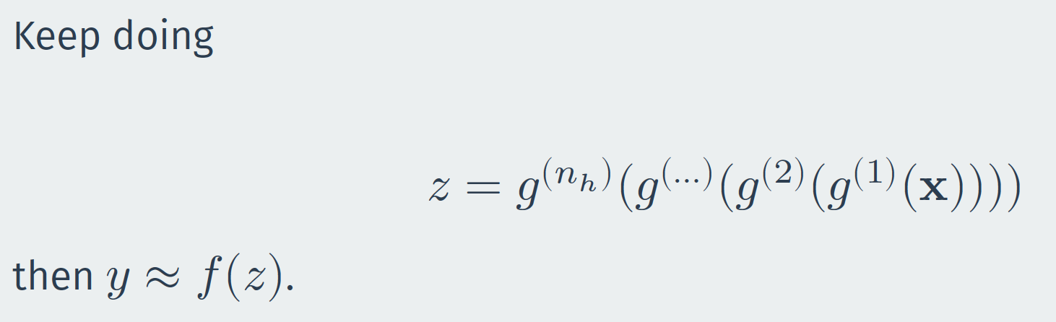
What makes a neural net “deep”?

Slide 45
Deep learning
Output of each hidden layer is input to subsequent one
Allow representation learning by building complex features out of simpler ones
Go deep: exponential advantages, less overfitting
Aggressive parameterization + aggressive regularization
Compositional: efficient parametrization
Learn relevant features: “End-to-end”

Slide 46
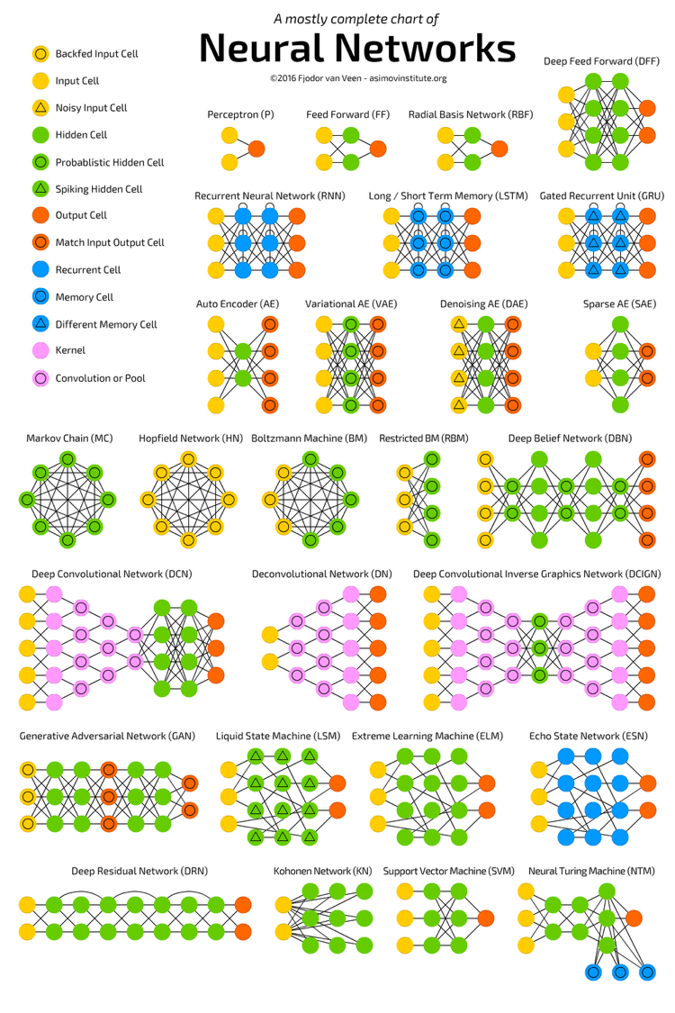
Different architectures
By adjusting the arrows, layers, and activation functions, you can create models that are tailored to specific data, e.g.
Convolutional (CNN): images, text, sound
Recurrent (RNN): time series, text
Graph (GNN): networks
…

Slide 47
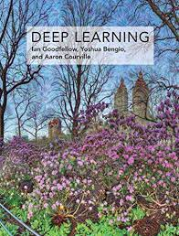
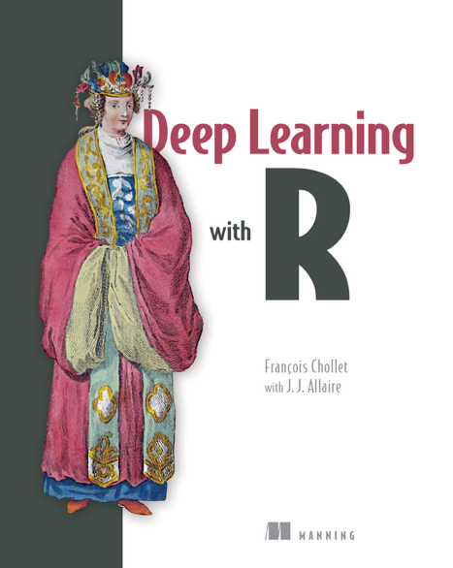
Deep learning in practice
Good places to start:
https://keras.rstudio.com/
ISLR Chapter 10
Goodfellow et al.
Chollet (R/Python version)

Slide 48
Evaluating classifiers

Slide 49
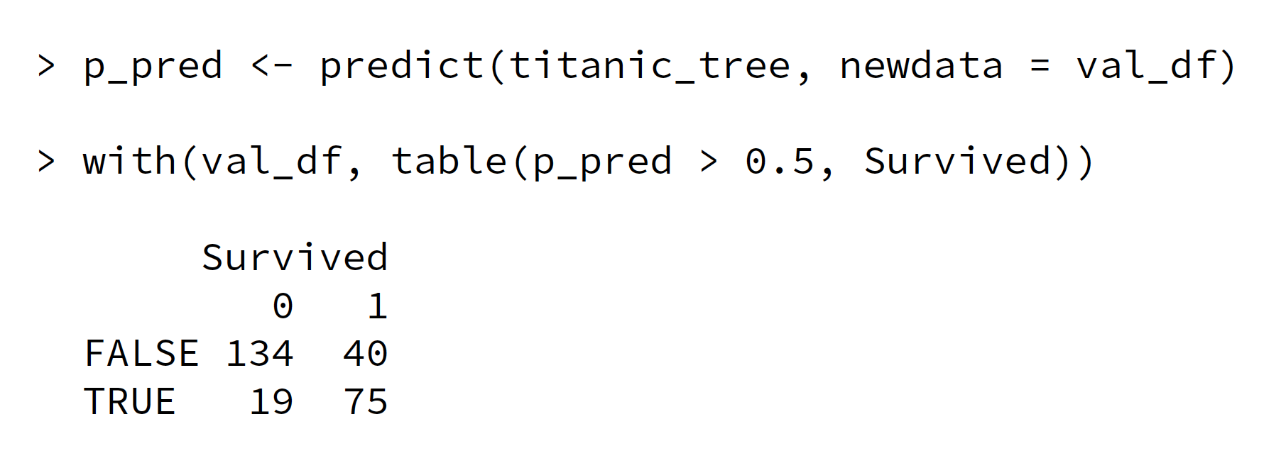
Confusion matrix: Counts

Slide 50
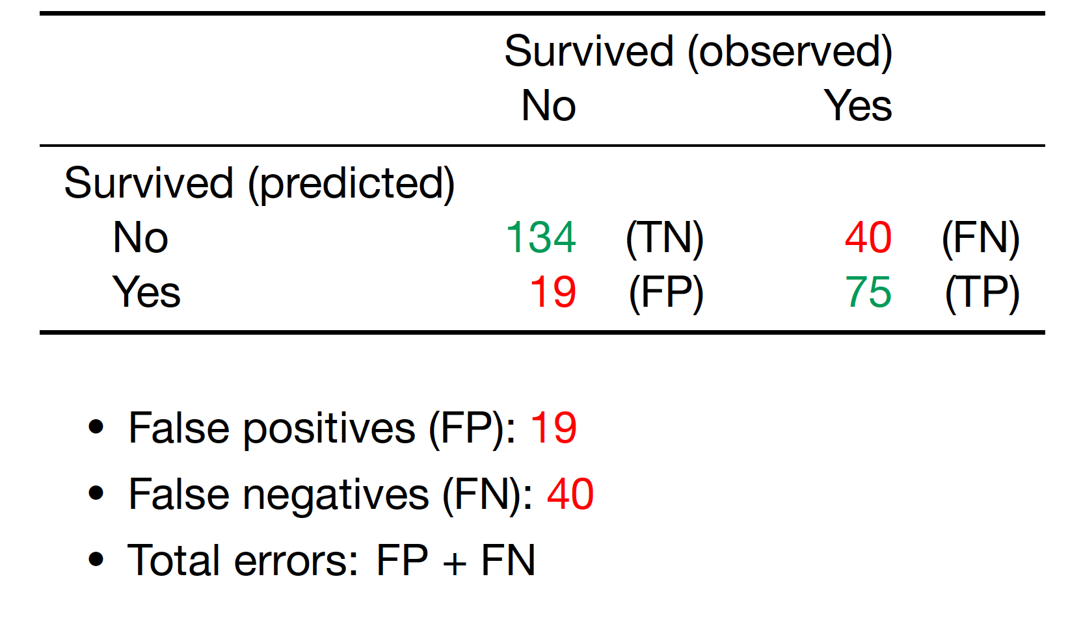
Confusion matrix: counts

Slide 51
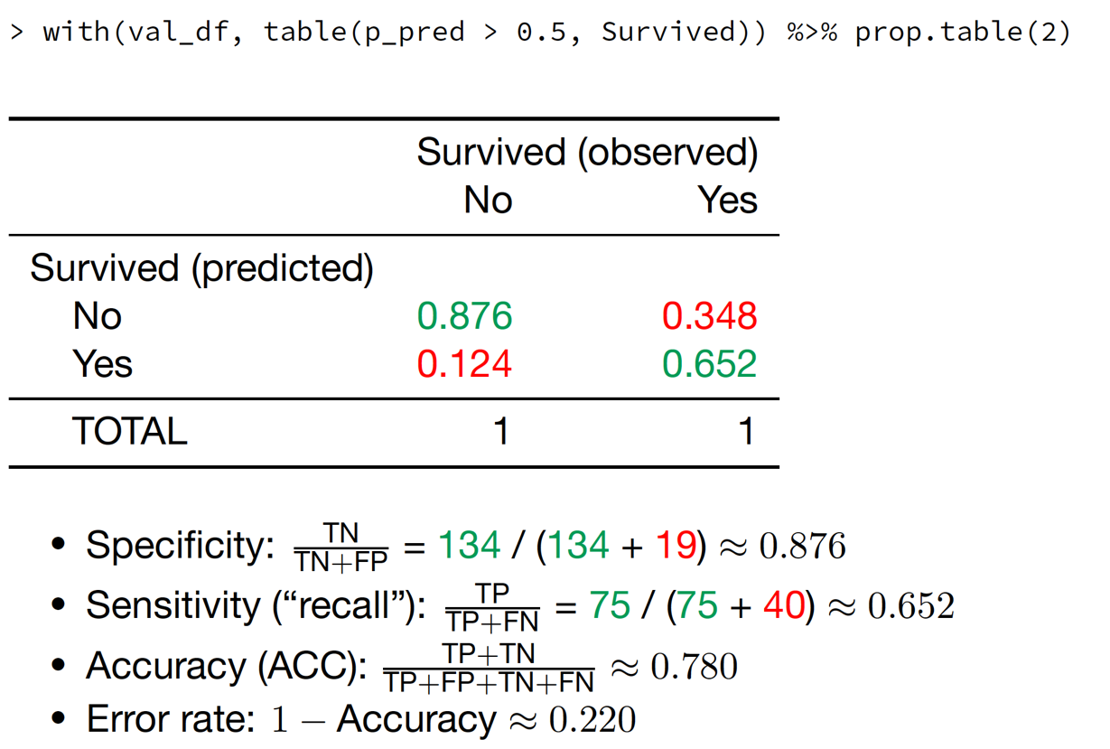
Confusion matrix: Sensitivity (“recall”) and Specificity

Slide 52
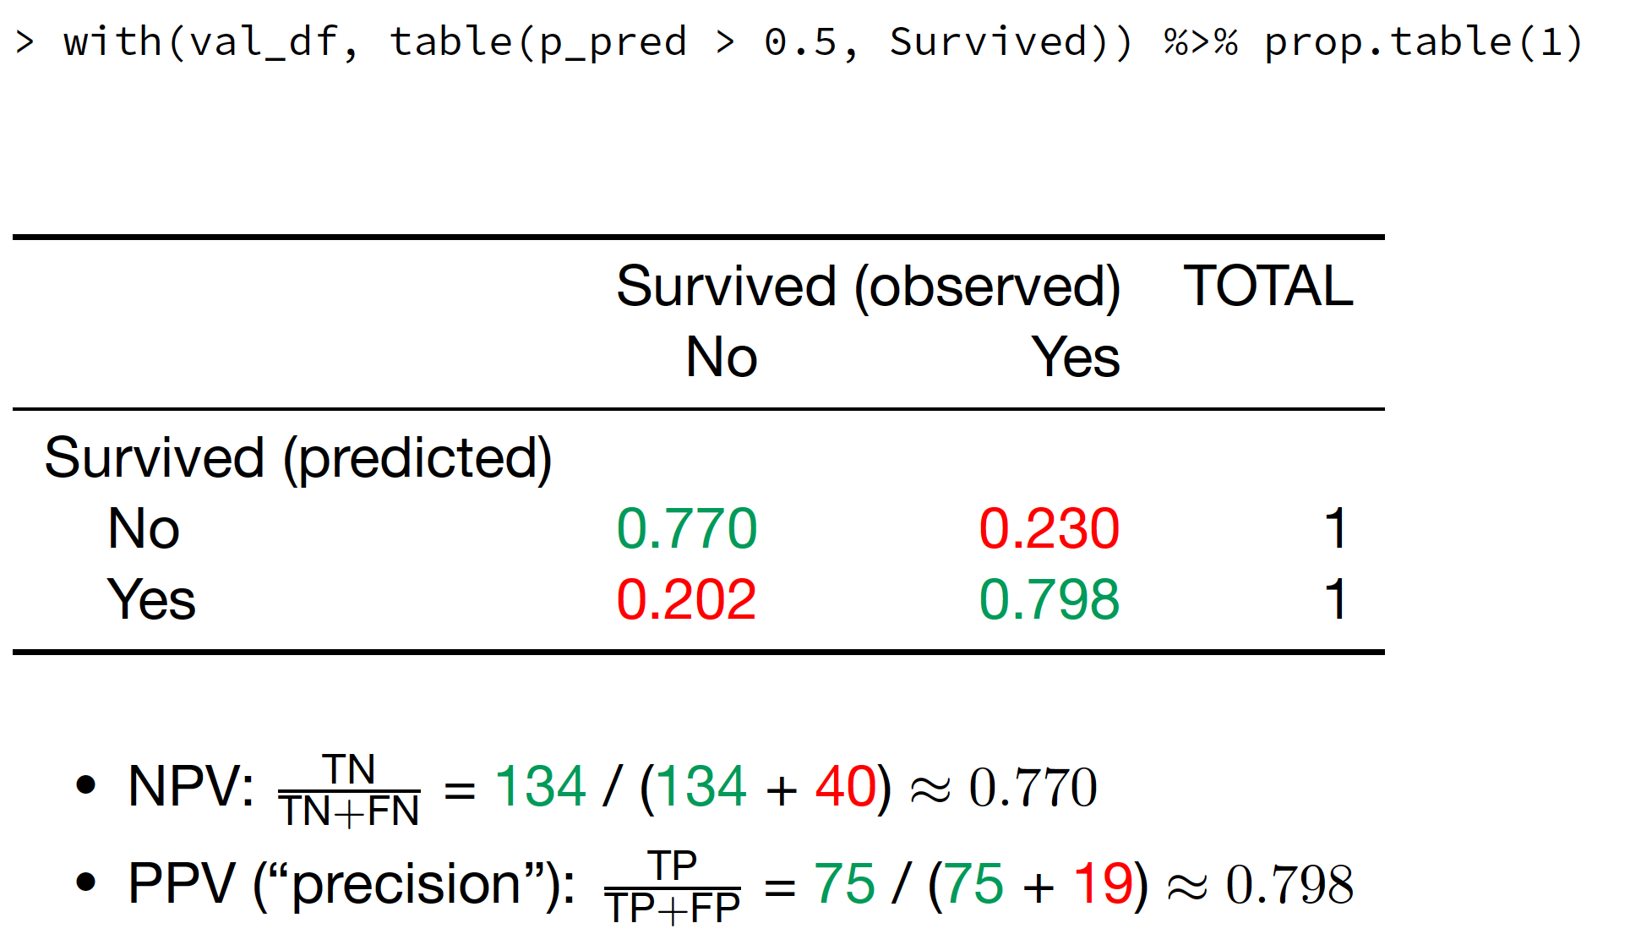
Confusion matrix: Negative & positive predictive value

Slide 53
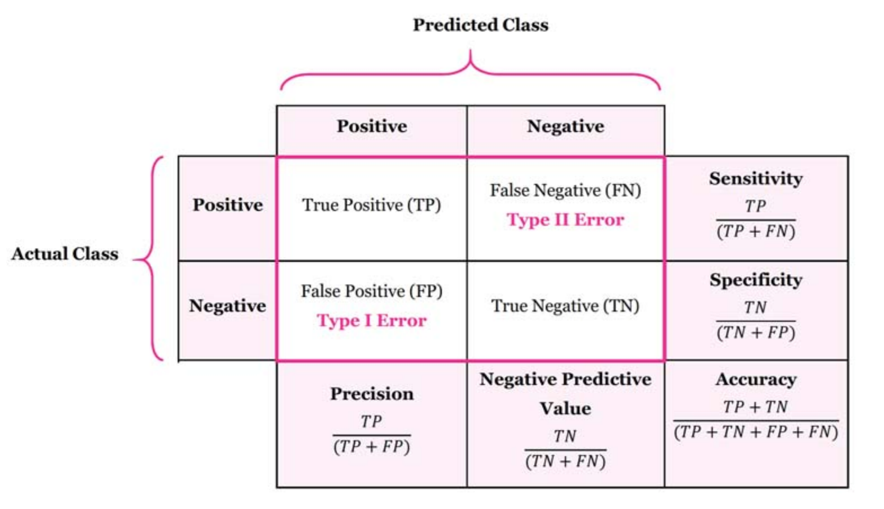
Confusion matrix

Slide 54
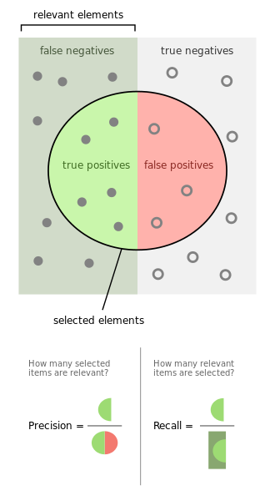
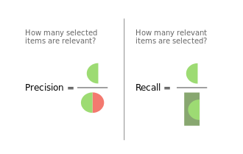
Source: https://en.wikipedia.org/wiki/F-score

Slide 55
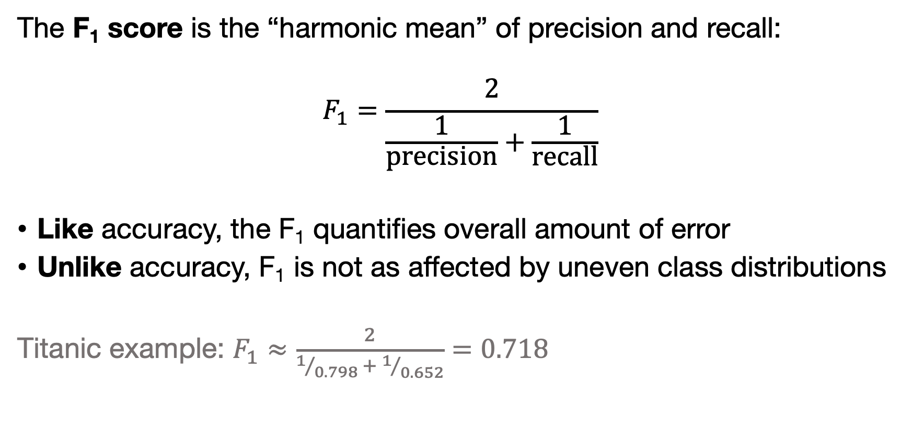
F₁ score
The F₁ score is the “harmonic mean” of precision and recall:
$$F_{1}=\frac{2}{\frac{1}{\text{precision}}+\frac{1}{\text{recall}}}$$
Like accuracy, the F₁ quantifies overall amount of error
Unlike accuracy, F₁ is not as affected by uneven class distributions
Titanic example: $F_{1}≈\frac{2}{1/{0.798} + 1/{0.652}}=0.718$

Slide 56
Overview: some classification metrics
Sensitivity (=Recall)
Specificity
Positive predictive value (=Precision)
Negative predictive value
Accuracy
Many! more: https://en.wikipedia.org/wiki/Sensitivity_and_specificity

Slide 57
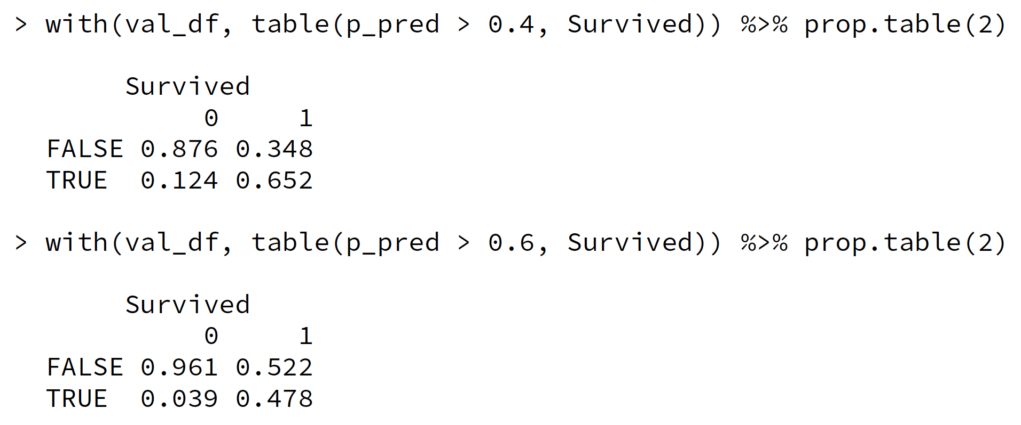
Different thresholds than 0.5
Moving around the threshold affects sensitivity and specificity!

Slide 60
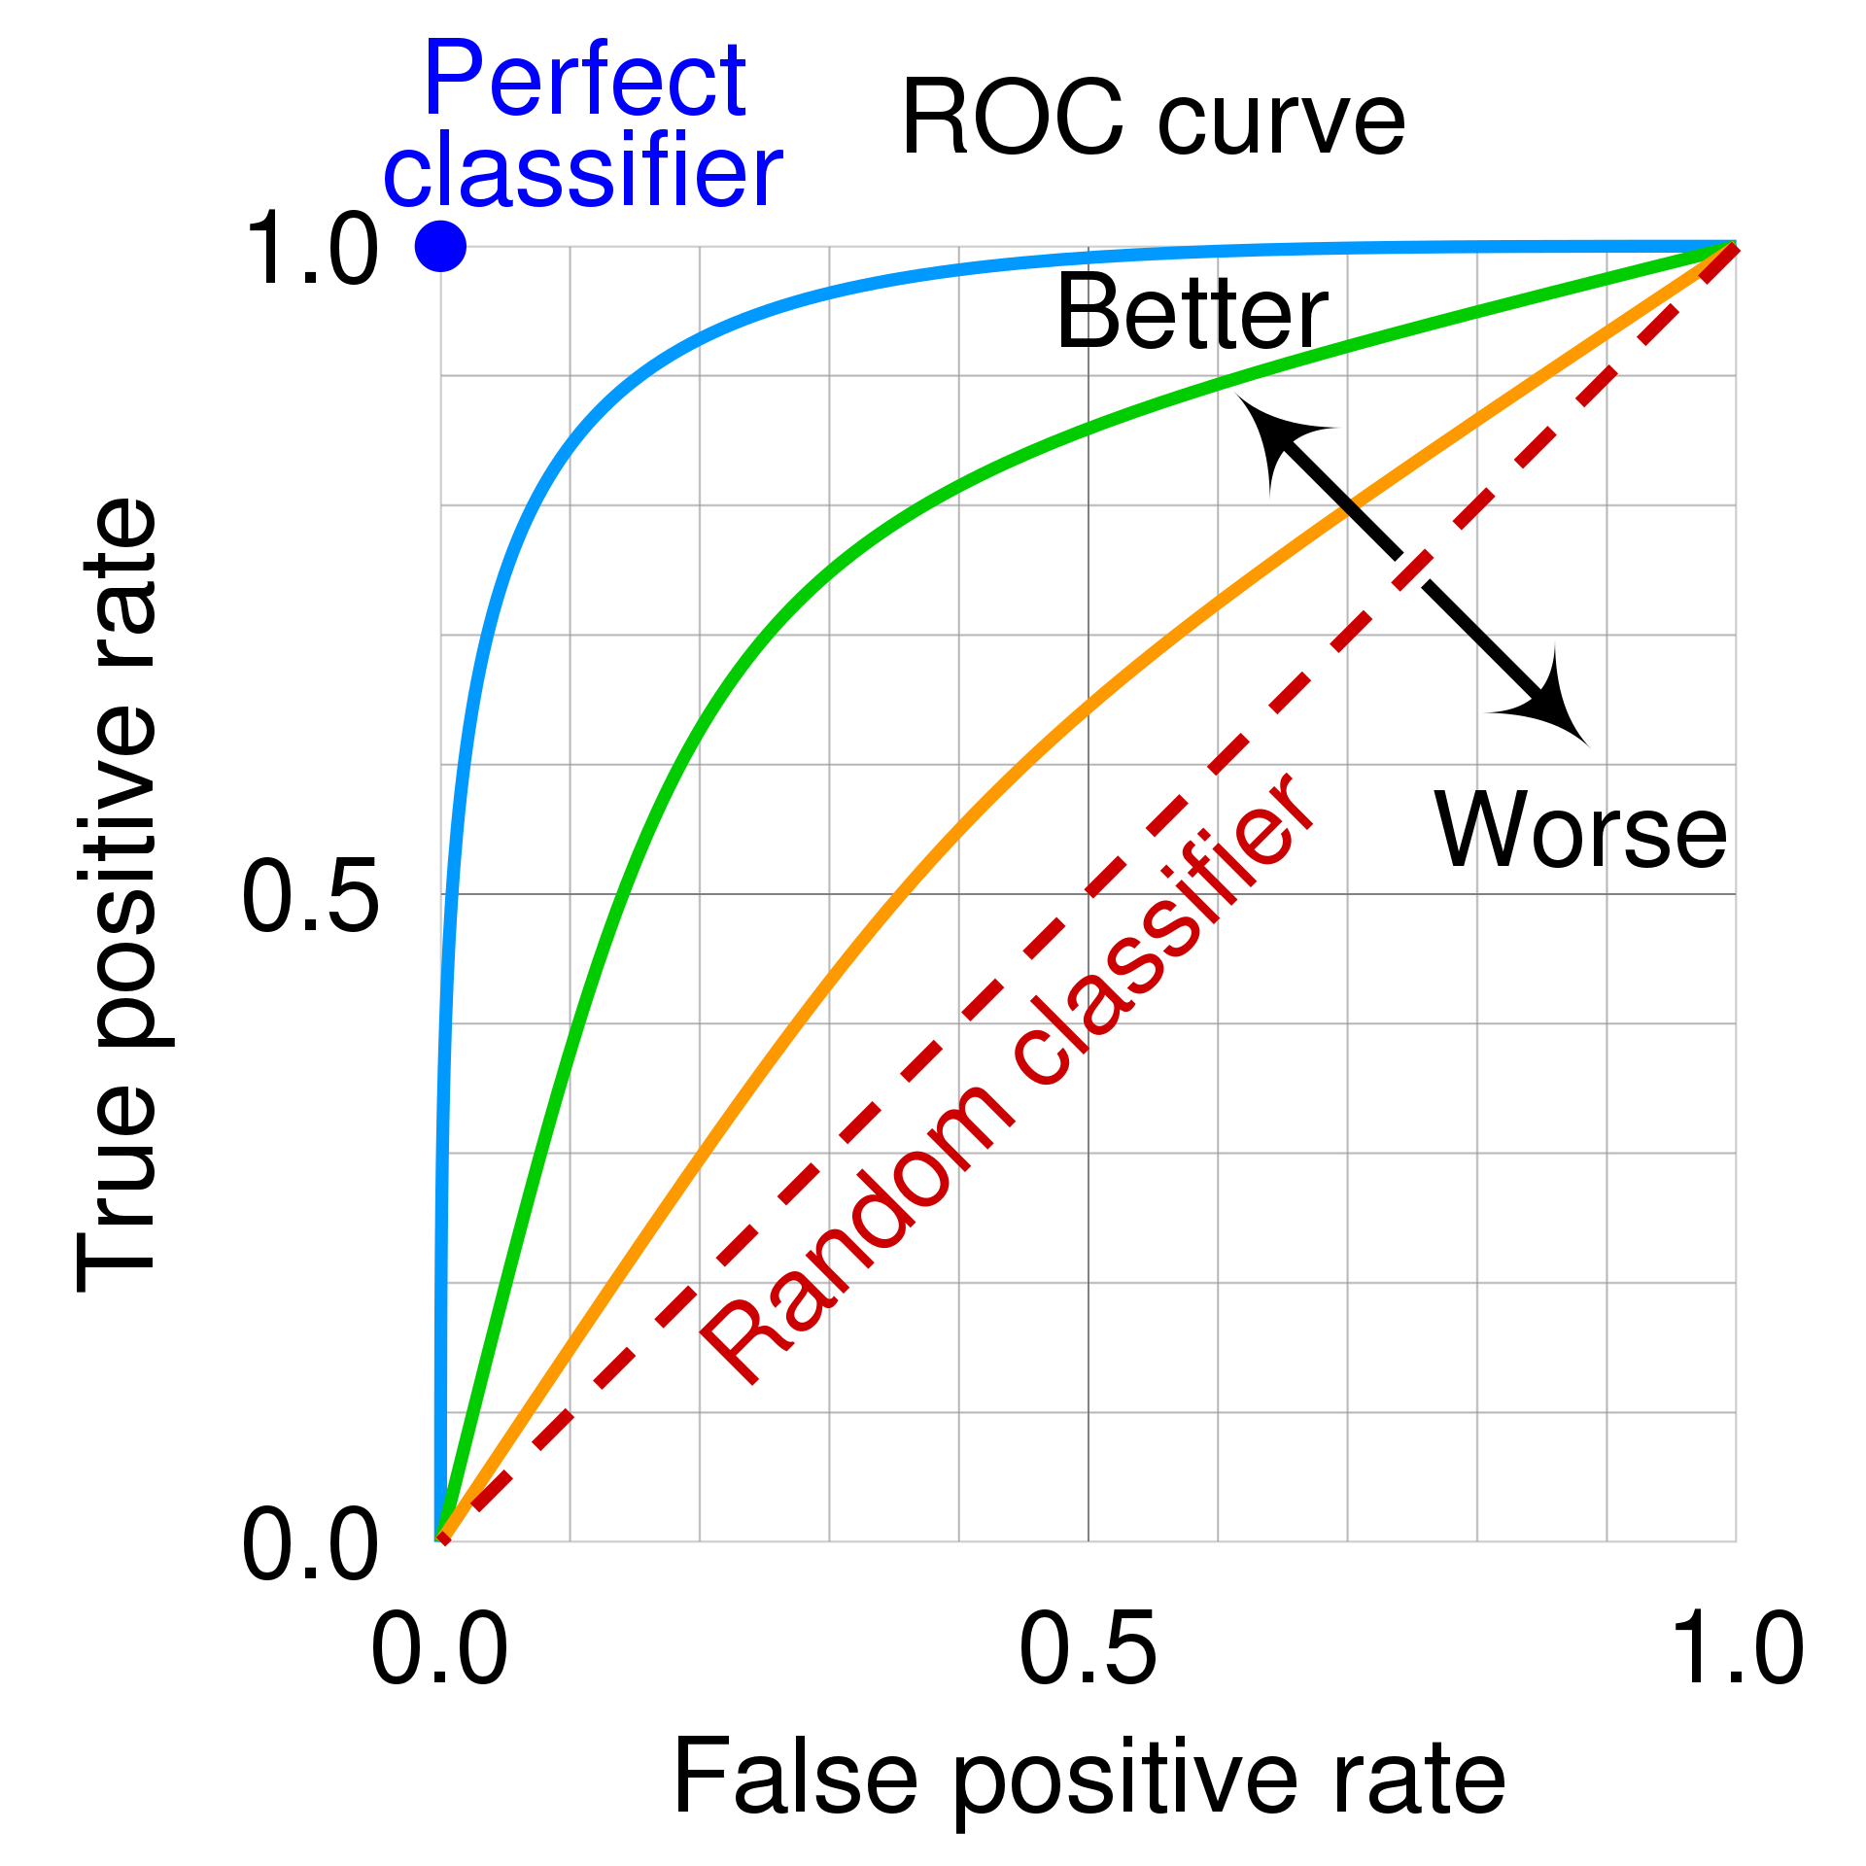

Slide 61
Calibration
Besides the quality of a single-shot predicted class (“yes/no”, “survive/not survive”, ...),
We could also be interested in the predicted probability.
E.g.: “casemix adjustment” for hospital/school evaluation, risk scores in medicine, betting, ...

Slide 62
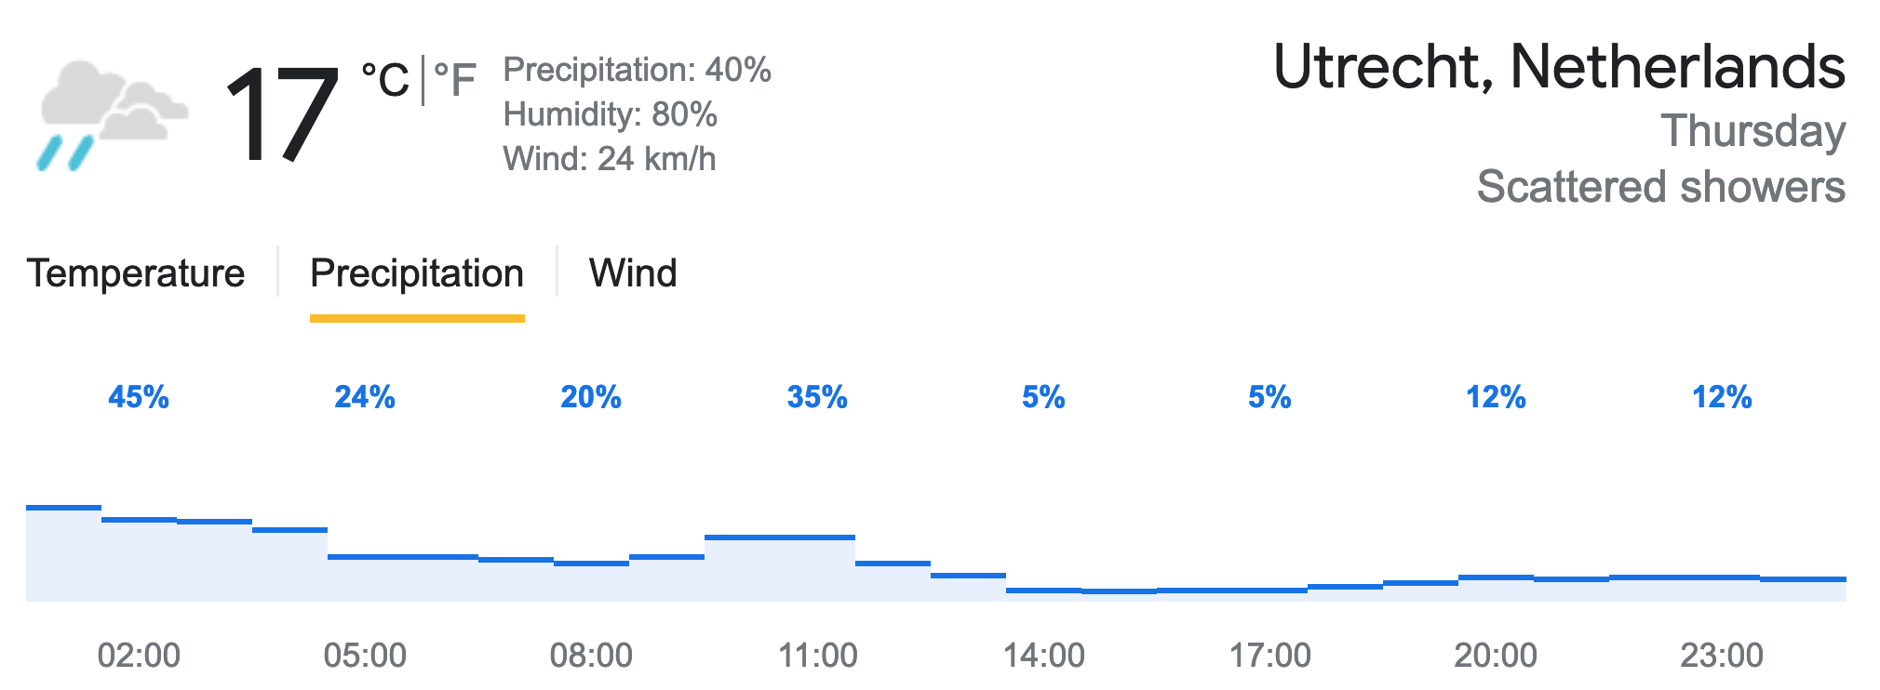
On days like today, how often does it rain?
Notes:
Think of the weather forecast: when the prediction says there’s a 24% chance of rain, does it really rain on 24% of such days?” If yes → the forecast is well calibrated. If not → it’s poorly calibrated.

Slide 63
Probability
A probability is a number p such that the proportion of events given that number is about p.
Ideally, the classification procedure (e.g. classification tree) outputs a predicted probability directly.
Unfortunately,
Not all classifiers output a predicted probability (e.g. SVM);
Many classifiers that do give a number between 0 and 1 called a “predicted probability”, the predicted probability does not give the correct proportion of events.
This is the “calibration problem”.

Slide 64
Calibration plot
Probability
A probability is a number p such that the proportion of events given that number is about p.
A predicted probability is calibrated when it conforms to the definition above;
Check this using a calibration plot

Slide 65
When the model says there’s a 60% chance of survival, that should mean that about 60% of people with that same prediction actually survived.
If the points lie on the diagonal, our model’s probabilities are well calibrated. If they fall below, the model is overconfident , it predicts higher probabilities than observed. If they lie above, it’s underconfident.

Slide 66
Post-hoc probability calibration
Some libraries allow you to tweak the predicted probabilities so they fit on the curve. This is called “probability calibration”.
There are many methods, but the most commonly used one takes a classification model we know is calibrated (“logistic regression”) and applies it to the uncalibrated scores outputted by the classifier;
You may encounter this in your readings.

Slide 67
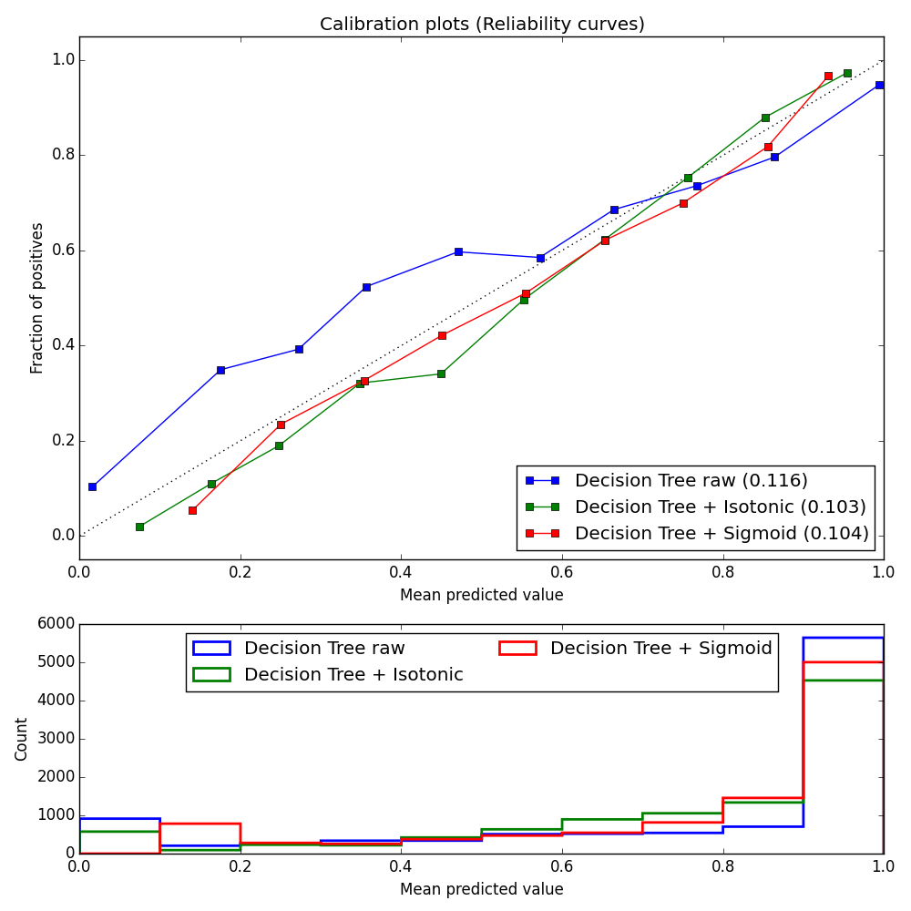

Slide 68
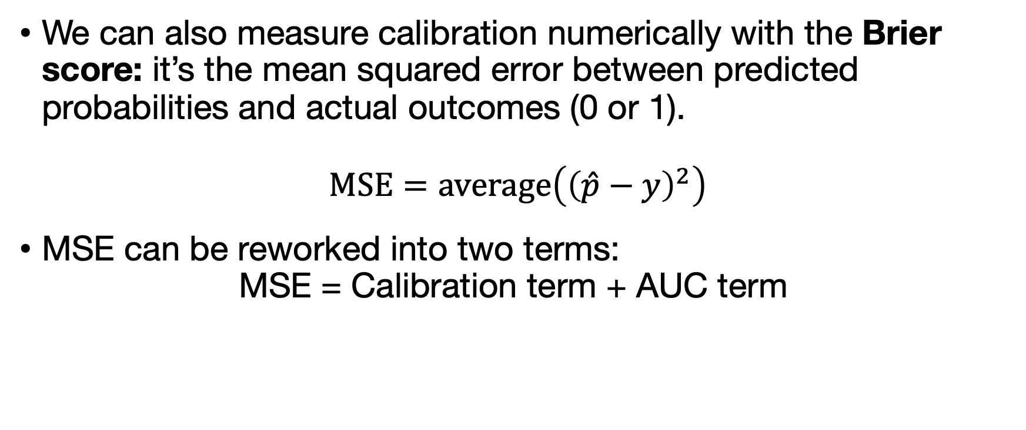
MSE (“Brier score”)
We can also measure calibration numerically with the Brier score: it’s the mean squared error between predicted probabilities and actual outcomes (0 or 1).
$$\text{MSE}=\text{average}\left({\left(\hat{p}−y\right)}^{2}\right)$$
MSE can be reworked into two terms:
$$\text{MSE}\text{ = }\text{Calibration} \text{term}\text{ + }\text{AUC} \text{term}$$

Slide 69
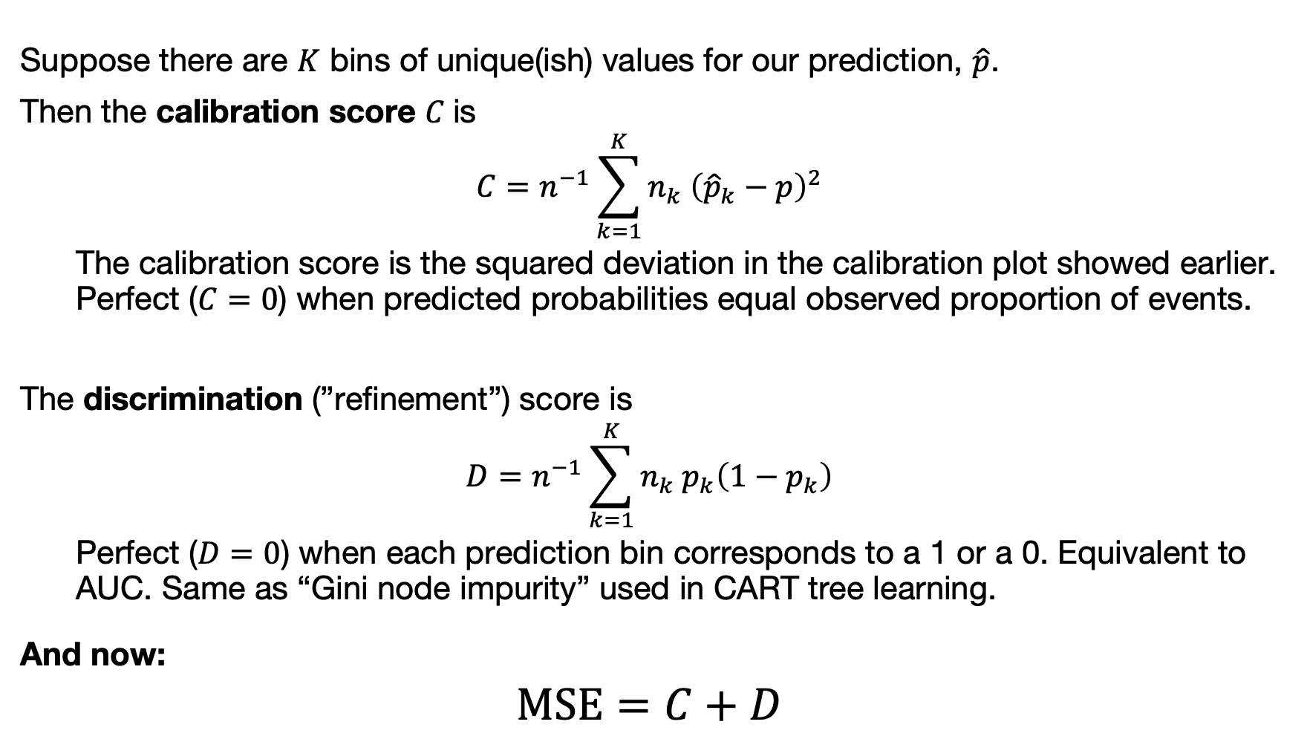
MSE can be reworked into two terms
OPTIONAL!! Not assessed.
Suppose there are $K$ bins of unique(ish) values for our prediction, $\hat{p}$.
Then the calibration score $C$is
$$C=n^{−1}\sum_{k=1}^{K}{n_{k} {\left({\hat{p}}_{k}−p\right)}^{2}}$$
The calibration score is the squared deviation in the calibration plot showed earlier. Perfect ($C=0$) when predicted probabilities equal observed proportion of events.
The discrimination (”refinement”) score is
$$D=n^{−1}\sum_{k=1}^{K}{n_{k}{ p}_{k}\left({1−p}_{k}\right)}$$
Perfect ($D=0$) when each prediction bin corresponds to a 1 or a 0. Equivalent to AUC. Same as “Gini node impurity” used in CART tree learning.
And now:
$$\text{MSE}=C+D$$
[Blattenberger & Lad 1985]

Slide 70
Calibration in evaluation of ML models
Calibration answers the question: when my model predicts a probability, can I trust that number?
Important for downstream decision-making
Sometimes overlooked in ML model evaluation
Many (most?) high-capacity models are not calibrated by default
Evaluate using more advanced methods in standard software

Slide 71
Class imbalance
In the Titanic example, the outcome classes are pretty evenly balanced;
That is not typical of many applications: debt default; illness; activity; buy/don’t buy; tank/dog/selfie/..; solid/liquid/gas/plasma; ...
When at least one class has very few observations, this is called class imbalance.

Slide 72
Class imbalance
Problem:
Measures such as SEN/SPE/ACC/F1 emphasize larger classes;
What if the smaller classes are the most/equally interesting?
Some solutions:
Oversampling minority/undersampling majority
Weighting
“Embedded”: class_weight='balanced’ in boosting

Slide 73
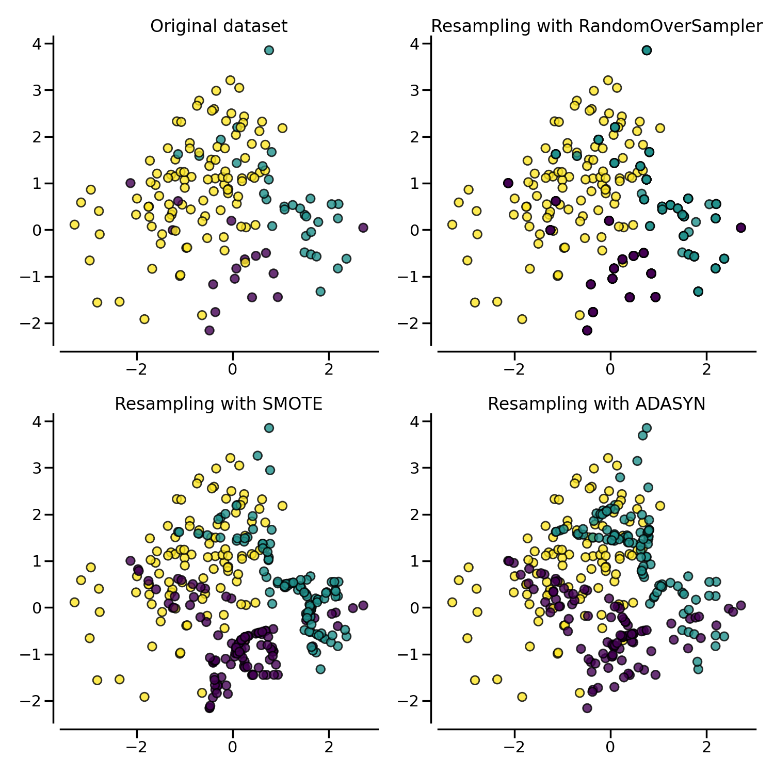
https://imbalanced-learn.org

Slide 74
Conclusion: Supervised learning is a large field
We have emphasized
Pluralistic approach, coupled with
Honest model evaluation
This includes thinking about the task, performance metric, and training and testing data
Some of these lead to specific issues in classification (e.g. calibration, class imbalance) discussed today (& in book)
You should now be equipped to start using supervised learning in practice!

Slide 75
Confusion matrix
 |  | Survived
 |  | No. | Yes.
Predicted to survive
 | “No” | 514 | 238
 | “Yes” | 35 | 104

