Slide 1
Deep learning
Feed-forward and convolutional neural networks for image recognition
Erik-Jan van Kesteren

Slide 2
Supervised machine learning
Regression (predicting continuous outcomes)
Model evaluation
Classification (predicting discrete outcomes)
Deep learning

Slide 3
Today
Introduction to neural networks
Feed-forward & deep neural networks
Estimation / optimization
Convolutional neural networks
Battling the curse of dimensionality

Slide 4
Introduction

Slide 5
Why should we learn this?
State-of-the-art performance on various tasks
Text prediction (your phone’s keyboard)
Text mining (at the end of this course!)
Forecasting
Object recognition
Sound recognition
Spam filtering
Image generation
Style transfer
Image denoising
Compression (dimension reduction)
…

Slide 6
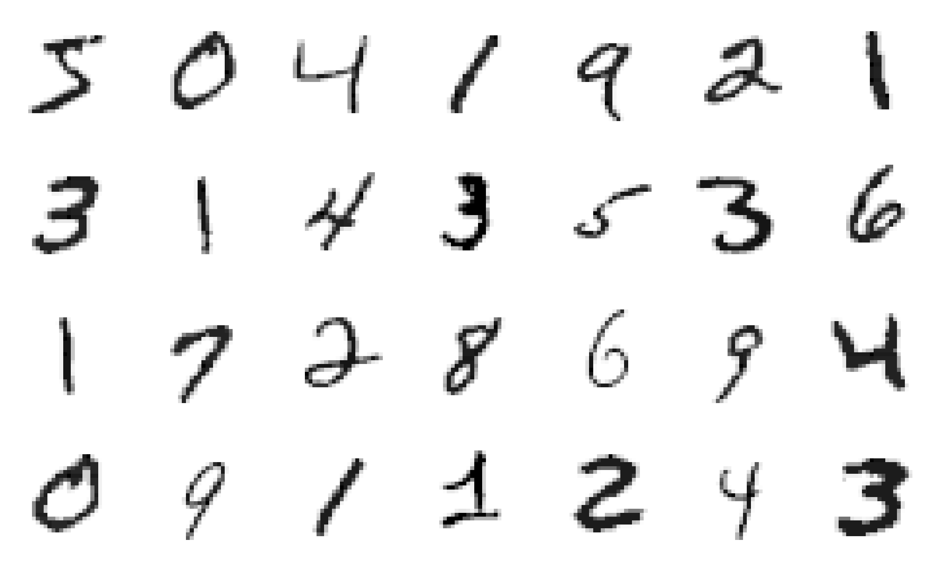
“Hello world” of neural networks
MNIST (Modified National Institute of Standards and Technology)
Handwritten digits
28 * 28 pixels
60 000 training images and 10 000 testing images

Slide 7
So what is a neural network?

Slide 8
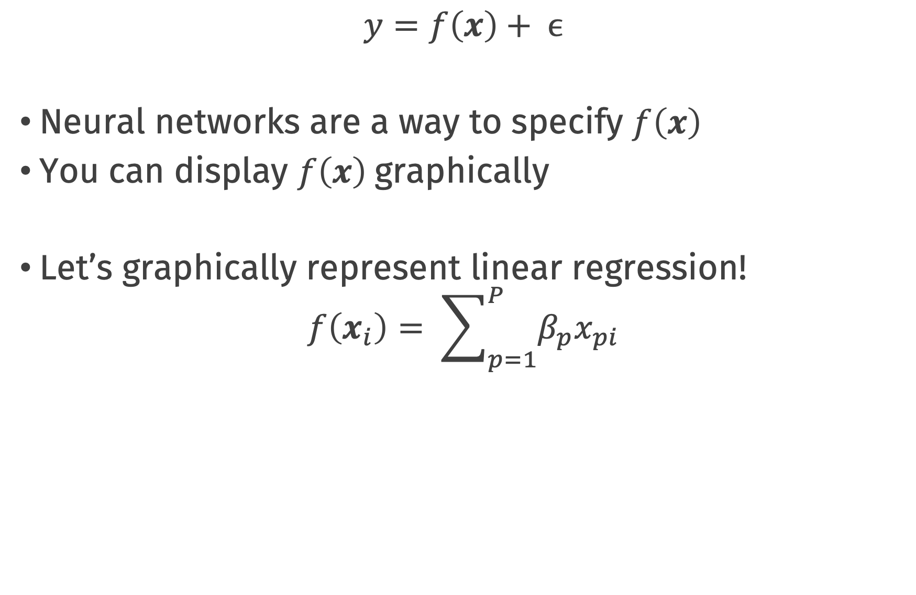
Neural networks
$$y=f\left(x\right)+ ϵ$$
Neural networks are a way to specify $f\left(x\right)$
You can display $f\left(x\right)$graphically
Let’s graphically represent linear regression!
$$f\left(x_{i}\right)= \sum_{p=1}^{P}{β_{p}x_{pi}}$$

Slide 9
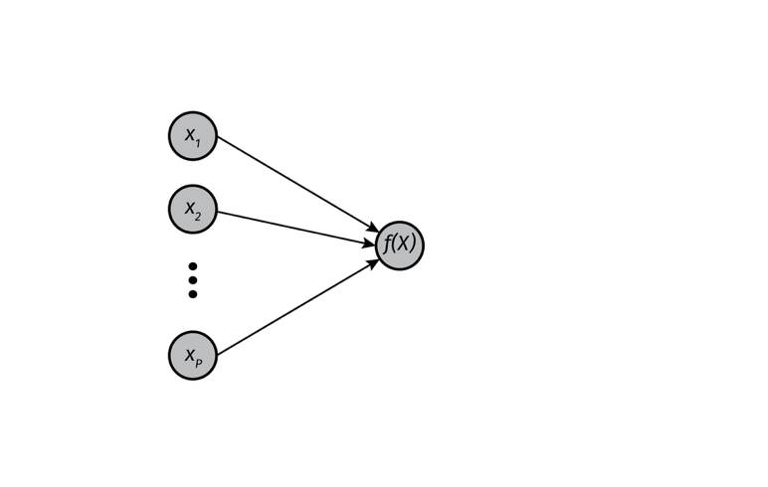
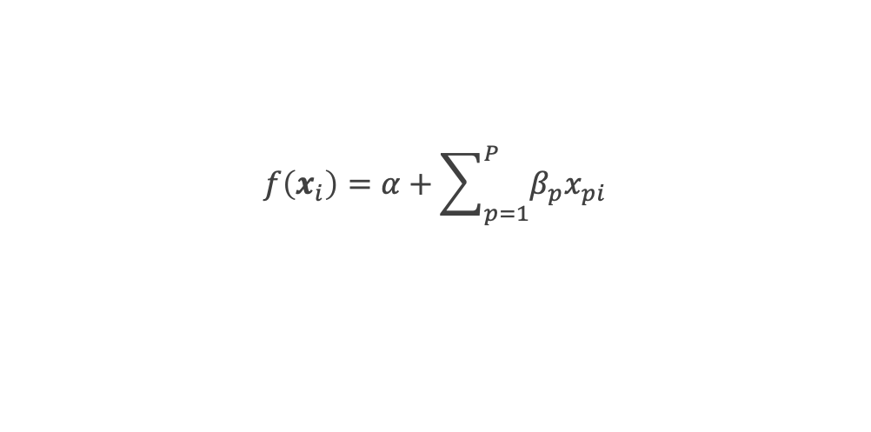
Linear regression as neural net
Graphical representation
Parameters are arrows
Arrows ending in a node are summed together
Intercept is not drawn
$$f\left(x_{i}\right)=α+\sum_{p=1}^{P}{β_{p}x_{pi}}$$

Slide 10
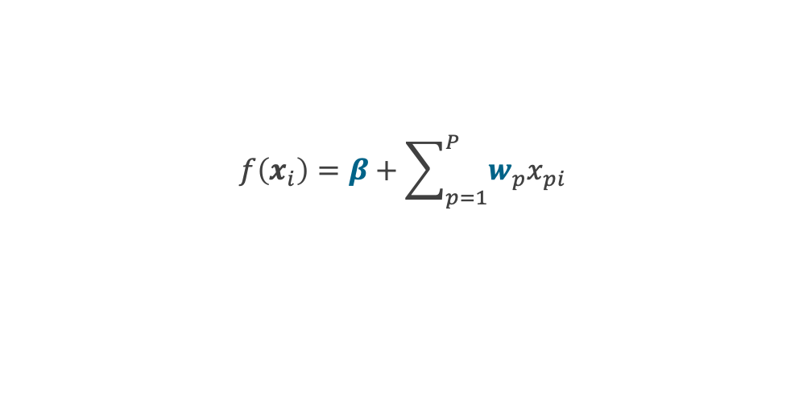
Linear regression as neural net
Neural network jargon
Parameter = weight
Intercept = bias
$$f\left(x_{i}\right)=β+\sum_{p=1}^{P}{w_{p}x_{pi}}$$

Slide 11
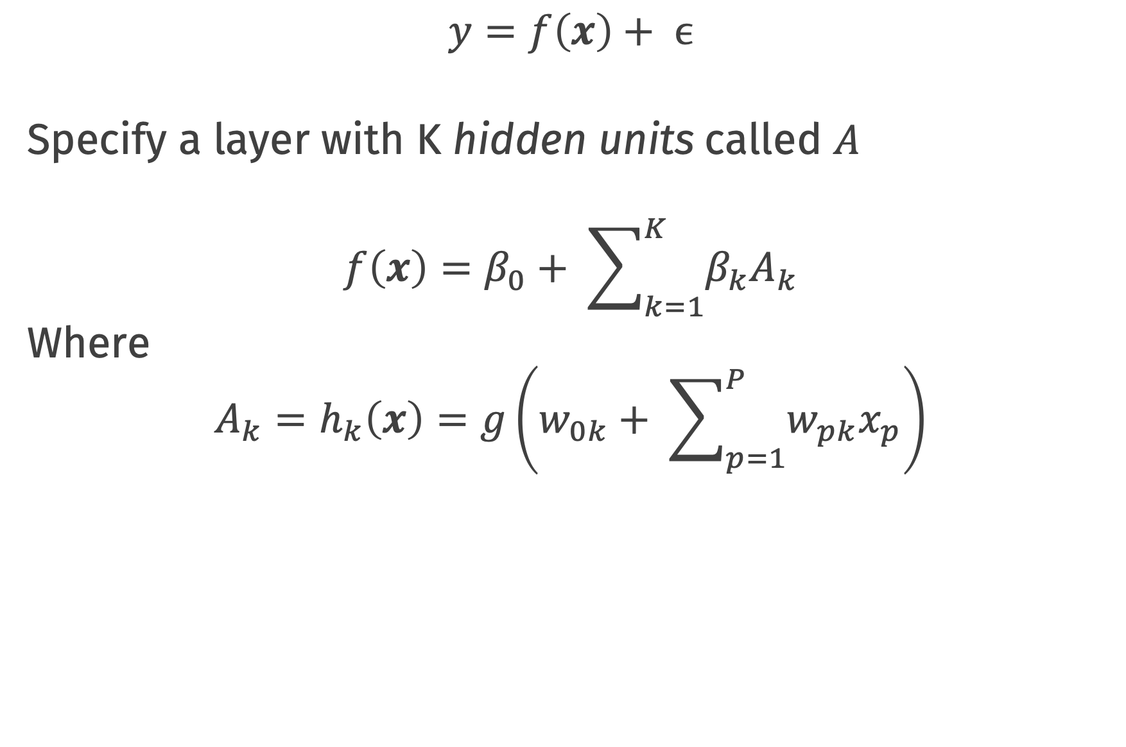
Single layer neural networks
$$y=f\left(x\right)+ ϵ$$
Specify a layer with K hidden units called $A$
$$f\left(x\right)=β_{0}+ \sum_{k=1}^{K}{β_{k}A_{k}}$$
Where
$$A_{k}=h_{k}\left(x\right)=g\left(w_{0k}+ \sum_{p=1}^{P}{w_{pk}x_{p}}\right)$$

Slide 12
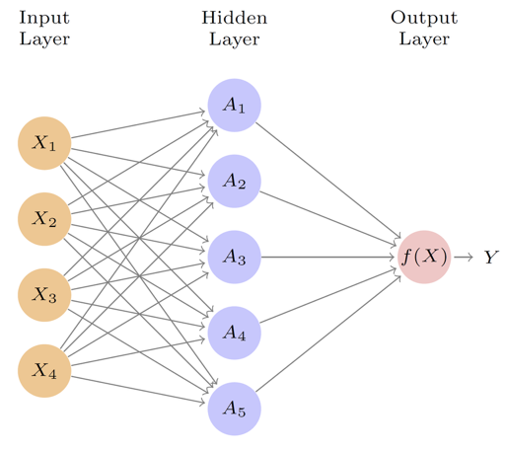
Single layer neural networks

Slide 13
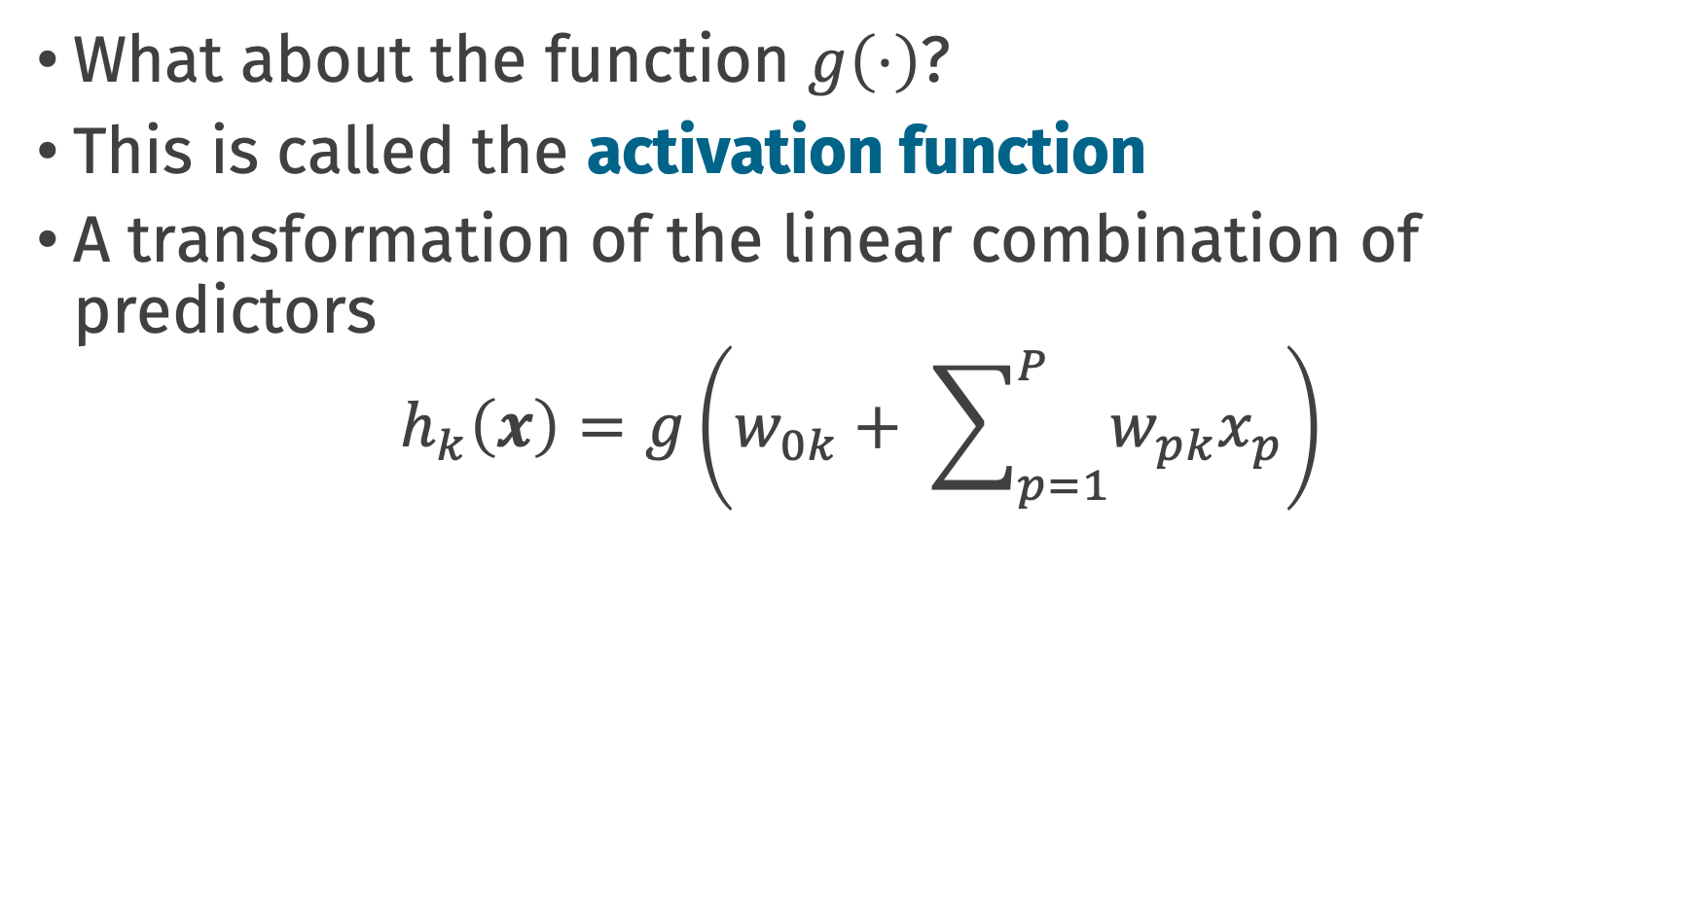
Single layer neural networks
What about the function $g\left(⋅\right)$?
This is called the activation function
A transformation of the linear combination of predictors
$$h_{k}\left(x\right)=g\left(w_{0k}+ \sum_{p=1}^{P}{w_{pk}x_{p}}\right)$$

Slide 14
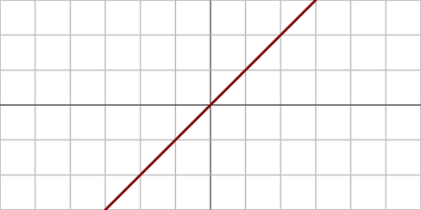
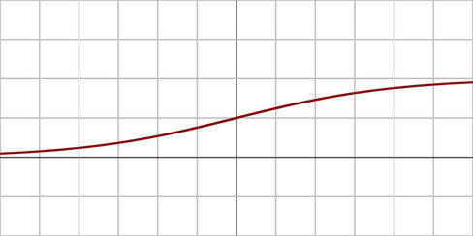
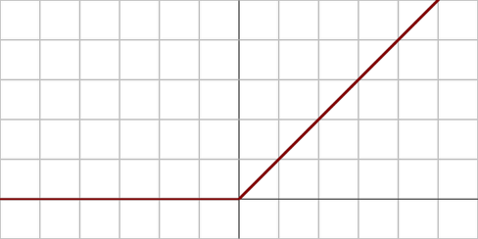



Activation functions
Linear: $g\left(x\right)=x$
Sigmoid: $g\left(x\right)=\frac{1}{1+e^{−x}}$
ReLu: $g\left(x\right)=max(0,x)$
Rectified linear (ReLu) is most popular nowadays
Nonlinearity necessary! Otherwise: collapse to linear regression

Slide 15
Activation functions
We can go wider
More hidden units -> more transformations of input
Similar to basis functions, feature engineering
Universal function approximation theorem
Any “well-behaved” function can be represented by neural net of sufficient width with nonlinear activation function
(you may need an inconvenient number of hidden units!)

Slide 16
Single layer neural networks

Slide 17
Let’s take it further

Slide 18
Feed-forward neural networks
We can go deeper
More hidden layers after one another
Higher-order features composed of lower-order features
Universal function approximation theorem, version 2
Any “well-behaved” function can be represented by neural net of sufficient depth with nonlinear activation function
(deep neural nets may be more tractable than wide)

Slide 19
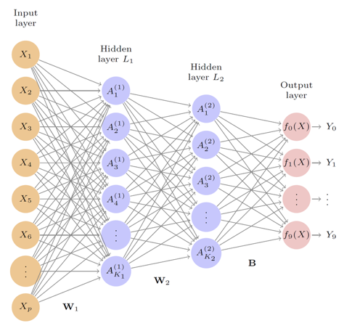
Feed-forward neural networks

Slide 20

Feed-forward neural networks
Feed-forward network architecture defined by:
Number of layers
Number of hidden units in each layer
Activation function for each layer
Activation function for output layer

Slide 21
Prediction for MNIST
Each example has:
28*28 = 784 input features
Values between 0-255 (8 bit)
Usually normalized to be 0-1
1 = black, 0 = white, 0.5 = grey
10 outcome categories (0-9)
One-hot encoding for outcome
(cool way to say dummy coding)
1 = 0 1 0 0 0 0 0 0 0 0
5 = 0 0 0 0 0 1 0 0 0 0

Slide 22
Keras!
library(keras)
model_dff <-
keras_model_sequential() %>%
layer_flatten(input_shape = c(28, 28)) %>%
layer_dense(units = 256, activation = "relu") %>%
layer_dense(units = 128, activation = "relu") %>%
layer_dense(10, activation = "softmax")

Slide 23
Keras!
summary(model_dff)
Layer (type) Output Shape Param #
======================================================================================
flatten (Flatten) (None, 784) 0
______________________________________________________________________________________
dense_1 (Dense) (None, 256) 200960
______________________________________________________________________________________
dense_2 (Dense) (None, 128) 32896
______________________________________________________________________________________
dense_3 (Dense) (None, 10) 1290
======================================================================================
Total params: 235,146
Trainable params: 235,146
Non-trainable params: 0
______________________________________________________________________________________

Slide 24
How to estimate parameters?

Slide 25
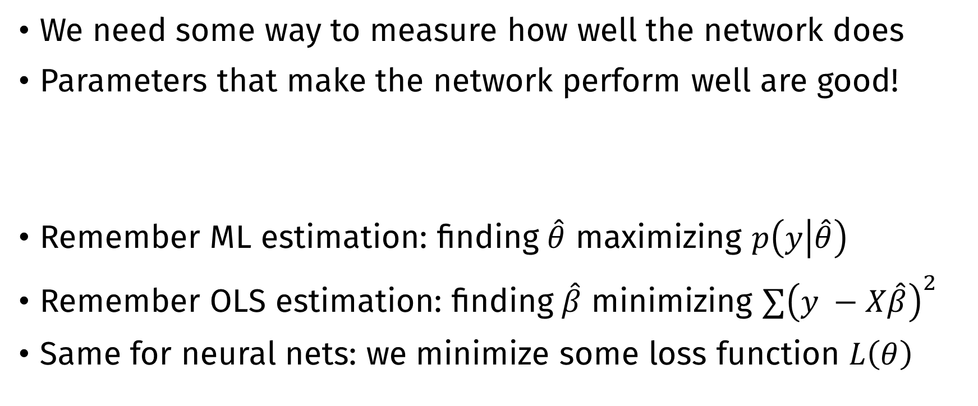
Estimating parameters
We need some way to measure how well the network does
Parameters that make the network perform well are good!
Remember ML estimation: finding $\hat{θ}$ maximizing $p\left(y | \hat{θ}\right)$
Remember OLS estimation: finding $\hat{β}$ minimizing $∑{\left(y −X\hat{β}\right)}^{2}$
Same for neural nets: we minimize some loss function $L\left(θ\right)$

Slide 26
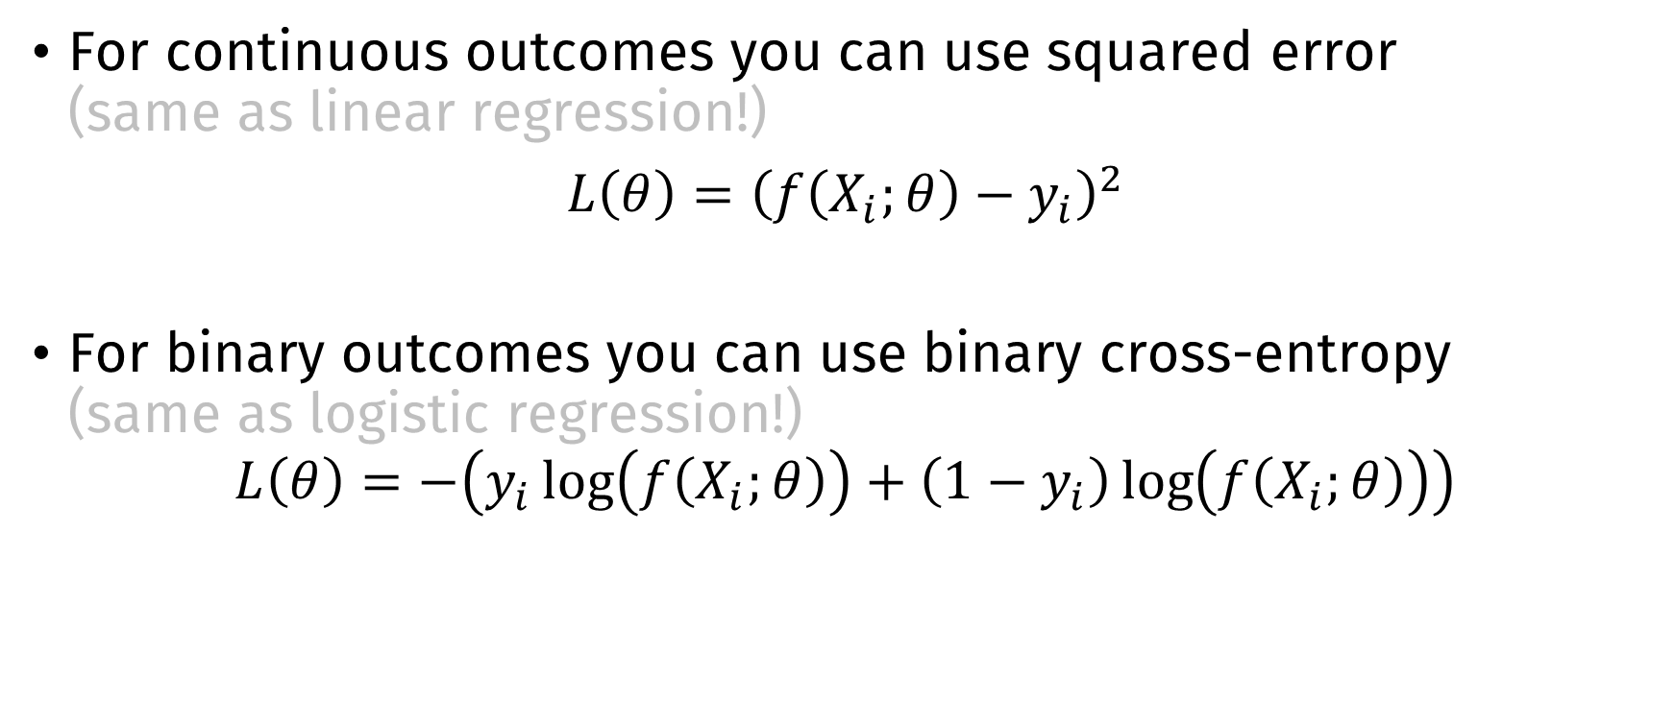
Loss function
For continuous outcomes you can use squared error (same as linear regression!)
$L\left(θ\right)={\left(f\left(X_{i};θ\right)−y_{i}\right)}^{2}$
For binary outcomes you can use binary cross-entropy (same as logistic regression!)
$$L\left(θ\right)=−\left(y_{i}\log\left(f\left(X_{i};θ\right)\right)+\left(1−y_{i}\right)\log\left(f\left(X_{i};θ\right)\right)\right)$$

Slide 27
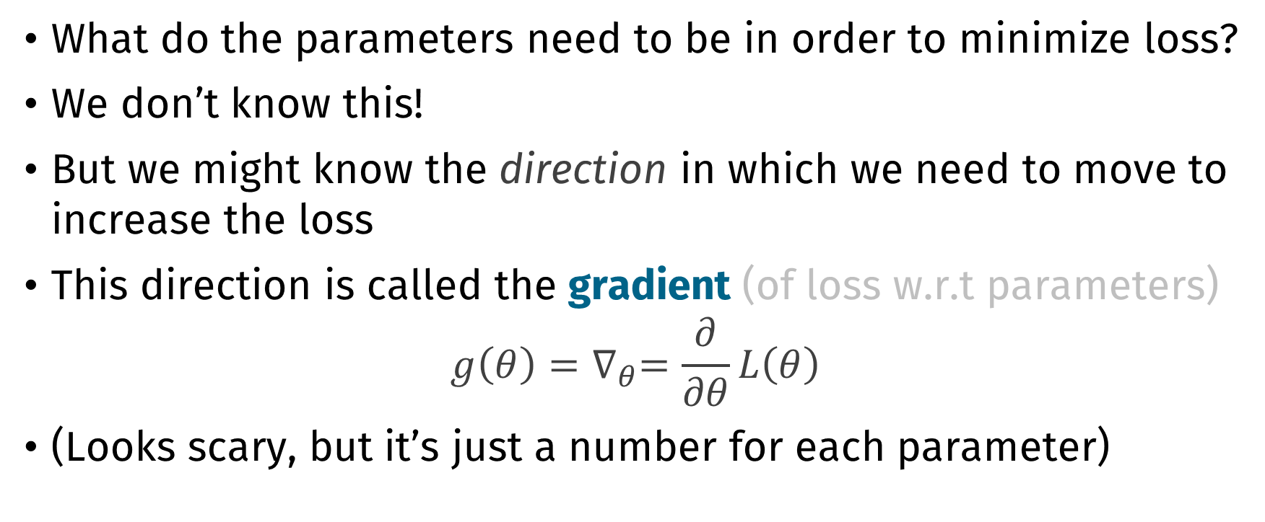
Loss function
What do the parameters need to be in order to minimize loss?
We don’t know this!
But we might know the direction in which we need to move to increase the loss
This direction is called the gradient (of loss w.r.t parameters)
$$g\left(θ\right)=∇_{θ}=\frac{∂}{∂θ}L\left(θ\right)$$
(Looks scary, but it’s just a number for each parameter)

Slide 28
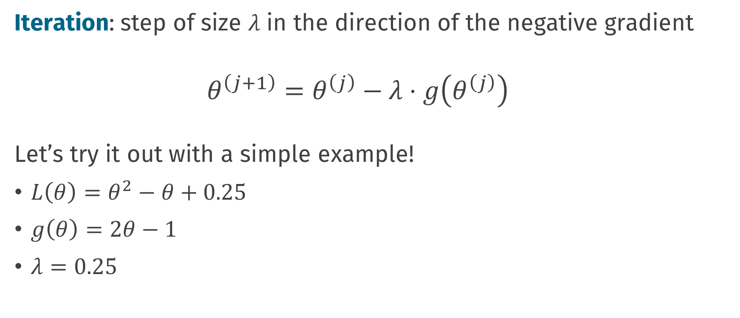
Gradient descent
Iteration: step of size 𝜆 in the direction of the negative gradient
$$θ^{\left(j+1\right)}=θ^{\left(j\right)}−λ⋅g\left(θ^{\left(j\right)}\right)$$
Let’s try it out with a simple example!
$L\left(θ\right)=θ^{2}−θ+0.25$
$g\left(θ\right)=2θ−1$
$λ=0.25$

Slide 29
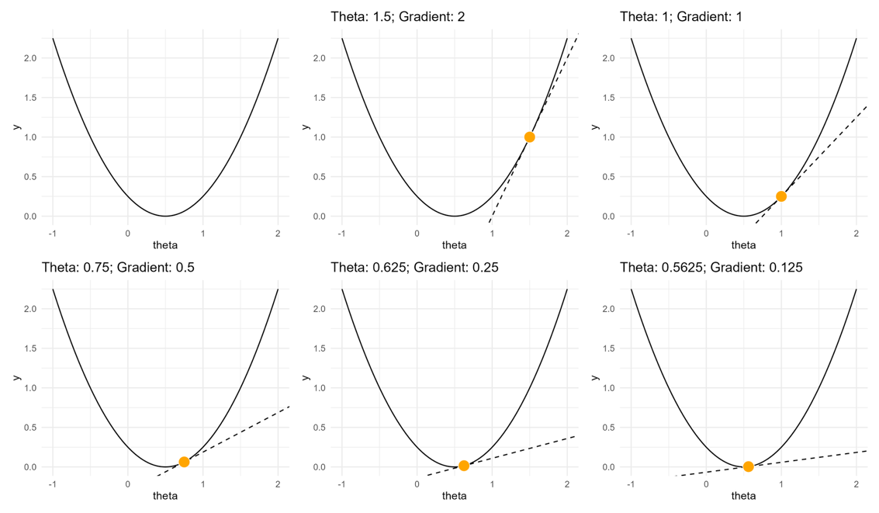

Slide 30
Stochastic gradient descent
Instead of computing the gradients w.r.t. the entire loss function, only use a random batch of data
Take a step after each batch (e.g., 32 rows)
If batch size = 1, take a step after each example
Common batch sizes: 32, 64, 128, 256, 512
One look at the full data = 1 epoch

Slide 31

Gradient computation
But in neural networks, how do we compute gradients?
We have functions of functions!
Software like tensorflow / Keras / torch does this for you!
Backpropagation: smart repeated use of the chain rule to compute derivatives
Software also implements gradient descent (and friends)

Slide 32

Nice visual explanations
https://www.youtube.com/playlist?list=PLZHQObOWTQDNU6R1_67000Dx_ZCJB-3pi

Slide 34
Programming pattern: training
model_dff %>%
compile(
loss = "sparse_categorical_crossentropy",
optimizer = "adam"
)
model_dff %>%
fit(
x = X,
y = y,
batch_size = 32,
epochs = 10
)

Slide 35
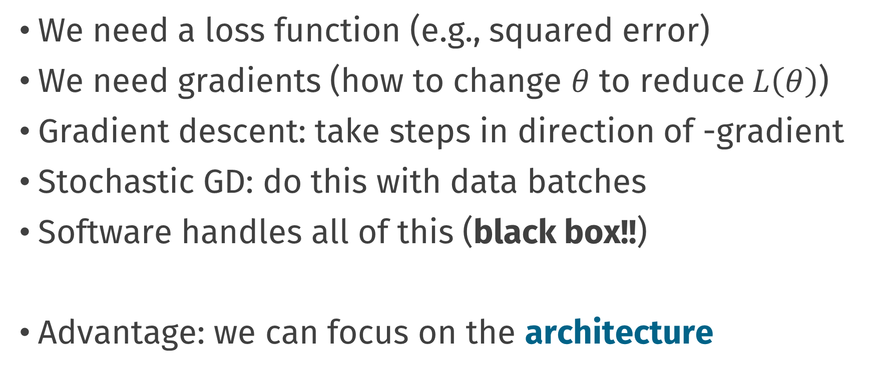
Conclusion: training
We need a loss function (e.g., squared error)
We need gradients (how to change $θ$ to reduce $L\left(θ\right)$)
Gradient descent: take steps in direction of -gradient
Stochastic GD: do this with data batches
Software handles all of this (black box!!)
Advantage: we can focus on the architecture

Slide 36
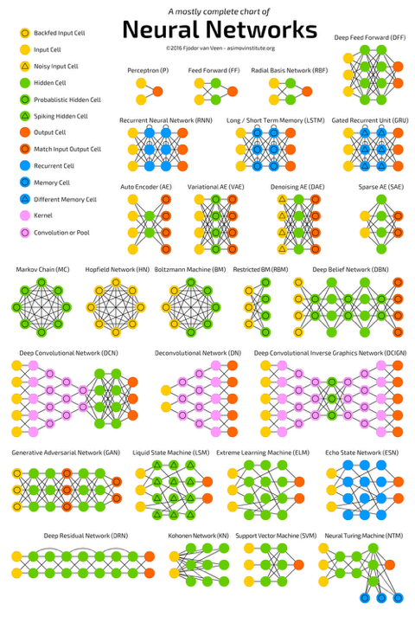
Different architectures
By adjusting the arrows, layers, and activation functions, you can create models that are tailored to specific data, e.g.
Convolutional (CNN): images, text, sound
Recurrent (RNN): time series, text
Graph (GNN): networks
…

Slide 37
Image processing with convolutional neural networks

Slide 38
What is a convolution
Convolution is applying a kernel (filter) over an image
Filter defines which feature is important in the image
https://github.com/vdumoulin/conv_arithmetic

Slide 39
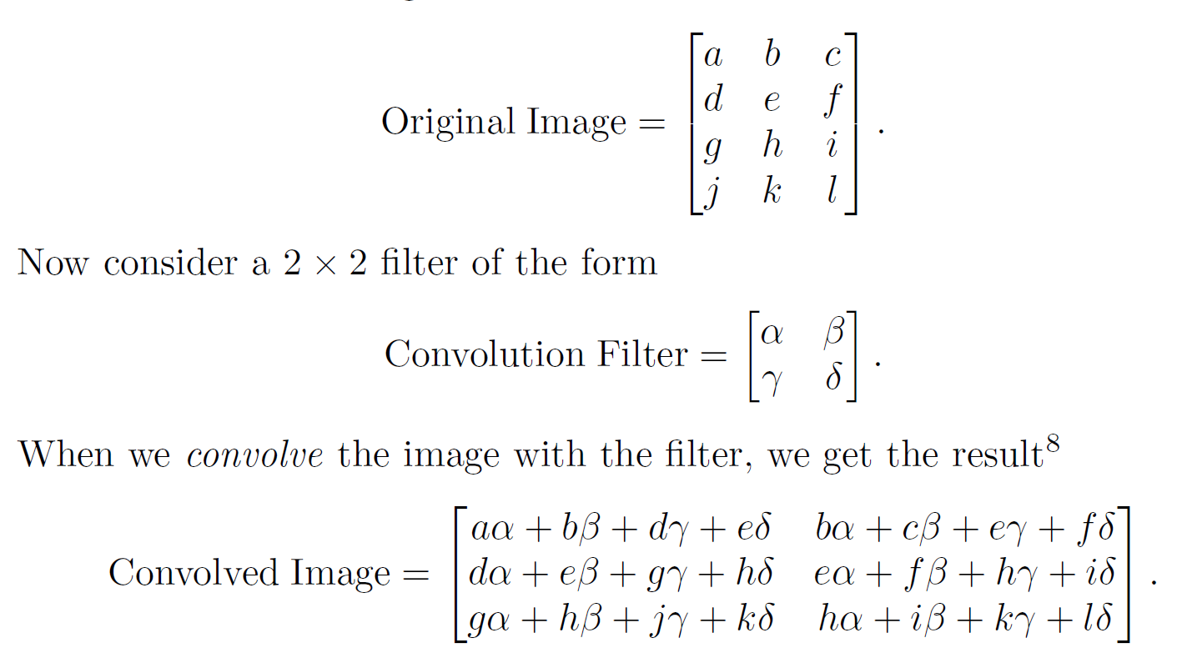
What is a convolution

Slide 40
Back to MNIST

Slide 41
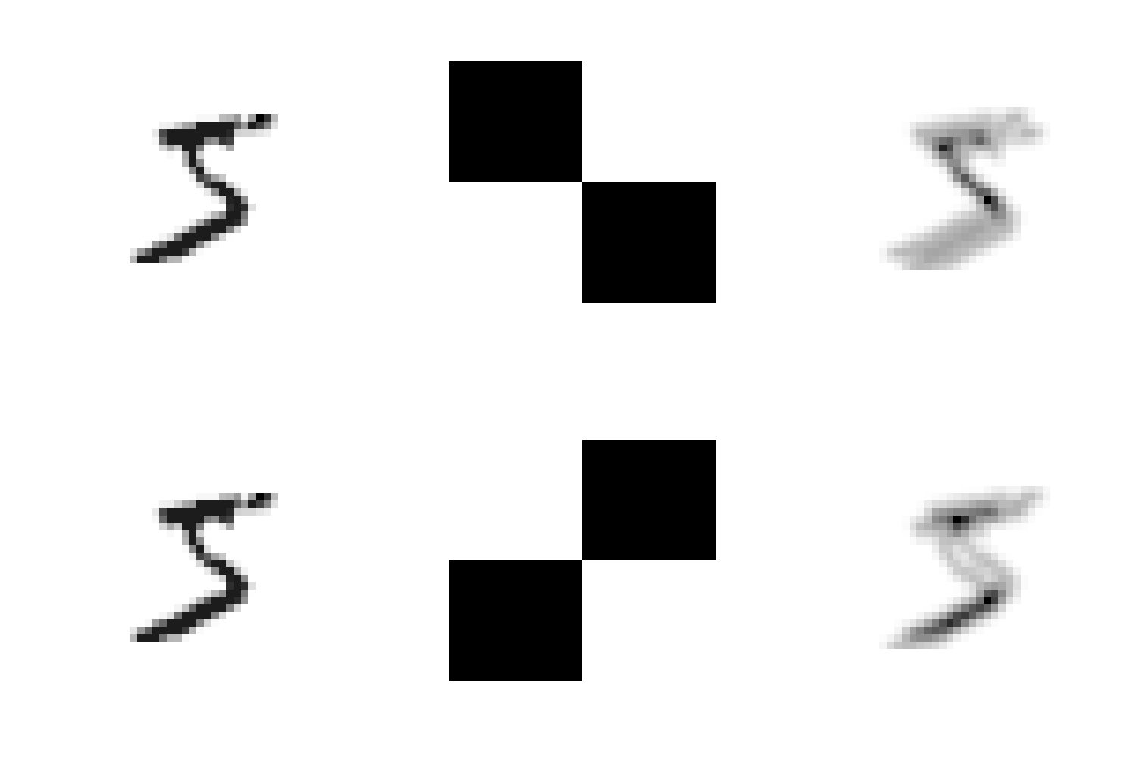
Detecting diagonal lines with convolution

Slide 42
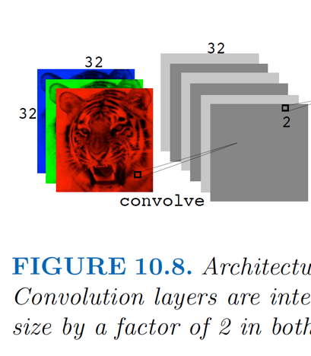
Convolution layers
A convolutional neural network is a NN with one or more convolution layers
The parameters / weights in a convolution layer are the elements of the filter
The filter is learnt by the network!

Slide 43
Convolution layers
In each convolution layer, you can create multiple filters
Number of parameters is function of:
Number of filters (e.g. 6)
Size of each filter (e.g. 2x2)
NOT the input dimension!
Parameter sharing

Slide 44
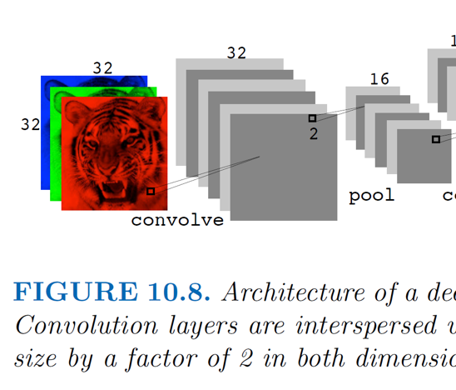
Pooling layer
Convolution layers are usually followed by a pooling layer
Reduces dimensionality
Location invariance: Robustness against pixel shift / small rotations
Max pool most common

Slide 45
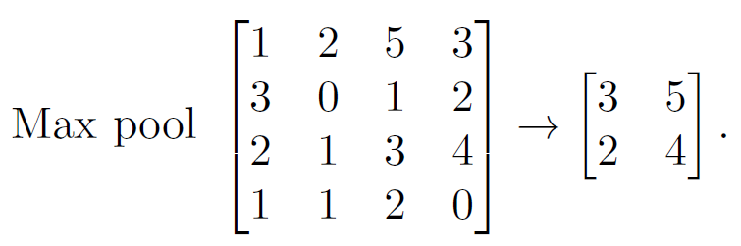
Pooling layer

Slide 46
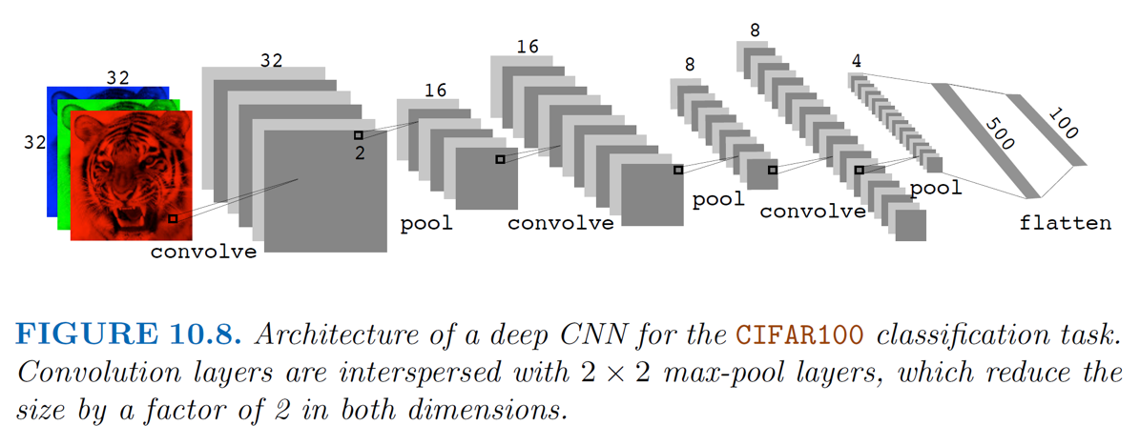
Architecture of a CNN

Slide 47
Applying CNN to MNIST
model_cnn <-
keras_model_sequential(input_shape = c(28, 28, 1)) %>%
layer_conv_2d(6, c(5, 5)) %>%
layer_max_pooling_2d(pool_size = c(4, 4)) %>%
layer_flatten() %>%
layer_dense(units = 32, activation = "relu") %>%
layer_dense(10, activation = "softmax")

Slide 48
Model summary
summary(model_cnn)
Layer (type) Output Shape Param #
=======================================================================================================
conv2d_2 (Conv2D) (None, 24, 24, 6) 156
_______________________________________________________________________________________________________
max_pooling2d_2 (MaxPooling2D) (None, 6, 6, 6) 0
_______________________________________________________________________________________________________
flatten_3 (Flatten) (None, 216) 0
_______________________________________________________________________________________________________
dense_8 (Dense) (None, 32) 6944
_______________________________________________________________________________________________________
dense_7 (Dense) (None, 10) 330
=======================================================================================================
Total params: 7,430
Trainable params: 7,430
Non-trainable params: 0

Slide 49
Compare to feed-forward model
summary(model_dff)
Layer (type) Output Shape Param #
======================================================================================
flatten (Flatten) (None, 784) 0
______________________________________________________________________________________
dense_1 (Dense) (None, 256) 200960
______________________________________________________________________________________
dense_2 (Dense) (None, 128) 32896
______________________________________________________________________________________
dense_3 (Dense) (None, 10) 1290
======================================================================================
Total params: 235,146
Trainable params: 235,146
Non-trainable params: 0
______________________________________________________________________________________

Slide 50
Applying CNN to MNIST
model_cnn %>%
compile(
loss = "sparse_categorical_crossentropy",
optimizer = "adam"
)
model_cnn %>%
fit(
x = mnist$train$x,
y = mnist$train$y,
epochs = 10,
validation_split = 0.2,
verbose = 2
)

Slide 51
Performance comparison: DFF
pred
obs 0 1 2 3 4 5 6 7 8 9
0 975 0 1 0 0 1 0 0 2 1
1 0 1129 1 1 0 1 1 2 0 0
2 4 0 1015 2 0 0 3 2 6 0
3 0 0 6 991 0 4 0 4 1 4
4 3 2 2 0 952 0 5 2 0 16
5 3 0 0 10 0 869 4 0 3 3
6 6 2 0 1 2 4 942 0 1 0
7 2 5 6 2 0 0 0 1004 3 6
8 6 0 2 3 2 4 1 4 946 6
9 4 3 0 2 3 1 1 3 1 991

Slide 52
Performance comparison: CNN
pred
obs 0 1 2 3 4 5 6 7 8 9
0 971 0 1 0 1 1 2 1 2 1
1 0 1126 2 1 0 0 2 0 4 0
2 1 1 1020 1 1 0 0 1 6 1
3 0 0 2 997 0 5 0 1 2 3
4 0 0 1 0 970 0 0 0 1 10
5 2 0 0 3 0 881 3 0 2 1
6 5 2 0 0 5 2 941 0 3 0
7 1 3 15 3 0 1 0 994 3 8
8 5 0 3 2 0 0 2 2 956 4
9 1 1 0 1 4 5 0 2 6 989

Slide 53
Performance comparison: CNN
# accuracy
sum(diag(cmat_dff)) / sum(cmat_dff)
#> [1] 0.9814
sum(diag(cmat_cnn)) / sum(cmat_cnn)
#> [1] 0.9845

Slide 54
What about the features?
Unboxing the black box
Extract the weights of the convolution layer to find the features (filters) that were learnt
Apply the filters to some example images to get an idea of which features are discriminative for the different numbers
(There are other advanced methods, like layerwise relevance propagation, shapley values, …)

Slide 55
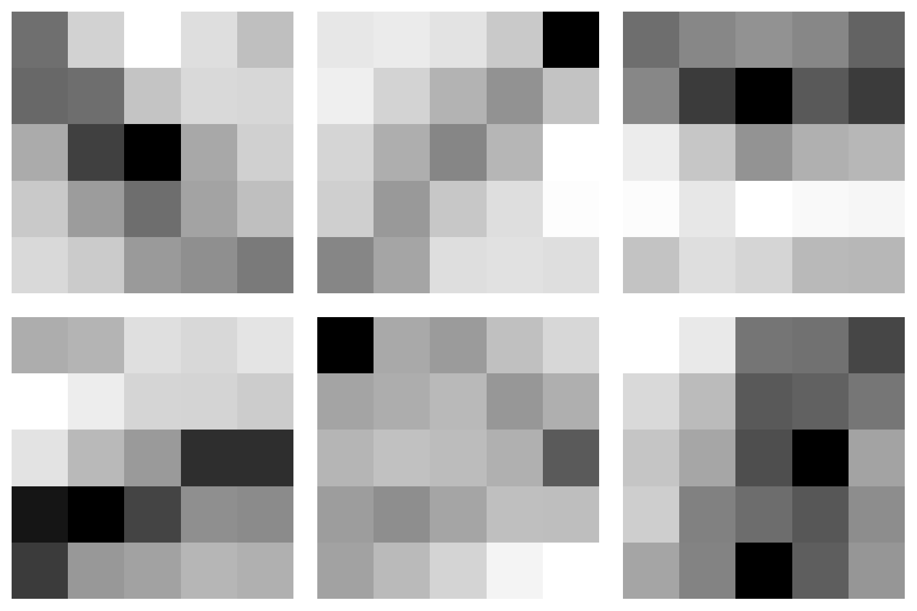

Slide 56
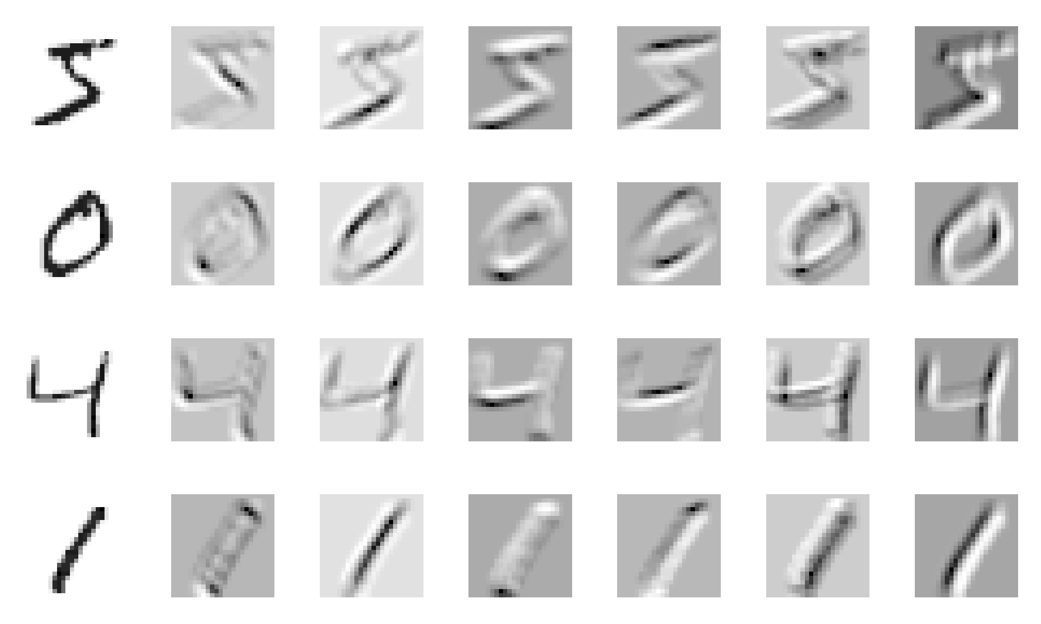

Slide 57
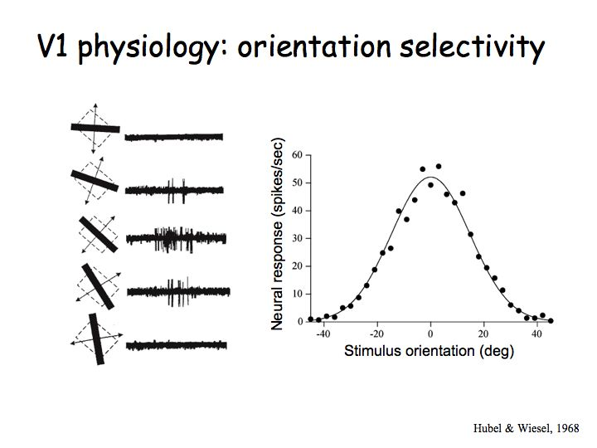
Similarity to visual brain area
These learnt filters are similar to monkey visual area 1 (V1) neuron sensitivities
http://www.cns.nyu.edu/~david/courses/perception/lecturenotes/V1/lgn-V1.html

Slide 58
Cool hack: pretrained CNNs
Download the convolutional layer weights from existing neural network trained on many images
Apply them to your own images
Result: a feature vector per image
Use these feature vectors as input dataset for:
Deep feedforward neural network
Logistic regression
Support vector machine
…
This can work really well!!

Slide 59
Conclusion: CNN
Convolution = applying kernel (filter) over an image
CNNs employ convolution layers
Parameter sharing
Feature detection
Followed by pooling layers
location invariance
State-of-the art in image recognition
Use pretrained networks as a quick proxy

Slide 60
Battling the curse of dimensionality

Slide 61
Regularization in NNs
We may have thousands or even millions of parameters
How can we avoid overfitting?
How can we fight the curse of dimensionality?
NNs are not magic: we need regularization.
Regularization is anything which introduces bias in the parameters to improve generalization (Goodfellow et al., 2016)

Slide 62
Regularization in NNs
Convolution: parameters are set to be equal to one another in different areas of image (parameter sharing)
L1 or L2 penalty applied to weights is common in neural networks (keras can do it!)
Dropout regularization: In each iteration, only update a subset of the parameters
Early stopping: Do not train for many epochs, but only until validation set loss does not improve
Data augmentation: Add shifted / rotated versions of images to input (upside-down tiger is still a tiger!)

Slide 63
Conclusion
Introduction to neural networks
Feed-forward & deep neural networks
Estimation / optimization
Convolutional neural networks
Battling the curse of dimensionality

Slide 64
Epilogue: neural network zoo

Slide 65
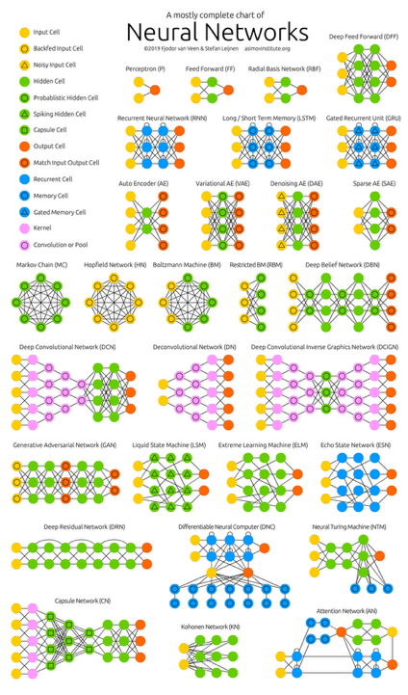
Neural network zoo
You can see how far we got:
Perceptron (nonlinear regression)
Feed forward
Deep feed forward
Deep convolutional network
There is much more ☺

Slide 66
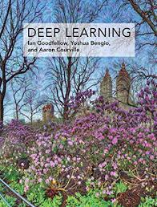
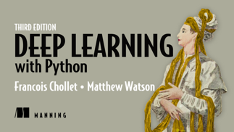
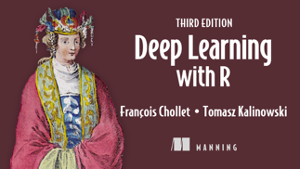
Deep learning in practice
Good places to start:
https://keras.rstudio.com/
ISLR Chapter 10
Goodfellow et al.
Chollet (R/Python version)

Slide 67
This was just the start
Recurrent neural networks: for sequences
Transformers (basis of all current LLMs)
Autoencoders (nonlinear dimension reduction)
Graph neural networks (GNNs; for “graph data”)
Diffusion models
…

