Slide 1
Data Wrangling and Data Analysis
Missing Data and Imputation
Daniel Oberski
Department of Methodology & Statistics
Utrecht University
VERSION: 2025-10-13

Slide 2
This week
Lecture 1: Problems with missing data
Lecture 2: Solutions to problems with missing data
Lecture 3: Clustering

Slide 3

Reading materials for this week
“Flexible Imputation of Missing Data”
https://stefvanbuuren.name/fimd
Chapter 1, Sections 1.1, 1.2, 1.3, 1.4
Optional:
Ch 3 (practical, recommended)
Ch 4 (practical, more technical)
Ch 2 and 6 (more theoretical)
Some of this week’s materials are adapted from Gerko Vink & Stef van Buuren’s courses on multiple imputation

Slide 4

Book recommendation
Dark Data: Why What You Don’t Know Matters
David J. Hand
A practical guide to making good decisions in a world of missing data

Slide 5
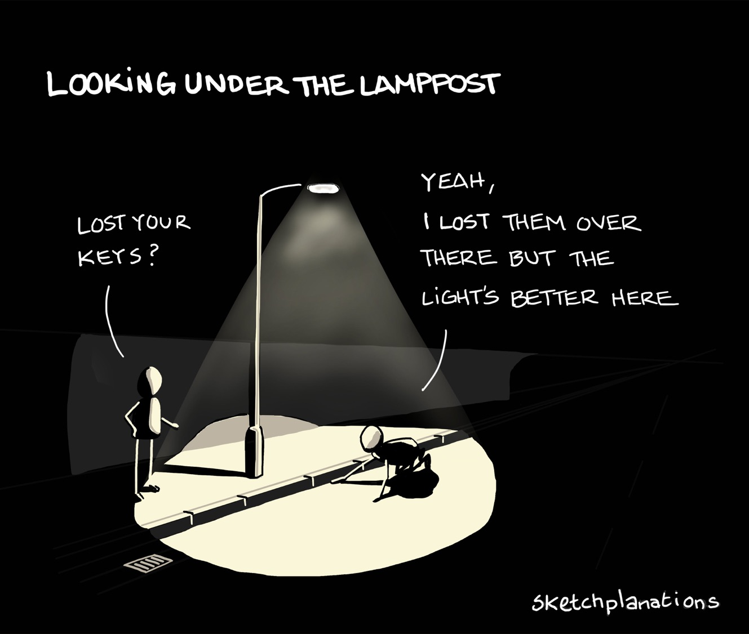
Image: Sketchplanations

Slide 6
“[missing data are] data you don’t have – perhaps data you wish you had, or hoped to have, or thought you had, but nonetheless data you don’t have. I argue, and illustrate with many examples, that the missing data are at least as important as the data you do have.”
–DJH (emphases mine)

Slide 7
Why a week on missing data
Missing data are everywhere
Ad-hoc fixes do not (always) work
A data scientist needs to understand when which methods do and do not work
Goal of the week: get comfortable with solving missing data problems

Slide 8
Why is missing data important?
“Obviously, the best way to treat missing data is not to have them.” (Orchard and Woodbury 1972)
…but…
“Sooner or later (usually sooner), anyone who does statistical analysis runs into problems with missing data” (Allison, 2002)
Missing data problems are at the heart of data analysis

Slide 9
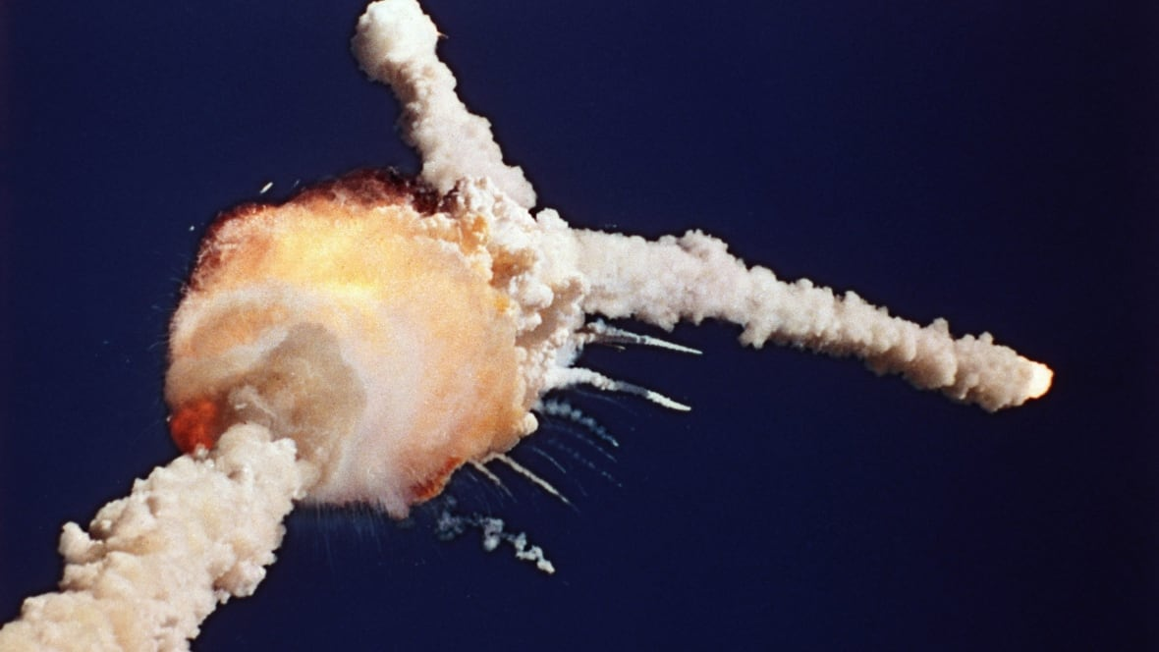
Example: Challenger (1986)

Slide 10
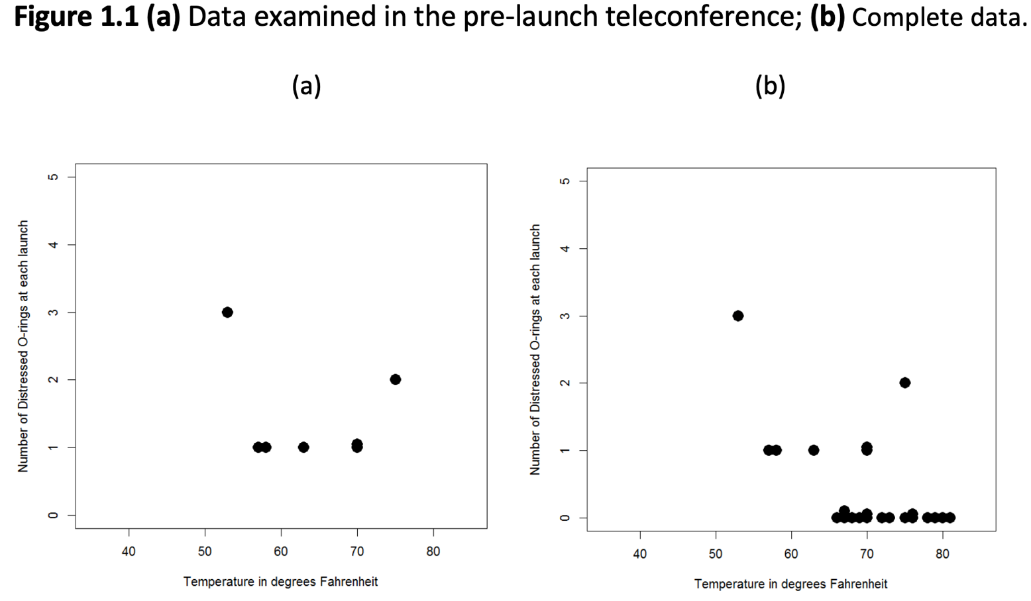

Slide 11
Why is missing data important?
Just annoying
Most procedures don’t deal with missings by default
Less information than planned:
Uncertainty of estimates (e.g. “standard errors”, “power”, “C.I”, etc.)
Accuracy of predictive models
Systematic biases:
Estimates of interest wrong on average
Prediction error seems better than it will be in reality

Slide 12
How to think about missing values
Values do exist, but we are unable to see them
Possible reasons:
Survey non-response
Person in medical study dies
Some users use high privacy settings in browser
Only high-income residents report potholes
Satellite experiences interference from sun
Etc.

Slide 13
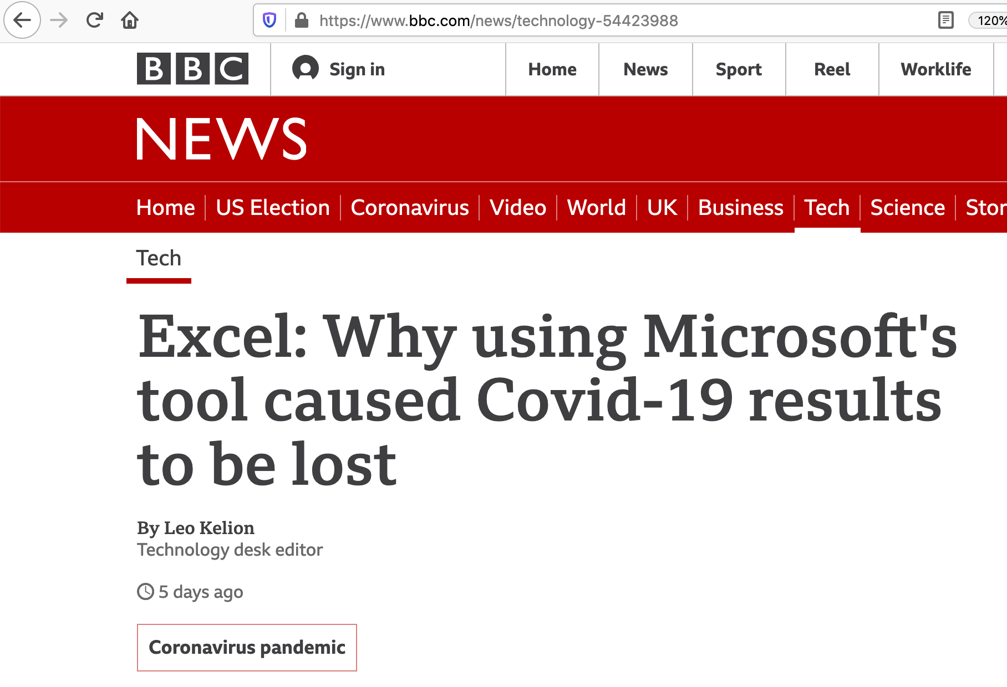

Slide 14
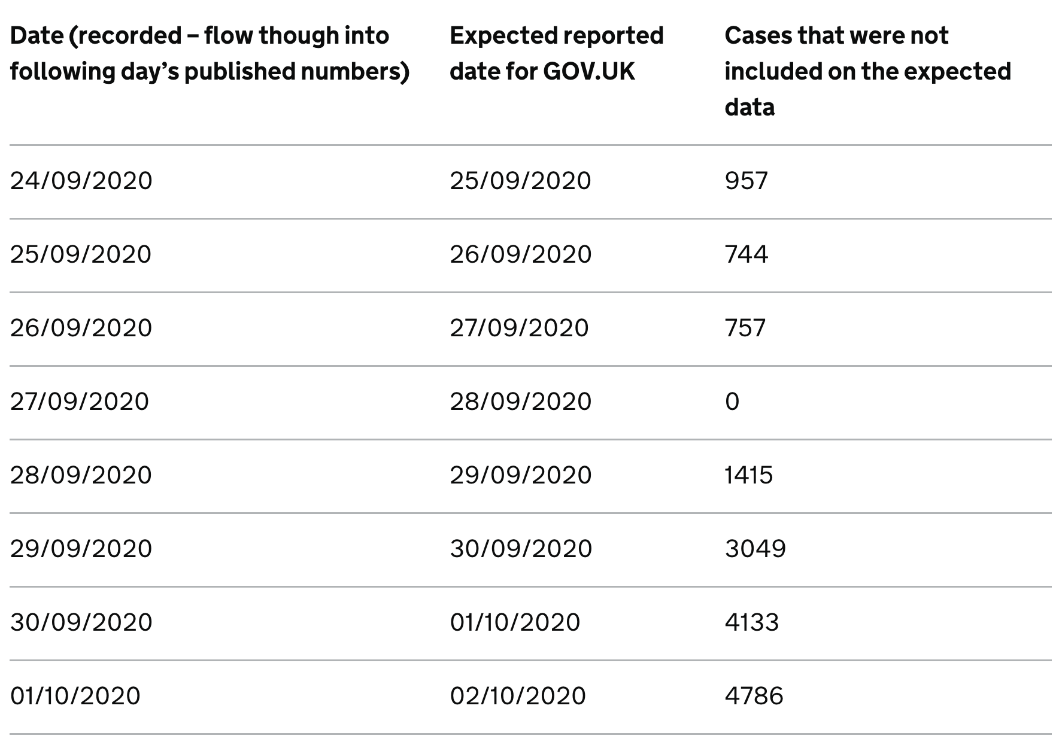

Slide 15
Question: we would like to quantify the trend in cases. What is the effect of the Excel error on estimates of this trend?

Slide 17
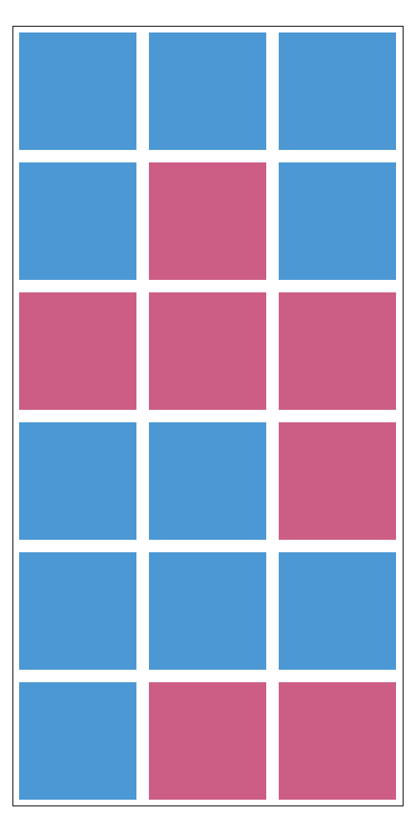
Complete data

Slide 18

Missing data

Slide 19

Observed data

Slide 20
How are missing data “coded”?
R data frames: NA
Python/Pandas: NaN
SQL: NULL
JavaScript/ json: null
.csv files: "NA", "", "NULL"
SPSS: -999, 99999, … *sigh*.
So pay attention during data wrangling!

Slide 21
Visualizing missing data
It can be helpful to visualize the missing data
Summarizes & provides insight into the amount and pattern of missingness
In the assignment this afternoon you will work in R with missing data and create visualizations
Visualization can help in understanding the missing data mechanism

Slide 22
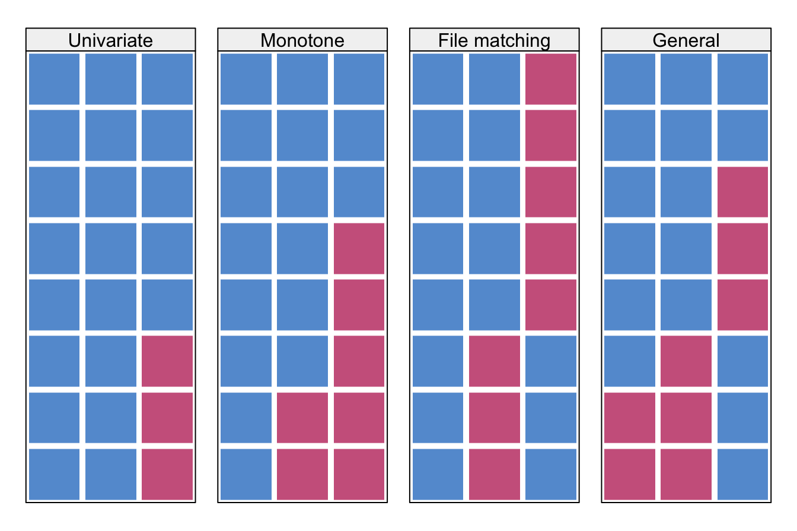

Slide 23
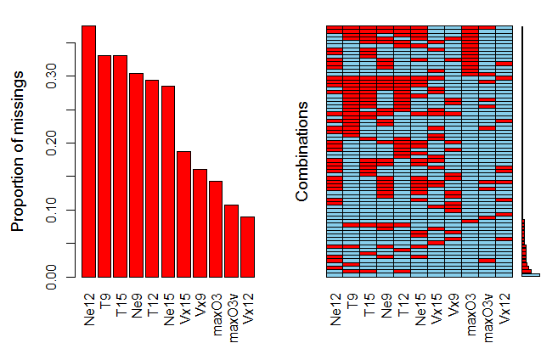

Slide 24
BMI example
BMI measured at two time points
Research question: does BMI decrease?
person_id | bmi_1 | bmi_2
1 | 18 | 19
2 | 25 | 22
3 | 24 | ?
4 | 34 | ?
5 | 17 | ?

Slide 25
BMI example
What is the average of bmi_2?
What is the correlation with bmi_1?
What is the average difference?
person_id | bmi_1 | bmi_2
1 | 18 | 19
2 | 25 | 22
3 | 24 | ?
4 | 34 | ?
5 | 17 | ?

Slide 26
Different kinds of people
Suppose there are three kinds of missing people:
People who just moved away or dropped out for other reasons unrelated to the study;
People who not dramatically overweight at the start and who dropped out because of loss of motivation;
People who drop out because they failed to stick to the program and felt too embarrassed to return to the group.

Slide 27
Shining a light
Use what you do know about what you don’t know
NDD: It’s missing for reasons unrelated to the data (MCAR)
Sickness preventing students from sitting exam
SDD: It’s missing for reasons related to data you have got (MAR)
School discouraging less able students from sitting exam
UDD: missing because of the values you would have obtained (MNAR) Student realised revised wrong material, so didn’t turn up to sit exam
Source: David Hand

Slide 28
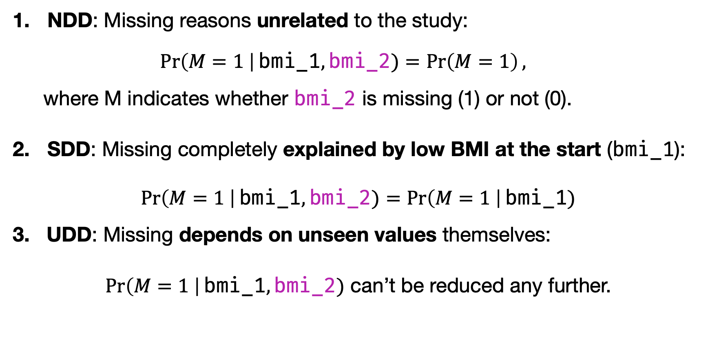
Different kinds of people
NDD: Missing reasons unrelated to the study:
$$\operatorname{Pr}\left(M=1 \right|\text{bmi}\text{_1},\text{bmi}\text{_2})=\operatorname{Pr}\left(M=1\right),$$
where M indicates whether bmi_2 is missing (1) or not (0).
SDD: Missing completely explained by low BMI at the start (bmi_1):
$$\operatorname{Pr}\left(M=1 \right|\text{bmi}\text{_1},\text{bmi}\text{_2})=\operatorname{Pr}\left(M=1 \right|\text{bmi}\text{_1})$$
3. UDD: Missing depends on unseen values themselves:
$\operatorname{Pr}\left(M=1 \right|\text{bmi}\text{_1},\text{bmi}\text{_2})$ can’t be reduced any further.

Slide 29
NDD, SDD, UDD
NDD: The probability to be missing is constant for all units
SDD: The probability to be missing depends on observed data
UDD: The probability to be missing depends on unobserved factors

Slide 30
MCAR, MAR, MNAR ????
MCAR: Missing Completely At Random (NDD)
MAR: Missing At Random (SDD)
MNAR: Missing Not At Random (UDD)
WARNING
This nomenclature is due to Rubin and has confused and confounded many generations of students and practictioners.
Hand’s (2020) terms refer to the exact same concepts, but have the advantage of being intelligible.
I advise you to switch to Hand’s terms.

Slide 31
Example:
Estimate what would be the average final exam score for a school if every student had been examined
The data are:
previous test results for all students
final exam score for those who sat it
Source: David Hand

Slide 32
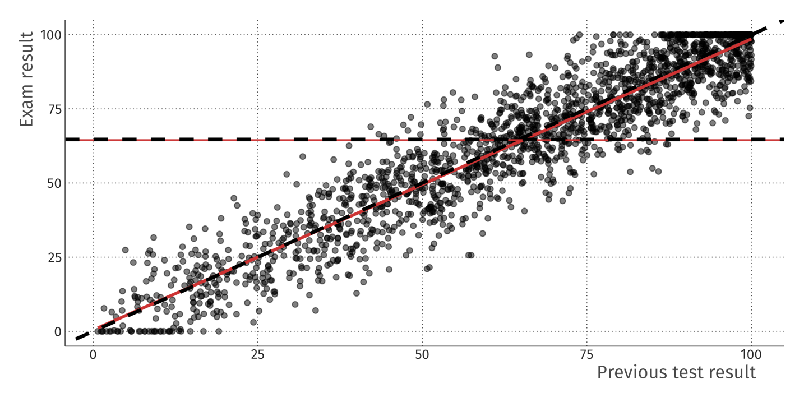
Complete data

Slide 33
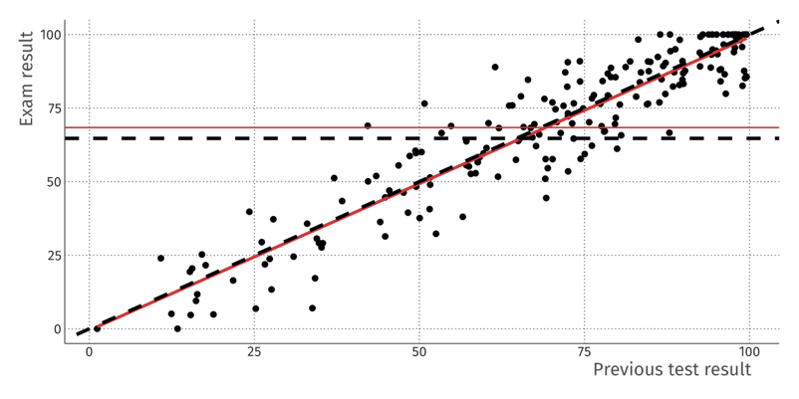
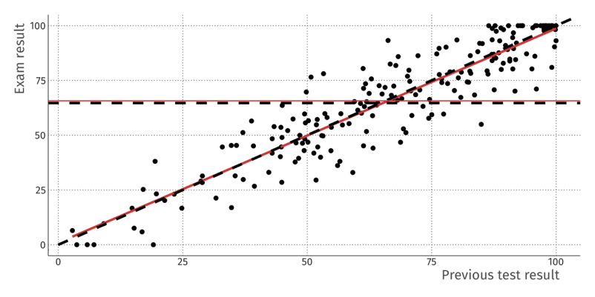
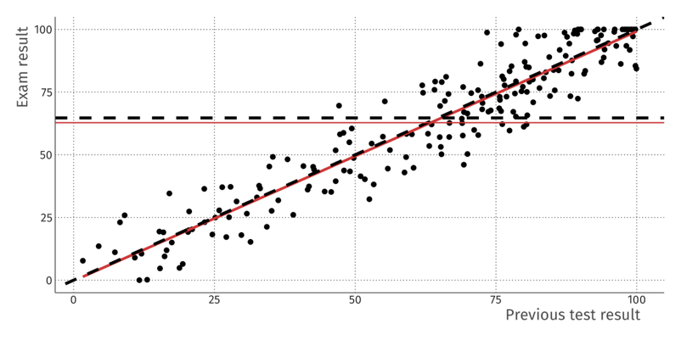
NDD Not Data-Dependent (“MCAR”)
Sickness preventing students from sitting exam

Slide 34
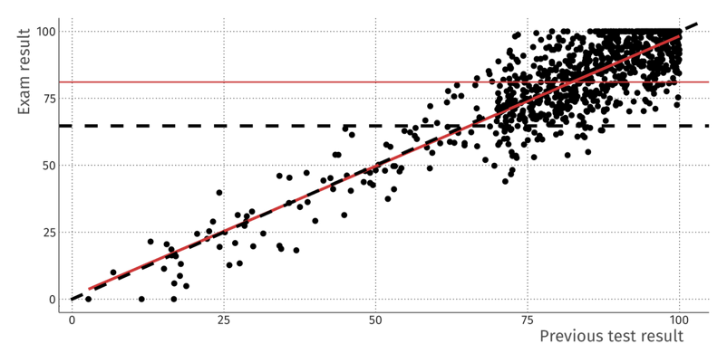
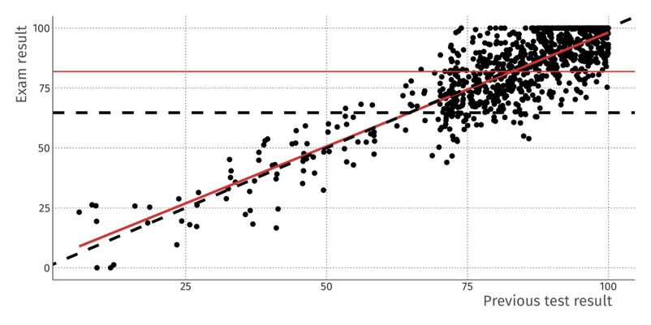
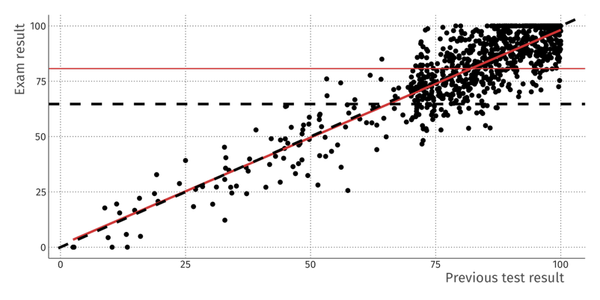
SDD Seen Data-Dependent (“MAR”)
School discouraging students from sitting exam based on previous test

Slide 35
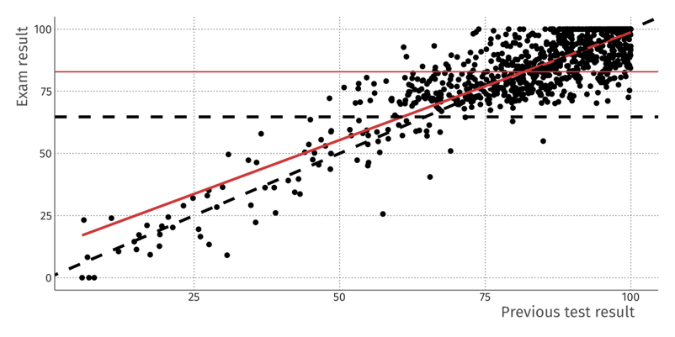
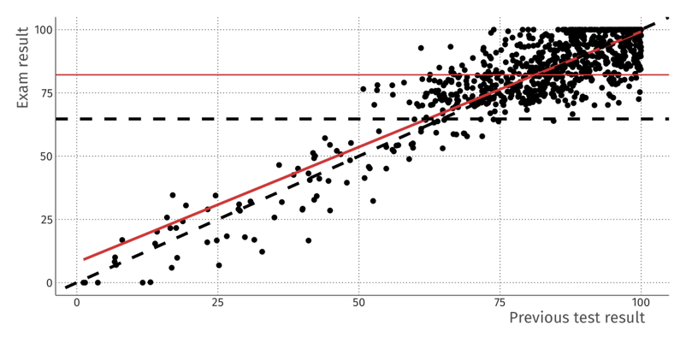
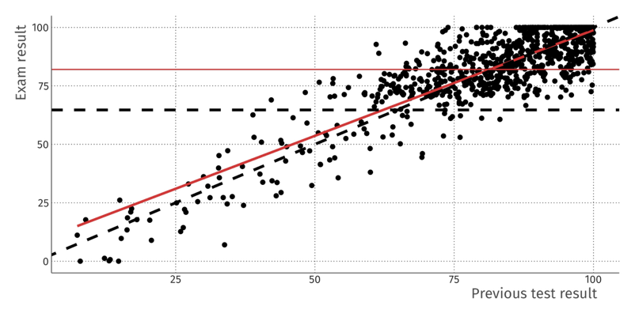
UDD Unseen Data-Dependent (“MNAR”)
Students realised they revised wrong material, so didn’t turn up to sit exam

Slide 36
Practice
Question: Is this (probably) NDD, SDD, or UDD:
We asked people’s income, and everybody answered. But then a server log file was accidentally deleted;
We asked people’s income, but the rich people did not want to say;
We asked people’s income, but those with a university education did not want to say. We only observe income.
Same as 3, but now we also observe education.

Slide 37
Questions
In practice, how can we tell whether we are in the not-data-dependent versus seen-data-dependent situation?
In practice, how can we tell whether we are in the seen-data dependent versus unseen-data-dependent situation?

Slide 38
Bias in machine learning due to missing data

Slide 39
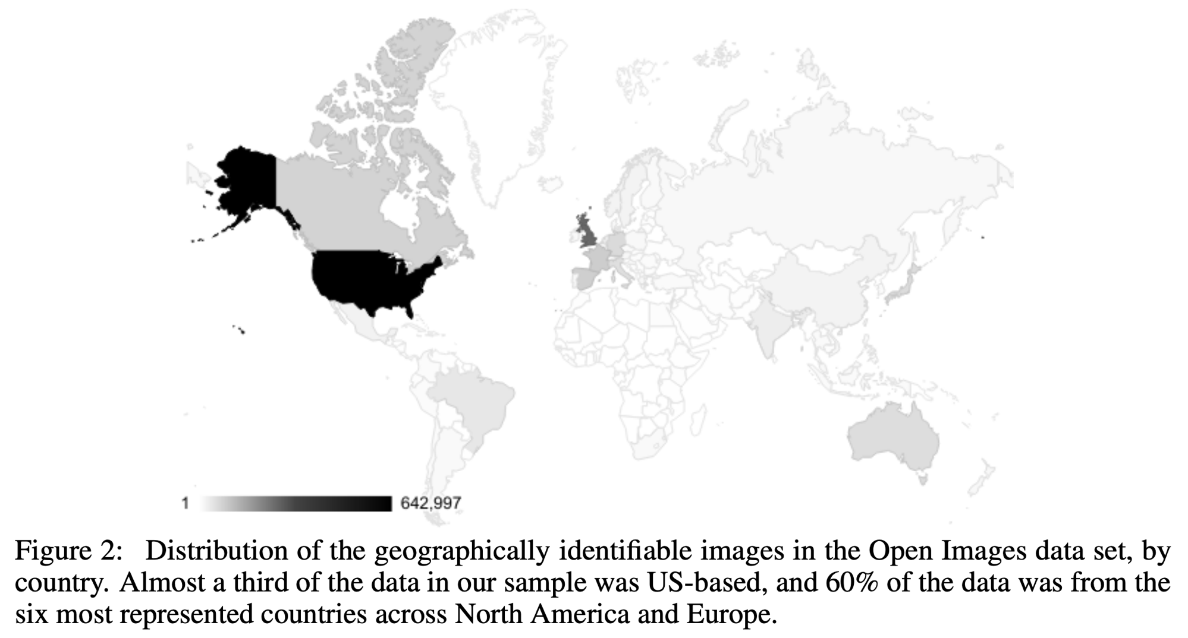
Source: Shankar et al. (2017). No classification without representation: Assessing geodiversity issues in open data sets for the developing world.

Slide 40
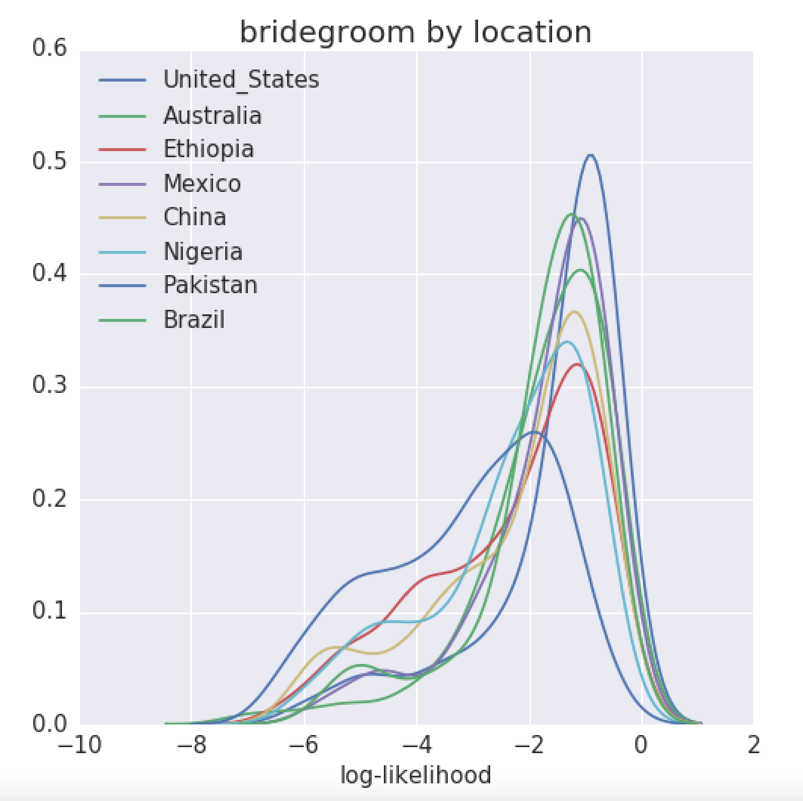
Source: Shankar et al. (2017).

Slide 41
Predicting mortality in pneumonia patients coming into the ICU
Caruana et al. (2015), KDD
Target: mortality, i.e. death (1) or not (0)
Data: patients at entry into ICU

Slide 42
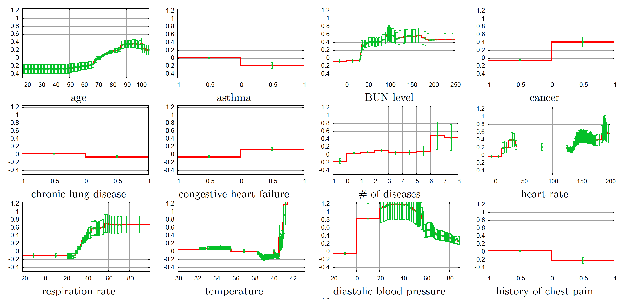
Question: do you see anything surprising?

Slide 43
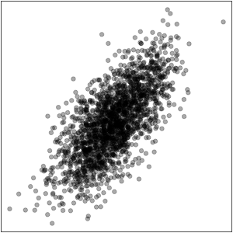
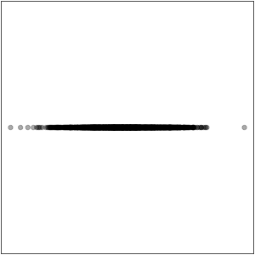
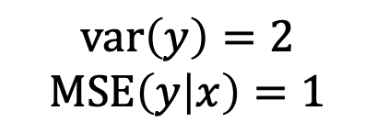
Why mean imputation is a bad idea
Before missingness
After mean imputation
What is the cross-validated MSE of the best model after mean imputation?
What is the true MSE of this model for new data?
$$\text{var}\left(y\right)=2$$
$$\text{MSE}\left(y | x\right)=1$$

Slide 44

Image: Sketchplanations

Slide 45

Conclusion
Missing data are not just annoying, but can also bias your analysis
Means, Trends, Covariances, Prediction models, …
We have seen that just ignoring (removing) missings doesn’t usually solve the problem
Mean imputation also does not usually solve the problem
What we can do:
Use what you do know about what you don’t know
This will be discussed tomorrow

