Slide 1
Data Wrangling and Data Analysis
Missing Data and Imputation
Daniel Oberski
Department of Methodology & Statistics
Utrecht University

Slide 2
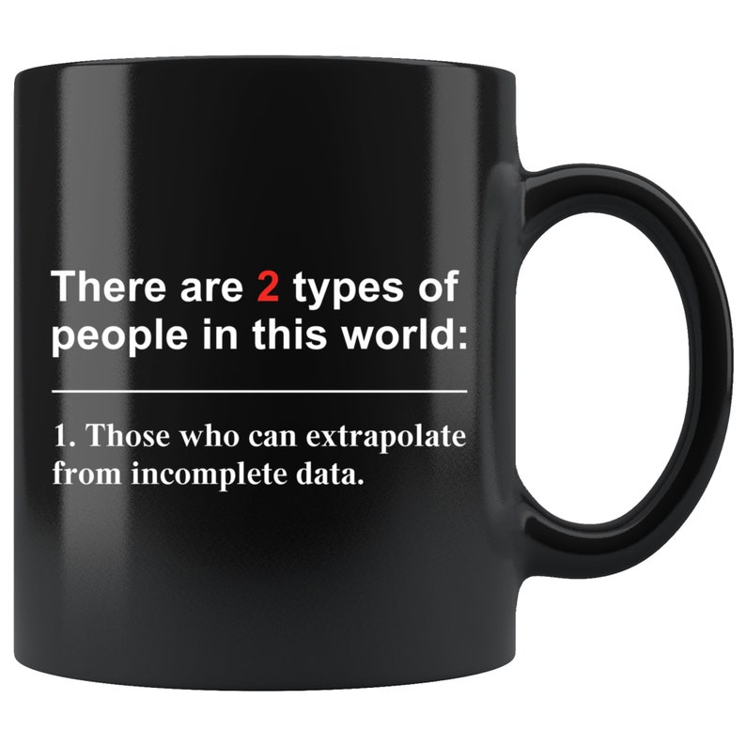
This week
Lecture 1: Problems with missing data
Lecture 2: Solutions to problems with missing data
Lecture 3: Clustering

Slide 3
Strategies to deal with missing data
Data collection
Data wrangling
Data Analysis
Prevention
(the golden road?)
Imputation
Ad-hoc methods
Single imputation
Multiple imputation
Adjustment
Weighting methods
Likelihood methods
EM-algorithm
…

Slide 4
Imputation
Replacing missing values with guessed values
## age weight
## 1 13 42
## 4 14 NA
## 6 18 61
## 5 23 70
## 3 24 73
## 7 25 68
## 2 40 80
## age weight
## 1 13 42
## 4 14 47
## 6 18 61
## 5 23 70
## 3 24 73
## 7 25 68
## 2 40 80

Slide 5
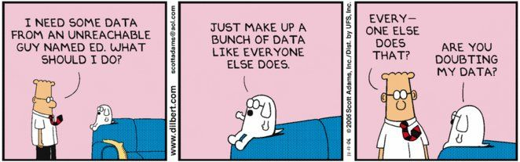
Imputation
Yields “complete” data
Statistics are now defined
Hooray?

Slide 6
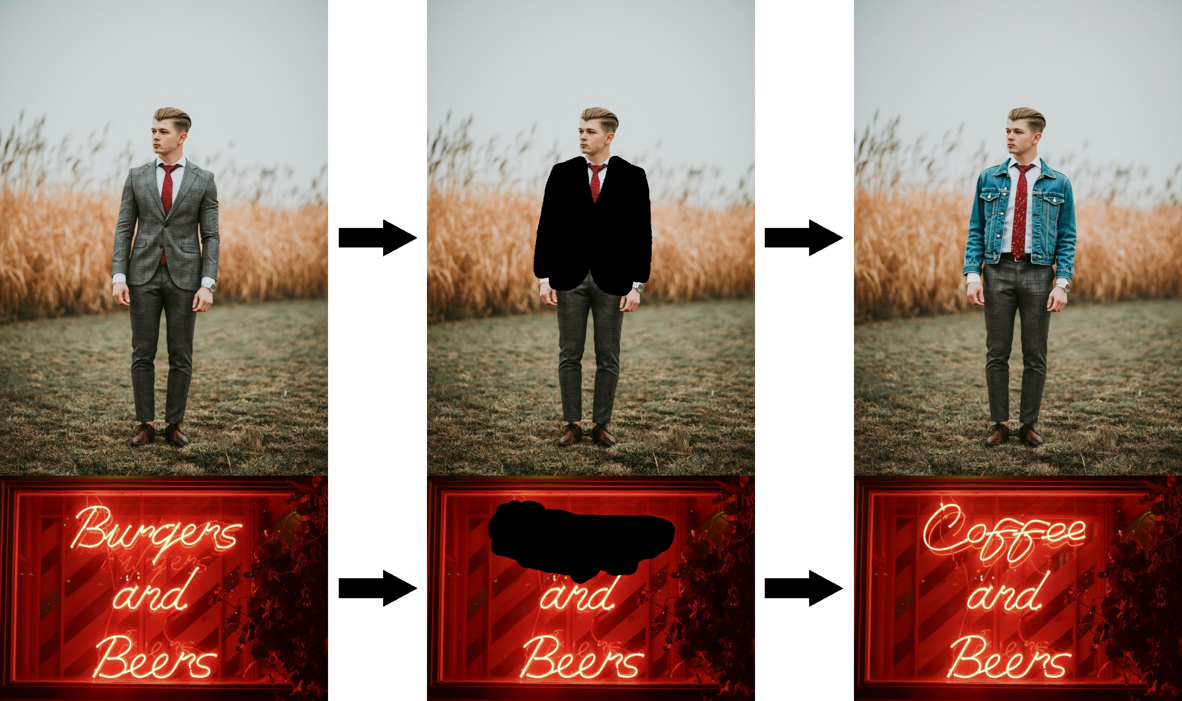
Good imputations are plausible
https://huggingface.co/black-forest-labs/FLUX.1-Fill-dev

Slide 7
Deductive imputation
If we know height and weight, we can calculate BMI
A male child is probably not pregnant
Converse also holds: If an observed value “must” be wrong, we can correct it or make it missing
Example: database may contain a 14 yr old female with 3 kids, married for 20 years and working as a manager at a public school
This may be a data entry error (perhaps it should have been 41?). We can set this value missing and let our algorithms do the rest.

Slide 8
Missing data procedures and your (implicit) assumptions
Missing data important because they can bias the analysis
Bias depends on NDD/SDD/UDD
→ Goal: prevent the bias
Logic of all missing data procedures:
IF NDD/SDD is causing the bias,
THEN procedure xyz will remove that bias
(On very rare occasions, specific forms of UDD can be dealt with)
In other words, each procedure has an implicit assumption

Slide 9
Methods and their assumptions
 | Assumption needed to get unbiased estimate
 | Mean | Regression coef. | Correlation | Standard Error
Listwise deletion
Mean imputation
Regression imputation
Stochastic imputation

Slide 10
Listwise deletion
Also known as:
“Complete Case Analysis”
“we deleted missing data”
“huh? Whaddayamean missing data?”

Slide 11
Listwise deletion
## age weight
## 1 13 42
## 4 14 NA
## 6 18 61
## 5 23 70
## 3 24 73
## 7 25 68
## 2 40 80
## age weight
## 1 13 42
## 6 18 61
## 5 23 70
## 3 24 73
## 7 25 68
## 2 40 80

Slide 12
Listwise deletion
Advantages
Simple (default in most software)
Unbiased under NDD
Disadvantages
Large loss of information, hopeless with many features
Biased under SDD and UDD, even for simple stuff like mean

Slide 13
Mean imputation
Replace the missing values by the mean of the observed data
Advantages
Simple
Unbiased for the mean, under NDD
Disadvantages
Doesn’t work
(okay, except in some very specific circumstances)

Slide 14
Mean imputation
## age weight
## 1 13 42
## 4 14 NA
## 6 18 61
## 5 23 70
## 3 24 73
## 7 25 68
## 2 40 80
## age weight
## 1 13 42
## 4 14 65.667
## 6 18 61
## 5 23 70
## 3 24 73
## 7 25 68
## 2 40 80

Slide 15
Mean imputation: univariate perspective

Slide 16
Mean imputation: bivariate perspective

Slide 19
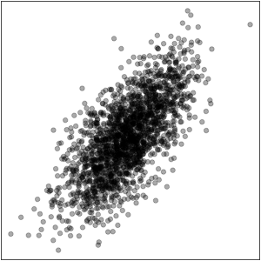
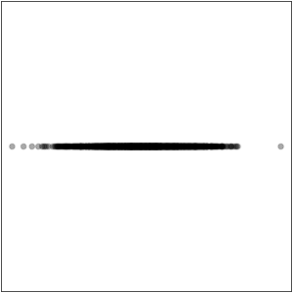
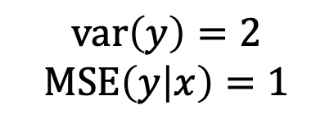
Mean imputation in prediction models
Before missingness
After mean imputation
What is the cross-validated MSE of the best model after mean imputation?
What is the true MSE of this model for new data?
$$\text{var}\left(y\right)=2$$
$$\text{MSE}\left(y | x\right)=1$$

Slide 20
Mean imputation
Disadvantages
Disturbs the distribution
Underestimates the variance
Biases correlations to zero
Biased under SDD
AVOID
(unless you know what you are doing (and probably even then))

Slide 21
Intermezzo: tiny crash course/reminder of classical statistics

Slide 22

Sample
Population/Data-generating process (DGP)

Slide 23
“Uncertainty”
Suppose there is a target “number of interest” in the DGP
We only have ONE sample that will let us estimate this target number
How close can we expect this estimate to be to the true number, given the sample size?

Slide 24
“Uncertainty”
Think about:
all the possible spoonfuls I could have taken
the estimates of our target number I would have gotten
the standard devation of estimates over spoons
Here is the Big Trick: we can estimate this standard deviation from our ONE sample!
This estimate is called the “standard error”
You can think of the standard error as an estimate of the uncertainty about your estimate

Slide 25
Using the standard error to deal with uncertainty
Every estimate you care about should preferably come with a standard error
Or some other measure of uncertainty (e.g. Bayesian)

Slide 26

You can also use the standard error to:
Calculate “confidence intervals”
Intervals with the following handy interpretation: “in 95% of the spoonfuls you will obtain a confidence interval that contains the true target value”
Calculate “p-values”
A decision rule that can tell you that when you lead your life as though some hypothesis were true, then you would be wrong 5% of hypothetical spoonfuls.

Slide 27
“Regression” imputation (in the statistics sense)
Just predict the missing value
Fit model for weight under listwise deletion: the imputation model
Predict body weight for records with missing weight
Replace missing values by prediction

Slide 28
Regression imputation
## age weight
## 1 13 42
## 4 14 NA
## 6 18 61
## 5 23 70
## 3 24 73
## 7 25 68
## 2 40 80
## age weight
## 1 13 42
## 4 14 53.45
## 6 18 61
## 5 23 70
## 3 24 73
## 7 25 68
## 2 40 80

Slide 30
Regression imputation
Advantages
Unbiased estimates of regression coefficients (under SDD)
Good approximation to the (unknown) true data if explained variance is high
The better your prediction, the better your approximation

Slide 31
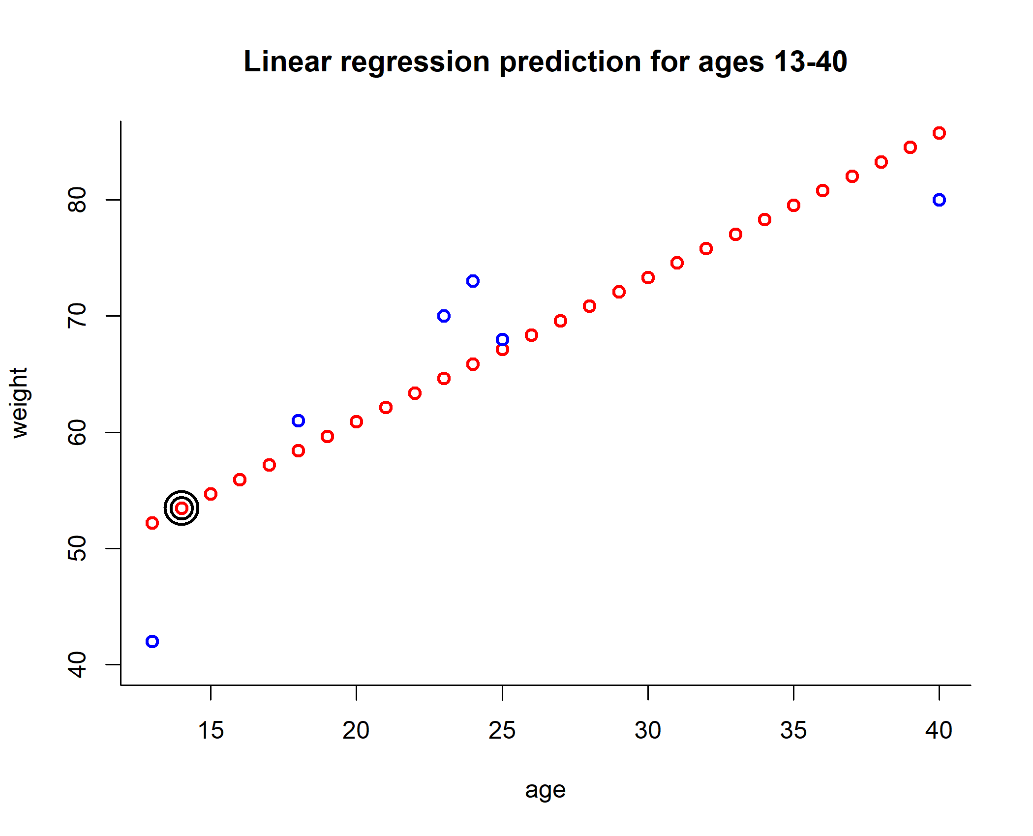
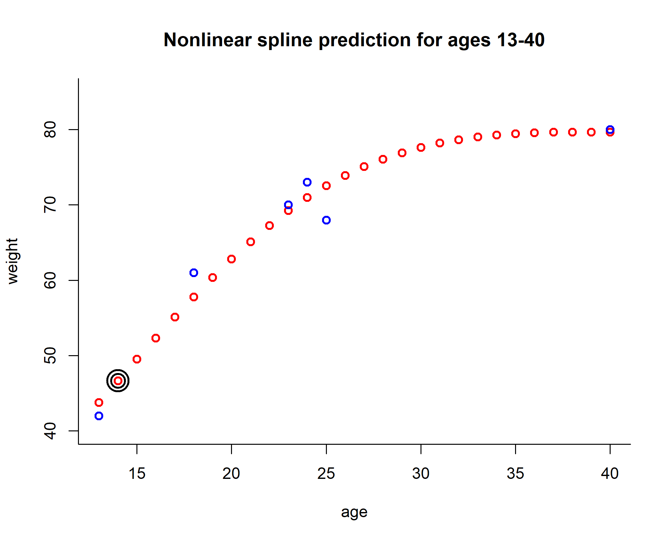
The better your prediction, the better your approximation

Slide 32
Regression imputation: spline
## age weight
## 1 13 42
## 4 14 NA
## 6 18 61
## 5 23 70
## 3 24 73
## 7 25 68
## 2 40 80
## age weight
## 1 13 42
## 4 14 46.65
## 6 18 61
## 5 23 70
## 3 24 73
## 7 25 68
## 2 40 80

Slide 33
Regression imputation
Disadvantages:
Artificially increases correlations
Consequently: underestimates prediction error
Systematically underestimates the uncertainty
p-values too optimistic, confidence intervals too narrow

Slide 34
Stochastic regression imputation
Like regression imputation, but adds noise to the predictions to reflect uncertainty
Uncertainty in the form of:
Parameter uncertainty in the prediction model
Uncertainty due to unexplained variance in the target feature
Related to prediction intervals (ISLR sections 3.2.2:“Four” and exercises on pages 111-112)

Slide 35


Slide 36
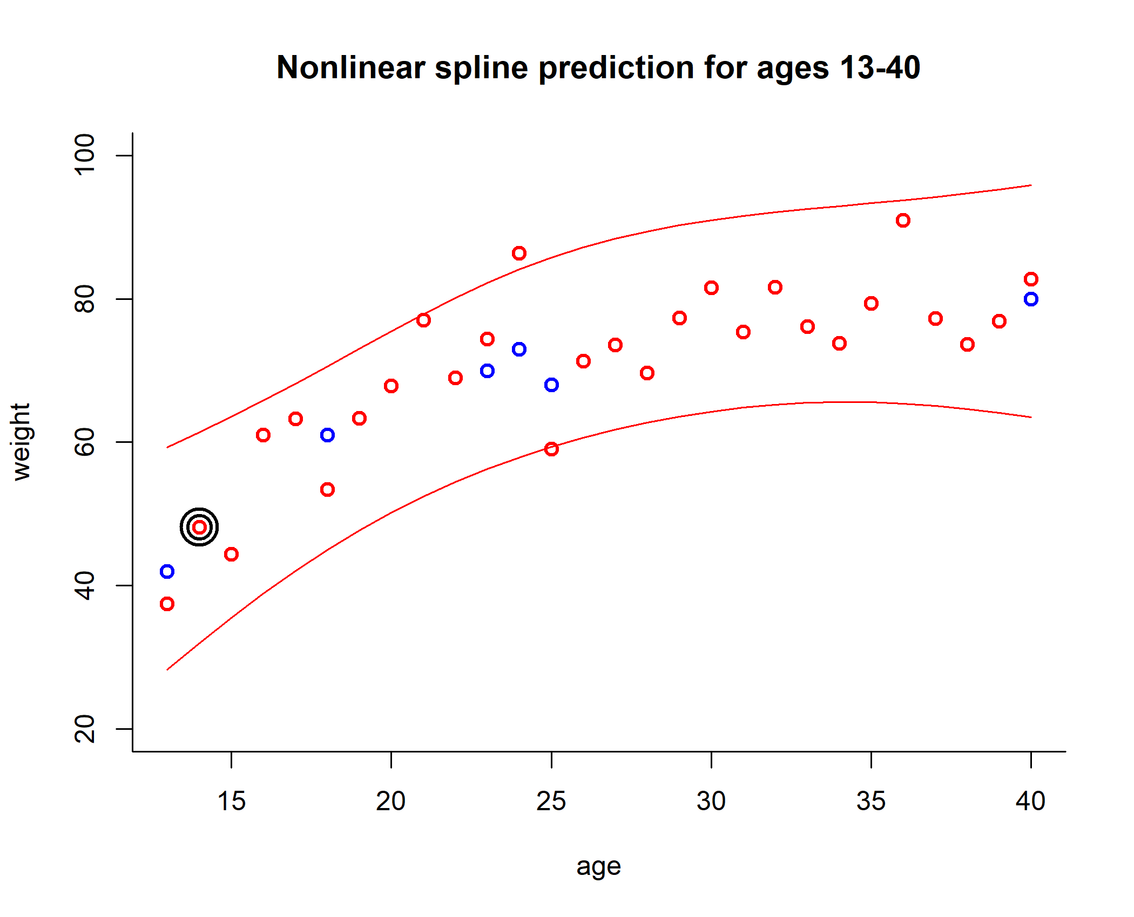
Stochastic regression imputation

Slide 37
Stochastic regression imputation
## age weight
## 1 13 42
## 4 14 NA
## 6 18 61
## 5 23 70
## 3 24 73
## 7 25 68
## 2 40 80
## age weight
## 1 13 42
## 4 14 48.13
## 6 18 61
## 5 23 70
## 3 24 73
## 7 25 68
## 2 40 80

Slide 38
Stochastic regression imputation
Advantages:
Preserves the distribution of body weight
Preserves the correlation between age and weight in the imputed data
Disadvantages:
Fiddly
Single imputation does not take uncertainty imputed data into account, and incorrectly treats them as real

Slide 39
“Embedded” methods (model-based)
Don’t impute, deal with missing values somehow in the (prediction) model itself
Depends on the model you are using
Almost always assumes SDD implicitly
Example on next slide given with classification tree, but other models may have a different approach

Slide 40
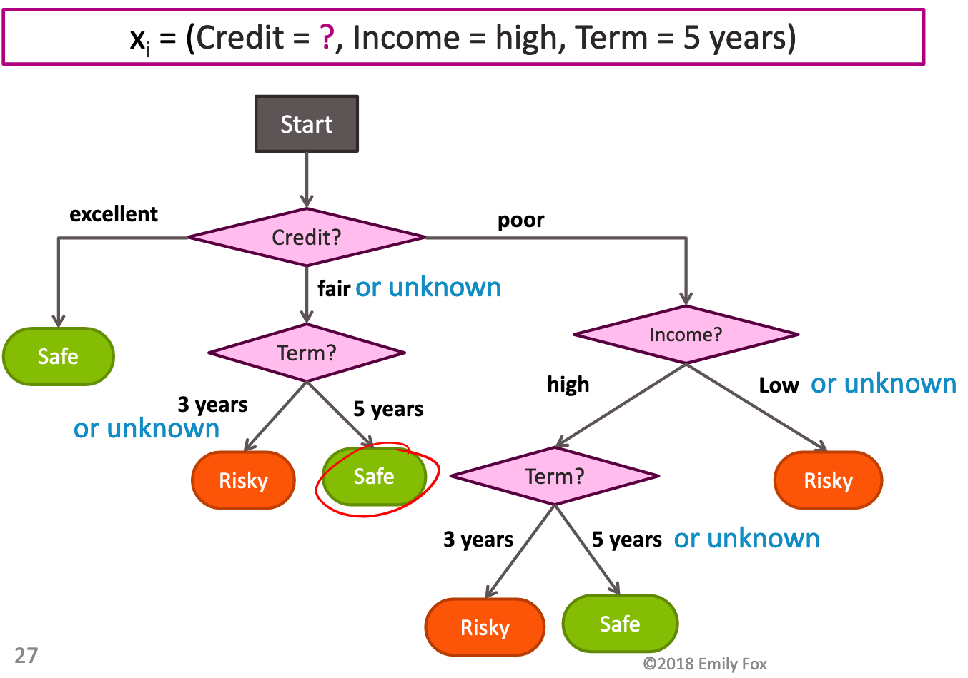
xgboost learns “default direction” for missing values
Tries both possibilities at each node and picks the one with most gain (greedy)
Source: Fox (2018)

Slide 41
Handy overview of methods
 | Assumption needed to get unbiased estimates
 | Mean | Regression coef. | Correlation | Standard Error
Listwise deletion | NDD | NDD | NDD | Too large
Mean imputation | NDD | - | - | Too small
Regression imputation | SDD | SDD | - | Too small
Stochastic imputation | SDD | SDD | SDD | Too small

Slide 42
Imputing one value for a missing datum cannot be correct in general, because we don’t know what value to impute with certainty (if we did, it wouldn’t be missing).
Donald Rubin

Slide 43
Fixing the SE: Multiple Imputation
Stochastic imputation, but create multiple datasets
Each dataset is slightly different
Appropriately consider the uncertainty around the imputed value:
Perform analysis multiple times
Pool results

Slide 44
Steps in Multiple Imputation
Create m imputations
Analyze m completed data sets
Combine the m results into one

Slide 45
Multiple Imputation: Imputation Step
Var 1 … p
!
!
!
?
?
!
!
?
!
!
!
!
Case 1 … n
!
...
!
?
!
?
!
!
!
Create m different imputed data sets

Slide 46
Multiple Imputation: Analysis Step
!
!
!
!
!
!
!
!
!
...
!
!
!
!
!
!
Do standard complete data analysis m times
Combine results
= take the mean,
and calculate SE from original SE + dataset variance

Slide 47
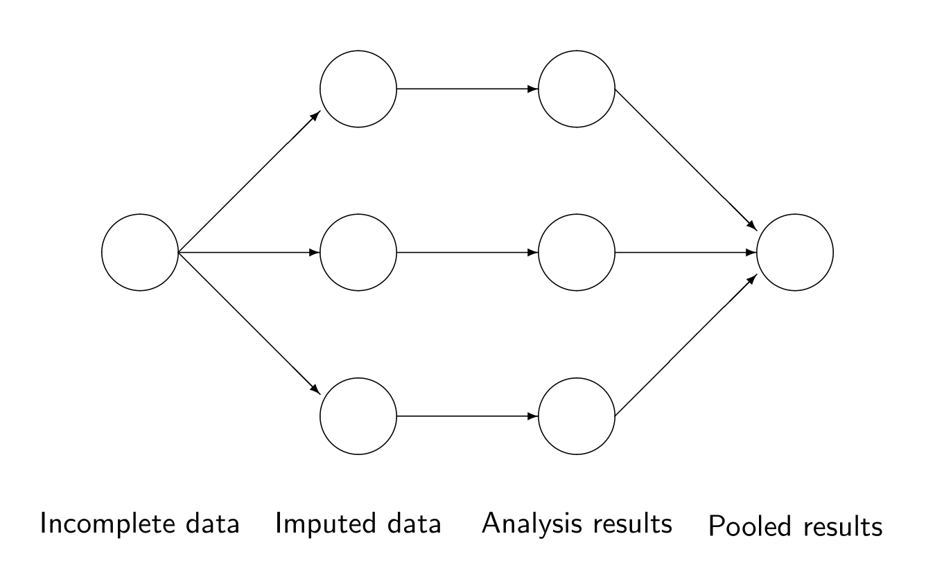
Multiple imputation

Slide 48
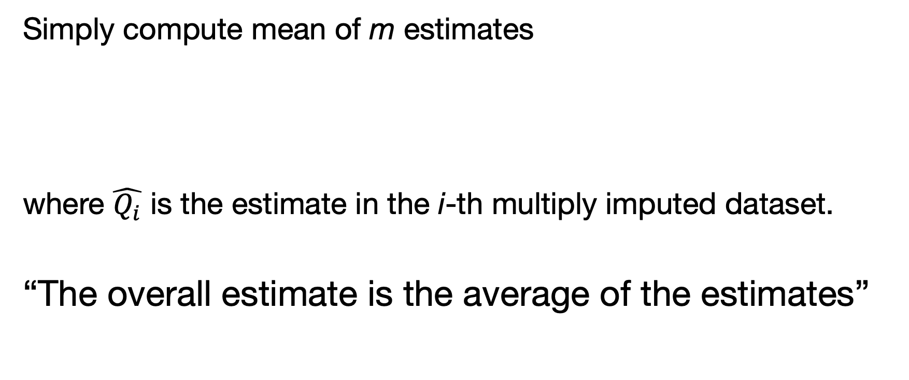
Combine the Results
Simply compute mean of m estimates
where $\hat{Q_{i}}$ is the estimate in the i-th multiply imputed dataset.
“The overall estimate is the average of the estimates”

Slide 49
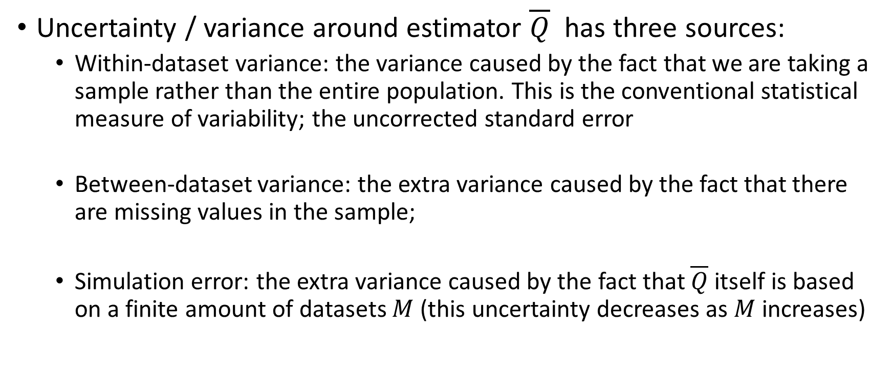
Difficult step: pooling

Slide 50
Combining Standard Errors
U: Within imputation variance = mean of m sampling variances (square of s.e.)
B = Between imputation variance = variance of point estimates
T = Total error variance

Slide 51
Software
The R package mice performs multiple imputation and automatic pooling of results
It has support for many analysis methods, such as anova, lm, glm, and many more
Python sklearn has mice algorithm in sklearn.impute.IterativeImputer
sklearn documentation: “It is still an open problem as to how useful single vs. multiple imputation is in the context of prediction and classification when the user is not interested in measuring uncertainty due to missing values.”

Slide 52
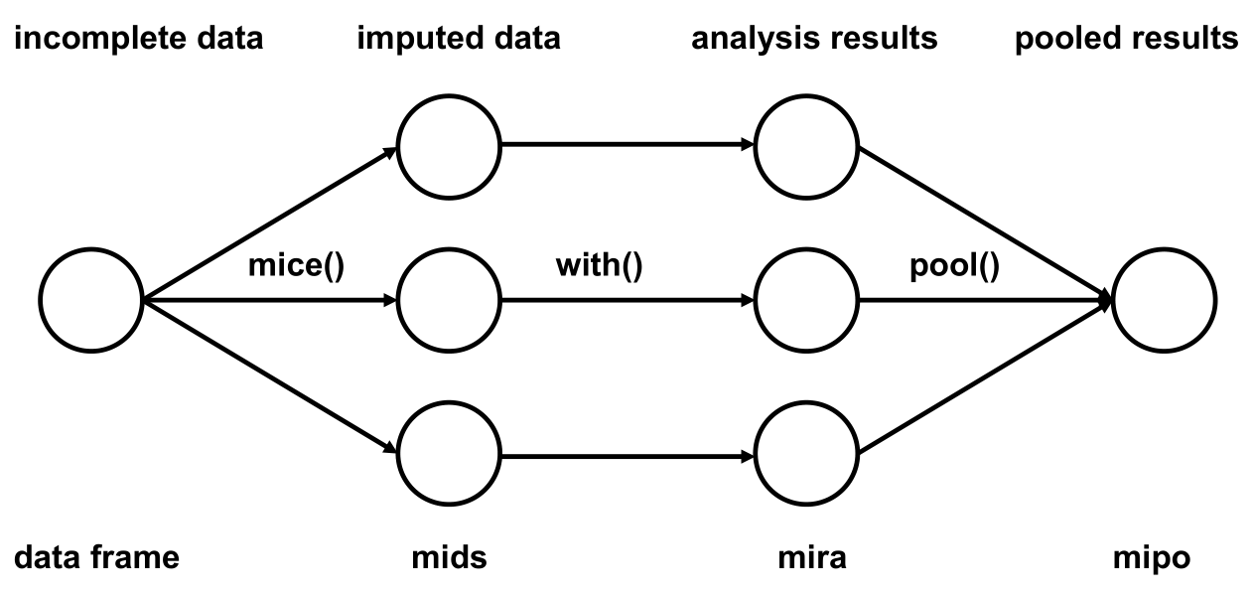
Typical workflow for mice

Slide 53
Ad hoc alternative to pooling: sensitivity
If conclusion does not change across the m imputed datasets, conclusion not sensitive to the imputation
For your topic this may be enough

Slide 54
Conclusion
Single imputation does not account for all uncertainty
One solution is multiple imputation
Analysis needs to be pooled after being performed on multiply imputed datasets
Sensitivity analysis can be an alternative to pooling
Multiple imputation fixes inferences, but still has the SDD assumption!

