Slide 1
Data Wrangling and Data Analysis
Clustering:
Daniel Oberski & Erik-Jan van Kesteren
Department of Methodology & Statistics
Utrecht University

Slide 2
This week
Lecture 1: Problems with missing data
Lecture 2: Solutions to problems with missing data
Lecture 3: Clustering

Slide 3
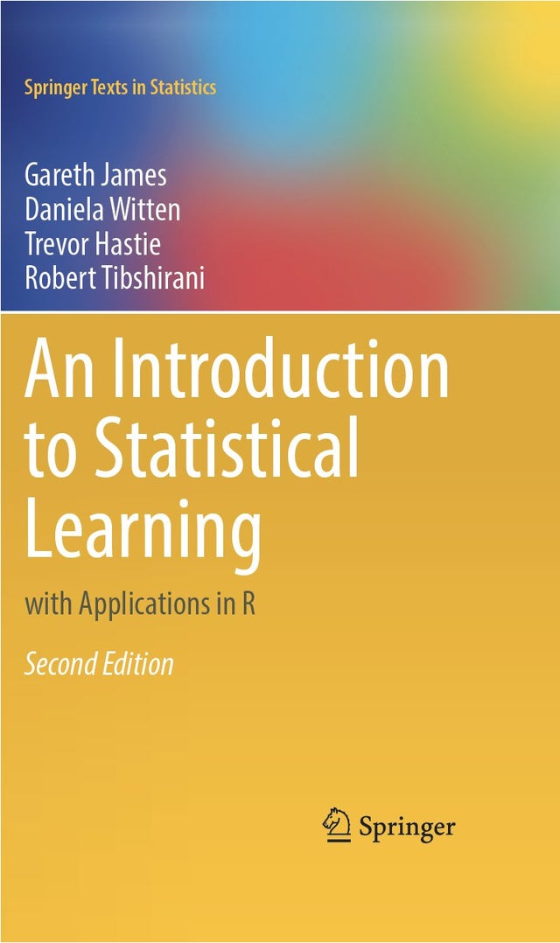
Reading materials about clustering (this week & next)
Selected paragraphs from Introduction to Statistical Learning (ISLR) §12.1 and 12.4
“Mixture models: latent profile and latent class analysis” [Oberski, 2016] §1, §2
http://daob.nl/wp-content/papercite-data/pdf/oberski2016mixturemodels.pdf

Slide 4
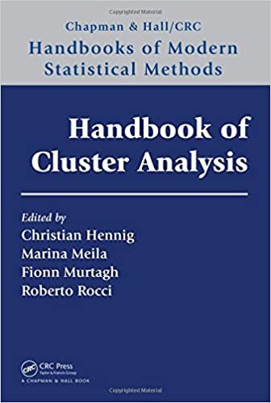
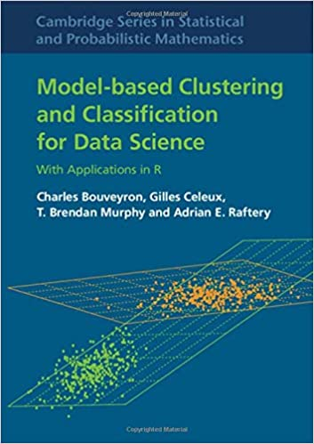
Optional, much more in-depth material
Clustering strategy and method selection (ch. 31), https://arxiv.org/pdf/1503.02059.pdf
Handbook of Cluster Analysis
Hennig et al. (2016)
Model-based Clustering and
Classification for Data Science
Bouveyron et al. (2018)

Slide 5
Clustering
Find subgroups (clusters) of similar examples in a database

Slide 6
Why clustering?
Unsupervised: expect groups in our data, but were not able to measure them
potential new subtypes of cancer tissue
We want to summarize features into a categorical feature to use in further decisions/analysis
subgrouping customers by their spending types

Slide 7
Some applications of clustering
Intermediate step for other fundamental data mining problems
Collaborative filtering
Customer segmentation
Data summarization
Dynamic trend detection
Multimedia data analysis
Biological data analysis
Social network analysis
Aggarwal & Reddy (2019)

Slide 8
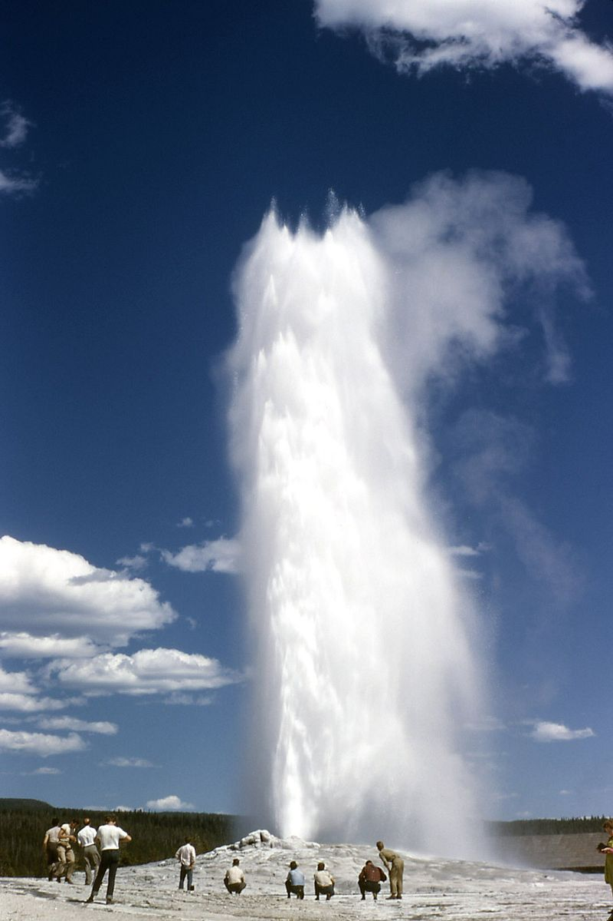
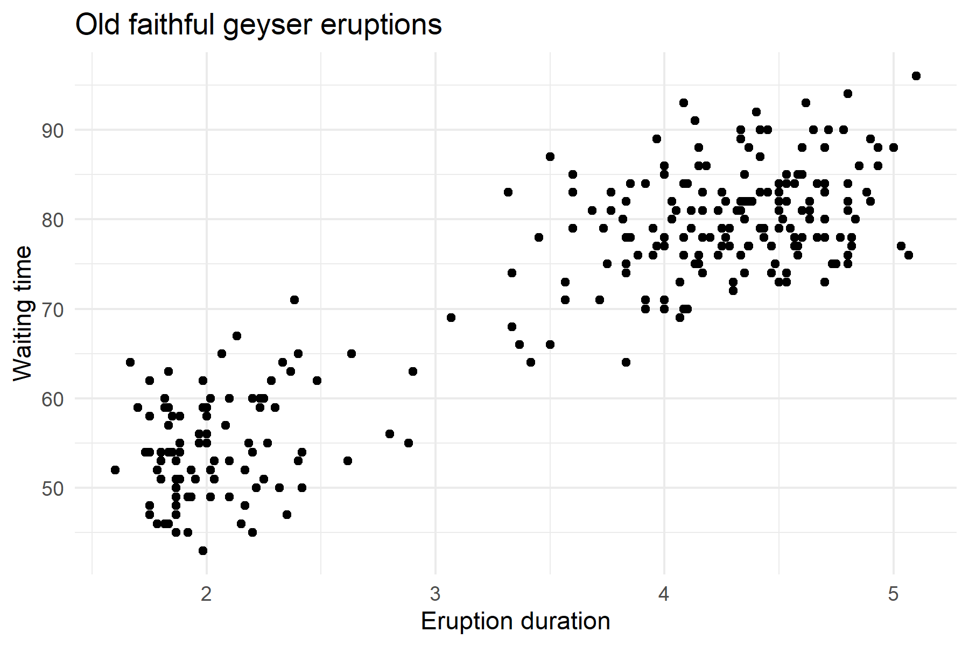
Old Faithful: two types of eruption?

Slide 9
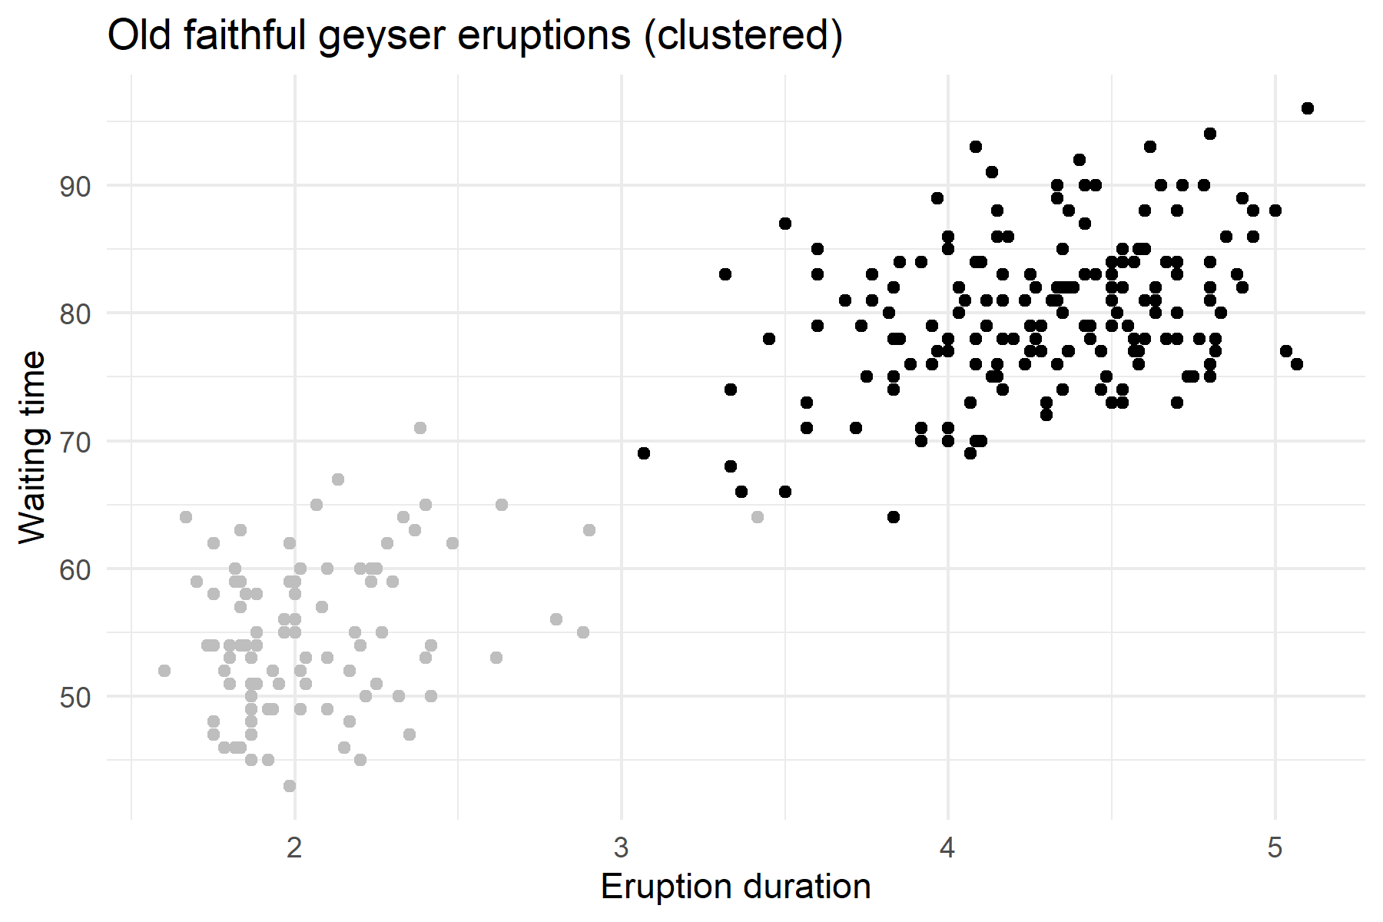
Old Faithful: two types of eruption?

Slide 10
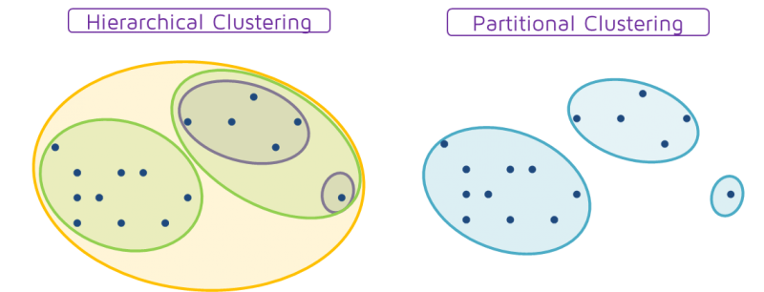
Clustering types
Source: T. Fuertes
https://quantdare.com/hierarchical-clustering/

Slide 11
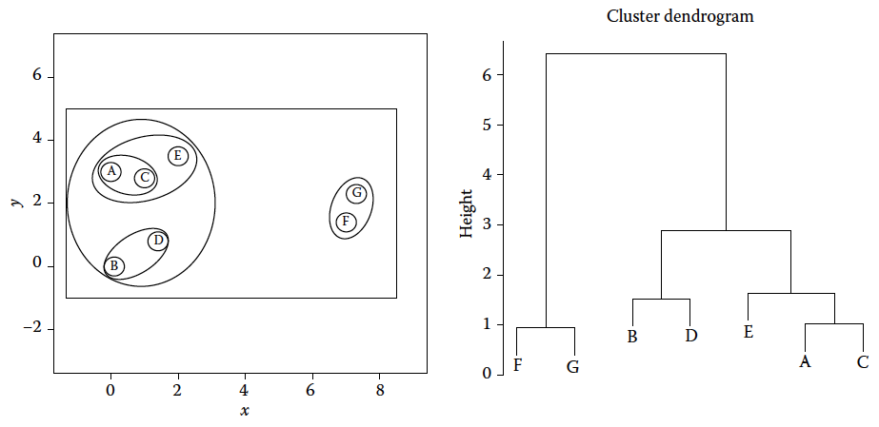
Source: Hennig et al. (2015) Handbook of cluster analysis.

Slide 12
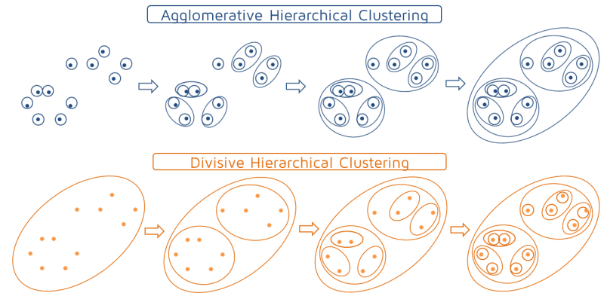
Source: T. Fuertes
https://quantdare.com/hierarchical-clustering/

Slide 13
Hierarchical clustering
Bottom-up agglomerative clustering
For each observation, compute the distance to all other observations
Assign all examples to their individual cluster
Combine most similar clusters
Keep combining clusters until there is only one cluster left
Select number of clusters for the final solution
(Divisive: start with one cluster and keep splitting most different)

Slide 14
Hierarchical clustering
In R:
Then we can plot the dendrogram with plot() or ggdendrogram
Then, select the number of clusters using a cutoff point
distances <- dist(faithful, method = "euclidean")
result <- hclust(distances, method = "average")
library(ggdendro)
ggdendrogram(result)
cutree(result, h = 2)

Slide 15
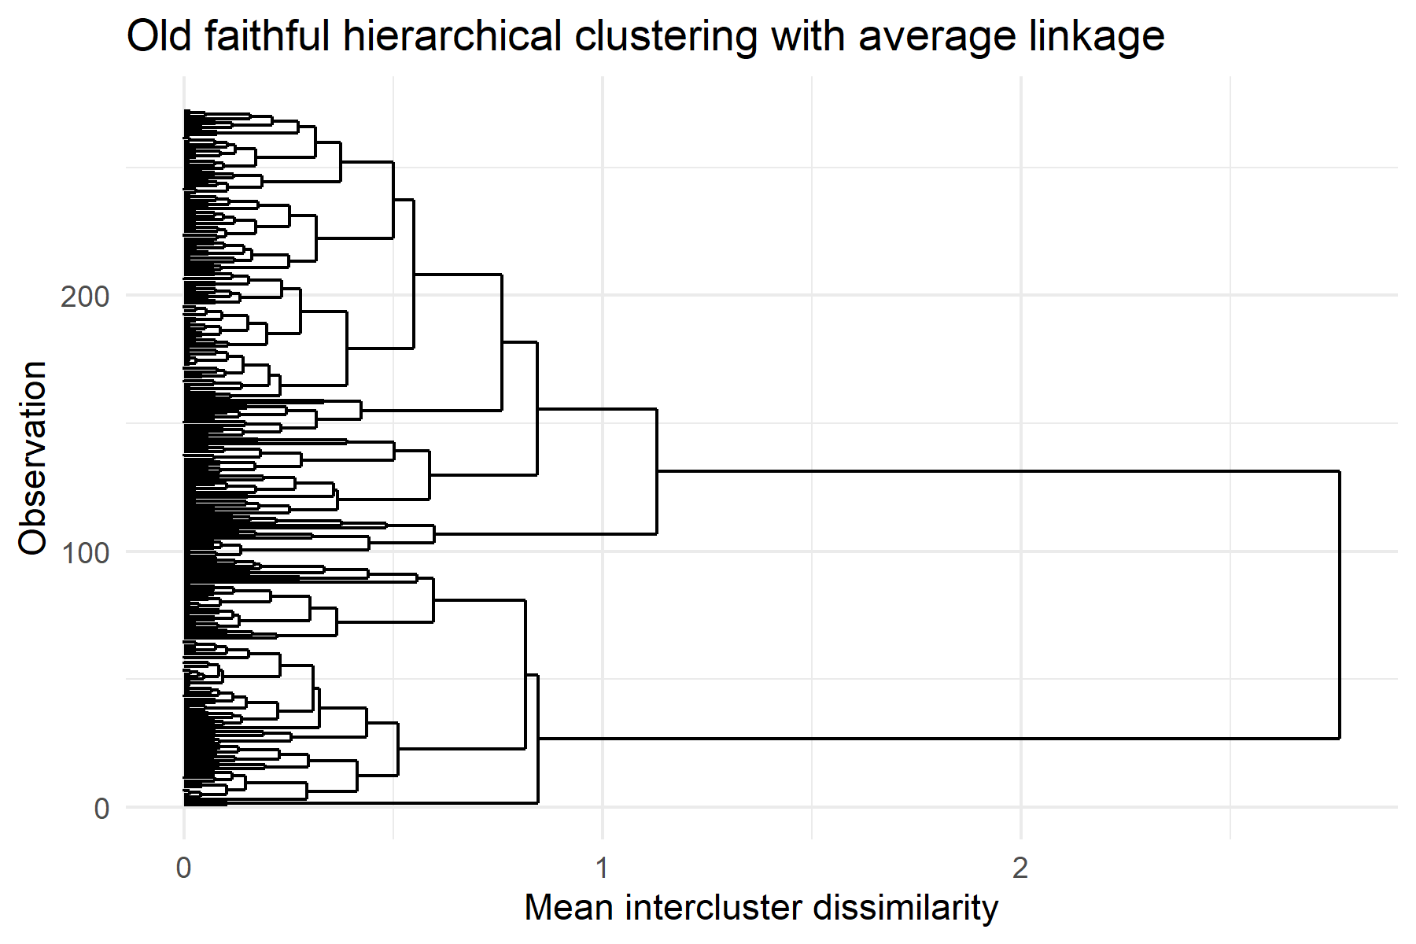
Hierarchical clustering

Slide 16

Hierarchical clustering

Slide 17
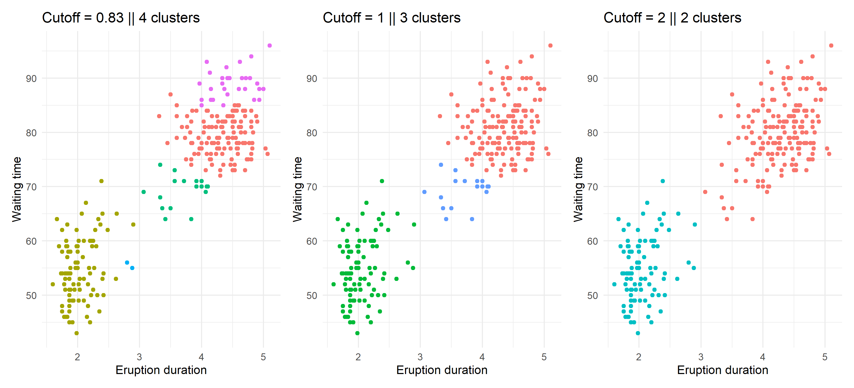
Hierarchical clustering
https://www.menti.com/uf9b1miv22
Notes:
Mentimeter question

Slide 18
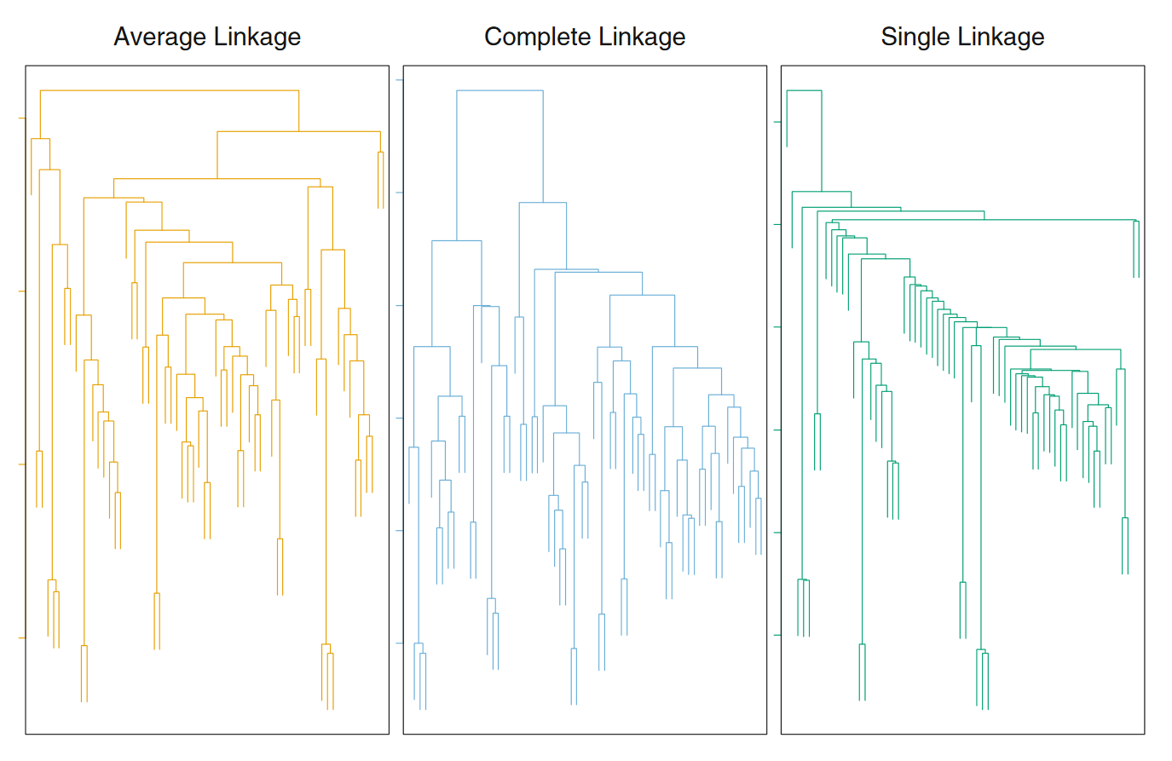
See ISLR, Table 12.3 for explanation of “linkage” options
Notes:
Linkage is a hypoerparameter

Slide 19
Note: scaling
It is generally a good idea to measure your features in the same scale before entering them into a clustering algorithm
Otherwise, height in cm will be more important in the distance computation than width in m
Generally, you want the features to have a similar scale
This can be done by standardization, or z-transformation: subtract the mean from each feature and divide by its observed standard deviation
Changes the interpretation of the values, but not their association

Slide 20
“Distance” matrix

Slide 21
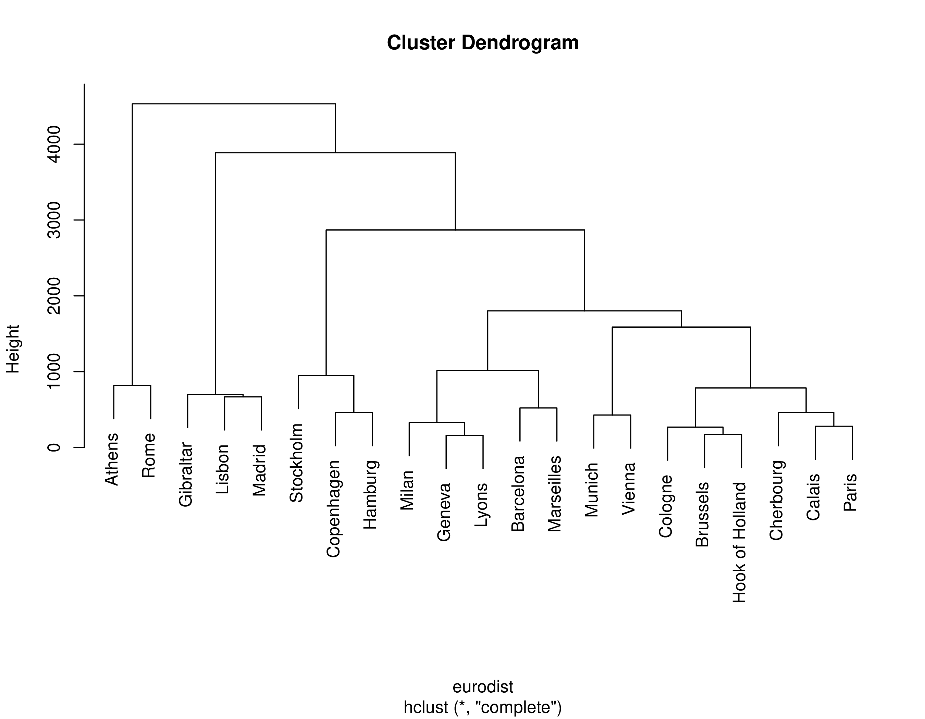
plot(hclust(eurodist))

Slide 22
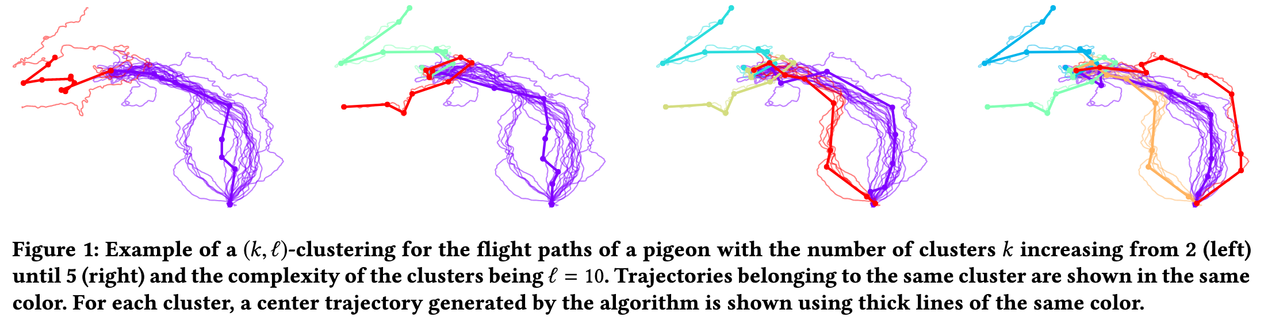
“Distance” can mean lots of things
Continuous: Euclidean, maximum, Manhattan, Minkowski, …
Time series: ”Dynamic time warping”, Fréchet, cross-corr., wavelets, …
Networks: Modularity, Shortest path, …
Text/DNA: Edit distance, Hamming distance, TF-IDF distance, ..
Images: “Structural similarity”, GAN loss…
Buchin et al. 2019

Slide 23
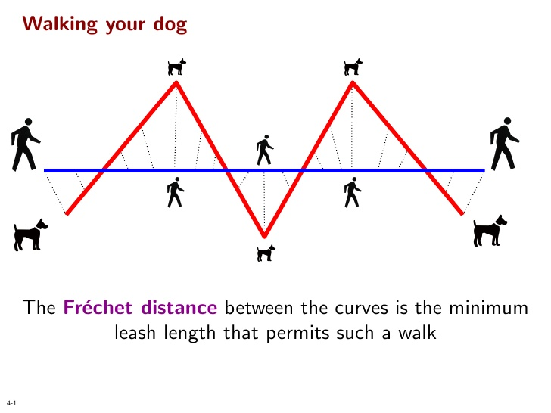
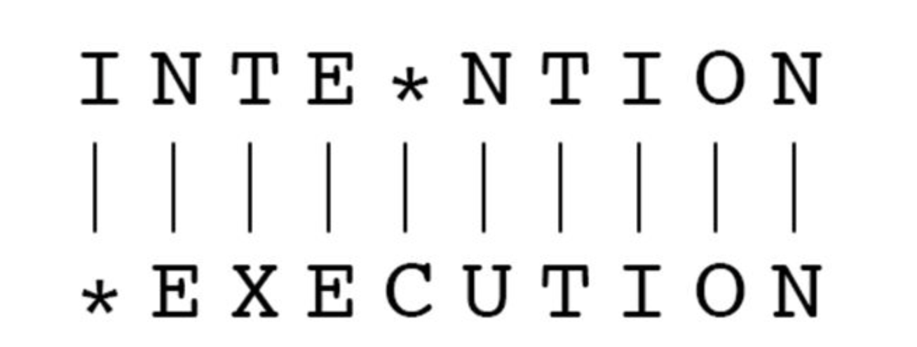
Some example distances that aren’t Euclidean but useful for specific data types
Fréchet distance for time series/curves
Minimum edit distance for text/DNA
(edit distance = 5)
https://www.menti.com/uf9b1miv22
Notes:
mentimeter

Slide 24
Hierarchical clustering: conclusion
Tree-based representation - dendrogram
Determine number of clusters afterwards
Different distance metrics possible
Different agglomeration methods (“linkage” rules) possible
Taking distance matrix as input → very flexible technique
Distance matrix N×N → can be tricky when N is large (esp. divisive)

Slide 25
Clustering types
Source: T. Fuertes
https://quantdare.com/hierarchical-clustering/

Slide 26

K-means clustering algorithm
1. Randomly assign examples to $K$ clusters
2a. Calculate the centroid (per-feature mean) for each cluster
2b. Assign each example to the cluster belonging to its closest centroid
3. If the assignments changed, go to step 2a, else stop
faithful %>% group_by(cluster) %>% summarize_all(mean)
#> cluster eruptions waiting
#> <int> <dbl> <dbl>
#> 1 1 3.69 73.4
#> 2 2 3.30 68.6

Slide 27
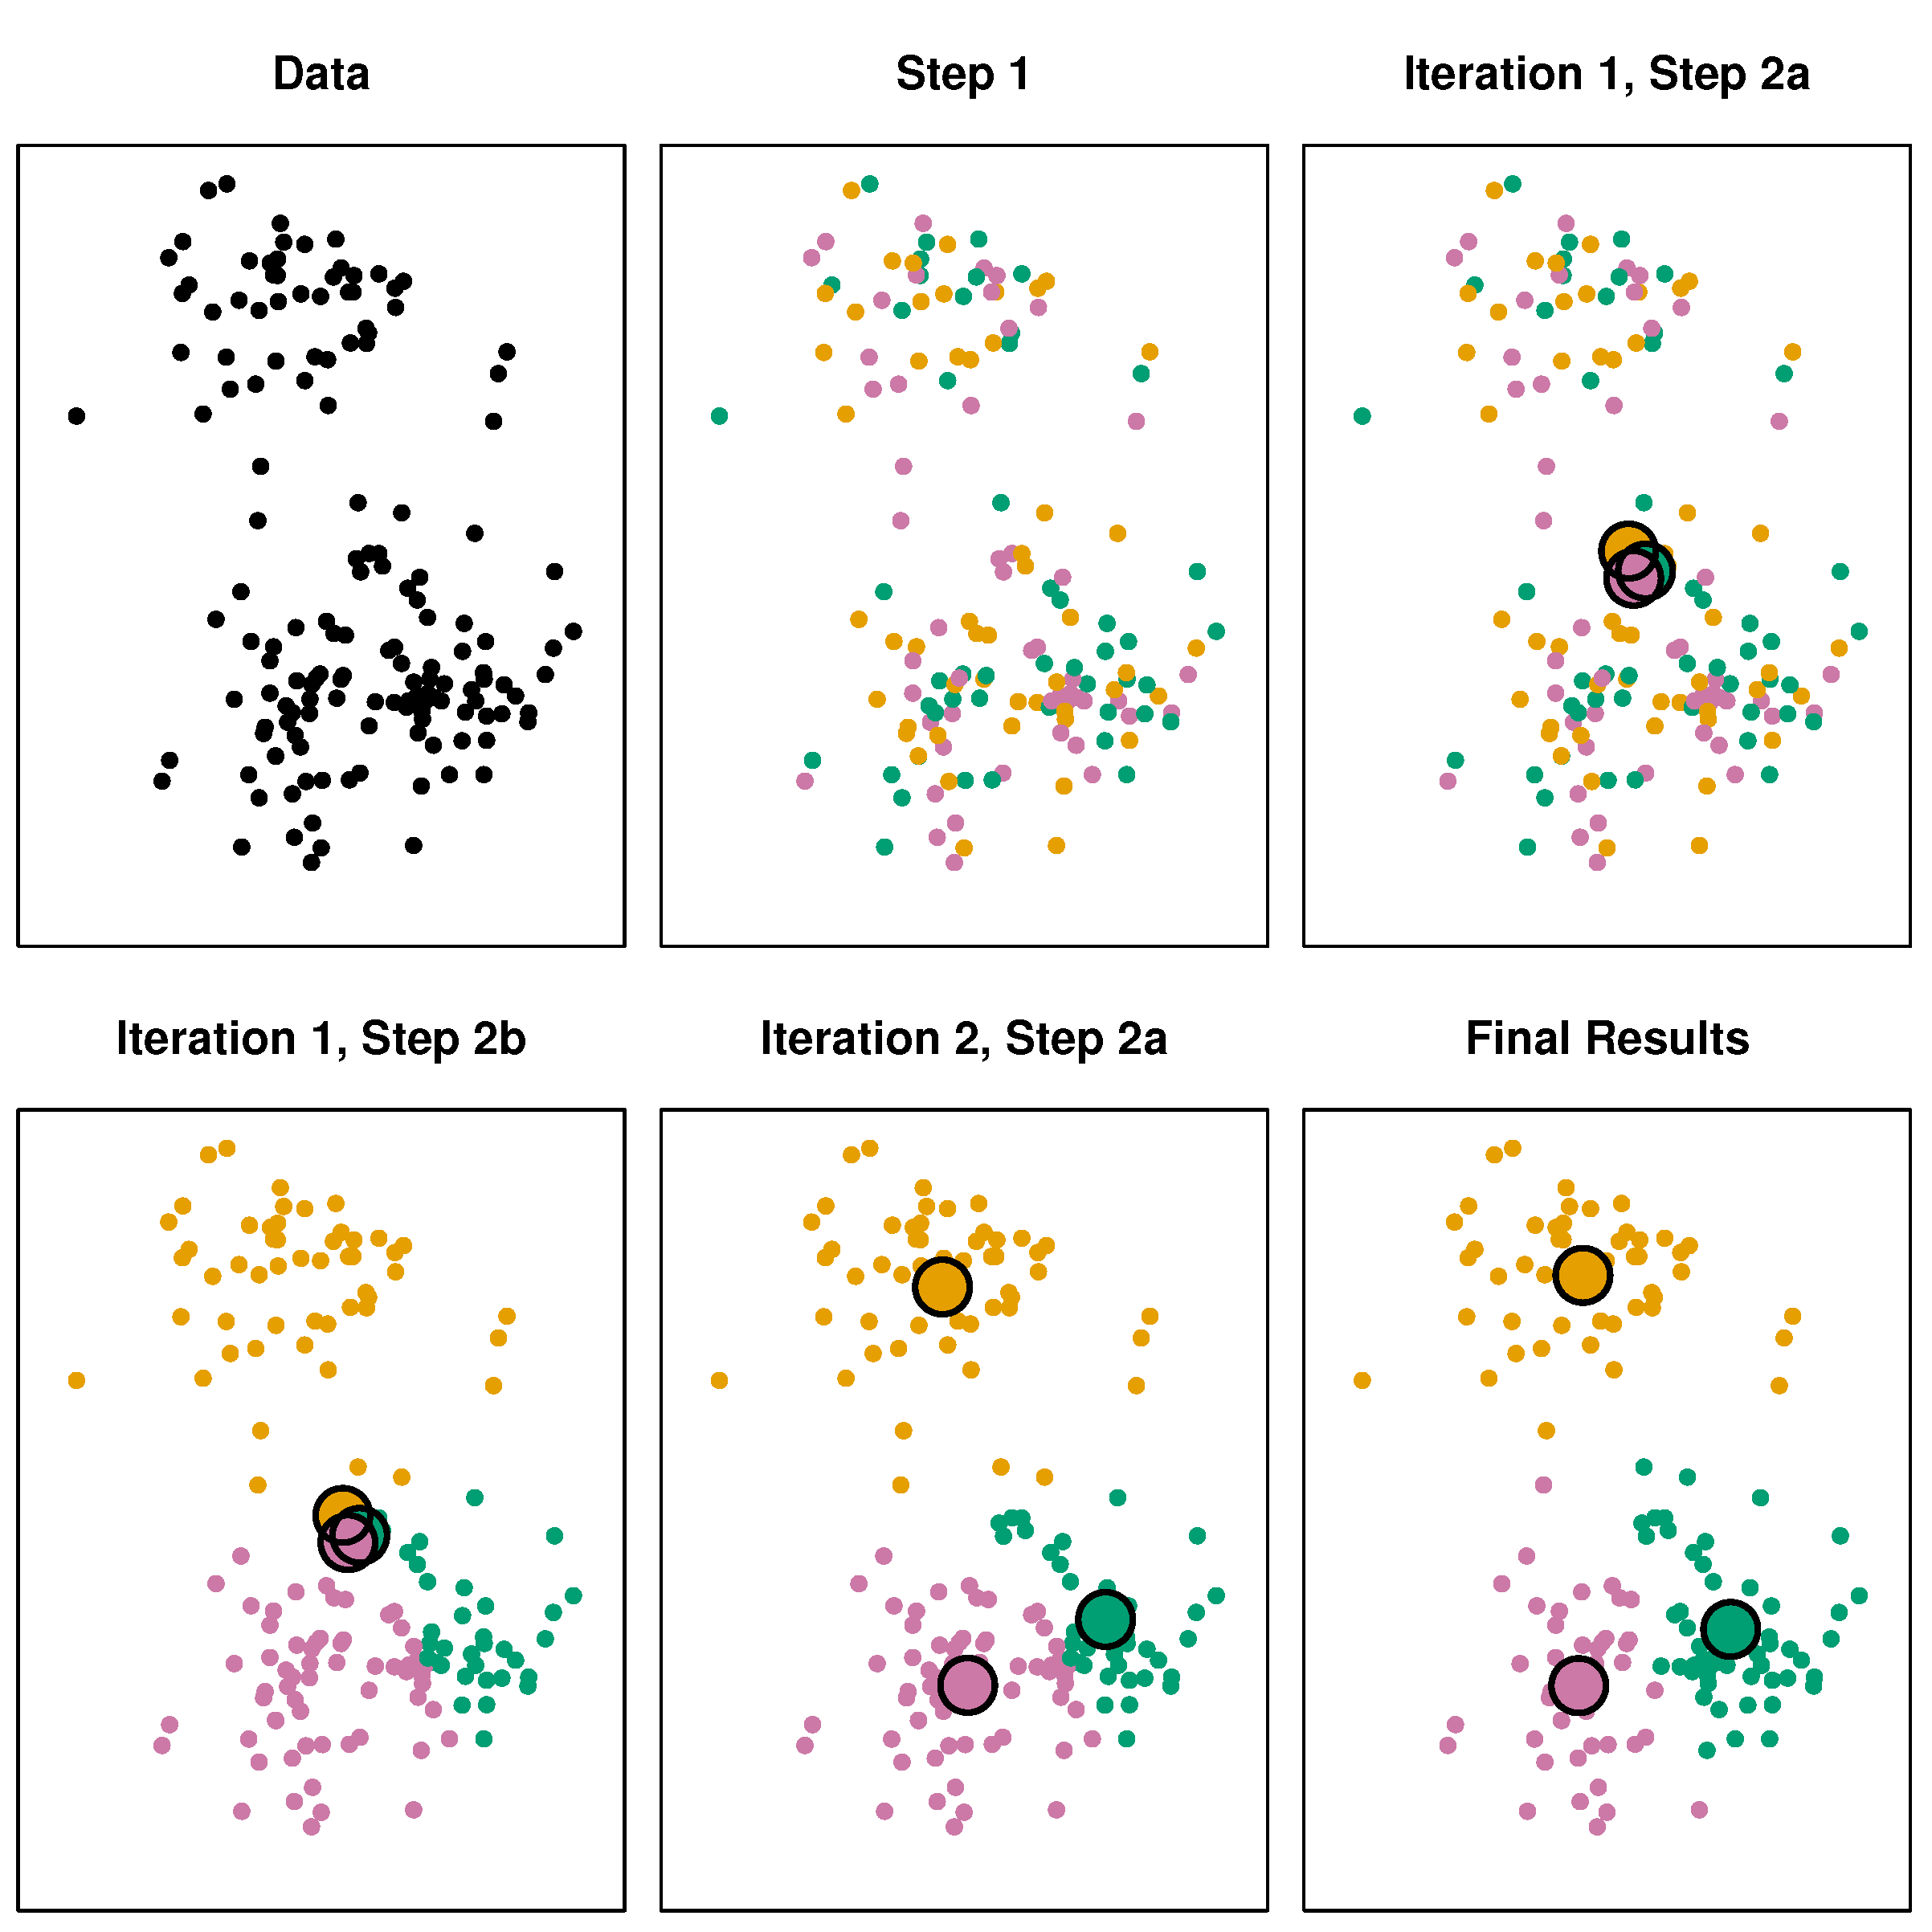
K-means clustering
ISLR, page 518

Slide 28
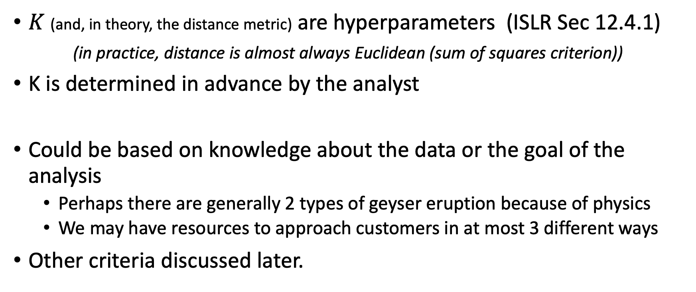
K-means clustering
$K$ (and, in theory, the distance metric) are hyperparameters (ISLR Sec 12.4.1)
(in practice, distance is almost always Euclidean (sum of squares criterion))
K is determined in advance by the analyst
Could be based on knowledge about the data or the goal of the analysis
Perhaps there are generally 2 types of geyser eruption because of physics
We may have resources to approach customers in at most 3 different ways
Other criteria discussed later.

Slide 29
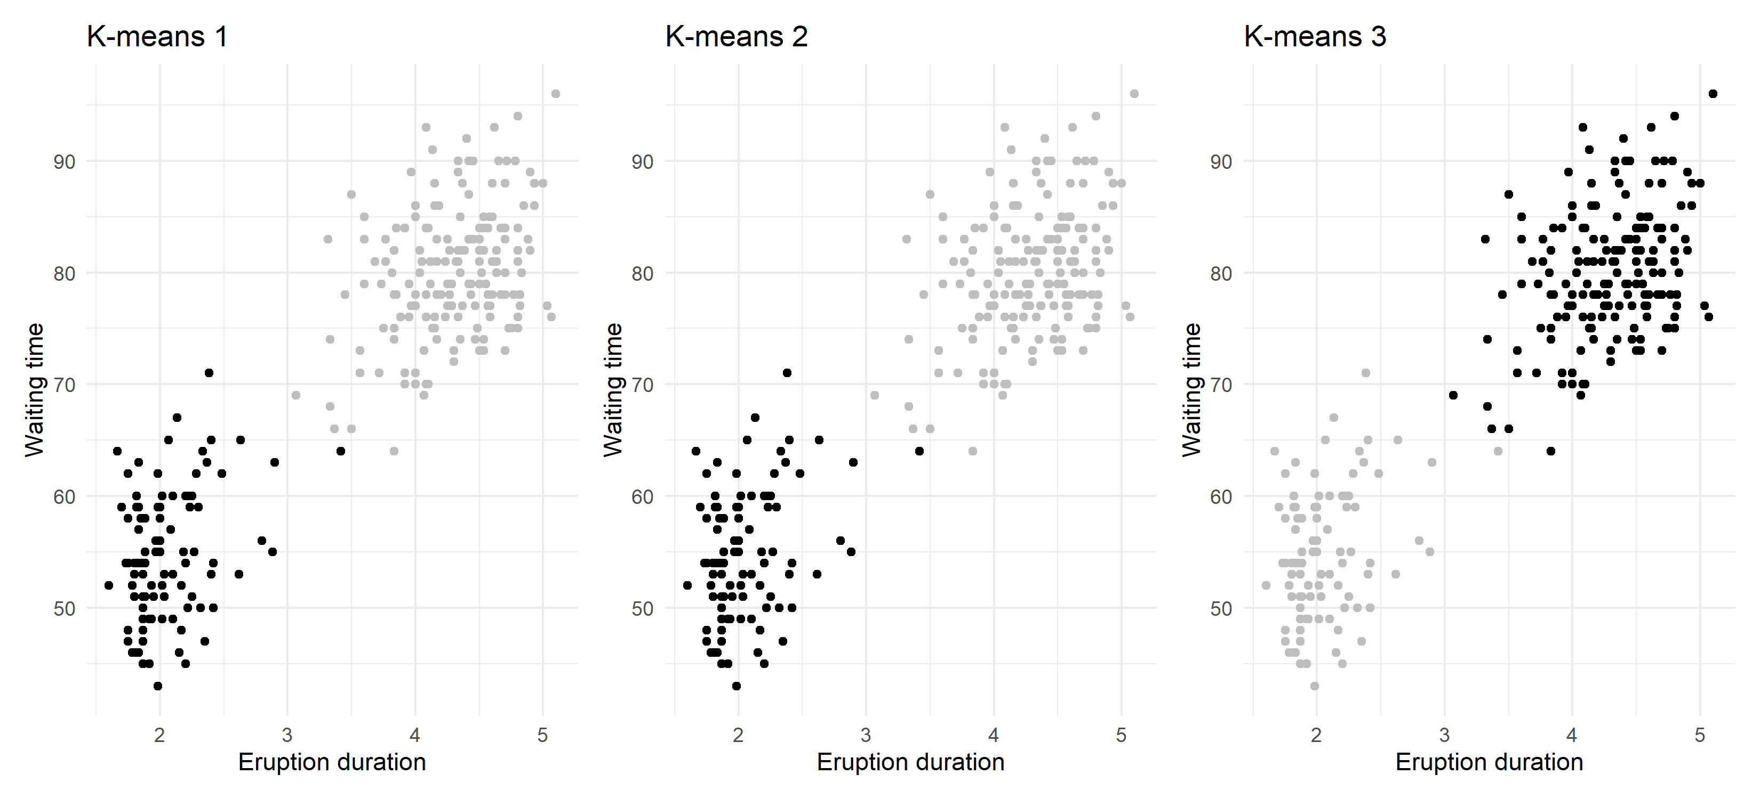
K-means clustering
Because the initialization is random, the result is random
Label switching: cluster 1, 2, 3 may end up in each other’s locations
Some examples at the boundary may end up in different clusters altogether
Use multiple starts to obtain the best solution

Slide 30
K-means clustering
K-means clustering applied to images is called “vector quantization”
Goal: image compression → less storage!
Cluster pixels, then replace them by their cluster centroid

Slide 31
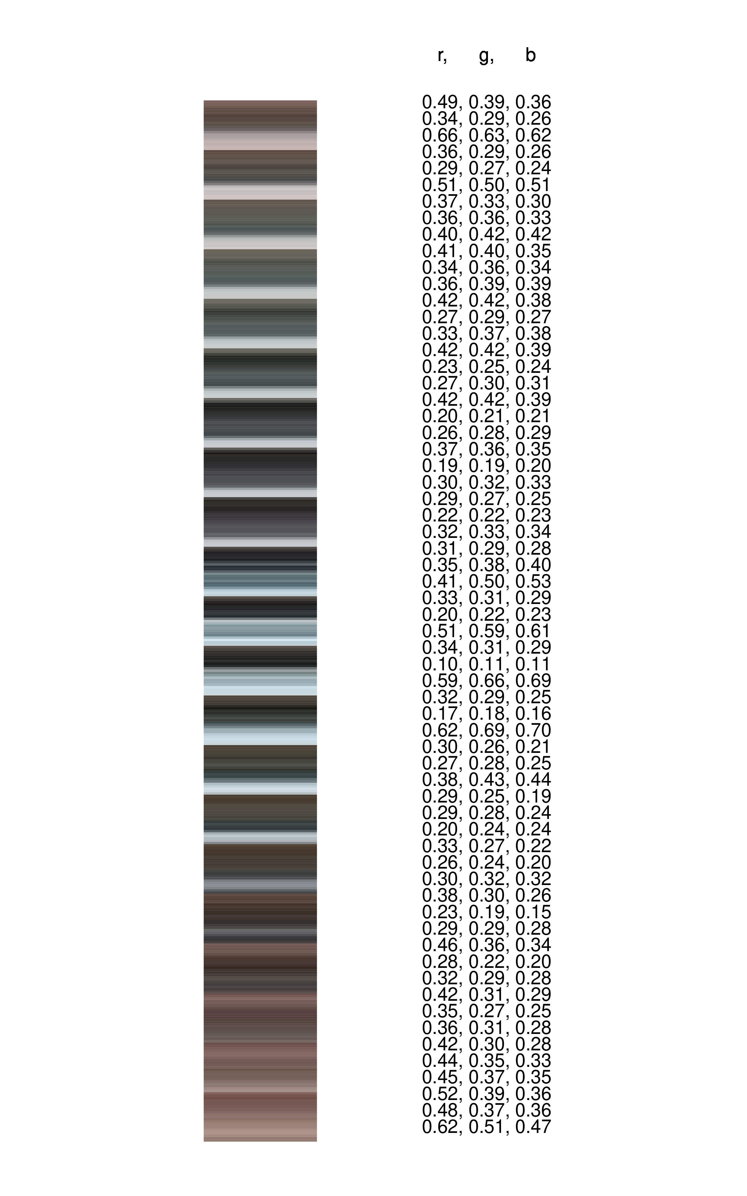
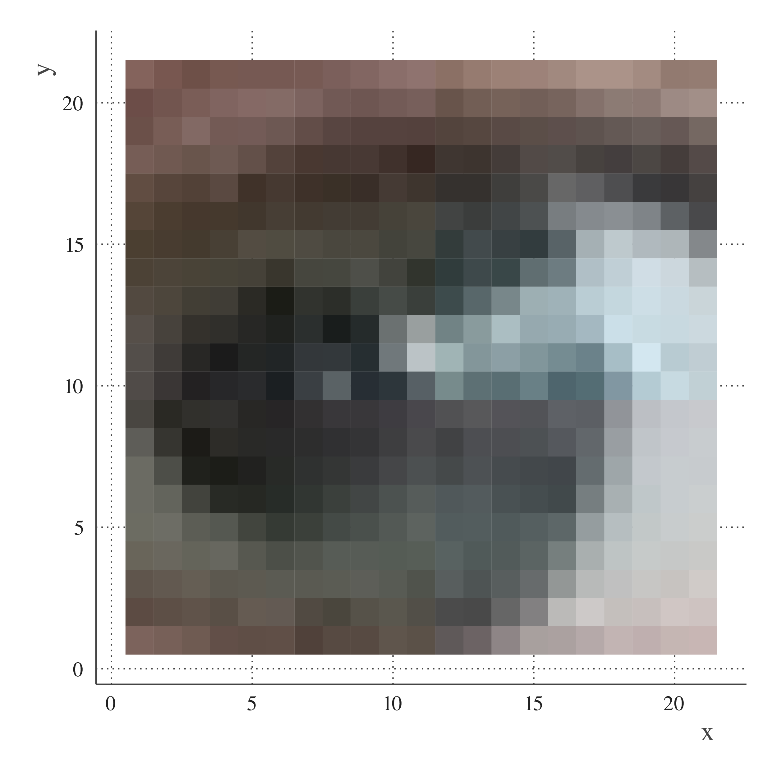

Slide 32








Original
K = 100
671 kB
419 kB

Slide 33
Original
K = 10
671 kB
126 kB

Slide 34
Original
K = 9
671 kB
117 kB

Slide 35
Original
K = 8
671 kB
101 kB

Slide 36

Original
K = 7
671 kB
93 kB

Slide 37
Original
K = 6
671 kB
79 kB

Slide 38
Original
K = 5
671 kB
65 kB

Slide 39

Original
K = 4
671 kB
57 kB

Slide 40

Original
K = 3
671 kB
36 kB

Slide 41
Original
K = 2
671 kB
18 kB

Slide 42

Original
K = 1
671 kB
4 kB

Slide 43
Notes:
Tradeoff compression - accuracy

Slide 44
Notes:
Tradeoff compression - accuracy

Slide 45

Which of these is the best and why?
https://www.menti.com/uf9b1miv22
K=
1
5
10
100
640,000
Notes:
menti

Slide 46
More clusters gives better “fit” in terms of reconstruction of the image
(compression is less “lossy”)
More clusters gives bigger file size
(solution is more complex, takes more bytes to store)
So the model loss and model complexity trade off against each other
This is a common theme in (unsupervised) machine learning and you should remember this for model-based clustering lecture
Notes:
Tradeoff compression - accuracy

Slide 47
How to evaluate clustering results
Use of external information
Visual exploration
Stability assessment / sensitivity analysis
Internal validation indexes
(Testing for clustering structure)
Much more info & helpful advice: Clustering strategy & method selection (ch 31 of Handbook of clustering), https://arxiv.org/pdf/1503.02059.pdf

Slide 48
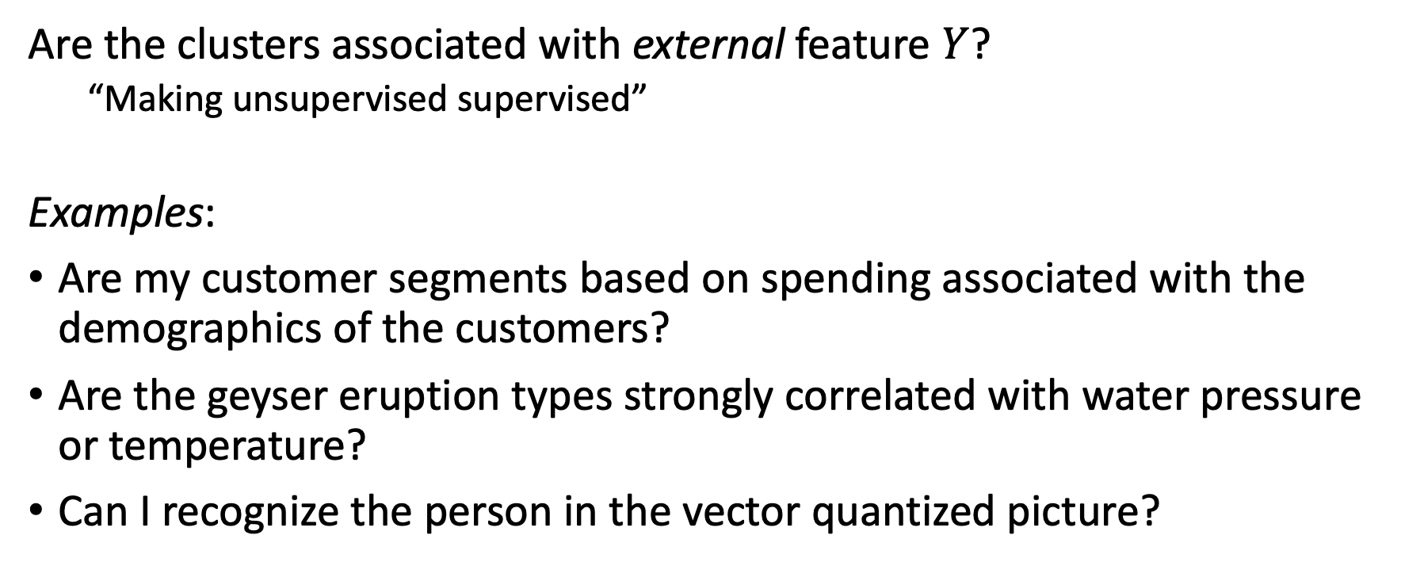
1. External validation
Are the clusters associated with external feature $Y$?
“Making unsupervised supervised”
Examples:
Are my customer segments based on spending associated with the demographics of the customers?
Are the geyser eruption types strongly correlated with water pressure or temperature?
Can I recognize the person in the vector quantized picture?

Slide 49
2. Visual exploration
Problem: Kind of hard to see already…
Wait till you get 1000 variables!
New idea: Reduce variables into 2D “manifold” for visualization
Popular techniques: UMAP, t-SNE, MDS, Discriminant Coordinates, (PCA)

Slide 50
2. Visual exploration (using “manifold”)

Slide 51
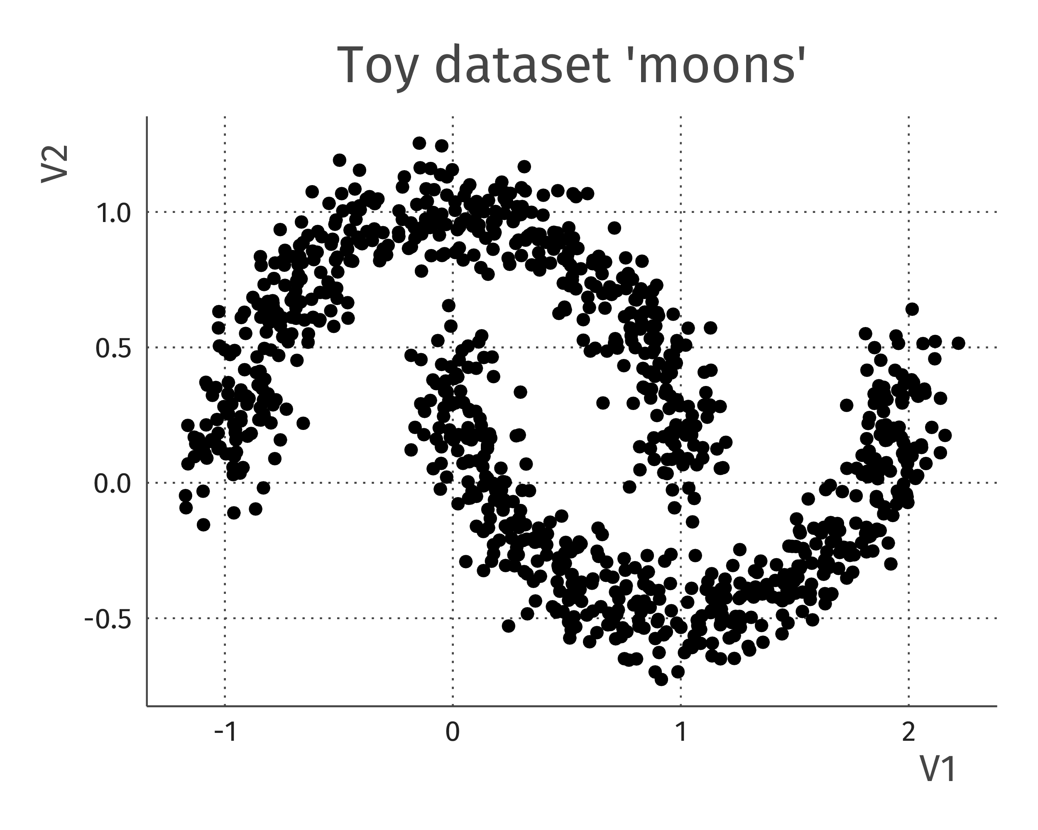
3. Stability assessment
A.k.a.: Clustering can be fiddly

Slide 52
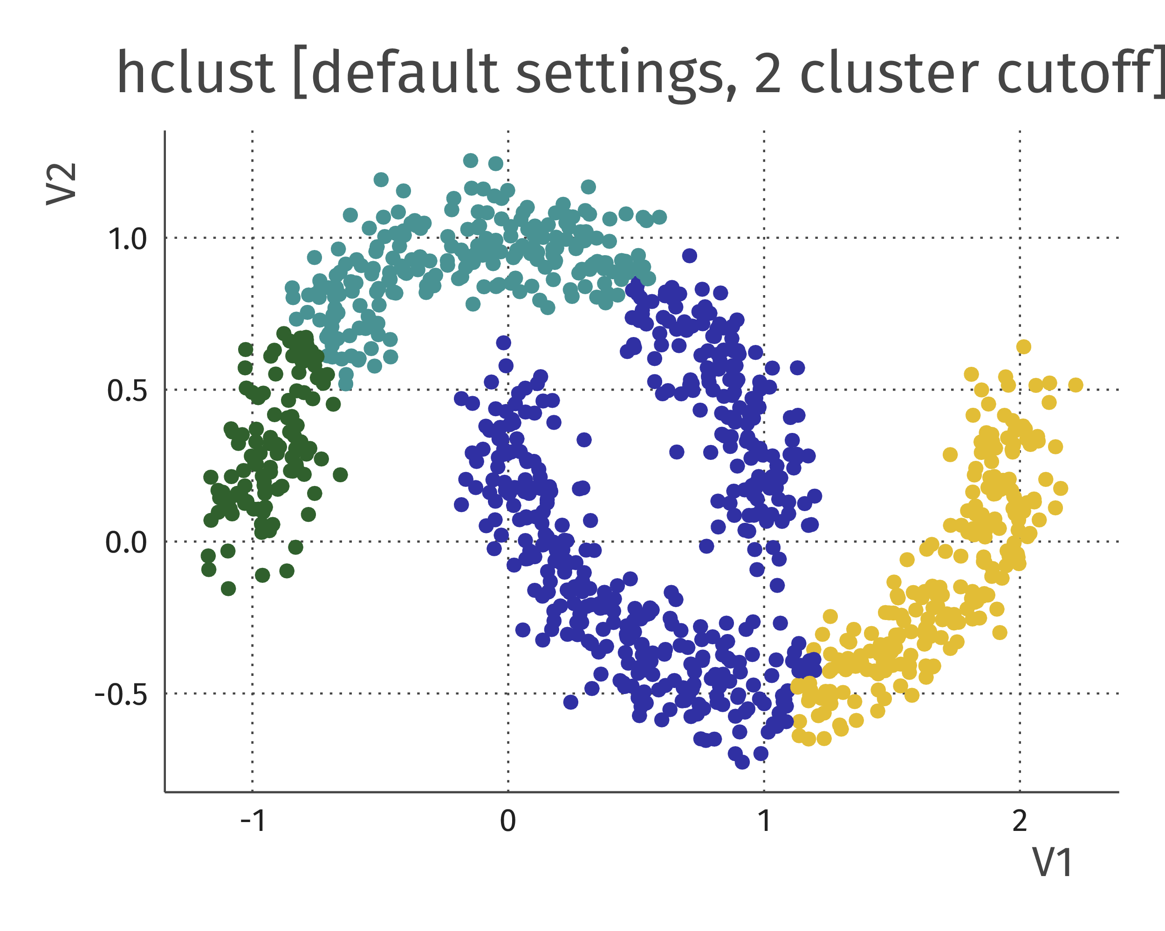
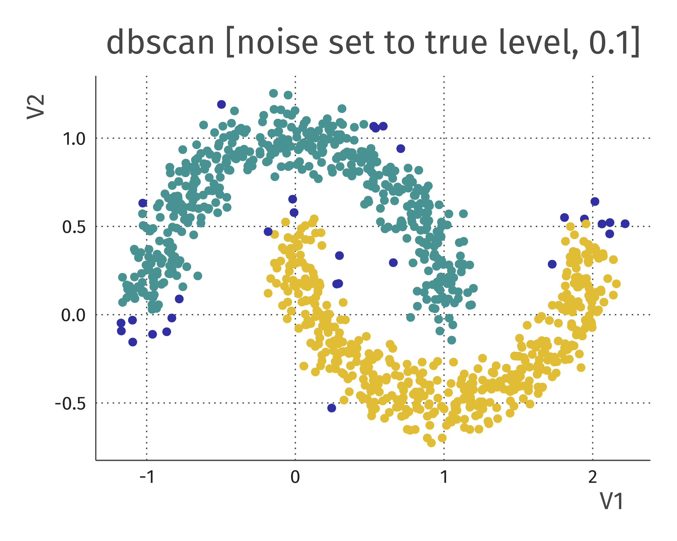
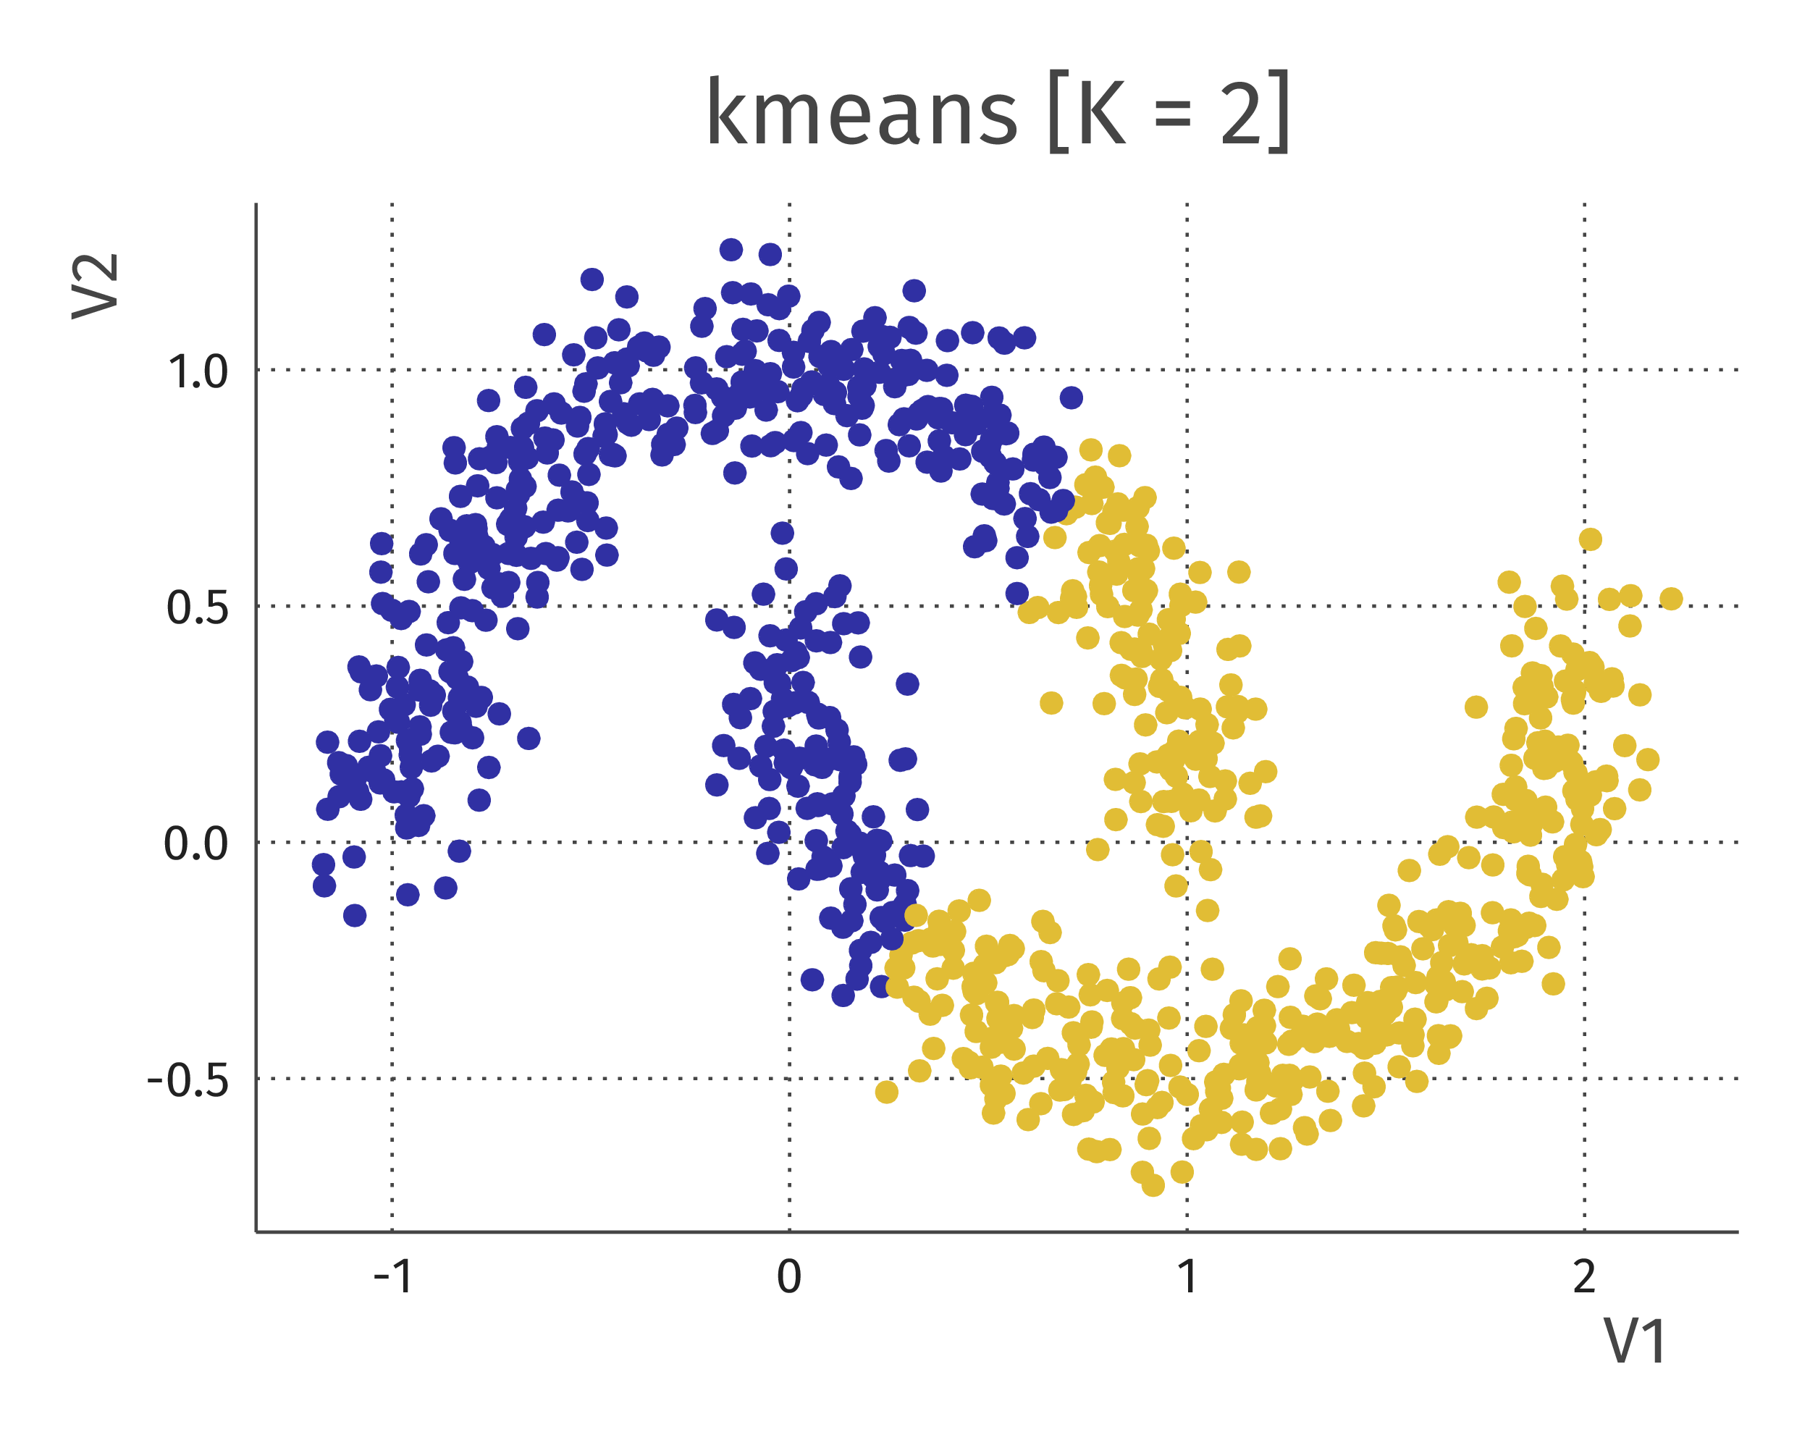
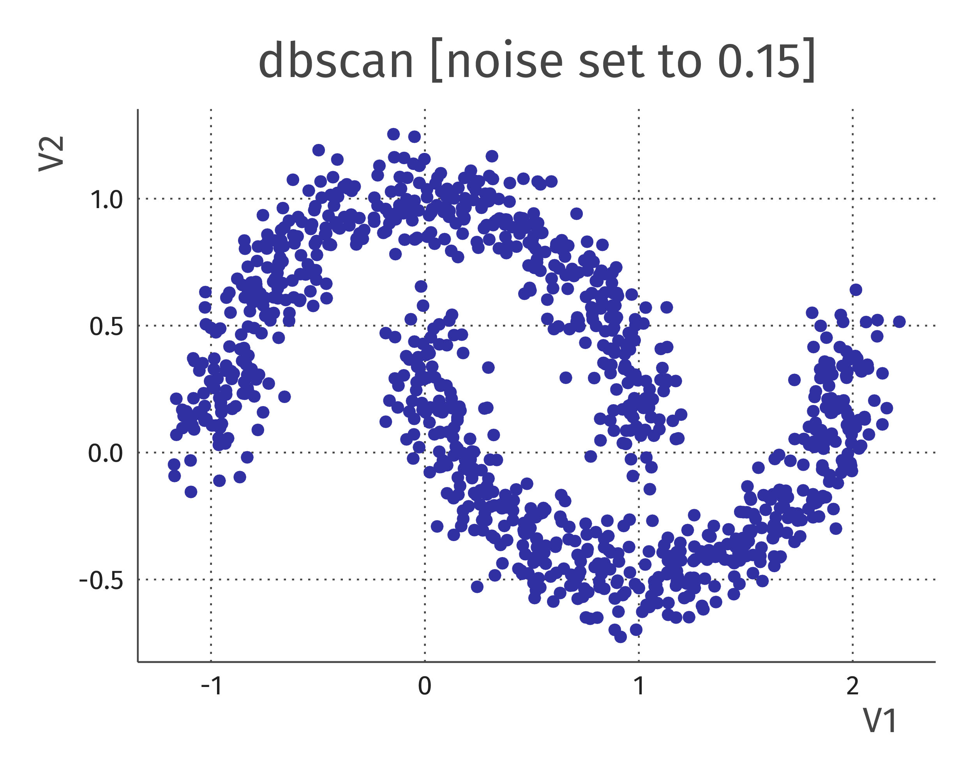
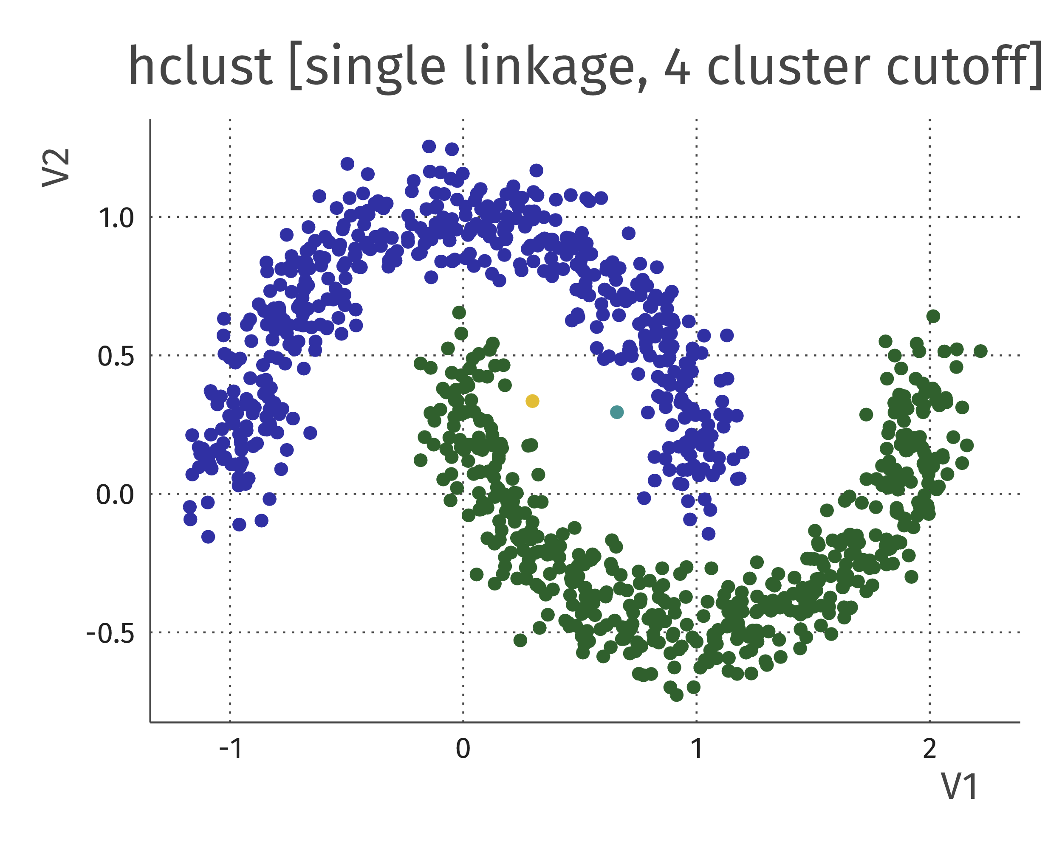
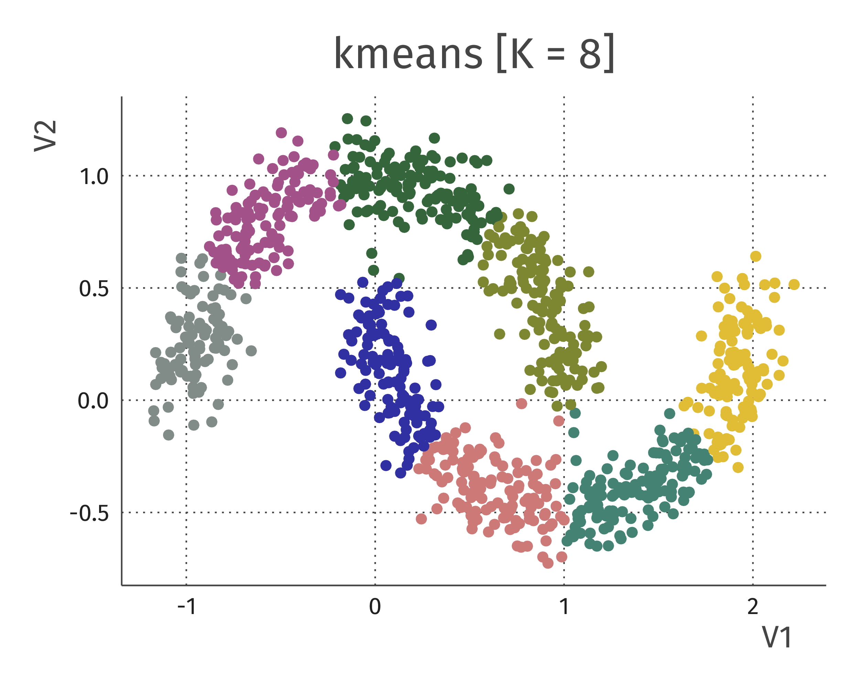

Slide 53
3. Cluster “stability”
Three “stabilities”. How much does clustering change when:
Changing some hyperparameters (distance metric, linkage, K, ...)
Changing some observations (bootstrapping, Hennig, 2007)
Changing some features
Check if observations are classified into same cluster across choices
e.g. using Jaccard index, Rand index

Slide 54
3. Clusterwise stability in R
library(fpc)
data(iris)
clusterboot(iris[, 1:4],
clustermethod = hclustCBI,
method = "complete", k = 3)
Clusterwise Jaccard bootstrap (omitting multiple points) mean:
[1] 0.891 0.459 0.719

Slide 55
4. Internal validation indices
Only look at “unsupervised” bit: data and clustering
Quantify how “successful” the clustering is in some sense
Popular measures:
Average sihouette width (ASW) (how close are points to other clusters)
“Gap statistic” (Tibshirani et al. 2001)
(measures from model-based clustering → tomorrow)
Disadvantage: don’t take account of the clustering aim!

Slide 56
Silhouette analysis in R
distmat_faithful <- dist(faithful)
hclust_faithful <- hclust(distmat_faithful)
clustering_faithful <- cutree(hclust_faithful, 2)
silhouette_scores <- silhouette(clustering_faithful, distmat_faithful)
plot(silhouette_scores)
Note that this works for any type of clustering!

Slide 60
What do you think the average silhouette width (ASW) of this solution will approximately be?
https://www.menti.com/uf9b1miv22

Slide 61
Conclusion: clustering
Clustering looks for “similar” groups of observations
Two basic clustering methods:
Hierarchical clustering (e.g. bottom-up agglomerative, top-down divisive, …)
Partitional clustering (e.g. k-means, DBSCAN, …).
Cluster evaluation is an important and subtle topic;
No way to get rid of critical thought.

