Slide 1
Data Wrangling and Data Analysis
Unsupervised learning:
Model-based clustering
Daniel Oberski & Erik-Jan van Kesteren
Department of Methodology & Statistics
Utrecht University
Notes:
Bouveyron ch 6 and 8
Other criteria
Merging
Other data types
Model-based vs. not
Posterior probabilities
Omgaan met noise

Slide 2
This week
Lecture 1: Clustering #2: Model-based clustering
Lecture 2: Text mining #1
Lecture 3: Text mining #2

Slide 3
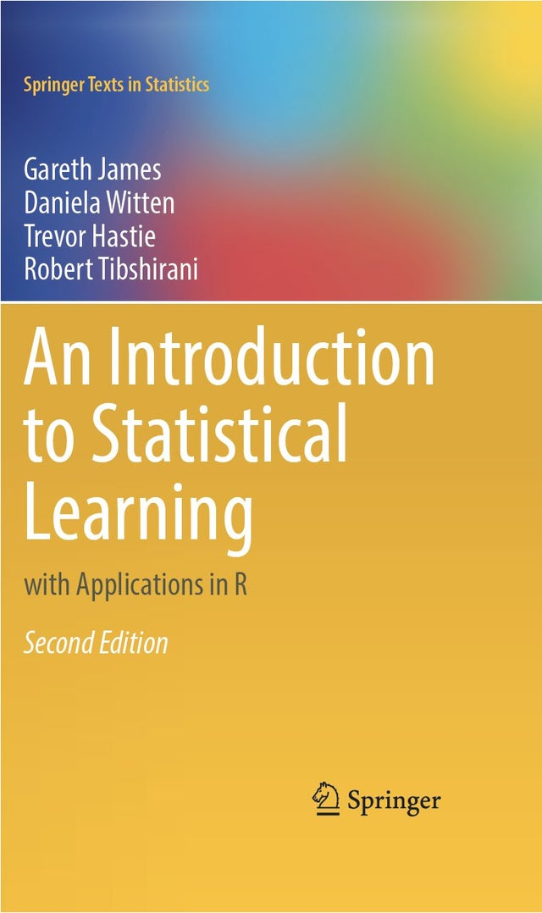
Reading materials about clustering (this week & next)
Selected paragraphs from Introduction to Statistical Learning (ISLR) §12.1 and 12.4
“Mixture models: latent profile and latent class analysis” [Oberski, 2016] §1, §2
http://daob.nl/wp-content/papercite-data/pdf/oberski2016mixturemodels.pdf

Slide 4

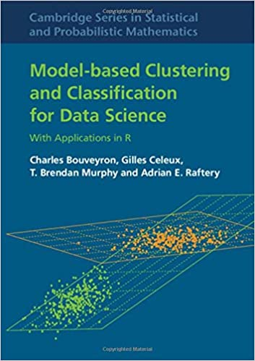
Optional, much more in-depth material
Clustering strategy and method selection (ch. 31), https://arxiv.org/pdf/1503.02059.pdf
Handbook of Cluster Analysis
Hennig et al. (2016)
Model-based Clustering and
Classification for Data Science
Bouveyron et al. (2018)

Slide 5
Model-based clustering

Slide 6
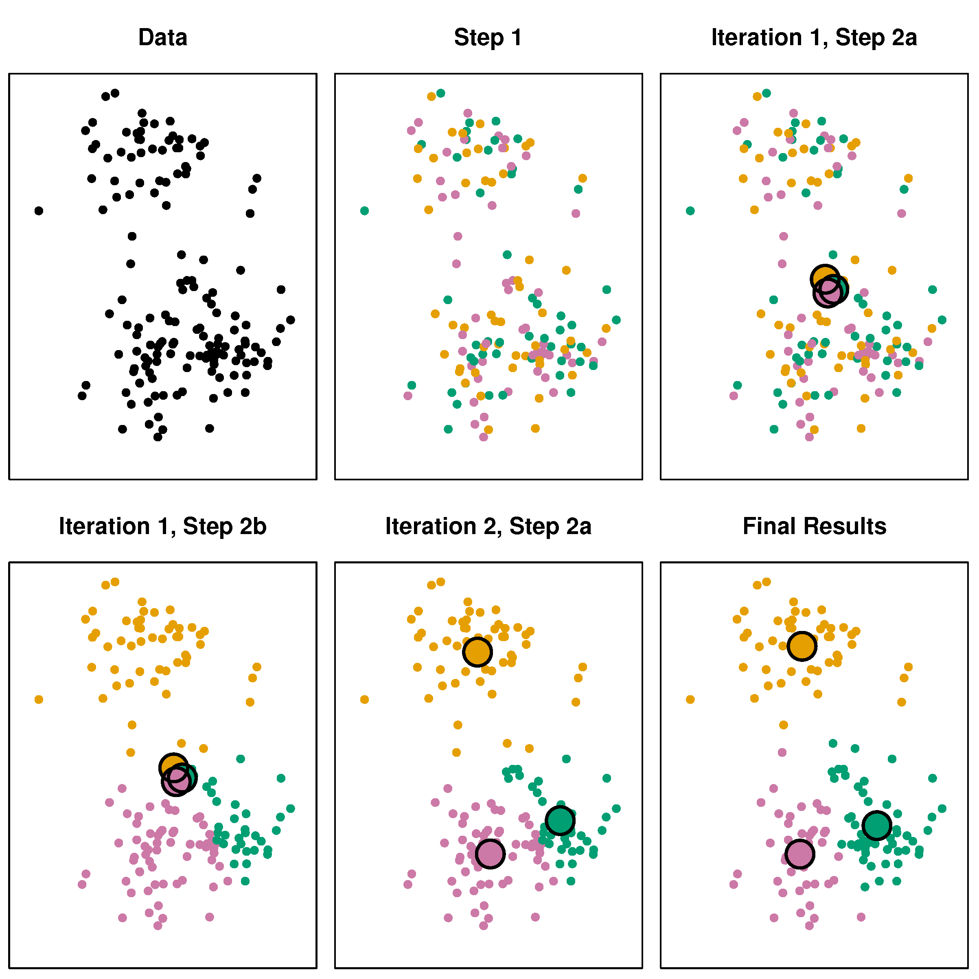
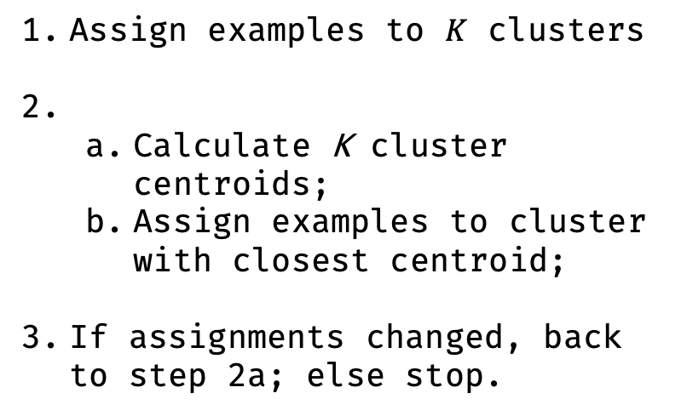
K-means again
Assign examples to $K$ clusters
Calculate K cluster centroids;
Assign examples to cluster with closest centroid;
If assignments changed, back to step 2a; else stop.

Slide 7
K-means again
K-means is based on a rule
Why this rule and not some other rule?
What kind of data does the rule work well for?
In what situations would the rule fail?
What happens if we want to change the rule?
All difficult to answer by staring at the algorithm.

Slide 8
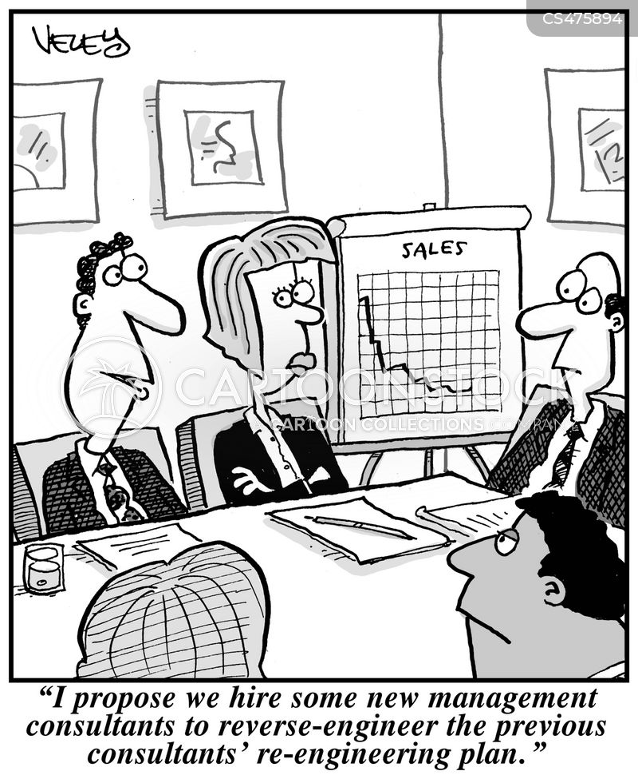

Slide 9
Model-based clustering
Steps:
Pretend we believe in some statistical model that describes data as belonging to unobserved (“latent”) groups;
Estimate (“train”) this model using the data.
The rule follows from the model!
Instead of worrying about algorithm, we worry about model.
Questions are easy to answer.

Slide 10
Model-based clustering
Assumptions about the clusters are explicit, not implicit.
We will look at the most commonly used family of models,
Gaussian mixture models (GMMs):
Data within each cluster (multivariate) normally distributed.
Parameters can be either the same or different across groups:
Volume (size of the clusters in data space);
Shape (circle or ellipse);
Orientation (the angle of the ellipse).

Slide 11
Model-based clustering
Another major advantage:
For each observation, get a posterior probability of belonging to each cluster;
Reflects that cluster membership is uncertain;
Cluster assignment can be done based on the highest probability cluster for each observation.

Slide 12
Model-based clustering
Specific examples of model-based clustering:
Gaussian mixture models
Latent profile analysis
Latent class analysis (categorical observations)
Latent Dirichlet allocation

Slide 13
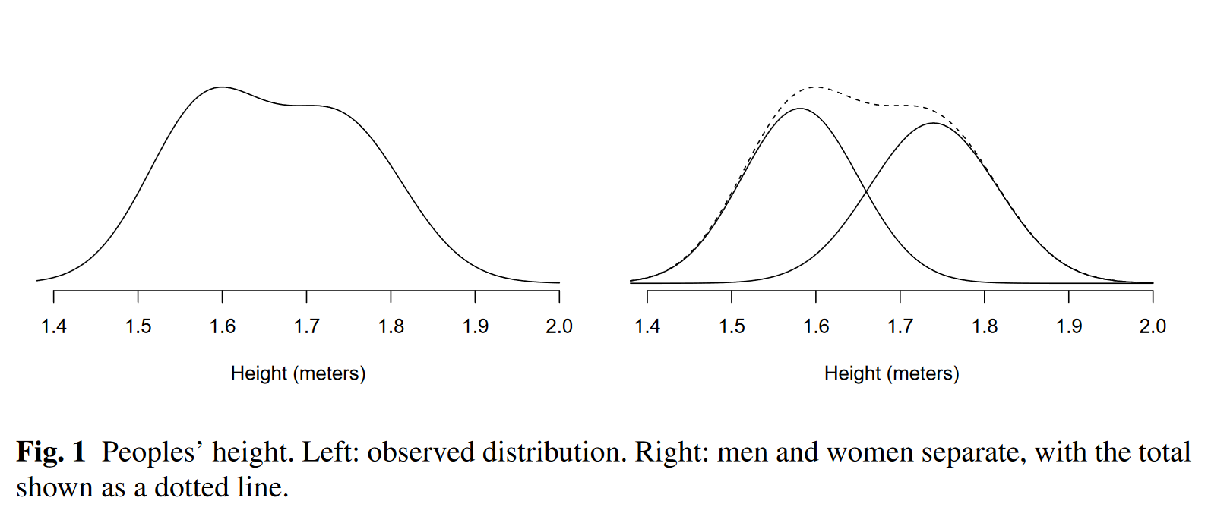
Gaussian mixture modeling

Slide 14
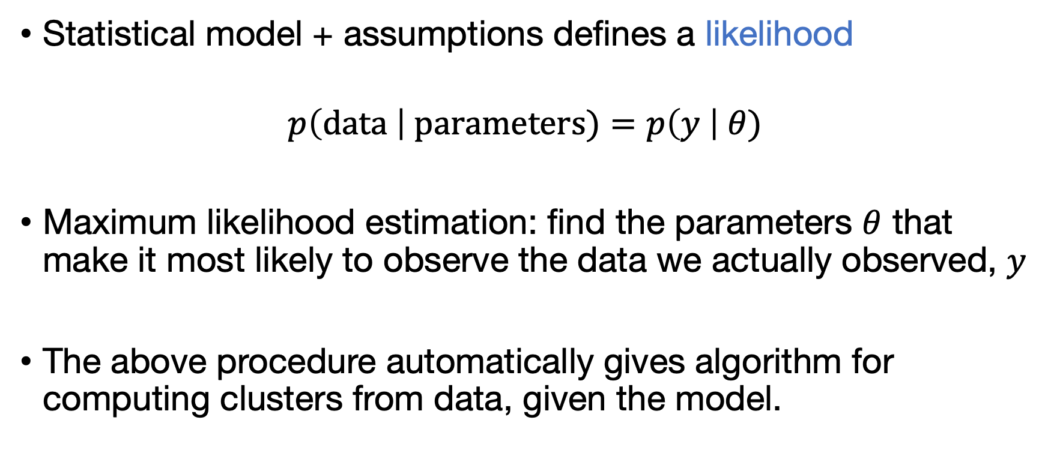
Model-based clustering
Statistical model + assumptions defines a likelihood
$$p\left(\text{data} \right| \text{parameters})=p\left(y \right| θ)$$
Maximum likelihood estimation: find the parameters $θ$ that make it most likely to observe the data we actually observed, $y$
The above procedure automatically gives algorithm for computing clusters from data, given the model.

Slide 15
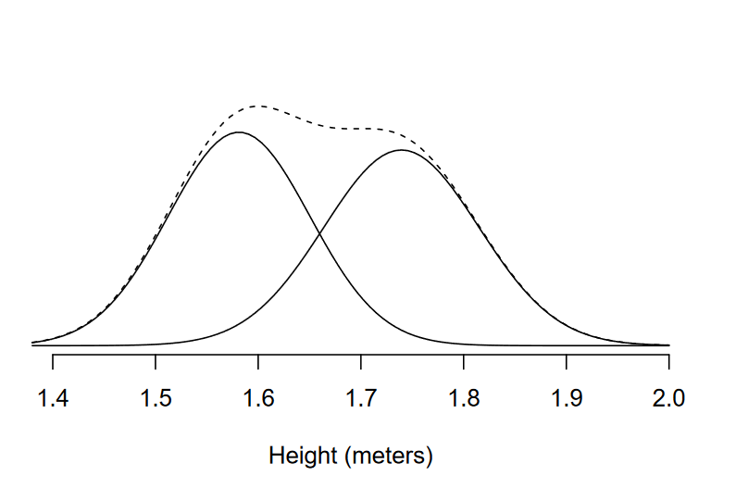

Model-based clustering
Likelihood (density) for height data:
$$p\left(\text{height} \right| θ)=$$
$\text{Pr}\left(\text{man}\right)\text{∙}\text{Normal}\left(μ_{\text{man}},σ_{\text{man}}\right)+$
$\text{Pr}(\text{woman})\text{∙}\text{Normal}(μ_{\text{wom}\text{an}},σ_{\text{wom}\text{an}})$
Or, more concise notation:
$$p\left(\text{height} \right| θ)=$$
$π_{1}^{X}\text{Normal}\left(μ_{1},σ_{1}\right)+$
${(1 −π}_{1}^{X})\text{Normal}\left(μ_{2},σ_{2}\right)$

Slide 16
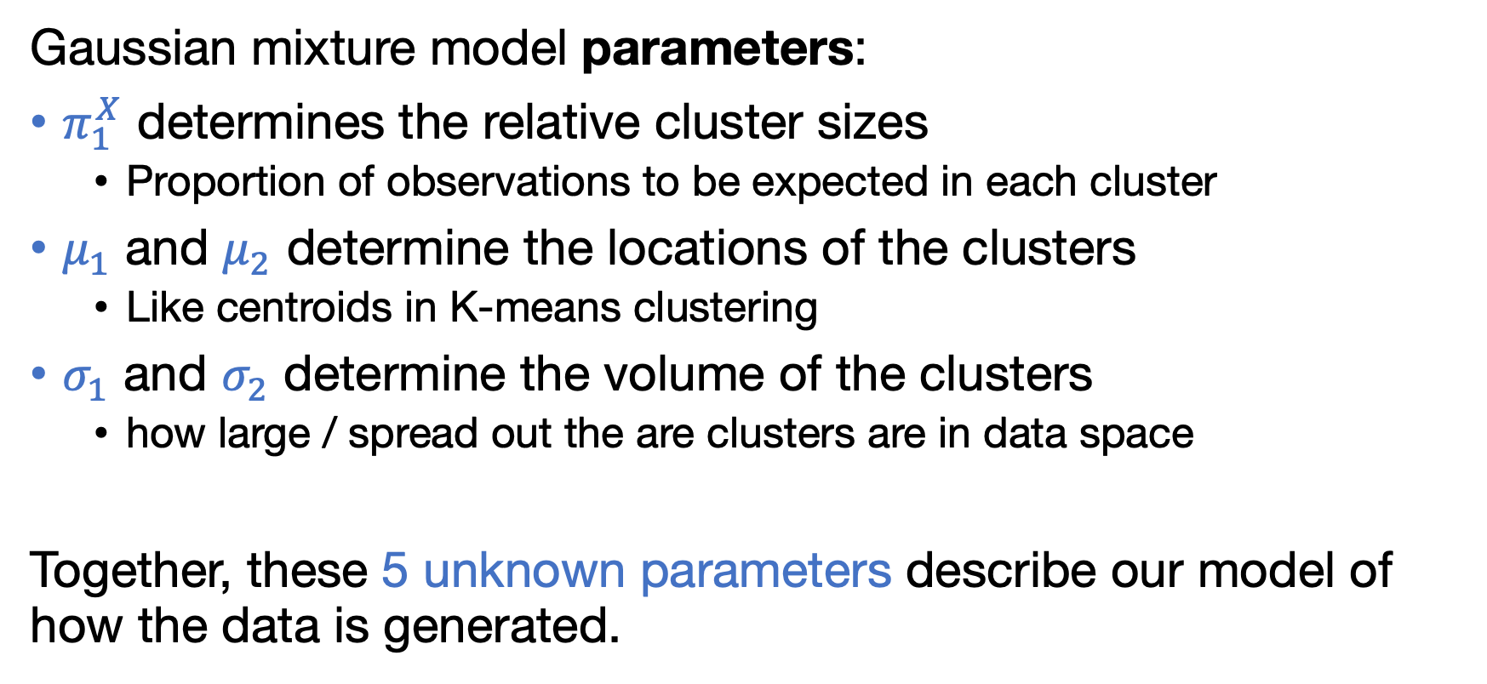
Model-based clustering
Gaussian mixture model parameters:
$π_{1}^{X}$ determines the relative cluster sizes
Proportion of observations to be expected in each cluster
$μ_{1}$ and $μ_{2}$ determine the locations of the clusters
Like centroids in K-means clustering
$σ_{1}$ and $σ_{2}$ determine the volume of the clusters
how large / spread out the are clusters are in data space
Together, these 5 unknown parameters describe our model of how the data is generated.

Slide 17
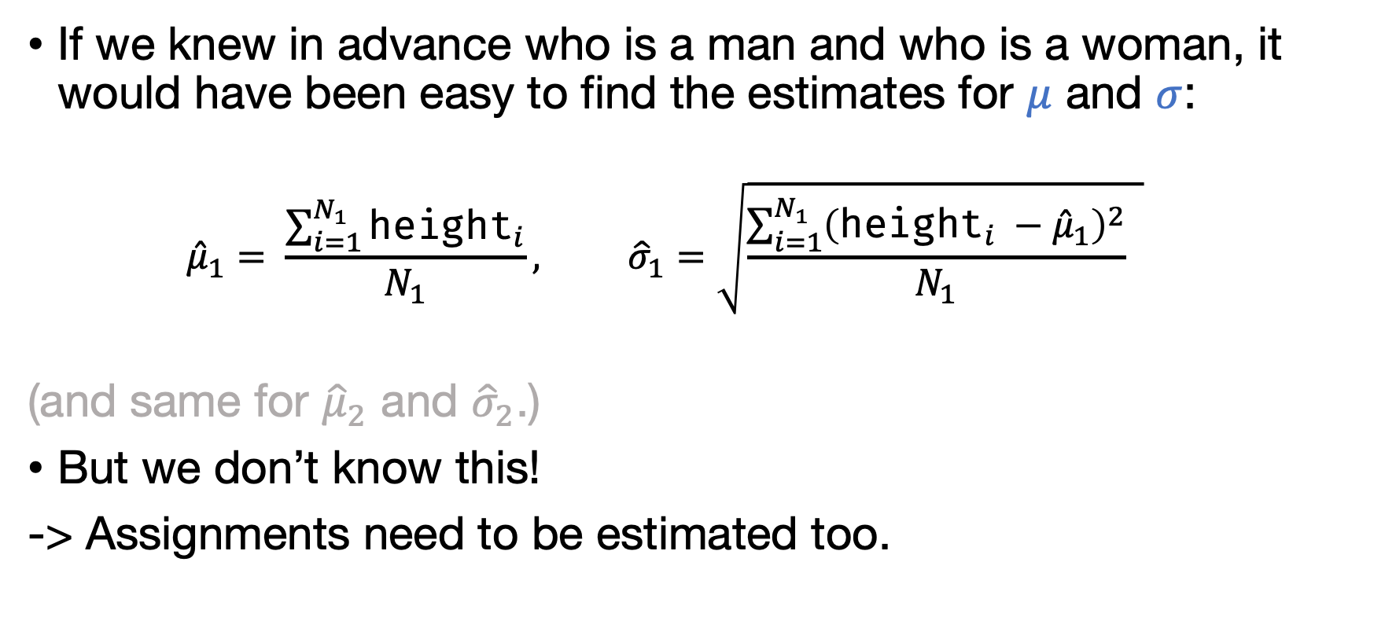
Estimation: the EM algorithm
If we knew in advance who is a man and who is a woman, it would have been easy to find the estimates for $μ$ and $σ$:
$${\hat{μ}}_{1}= \frac{\sum_{i=1}^{N_{1}}{{\text{height}}_{i}}}{N_{1}}, {\hat{σ}}_{1}=\sqrt{\frac{\sum_{i=1}^{N_{1}}{{\left({\text{height}}_{i} −{\hat{μ}}_{1}\right)}^{2}}}{N_{1}} }$$
(and same for ${\hat{μ}}_{2}$ and ${\hat{σ}}_{2}$.)
But we don’t know this!
-> Assignments need to be estimated too.

Slide 18
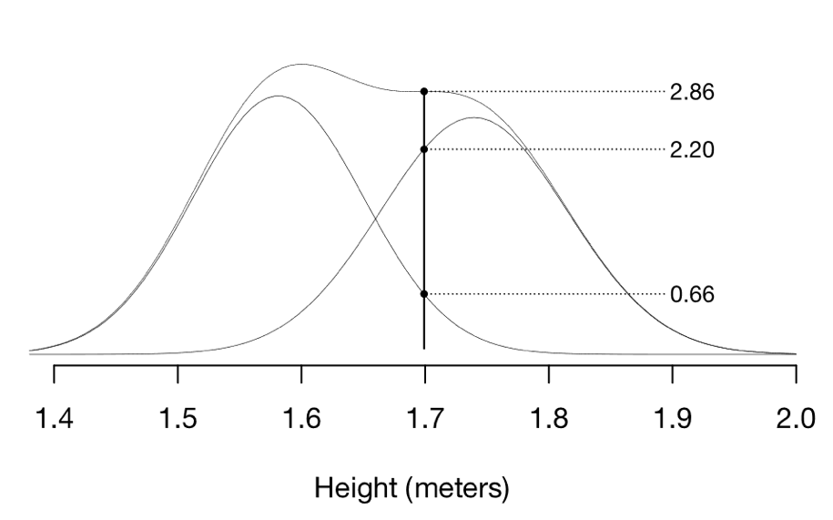
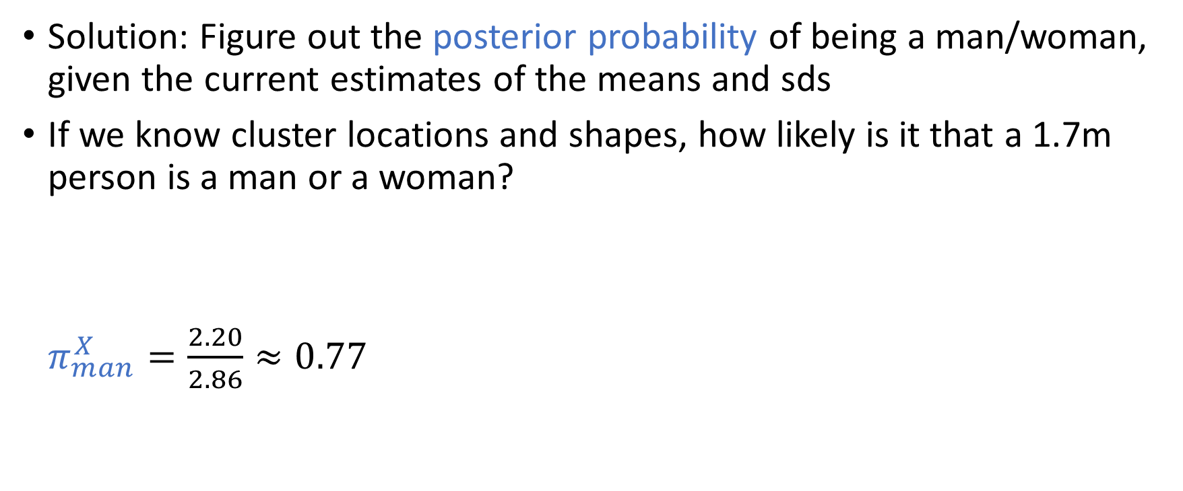
Estimation: the EM algorithm
Solution: Figure out the posterior probability of being a man/woman, given the current estimates of the means and sds
If we know cluster locations and shapes, how likely is it that a 1.7m person is a man or a woman?
$π_{man}^{X}=\frac{2.20}{2.86}≈0.77$

Slide 19
Estimation: the EM algorithm
Now we have some class assignments (probabilities);
So we can go back to the parameters and update them using our easy rule (M-step)
Then, we can compute new posterior probabilities (E-step)
Does it remind you of something…?

Slide 20
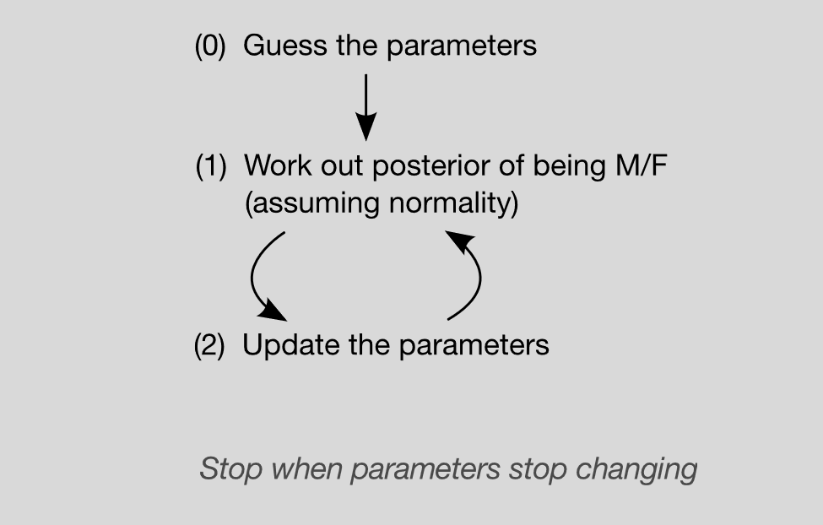
Estimation: the EM algorithm
“E-step”
“M-step”

Slide 21
Estimation: the EM algorithm
By Chire - Own work, CC BY-SA 3.0, https://commons.wikimedia.org/w/index.php?curid=20494862

Slide 22
Multivariate model-based clustering
With 2 observed features:
mean becomes a vector of 2 means
standard deviation turns into a 2x2 variance-covariance matrix determining the shape of the cluster
So we have multiple within-cluster parameters:
Two means
Two variances, one for each observed variable
A single covariance among the features
Together, the 11 parameters define the likelihood in bivariate space, which from the top looks like ellipses

Slide 23
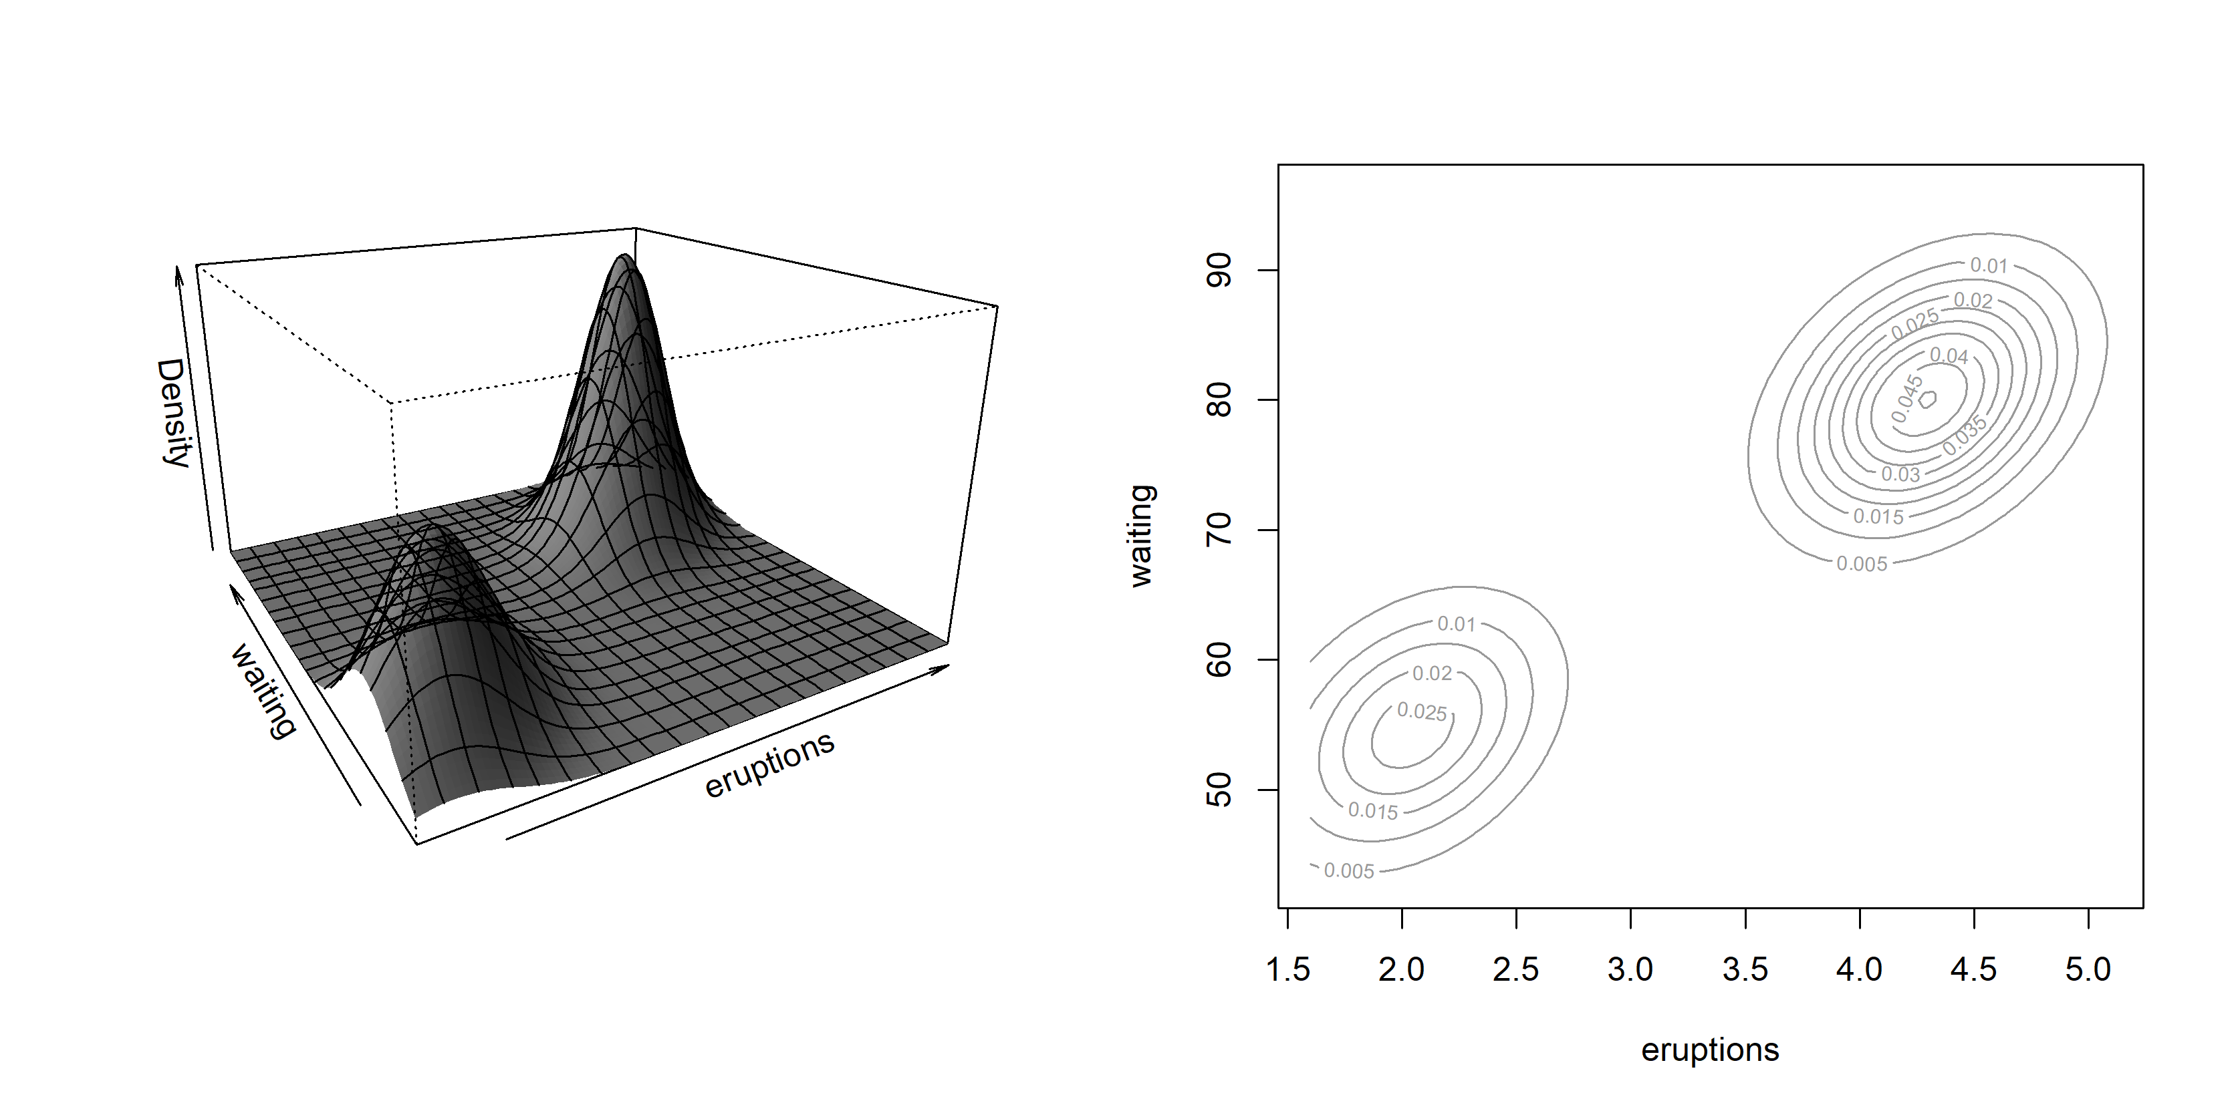

Multivariate model-based clustering
$$p\left(y\right| θ)=π_{1}^{X}MVN\left(μ_{1},Σ_{1}\right)+{(1 −π}_{1}^{X})MVN\left(μ_{2},Σ_{2}\right)$$

Slide 24
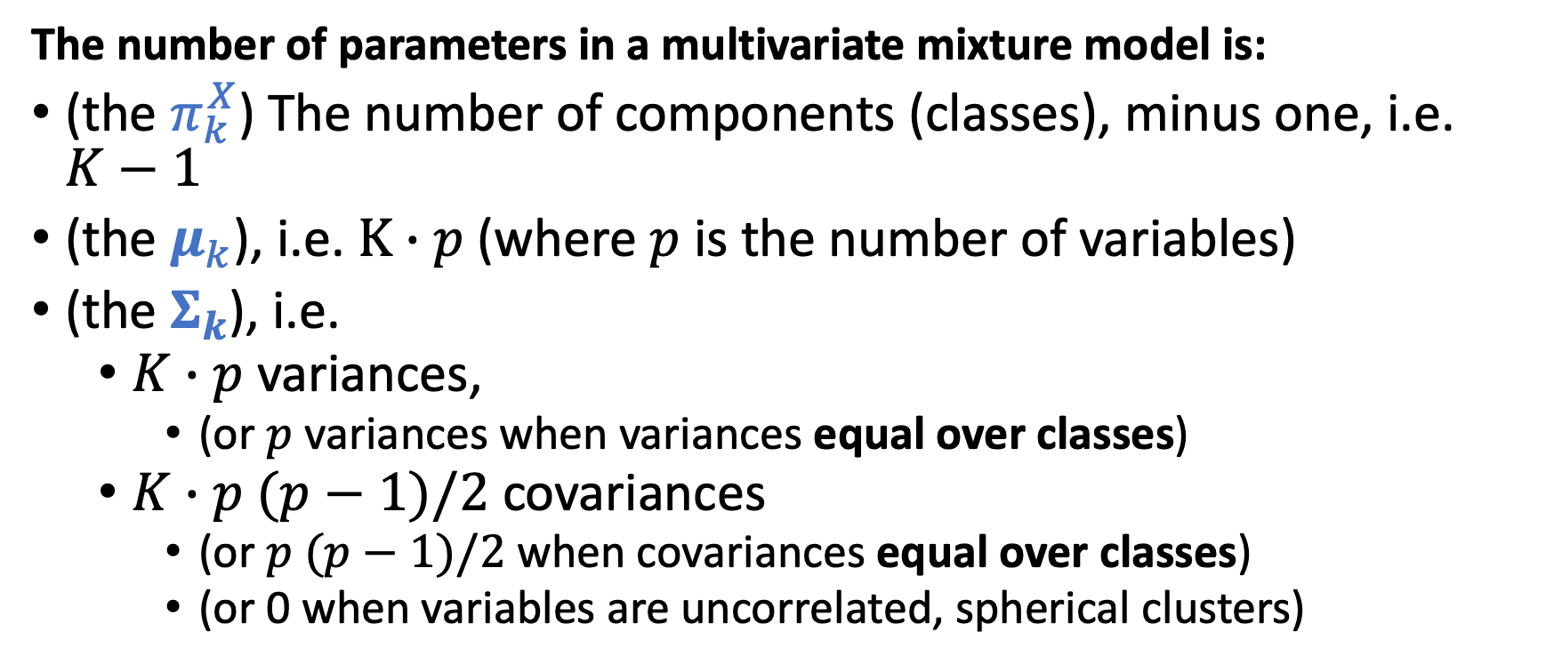
Number of parameters in a (multivariate) Gaussian mixture model
The number of parameters in a multivariate mixture model is:
(the $π_{k}^{X}$) The number of components (classes), minus one, i.e. $K−1$
(the $μ_{k}$), i.e. $K∙p$ (where $p$ is the number of variables)
(the $Σ_{k}$), i.e.
$K∙p$ variances,
(or $p$ variances when variances equal over classes)
$K∙p (p−1)/2$ covariances
(or $p (p−1)/2$ when covariances equal over classes)
(or 0 when variables are uncorrelated, spherical clusters)

Slide 25

Number of parameters
$$m=\left(K−1\right)+Kp+Kp+K\frac{p\left(p−1\right)}{2}$$
For example:
$K=3$
$p=2$
Ellipsoidal (correlated within cluster)
But: equal variances and covariance
$$m=\left(K−1\right)+Kp+p+\frac{p\left(p−1\right)}{2} \\ =2+3×2+2+1 \\ =11$$

Slide 26
Multivariate model-based clustering
Cluster shape parameters (the variance-covariance matrix) can be constrained to be equal across clusters
Can also be different across clusters
More flexible, complex model
Think: bias-variance tradeoff

Slide 27
How to evaluate clustering results
Use of external information
Visual exploration
Stability assessment / sensitivity analysis
Internal validation indexes
Testing for clustering structure
Much more info & helpful advice: Clustering strategy & method selection (ch 31 of Handbook of clustering), https://arxiv.org/pdf/1503.02059.pdf

Slide 28




Notes:
Tradeoff compression - accuracy

Slide 29
Notes:
Tradeoff compression - accuracy

Slide 30
More clusters gives better “fit” in terms of reconstruction of the image
(compression is less “lossy”)
More clusters gives bigger file size
(solution is more complex, takes more bytes to store)
So the model loss and model complexity trade off against each other
This is a common theme in (unsupervised) machine learning and you should remember this for model-based clustering lecture
Notes:
Tradeoff compression - accuracy

Slide 31
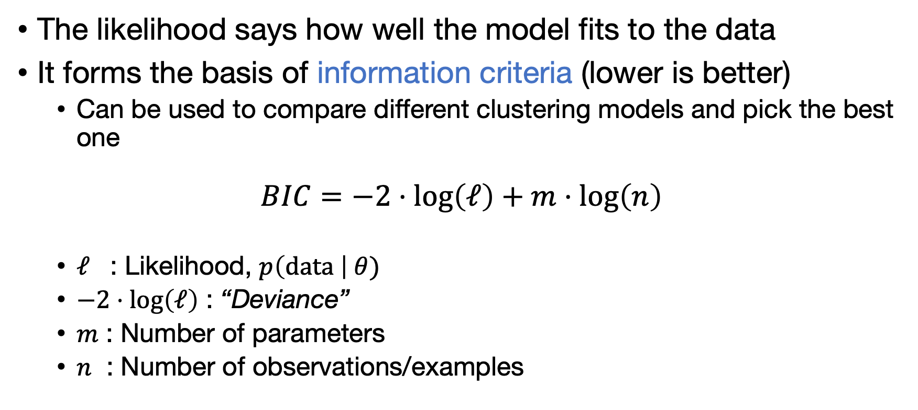
Model fit
The likelihood says how well the model fits to the data
It forms the basis of information criteria (lower is better)
Can be used to compare different clustering models and pick the best one
$$BIC=−2⋅log\left(ℓ\right)+m⋅log\left(n\right)$$
$ℓ$ : Likelihood, $p\left(\text{data} \right| θ)$
$−2⋅log\left(ℓ\right)$ : “Deviance”
$m$ : Number of parameters
$n$ : Number of observations/examples
Notes:
Why does one have to be negative and the other positive

Slide 32
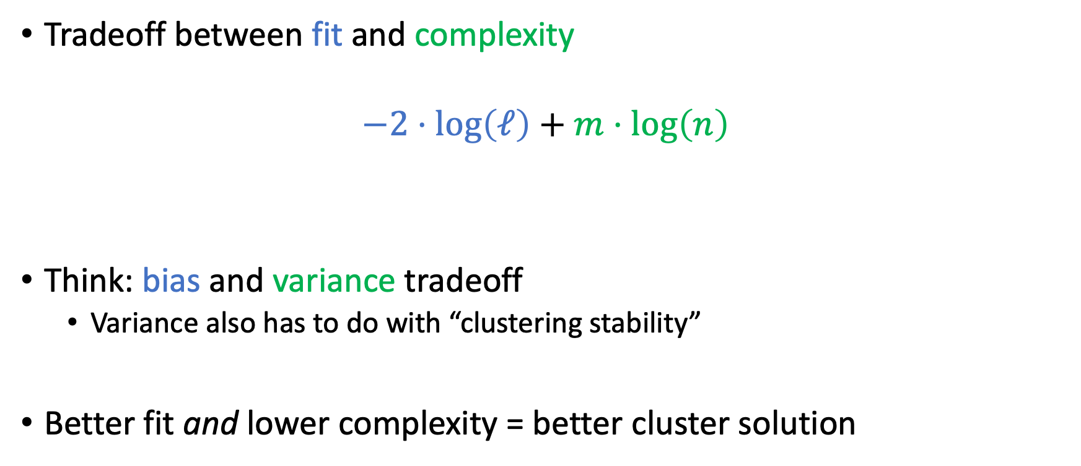
Model fit
Tradeoff between fit and complexity
$$−2⋅log\left(ℓ\right)+m⋅log\left(n\right)$$
Think: bias and variance tradeoff
Variance also has to do with “clustering stability”
Better fit and lower complexity = better cluster solution
“Training data fit”
“Model capacity”

Slide 33
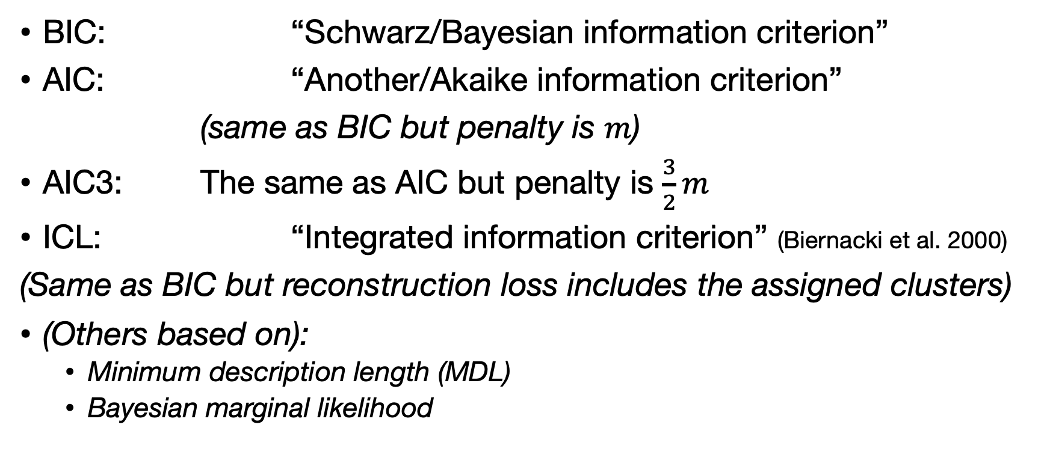
More model fit criteria
BIC: “Schwarz/Bayesian information criterion”
AIC: “Another/Akaike information criterion”
(same as BIC but penalty is $m$)
AIC3: The same as AIC but penalty is $\frac{3}{2}m$
ICL: “Integrated information criterion” (Biernacki et al. 2000)
(Same as BIC but reconstruction loss includes the assigned clusters)
(Others based on):
Minimum description length (MDL)
Bayesian marginal likelihood

Slide 34
Model-based clustering in R/Python
mclust implements multivariate model-based clustering
Provides an easy interface to fit several parameterizations
Model comparison with BIC
Plotting functionality
In Python: sklearn.mixture.GaussianMixture
> library(mclust)
__ ___________ __ _____________
/ |/ / ____/ / / / / / ___/_ __/
/ /|_/ / / / / / / / /\__ \ / /
/ / / / /___/ /___/ /_/ /___/ // /
/_/ /_/\____/_____/\____//____//_/ version 5.4.6

Slide 35
Model-based clustering in R
Mclust uses an identifier for each possible parametrization :
E for equal, V for variable, I for identity matrix:
Volume (size of the clusters in data space):
Shape (circle or ellipse)
Orientation (the angle of the ellipse)
E.g. an “EEE” model has equal volume, shape and orientation
A VVV model has variable volume, shape, and orientation
A VVE model has variable volume and shape but equal orientation

Slide 36
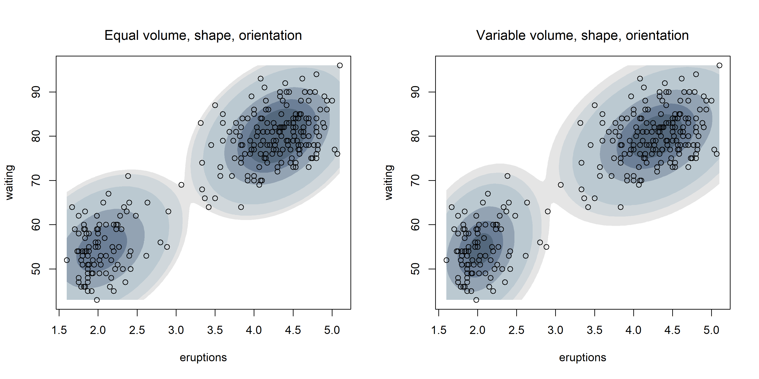
Model-based clustering in R: EEE vs. VVV

Slide 37
TOP SECRET SLIDE
K-MEANS IS A GMM WITH THE FOLLOWING MODEL:
All prior class proportions are 1/K;
EII model: equal volume, only circles;
All posteriors are either 0 or 1 (“classification likelihood”).

Slide 38
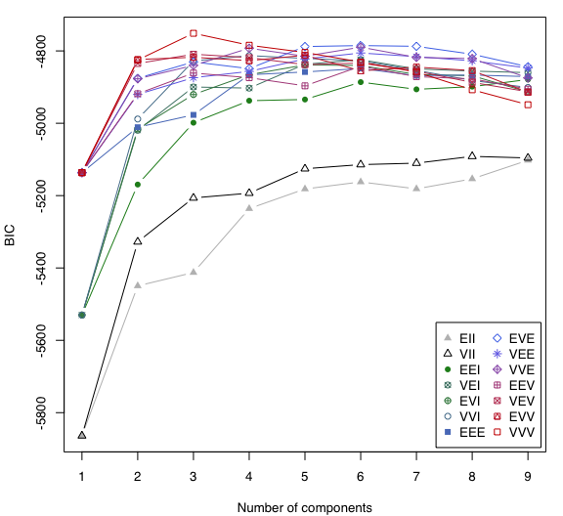
Model-based clustering in R
VVV, 3 clusters
How mclust optimizes hyperparameters:
Fit all the models with up to 9 clusters (or more, your choice!)
Compute the BIC (or ICL) of each model
Choose the model with the best BIC
R assignment: using mclust

Slide 39

Model selection using BIC for image example

Slide 40
> fit_mc <- Mclust(im_ar, G = 1:10)
fitting ...
|========================================================| 100%
> summary(fit_mc)
----------------------------------------------------
Gaussian finite mixture model fitted by EM algorithm
----------------------------------------------------
Mclust VVV (ellipsoidal, varying volume, shape, and orientation) model with 8 components:
log-likelihood n df BIC ICL
3808542 640000 79 7616028 7530927
Clustering table:
1 2 3 4 5 6 7 8
151032 48661 155542 34602 82621 49494 41665 76383

Slide 41
Merging components to get clusters
GMM obviously has trouble with clusters that are not ellipses
Secret weapon: merging
Powerful idea:
Start out with the usual Gaussian mixture solution;
merge “similar” components to create non-Gaussian clusters.
Note: we’re distinguishing “components” from “clusters” now.

Slide 42
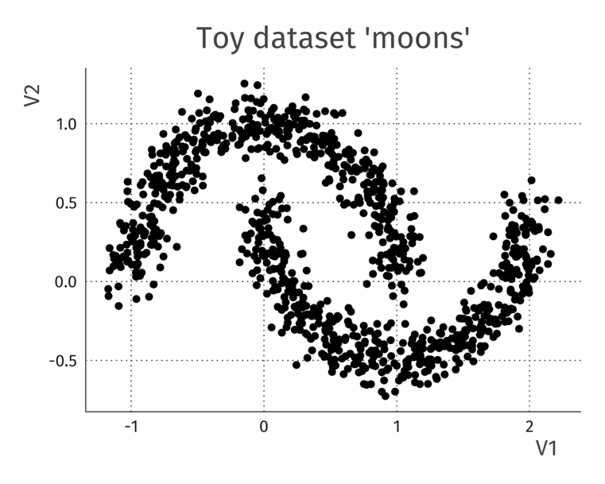
Merging components to get clusters
library(mclust)
output <- clustCombi(data = x)
plot(output)

Slide 52
Clustering other types of things

Slide 53
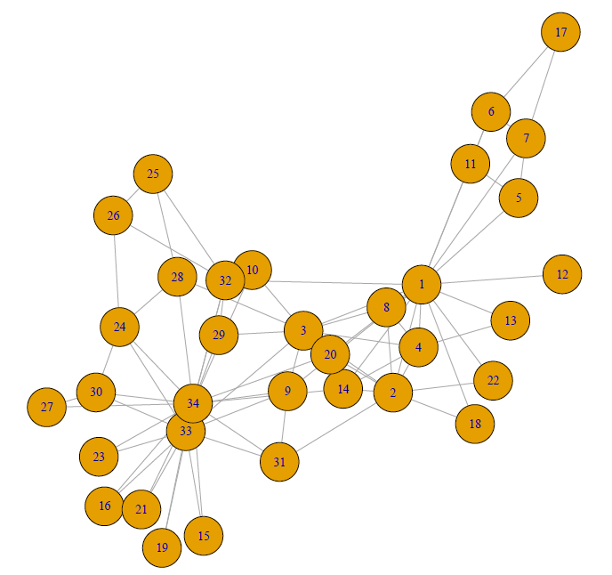
Network data: Karate club
(Zachary, 1977)

Slide 54
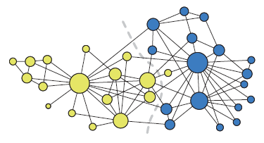
Karate club “stochastic block model”
(Karrer & Newman 2010)

Slide 55
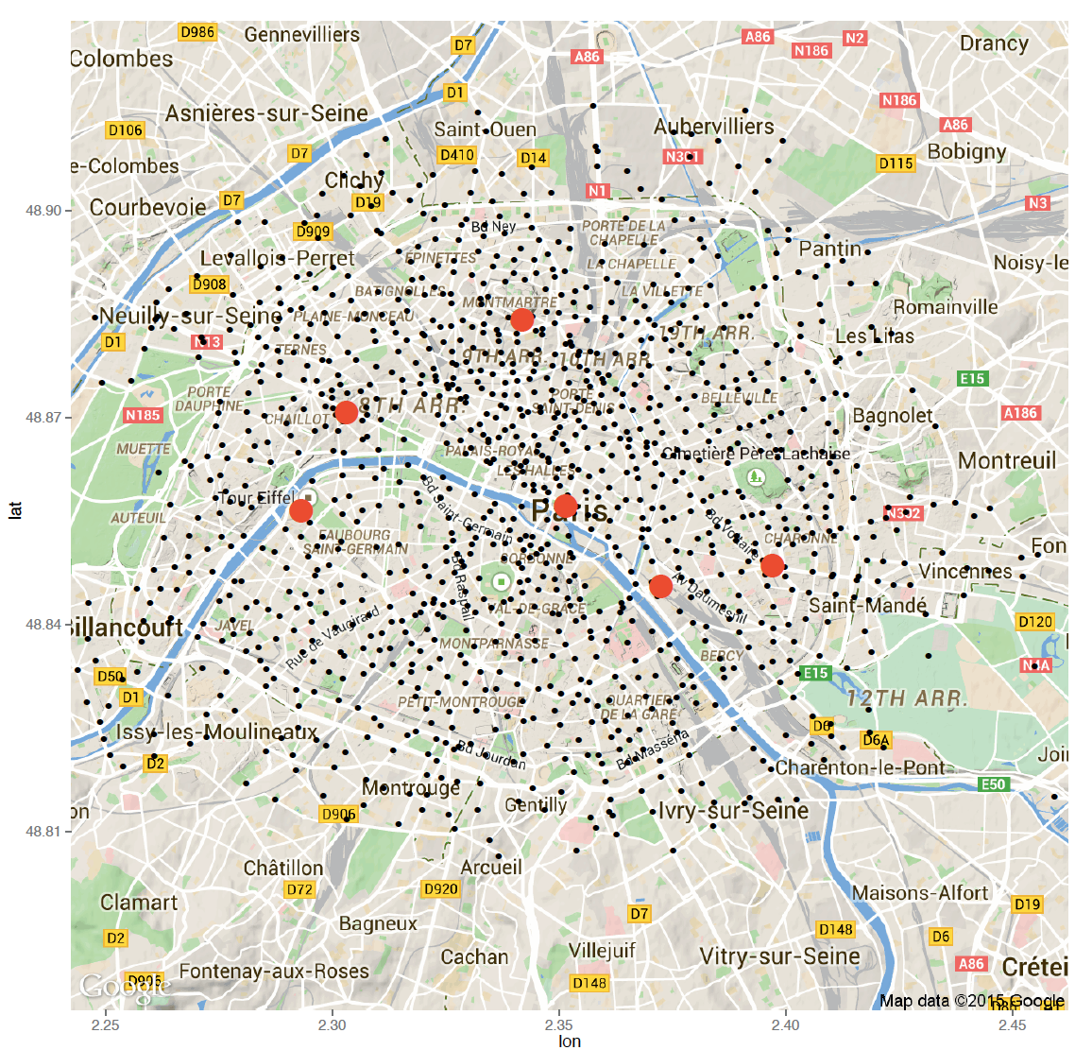

Slide 56
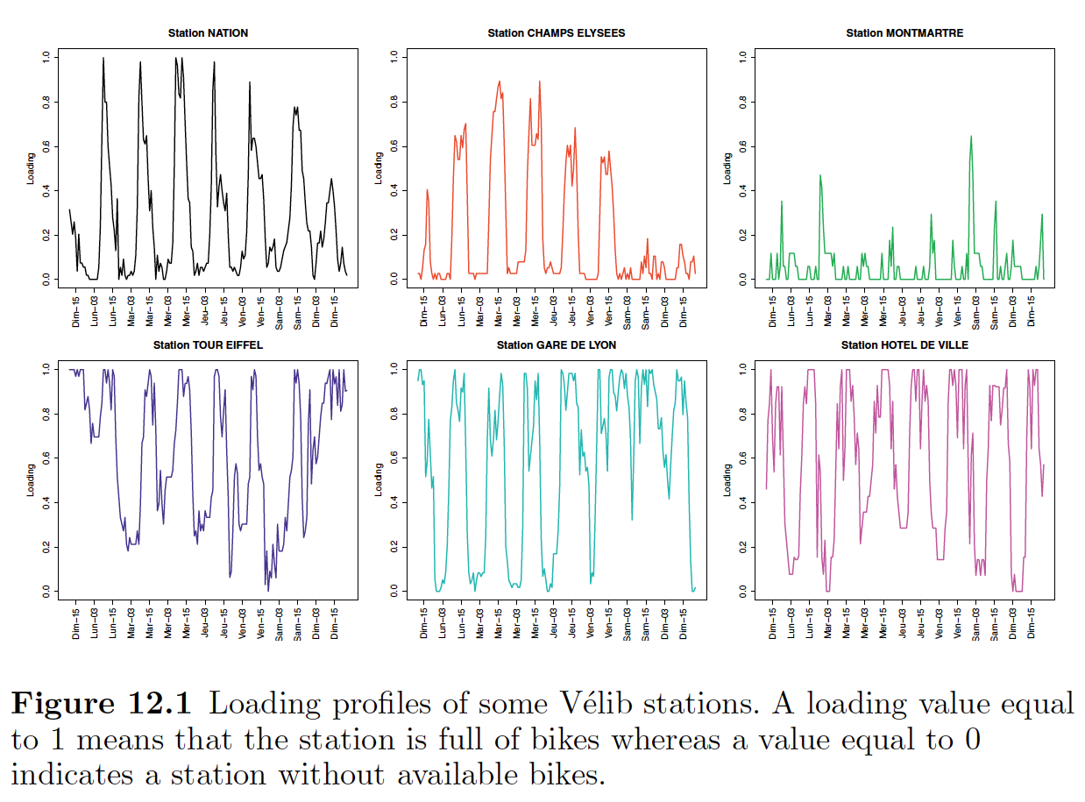
Bouveyron et al. 2018

Slide 57
“functional data” clustering in R
# Loading libraries and data
library(funFEM)
data(velib)
# Transformation of the raw data as curves
basis = create.fourier.basis(c(0, 181) , nbasis =25)
fdobj = smooth.basis (1:181 ,t(velib$data),basis)$fd
# Clustering with funFEM
res = funFEM(fdobj ,K=6)

Slide 58
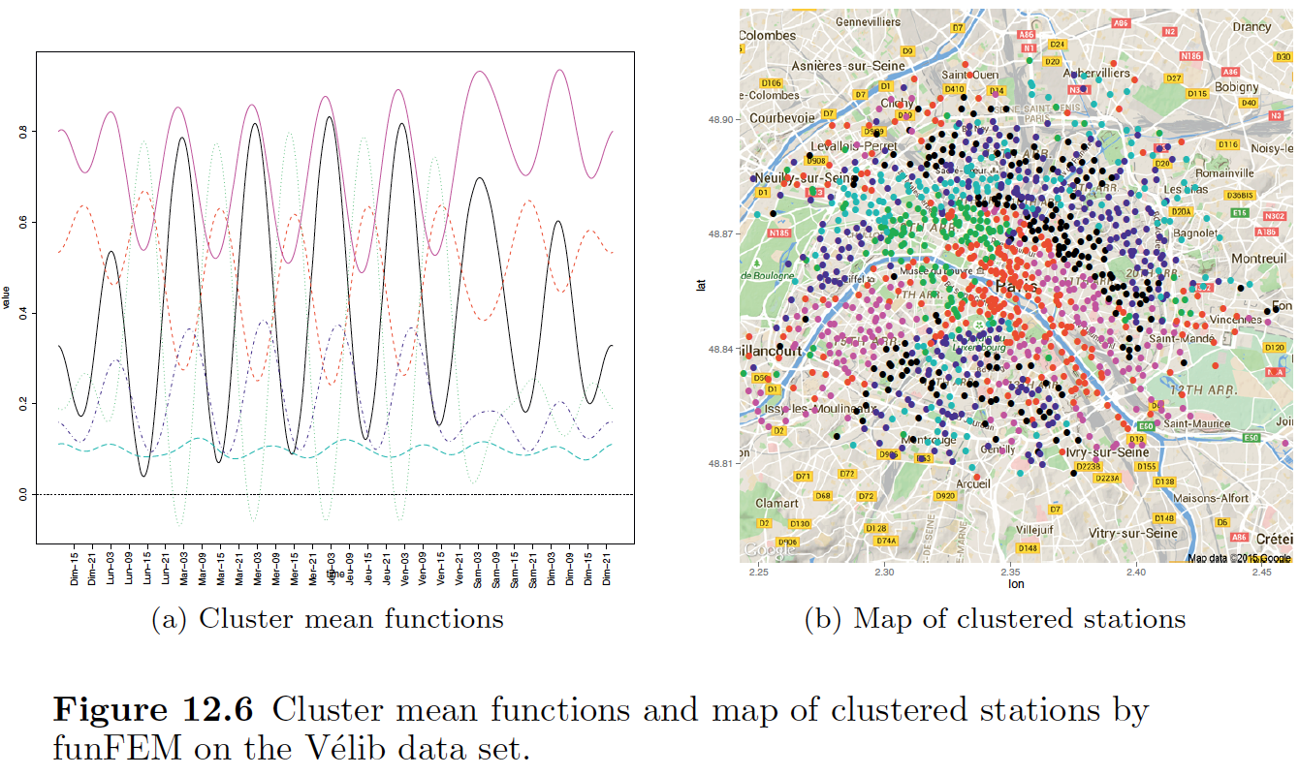

Slide 59
Conclusion
Model-based clustering:
Pretend we believe in a model;
Estimate the model.
Algorithm is defined by the model;
Easy to think about assumptions;
Flexible in using other data types;
Common model: GMM (implementation mclust in R);
Secret weapon: component merging.

