Slide 1
Data Wrangling and Data Analysis
Text mining #1
DL Oberski
Department of Methodology & Statistics
Utrecht University
Notes:
Bouveyron ch 6 and 8
Other criteria
Merging
Other data types
Model-based vs. not
Posterior probabilities
Omgaan met noise

Slide 2
This week
Day 1: Clustering #2: Model-based clustering
Day 2: Text mining #1
Day 3: Text mining #2

Slide 3
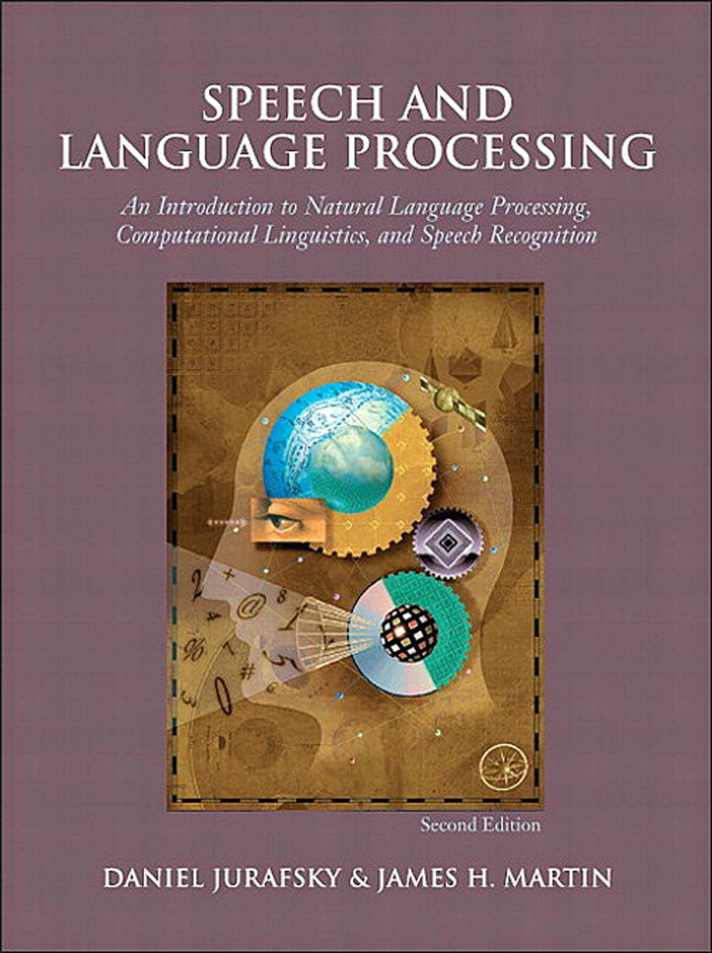
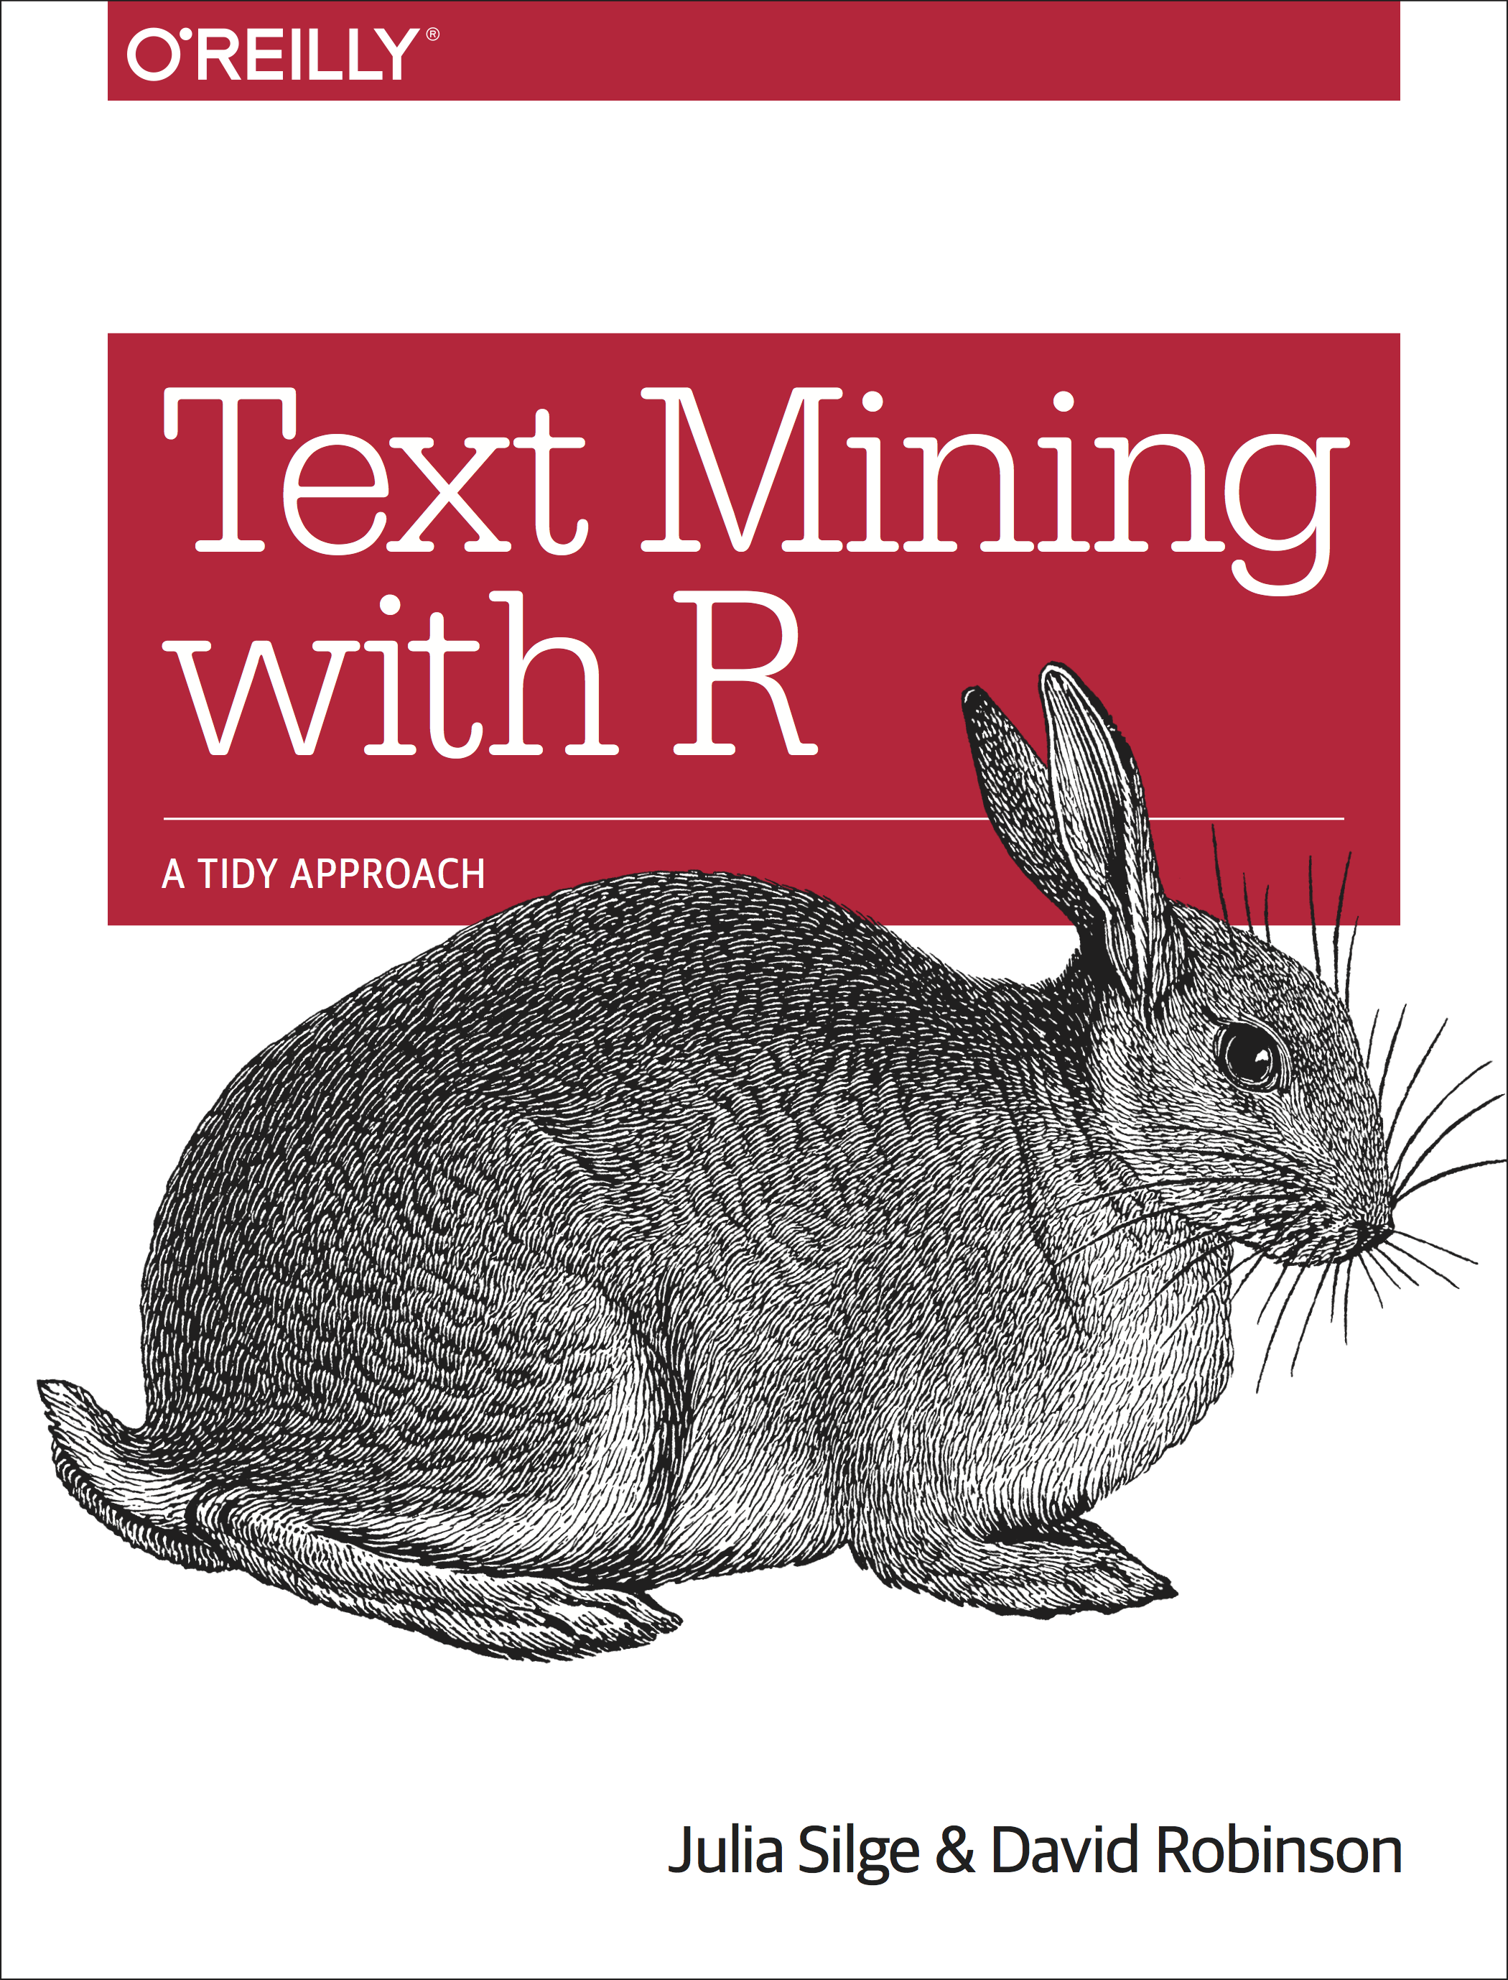
Readings about text mining
Jurafsky & Martin (2021). Speech and language processing (3rd ed draft) https://web.stanford.edu/~jurafsky/slp3/
Sections
2.1, 2.4, (regular expressions)
6.2, 6.3, 6.4, 6.5, 6.8
Silge & Robinson (2021). Text mining with R: A tidy approach. https://www.tidytextmining.com/
Chapter 3
More accessible (?) intro to regular expressions:
R4 data science ch. 14
https://r4ds.had.co.nz/strings.html#matching-patterns-with-regular-expressions
3rd EDITION

Slide 4
Why learn text mining
Text data is everywhere:
websites (e.g., news), social media (e.g., twitter), databases (e.g., doctors’ notes), digital scans of printed materials, …
Applications in industry: search, machine translation, sentiment analysis, question answering, …
Applications in science: cognitive modelling, understanding bias in language, automated systematic literature reviews, …

Slide 5
Regular expressions

Slide 6
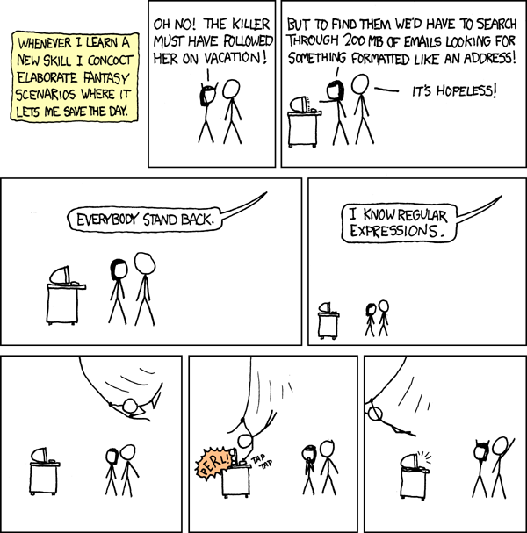
http://xkcd.com/208/

Slide 7
Regular expressions (regex)
Powerful and very very useful tool for text (pre)processing
Used in pretty much every pipeline involving text
Typical applications:
Extracting numbers, emails, IP-addresses, etc.
Validating text inputs in GUIs
Reformatting annoying incorrect dates (everything not yyyy-mm-dd)
Scrubbing names and addresses for pseudonimization
Powerful: e.g. J&M implement (part of) ELIZA (see link) in regex!
Cryptic & takes a lot of practice!

Slide 8
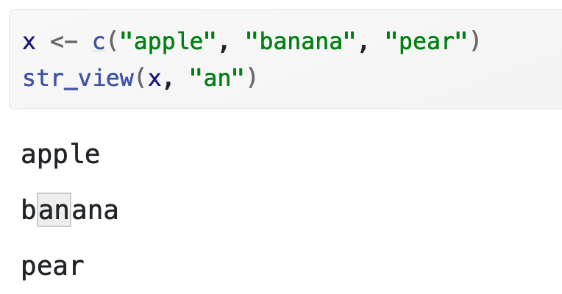
Basic matching using stringr

Slide 9
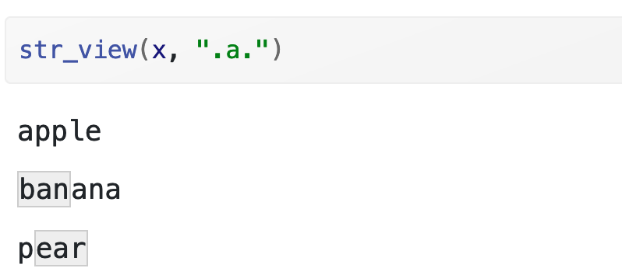
Basic matching
. matches any character

Slide 10
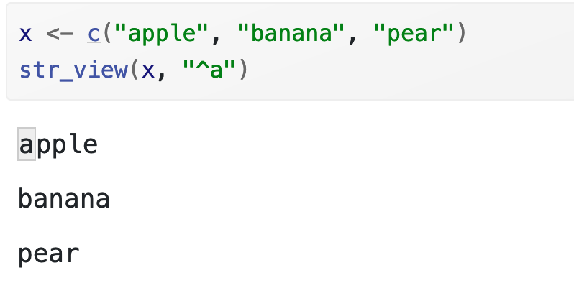
Anchors
By default, regular expressions will match any part of a string. It’s often useful to anchor the regular expression so that it matches from the start or end of the string. You can use:
^ to match the start of the string.
$ to match the end of the string.

Slide 11
Game
Match the word “monarch”
Match all 8-letter words
Barbados is moving from a parliamentary constitutional monarchy under the hereditary monarch of Barbados (currently Queen Elizabeth II) to a parliamentary republic with a ceremonial elected president as head of state.

Slide 12
Examples
Regex | Matches any string that
hello | contains {hello}
gray|grey | contains {gray, grey}
gr(a|e)y | contains {gray, grey}
gr[ae]y | contains {gray, grey}
b[aeiou]bble | contains {babble, bebble, bibble, bobble, bubble}
[b-chm-pP]at|ot | contains {bat, cat, hat, mat, nat, oat, pat, Pat, ot}
colou?r | contains {color, colour}

Slide 13
More complicated examples
Regex | Matches any string that
\d | contains {0,1,2,3,4,5,6,7,8,9}
1\d{10} | contains an 11-digit string starting with a 1
\d+(\.\d\d)? | contains a positive integer or a floating point number with exactly two characters after the decimal point.
^dog | begins with "dog"
dog$ | ends with "dog"
^dog$ | is exactly "dog"

Slide 14
Matching and Extracting Data
The function str_detect() returns a True/False depending on whether the string matches the regular expression
If we actually want the matching strings to be extracted, we use str_extract()
> library(stringr)
> s = 'My 2 favorite numbers are 19 and 42'
> str_extract_all(s, '[0-9]+')
[[1]]
[1] "2" "19" "42"
[0-9]+
One or more digits

Slide 15
Regular expression conclusion
You have now heard of regular expressions
And might have a basic idea of what you might do with them
The only way to really learn, however, is practice
Read the set texts (J&M ch 2 and/or R4DS ch 14)
Next time you encounter some text you need to work on think “can I do this using regular expressions?”
The answer is probably “yes”.

Slide 16
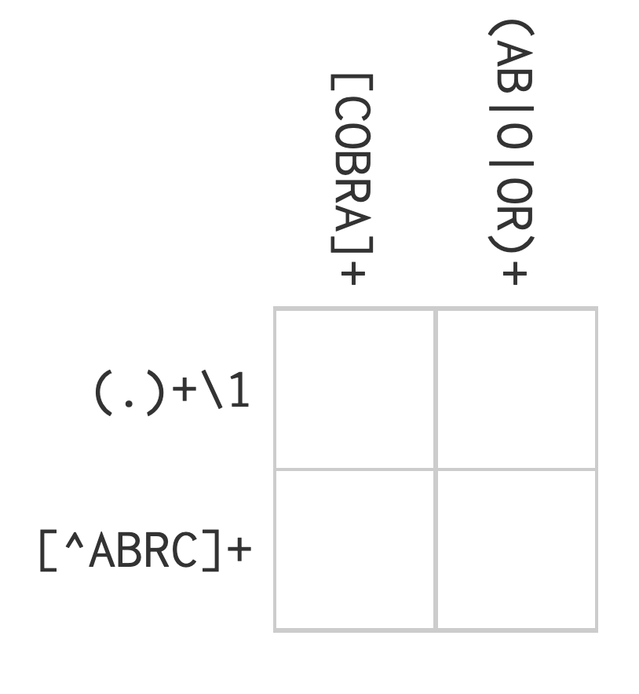
Challenge problem: regex crossword

Slide 17
Character classes and alternatives
Special patterns that match more than one character:
\d: matches any digit.
\s: matches any whitespace (e.g. space, tab, newline).
[abc]: matches a, b, or c.
[a-z]:matches lowercase a through z
[A-Z]:matches uppercase A through Z
[^abc]: matches anything except a, b, or c.
(To create a regular expression containing \d or \s, you’ll need to escape the \ for the string, so you’ll type "\\d" or "\\s".)

Slide 18
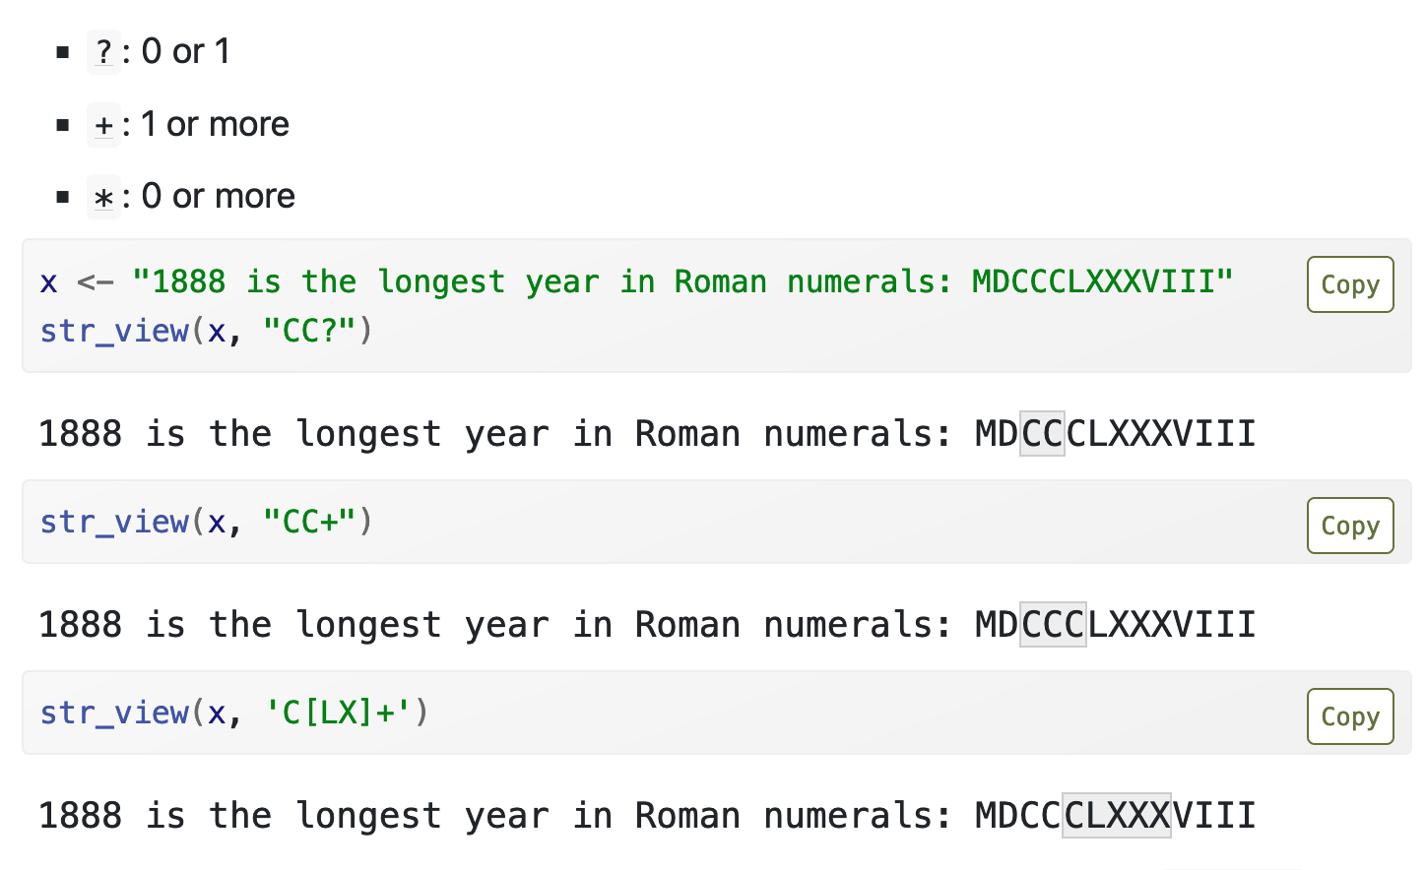
Repetition

Slide 19
Regular Expression Quick Guide
^ Matches the beginning of a line
$ Matches the end of the line
. Matches any character
\s Matches whitespace
\S Matches any non-whitespace character
* Repeats a character zero or more times
*? Repeats a character zero or more times (non-greedy)
+ Repeats a chracter one or more times
+? Repeats a character one or more times (non-greedy)
[aeiou] Matches a single character in the listed set
[^XYZ] Matches a single character not in the listed set
[a-z0-9] The set of characters can include a range
( Indicates where string extraction is to start
) Indicates where string extraction is to end
Source: Charles Severance

Slide 20
Wild-Card Characters
The dot character matches any character
If you add the asterisk character, the character is "any number of times"
X-Sieve: CMU Sieve 2.3
X-DSPAM-Result: Innocent
X-DSPAM-Confidence: 0.8475
X-Content-Type-Message-Body: text/plain
^X.*:

Slide 21
Wild-Card Characters
The dot character matches any character
If you add the asterisk character, the character is "any number of times"
Match the start of the line
Many times
X-Sieve: CMU Sieve 2.3
X-DSPAM-Result: Innocent
X-DSPAM-Confidence: 0.8475
X-Content-Type-Message-Body: text/plain
^X.*:
Match any character

Slide 22
Fine-Tuning Your Match
Depending on how "clean" your data is and the purpose of your application, you may want to narrow your match down a bit
Match the start of the line
Many times
X-Sieve: CMU Sieve 2.3
X-DSPAM-Result: Innocent
X-Plane is behind schedule: two weeks
^X.*:
Match any character

Slide 23
Fine-Tuning Your Match
Depending on how "clean" your data is and the purpose of your application, you may want to narrow your match down a bit
One or more times
Match the start of the line
X-Sieve: CMU Sieve 2.3
X-DSPAM-Result: Innocent
X-Plane is behind schedule: two weeks
^X-\S+:
Match any non-whitespace character

