Slide 1
Data Wrangling and Data Analysis
Text mining #2
Sentiment analysis & Embeddings
DL Oberski
With slides by Dr. Dong Nguyen
Dept of Computing Sciences
Utrecht University
Dept of Methodology & Statistics
Utrecht University
Notes:
Bouveyron ch 6 and 8
Other criteria
Merging
Other data types
Model-based vs. not
Posterior probabilities
Omgaan met noise

Slide 2
This week
Day 1: Clustering #2: Model-based clustering
Day 2: Text mining #1: regular expressions, BoW, TF-IDF
Day 3: Text mining #2: sentiment analysis, embeddings

Slide 3
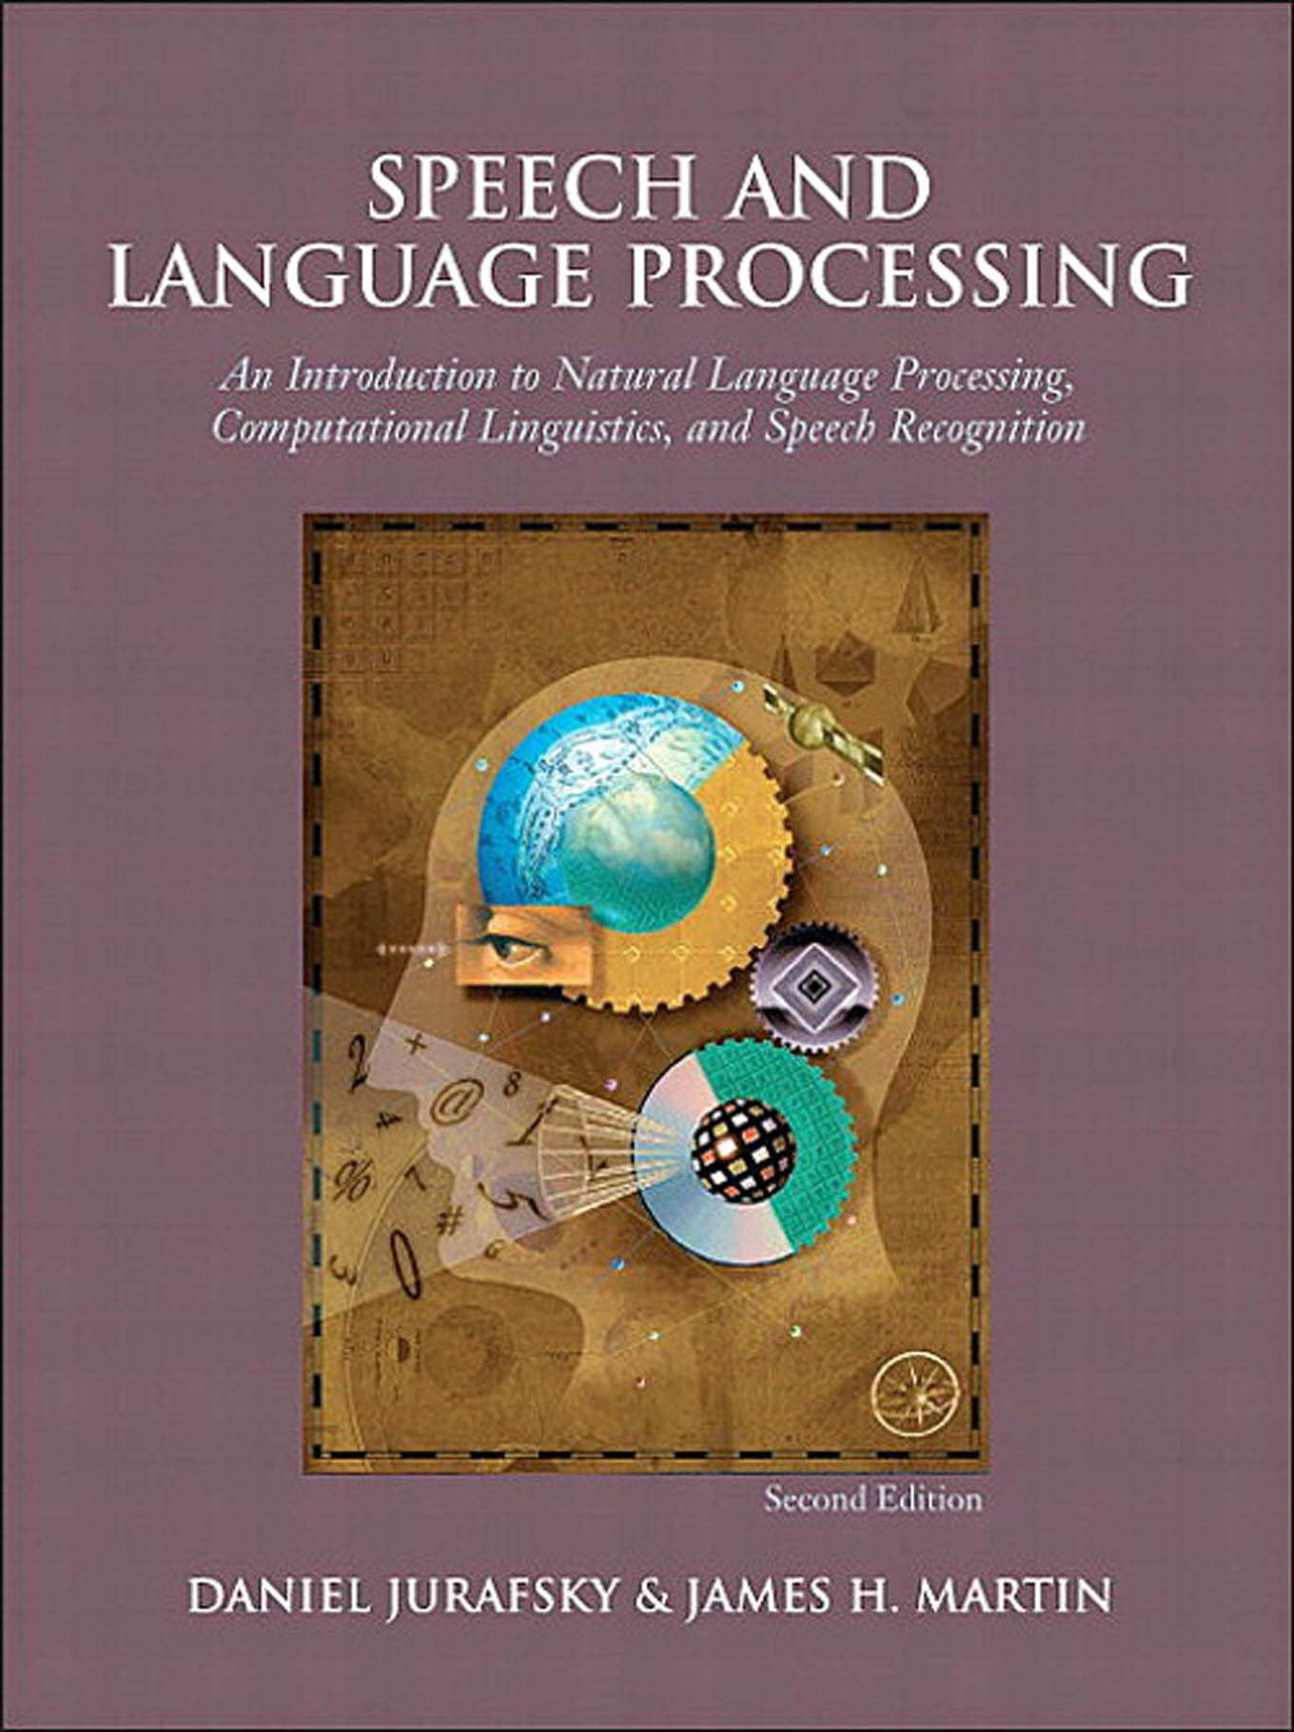

Readings about text mining
Jurafsky & Martin (2021). Speech and language processing (3rd ed draft) https://web.stanford.edu/~jurafsky/slp3/
Sections
2.1, 2.4, (regular expressions)
6.2, 6.3, 6.4, 6.5, 6.8
Silge & Robinson (2021). Text mining with R: A tidy approach. https://www.tidytextmining.com/
Chapter 3
More accessible (?) intro to regular expressions:
R4 data science ch. 14
https://r4ds.had.co.nz/strings.html#matching-patterns-with-regular-expressions
3rd EDITION

Slide 4
Sentiment analysis
“task of classifying the polarity of a given text.”
Classify the following Google reviews of UU into
☺, 😐, or ☹:
“Great university and great campus”
“Overrated university. The facilities for the humanities studies are severely outdated and really poor quality.”
“Good school but hideous building”

Slide 5
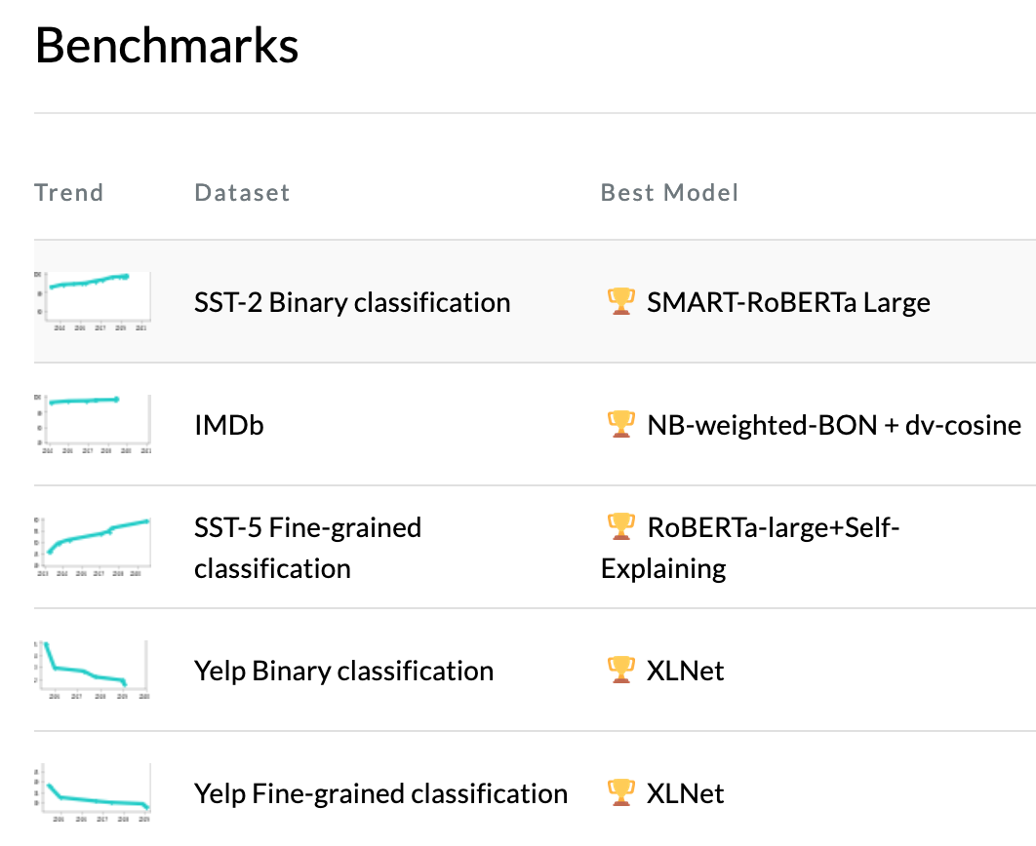
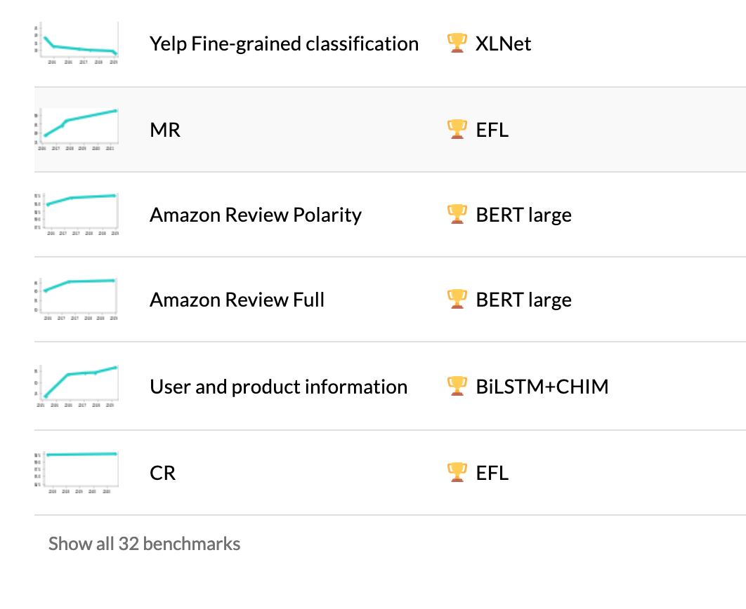
https://paperswithcode.com/task/sentiment-analysis

Slide 6
Old-school sentiment analysis
Algorithm. Start with a list of “positive” words and “negative” words, the “lexicon”. Then count them.
Sentiment = Total no. positive words − Total no. negative words.
Popular lexicons are: LIWC, FINN, bing, NRC, …
Tidytext has AFINN, bing, and nrc
There are also domain-specific sentiment lexicons, and lexicons for languages that are not English

Slide 7
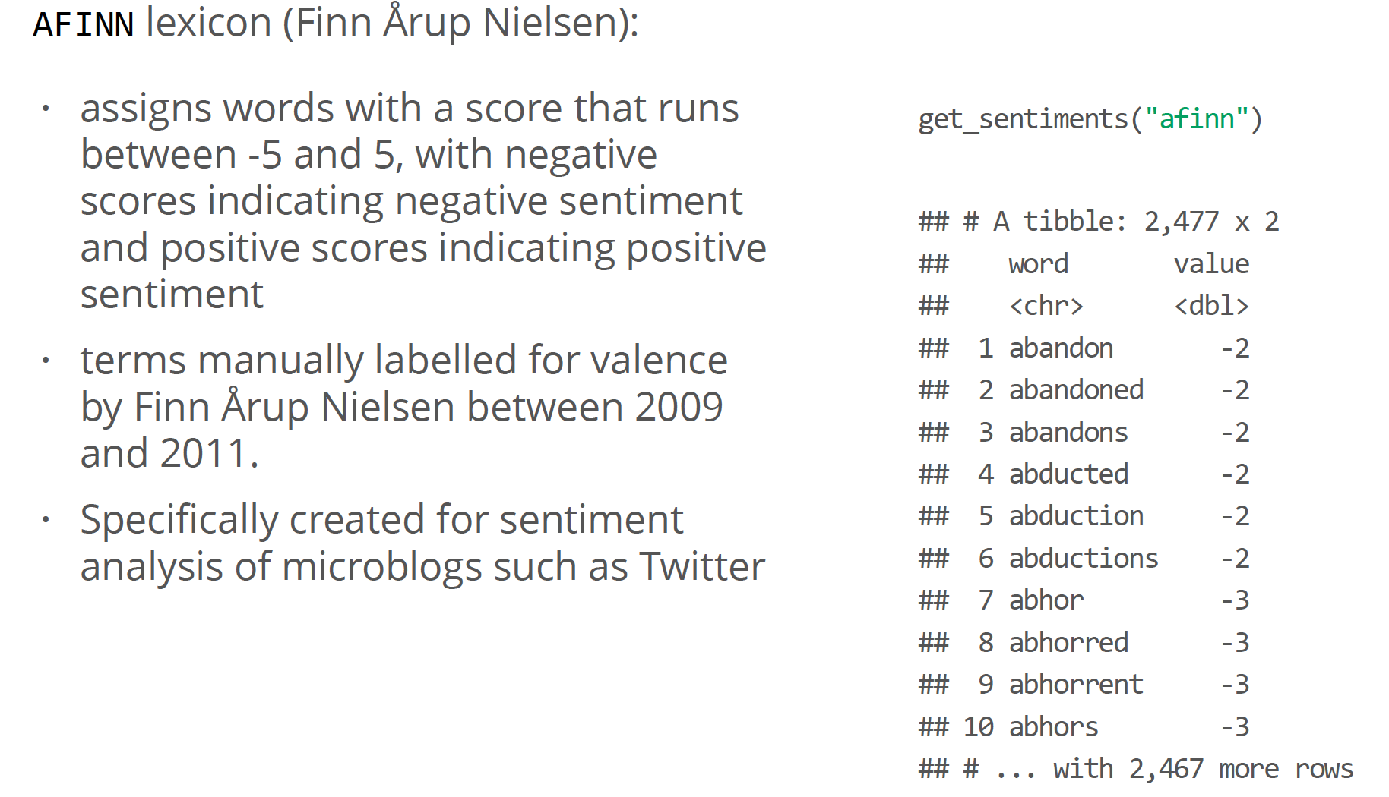
Old-school sentiment analysis

Slide 8
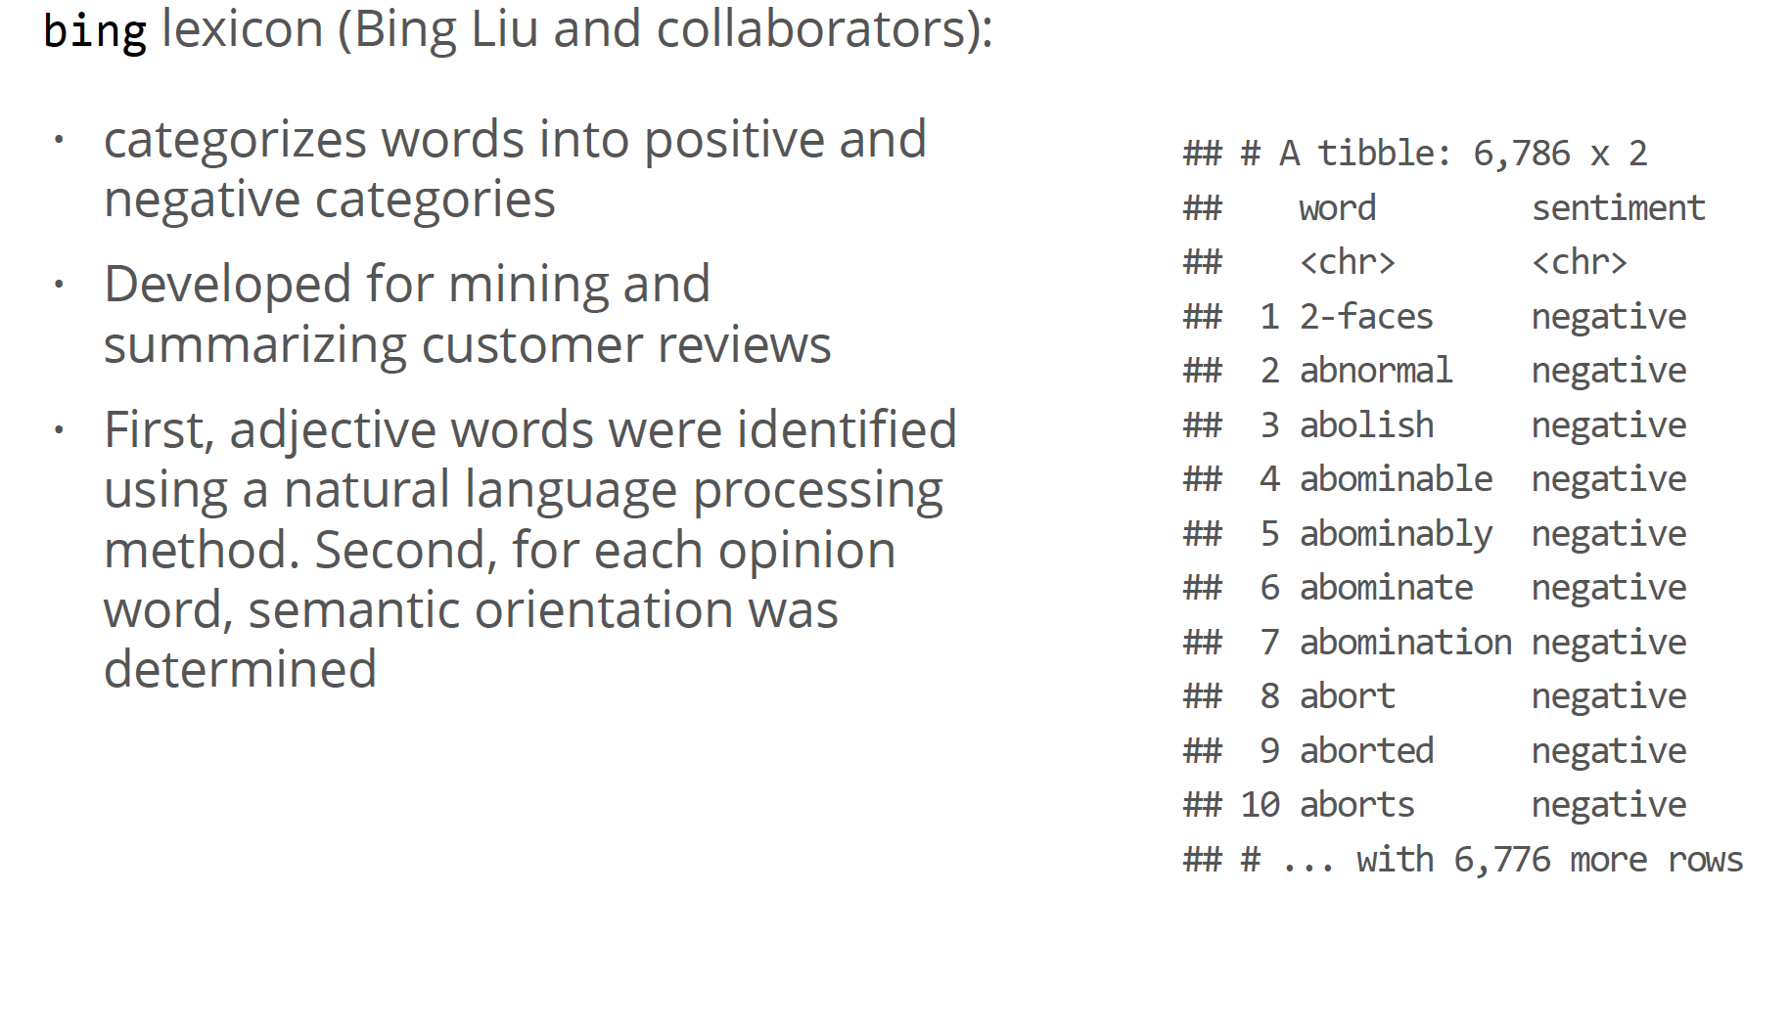
Old-school sentiment analysis

Slide 9
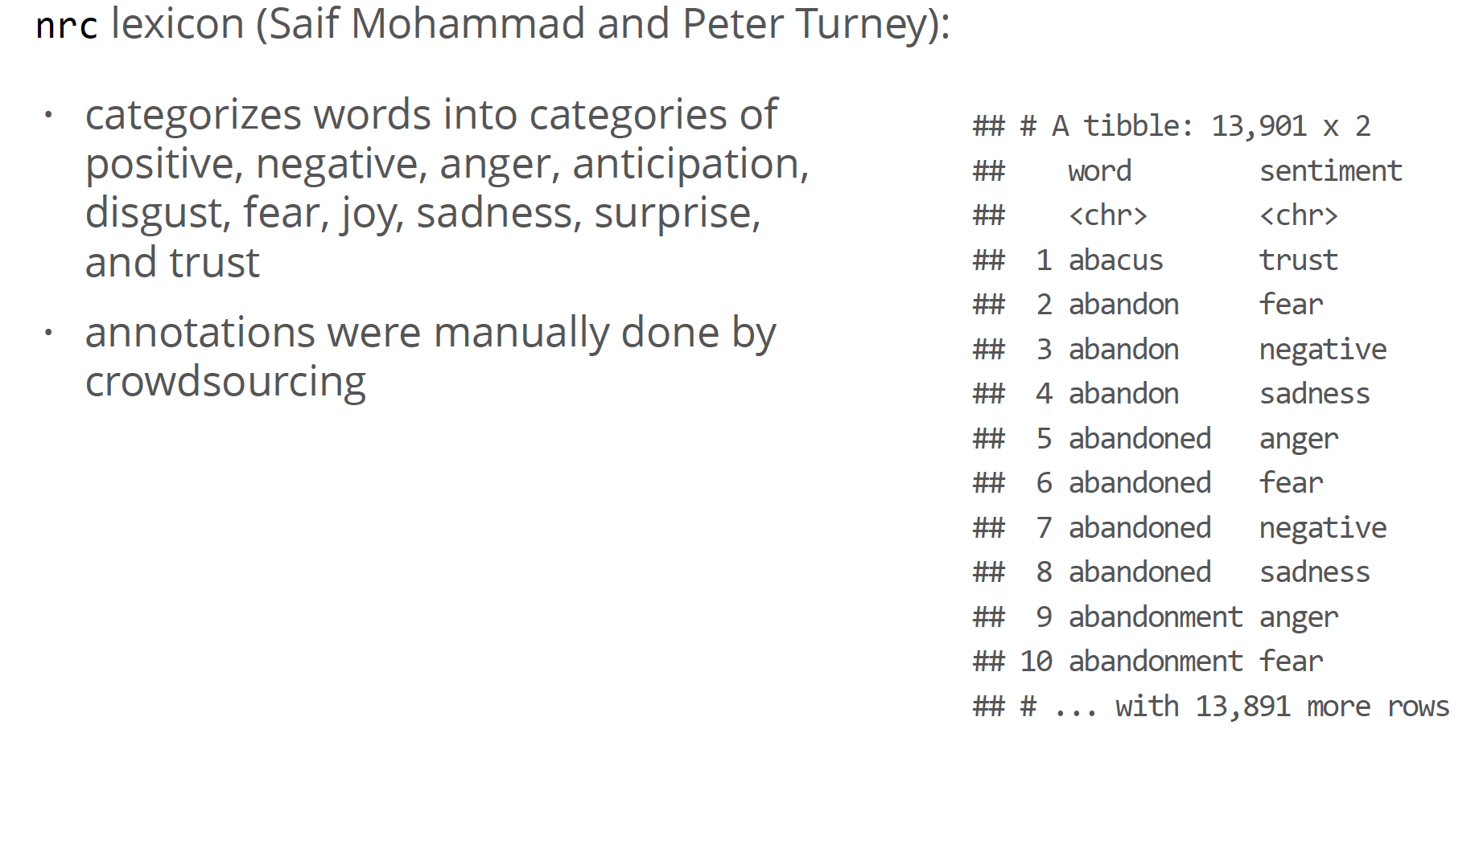
Old-school sentiment analysis

Slide 10
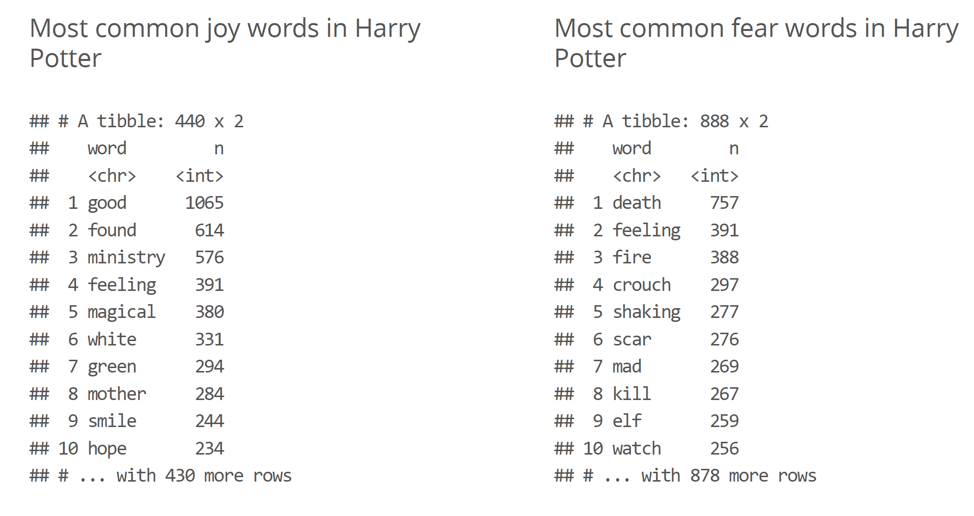
Example using NRC

Slide 11
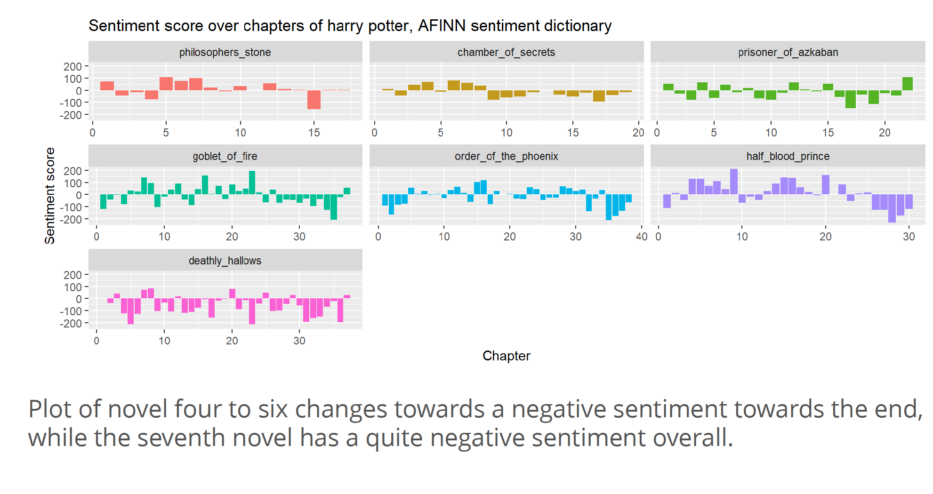
Example AFINN

Slide 12
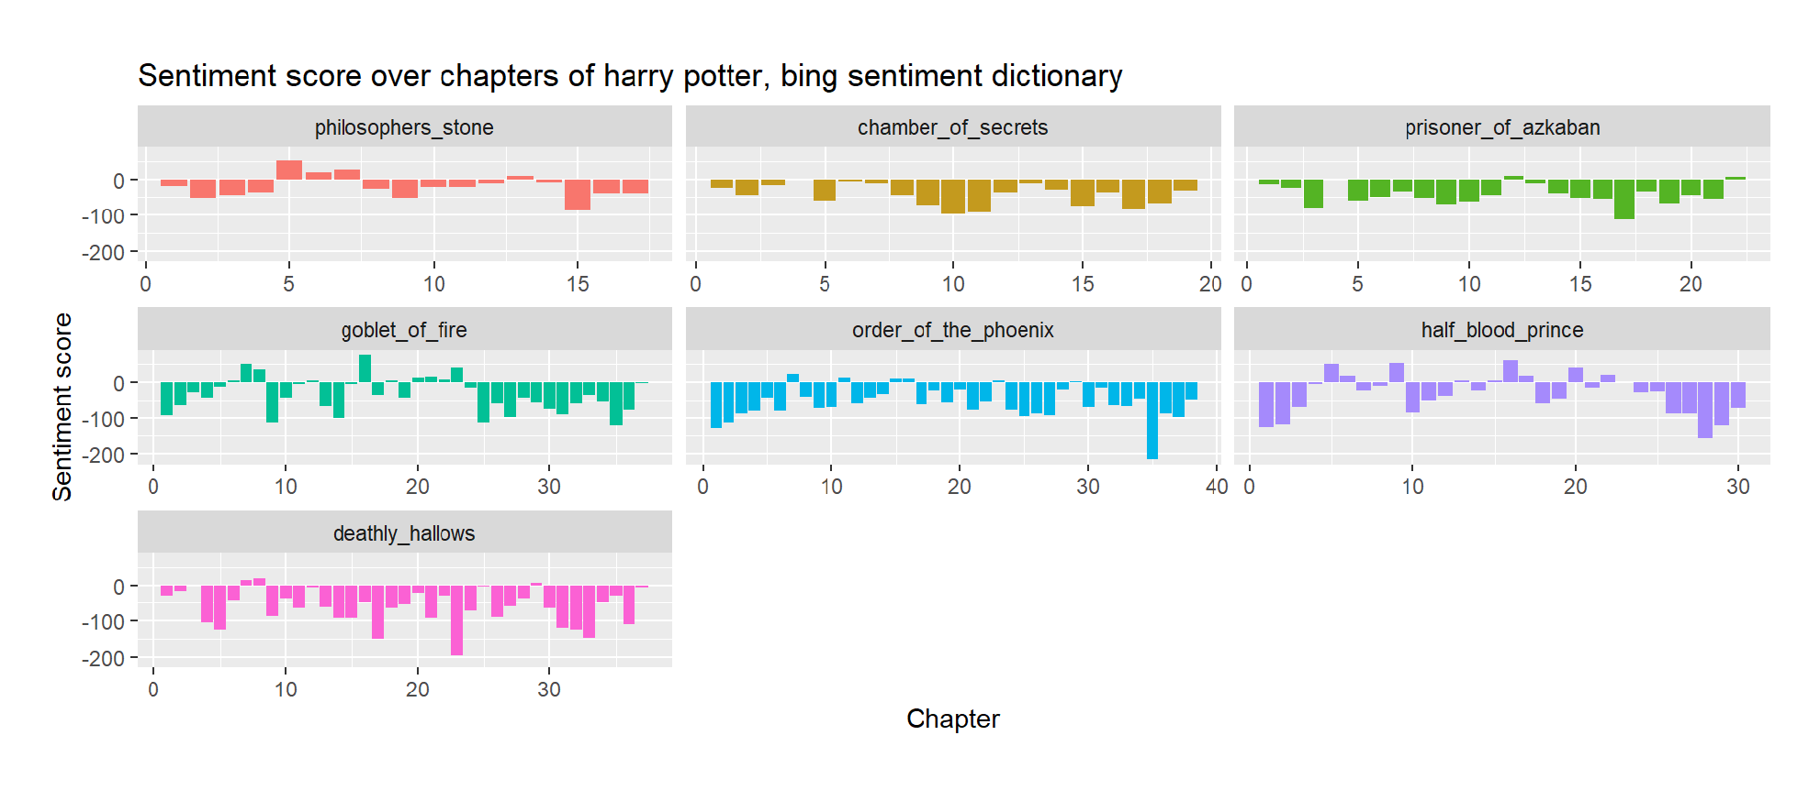
Example AFINN

Slide 13
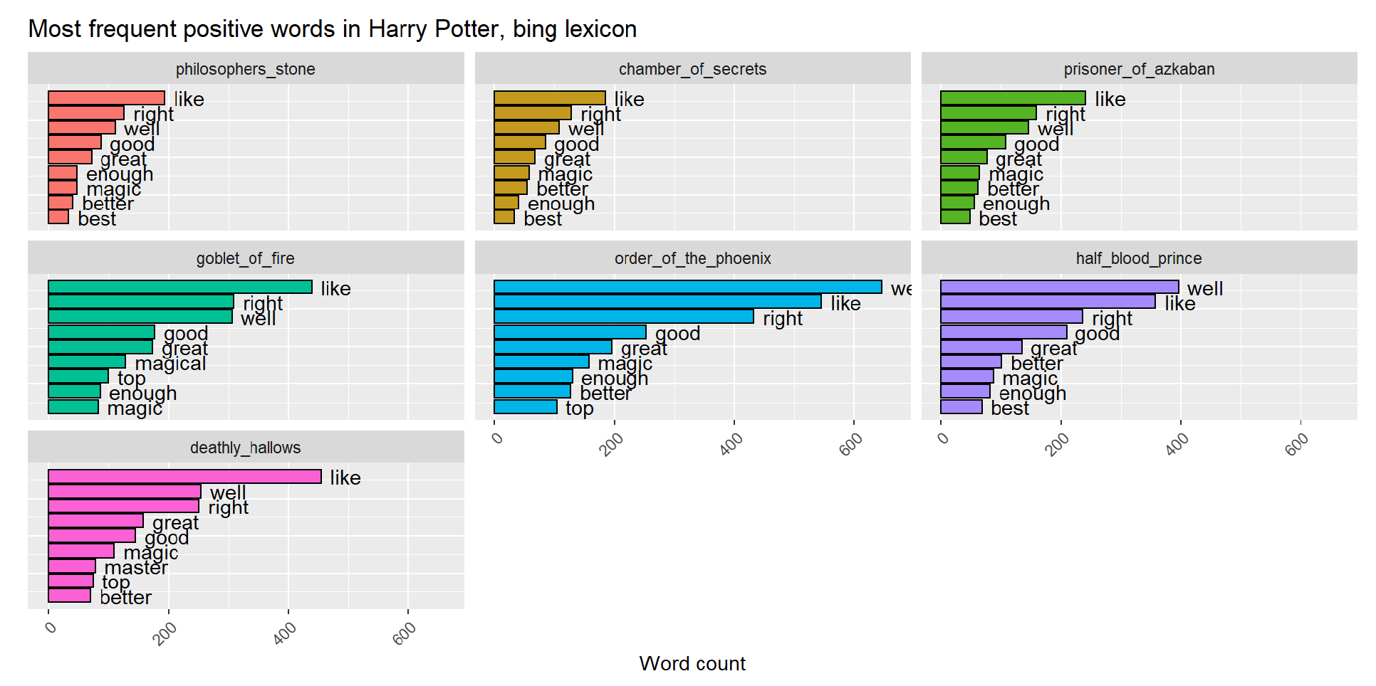

Slide 14
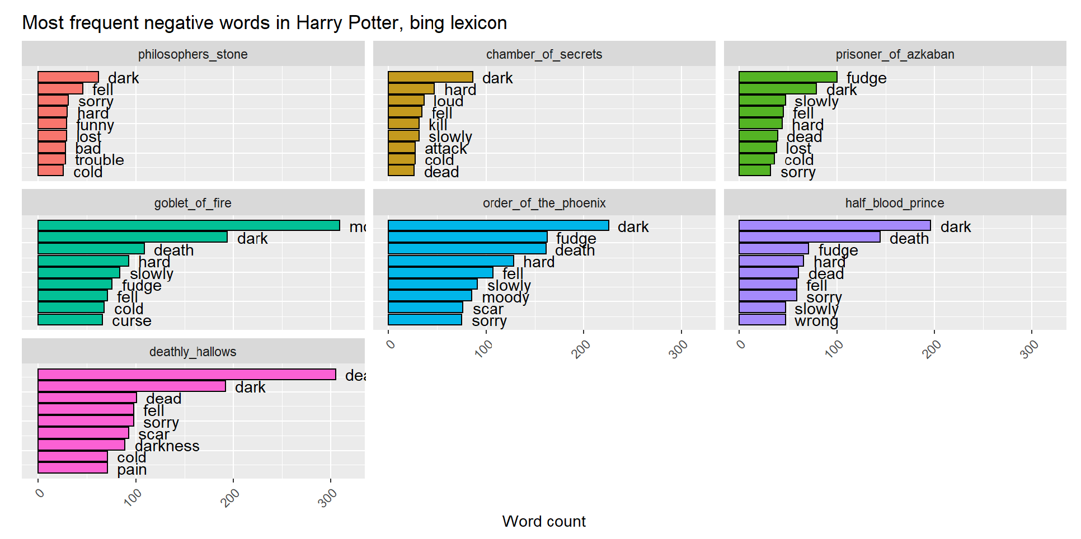

Slide 15
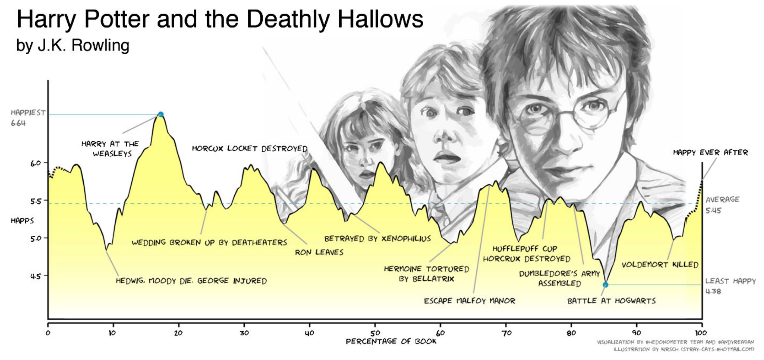
Reagan et al. (2016). The emotional arcs of stories are dominated by six basic shapes.
http://doi.org/10.1140/epjds/s13688-016-0093-1

Slide 16
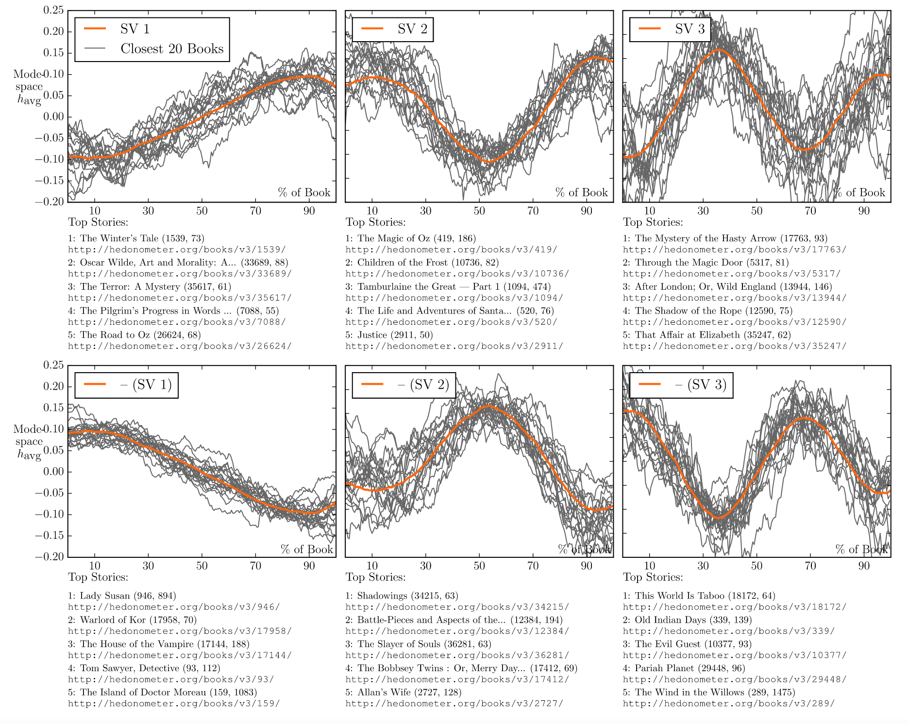

Slide 17
Sentiment analysis
The “old-school” (lexicon-based) method is not great with:
Longer texts (why?)
Negation
Context-dependency in general
You can also just consider this a classification task, where the input data is the text and the target is categorical
Could use BoW and TF-IDF, sometimes better
Sometimes BoW similar problems as lexicon-based method
Big disadvantage is that you will need (partly) labeled data

Slide 18
Word embeddings
based on slides by dr. Dong Nguyen

Slide 19
Conclusion
Lexicon-based sentiment analysis: just count ”positive” and “negative” words;
Embeddings are SotA for many NLP tasks, including (but not limited to!) sentiment analysis;
Key idea is the “distributional hypothesis”: “you will know a word by the company it keeps”;
→ Map each word into a low-dimensional vector space
Or, in English: assign a bunch of numbers to each word, in such a way that “similar” words are closer together;
Very fast-moving field.

