Slide 1
Data Wrangling and Data Analysis
Time Series and Demand Forecasting
Hakim Qahtan
Department of Information and Computing Sciences
Utrecht University

Slide 2
Topics for Today
Time Series Analysis
Demand Forecasting

Slide 3

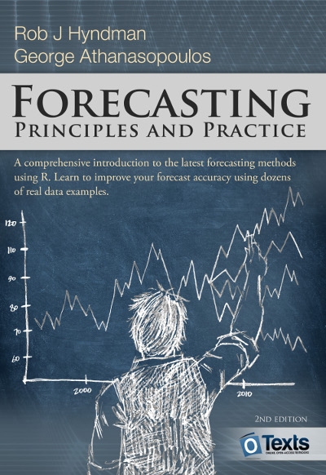
Reading Material
Operations Management (4-th Edition) Reid Sanders
pages 265-294 (forecasting)
A good replacement would be:
Forecasting: Principles and Practice (2nd ed)
Rob J Hyndman and George Athanasopoulos
Relevant sections that explain the concepts in the slides

Slide 4
Time Series Analysis

Slide 5
Time Series
A Time Series is a set of observations measured at specified, usually equal, time intervals
Adjacent observations are dependent
Oil Price in Ecuador 2013

Slide 6
Car Sales Dataset

Slide 7
Time Series Examples
Sales data
Gross national product
Share prices
Euro-to-Dollar Exchange rate
Unemployment rates
Population
Interest rates
Weather readings: temperature, humidity and wind speed
…

Slide 8
Time Series Analysis
Adjacent observations in a time series are dependent
Time series analysis attempts to identify the factors that exert influence on the values in the series
Concerned with techniques for the analysis of dependence between the observations

Slide 9
Time Series Analysis
Areas of application
Forecasting
Industry and government must forecast future activity to make decisions and plans to meet projected changes
Determining the transfer function of a system
Determining the effect of any given series of inputs on the output of a system
Using indicator input variables in transfer function
Assess the effects of unusual intervention events on the behavior of a time series
Examining the interrelationships among several related time series variables

Slide 10
Time Series Components
Can be broken into these four components:
Trend
Seasonal variation
Cyclical variation
Irregular variation

Slide 11
Time Series Components
Irregular
fluctuations
Cyclical
Trend
Seasonal
1
2
3
4
5
6
7
8
9
10
11
12
13
Year

Slide 12
Time Series Components – Trend
This is the long-term growth or decline of the series
In economic terms, long term may mean >10 years
Describes the history of the time series
Uses past trends to make prediction about the future
An analysis of the trend of the observations is needed to acquire an understanding of the progress of events leading to prevailing conditions

Slide 13
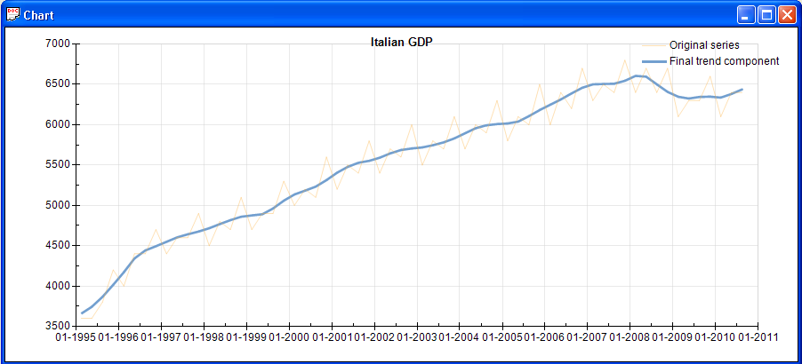
Time Series Components – Trend
© 2015 by EUROSTAT. All rights reserved. Open to the public

Slide 14
Remarks: Time Series Components – Trend
Trend estimates are often reliable; however, in some instances the usefulness of estimates is reduced by:
high degree of irregularity in original or seasonally adjusted series or
abrupt change in the time series characteristics of the original data

Slide 15
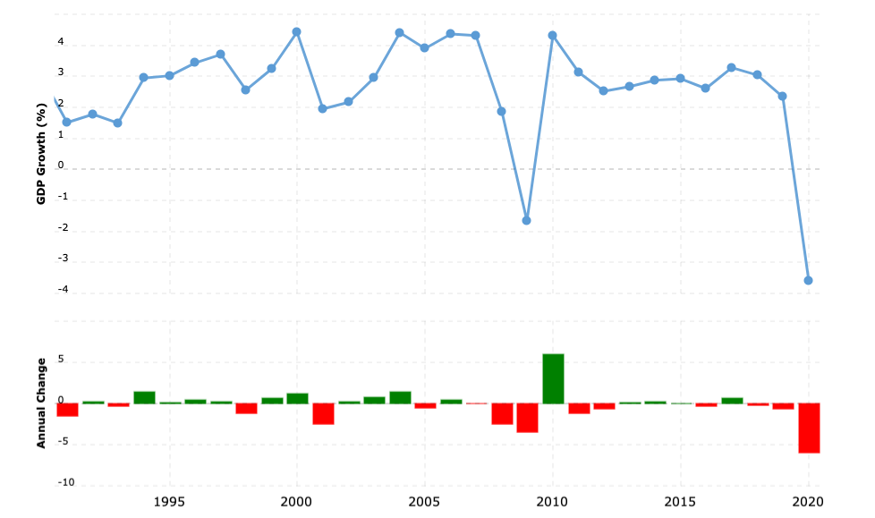
Remarks: Time Series Components – Trend
Global Financial Crisis 2007 - 2008
COVID-19 Crisis

Slide 16
Time Series Components – Seasonal Variation (Seasonality)
Seasonal variation of a time series is a pattern of change that recurs regularly over time.
Seasonal variations are usually due to the differences between seasons and to festive occasions such as Easter and Christmas.
Usually changes occur within a year
Examples include:
Air conditioner sales in Summer
Heater sales in Winter
Flu cases in Winter
Airline tickets for flights during school vacations

Slide 17
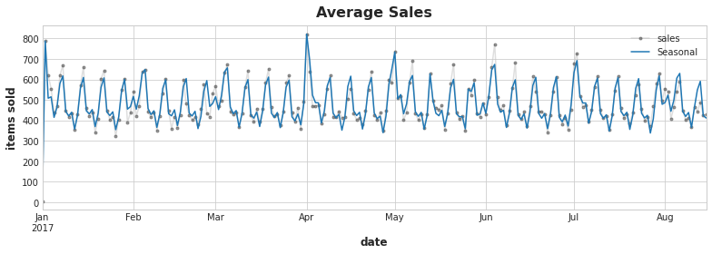
Time Series Components – Seasonal Variation (Seasonality)
Seasonality in a time series can be identified by regularly spaced peaks and troughs (Kaggle)

Slide 18
Time Series Components – Cyclical Variation
Cyclical variations have recurring patterns but with a longer and more erratic time scale compared to Seasonal variations (e.g. 2- 10 years)
The name is quite misleading
these cycles can be far from regular
it is usually impossible to predict the length of expansion/contraction periods
There are no guarantees of a regularly returning pattern.
Examples include:
Floods
Wars
Changes in interest rates
Economic depressions or recessions

Slide 19
Time Series Components – Cyclical Variation
Average temperature in Algeria (10-1997 to 2-1999)

Slide 20
Time Series Components – Cyclical Variation
Peak
Expansion
Average temperature in Algeria (2-1998 to 1-2001) smoothed by moving average
recession
Trough

Slide 21
Time Series Components – Irregular Variation
An irregular (or random) variation in a time series occurs over varying (usually short) periods.
It follows no pattern and is, by nature, unpredictable.
It usually occurs randomly and may be linked to events that also occur randomly.
Irregular variation cannot be explained mathematically.

Slide 22
Time Series Components – Irregular Variation
If the variation cannot be accounted for by the trend, season or cyclical variation, then it is usually attributed to irregular variation.
Example include:
Sudden changes in interest rates
Collapse of companies
Natural disasters
Sudden shifts in government policy
Dramatic changes to the stock market
Effect of Middle East unrest on petrol prices

Slide 23
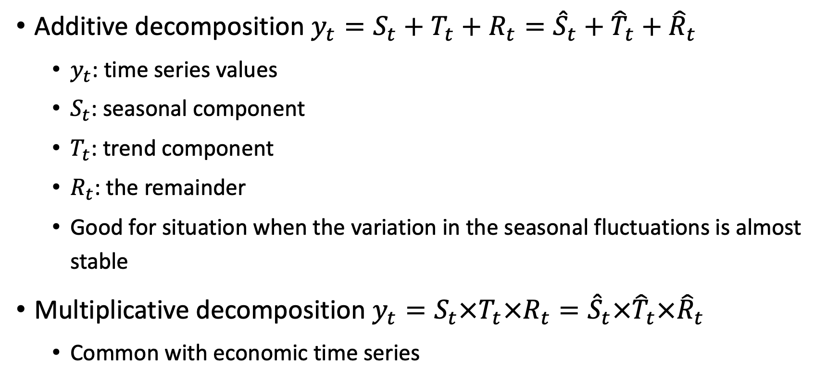
Time Series Decomposition
Additive decomposition $y_{t}=S_{t}+T_{t}+R_{t}={\hat{S}}_{t}+{\hat{T}}_{t}+{\hat{R}}_{t}$
$y_{t}$: time series values
$S_{t}$: seasonal component
$T_{t}$: trend component
$R_{t}$: the remainder
Good for situation when the variation in the seasonal fluctuations is almost stable
Multiplicative decomposition $y_{t}=S_{t}×T_{t}×R_{t}={\hat{S}}_{t}×{\hat{T}}_{t}×{\hat{R}}_{t}$
Common with economic time series

Slide 24
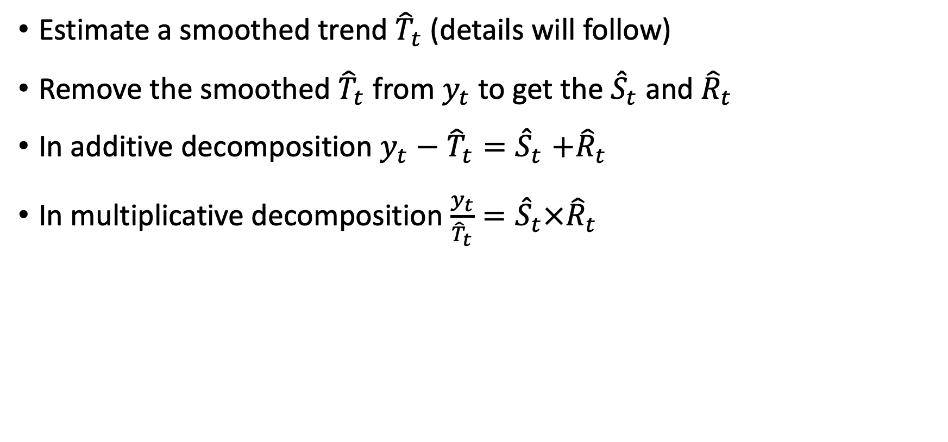
Time Series Decomposition – Detrending
Estimate a smoothed trend ${\hat{T}}_{t}$ (details will follow)
Remove the smoothed ${\hat{T}}_{t}$ from $y_{t}$ to get the ${\hat{S}}_{t}$ and${\hat{R}}_{t}$
In additive decomposition $y_{t}−{\hat{T}}_{t}{=\hat{S}}_{t}+{\hat{R}}_{t}$
In multiplicative decomposition $\frac{y_{t}}{{\hat{T}}_{t}}{=\hat{S}}_{t}×{\hat{R}}_{t}$

Slide 25
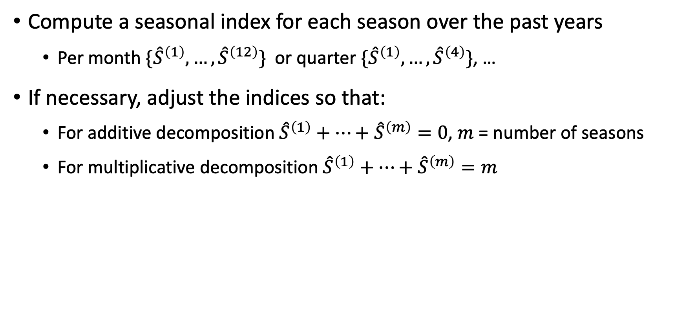
Time Series Decomposition – Seasonal Component
Compute a seasonal index for each season over the past years
Per month $\{{\hat{S}}^{\left(1\right)}, …,{\hat{S}}^{\left(12\right)}\}$ or quarter $\{{\hat{S}}^{\left(1\right)}, …,{\hat{S}}^{\left(4\right)}\}$, …
If necessary, adjust the indices so that:
For additive decomposition ${\hat{S}}^{\left(1\right)}+…+{\hat{S}}^{\left(m\right)}=0$, $m$ = number of seasons
For multiplicative decomposition ${\hat{S}}^{\left(1\right)}+…+{\hat{S}}^{\left(m\right)}=m$

Slide 26

Time Series Decomposition – Remainder Component
For additive decomposition ${\hat{R}}_{t}=y_{t}−{\hat{T}}_{t}−{\hat{S}}_{t}$
For multiplicative decomposition ${\hat{R}}_{t}=\frac{y_{t}}{{\hat{T}}_{t}{\hat{S}}_{t}}$

Slide 27
You can use 'additive'
from pandas import Series
from matplotlib import pyplot as plt
from statsmodels.tsa.seasonal import seasonal_decompose
%matplotlib inline
series = list(df_oil.dcoilwtico.dropna())
result = seasonal_decompose(series, model='multiplicative', period=100)
result.plot()
plt.savefig("oil_price.pdf", format="pdf", bbox_inches="tight")
plt.show()

Slide 28
Time Series Components – Trend

Slide 29
Measuring the Trend
An essential aim in time series analysis is using the past information to establish plan for the next period.
Measuring the trend depicts the general direction of the trend line over time
The trend can be affected by:
Population changes
Productivity improvement
Technological advancements
Global crisis
Market changes
…

Slide 30
Why Examine the Trend?
If the current trend is expected to continue, it can be used for future planning:
Capacity planning for increased population
Utility loads
Market progress
Required resource for new students
Expected workload
Emergency calls
Taxi demand
Occupied beds in a hospital

Slide 31
Depicting the Trend
Common methods include:
Semi-average
Moving average
Least-square
Exponential smoothing

Slide 32
Depicting the Trend – Semi-Average
Attempts to fit a straight line to describe the trend:
Divide the data into 2 equal time ranges
Calculate the average of the observations in each of the 2-time ranges
Draw a straight line between the 2 points
Extend the line slightly past the end of the original observation to make predictions for future years

Slide 33
Depicting the Trend – Moving-Average
Based on the premise that if values in a time series are averaged over a sufficient period, the effect of short-term variations will be reduced
The degree of smoothing can be controlled by selecting the number of cases to be included in an average.

Slide 34
Depicting the Trend – Least-Square Linear Regression
A more sophisticated way for fitting a straight line to a time series is using the method of least squares regression.
Sound familiar?
Observations are the dependant variables (y)
Time is the independent variable (x).
Observations
Time

Slide 35
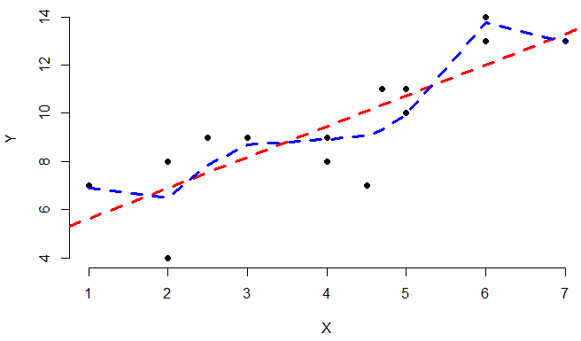
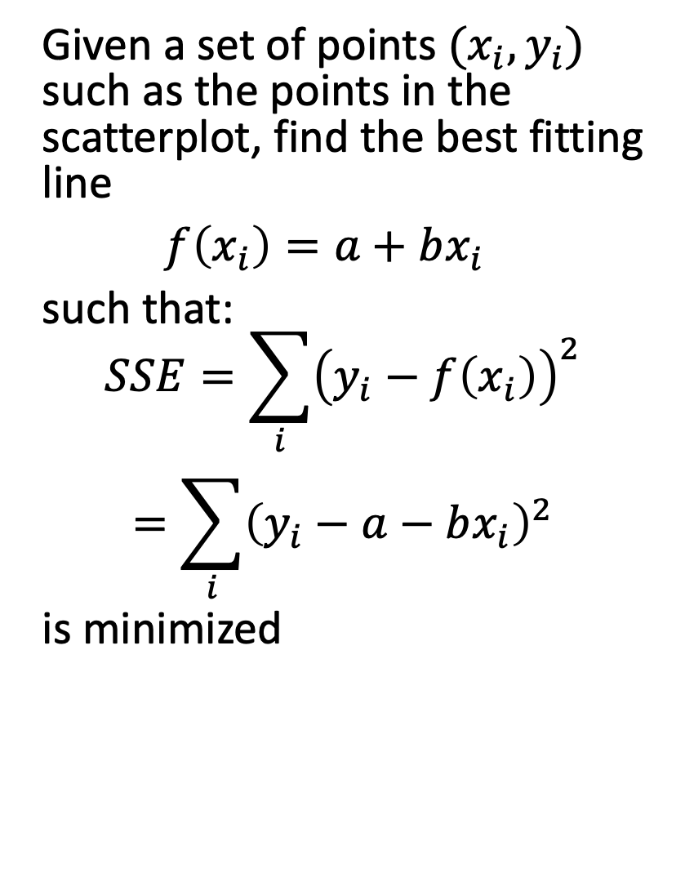
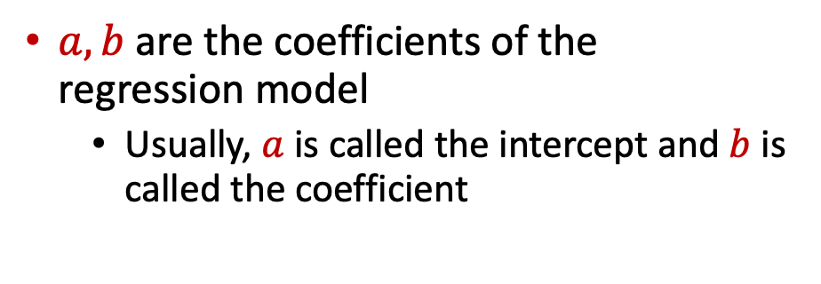
Depicting the Trend – Least-Square Linear Regression
Given a set of points $(x_{i}, y_{i})$ such as the points in the scatterplot, find the best fitting line
$f\left(x_{i}\right)=a+bx_{i}$
such that:
$$\begin{matrix}SSE=\sum_{i}{{\left(y_{i}−f\left(x_{i}\right)\right)}^{2}} \\ =\sum_{i}{{\left(y_{i}−a−bx_{i}\right)}^{2}}\end{matrix}$$
is minimized
$a, b$ are the coefficients of the regression model
Usually, $a$ is called the intercept and $b$ is called the coefficient

Slide 36
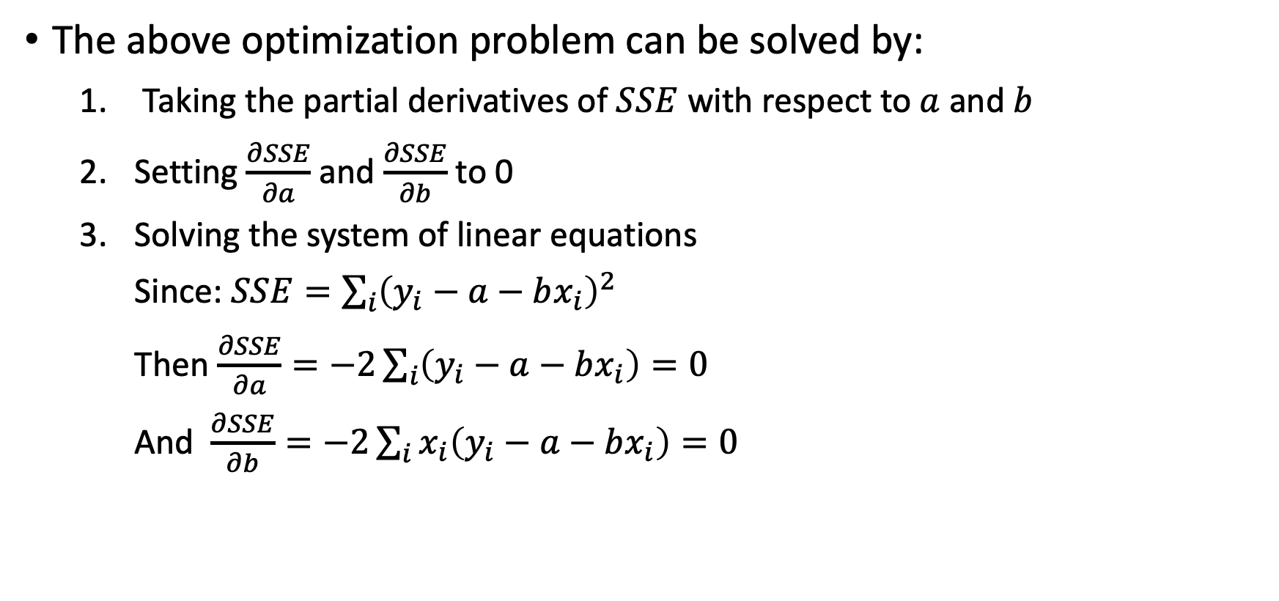
Depicting the Trend – Least-Square Linear Regression
The above optimization problem can be solved by:
Taking the partial derivatives of $SSE$ with respect to $a$ and $b$
Setting $\frac{∂SSE}{∂a}$ and $\frac{∂SSE}{∂b}$ to 0
Solving the system of linear equations
Since: $SSE=\sum_{i}{{\left(y_{i}−a−bx_{i}\right)}^{2}}$
Then $\frac{∂SSE}{∂a}=−2\sum_{i}{\left(y_{i}−a−bx_{i}\right)}=0$
And $\frac{∂SSE}{∂b}=−2\sum_{i}{x_{i}\left(y_{i}−a−bx_{i}\right)}=0$

Slide 37
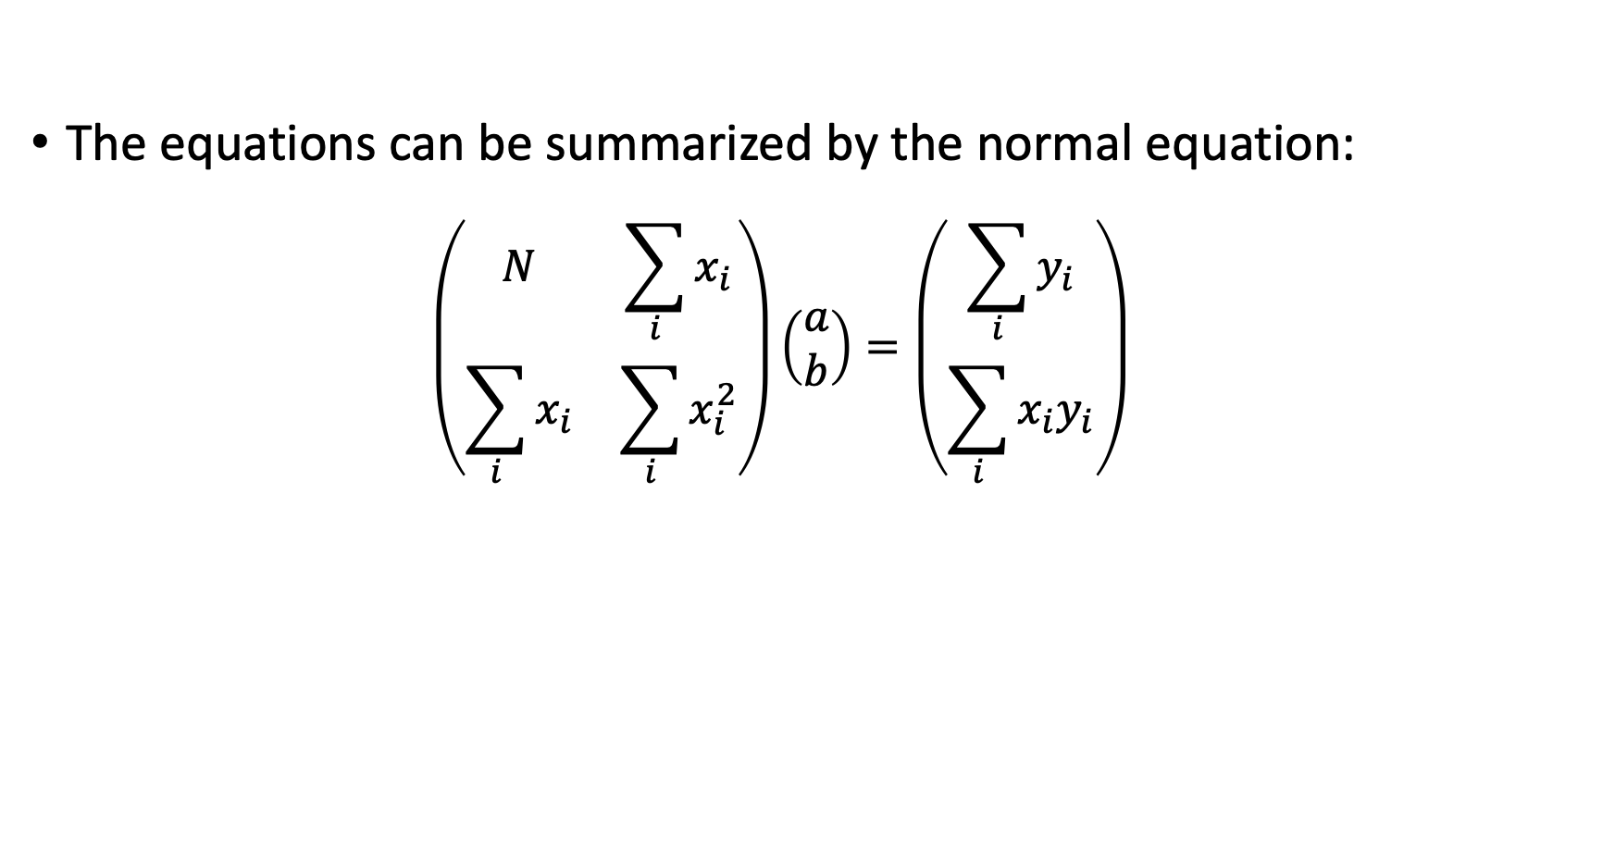
Depicting the Trend – Least-Square Linear Regression
The equations can be summarized by the normal equation:
$$\left(\begin{matrix}N & \sum_{i}{x_{i}} \\ \sum_{i}{x_{i}} & \sum_{i}{x_{i}^{2}}\end{matrix}\right)\left(\begin{matrix}a \\ b\end{matrix}\right)=\left(\begin{matrix}\sum_{i}{y_{i}} \\ \sum_{i}{x_{i}y_{i}}\end{matrix}\right)$$

Slide 38
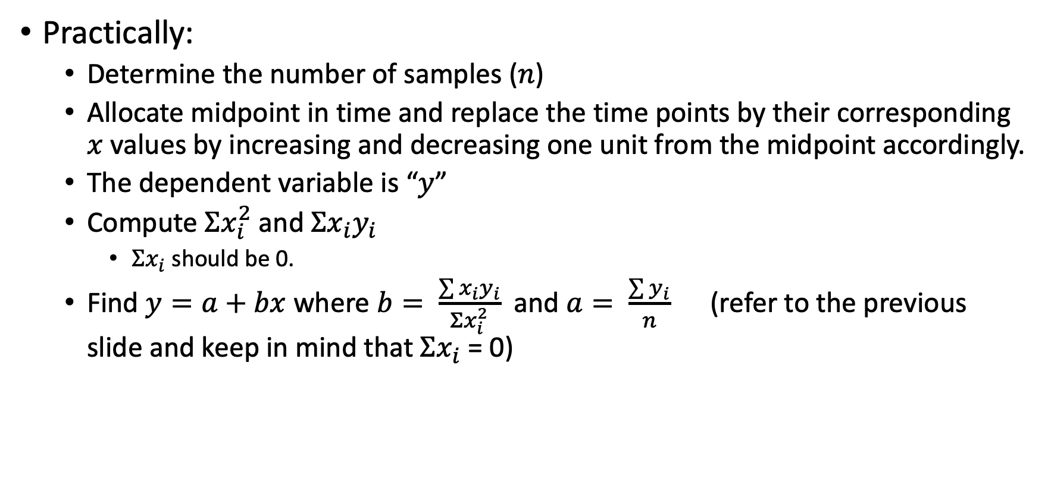
Depicting the Trend – Least-Square Linear Regression
Practically:
Determine the number of samples ($n$)
Allocate midpoint in time and replace the time points by their corresponding $x$ values by increasing and decreasing one unit from the midpoint accordingly.
The dependent variable is “$y$”
Compute $Σx_{i}^{2}$ and $Σx_{i}y_{i}$
$Σx_{i}$ should be 0.
Find $y=a+bx$ where $b= \frac{\sum{x_{i}y_{i}}}{Σx_{i}^{2}}$ and $a= \frac{\sum{y_{i}}}{n}$ (refer to the previous slide and keep in mind that $Σx_{i}$ = 0)

Slide 39
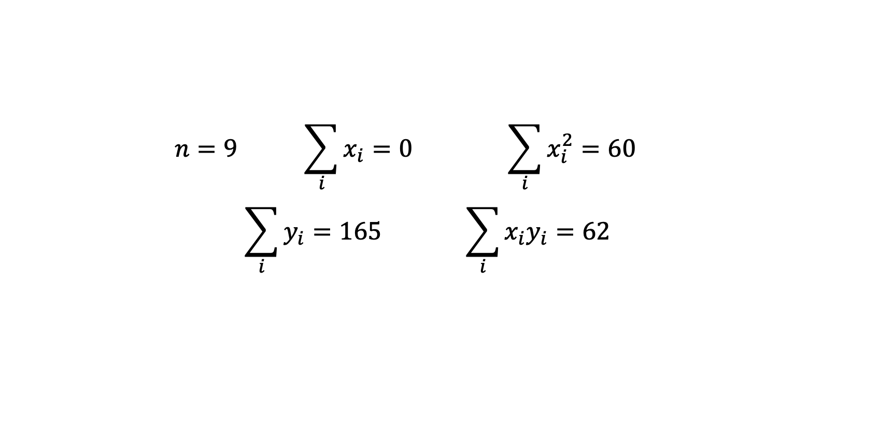
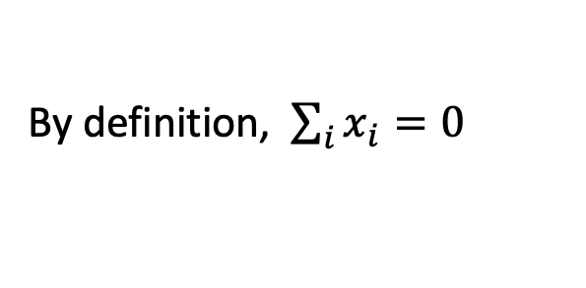
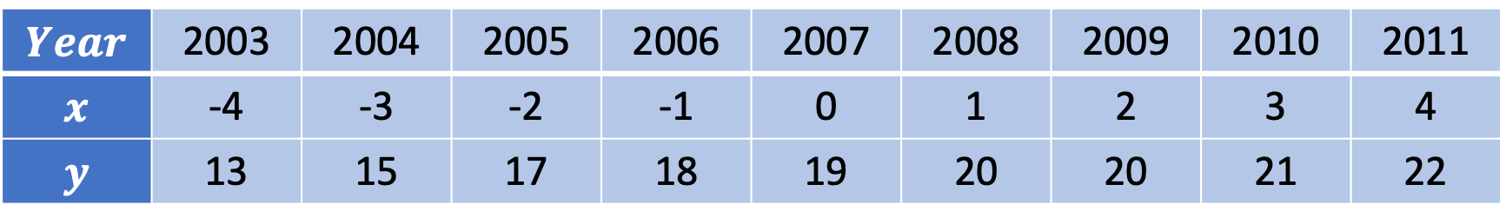
Example
Consider the following dataset
$$Year$$ | 2003 | 2004 | 2005 | 2006 | 2007 | 2008 | 2009 | 2010 | 2011
$$x$$ | -4 | -3 | -2 | -1 | 0 | 1 | 2 | 3 | 4
$$y$$ | 13 | 15 | 17 | 18 | 19 | 20 | 20 | 21 | 22
$$n=9 \sum_{i}{x_{i}}=0 \sum_{i}{x_{i}^{2}}=60$$
$$\sum_{i}{y_{i}}=165 \sum_{i}{x_{i}y_{i}}=62$$
By definition, $\sum_{i}{x_{i}}=0$

Slide 40

Example
Consider the following dataset
$$Year$$ | 2003 | 2004 | 2005 | 2006 | 2007 | 2008 | 2009 | 2010 | 2011
$$x$$ | -4 | -3 | -2 | -1 | 0 | 1 | 2 | 3 | 4
$$y$$ | 13 | 15 | 17 | 18 | 19 | 20 | 20 | 21 | 22
$$a=\frac{\sum{y_{i}}}{n}=\frac{165}{9}=18.3$$
$$b=\frac{\sum{{x_{i}y}_{i}}}{Σx_{i}^{2}}=\frac{62}{60}=1.03$$
Exercise: Predict the sales for year 2014.

Slide 41
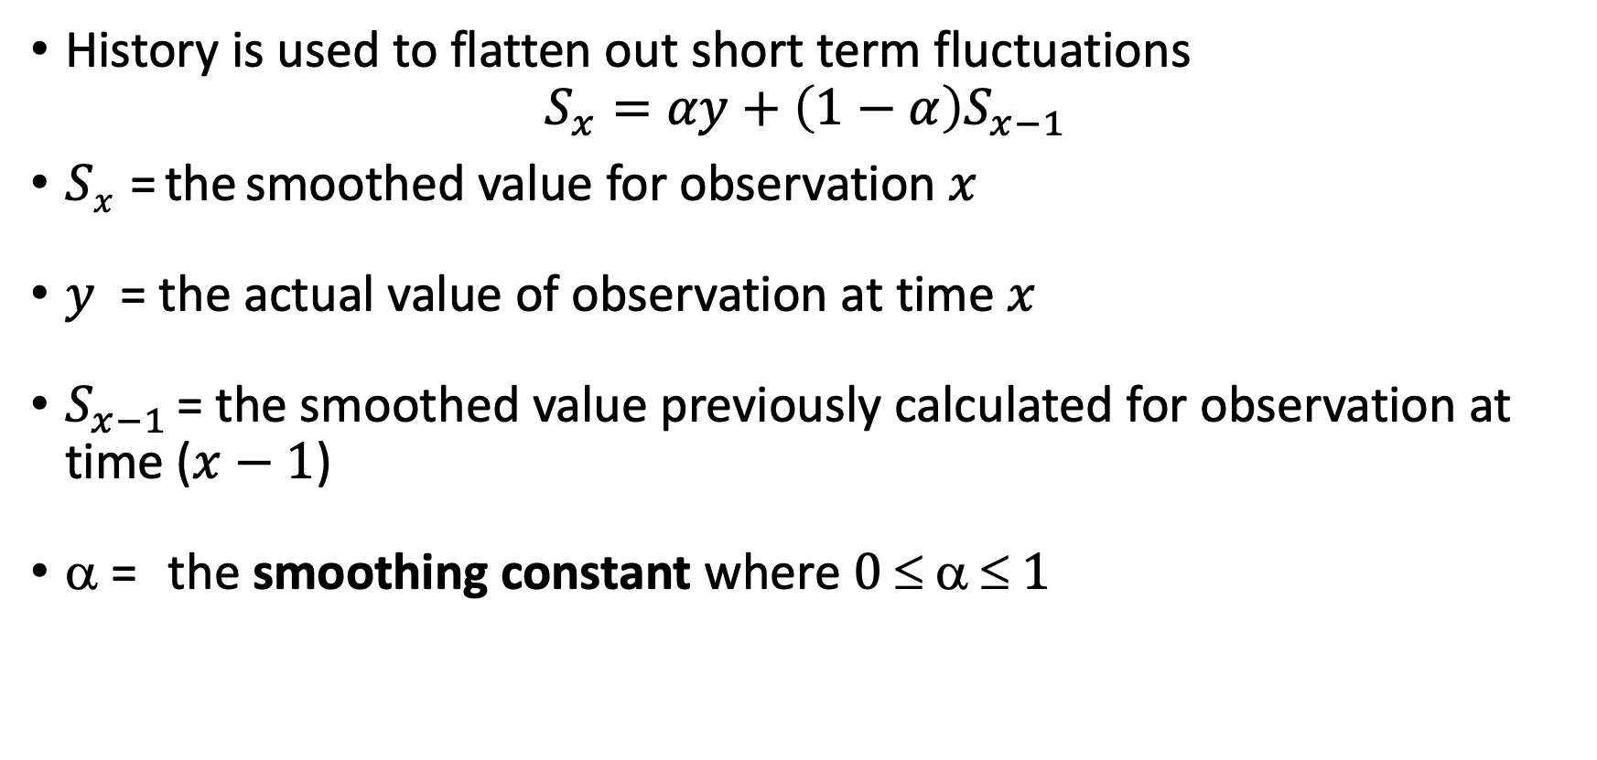
Depicting the Trend – Exponential Smoothing
History is used to flatten out short term fluctuations
$$S_{x}=αy+\left(1−α\right)S_{x−1}$$
$Sx$ = the smoothed value for observation $x$
$y$ = the actual value of observation at time $x$
$S_{x−1}$ = the smoothed value previously calculated for observation at time ($x−1$)
$$ = the smoothing constant where $0    1$

Slide 42
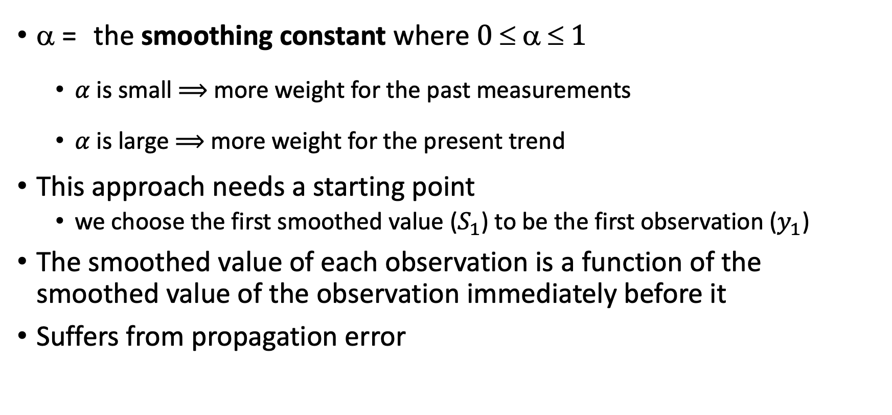
Depicting the Trend – Exponential Smoothing
$$ = the smoothing constant where $0    1$
$α$ is small $⟹$ more weight for the past measurements
$α$ is large $⟹$ more weight for the present trend
This approach needs a starting point
we choose the first smoothed value ($S_{1}$) to be the first observation ($y_{1}$)
The smoothed value of each observation is a function of the smoothed value of the observation immediately before it
Suffers from propagation error

Slide 43
Seasonal Variation

Slide 44
Seasonal Variations
Periodic movements in the time series
It is important to consider seasonal variations for future planning
A seasonally adjusted series involves estimating and removing the cyclical and seasonal effects from the original data
For example:
employment and unemployment are often seasonally adjusted so that the actual change in employment and unemployment levels can be seen, without the impact of periods of peak employment such as Christmas/New Year when a large number of casual workers are temporarily employed

Slide 45
Seasonal Variations – Example
Adverse publicity in December about ice-cream
It would be incorrect simply to compare the sales of ice-cream in June with those in December to determine the effect of the adverse publicity. Sales rate in June is higher in any case, because it is warmer
Useful comparisons of sales could only be made after removing the seasonal variation so the true impact of the publicity would be more realistic

Slide 46
Compute the Seasonal Index
To remove the seasonal effect before finding the trend in the data
Simple average method
Take the average for each period (period mean) over at least three years
Express that as an index by comparing it to the average of all periods over the same period of time
Note: indices can be based on periods such as months or weeks

Slide 47
Compute the Seasonal Index – Example
Consider the data
Year | Quarter
 | 1 | 2 | 3 | 4
1994 | 43 | 64 | 63 | 41
1995 | 46 | 64 | 67 | 43
1996 | 51 | 69 | 75 | 39
1997 | 55 | 73 | 79 | 48
Quarterly total | 195 | 270 | 284 | 171
Quarterly mean | 48.75 | 67.5 | 71 | 42.75
Yearly average 1994 = (43 + 64 + 63 + 41)/4 = 211/4 = 52.75
Yearly average 1995 = (46 + 64 + 67 + 43 )/4 = 220 /4 = 55.0
Yearly average 1996 = (51 + 69 + 75 + 39 )/4 = 234/4 = 58.5
Yearly average 1997 = (55 + 73 + 79 + 48 )/4 = 255 / 4 =63.75

Slide 48
Compute the Seasonal Index – Example
Compute the yearly average of the values and divide the quarterly reading over the yearly average
Year | Quarter
 | 1 | 2 | 3 | 4
1994 | 43/52.75 | 64/52.75 | 63/52.75 | 41/52.75
1995 | 46/55 | 64/55 | 67/55 | 43/55
1996 | 51/58.5 | 69/58.5 | 75/58.5 | 39/58.5
1997 | 55/63.75 | 73/63.75 | 79/63.75 | 48/63.75
Yearly average 1994 = (43 + 64 + 63 + 41)/4 = 211/4 = 52.75
Yearly average 1995 = (46 + 64 + 67 + 43 )/4 = 220 /4 = 55.0
Yearly average 1996 = (51 + 69 + 75 + 39 )/4 = 234/4 = 58.5
Yearly average 1997 = (55 + 73 + 79 + 48 )/4 = 255 / 4 =63.75

Slide 49
Compute the Seasonal Index – Example
Compute the index as the quarterly average over the years
Year | Quarter
 | 1 | 2 | 3 | 4
1994 | 0.82 | 1.21 | 1.19 | 0.78
1995 | 0.84 | 1.16 | 1.22 | 0.78
1996 | 0.87 | 1.18 | 1.28 | 0.67
1997 | 0.86 | 1.15 | 1.24 | 0.75
Year | Seasonal index (Quarterly)
 | 1 | 2 | 3 | 4
1994 | 82 | 121 | 119 | 78
1995 | 84 | 116 | 122 | 78
1996 | 87 | 118 | 128 | 67
1997 | 86 | 115 | 124 | 75
Seasonal Index (Over the years) | 84.8 | 117.5 | 123.3 | 74.5
Divide the Quarterly value over the yearly average
Summation of the values in each row is 4
Multiply by 100
Summation of the values in each row is 400

Slide 50
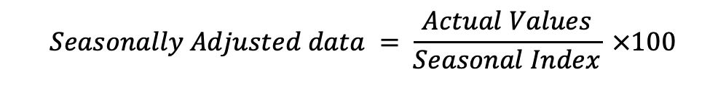
Compute the Seasonal Index – Example
Remove the seasonal effect from the data (multiplicative model)
Year | Quarter | Actual Value | Seasonal Index | Adjusted Values
1996 | 1 | 51 | 84.8 | 60
 | 2 | 69 | 117.5 | 59
 | 3 | 75 | 123.3 | 61
 | 4 | 39 | 74.5 | 52
1997 | 1 | 55 | 84.8 | 65
 | 2 | 73 | 117.4 | 62
 | 3 | 79 | 123.3 | 64
 | 4 | 48 | 74.5 | 64
$$Seasonally Adjusted data = \frac{Actual Values}{Seasonal Index} ×100$$

Slide 51
Compute the Seasonal Index – Example
Alternate approach to calculate Seasonal Index number for each quarter
Take the quarterly mean over the years
Divide each mean value by the mean of means multiplied by 100
Quarter | Quarterly mean | Seasonal Index
1 | 48.75 | 48.75/57.5*100 = 84.78
2 | 67.5 | 67.5/57.5*100 = 117.39
3 | 71 | 71/57.5*100 = 123.478
4 | 42.75 | 42.75/57.5*100 = 74.348
Means Total | 230 | 400
Mean of Means | 57.5 | 100

Slide 52
Compute the Seasonal Index – Example
Remove the seasonal effect from the data
Year | Quarter | Actual Value | Seasonal Index | Adjusted Values
1996 | 1 | 51 | 84.8 | 60
 | 2 | 69 | 117.4 | 59
 | 3 | 75 | 123.5 | 61
 | 4 | 39 | 74.3 | 52
1997 | 1 | 55 | 84.8 | 65
 | 2 | 73 | 117.4 | 62
 | 3 | 79 | 123.5 | 64
 | 4 | 48 | 74.3 | 65
$$Seasonally Adjusted data = \frac{Actual Values}{Seasonal Index} ×100$$

Slide 53
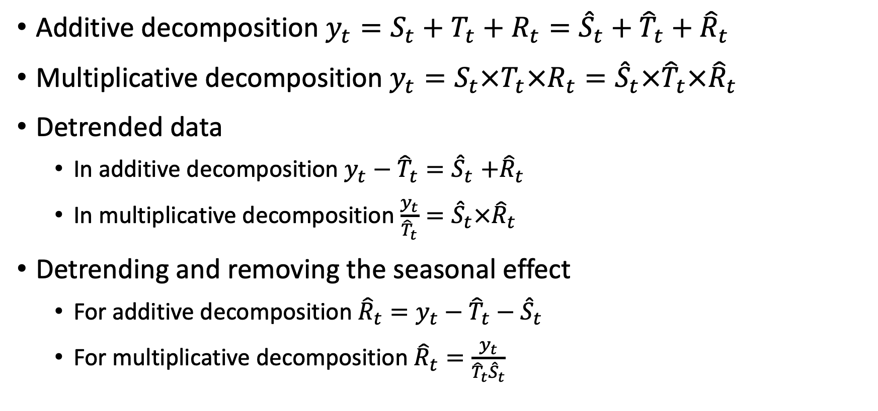
Time Series Decomposition – Summary
Additive decomposition $y_{t}=S_{t}+T_{t}+R_{t}={\hat{S}}_{t}+{\hat{T}}_{t}+{\hat{R}}_{t}$
Multiplicative decomposition $y_{t}=S_{t}×T_{t}×R_{t}={\hat{S}}_{t}×{\hat{T}}_{t}×{\hat{R}}_{t}$
Detrended data
In additive decomposition $y_{t}−{\hat{T}}_{t}{=\hat{S}}_{t}+{\hat{R}}_{t}$
In multiplicative decomposition $\frac{y_{t}}{{\hat{T}}_{t}}{=\hat{S}}_{t}×{\hat{R}}_{t}$
Detrending and removing the seasonal effect
For additive decomposition ${\hat{R}}_{t}=y_{t}−{\hat{T}}_{t}−{\hat{S}}_{t}$
For multiplicative decomposition ${\hat{R}}_{t}=\frac{y_{t}}{{\hat{T}}_{t}{\hat{S}}_{t}}$

Slide 54
STL Decomposition
Seasonal and Trend decomposition using Loess
Handle any type of seasonality
Seasonal component is allowed to change over time
Smoothness of the trend can be controlled by the user
Can be robust to outliers
from statsmodels.tsa.seasonal import STL
df_oil_new = df_oil.dropna()
dcoilwtico = list(df_oil_new.dcoilwtico)
oil_data = pd.Series(
dcoilwtico, index=df_oil_new.date, name="OIL")
stl = STL(oil_data, period = 100)
res = stl.fit()
fig = res.plot()

Slide 55
Demand Forecasting

Slide 56
Decisions that Require Forecasting
What products to produce?
How many people to hire?
How many units to purchase?
How many units to produce?
How many items to order?
And so on……

Slide 57
Common Characteristics of Forecasting
Forecasts are rarely perfect
Forecasts are more accurate for aggregated data than for individual items
Forecast are more accurate for shorter than longer time periods

Slide 58


Why Forecasting is Important?

Slide 59
Forecasting Techniques
Naïve Forecasting
Simple Mean
Moving Average
Weighted Moving Average
Exponential Smoothing

Slide 60
Forecasting – Example
Determine forecast for periods 11
Naïve forecast
Simple average
3- and 5-period moving average
3-period weighted moving average with weights 0.5, 0.3, and 0.2
Exponential smoothing with alpha=0.2 and 0.5
Period | Orders
1 | 122
2 | 91
3 | 100
4 | 77
5 | 115
6 | 58
7 | 75
8 | 128
9 | 111
10 | 88

Slide 61
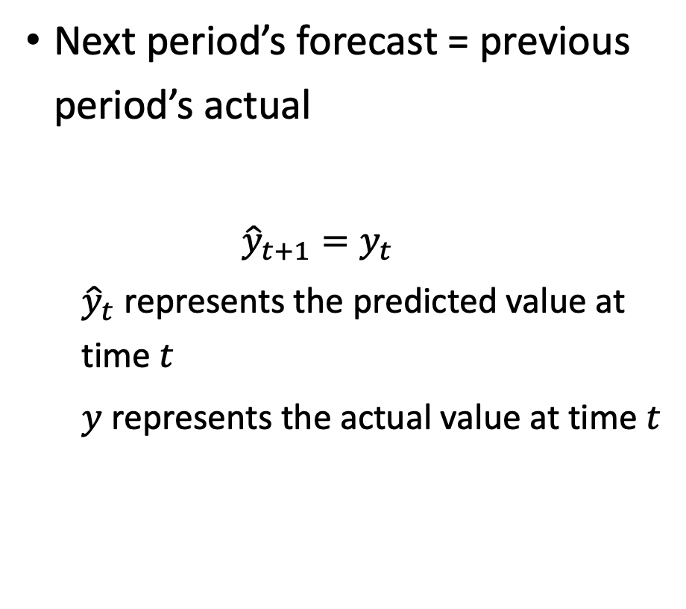
Naïve Forecasting
Period | Orders | Naïve Forecast
1 | 122
2 | 91 | 122
3 | 100 | 91
4 | 77 | 100
5 | 115 | 77
6 | 58 | 115
7 | 75 | 58
8 | 128 | 75
9 | 111 | 128
10 | 88 | 111
11 |  | 88
Next period’s forecast = previous period’s actual
$${\hat{y}}_{t+1}=y_{t}$$
${\hat{y}}_{t}$ represents the predicted value at time $t$
$y$ represents the actual value at time $t$

Slide 62
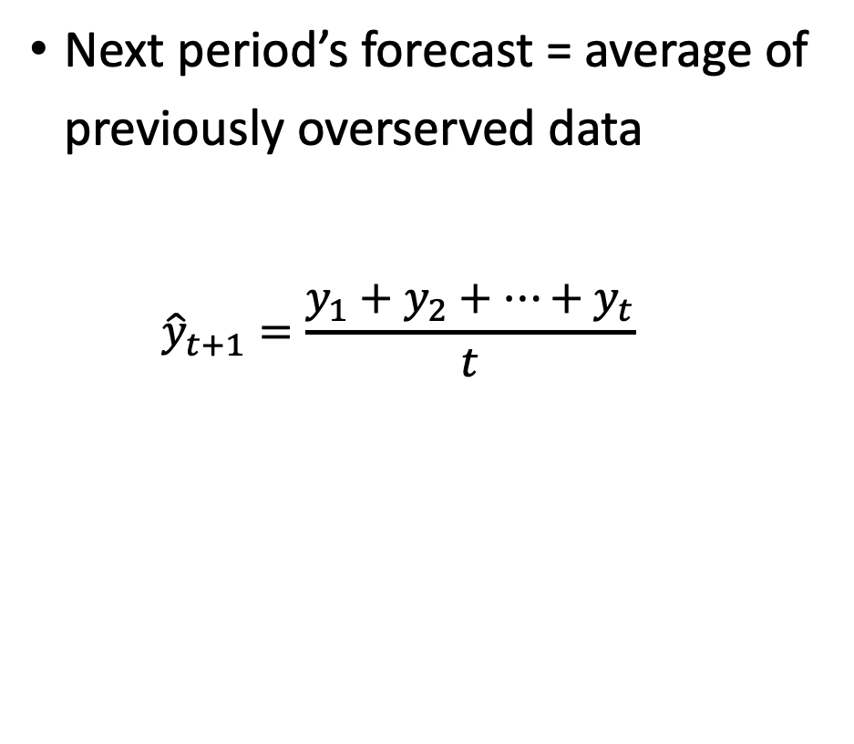
Simple Average
Period | Orders | Simple Average
1 | 122
2 | 91 | 122
3 | 100 | 107
4 | 77 | 104
5 | 115 | 98
6 | 58 | 101
7 | 75 | 94
8 | 128 | 91
9 | 111 | 96
10 | 88 | 97
11 |  | 97
Next period’s forecast = average of previously overserved data
$${\hat{y}}_{t+1}=\frac{y_{1}+y_{2}+…+y_{t}}{t}$$

Slide 63
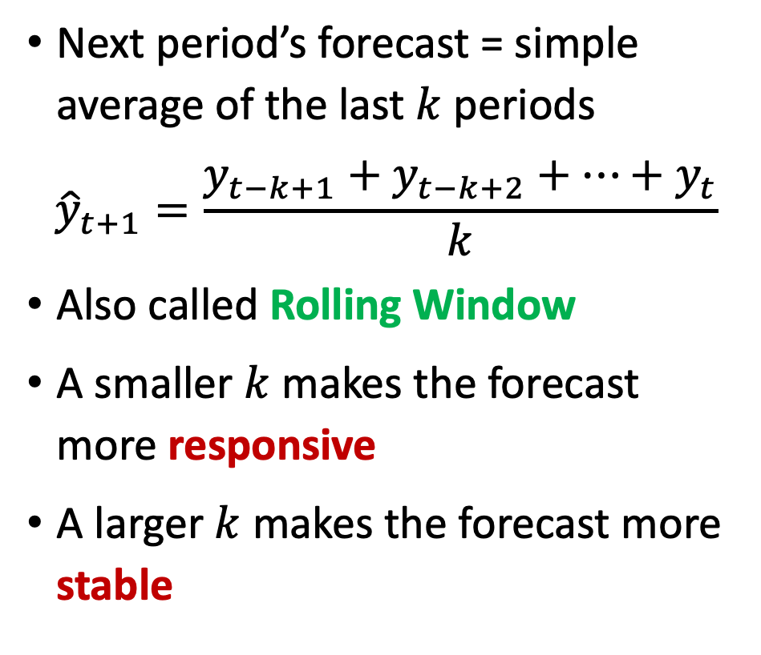
Moving Average
Period | Orders | Moving Average (k = 3) | Moving Average (k = 5)
1 | 122
2 | 91
3 | 100
4 | 77 | 104
5 | 115 | 89
6 | 58 | 97 | 101
7 | 75 | 83 | 88
8 | 128 | 83 | 85
9 | 111 | 87 | 91
10 | 88 | 105 | 97
11 |  | 109 | 92
Next period’s forecast = simple average of the last $k$ periods
$${\hat{y}}_{t+1}=\frac{y_{t−k+1}+y_{t−k+2}+…+y_{t}}{k}$$
Also called Rolling Window
A smaller $k$ makes the forecast more responsive
A larger $k$ makes the forecast more stable

Slide 64
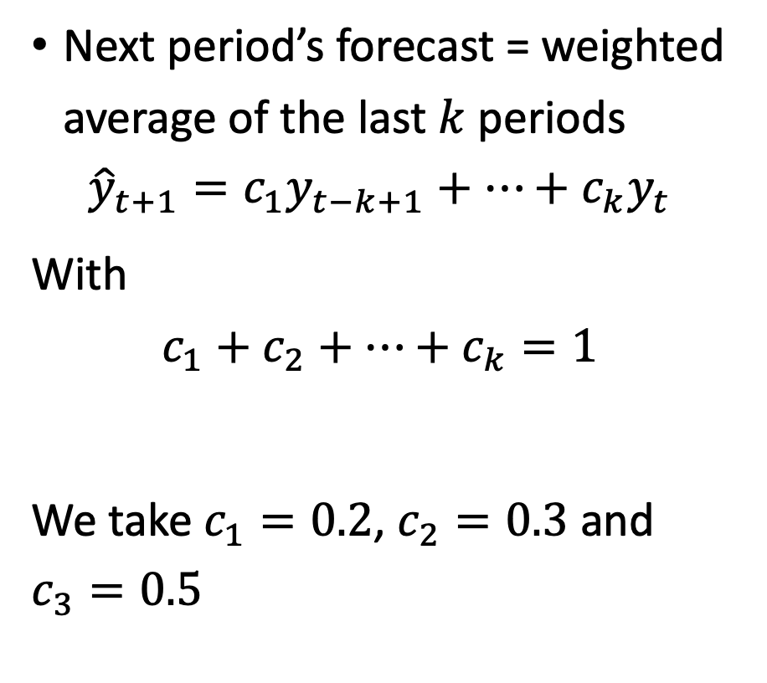
Weighted Moving Average
Period | Orders | Weighted Moving Average (k = 3)
1 | 122
2 | 91
3 | 100
4 | 77 | 102
5 | 115 | 87
6 | 58 | 101
7 | 75 | 79
8 | 128 | 78
9 | 111 | 98
10 | 88 | 109
11 |  | 103
Next period’s forecast = weighted average of the last $k$ periods
$${\hat{y}}_{t+1}={c_{1}y}_{t−k+1}+…+{c_{k}y}_{t}$$
With
$$c_{1}+c_{2}+…+c_{k}=1$$
We take $c_{1}=0.2$, $c_{2}=0.3$ and $c_{3}=0.5$

Slide 65
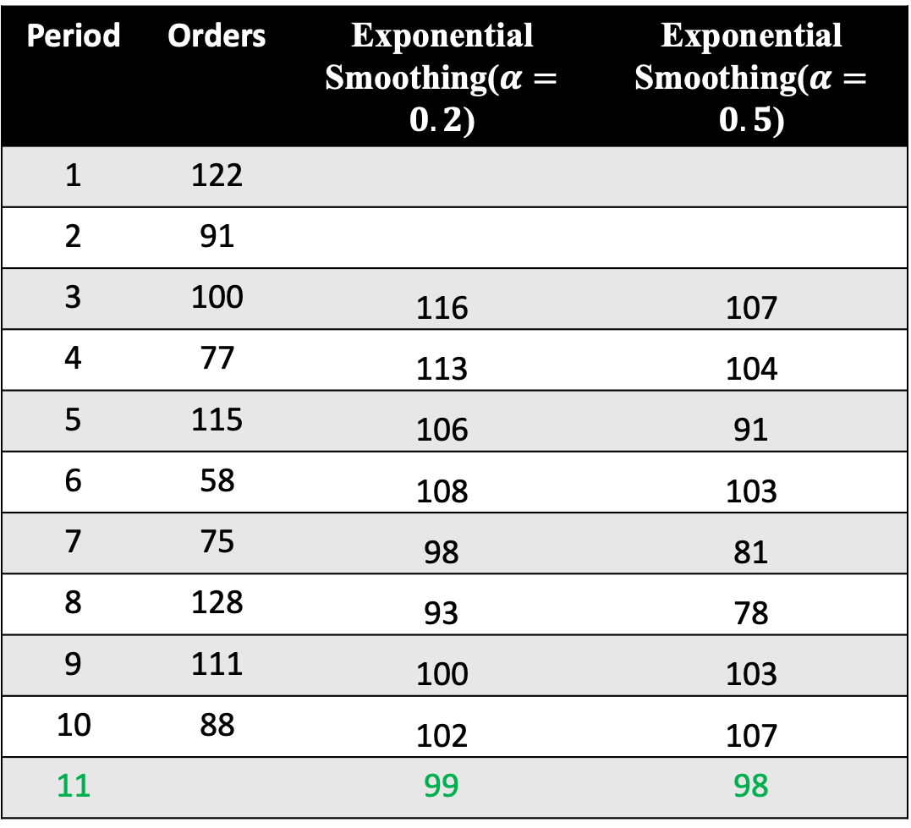
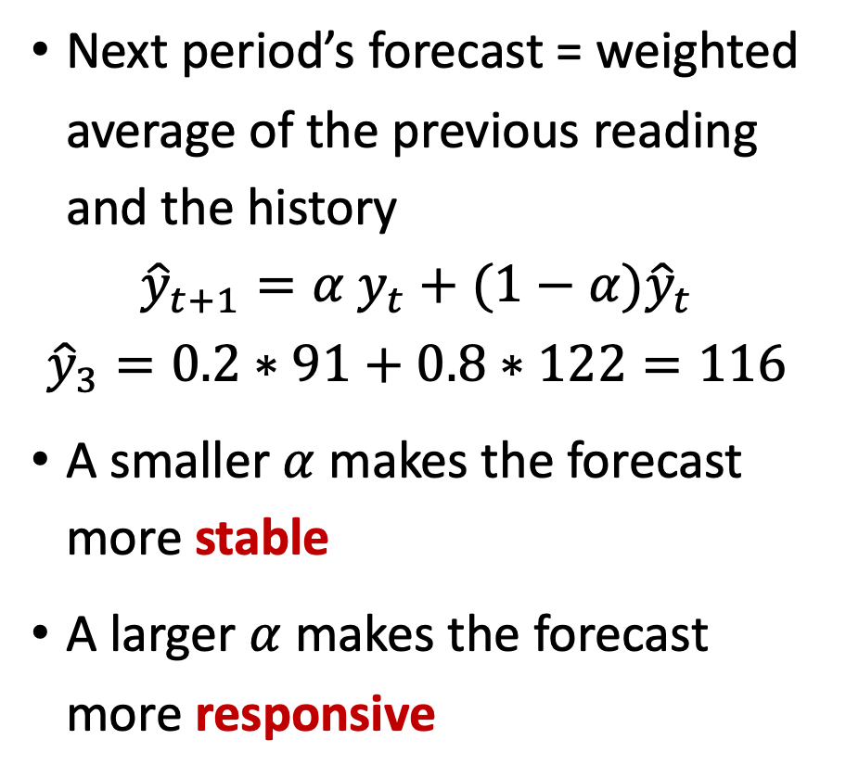
Exponential Smoothing
Period | Orders | Exponential Smoothing($α=0.2$) | Exponential Smoothing($α=0.5$)
1 | 122
2 | 91
3 | 100 | 116 | 107
4 | 77 | 113 | 104
5 | 115 | 106 | 91
6 | 58 | 108 | 103
7 | 75 | 98 | 81
8 | 128 | 93 | 78
9 | 111 | 100 | 103
10 | 88 | 102 | 107
11 |  | 99 | 98
Next period’s forecast = weighted average of the previous reading and the history
$${\hat{y}}_{t+1}={α y}_{t}+(1−α){\hat{y}}_{t}$$
$${\hat{y}}_{3}=0.2∗91+0.8∗122=116$$
A smaller $α$ makes the forecast more stable
A larger $α$ makes the forecast more responsive

Slide 66
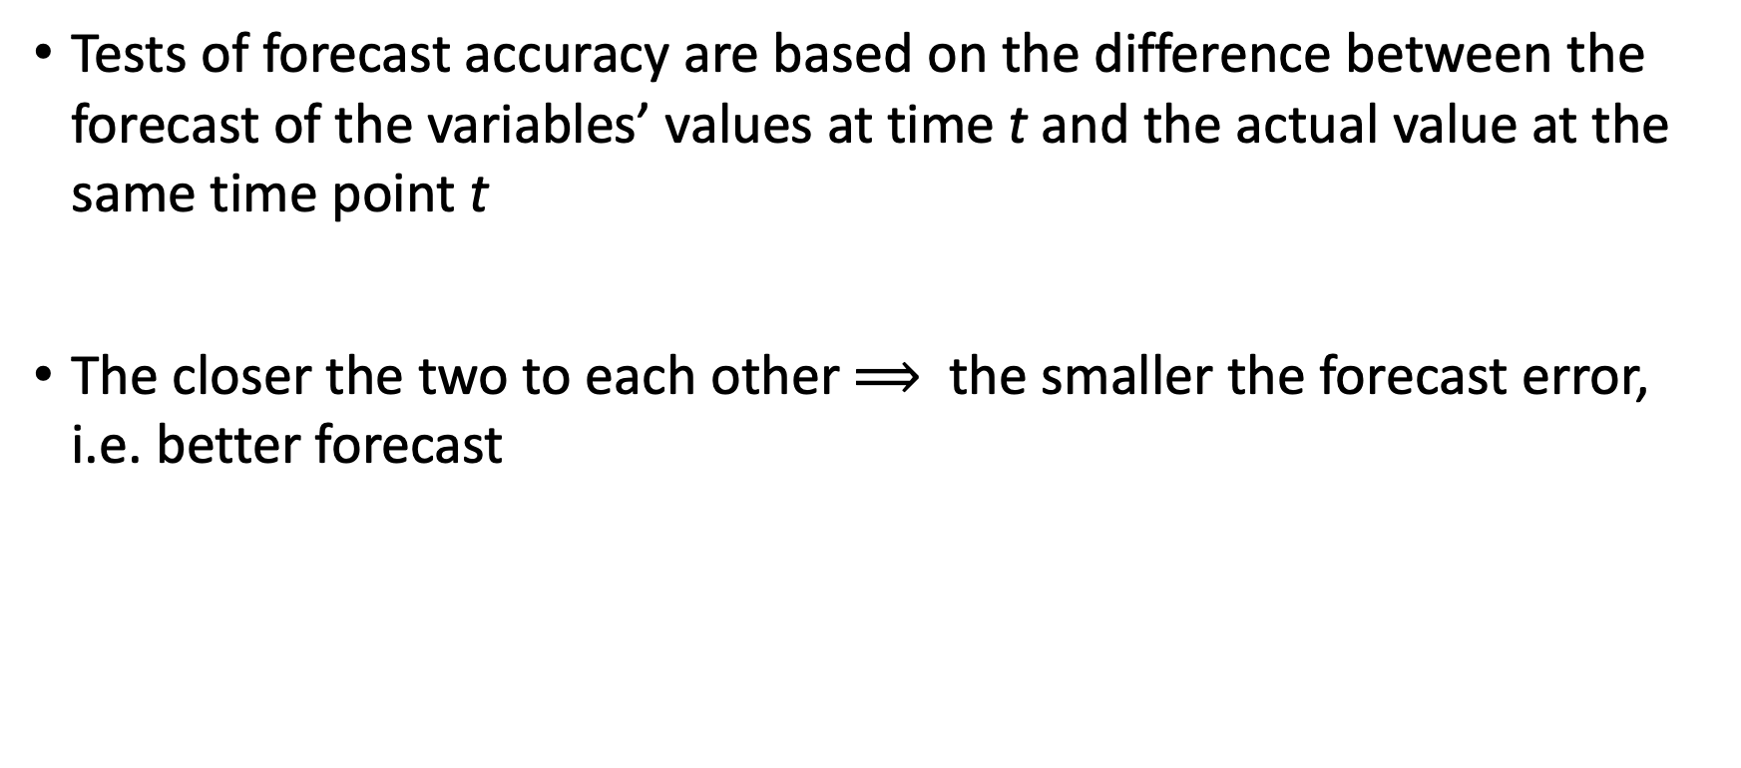
Forecast Accuracy
Tests of forecast accuracy are based on the difference between the forecast of the variables’ values at time t and the actual value at the same time point t
The closer the two to each other $⟹$ the smaller the forecast error, i.e. better forecast

Slide 67
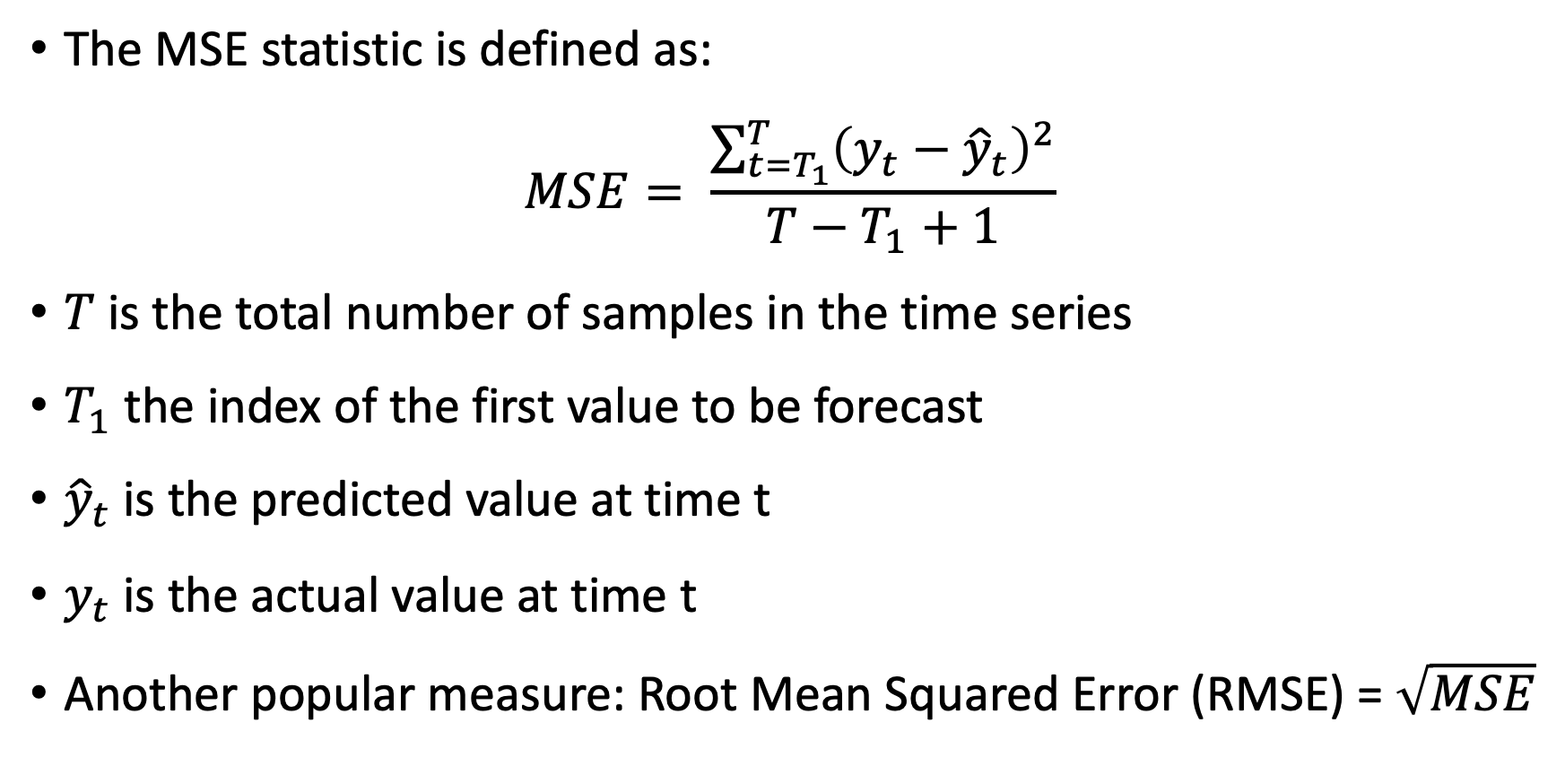
Forecast Accuracy – Mean Squared Error (MSE)
The MSE statistic is defined as:
$$MSE= \frac{\sum_{t=T_{1}}^{T}{{\left(y_{t}−{\hat{y}}_{t}\right)}^{2}}}{T−T_{1}+1}$$
$T$ is the total number of samples in the time series
$T_{1}$ the index of the first value to be forecast
${\hat{y}}_{t}$ is the predicted value at time t
$y_{t}$ is the actual value at time t
Another popular measure: Root Mean Squared Error (RMSE) = $\sqrt{MSE}$

Slide 68
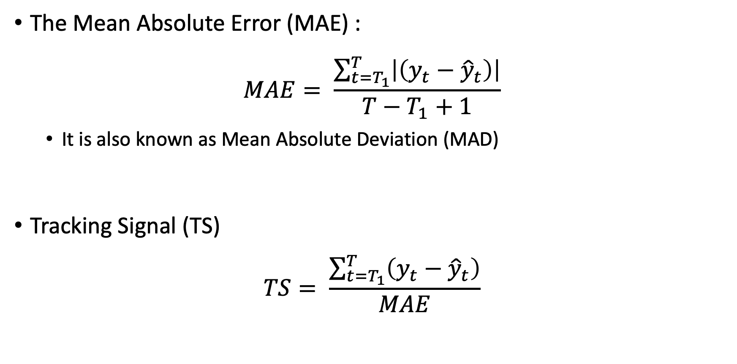
Forecast Accuracy – More Measures
The Mean Absolute Error (MAE) :
$$MAE= \frac{\sum_{t=T_{1}}^{T}{\left|\left(y_{t}−{\hat{y}}_{t}\right)\right|}}{T−T_{1}+1}$$
It is also known as Mean Absolute Deviation (MAD)
Tracking Signal (TS)
$$TS= \frac{\sum_{t=T_{1}}^{T}{\left(y_{t}−{\hat{y}}_{t}\right)}}{MAE}$$

Slide 69

Summarize what you learned today in 2-minutes

Slide 70
Next lecture
Process Discovery
Conformance Checking

