Slide 1
Data Wrangling and Data Analysis
Data Streams
Hakim Qahtan
Department of Information and Computing Sciences
Utrecht University

Slide 2

Topics for Today
Mining Data Streams
Mining of Massive Datasets
Chapter 4 (4.1 – 4.4)
Reading Material

Slide 3
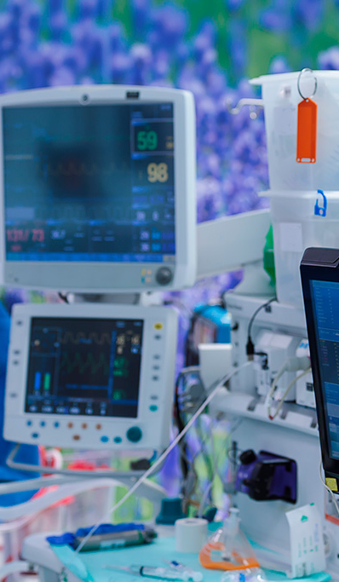
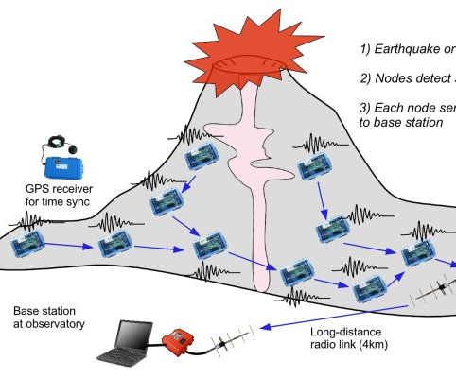
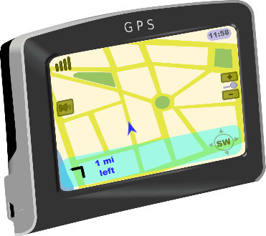

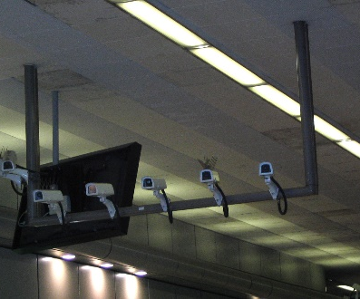

Slide 4
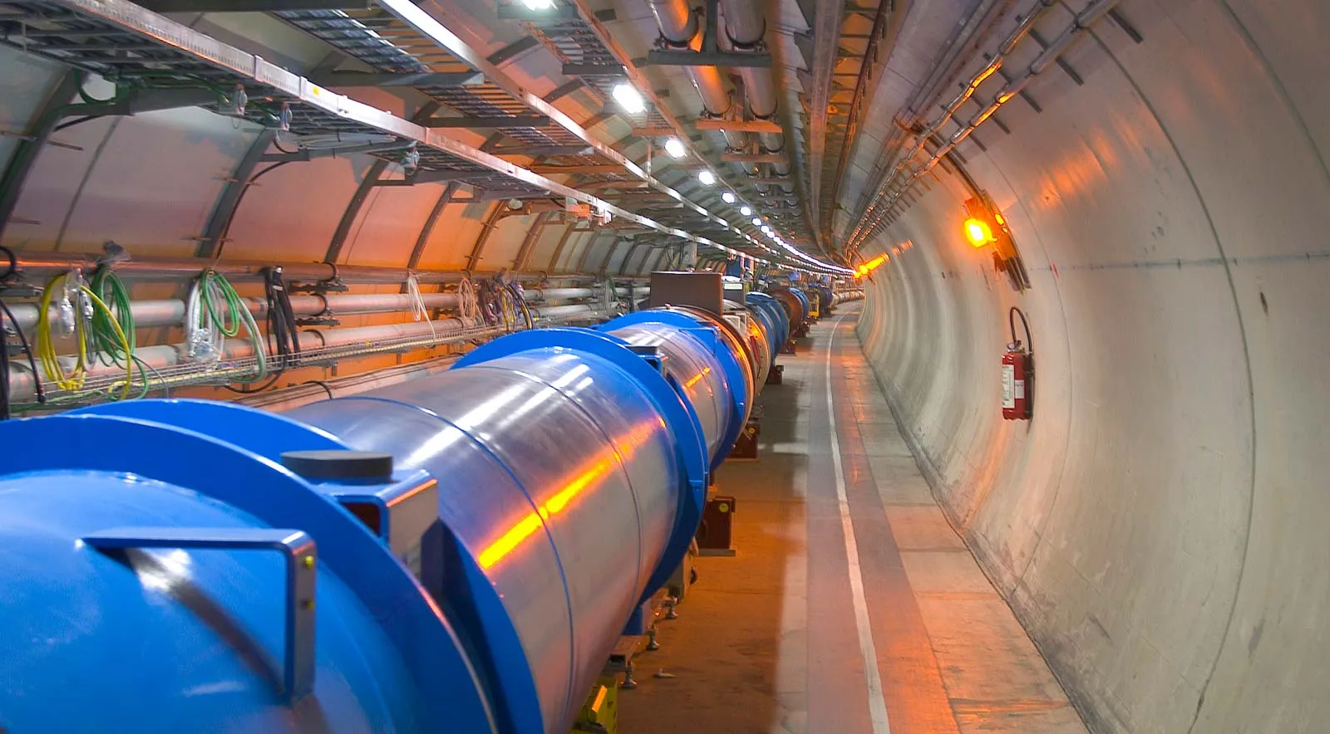
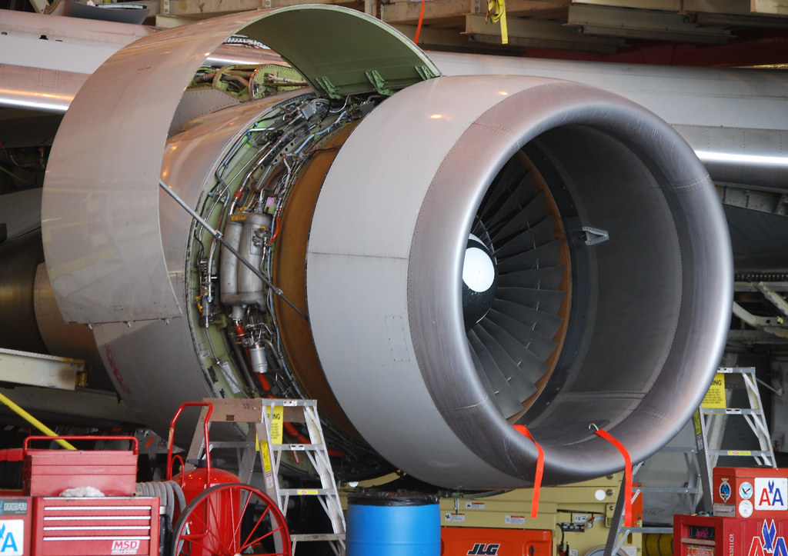

A Boeing Jet Engine creates 20TB information every Hour
Large Hadron Collider generates 40TB data per second
YouTube viewers watch over one billion hours of videos on its platform every single day

Slide 5
Applications
Telecommunication calling records
Business: credit card transaction flows
Network monitoring and traffic engineering
Financial market: stock exchange
Engineering & industrial processes: power supply & manufacturing
Sensor, monitoring & surveillance: video streams
Web logs and Web page click streams
Massive data sets (even saved but random access is too expensive)

Slide 6
Characteristics of Data Streams
Entire data is not available
Data arrives (more likely) at a high-speed rate
The system cannot store the entire stream, but only a small fraction
Huge volume of continuous data (possibly infinite)
Requires single scan algorithms (can only have one look)
Distribution is non-stationary
Requires fast, real-time response

Slide 7
General Stream Processing Model
Ad-Hoc
Queries
Processor
. . . 1, 5, 2, 7, 0, 9, 3
. . . a, r, v, t, y, h, b
. . . 0, 0, 1, 0, 1, 1, 0
time
Streams Entering.
Each is stream is composed of elements/tuples
Standing
Queries
Output
Limited
Working
Storage
Archival
Storage

Slide 8
How can we perform critical calculations on data streams using a limited size of memory?

Slide 9
Handling Data Streams
Online learning
Sampling data from data streams
Windowing functions (models)

Slide 10
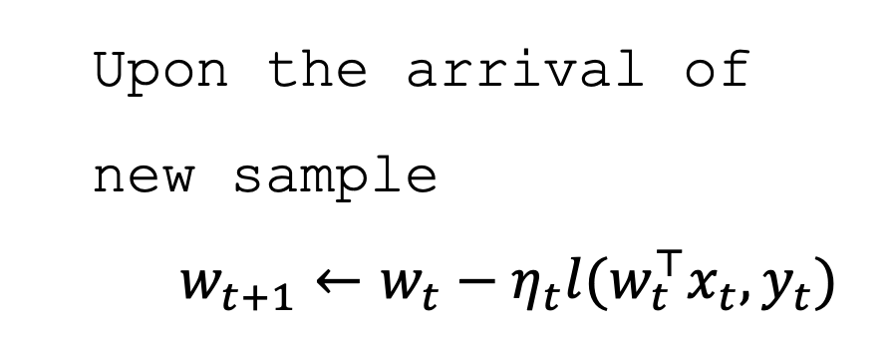

Online Learning
Main idea: perform small changes to update the model
Training: use the first batch of the data to train a model
Updating: upon the arrival of a new samples from the stream, slightly update the model
Problem: concept drifts
Training
Updating
$$w_{1}←0$$
FOR $t=1$ to $T$ DO
$w_{t+1}←w_{t}−η_{t}l(w_{t}^{⊤}x_{t}, y_{t})$
Upon the arrival of new sample
$w_{t+1}←w_{t}−η_{t}l(w_{t}^{⊤}x_{t}, y_{t})$

Slide 11
Sampling Data Stream

Slide 12
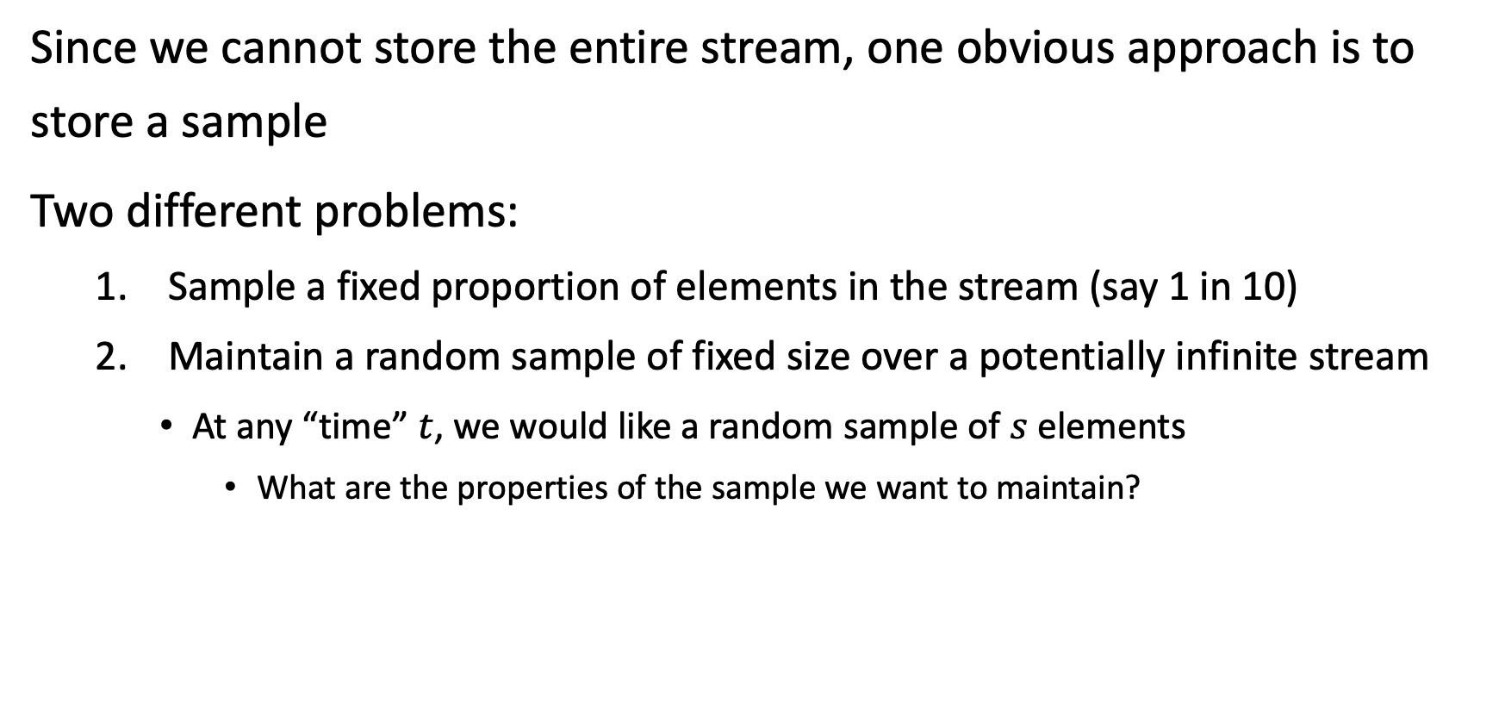
Sampling from Data Streams
Since we cannot store the entire stream, one obvious approach is to store a sample
Two different problems:
Sample a fixed proportion of elements in the stream (say 1 in 10)
Maintain a random sample of fixed size over a potentially infinite stream
At any “time” $t$, we would like a random sample of $s$ elements
What are the properties of the sample we want to maintain?

Slide 13
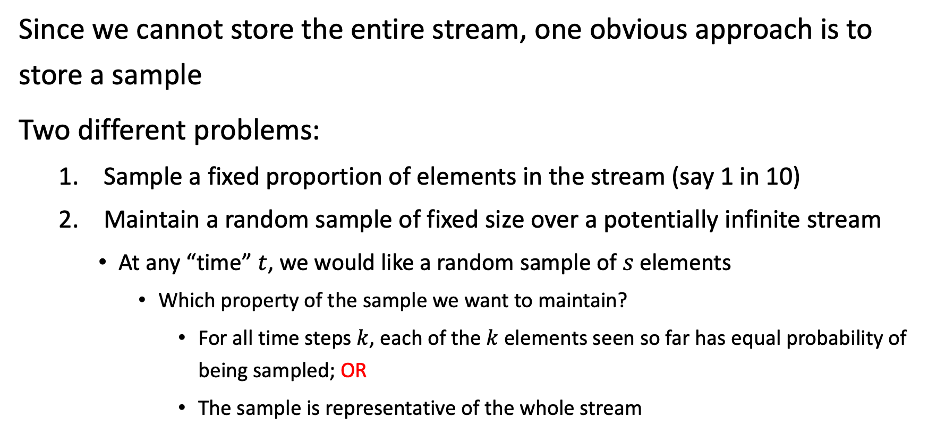
Sampling from Data Streams
Since we cannot store the entire stream, one obvious approach is to store a sample
Two different problems:
Sample a fixed proportion of elements in the stream (say 1 in 10)
Maintain a random sample of fixed size over a potentially infinite stream
At any “time” $t$, we would like a random sample of $s$ elements
Which property of the sample we want to maintain?
For all time steps $k$, each of the $k$ elements seen so far has equal probability of being sampled; OR
The sample is representative of the whole stream

Slide 14
Sampling from Data Streams – Sample a fixed proportion
Assume we have space to store 1/10-th of the stream
Naïve solution:
Generate a random integer in [0..9] for each query
Store the sample if the integer is 0, otherwise discard
Problem:
As the stream grows, the sample size will grow also

Slide 15
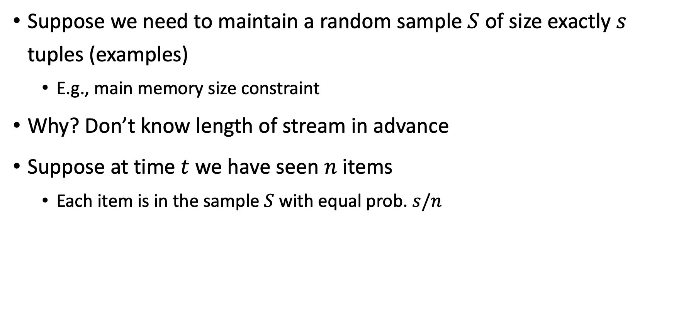
Sampling from Data Streams – Sample a fixed Size sample
Suppose we need to maintain a random sample $S$ of size exactly $s$ tuples (examples)
E.g., main memory size constraint
Why? Don’t know length of stream in advance
Suppose at time $t$ we have seen $n$ items
Each item is in the sample $S$ with equal prob. $s/n$

Slide 16
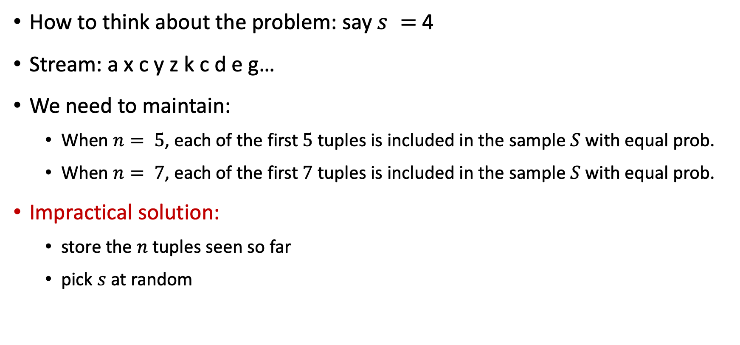
Sampling from Data Streams – Sample a fixed Size sample
How to think about the problem: say $s =$ 4
Stream: a x c y z k c d e g…
We need to maintain:
When $n= 5$, each of the first $5$ tuples is included in the sample $S$ with equal prob.
When $n= 7$, each of the first $7$ tuples is included in the sample $S$ with equal prob.
Impractical solution:
store the $n$ tuples seen so far
pick $s$ at random

Slide 17
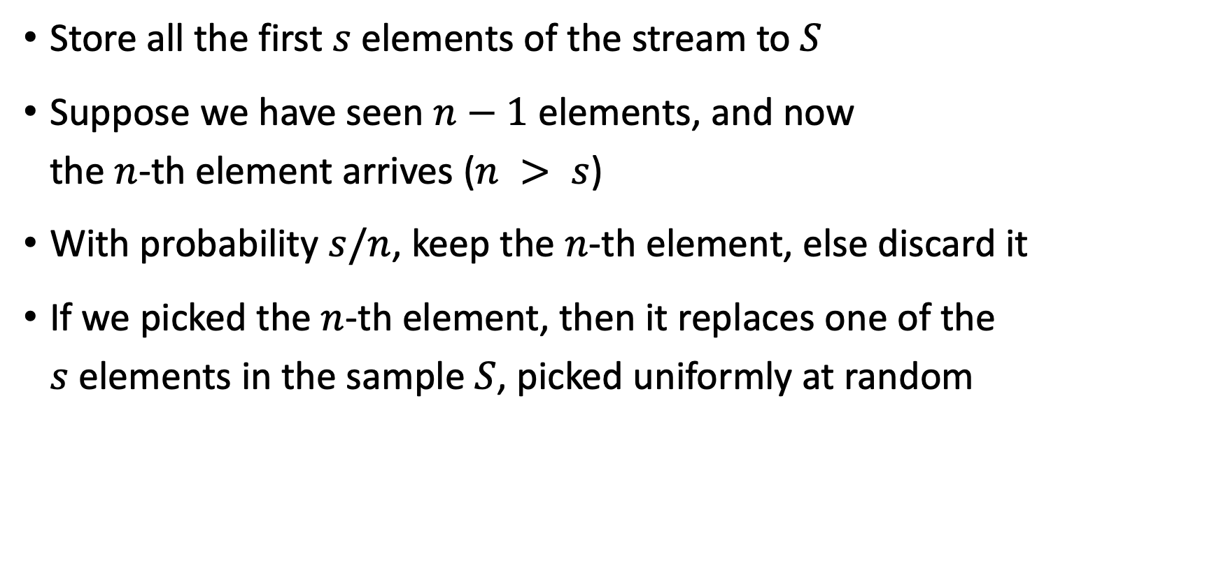
Sampling from Data Streams – Reservoir Sampling
Store all the first $s$ elements of the stream to $S$
Suppose we have seen $n−1$ elements, and now the $n$-th element arrives ($n > s$)
With probability $s/n$, keep the $n$-th element, else discard it
If we picked the $n$-th element, then it replaces one of the $s$ elements in the sample $S$, picked uniformly at random

Slide 18










Sampling from Data Streams – Reservoir Sampling
Discard
p = 0
p = 0
p = 0
p = 0
p = 0
Stream
$$a_{1}$$
$$a_{2}$$
$$a_{3}$$
$$a_{4}$$
$$a_{5}$$
p = 1
p = 1
p = 1
Select
p = 1
p = 1
$$a_{1}$$ | $$a_{2}$$ | $$a_{3}$$ | $$a_{4}$$ | $$a_{5}$$
$$a_{1}$$ | $$a_{2}$$ | $$a_{3}$$ | $$a_{4}$$
$$a_{1}$$ | $$a_{2}$$
$$a_{1}$$
Reservoir
$$a_{1}$$ | $$a_{2}$$ | $$a_{3}$$
p = 0
p = 0
Discard
p = 0
p = 0

Slide 19

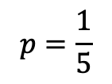
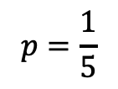


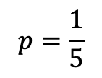

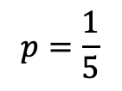
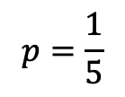
Sampling from Data Streams – Reservoir Sampling
Discard
$$p=1/6$$
Stream
$$a_{1}$$
$$a_{2}$$
$$a_{3}$$
$$a_{4}$$
$$a_{5}$$
$$a_{6}$$
Select
$$p=5/6$$
Reservoir
$$a_{1}$$ | $$a_{2}$$ | $$a_{3}$$ | $$a_{4}$$ | $$a_{5}$$
$$p=\frac{1}{5}$$
$$p=\frac{1}{5}$$
$$p=\frac{1}{5}$$
Discard
$$p=\frac{1}{5}$$
$$p=\frac{1}{5}$$

Slide 20

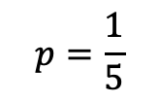
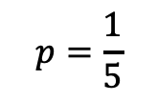




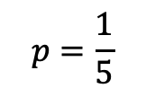
Sampling from Data Streams – Reservoir Sampling
Discard
$$p=(n−5)/n$$
Stream
$$a_{1}$$
$$a_{2}$$
$$a_{3}$$
$$a_{4}$$
$$a_{5}$$
…
…
…
…
…
$$a_{n−1}$$
$$a_{n}$$
…
…
…
Select
$$p=5/n$$
Reservoir
$$a_{s1}$$ | $$a_{s2}$$ | $$a_{s3}$$ | $$a_{s4}$$ | $$a_{s5}$$
$$p=\frac{1}{5}$$
$$p=\frac{1}{5}$$
$$p=\frac{1}{5}$$
Discard
$$p=\frac{1}{5}$$
$$p=\frac{1}{5}$$

Slide 21
Windowing Models

Slide 22
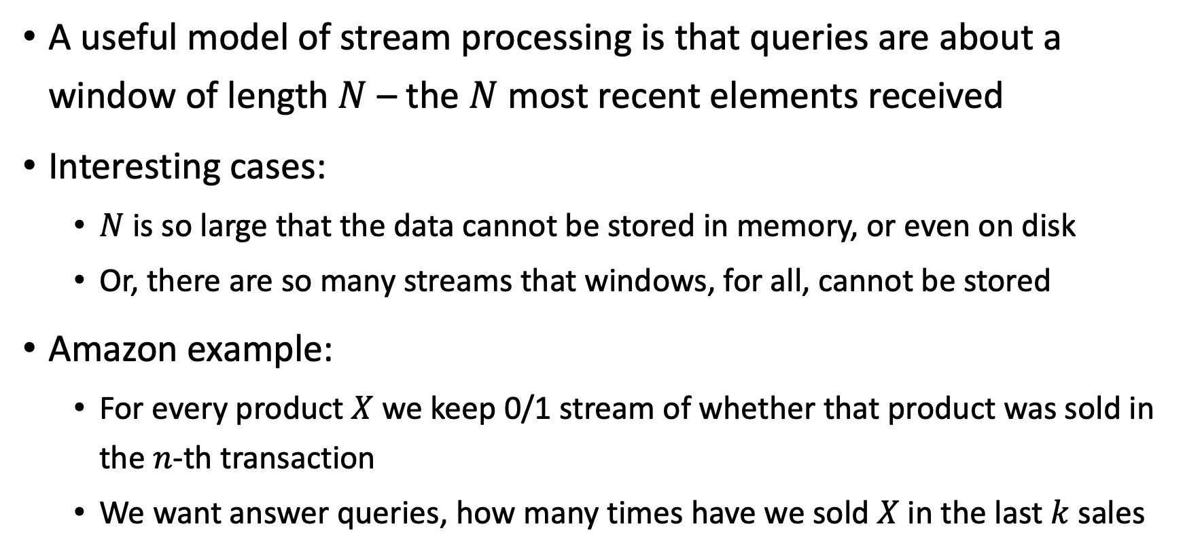
Windowing Models
A useful model of stream processing is that queries are about a window of length $N$ – the $N$ most recent elements received
Interesting cases:
$N$ is so large that the data cannot be stored in memory, or even on disk
Or, there are so many streams that windows, for all, cannot be stored
Amazon example:
For every product $X$ we keep 0/1 stream of whether that product was sold in the $n$-th transaction
We want answer queries, how many times have we sold $X$ in the last $k$ sales

Slide 23
Sliding Window
Past Future
q w e r t y u i o p a s d f g h
q w e r t y u i o p a s d f g h j
N = 6
q w e r t y u i o p a s d f g h j k
q w e r t y u i o p a s d f g h j k l
Upon the arrival of a new item from the stream
Discard the oldest item

Slide 24
Tumbling Window (Disjoint Windows)
Past Future
q w e r t y
q w e r t y u i o p a s
N = 6
q w e r t y u i o p a s d f g h j k
q w e r t y u i o p a s d f g h j k l g m s p v
Upon the arrival of a new batch of items (of size N) from the stream
Discard the previous batch

Slide 25
Hopping Window
Past Future
q w e r t y
N = 6,
Step = 2
q w e r t y u i
q w e r t y u i o p
q w e r t y u i o p a s
Upon the arrival of a new (Step) of items from the stream
Keep the last N items only

Slide 26
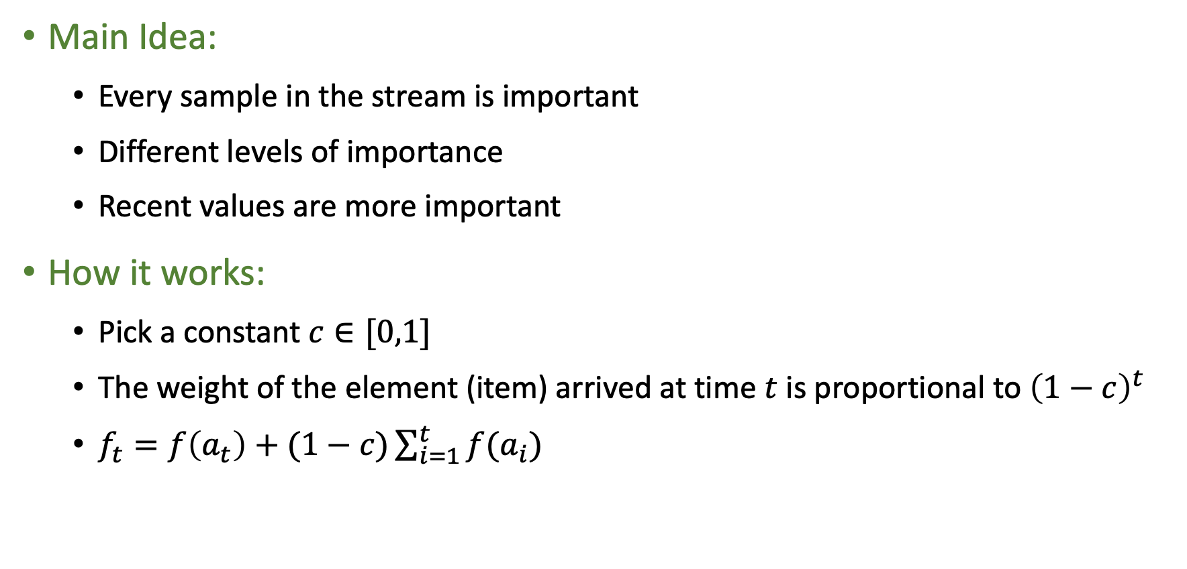
Exponentially Decaying Windows
Main Idea:
Every sample in the stream is important
Different levels of importance
Recent values are more important
How it works:
Pick a constant $c∈[0,1]$
The weight of the element (item) arrived at time $t$ is proportional to ${\left(1−c\right)}^{t}$
$f_{t}=f\left(a_{t}\right)+(1−c)\sum_{i=1}^{t}{f(a_{i})}$

Slide 27
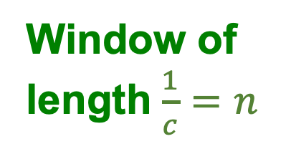
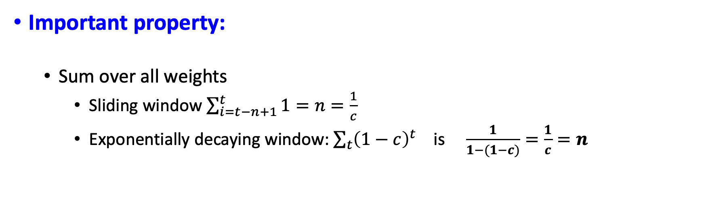
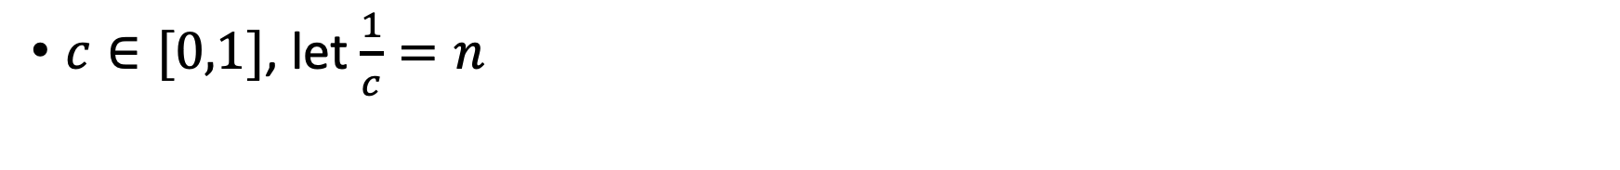
Sliding vs Exponentially Decaying Windows
$c∈[0,1]$, let $\frac{1}{c}=n$
. . .
Window of length $\frac{1}{c}=n$
Important property:
Sum over all weights
Sliding window $\sum_{i=t−n+1}^{t}{1}=n=\frac{1}{c}$
Exponentially decaying window: $\sum_{t}{{\left(1−c\right)}^{t}}$ is $\frac{1}{1−(1−c)}=\frac{1}{c}=n$

Slide 28
Examples of Queries over Data Streams

Slide 29
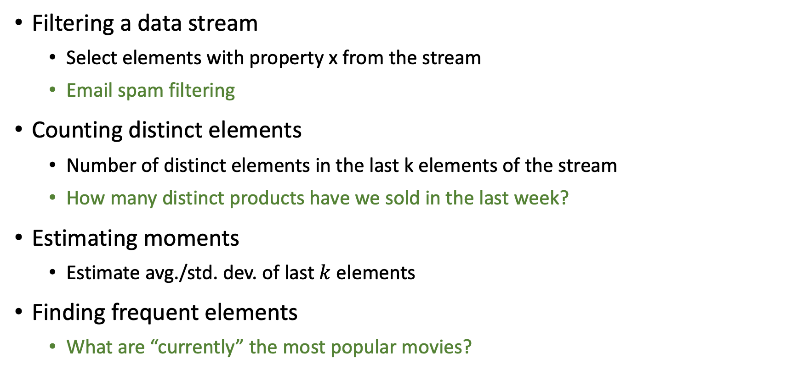
Querying Data Streams (Examples)
Filtering a data stream
Select elements with property x from the stream
Email spam filtering
Counting distinct elements
Number of distinct elements in the last k elements of the stream
How many distinct products have we sold in the last week?
Estimating moments
Estimate avg./std. dev. of last $k$ elements
Finding frequent elements
What are “currently” the most popular movies?

Slide 30
Filtering Data Streams

Slide 31
Filtering Data Streams
Given: a set of Keys S
Determine: which tuples of the stream are in S
Obvious solution: Hash Table
Problem: we may not have enough memory

Slide 32
Filtering Data Streams
Output the item since it may be in S.
Item hashes to a bucket that at least one of the items in S hashed to.
Filter
Item
Hash function h
0010001011000
Bit array B
Drop the item.
It hashes to a bucket set to 0 so it is surely not in S.
If the item in S (set of keys), return it.
If the item is not in S, it may still be returned (no FNs, but FPs)

Slide 33
Filtering Data Streams (discussion)
We have:
|S| = 1M (We have one million legitimate email addresses)
|B| = 1MB (Bit array with 8 million bits)
Question:
What is the probability that an email with un-registered address is going through?

Slide 34
Filtering Data Streams (discussion)
Approximately 1/8 of the bits will be set to 1
Given a spam email, it will hash to a bit that includes 1 with p = 1/8
Approximately (1/8 = 0.125) of the spam emails may go through.
This is called the false positive ratio (FP ratio)

Slide 35
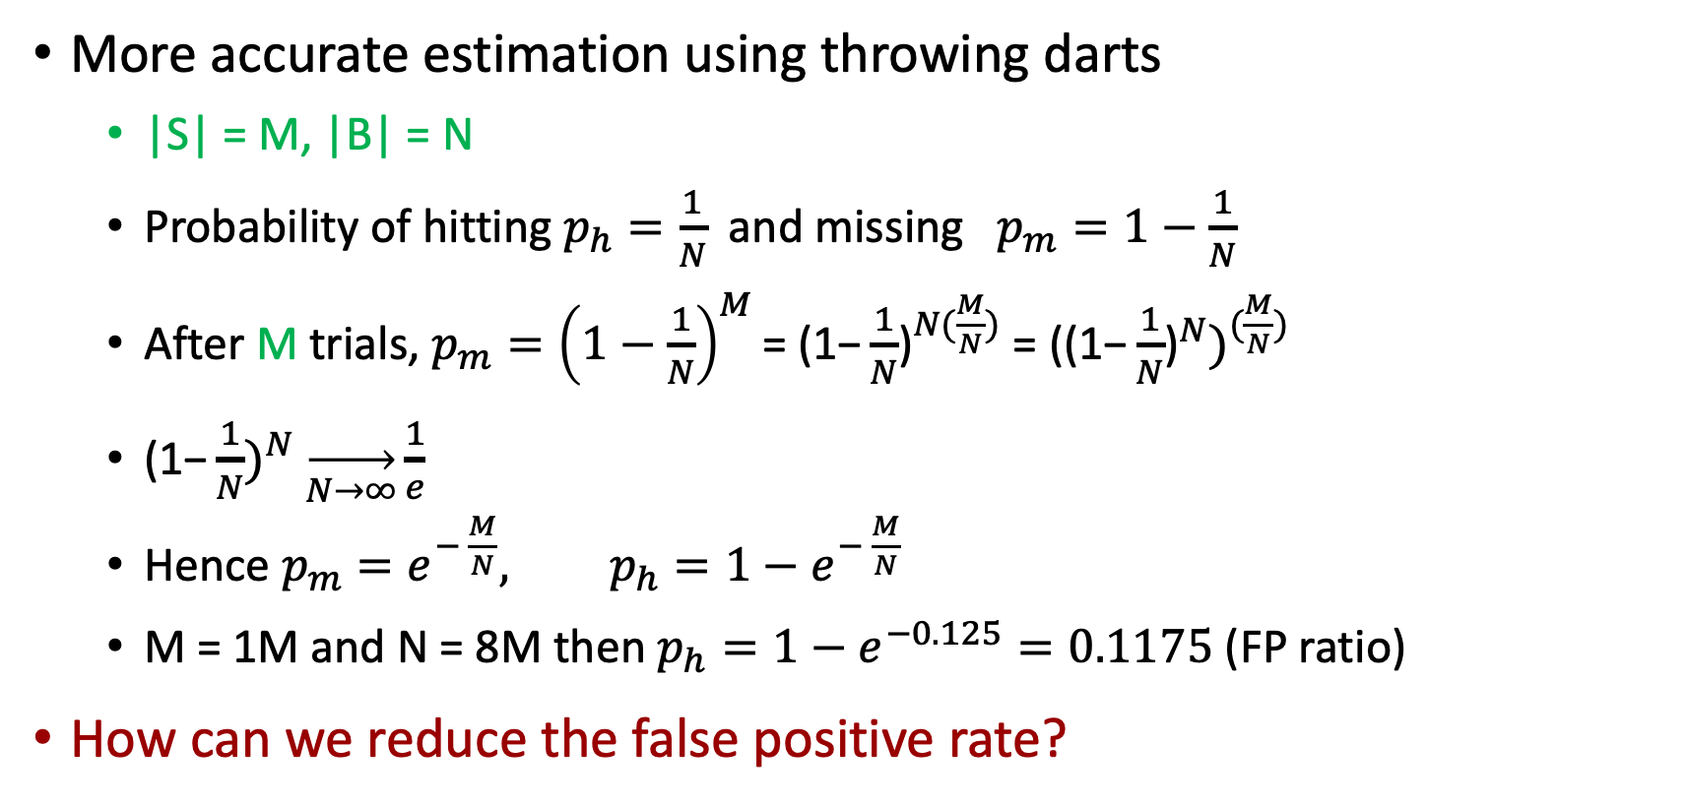
Filtering Data Streams (discussion)
More accurate estimation using throwing darts
|S| = M, |B| = N
Probability of hitting $p_{h}=\frac{1}{N}$ and missing $p_{m}=1−\frac{1}{N}$
After M trials, $p_{m}={\left(1−\frac{1}{N}\right)}^{M}\text{= (1−}\frac{1}{N}{\text{)}}^{N(\frac{M}{N})}\text{ =} \text{(}\text{(1−}\frac{1}{N}{{\text{)}}^{N})}^{(\frac{M}{N})}$
${\text{(1−}\frac{1}{N})}^{N} \overset{→}{N→∞}\frac{1}{e}$
Hence ${p_{m}=e^{− \frac{M}{N}}, p}_{h}=1−e^{− \frac{M}{N}}$
M = 1M and N = 8M then $p_{h}=1−e^{−0.125}=0.1175$ (FP ratio)
How can we reduce the false positive rate?

Slide 36

Bloom Filters
We have:
|S| = M, |B| = N
Use $k$ hashing functions $H = h_{1}, h_{2}, …, h_{k}$
$B←zeros$
FOR $m∈M$ DO
FOR $h_{i}∈H$ DO
${B[h}_{i}\left(m\right)]←1$

Slide 37
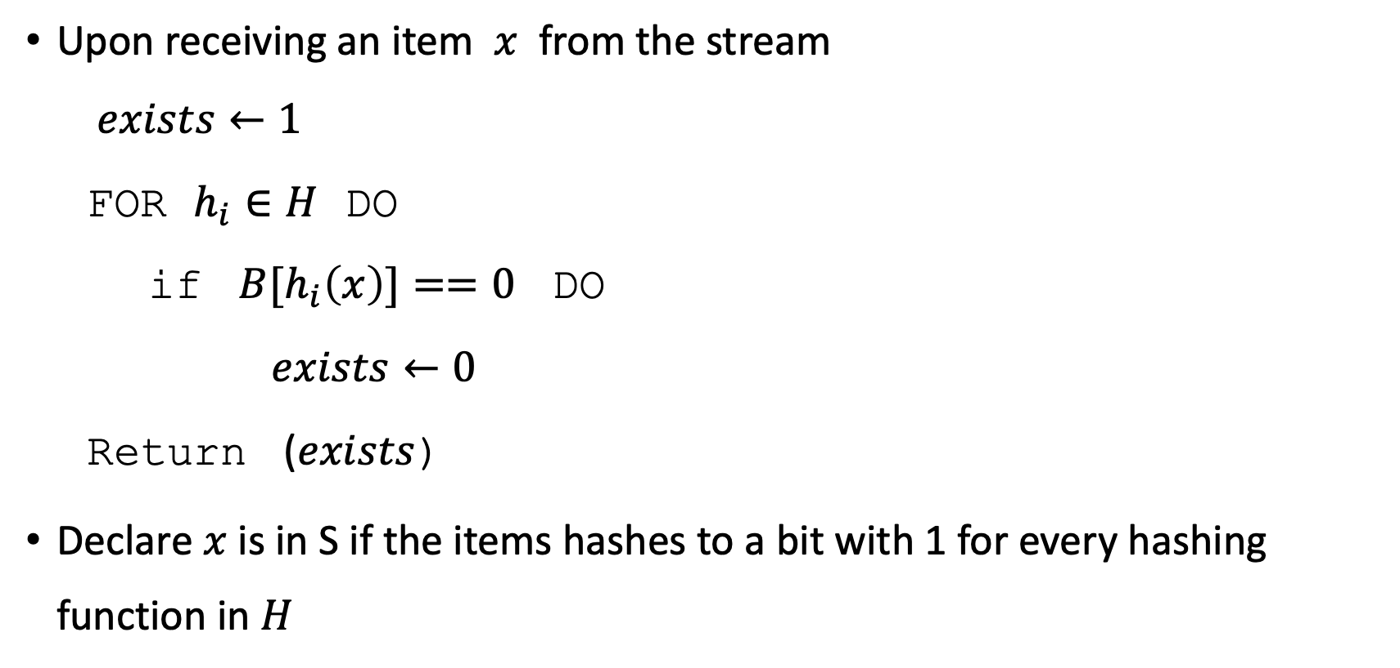
Bloom Filters
Upon receiving an item $x$ from the stream
$exists←1$
FOR $h_{i}∈H$ DO
if ${B[h}_{i}\left(x\right)]==0$ DO
$exists←0$
Return ($exists$)
Declare $x$is in S if the items hashes to a bit with 1 for every hashing function in $H$

Slide 38
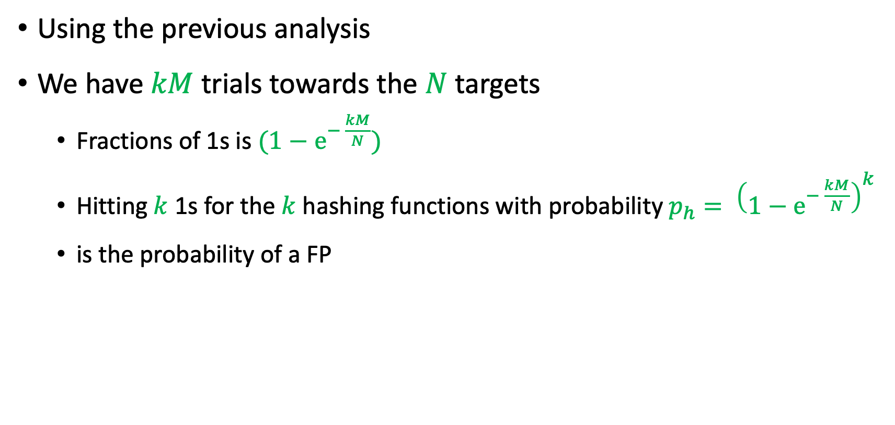
Bloom Filters
Using the previous analysis
We have $kM$ trials towards the $N$ targets
Fractions of 1s is $(1−e^{− \frac{kM}{N}})$
Hitting $k$ 1s for the $k$ hashing functions with probability $p_{h}= {\left(1−e^{− \frac{kM}{N}}\right)}^{k}$
is the probability of a FP

Slide 39
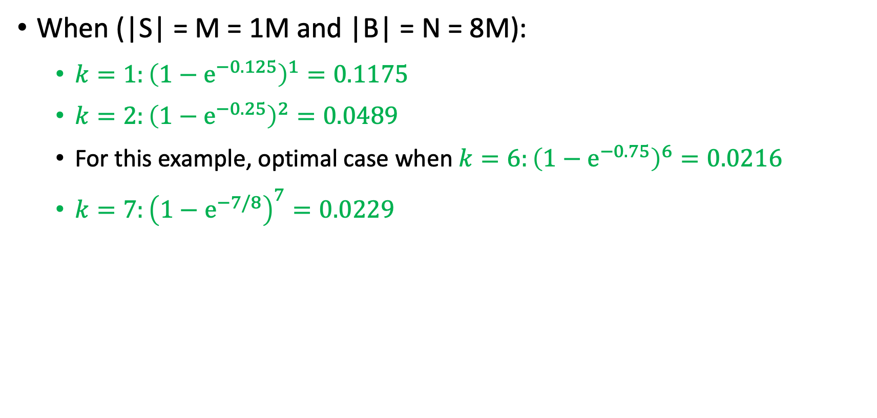
Bloom Filters
When (|S| = M = 1M and |B| = N = 8M):
$k=1:{\left(1−e^{−0.125}\right)}^{1}=0.1175$
$k=2:{\left(1−e^{−0.25}\right)}^{2}=0.0489$
For this example, optimal case when $k=6:{\left(1−e^{−0.75}\right)}^{6}=0.0216$
$k=7:{\left(1−e^{−7/8}\right)}^{7}=0.0229$

Slide 40
Counting Distinct Elements

Slide 41
Counting Distinct Elements
Problem:
Data stream consists of a universe of elements
Maintain a count of the number of distinct elements seen so far
Obvious approach: Maintain the set of elements seen so far
That is, keep a hash table of all the distinct elements seen so far

Slide 42
Example Queries
How many different words are found among the Web pages being crawled at a site?
Unusually low or high numbers could indicate artificial pages (spam?)
How many different Web pages does each customer request in a week?
How many distinct customers accepted to receive promotional offers during the last month?

Slide 43
Using Small Storage
Real problem: What if we do not have space to maintain the set of elements seen so far?
Estimate the count in an unbiased way
Accept that the count may have a little error, but limit the probability that the error is large

Slide 44
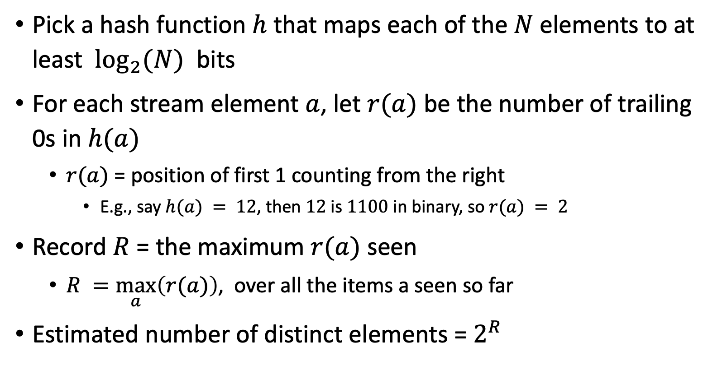
Flajolet-Martin Approach
Pick a hash function $h$ that maps each of the $N$ elements to at least $\log_{2}(N)$ bits
For each stream element $a$, let $r(a)$ be the number of trailing 0s in $h(a)$
$r(a)$ = position of first 1 counting from the right
E.g., say $h(a) = 12$, then $12$ is $1100$ in binary, so $r(a) = 2$
Record $R$ = the maximum $r(a)$ seen
$R =\max_{a}\left(r(a)\right)$, over all the items a seen so far
Estimated number of distinct elements = $2^{R}$

Slide 45
Classification

Slide 46
Classifying Data Streams
Offline classification
train a classifier (model) using labelled examples
the model is used to predict the label for unlabelled instances
Best practices
split the labelled dataset into train/validate/test
maybe use cross-validation to train accurate model
Online (streaming) classification
no clear separation between train/validate/test sets

Slide 47
Classifying Data Streams
Restrictions
process one instance at a time, and inspect it (at most) once
limited time to process each instance
limited memory
be ready to give predictions at any time
adapt to changes (concept drifts)

Slide 48
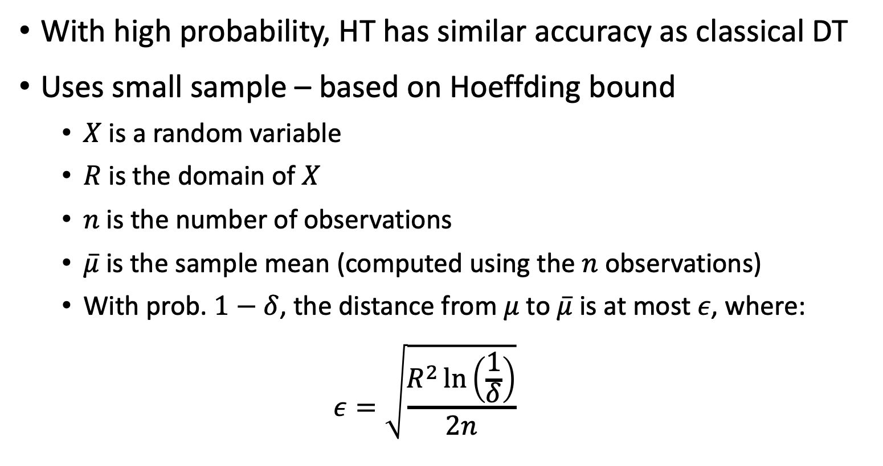
Hoeffding Tree (HT)
With high probability, HT has similar accuracy as classical DT
Uses small sample – based on Hoeffding bound
$X$ is a random variable
$R$ is the domain of $X$
$n$ is the number of observations
$\overline{μ}$ is the sample mean (computed using the $n$ observations)
With prob. $1−δ$, the distance from $μ$ to $\overline{μ}$ is at most $ε$, where:
$$ε=\sqrt{\frac{R^{2}\ln\left(\frac{1}{δ}\right)}{2n}}$$

Slide 49
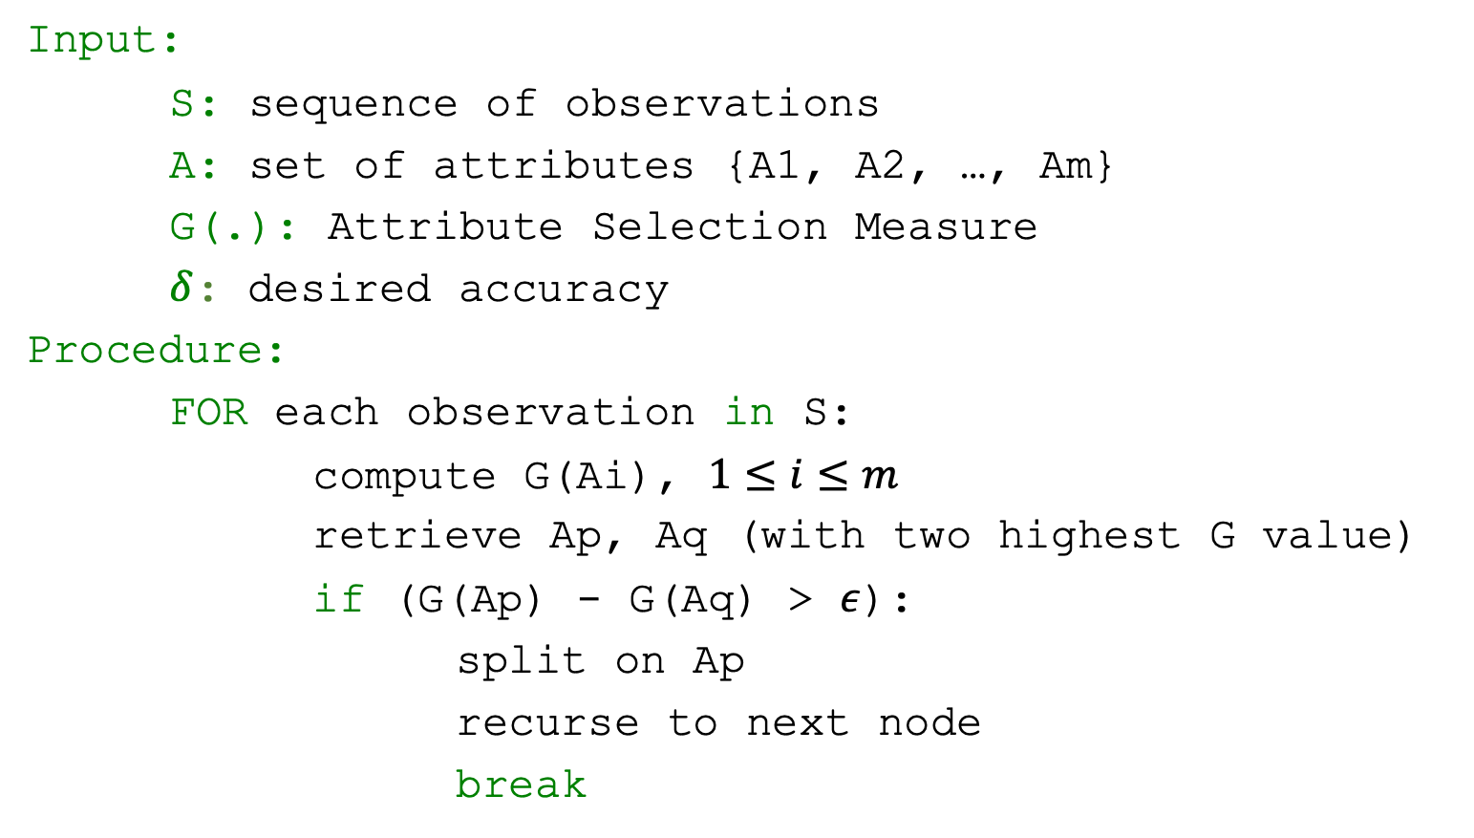
Hoeffding Tree (HT) Algorithm
Input:
S: sequence of observations
A: set of attributes {A1, A2, …, Am}
G(.): Attribute Selection Measure
$δ$: desired accuracy
Procedure:
FOR each observation in S:
compute G(Ai), $1≤i≤m$
retrieve Ap, Aq (with two highest G value)
if (G(Ap) - G(Aq) > $ε$):
split on Ap
recurse to next node
break

Slide 50


Parent Visiting
Data Stream
no
yes
Cinema
Parent Visiting
Data Stream
$$G\left(weather\right)−G\left(has a car\right)>ε$$
no
yes
Weather
Cinema
Sunny
Windy
Money
$$G\left(money\right)−G\left(has a car\right)>ε$$
Play Tennis
Rich
Poor
Shopping
Cinema

Slide 51
HT Strengths and Weaknesses
Strengths
Scales better than traditional methods
Incremental: new examples are added as they come
Weaknesses
Could spend a lot of time with ties
Memory used with tree expansion
Number of candidate attributes

Slide 52
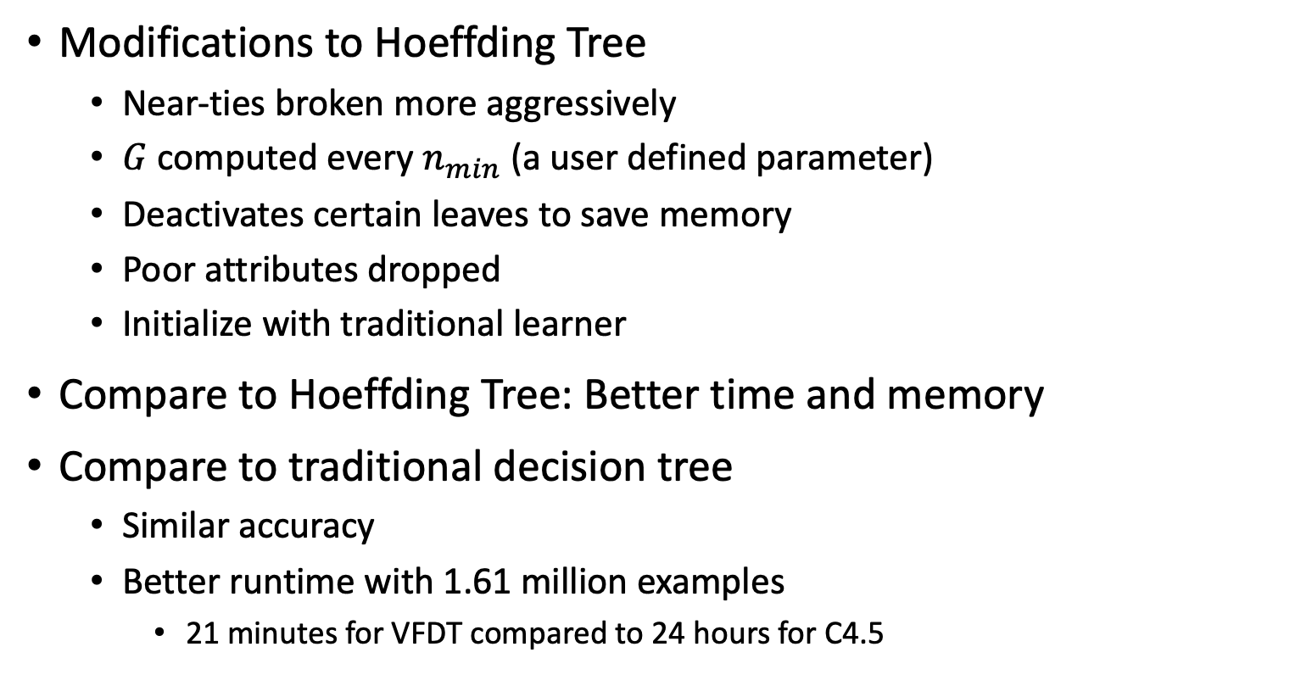
Very Fast Decision Tree (VFDT)
Modifications to Hoeffding Tree
Near-ties broken more aggressively
$G$ computed every $n_{min}$ (a user defined parameter)
Deactivates certain leaves to save memory
Poor attributes dropped
Initialize with traditional learner
Compare to Hoeffding Tree: Better time and memory
Compare to traditional decision tree
Similar accuracy
Better runtime with 1.61 million examples
21 minutes for VFDT compared to 24 hours for C4.5

Slide 53

Wrap-Up
We discussed
The data streams
Models for handling data streams
Example queries over data streams (filtering, counting distinct elements)
Classification and Clustering of Data streams

Slide 54
Next lecture
Process Discovery
Conformance Checking

Slide 55
Extra material for interested students
Not part of the final exam

Slide 56
Does each sample have the same probability to be in the reservoir?

Slide 57
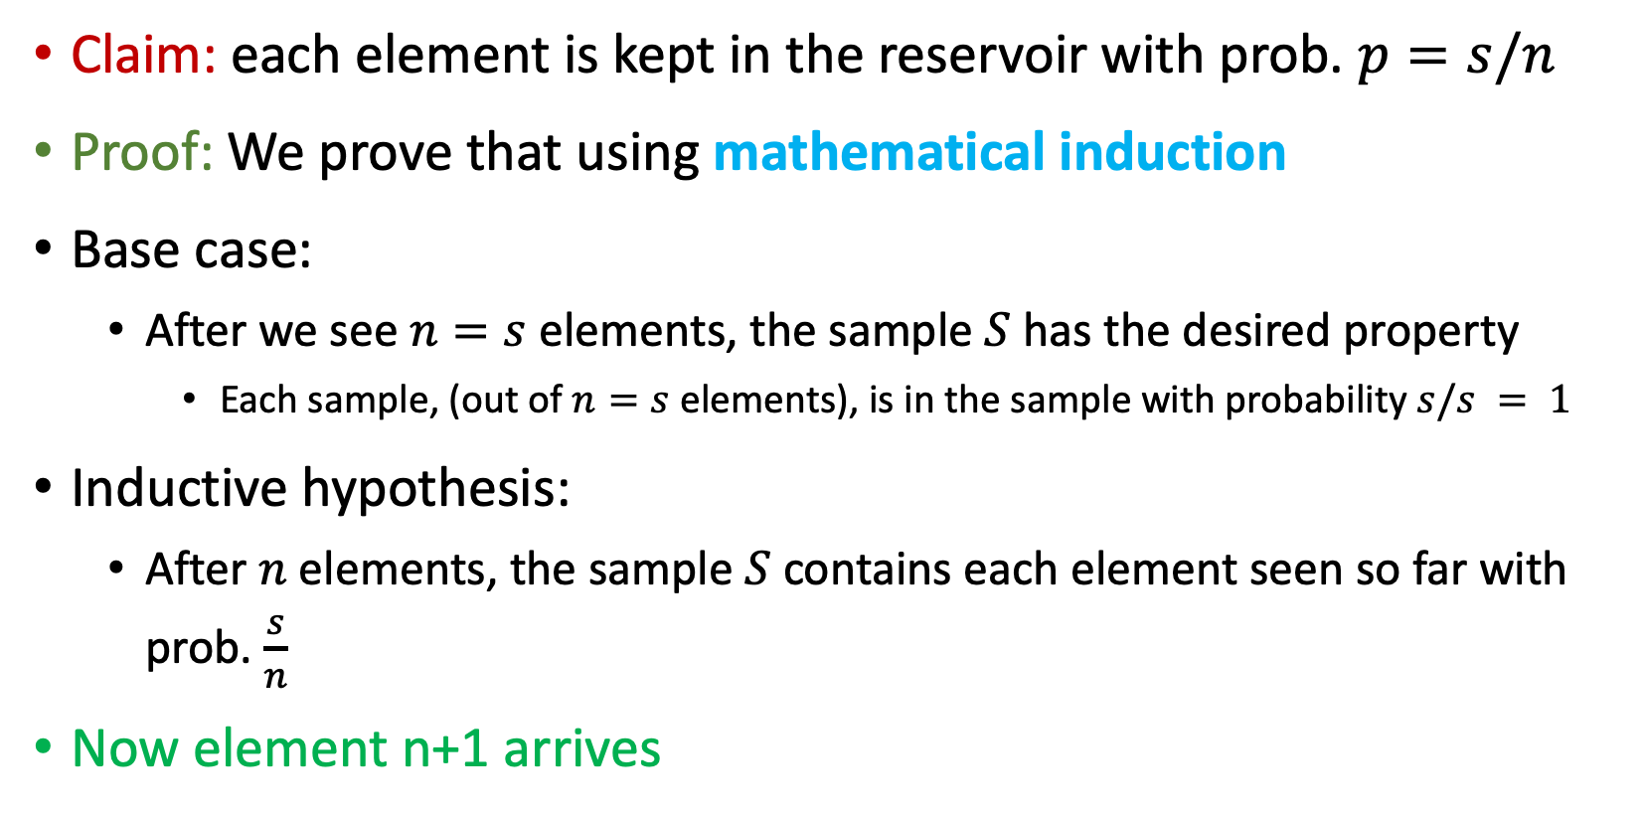
Sampling from Data Streams – Reservoir Sampling
Claim: each element is kept in the reservoir with prob. $p=s/n$
Proof: We prove that using mathematical induction
Base case:
After we see $n=s$ elements, the sample $S$ has the desired property
Each sample, (out of $n=s$ elements), is in the sample with probability $s/s = 1$
Inductive hypothesis:
After $n$ elements, the sample $S$ contains each element seen so far with prob. $\frac{s}{n}$
Now element n+1 arrives

Slide 58
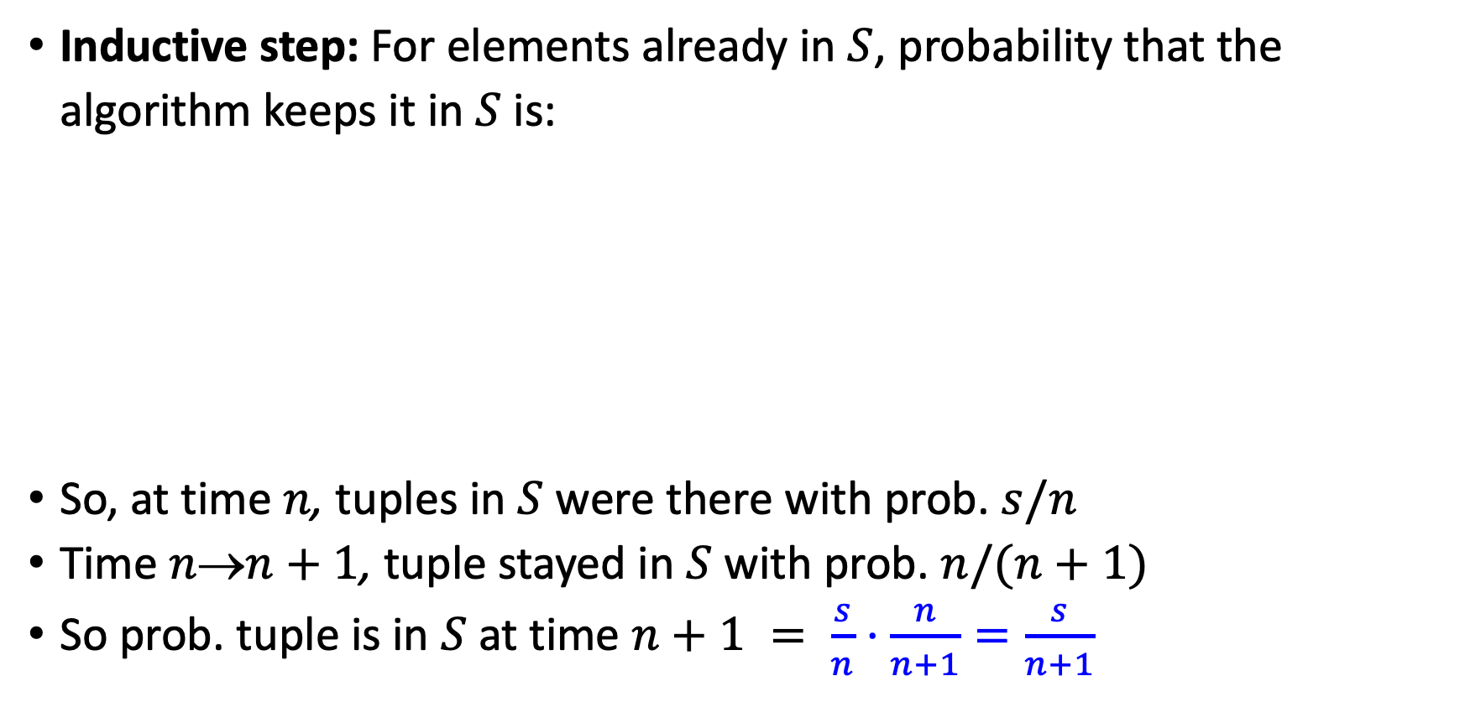
Sampling from Data Streams – Reservoir Sampling
Inductive step: For elements already in $S$, probability that the algorithm keeps it in $S$ is:
So, at time $n$, tuples in $S$ were there with prob. $s/n$
Time $nn+1$, tuple stayed in $S$ with prob. $n/(n+1)$
So prob. tuple is in $S$ at time $n+1 = \frac{s}{n}⋅\frac{n}{n+1}=\frac{s}{n+1}$
Element n+1 discarded
Element n+1 not discarded
Element in the sample not picked

Slide 59
Flajolet-Martin Approach for Counting Distinct Items in Data Streams

Slide 60
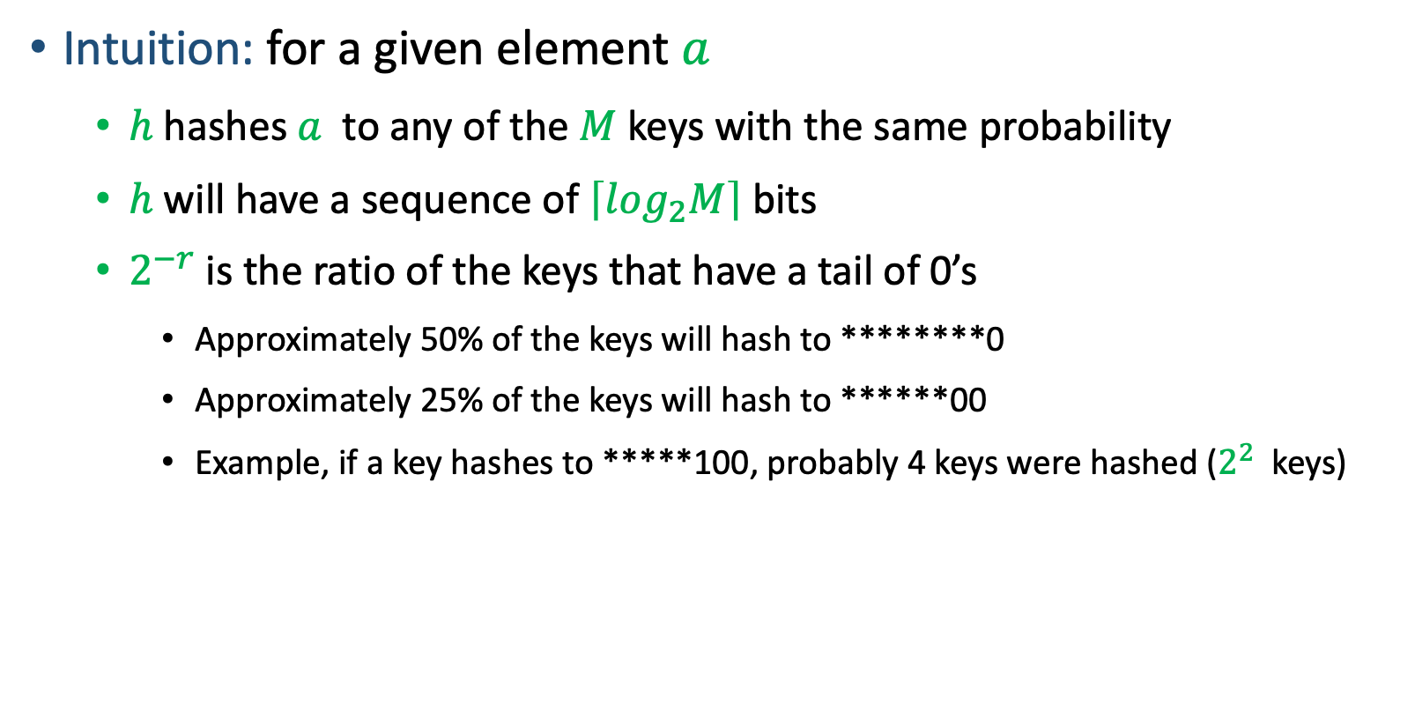
Why Flajolet-Martin Approach Works?
Intuition: for a given element $a$
$h$hashes $a$ to any of the $M$keys with the same probability
$h$will have a sequence of $\left\lceil log_{2}M\right\rceil$ bits
$2^{−r}$is the ratio of the keys that have a tail of 0’s
Approximately 50% of the keys will hash to ********0
Approximately 25% of the keys will hash to ******00
Example, if a key hashes to *****100, probably 4 keys were hashed ($2^{2}$ keys)

Slide 61
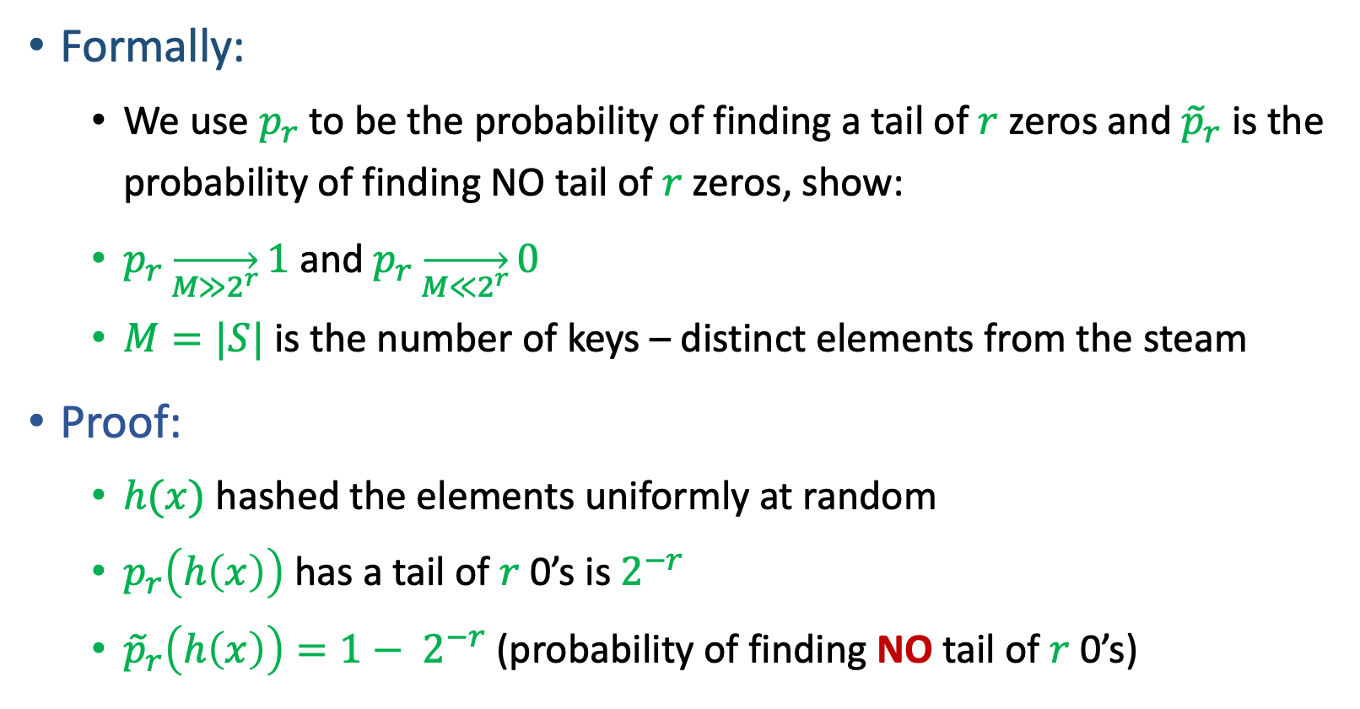
Why Flajolet-Martin Approach Works?
Formally:
We use $p_{r}$ to be the probability of finding a tail of $r$zeros and ${\tilde{p}}_{r}$ is the probability of finding NO tail of $r$zeros, show:
$p_{r}\overset{→}{M≫2^{r}}1$ and $p_{r}\overset{→}{M≪2^{r}}0$
$M=|S|$ is the number of keys – distinct elements from the steam
Proof:
$h(x)$ hashed the elements uniformly at random
$p_{r}\left(h\left(x\right)\right)$ has a tail of $r$ 0’s is $2^{−r}$
${\tilde{p}}_{r}\left(h\left(x\right)\right)=1− 2^{−r}$ (probability of finding NO tail of $r$ 0’s)

Slide 62
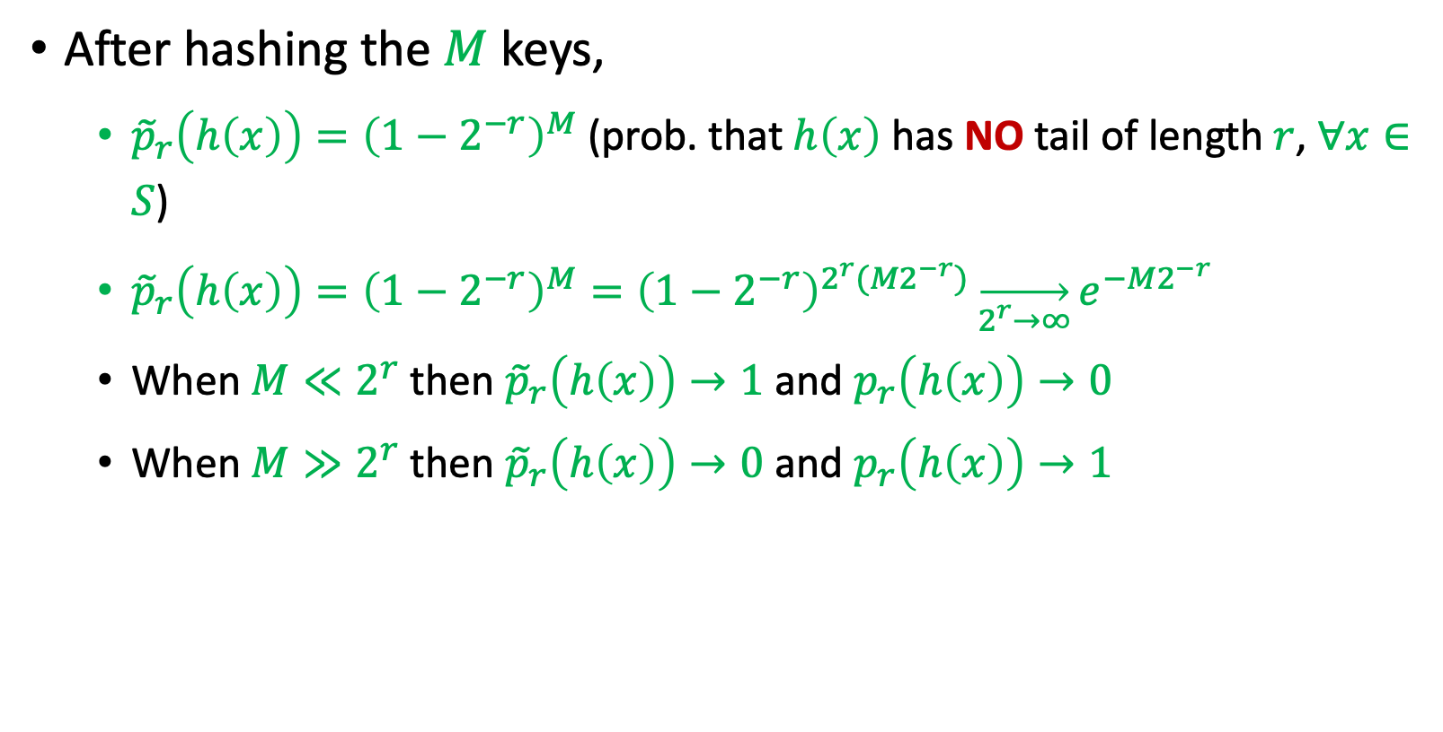
Why Flajolet-Martin Approach Works?
After hashing the $M$ keys,
${\tilde{p}}_{r}\left(h\left(x\right)\right)={\left(1−2^{−r}\right)}^{M}$ (prob. that $h\left(x\right)$ has NO tail of length $r$, $∀x∈S$)
${\tilde{p}}_{r}\left(h\left(x\right)\right)={\left(1−2^{−r}\right)}^{M}={\left(1−2^{−r}\right)}^{2^{r}(M2^{−r})}\overset{→}{2^{r}→∞}e^{−M2^{−r}}$
When $M≪2^{r}$ then ${\tilde{p}}_{r}\left(h\left(x\right)\right)→1$ and $p_{r}\left(h\left(x\right)\right)→0$
When $M≫2^{r}$ then ${\tilde{p}}_{r}\left(h\left(x\right)\right)→0$ and $p_{r}\left(h\left(x\right)\right)→1$

Slide 63
Clustering

Slide 64
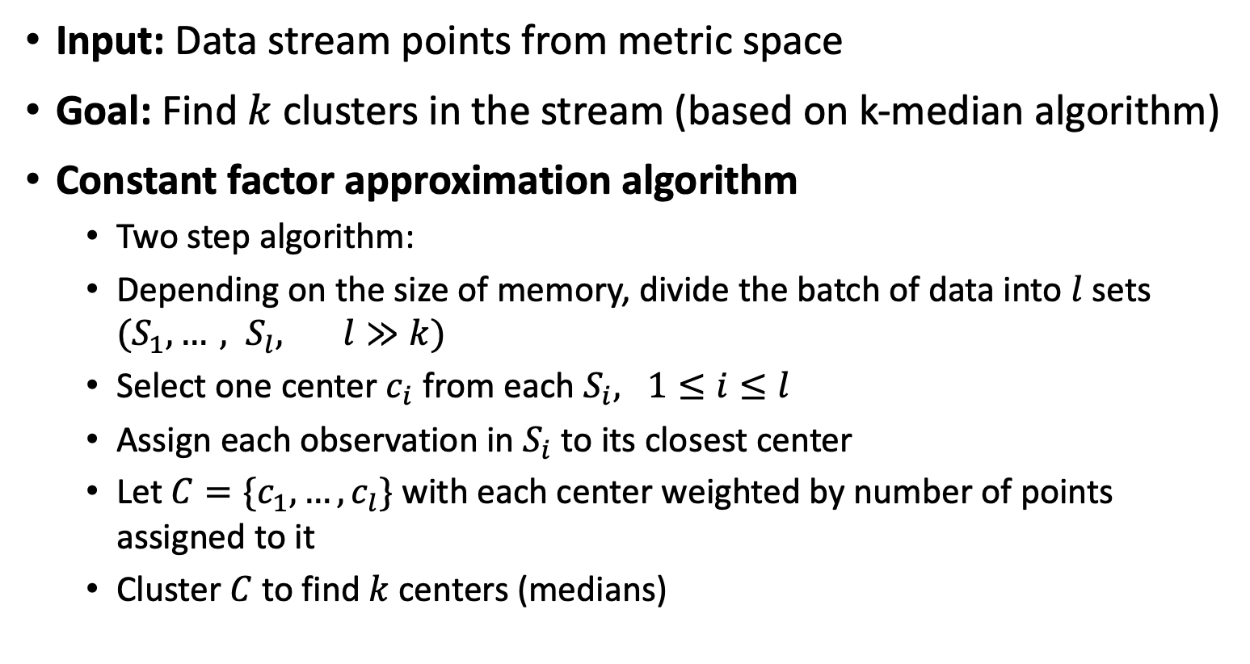
Clustering Data Streams
Input: Data stream points from metric space
Goal: Find $k$ clusters in the stream (based on k-median algorithm)
Constant factor approximation algorithm
Two step algorithm:
Depending on the size of memory, divide the batch of data into $l$ sets $(S_{1}, …, S_{l}, l≫k)$
Select one center $c_{i}$ from each $S_{i}, 1≤i≤l$
Assign each observation in $S_{i}$ to its closest center
Let $C=\{c_{1}, …, c_{l}\}$ with each center weighted by number of points assigned to it
Cluster $C$to find $k$ centers (medians)

Slide 65
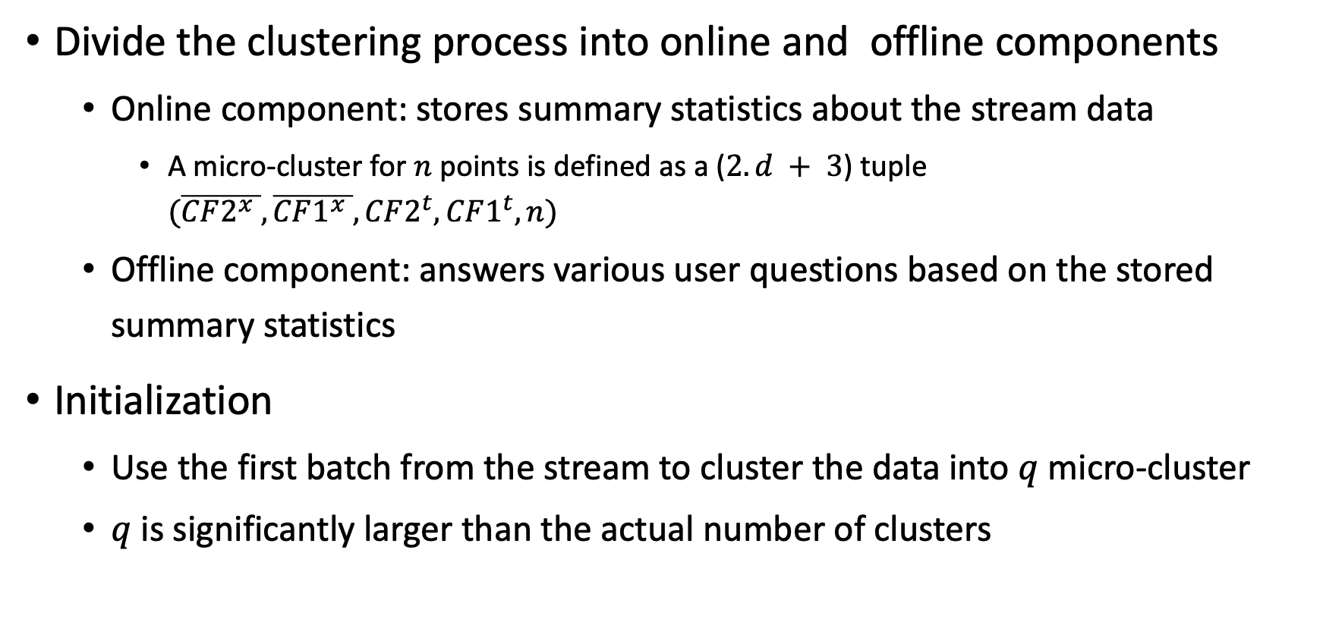
CluStream
Divide the clustering process into online and offline components
Online component: stores summary statistics about the stream data
A micro-cluster for $n$ points is defined as a ($2.d + 3$) tuple $(\overline{CF2^{x} },\overline{CF1^{x} }, CF2^{t}, CF1^{t}, n)$
Offline component: answers various user questions based on the stored summary statistics
Initialization
Use the first batch from the stream to cluster the data into $q$ micro-cluster
$q$ is significantly larger than the actual number of clusters

Slide 66
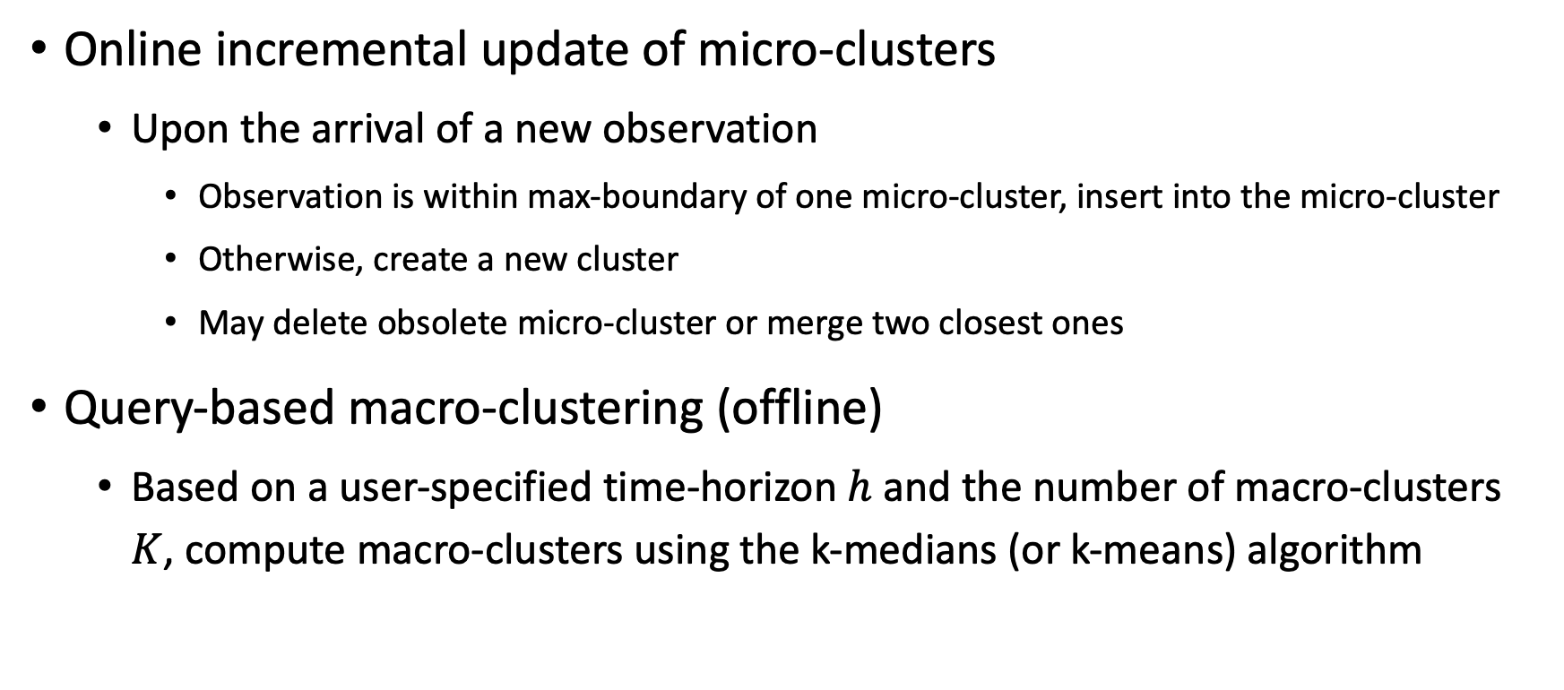
CluStream
Online incremental update of micro-clusters
Upon the arrival of a new observation
Observation is within max-boundary of one micro-cluster, insert into the micro-cluster
Otherwise, create a new cluster
May delete obsolete micro-cluster or merge two closest ones
Query-based macro-clustering (offline)
Based on a user-specified time-horizon $h$ and the number of macro-clusters $K$, compute macro-clusters using the k-medians (or k-means) algorithm

