Slide 1
Please note that these are sample questions for practicing on the concepts and not questions from the exam

Slide 2
Q
a. (2 pnts) Handling the imbalanced data can be done in different ways, list the different techniques that can be used for this purpose. Which one of them is the least feasible technique and why?
b. (2 pnts) Given:
the number of positive/negative examples in a dataset is 600/300
200 examples from the unprivileged group with 120 positive examples
480 positive examples from the privileged group.
We have only privileged/ unprivileged but nothing in between.
Compute the disparate impact ratio and comment on whether this dataset is fair or not and why? (Note: the formula of DI-ratio metric will be given in the exam if you have a question that requires it or the other fairness metrics).

Slide 3
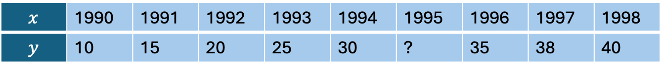
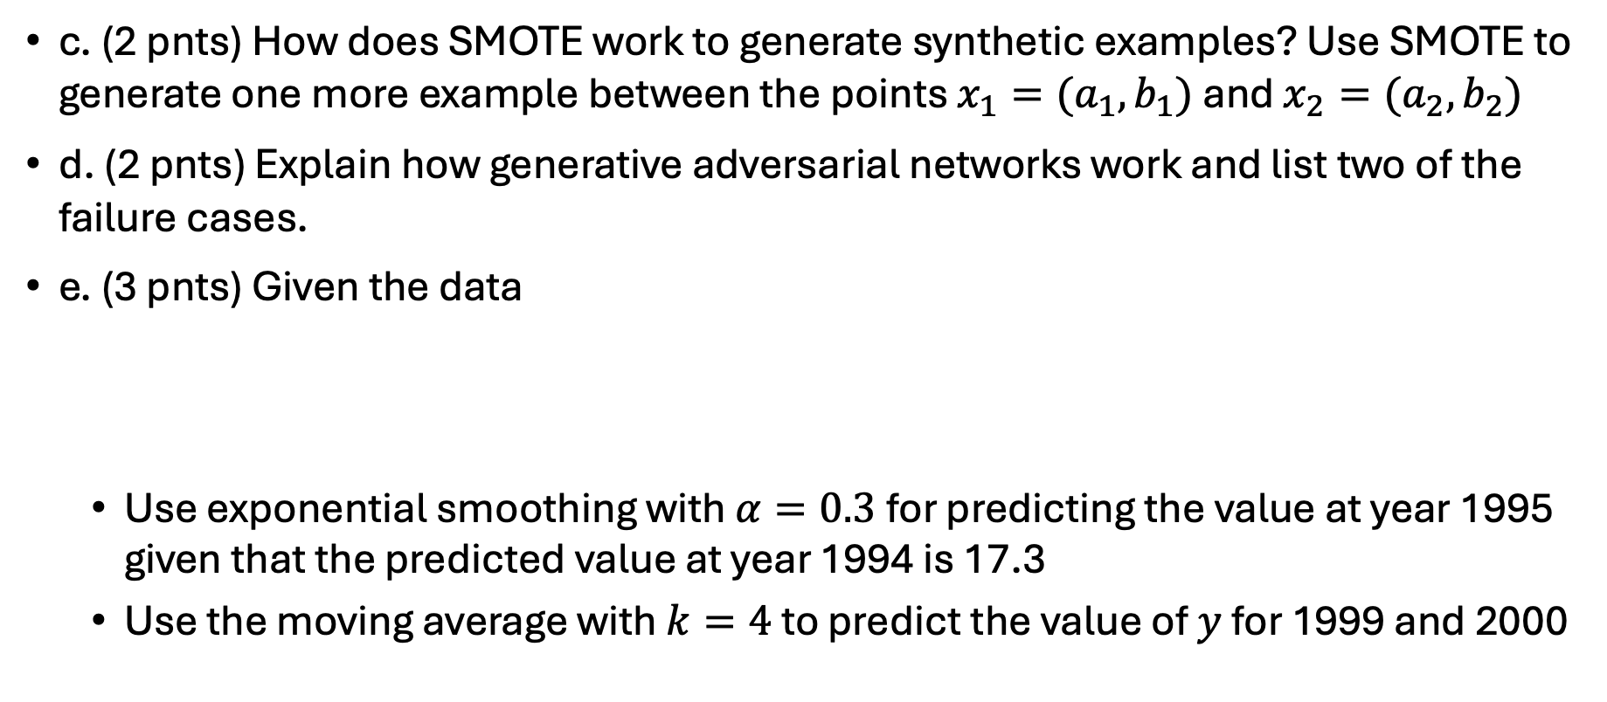
Q
c. (2 pnts) How does SMOTE work to generate synthetic examples? Use SMOTE to generate one more example between the points $x_{1}=(a_{1}, b_{1})$ and $x_{2}=(a_{2}, b_{2})$
d. (2 pnts) Explain how generative adversarial networks work and list two of the failure cases.
e. (3 pnts) Given the data
Use exponential smoothing with $α=0.3$for predicting the value at year 1995 given that the predicted value at year 1994 is 17.3
Use the moving average with $k=4$ to predict the value of $y$ for 1999 and 2000
$$x$$ | 1990 | 1991 | 1992 | 1993 | 1994 | 1995 | 1996 | 1997 | 1998
$$y$$ | 10 | 15 | 20 | 25 | 30 | ? | 35 | 38 | 40

Slide 4
A
a. (2 pnts) Handling the imbalanced data can be done in different ways, list the different techniques that can be used for this purpose. Which one of them is the least feasible technique and why?
Answer:
Imbalanced data can be handled with:
Collecting more sample for the under-represented class
Over/under sample the data
Generate synthetic data
Use cost sensitive classifier
Use ensemble of classifiers
Which one of them is the least feasible technique and why?
The least feasible technique is collecting more samples as this requires a long time and there is no control on how to get more examples from the under-represented class.

Slide 5
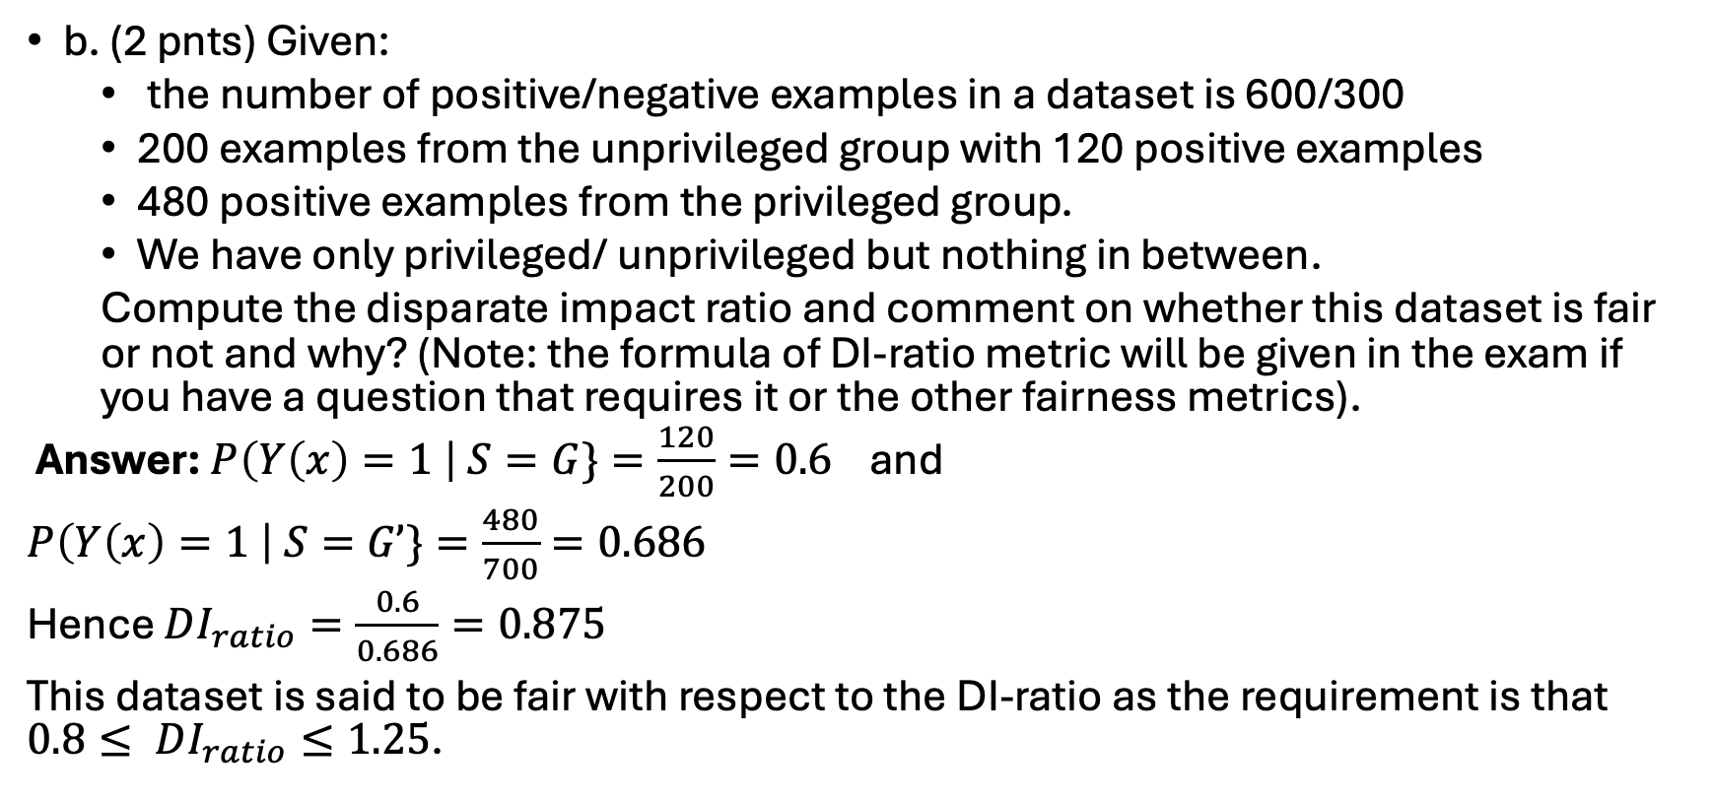
A
b. (2 pnts) Given:
the number of positive/negative examples in a dataset is 600/300
200 examples from the unprivileged group with 120 positive examples
480 positive examples from the privileged group.
We have only privileged/ unprivileged but nothing in between.
Compute the disparate impact ratio and comment on whether this dataset is fair or not and why? (Note: the formula of DI-ratio metric will be given in the exam if you have a question that requires it or the other fairness metrics).
Answer: $P\left(Y\left(x\right)=1 \right| S=G\}=\frac{120}{200}=0.6$ and
$P\left(Y\left(x\right)=1 \right| S=G’\}=\frac{480}{700}=0.686$
Hence $DI_{ratio}=\frac{0.6}{0.686}=0.875$
This dataset is said to be fair with respect to the DI-ratio as the requirement is that $0.8≤ DI_{ratio}≤1.25$.

Slide 6
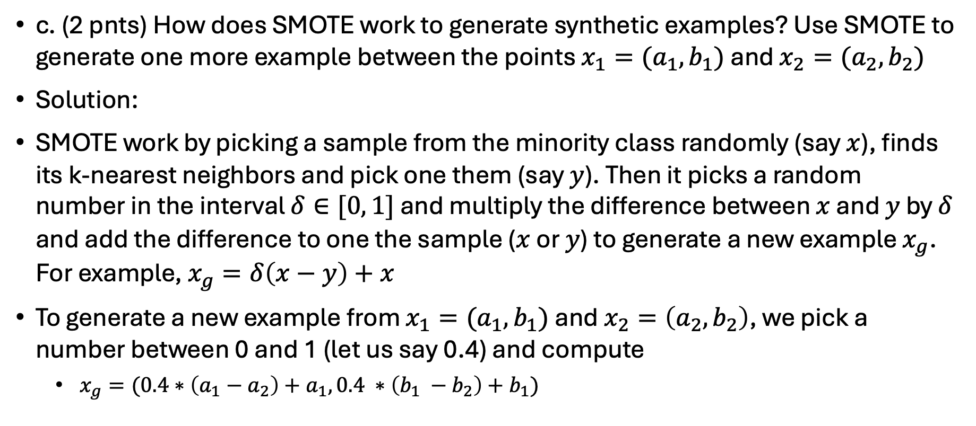
A
c. (2 pnts) How does SMOTE work to generate synthetic examples? Use SMOTE to generate one more example between the points $x_{1}=(a_{1}, b_{1})$ and $x_{2}=(a_{2}, b_{2})$
Solution:
SMOTE work by picking a sample from the minority class randomly (say $x$), finds its k-nearest neighbors and pick one them (say $y$). Then it picks a random number in the interval $δ∈[0, 1]$ and multiply the difference between $x$ and $y$ by $δ$ and add the difference to one the sample ($x$ or $y$) to generate a new example $x_{g}$. For example, $x_{g}=δ\left(x−y\right)+x$
To generate a new example from $x_{1}=(a_{1}, b_{1})$ and $x_{2}=\left(a_{2}, b_{2}\right)$, we pick a number between 0 and 1 (let us say 0.4) and compute
$x_{g}=(0.4∗\left(a_{1}−a_{2}\right)+a_{1}, 0.4 ∗\left(b_{1} −b_{2}\right)+b_{1})$

Slide 7
A
d. (2 pnts) Explain how generative adversarial networks work and list two of the failure cases.
Solution:
Generative adversarial networks consists of two neural networks (generator and discriminator). The two networks compete in a zero-sum game approach, where the generator generates new samples that are similar to the original data and the discriminator classifies the samples as real or fake.
Failure cases:
The discriminator become very strong and correctly identifies all the generated examples
The generator learns only a few specific weaknesses of the discriminator

Slide 8
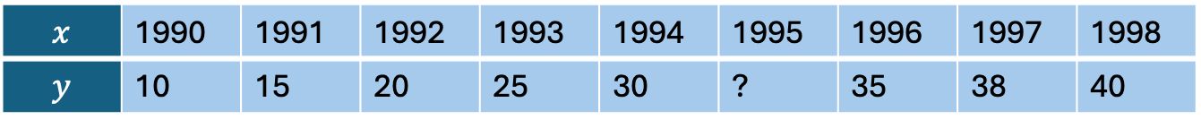
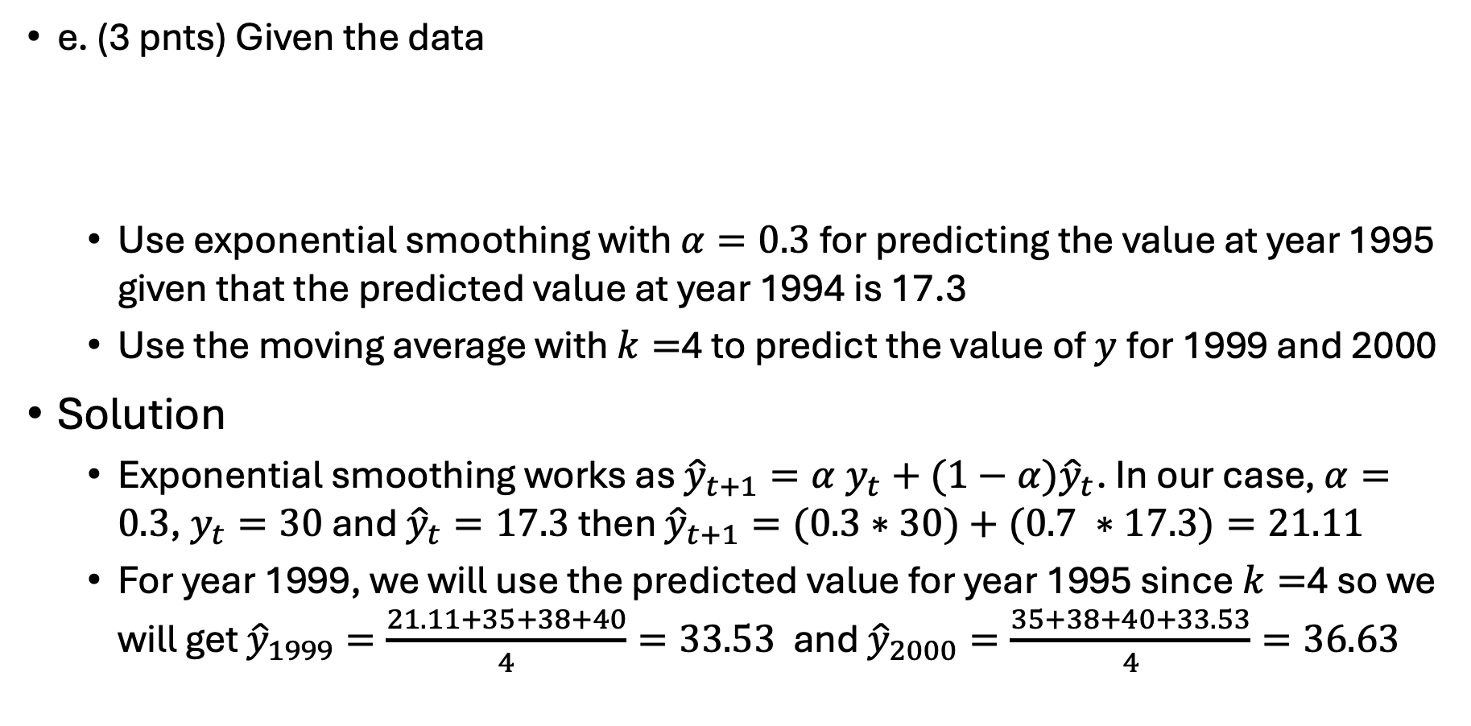
A
e. (3 pnts) Given the data
Use exponential smoothing with $α=0.3$for predicting the value at year 1995 given that the predicted value at year 1994 is 17.3
Use the moving average with $k=$4 to predict the value of $y$for 1999 and 2000
Solution
Exponential smoothing works as ${\hat{y}}_{t+1}={α y}_{t}+(1−α){\hat{y}}_{t}$. In our case, $α=0.3$, $y_{t}=30$ and ${\hat{y}}_{t}=17.3$ then ${\hat{y}}_{t+1}=(0.3∗30)+(0.7 ∗17.3)=21.11$
For year 1999, we will use the predicted value for year 1995 since $k=$4 so we will get ${\hat{y}}_{1999}=\frac{21.11+35+38+40}{4}=33.53$ and ${\hat{y}}_{2000}=\frac{35+38+40+33.53}{4}=36.63$
$$x$$ | 1990 | 1991 | 1992 | 1993 | 1994 | 1995 | 1996 | 1997 | 1998
$$y$$ | 10 | 15 | 20 | 25 | 30 | ? | 35 | 38 | 40

