Slide 1

Our goal is to bridge the gap between academia and industry by providing students with insights from professionals in data science and AI-related fields
UTRECHT DATA SCIENCE COMMUNITY

Slide 2
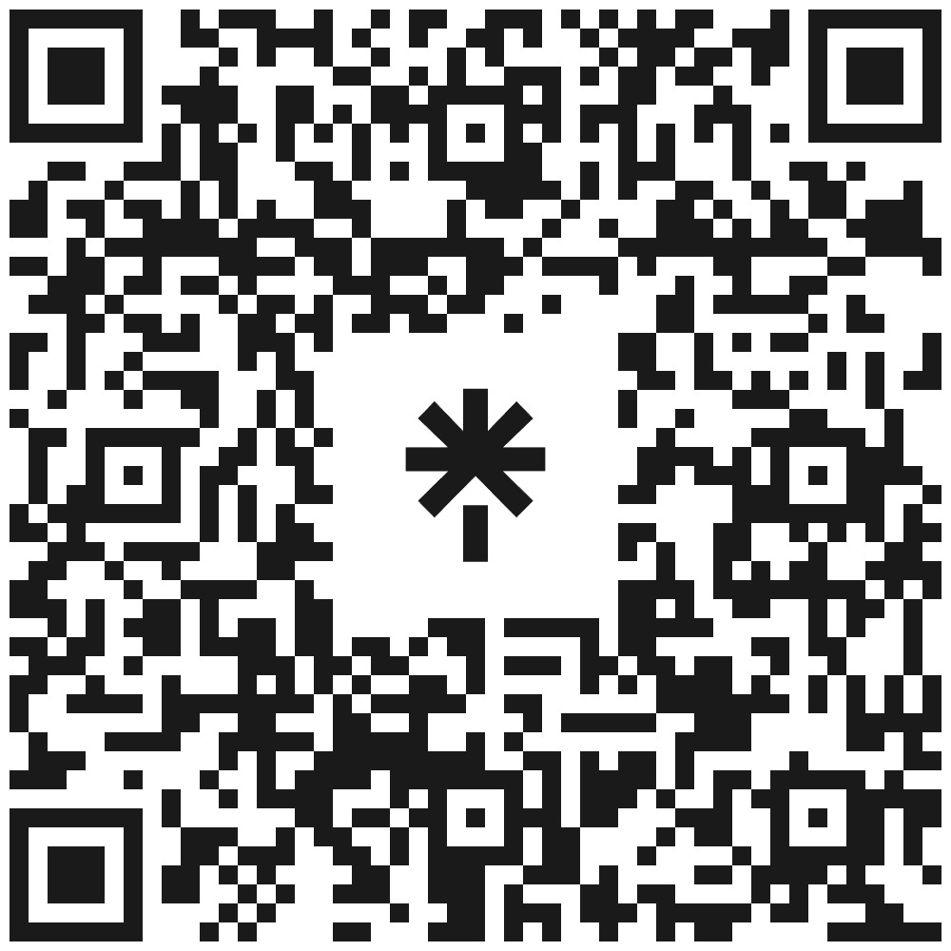
Follow us on Instagram and LinkedIn!
Upcoming events:
Symposium (January)
Inhousedays (May)
Possibly more events!
UTRECHT DATA SCIENCE COMMUNITY

