Slide 1
INFOMDW: Data Wrangling
Introduction to the course
Hakim Qahtan
Department of Information and Computing Sciences
Utrecht University

Slide 2
Today
Who are we?
Introduction to the course content
Getting to know you a little
Break
Practicalities & course flow
Time for questions
But first…

Slide 3
Who are we?

Slide 4
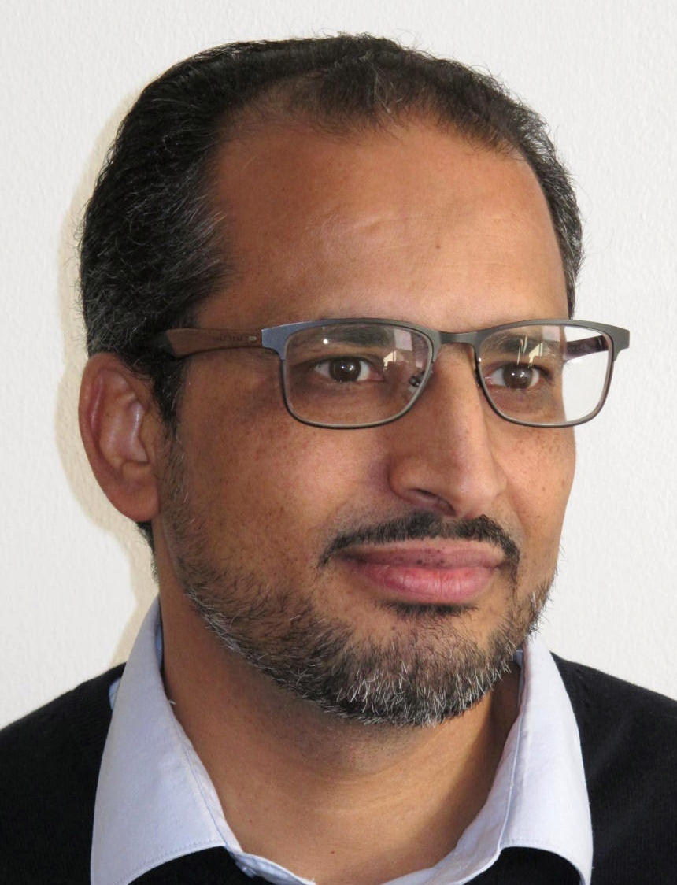
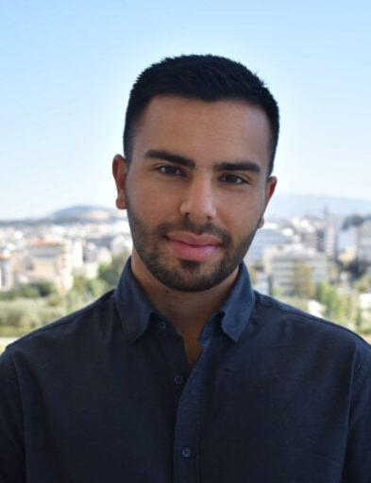
The Teaching team
Hakim Qahtan
a.qahtan@uu.nl
Konstantinos Nikoletos
k.nikoletos@uu.nl

Slide 5
Course introduction

Slide 6



Extracting value from data
Data
Information

Slide 7
KDD process
interpretation /
evaluation
knowledge
data mining
Patterns
transformation
preprocessing
Transformed
Data
select
Preprocessed
Data
Target
Data
Data
KDD = Knowledge Discovery in Databases

Slide 8




We collect a lot of data
Title
Author
<Title> …
<Author> …
<Date> …
Date
Name
Author
paper
© Yannis Velegrakis, UU

Slide 9

Data quality issues
Noise
Missing Values
Duplicate Data
Outdated Values
Outliers
Inconsistent Values
Unreliable sources
For any data retrieval or data analytiscs task,
it is critically important to know the quality of your data
For the US alone, poor data quality costs around US economy $3 trillions a year (2016).

Slide 10
Data preparation
Transformation
Integration
Cleaning
Discretization
Reduction

Slide 11

How are you going to spend your time?
Other
Building Training Set
Refining Algorithms
Mining Data for Patterns
Cleaning +
Organizing
Data Scientists: 80% of their time looking for and cleaning the data
Sometimes, they are called data janitors

Slide 12

Data Wrangling

Slide 13
Additional Topics
Ad-Hoc
Queries
Processor
. . . 1, 5, 2, 7, 0, 9, 3
. . . a, r, v, t, y, h, b
. . . 0, 0, 1, 0, 1, 1, 0
time
Streams Entering.
Each is stream is composed of elements/tuples
Standing
Queries
Output
negatives
positives
Bias detection
Limited
Working
Storage
Archival
Storage
Algorithmic Fairness

Slide 14




This course is not
Database course
Systems course
Artificial intelligence course
Machine learning course

Slide 15
https://app.wooclap.com/DW2627

Slide 16
Break

Slide 17
Practicalities

Slide 18
https://hqahtan.github.io/teaching.html

Slide 19
Practicalities
Everything is on the course website https://hqahtan.github.io/teaching.html, except:
Room locations (on mytimetable.uu.nl)
Announcements (in your email and on uu.brightspace.com)
Assignment hand-in (on uu.brightspace.com)
Exams (on the university digital assessment tool Remindo)
Lectures / tutorials will be in person
🚧 materials on the website are constantly under construction 🏗️

Slide 20
Course flow
This is a mandatory course.
Every* week you will:
📃Read the required readings
👩‍🏫Attend the lectures: Tuesday, Thursday
💻Attend and work on the hands-on tutorials: Thursday
🧑‍🤝‍🧑Work on the group and the individual assignments
🍸Review materials diligently for the midterm and final exams
* some weeks contain other stuff like exams and study time

Slide 21
Schedule & readings
The course website contains a full schedule with required readings
Reading materials can be found online for free!🕵️(you are resourceful students)

Slide 22
Lectures: Prepare for next lecture!
Look up reading materials in course website
Look up time and location for the lecture

Slide 23
Tutorials
Hands-on tutorials with practical exercises
Put into practice what you learnt in the lectures
We incorporate real-world data and use-cases: APPLIED data science!
One session per week with practical exercises from the theoretical lectures
The teaching assistant is your main point of contact for questions!
Tutorials provide skills needed to do the assignments

Slide 24
Assignments
Every two weeks
Assignments are already available on the course website
deadlines on: weeks 3 and 7 for Group assignments and weeks 5 and 9 for individual assignments
Hand in on Brightspace
Group work!
You can assign yourself in a group starting from Friday (tomorrow) until Wednesday next week.
Plan ahead

Slide 25
Assignments: prepare!
When is the deadline of the first assignment?
Check the course website
Quickly check the content of the first assignment
Log in to Brightspace and find the INFOMDWR course
If we were organized coordinators:
Find the group sign-up page there to see how you can sign up
Find the assignment hand-in page to see how you can submit
If we are disorganized coordinators, don’t worry, it’ll be there soon ☺

Slide 26
Announcements

Slide 27

Join the Teams channel for communication with the ADS admin

Slide 28






ADS OAC is looking for Student Members
ADS Education Advisory Committee (OAC) is looking for three student members
One member (vice-chair) will be a member of GSNS OC
OAC is composed of equal number of staff and student members.

Slide 29


What will you do?
You will:
Review the Caracal evaluations
Comment and give suggestions on the GSNS OER (Education and Examination Rules) and program-wise (ADS) OER Annex
Help in solving other education quality-related issues
Expected time dedication
Weekly average: 2 hours for OAC members, 4 hours for vice-chair (also member of GSNS-OC)
You will be compensated for the time you spent

Slide 30



How to apply?
Interested?
Angelos Chatzimparmpas
a.chatzimparmpas@uu.nl

Slide 31
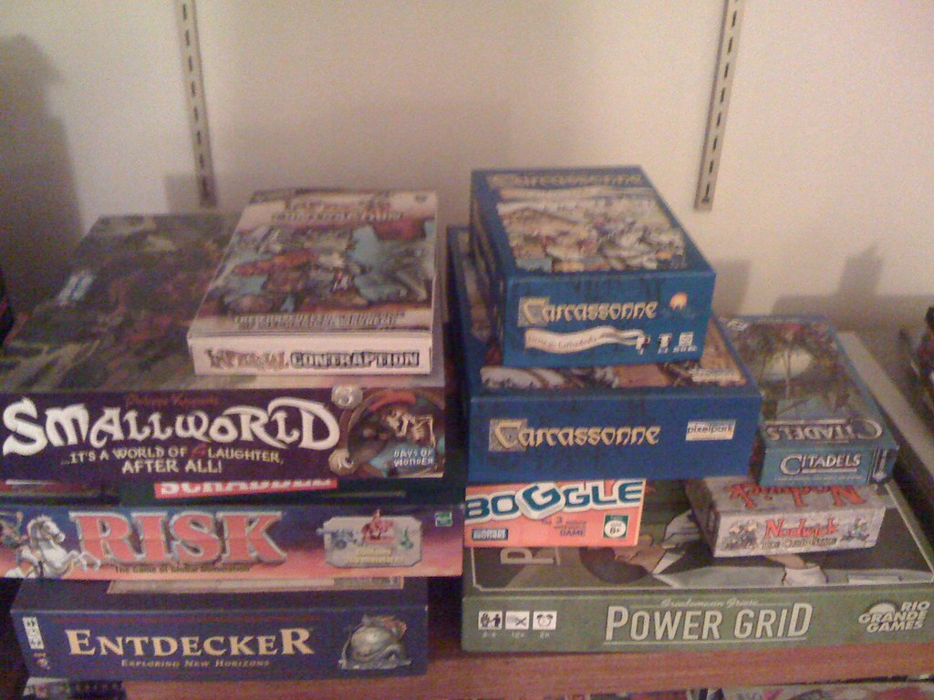
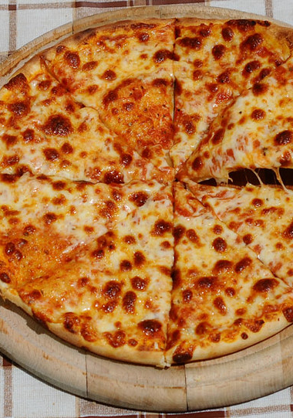
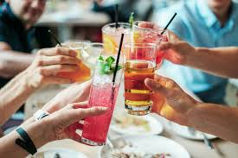
ADS SOCIAL EVENT
LOCATION: The Playground
DATE: THURSDAY SEPTEMBER 17
TIME: 17:00 - 20:00
Come by for a drink and a piece of Pizza, chat with your peers, instructors and play some board games
Volunteers are needed

Slide 32
Further questions?

Slide 33
See you in the tutorial session 👋 First session is optional!

