Slide 1
Data Wrangling and Data Analysis
Hakim Qahtan
Erik-Jan van Kesteren
Ayoub Bagheri

Slide 2
Today
Who are we?
Introduction to the course content
Getting to know you a little
Break
Practicalities & course flow
Time for questions
But first…

Slide 3
Who are we?

Slide 4
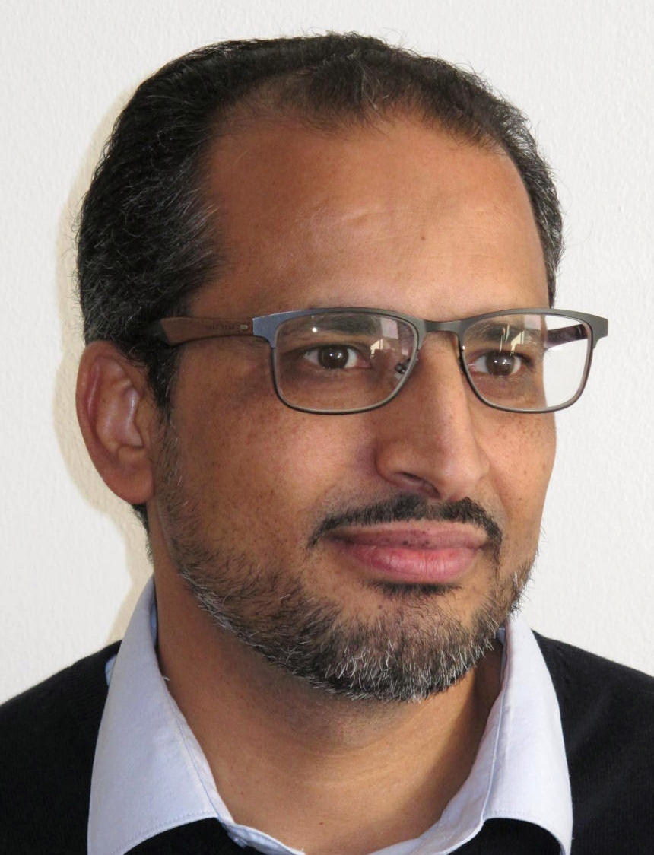
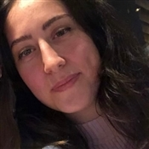
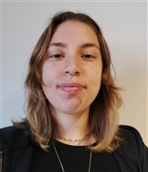

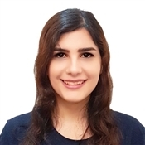

Faculty of Science team
Duygu Islakoglu
d.s.islakoglu@uu.nl
Anastasia S. Apeiron b.s.akkuzu@uu.nl
Hakim Qahtan
a.a.a.qahtan@uu.nl
Ramón Rico Cuevas
r.ricocuevas@uu.nl
Mahsa Ghanavatinasab
m.ghanavatinasab@uu.nl
Vahid Shahrivari Joghan
v.shahrivarijoghan@uu.nl
Lab Group 1
Lab Group 2
Lab Group 3

Slide 5
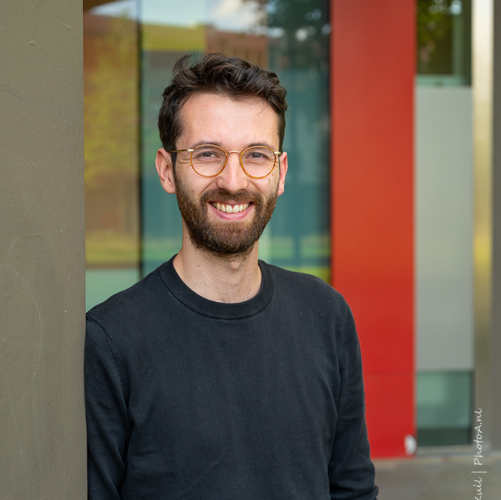
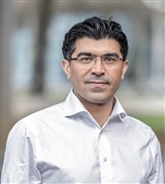
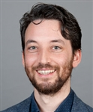
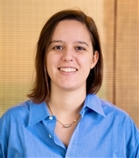
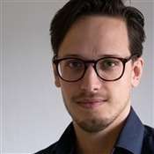

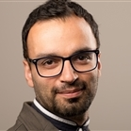
Social & Behavioural Science team
Erik-Jan
e.vankesteren1@uu.nl
Ayoub
a.bagheri@uu.nl
Daniel
d.l.oberski@uu.nl
Elena
e.candellone@uu.nl
Jelle
j.j.teijema@uu.nl
Özgür
o.togay@uu.nl
Mahdi
m.shafieekamalabad@uu.nl

Slide 6
Introduction

Slide 7










Extracting value from data
Data
Information

Slide 8





KDD process
interpretation /
evaluation
knowledge
data mining
Patterns
transformation
preprocessing
Transformed
Data
select
Preprocessed
Data
Target
Data
Data
KDD = Knowledge Discovery in Databases

Slide 9




We collect a lot of data
Title
Author
<Title> …
<Author> …
<Date> …
Date
Name
Author
paper
© Yannis Velegrakis, UU

Slide 10

Data quality issues
Noise
Missing Values
Duplicate Data
Outdated Values
Outliers
Inconsistent Values
Unreliable sources
For any data retrieval or data analytiscs task,
it is critically important to know the quality of your data
For the US alone, poor data quality costs around US economy $3 trillions a year (2016).

Slide 11
Data preparation
Transformation
Integration
Cleaning
Discretization
Reduction

Slide 12
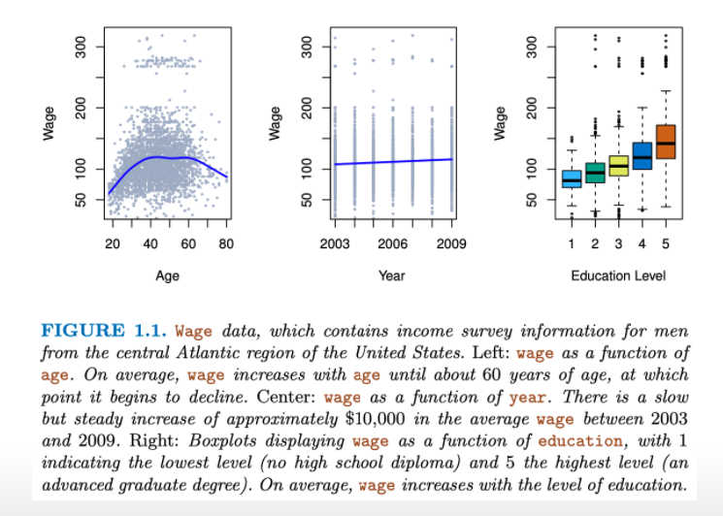
Regression: How do wages differ?
https://www.statlearning.com/

Slide 13
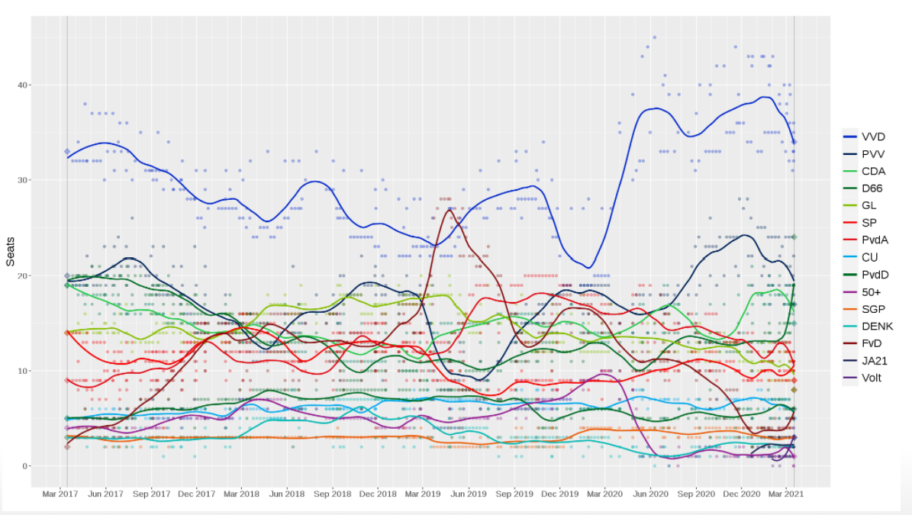
Classification & visualisation
Predicting the outcome of the 2021 Dutch election: https://gitlab.com/gbuvn1/opinion-polling-graph

Slide 14
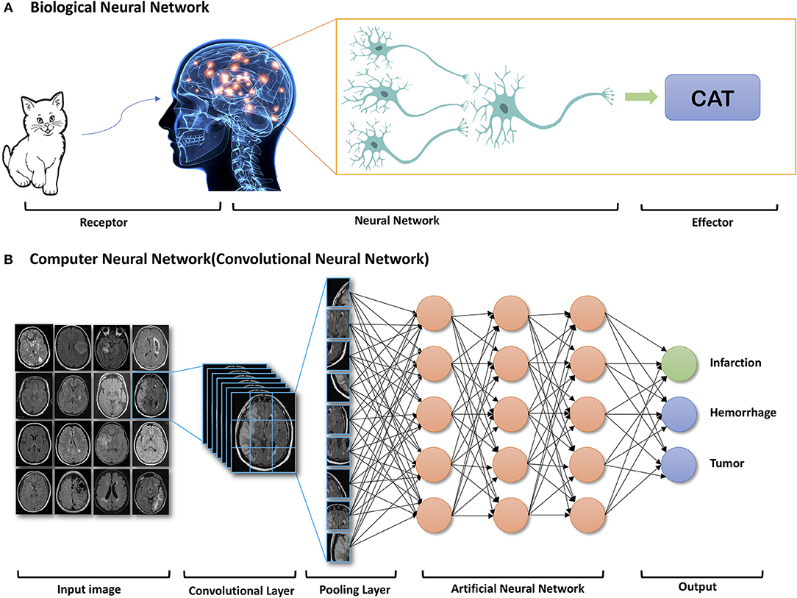
Deep learning

Slide 15
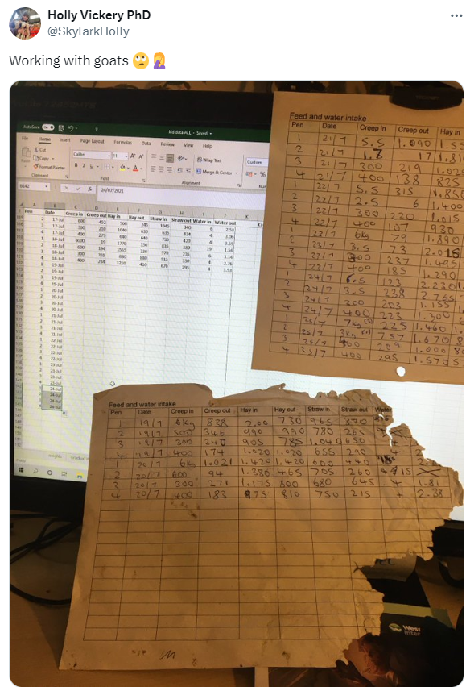
Missing data
Missing data mechanisms
Imputation methods

Slide 16
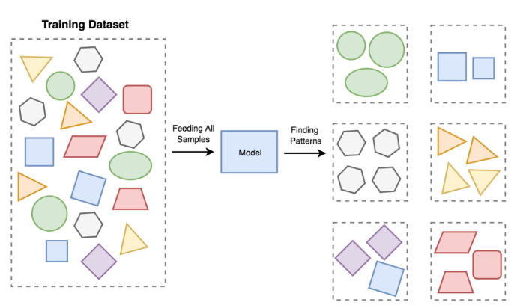
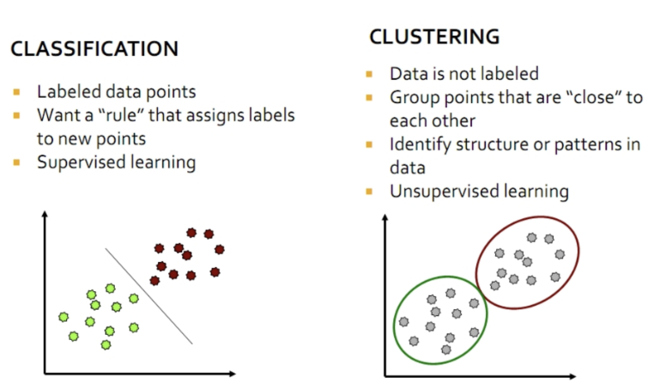
Clustering

Slide 17
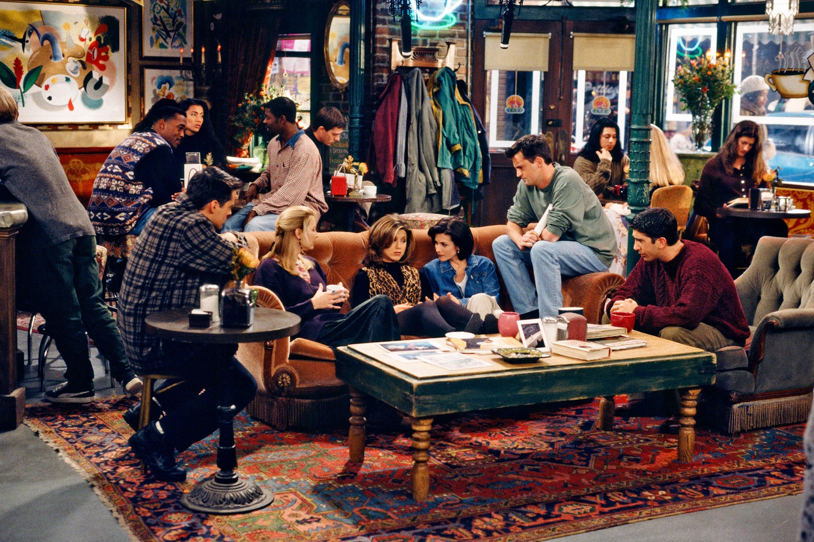
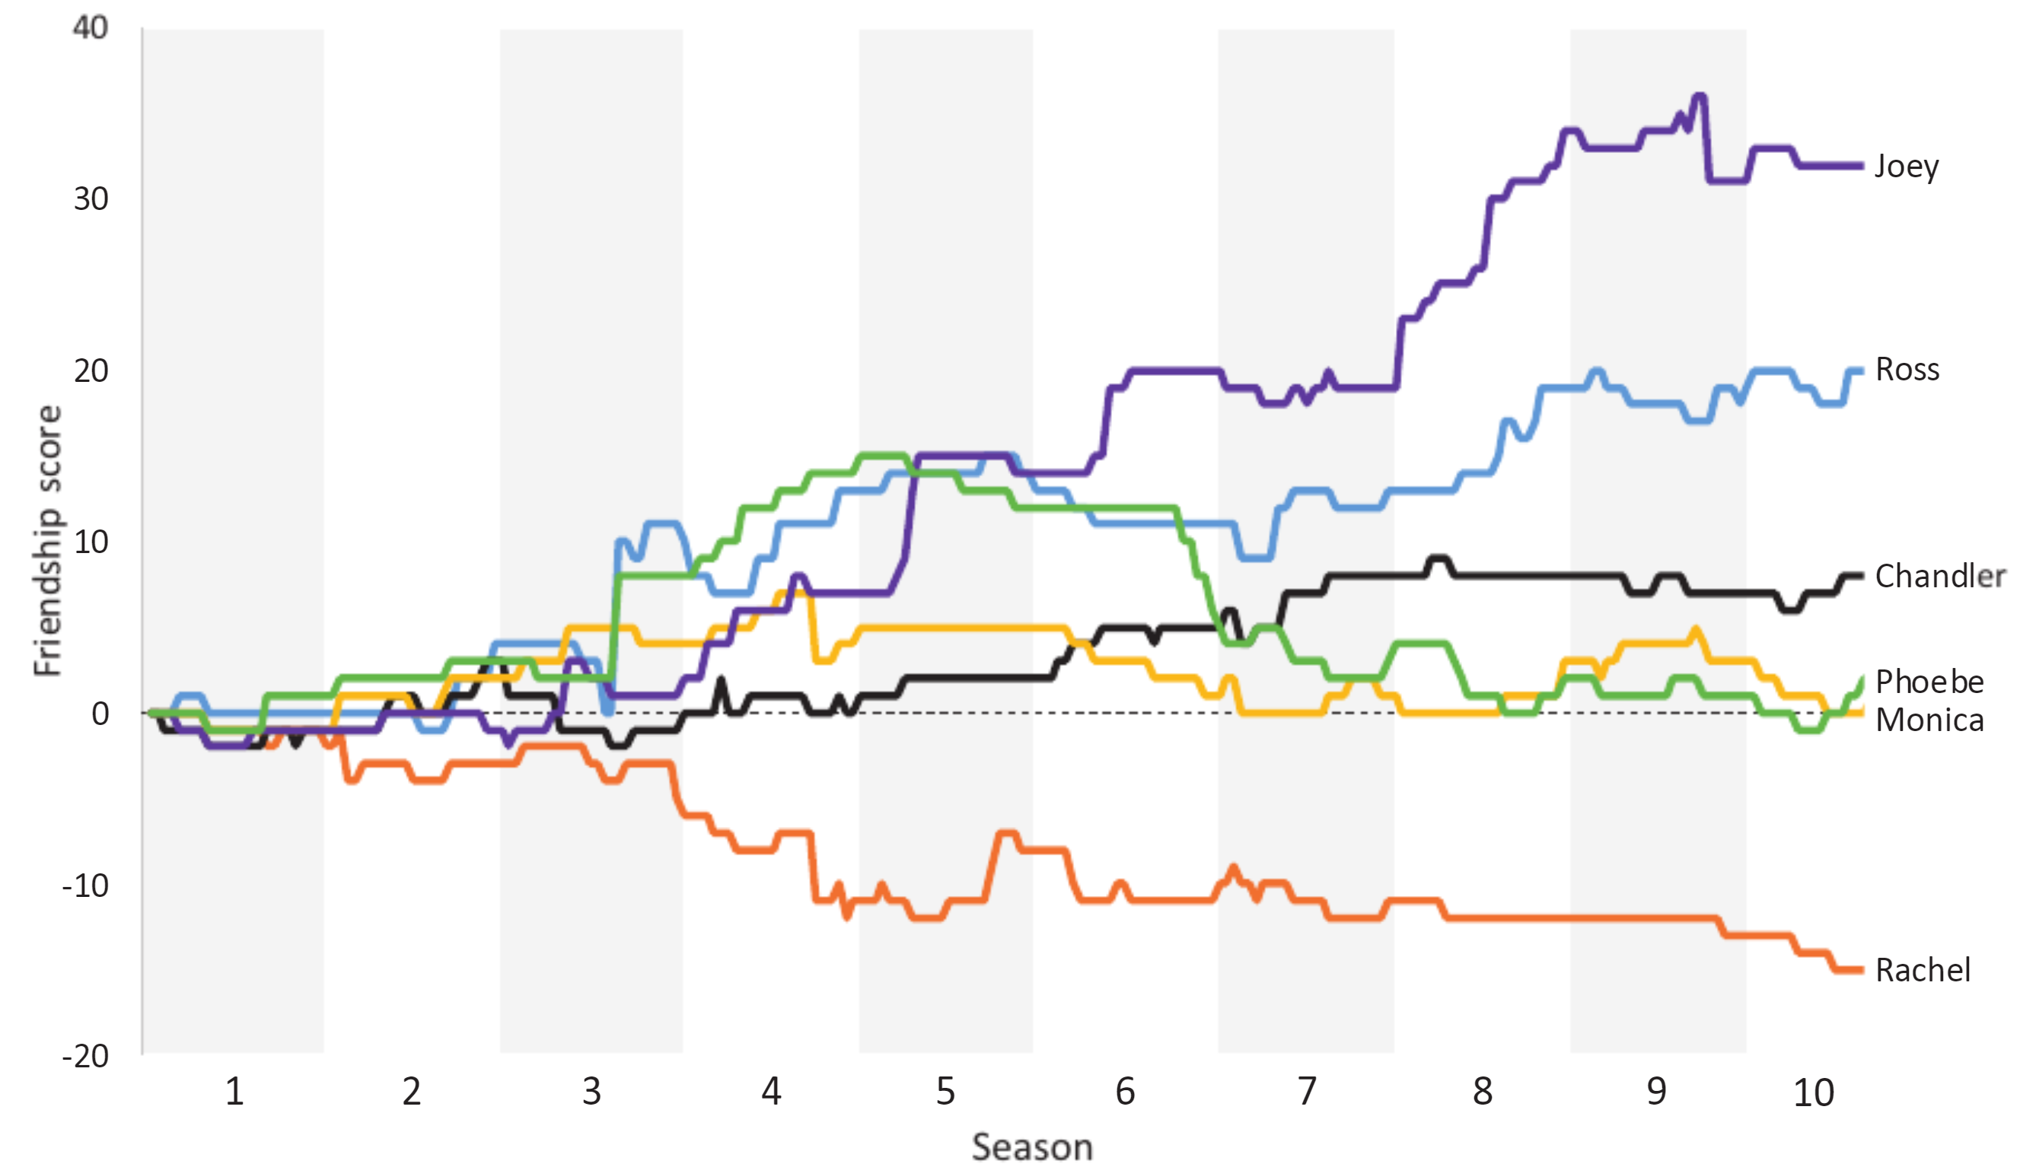
Text Mining: Who was the best Friend?
https://rss.onlinelibrary.wiley.com/doi/epdf/10.1111/1740-9713.01574

Slide 18
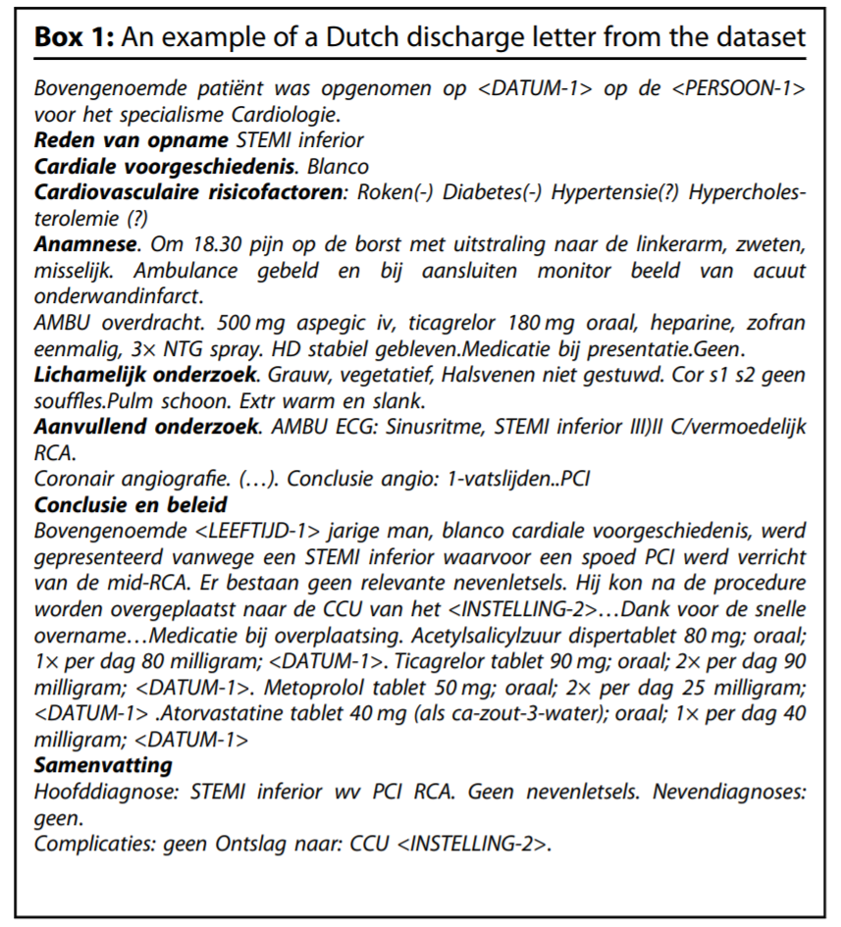
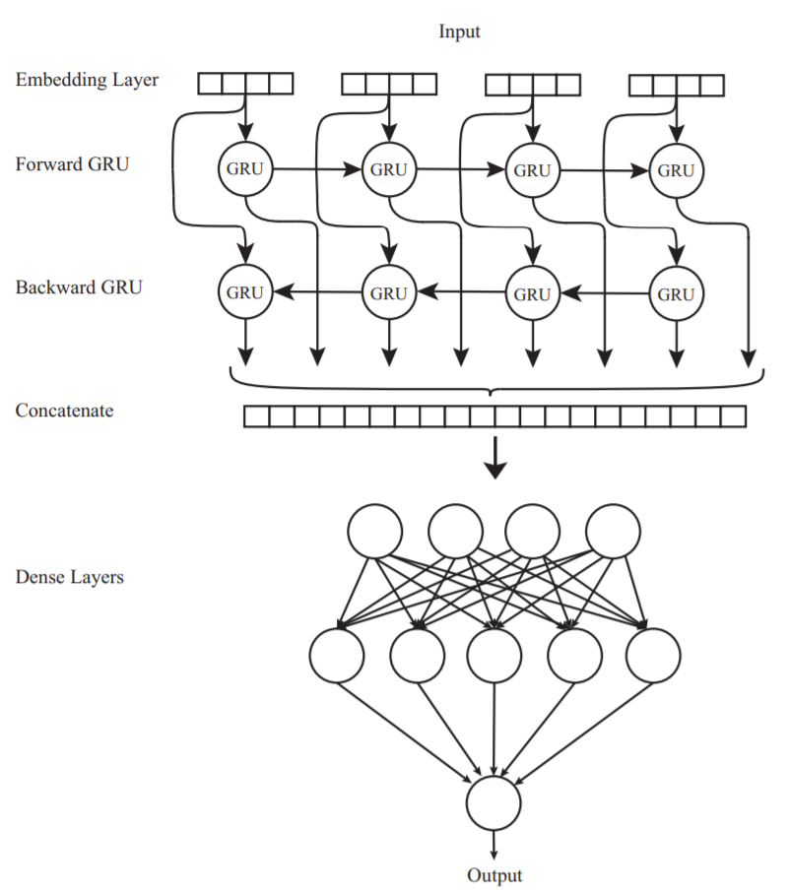
Natural language processing
https://www.nature.com/articles/s41746-021-00404-9

Slide 19
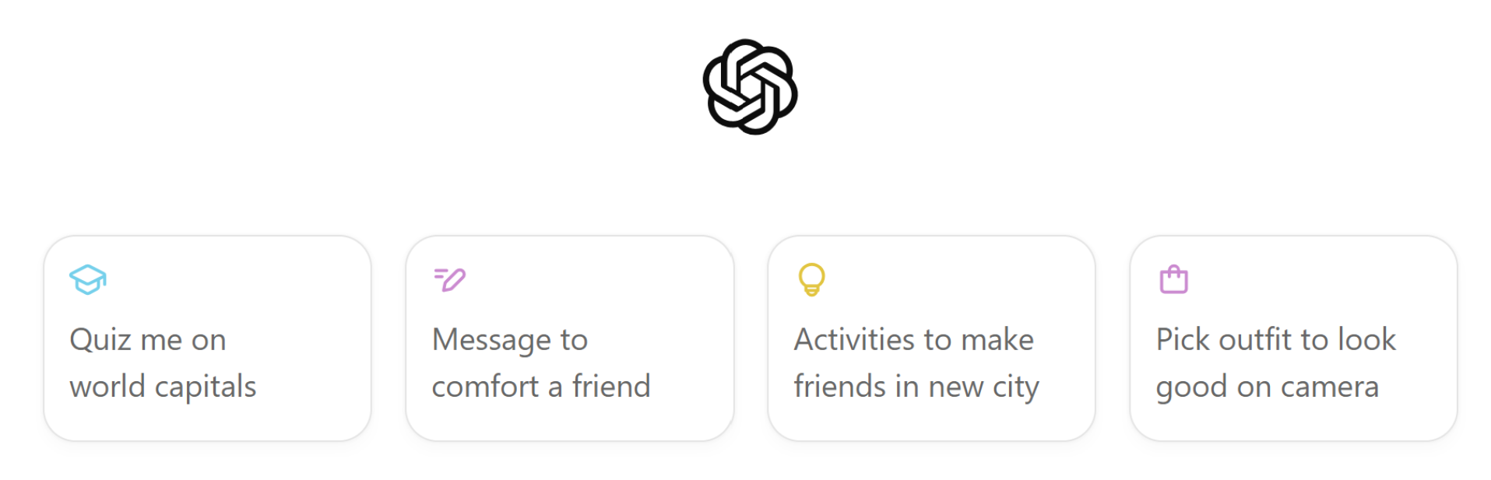
NLP: ChatGPT4o

Slide 20

Case studies
Ad-Hoc
Queries
Processor
. . . 1, 5, 2, 7, 0, 9, 3
. . . a, r, v, t, y, h, b
. . . 0, 0, 1, 0, 1, 1, 0
time
Streams Entering.
Each is stream is composed of elements/tuples
Standing
Queries
Output
Algorithmic Fairness
Limited
Working
Storage
Archival
Storage

Slide 21
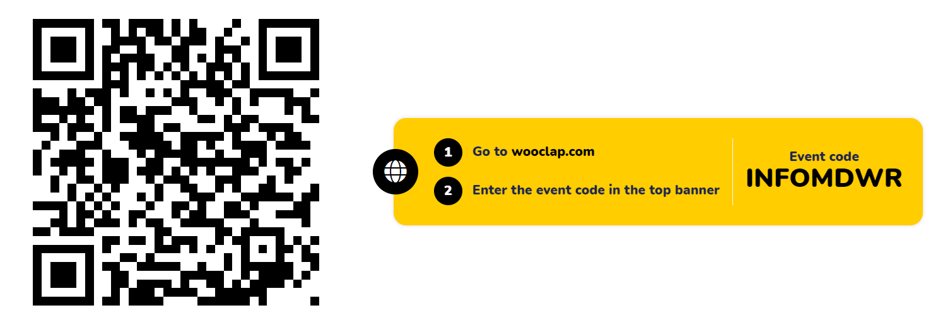
app.wooclap.com/INFOMDWR

Slide 22
10 minute break!

Slide 23
Practicalities

Slide 24
https://infomdwr.nl

Slide 25
Practicalities
Everything is on our course website infomdwr.nl, except:
Room locations (on mytimetable.uu.nl)
Announcements (in your email and on uu.brightspace.com)
Assignment hand-in (on uu.brightspace.com)
Exams (on our digital assessment thing Remindo)
Lectures / Labs will be in person, one online lecture (on Teams)
🚧 materials on the website are constantly under construction 🏗️

Slide 26
Course flow
This is a 14EC course. That’s a lot!
Every* week you will:
📃Read the required readings
👩‍🏫Attend three lectures: Monday, Tuesday, Wednesday morning
💻Attend and work on three lab sessions: Mon, Tue, Wed afternoon
🧑‍🤝‍🧑Work on bi-weekly group assignments
🍸Review materials diligently for the midterm and final exams
* some weeks contain other stuff like exams and study time

Slide 27
Schedule & readings
The syllabus contains a full schedule with required readings
https://infomdwr.nl/syllabus.html#required-readings
Reading materials can be found online for free!🕵️(you are resourceful students)

Slide 28
Lectures: Prepare for tomorrow!
Look up reading materials in syllabus
Look up time and location for the lecture

Slide 29
Next Monday: your ONLY online lecture
The university did not have a room for us 😔
You will receive a Teams meeting invitation to follow this lecture online
NB: the afternoon labs are in-person

Slide 30
Labs
Computer labs with practical exercises
Put into practice what you learnt in the lectures
We incorporate real-world data and use-cases: APPLIED data science!
4 different sessions for different groups
Lab teachers are your main point of contact for questions!
Labs provide skills needed to do the assignments

Slide 31
Labs: prepare!
Quickly check what todays and tomorrow’s labs are about
Look up time and location for the labs: mytimetable.uu.nl
Which parallel lab group are you assigned to? This should also be reflected in Brightspace

Slide 32
Assignments
Every two weeks
Hand in on Brightspace
Group work!
Plan ahead

Slide 33
Assignments: prepare!
What is the deadline of the first assignment? infomdwr.nl
Quickly check the content of the first assignment
Log in to Brightspace and find the INFOMDWR course
If we were organized coordinators:
Find the group sign-up page there to see how you can sign up
Find the assignment hand-in page to see how you can submit
If we are disorganized coordinators, don’t worry, it’ll be there soon ☺

Slide 34

Read the syllabus

Slide 35
Announcements

Slide 36


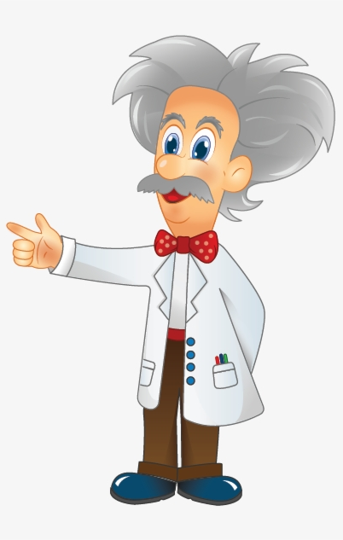



ADS OAC is looking for Student Members
ADS Education Advisory Committee (OAC) is looking for three student members
One member (vice-chair) will be a member of GSNS OC
OAC is composed of equal number of staff and student members.

Slide 37

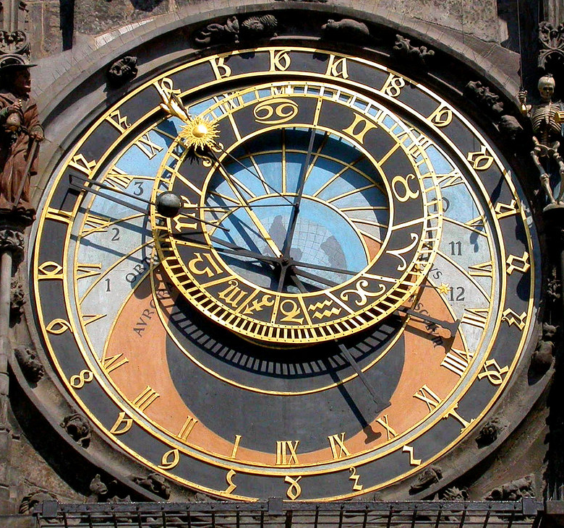
What will you do?
You will:
Review the Caracal evaluations
Comment and give suggestions on the GSNS OER (Education and Examination Rules) and program-wise (ADS) OER Annex
Help in solving other education quality-related issues
Expected time dedication
Weekly average: 2 hours for OAC members, 4 hours for vice-chair (also member of GSNS-OC)
You will be compensated for the time you spent

Slide 38

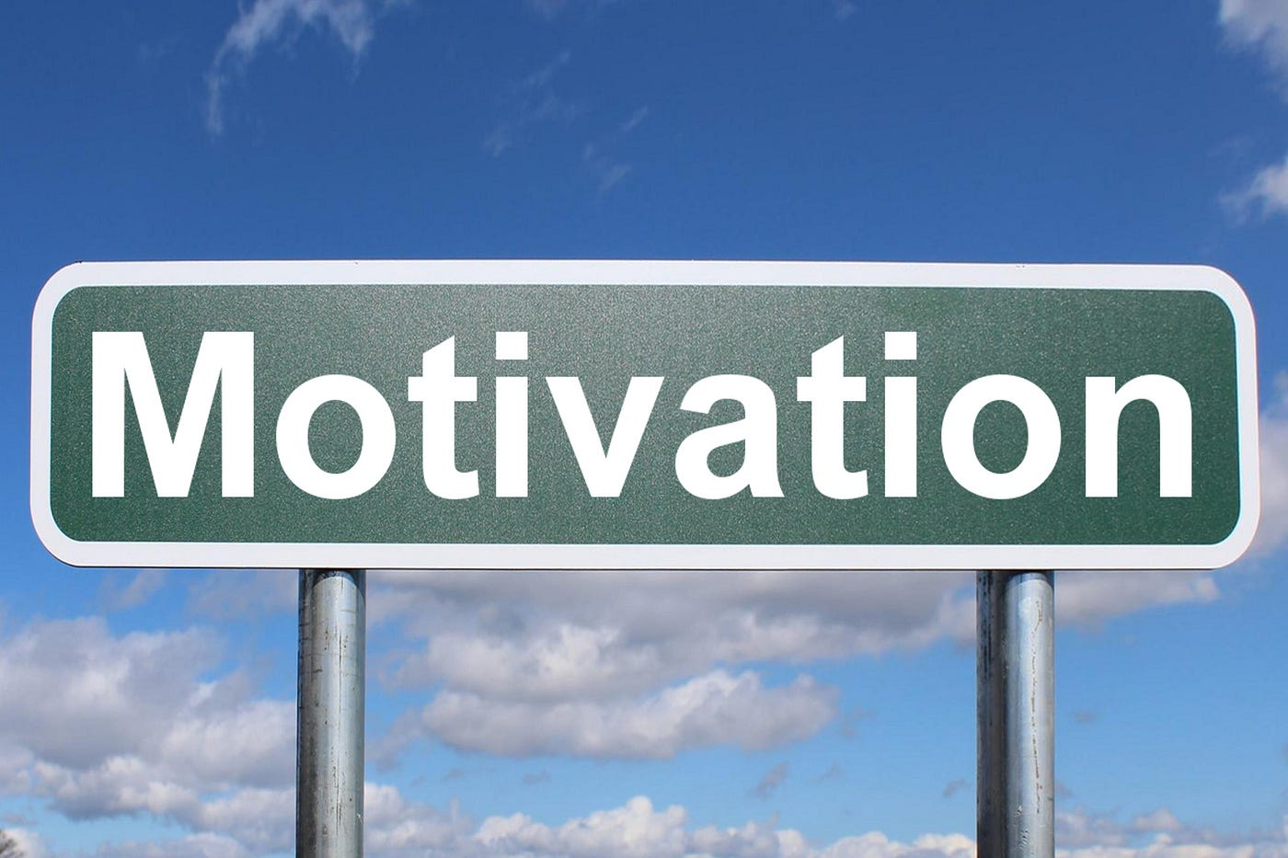


How to apply?
Interested?
h.kaya@uu.nl

Slide 39
We need volunteers for the ADS Social Event
DATE: TUESDAY SEPTEMBER 17 (15:00 – 20:00)
Come by for a drink and (hopefully) a piece of pizza, chat with your peers, instructors, and the program administration, and compete at table football

Slide 40
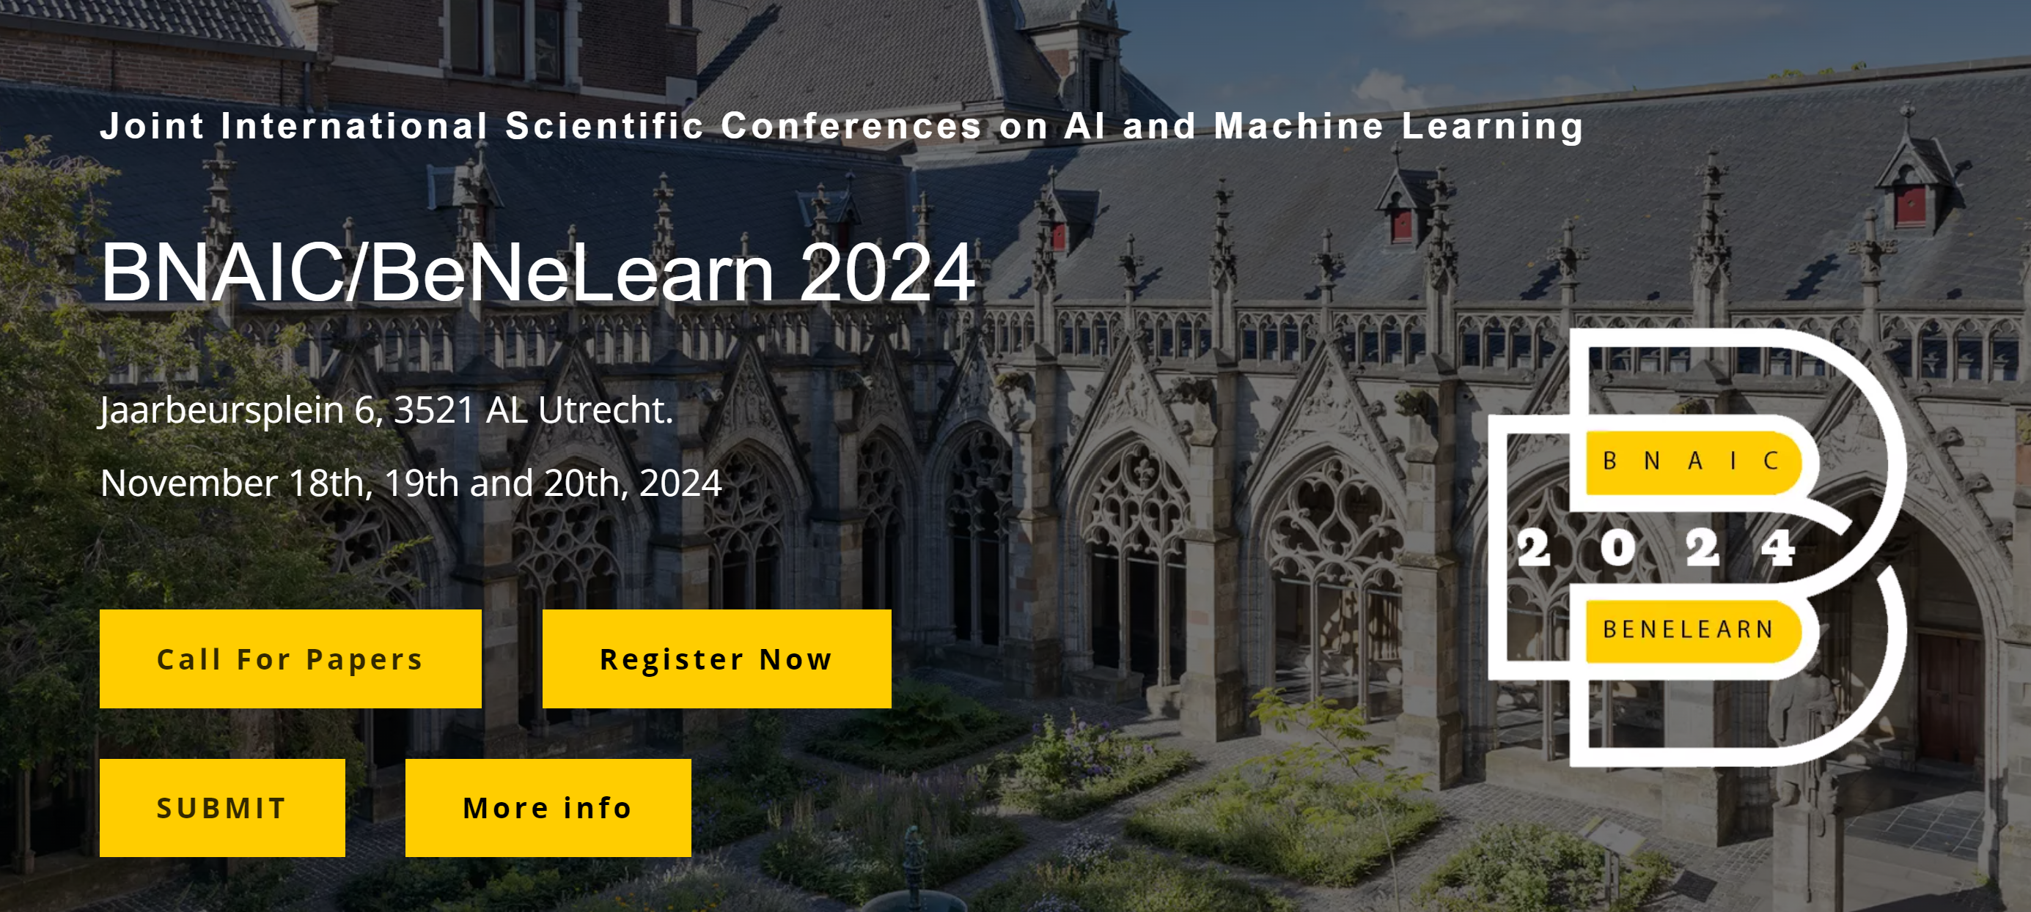
The BNAIC conference is looking for volunteers: https://bnaic2024.sites.uu.nl/
Send an email to h.t.schavemaker@uu.nl if you are interested.

Slide 41



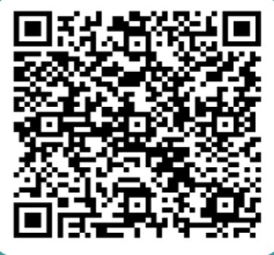
THE AI HELPDESK
What is it?
It is an online platform dedicated to providing clear, reliable ANSWERS to the public’s QUESTIONS ABOUT AI.
Individuals can submit their questions to the AI helpdesk, these questions will be addressed by experts in the field through clear and accessible responses.
Funded by the Utrecht Young Academy
Website to launch Autumn 2024*
Feel free to scan the QR code to stay informed and/or ask any questions you have about AI!!
* First phase will be in Dutch

Slide 42
Further questions?

Slide 43
See you in the lab 👋

