Slide 1
INFOMDW: Data Wrangling
Data Models
Hakim Qahtan
Department of Information and Computing Sciences
Utrecht University

Slide 2
Reading Material for Today
Database System Concepts (7th Edition)
CH 1, 3.2, 3.9
Office Hours: upon request by email

Slide 3
Introduction

Slide 4

© Yannis Velegrakis, UU

Slide 5
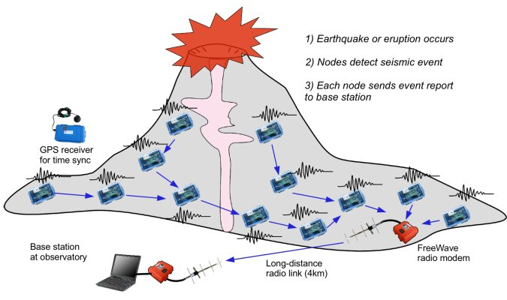

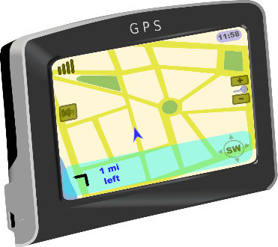
We Collect Huge Amount of Data
Data Streams
Merck (a pharma company) has:
~ 4000 Oracle databases
Plus a data lake
Plus untold files
Plus untold spreadsheets
Plus they are interested in public data from the web
Static Data

Slide 6



Extracting Value from the Data
Data
Information

Slide 7










The Data Processing Pipeline
Acquisition
&
Storage
Aggregation
Data
Analysis
Integration
Exploration
Querying
Modeling &
Annotation
&
Cleaning
Data Curation
Data scientists, according to interviews and expert estimates, spend 50% to 80% of their time mired in the mundane labor of collecting and preparing unruly digital data, before it can be explored for useful nuggets
(New York Times)
© Yannis Velegrakis, UU

Slide 8
OSEMN Framework
O
S
E
M
N
Obtain
Scrub
Explore
Model
INterpret
Gather data from relevant sources
Clean data to formats that machine understands
Find significant patterns and trends using statistical methods
Construct models to predict and forecast
Put the results into good use

Slide 9
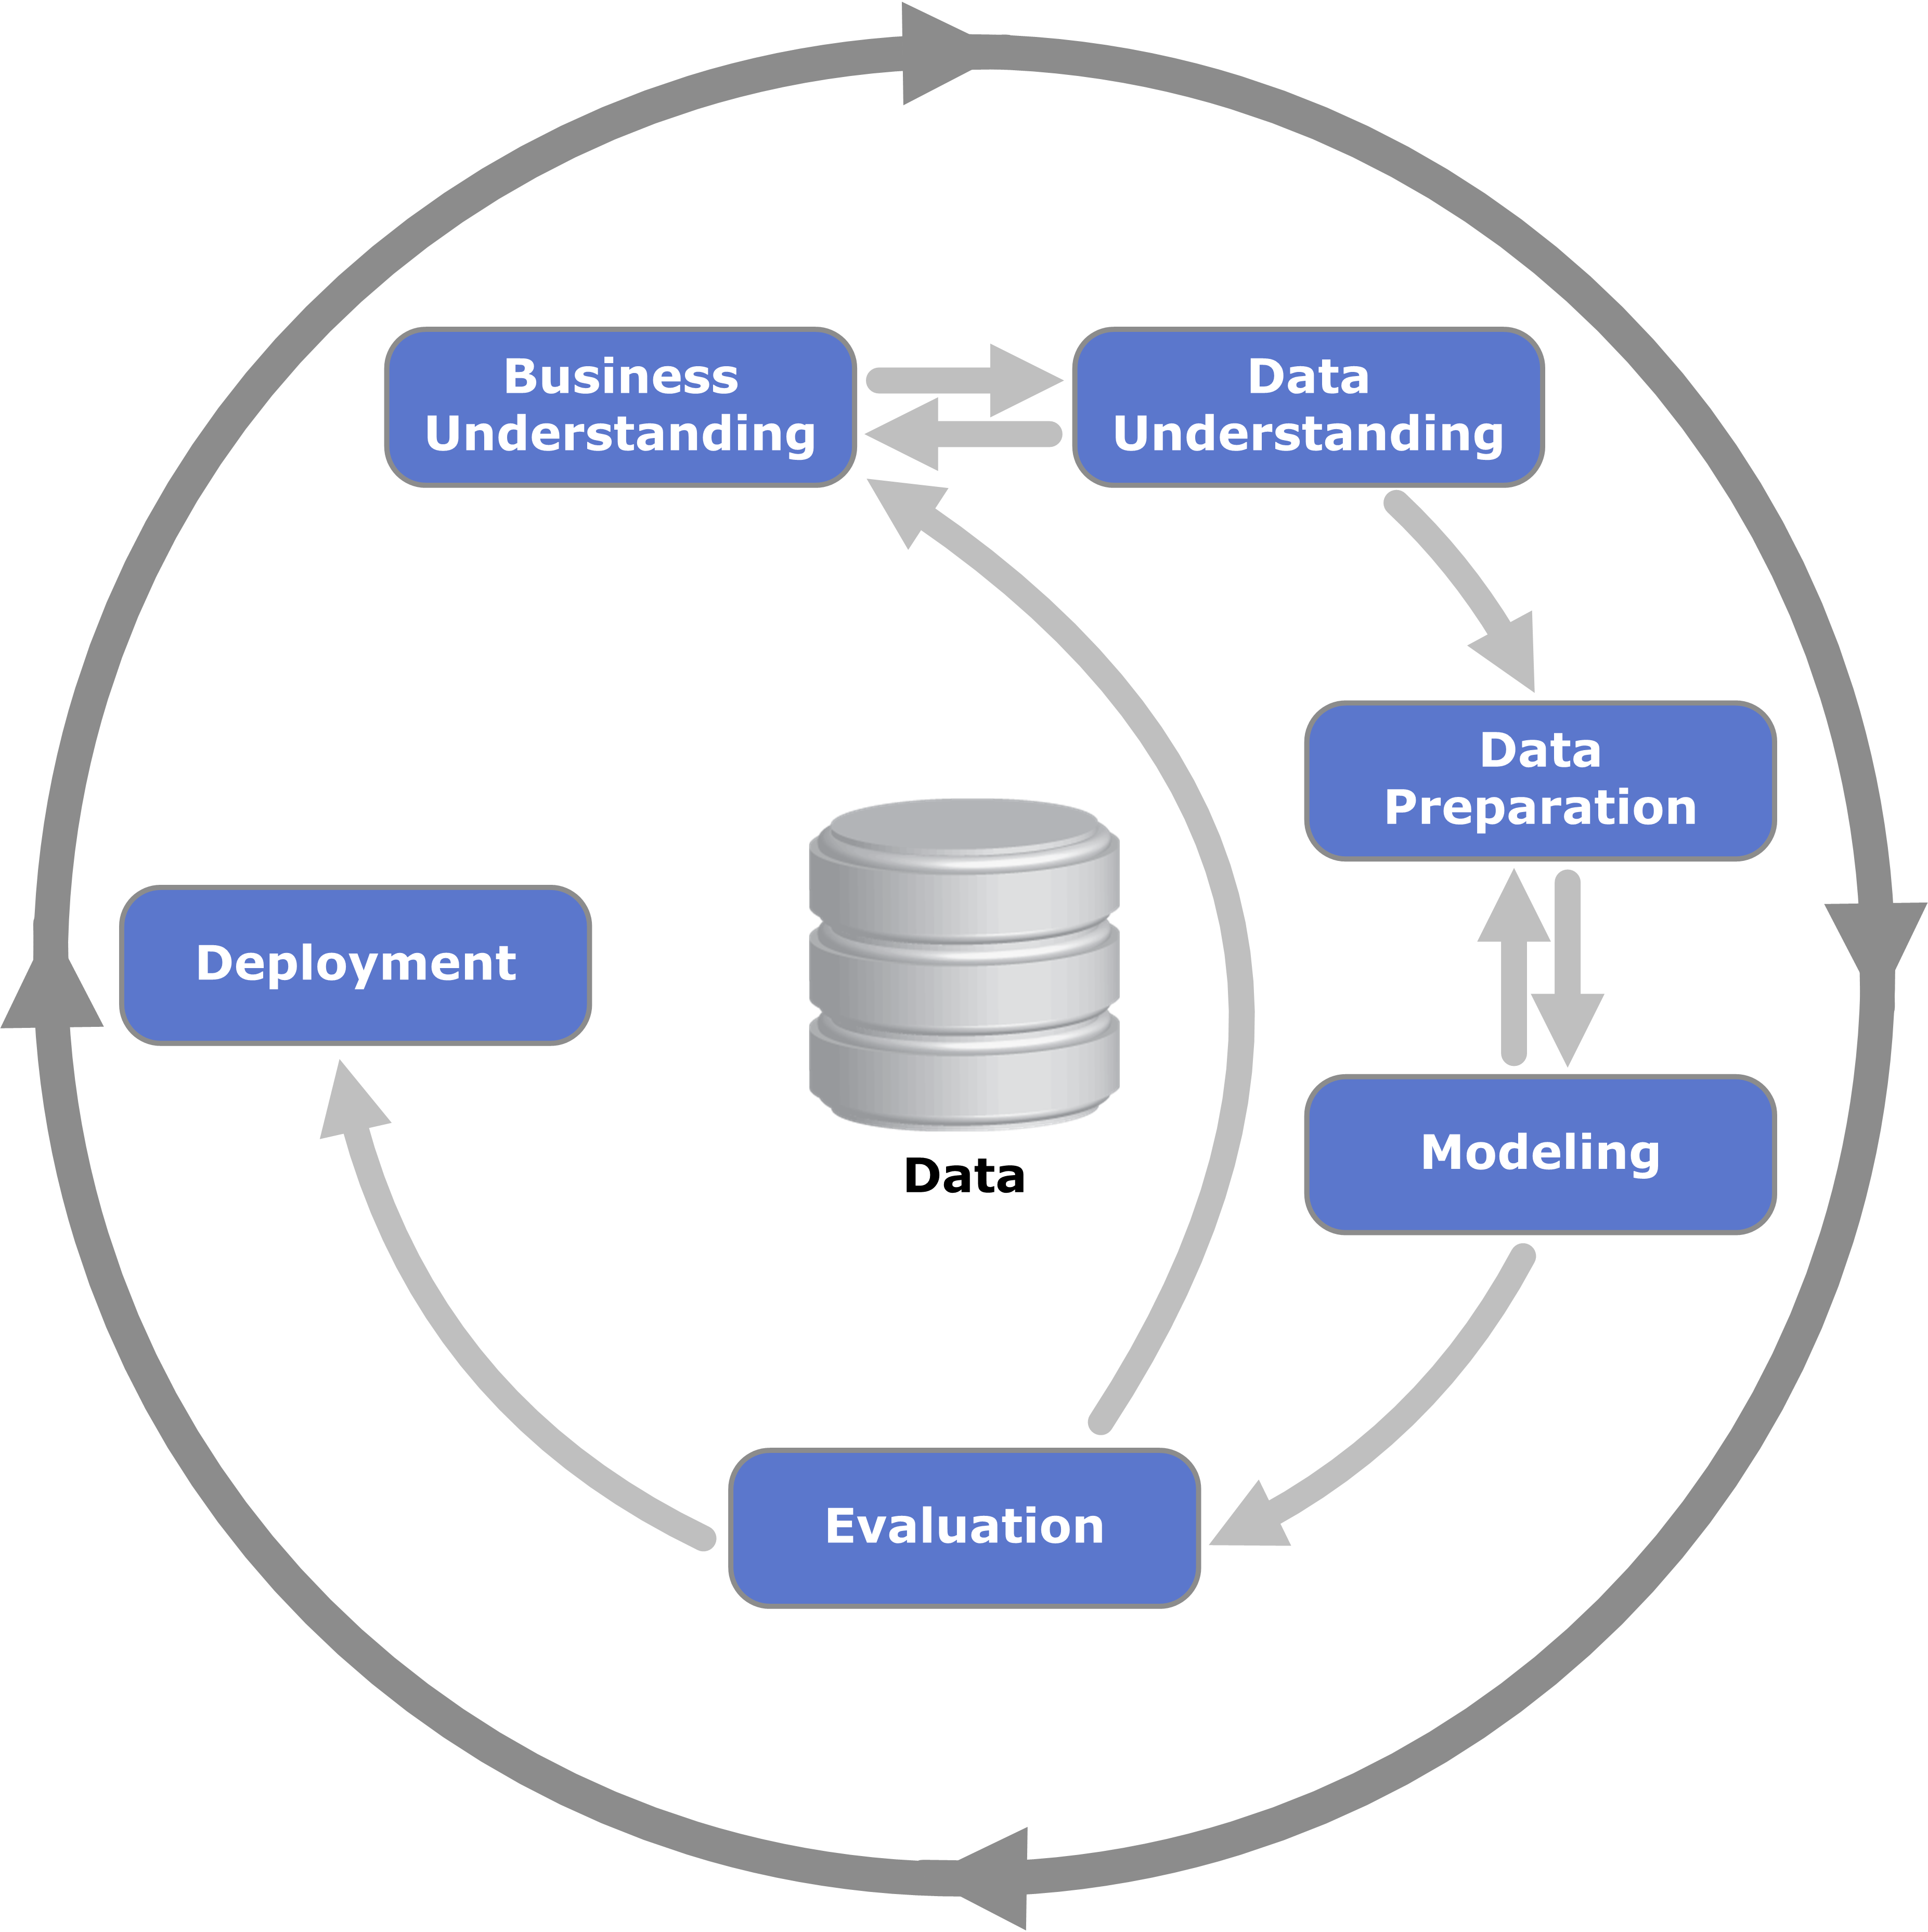
CRISP-DM
CRISP-DM = CRoss Industry Standard Process for Data Mining

Slide 10
KDD Process
Interpretation /
Evaluation
Knowledge
Transformation
Patterns
Transformation
Preprocessing
Transformed
Data
Select
Preprocessed
Data
Target
Data
Data
KDD = Knowledge Discovery in Databases

Slide 11
What is Data Wrangling?
Data Wrangling (Munging): an iterative process to convert the raw data into more understandable format.
Discovering
Publishing
Structuring
Validating
Cleaning & Transformation
Enriching

Slide 12
Data Wrangling
Discovering
Understanding the data with respect to the application
Creating a plan for preparing the data (structuring, cleaning and normalizing the data).
Structuring
Defining a structure that suits the analytical model
Various datasets should be in compatible formats
Data may come from different sources (Union, Join)

Slide 13
Data Wrangling
Transformation and cleaning involve
Normalizing the data, removing redundant and irrelevant data, combining multiple datasets.
Removing errors, de-duplication, fixing inaccuracies and inconsistences, and handling data bias.
Enriching
Do you have the required data to perform accurate analysis?
If the data is not enough, can we add more examples/features?
What about enriching with synthetic data?

Slide 14
Data Wrangling
Validating
Confirm whether the steps that were done during the structuring, transformation and cleaning are correct or not.
Publishing
Choose the file format
Store the data in a place where it can be accessed by others
In many cases, data privacy should be considered before sharing the data (anonymize the data).

Slide 15

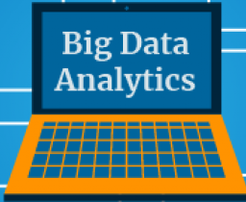


We Collect Huge Amount of Data
J
S
O
N
J
S
O
N
J
S
O
N
X
M
L
X
M
L
X
M
L
HTML
HTML
HTML
C
S
V
C
S
Data Analytics
V
C
S
V
Data is stored in different formats

Slide 16
Data Formats
Structured
Data
Unstructured
Data
Semistructured
Data
HTML
X
M
XLSX
L
J
S
O
N
C
S
V
Our focus in this course

Slide 17
Metadata
Data about data
Describes the context of the data, the attributes and their domains.
How the data was collected and where it is stored.
How the data can be used.

Slide 18
Data Models

Slide 19
Data Models
Data model: mathematical representation of the data.
Relational model: uses tables to represent both data and relationships
Entity-Relationship (E-R) model: Conceptual model
Data is represented as a collection of entities (real-world objects) and the relationships among the objects
Semistructured model: different objects may have different sets of attributes (e.g. JSON and XML)
Object-Based data model: entities (real-world objects) are represented using objects.
Currently, the concept of object is integrated into relational databases.

Slide 20
Data Models
Data models can be viewed as a collection of tools describing:
Data
Data relationships
Data semantics
Data operations
Structure
Constraints

Slide 21
Data Models
Data models are said to contain three main components:
Structures: define the format
Rows and columns?
Nodes and edges?
Key-value pairs?
Constraints: define the relationships and semantics
All rows must have the same number of columns
Column A3 contains numerical values
The age must be positive
Operations: store and retrieve the data
Return the values of record x
Find the rows where the column "lastname" is "Miller"

Slide 22
Data Models
Structure – The Relational Model

Slide 23
The Relational Model
Relation (R): made up of 2 parts:
Instance: a table, with rows and columns. #Rows = cardinality, #fields = degree / arity.
Schema: specifies name of relation, plus name and type of each column.
E.G. Students(sid string, name string, login string, age integer, gpa real).
Relation: a set of rows or tuples (i.e., all rows are distinct).
There should be a subset of the attributes where each tuple differs from the other in at least one value (the concept of Keys).

Slide 24
The Relational Model
Columns (Attributes, fields or Features)
#columns = degree
Data stored in different tables
Example of tabular data
ID | name | dept_name | Salary
22322 | Einstein | Physics | 95000
21212 | Wu | Finance | 90000
32343 | El Said | History | 86000
43521 | Katz | Comp. Sci. | 75000
98531 | Kim | Biology | 78000
58763 | Crick | Elec. Eng. | 80000
52187 | Mozart | Music | 65000
33452 | Katz | Physics | 78000
Rows (Records or tuples)
#row = Cardinality
Values of ID are different for each tuple

Slide 25
Relations are Unordered
Order of tuples is not considered (tuples might be stored in an arbitrary order)
The same is also true in the case of attributes
Example: putting “salary” before/after “dept_name” will have no effect on the relation (table)
ID | name | dept_name | salary
22322 | Einstein | Physics | 95000
21212 | Wu | Finance | 90000
32343 | El Said | History | 86000
43521 | Katz | Comp. Sci. | 75000
98531 | Kim | Biology | 78000
58763 | Crick | Elec. Eng. | 80000
52187 | Mozart | Music | 65000
33452 | Gold | Physics | 87000

Slide 26
The Relational Model
The instructor table
The department table
ID | name | dept_name | Salary
22322 | Einstein | Physics | 95000
21212 | Wu | Finance | 90000
32343 | El Said | History | 86000
43521 | Katz | Comp. Sci. | 75000
98531 | Kim | Biology | 78000
58763 | Crick | Elec. Eng. | 80000
52187 | Mozart | Music | 65000
33452 | Katz | Physics | 87000
dept_name | building | Budget
Comp. Sci. | Turing | 1000000
Physics | Watson | 800000
Chemistry | Ibn-Hayyan | 850000
Biology | AlRazi | 800000
Elec. Eng. | Taylor | 690000
Music | Packard | 400000
Finance | Painter | 1200000
History | Painter | 500000
Unique values
Unique values

Slide 27
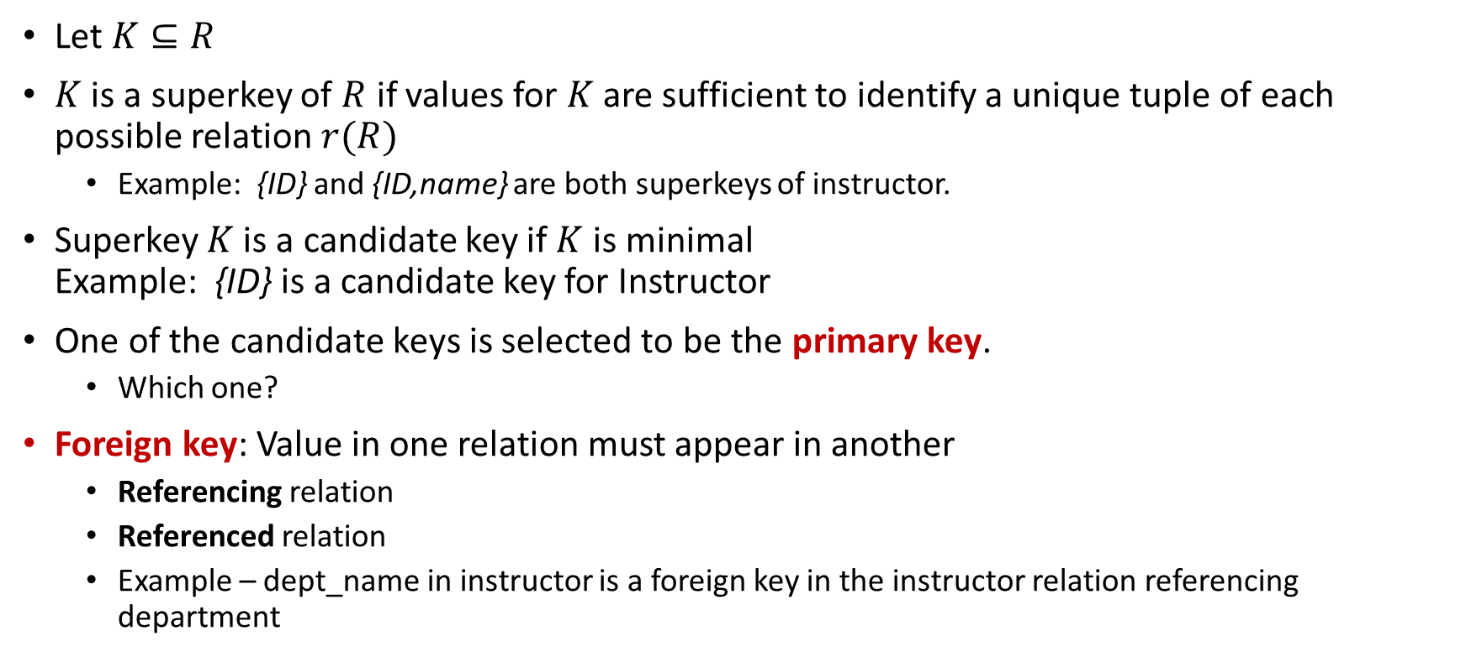
Keys
Let $K⊆R$
$K$ is a superkey of $R$ if values for $K$ are sufficient to identify a unique tuple of each possible relation $r(R)$
Example: {ID} and {ID,name} are both superkeys of instructor.
Superkey $K$ is a candidate key if $K$ is minimal Example: {ID} is a candidate key for Instructor
One of the candidate keys is selected to be the primary key.
Which one?
Foreign key: Value in one relation must appear in another
Referencing relation
Referenced relation
Example – dept_name in instructor is a foreign key in the instructor relation referencing department

Slide 28
Attribute Types
The set of allowed values for each attribute is called the domain of the attribute
Attribute values are (normally) required to be atomic; that is, indivisible
The special value null is a member of every domain. Indicating that the value is "unknown"
The null value causes complications in the definition of many operations

Slide 29
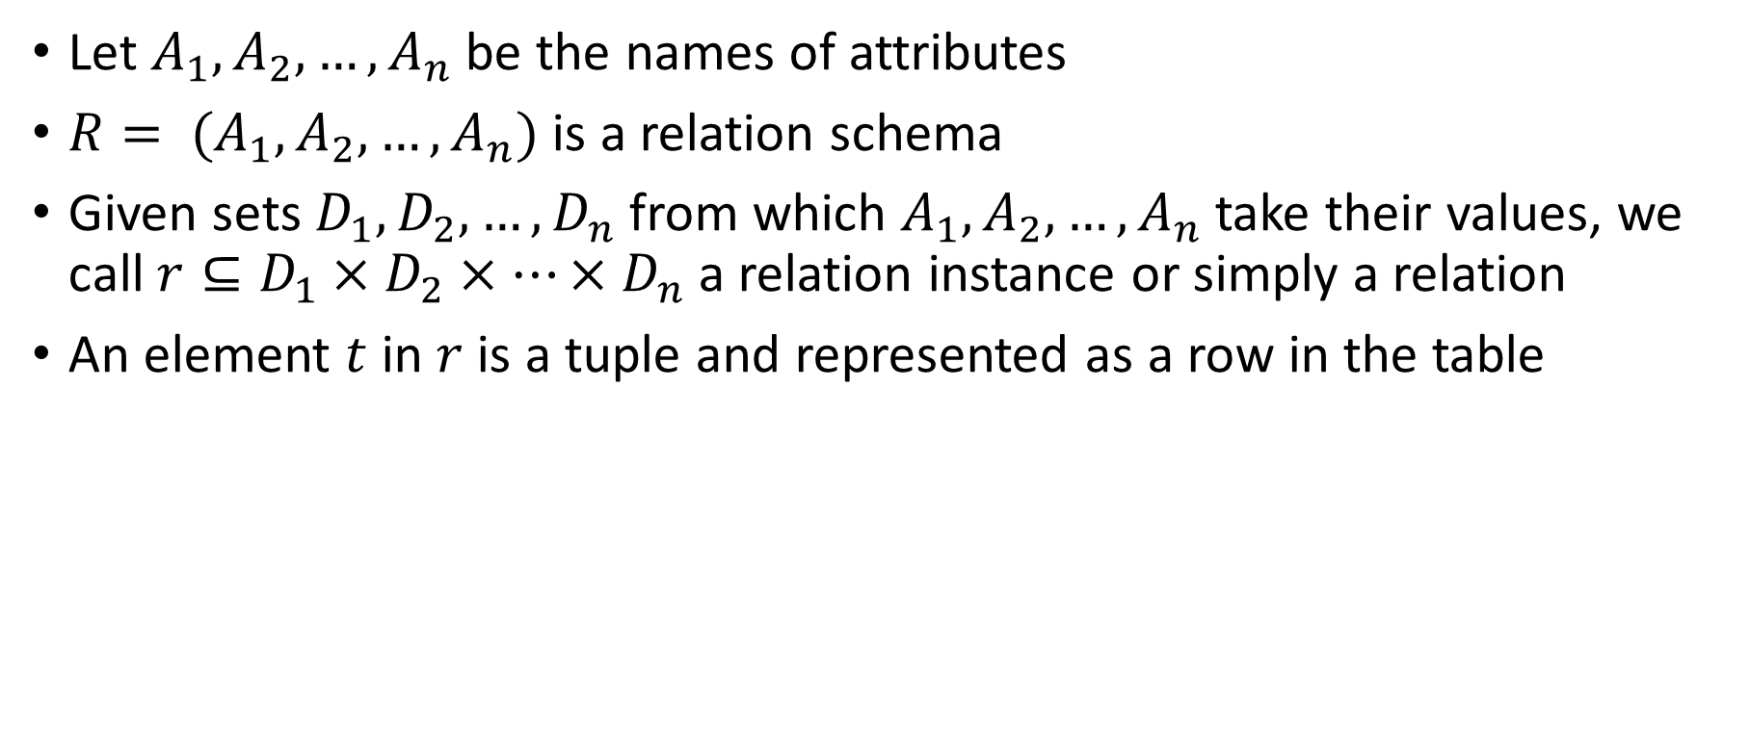
Relation Schema and Instance
Let $A_{1},A_{2}, …, A_{n}$ be the names of attributes
$R= (A_{1},A_{2}, …, A_{n})$ is a relation schema
Given sets $D_{1},D_{2}, …, D_{n}$from which $A_{1},A_{2}, …, A_{n}$ take their values, we call ${r⊆D}_{1}×D_{2}×…×D_{n}$ a relation instance or simply a relation
An element $t$ in $r$ is a tuple and represented as a row in the table

Slide 30
Data Models
Constraints

Slide 31
Constraints
Guard against accidental damage to the data
Ensure that authorized changes to the data do not violate data consistency.
An account must have a balance greater than $10.00
A salary of a bank employee must be at least $4.00 per hour
A customer must have a (non-null) phone number
Constraints on a single relation
Not null
Primary key
Unique
Check (P), P is a predicate

Slide 32
Data Models
Operations

Slide 33
Operations
Define a set of operations for accessing and manipulating the data
Create a relation
Add more records/attributes (tuples/columns)
Delete or alter a set of records/attributes/values
Retrieve a set of records
…

Slide 34
How to store the data?

Slide 35
File system as data storage
Drawbacks of using file systems to store data include:
Data redundancy and inconsistency
Multiple file formats, duplication of information in different files
Difficulty in accessing data
Need to write a new program to carry out each new task
Data isolation
Data are scattered in various files with (possibly) different formats
Integrity problems
Integrity constraints (e.g., account balance > 0) become “buried” in program code rather than being stated explicitly
Hard to add new constraints or change existing ones

Slide 36
File system as data storage (Cont.)
Drawbacks of using file systems to store data include:
Atomicity of updates
Failures may leave database in an inconsistent state with partial updates carried out
Example: Transfer of funds from one account to another should either complete or not happen at all
Concurrent access by multiple users
Concurrent access needed for performance
Uncontrolled concurrent accesses can lead to inconsistencies
Example: Two people reading a balance (say 100) and updating it by withdrawing money (say 50 each) at the same time
Security problems
Hard to provide user access to some, but not all, data
Database systems offer solutions to all the above problems

Slide 37
Databases

Slide 38
Databases
Traditionally: systems that contain records about real world entities
Employee records, bank records, etc.
Today, the field covers all the largest sources of data, with many new ideas.
Web search.
Data mining.
Scientific and medical databases.
Graph databases.
Integrating information.

Slide 39
Databases – More
You may not notice it, but databases are behind almost everything you do on the Web.
Google searches.
Queries at Amazon, eBay, etc.
DBMS contains information about a particular enterprise
Collection of interrelated data
Set of programs to access the data
An environment that is both convenient and efficient to use

Slide 40
Database – Example
University Database Example:
Add new students, instructors, and courses
Register students for courses, and generate class rosters
Assign grades to students, compute grade point averages (GPA) and generate transcripts

Slide 41
Database levels of abstraction
Physical level: describes how a record (e.g., instructor) is stored.
Logical level: describes data stored in database, and the relationships among the data.
type instructor = record
ID : string; name : string; dept_name : string; salary : real;
end;
View level: application programs which hide details of data types. Views can also hide information for security/privacy purposes (such as an employee’s salary).

Slide 42
Database levels of abstraction
Architecture of a database system
View Level
View 1
View 2
…
View n
Logical View
Physical View

Slide 43
Data Modeling in Databases

Slide 44
Data Definition Language (DDL)
Specification notation for defining the database schema
DDL is used to create and modify database objects such as tables, indexes and users
Example: create table instructor ( ID char(5), name varchar(20), dept_name varchar(20), salary real);
DDL include:
Commands for specifying integrity constraints
Commands for defining views
Commands for specifying access rights

Slide 45
Data Manipulation Language (DML)
Language for accessing and manipulating the data organized by the appropriate data model
DML also known as query language to retrieve information from the database
DML allows for adding (inserting), deleting, and modifying (updating) the records in a database

Slide 46
DDL and DML are not two separate languages – they form parts of a single database language (e.g. SQL)

Slide 47
SQL

Slide 48
Structured Query Language (SQL)
High level language to manipulate relational data
Say “what to do” rather than “how to do it.”
Avoid a lot of data-manipulation details needed in procedural languages like C++ or Java.
Database management system figures out “best” way to execute query.
Called “query optimization.”
SQL has three categories based on the functionality involved
DDL: Data Definition Language
DML: Data Manipulation Language
DCL: Data Control Language -- used to grant and revoke authorization.

Slide 49
Structured Query Language (SQL)
SQL DDL is used to define:
The schema for each relation.
The types of values associated with each attribute.
The integrity constraints.
The security and authorization information for each relation.

Slide 50
Example: Schema Diagram for University Database
Source: Database System Concepts – 7th Edition

Slide 51

Creating Relations in SQL
Creating relation in SQL can be done as:
CREATE TABLE tab_name (
A1 D1,
A2 D2,
…,
An Dn,
$\left\langle \text{IC}\text{1}\right\rangle$,
$\left\langle \text{IC}\text{2}\right\rangle$,
…,
$\left\langle \text{IC}\text{n}\right\rangle$
);
Di is the domain of the values in attribute (column) Ai
IC = integrity constraint
Notes:
15

Slide 52
Creating Relations in SQL – Examples
CREATE TABLE student (
id CHAR(20),
name CHAR(20),
dept_name CHAR(20),
tot_cred INTEGER );
Creating the Student relation
Observe that the type (domain) of each field is specified, and enforced by the DBMS whenever tuples are added or modified.
Another example, the `takes’ table holds information about courses that students take.
CREATE TABLE takes (
id CHAR(20),
course_id CHAR(20),
sec_id CHAR(2),
semester CHAR(3),
year NUMERIC(4,0),
grade REAL );
Notes:
15

Slide 53
Deleting and Altering Relations
DROP TABLE students
Destroys the relation `student’. The schema information and the tuples are deleted.
The schema of `student’ is altered by adding a new field; every tuple in the current instance is extended with a null value in the new field.
ALTER TABLE students
ADD COLUMN firstYear integer;
Notes:
16

Slide 54
Insertion
Can insert a single tuple using:
INSERT INTO student
VALUES (53688, `Smith’, `ICS’, 18);
INSERT INTO Student (name, id, tot_cred, dept_name)
VALUES (`Smith’, 53688, 18, `ICS’);
Notes:
10

Slide 55
Deletion
Can delete all tuples satisfying some condition (e.g., name = Smith):
Deleting all records from a relation
DELETE
FROM student S
WHERE S.name = `Smith’
DELETE FROM student
Notes:
10

Slide 56
Update
Change specific values of the tuples:
Example: change the department name from Math to Mathematics
UPDATE tab_name
SET Ai = vi
[WHERE Aj = vj ]
UPDATE department
SET dept_name = `Mathematics’
WHERE dept_name = `Math’
Notes:
10

Slide 57

Wrap-Up
Summerize what you learned today in 2-minutes

Slide 58
Next lecture
Process Discovery
Conformance Checking

