Slide 1
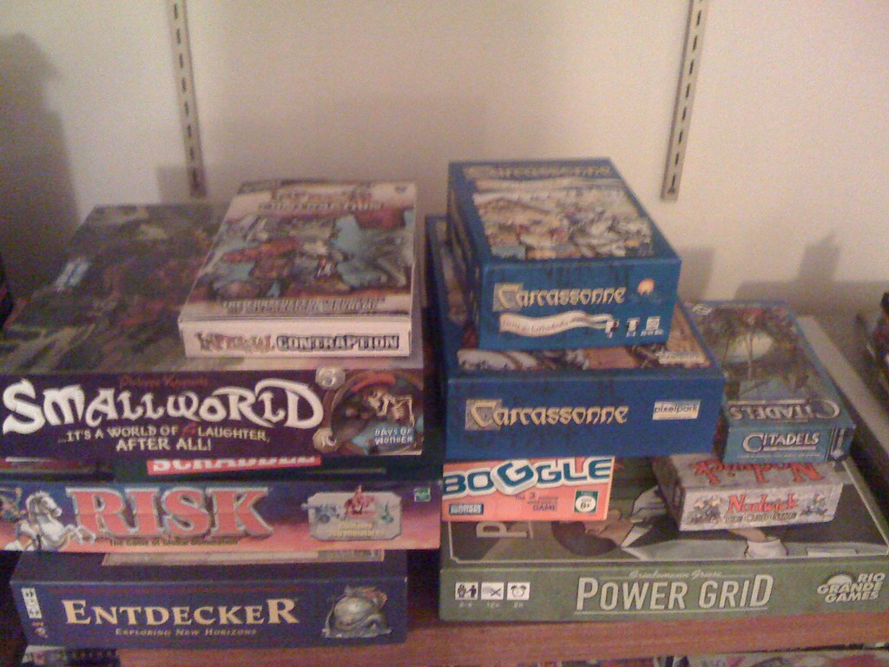
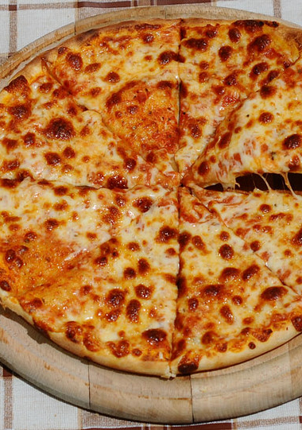

ADS SOCIAL EVENT
LOCATION: The Playground
DATE: TUESDAY SEPTEMBER 16 (13:00 - 17:00)
Come by for a drink and a piece of Pizza, chat with your peers, instructors and play some board games

