Slide 1

Final Project Google Cloud Dataflow Real-time Service for Batch and Stream Processing
Hanjiao Qiu
CSCI E-63 Big Data Analytics
2016
Harvard University Extension School
Prof. Zoran B. Djordjević

Slide 2
What is Cloud Dataflow?
A fully-managed cloud service and programming model for batch and streaming big data processing.
Can process massive-scale, unbounded and unordered data.
Support the unaligned, event-time-ordered windows modern data consumers require.
Key features:
Automated resource management
Intelligent work scheduling
Horizontal auto scaling
Unified programming model
Real-time monitoring
Integrated with Google Cloud products
Reliable & consistent processing

Slide 3
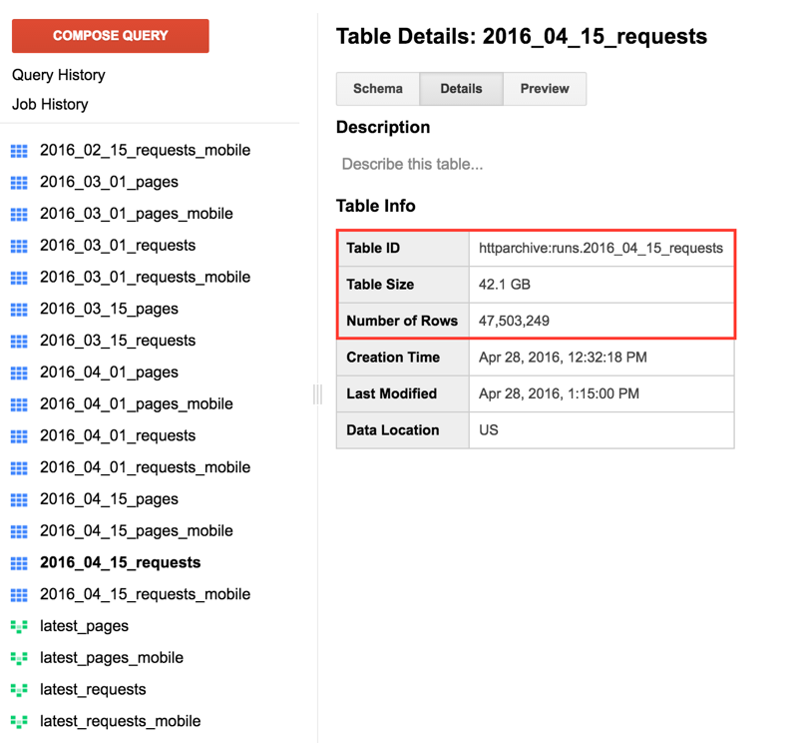
Problems to solve
Process massive HTTP Archive dataset. Analyze the trends in web technology and measure the website performance.
Build linear pipeline
Search and sort the popular CDN (Content Delivery Network) provider
Compute the distribution of requests for different image format.
Calculate the average response content length based on content type
Complex pipeline, use pipeline derived data as a side input
Filter image object whose size is larger than global mean value
Apply Dataflow time-based windowing model
Aggregate total number of requests per page during a certain time

Slide 4
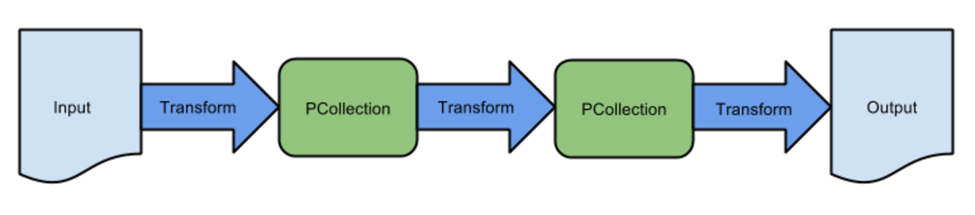
Cloud Dataflow Programming Model
Pipelines
A data processing job
Consist operations like read/write, transform data
PCollections
Specialized class in Dataflow SDK, represent multi-element data
Data in pipeline must be in form of PCollections
Transforms
A step or processing operation to transform data
Pipeline I/O
Read/Write data from external resource (Cloud Storage, BigQuery)
Simple linear Dataflow pipeline

Slide 5
Create a Pipeline using Dataflow SDK
Steps to create a pipeline:
Create the pipeline object.
Read data into the pipeline.
Apply transforms to process pipeline data.
Write / Output the final pipeline data.
Run the pipeline.
Search and sort the popular CDN (Content Delivery Network) providers by building linear Dataflow pipeline.

Slide 6
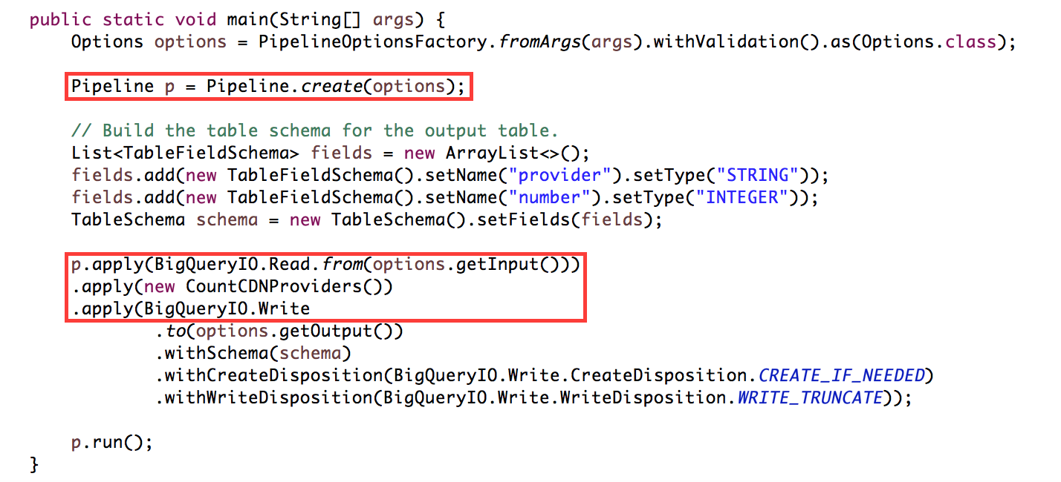
Create a Pipeline using Dataflow SDK
Create a Pipeline object and pass it configuration options.
Construct and run a pipeline with three transforms: a transform to read in some data, a transform to do some processing, and a transform to write out the results.

Slide 7
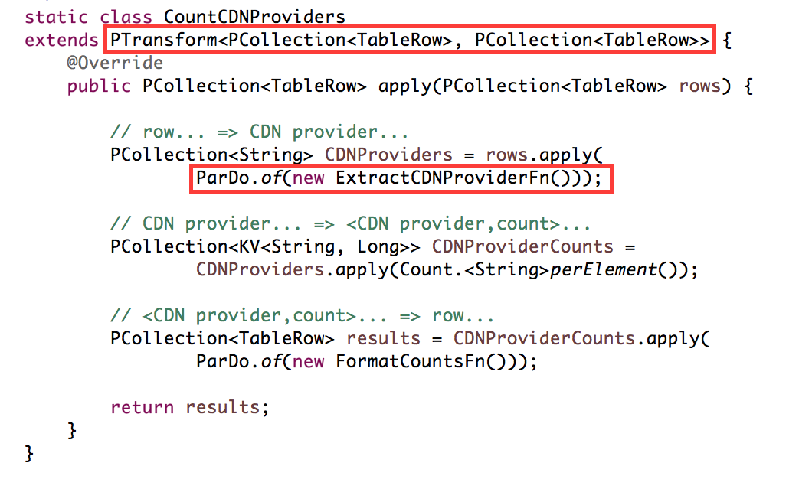
Create a Pipeline using Dataflow SDK
Each transform takes one or more PCollections as input, changes or otherwise manipulates the elements of that PCollection, and produces one or more new PCollections as output.
ParDo is the core parallel processing operation in the Dataflow SDKs. Its processing style is similar to "Mapper/Reducer”.

Slide 8
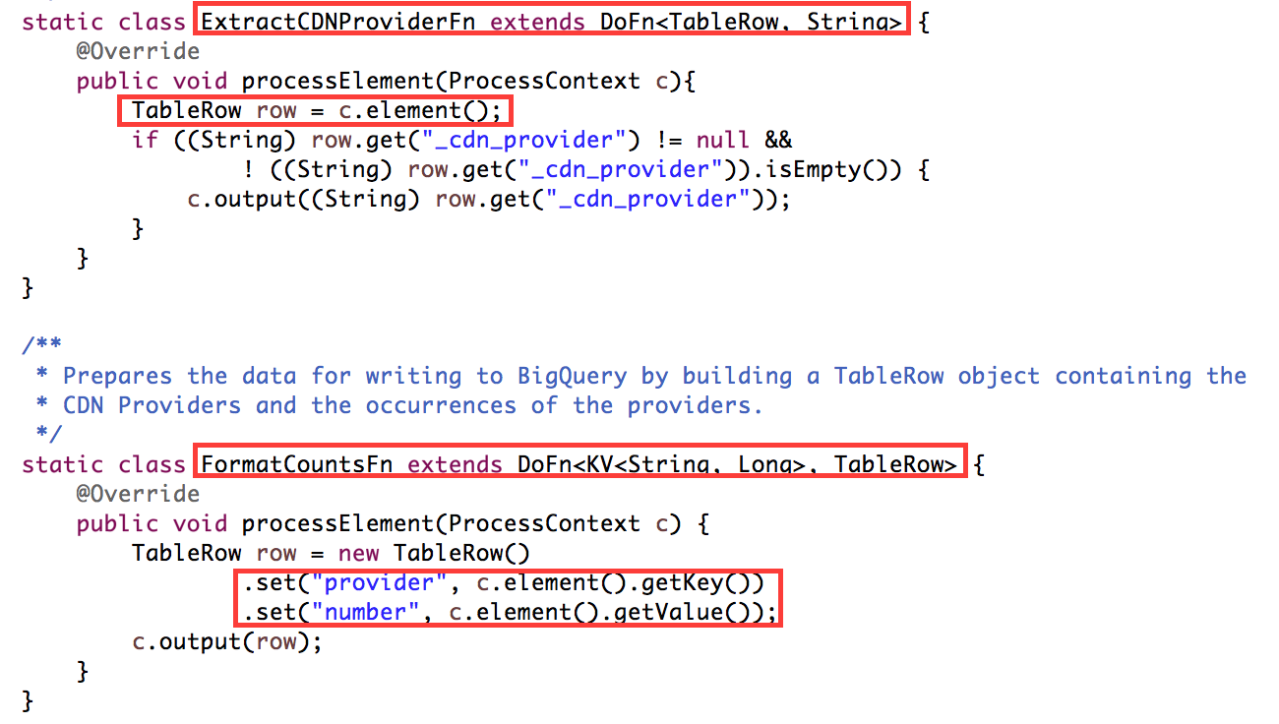
Create a Pipeline using Dataflow SDK
The argument that provide to ParDo must be a subclass of a specific type provided by the Dataflow SDK, called DoFn. A DoFn processes one element at a time from the input Pcollection.

Slide 9
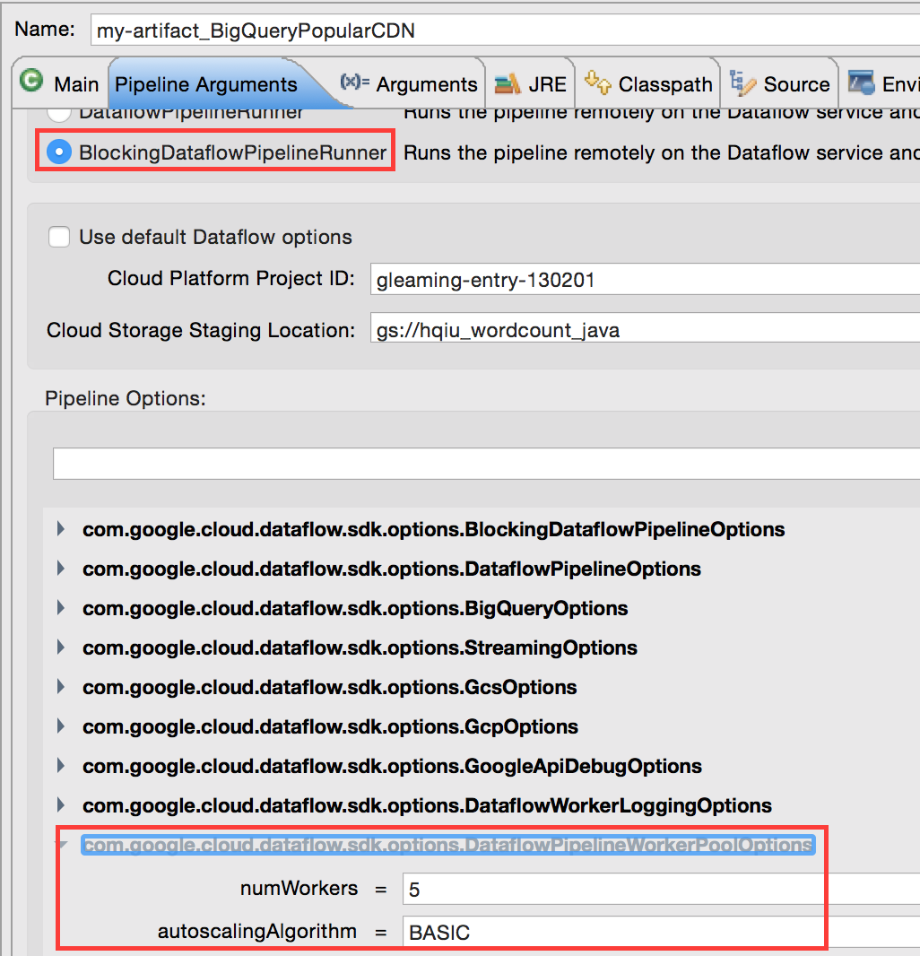
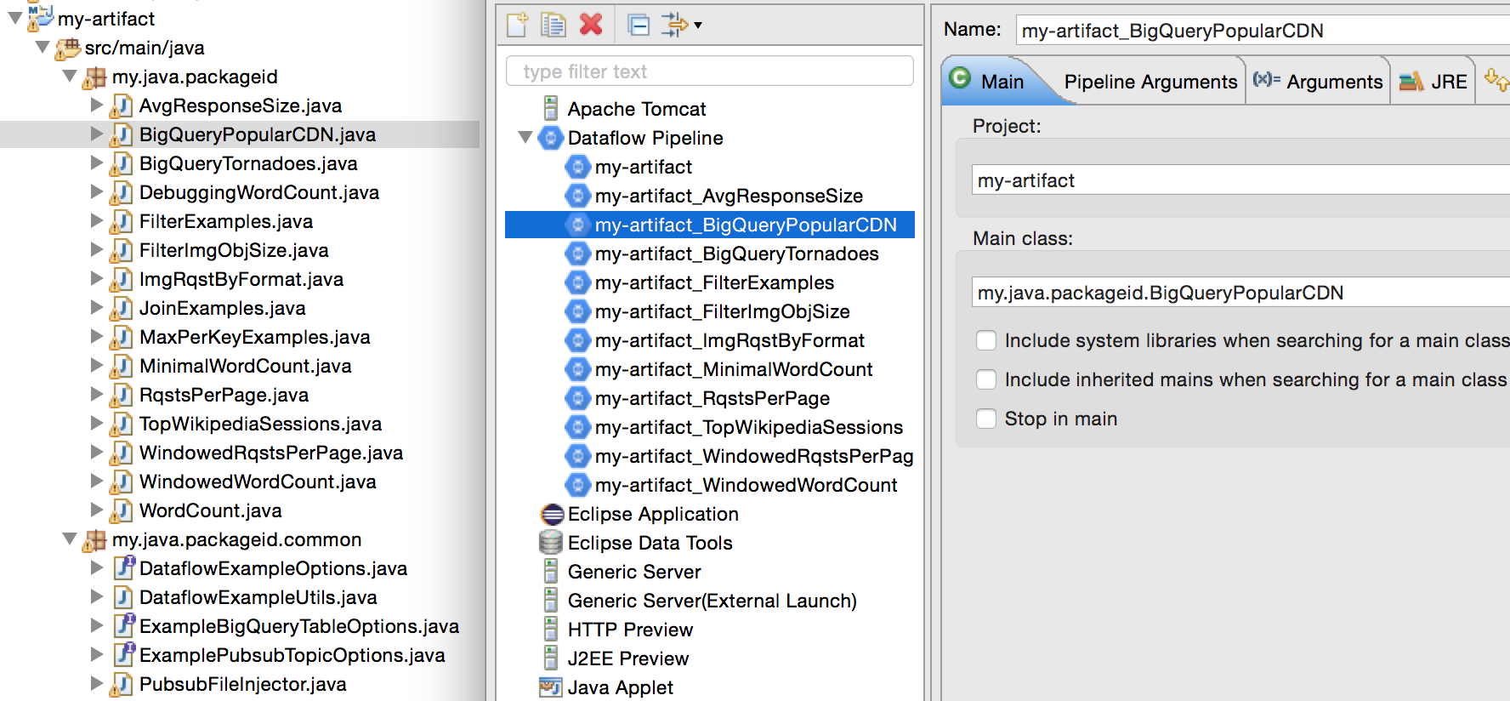
Run configuration in Eclipse

Slide 10
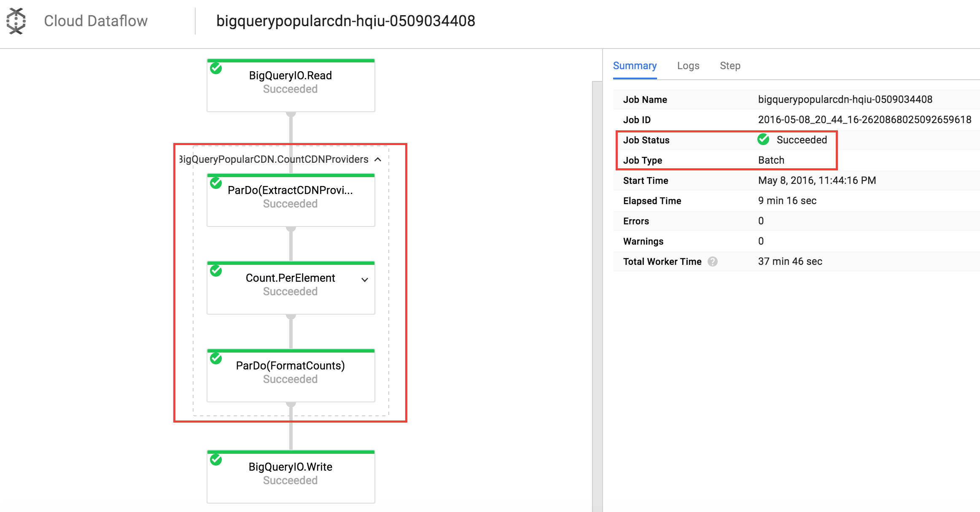
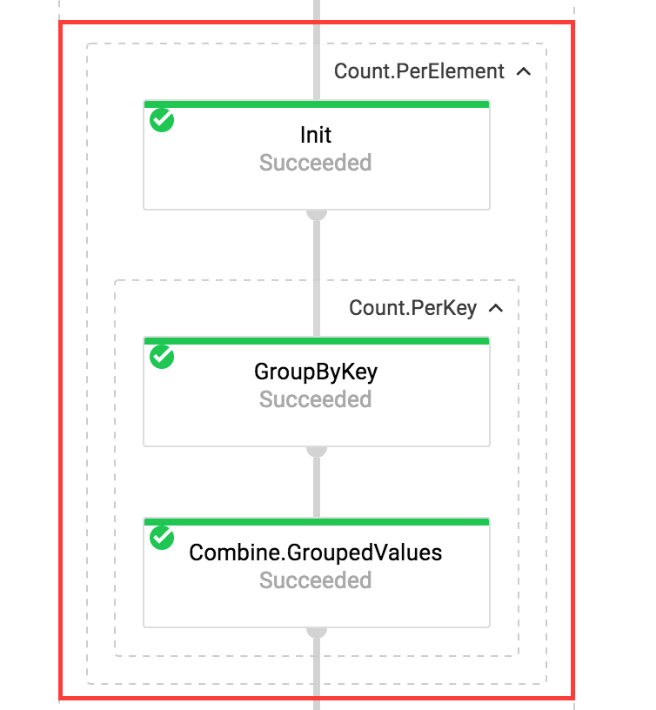
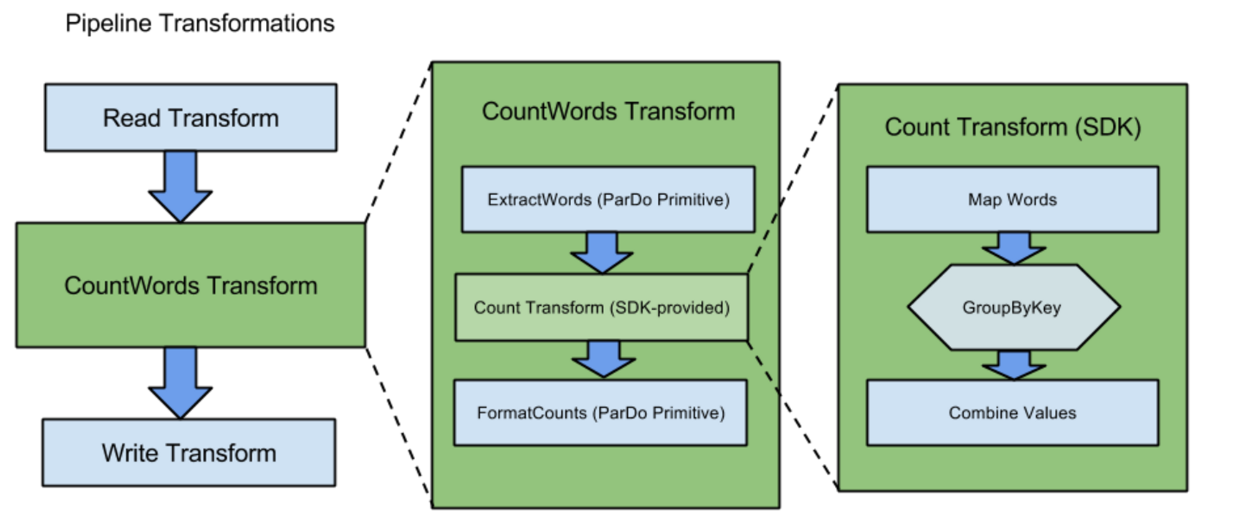
Dataflow Structure

Slide 11
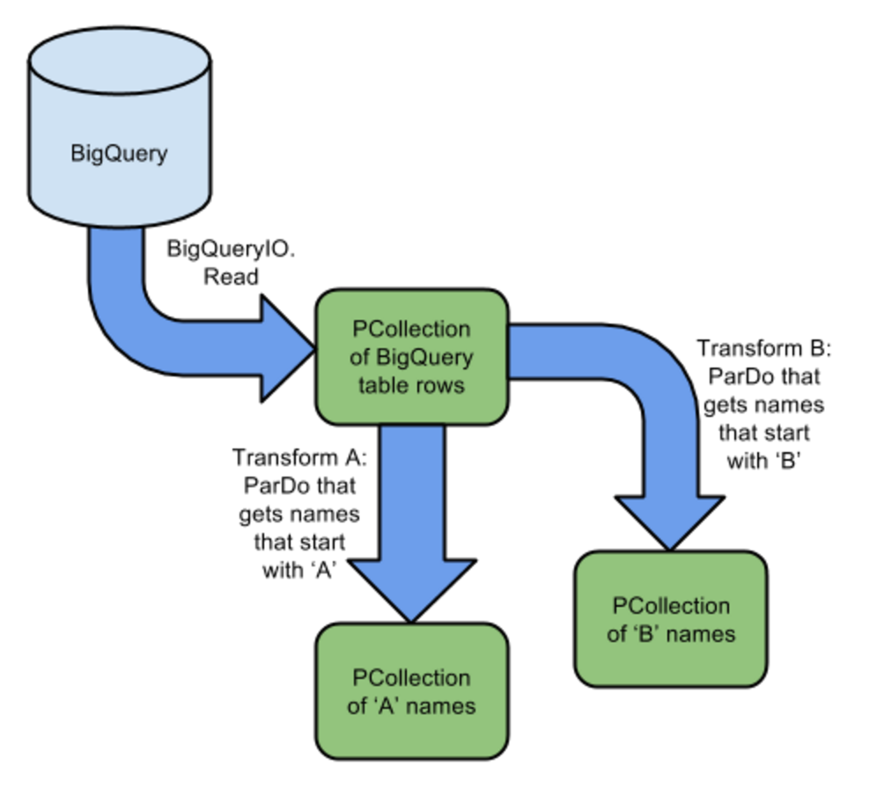
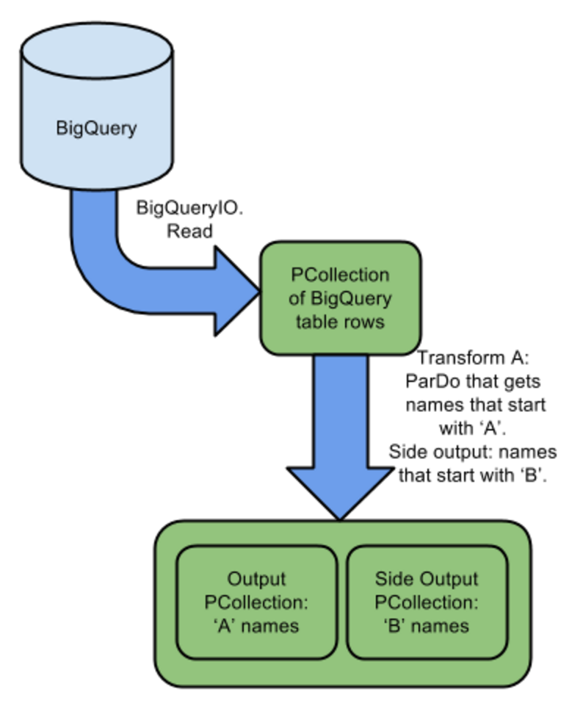
More complex Pipeline
Branching PCollections
Multiple transforms process the same PCollection
A single transform that uses side outputs

Slide 12
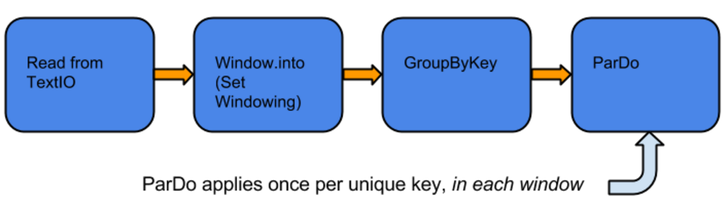
Windowing model
The Dataflow SDKs use Windowing to subdivide a PCollection according to the timestamps of its individual elements. Dataflow transforms that aggregate multiple elements, such as GroupByKey and Combine, work implicitly on a per-window.
The window types can be:
Fixed Time Windows
Sliding Time Windows
Per-Session Windows
Single Global Window

Slide 13
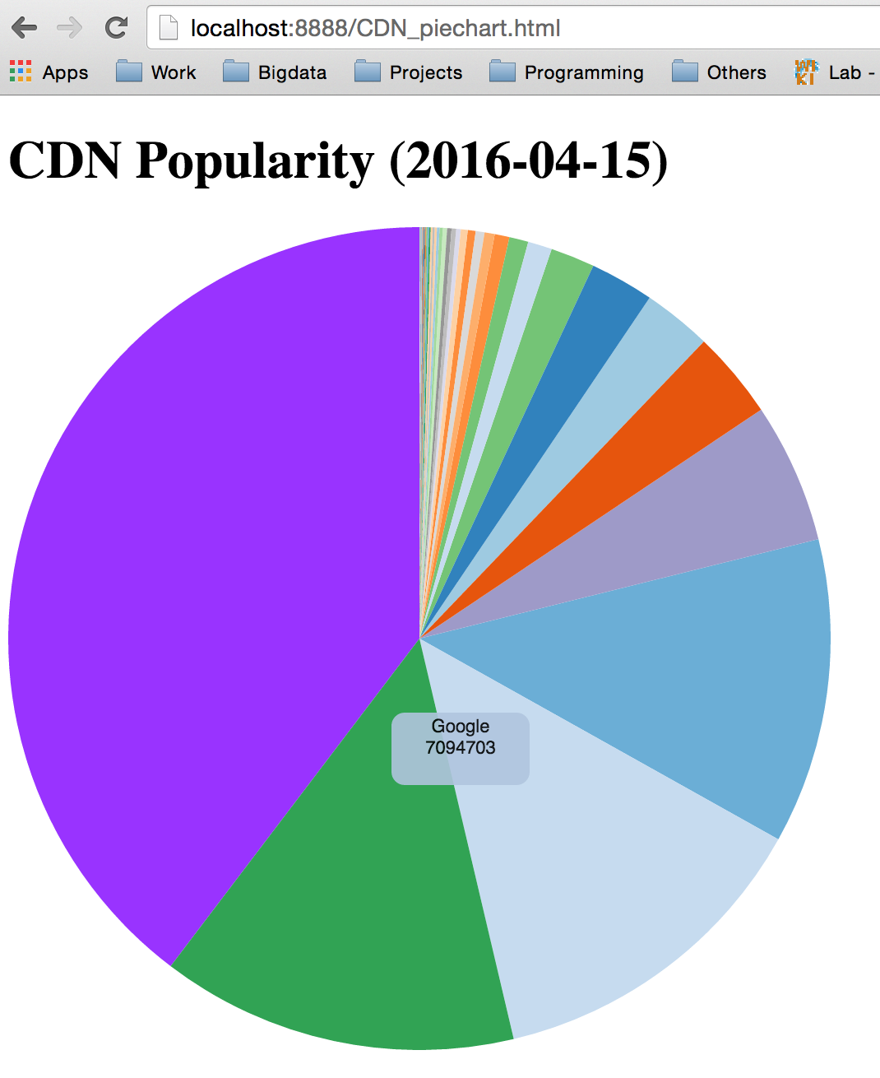
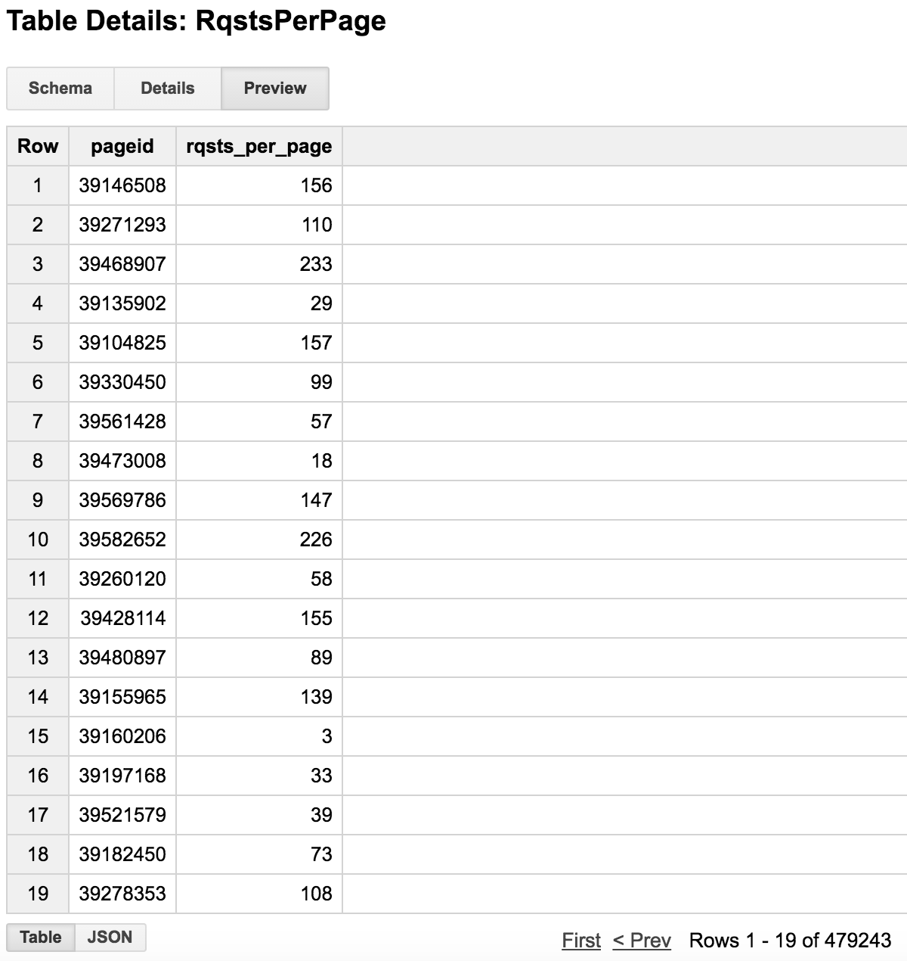
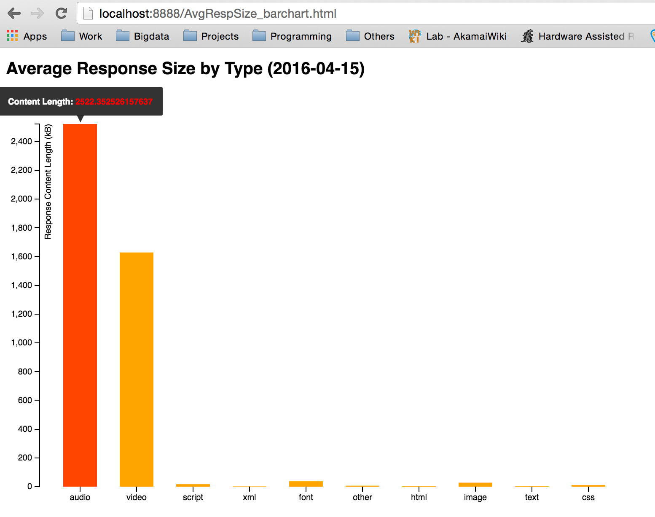
Results using no-windowing model

Slide 14
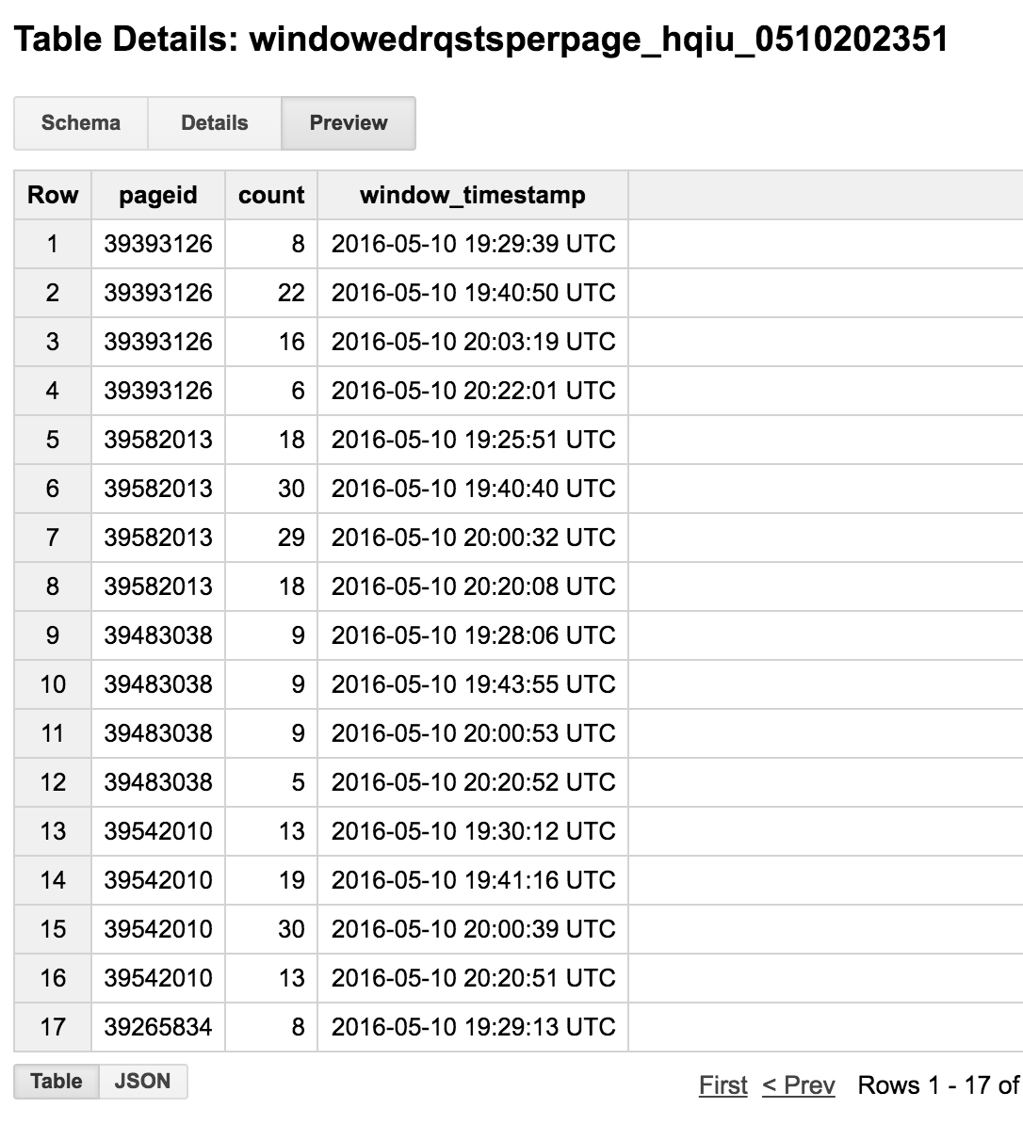
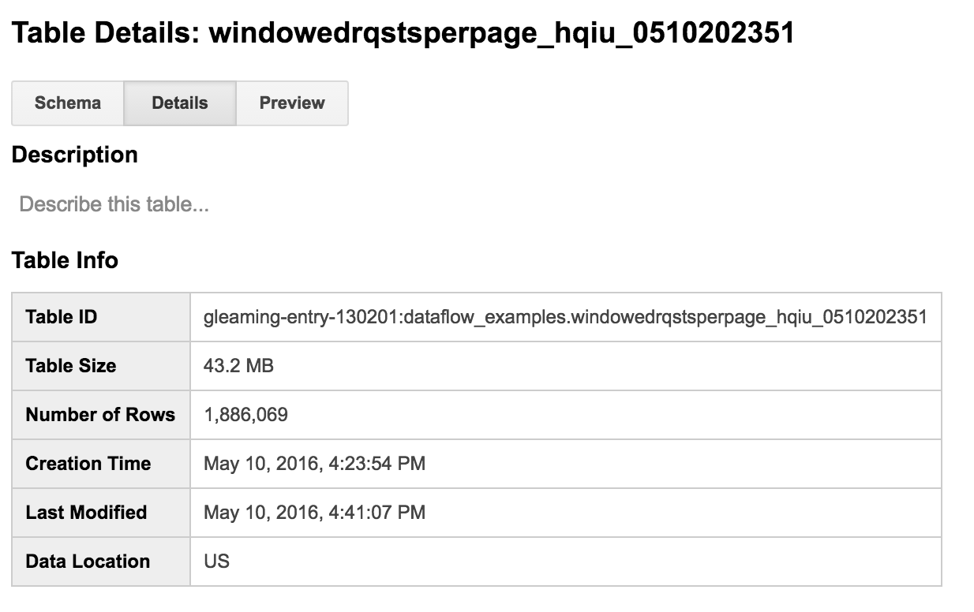
Results using windowing model
Pageid is processed by both key and window

Slide 15
Future work
Try more complicated models in windowing, triggering, incremental processing model and so on.
Do some benchmarking or performance comparison with other data processing models.
Highly recommend reading the official research paper and try using them to solve real world problems.

Slide 16
References
Google Cloud Dataflow documentation:
https://cloud.google.com/dataflow/docs/
Examples of the Cloud Dataflow SDK for Java:
https://github.com/GoogleCloudPlatform/DataflowJavaSDK-examples
Complete end-to-end example pipelines that perform complex data processing tasks:
https://github.com/GoogleCloudPlatform/DataflowJavaSDK/tree/master/examples/src/main/java/com/google/cloud/dataflow/examples/complete
Simple "cookbook" examples, which show how to define commonly-used data analysis patterns that you would likely incorporate into a larger Dataflow pipeline:
https://github.com/GoogleCloudPlatform/DataflowJavaSDK/tree/master/examples/src/main/java/com/google/cloud/dataflow/examples/cookbook
Google Dataflow model research paper:
http://research.google.com/pubs/pub43864.html

Slide 17
YouTube URLs
Two minute (short): https://youtu.be/Jt5J4SMQNko
15 minutes (long): https://youtu.be/kjFoB6ZM9Iw

