Slide 1

Final Project
Google BigQuery
Hanjiao Qiu
cscie90 Cloud Computing
Harvard University Extension School
Prof. Zoran B. Djordjević

Slide 2
What’s BigQuery?
Service for interactive analysis of massive datasets (TBs)
  Query billions of rows: seconds to write, seconds to return
  Uses a SQL-style query syntax
  It’s a service, accessed by a RESTful API
Reliable and secure
  Replicated across multiple sites
  Secured through Access Control Lists
Large scale
  Store hundreds of terabytes
  Pay only for what you use
Super fast
  Run ad hoc queries on multi-terabyte data sets in seconds
  1.4 TB data: on an average its within 8 ~ 10 seconds!!

Slide 3
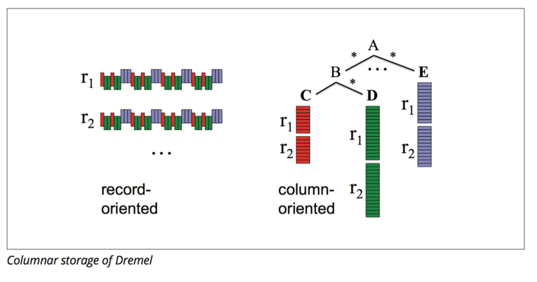
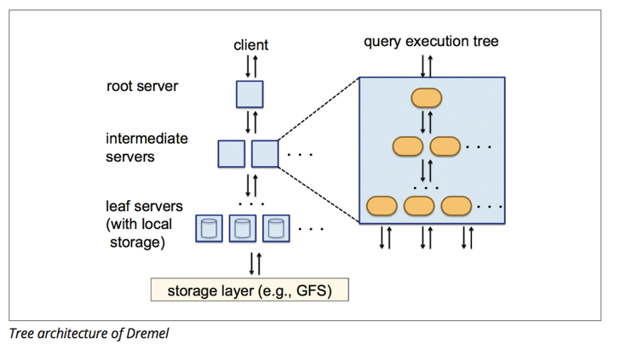
Inside BigQuery
It used Columnar storage & multi-level execution trees to achieve interactive performance for queries against multi-terabytes datasets.

Slide 4
Three ways to access BigQuery
Web UI
bq command line tool
BigQuery API
Interact with third party tools
  Visualization and business intelligence tools
  ETL tools for loading data into BigQuery
  Connectors and developer tools

Slide 5
Problems to solve
Search and sort the popular CDN (Content Delivery Network) providers, top sites to have content security policy to prevent XSS and explore other web behaviors.
Do real-time system log analysis, execute queries and visualize the log data through interacting with the BigQuery in Google sheets.

Slide 6
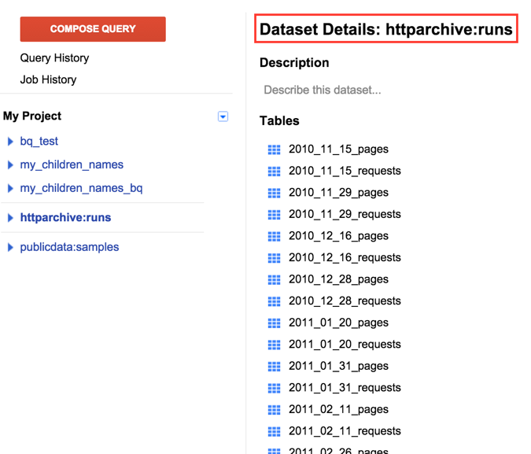
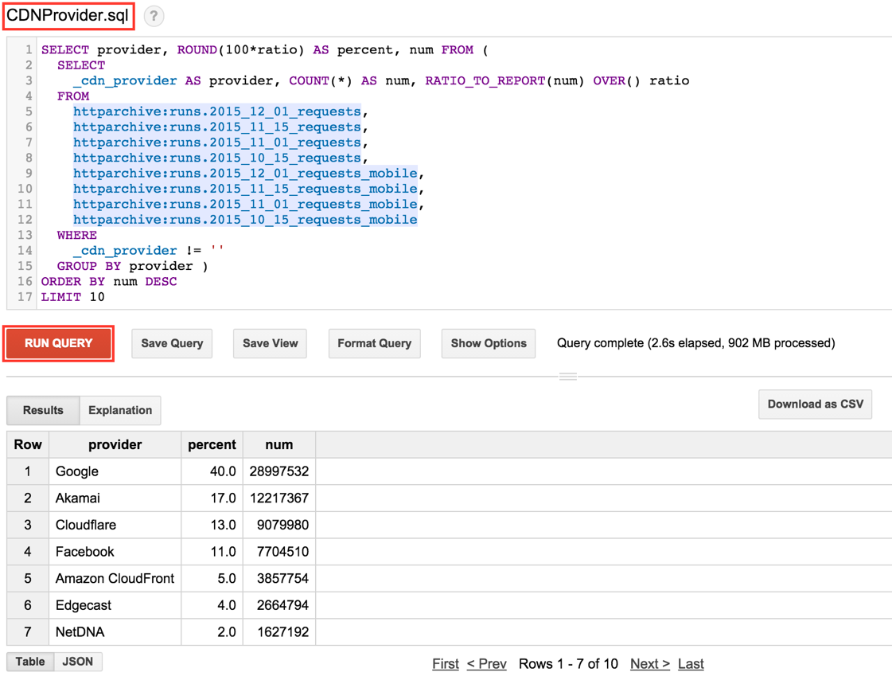
Query through Web UI
Show popularity of CDN providers!

Slide 7
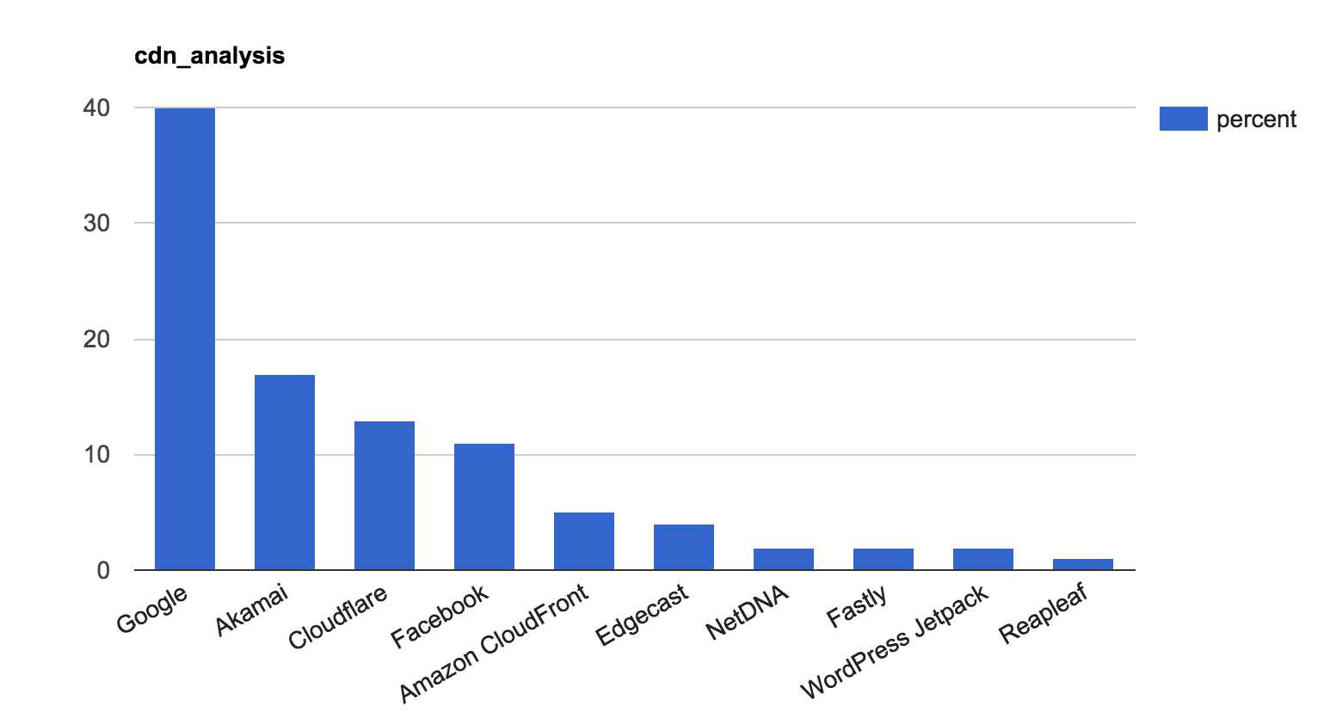
Visualize results through Google sheet
Execute BigQuery and visualize results in Google sheet!

Slide 8
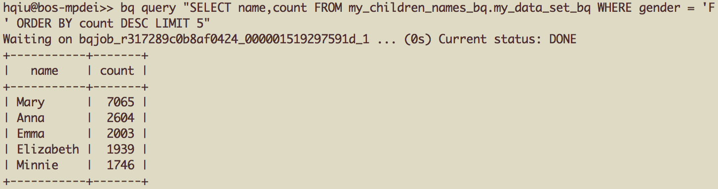
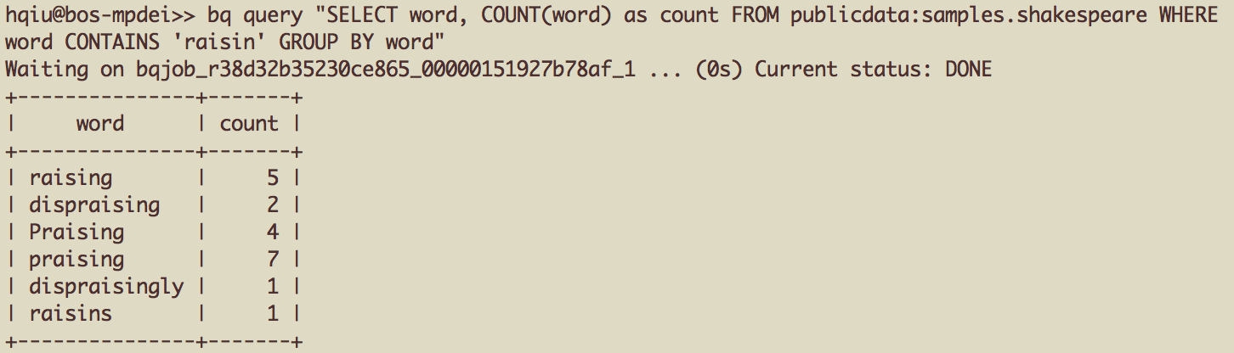
Query through bq command line
Query directly through the command line!

Slide 9
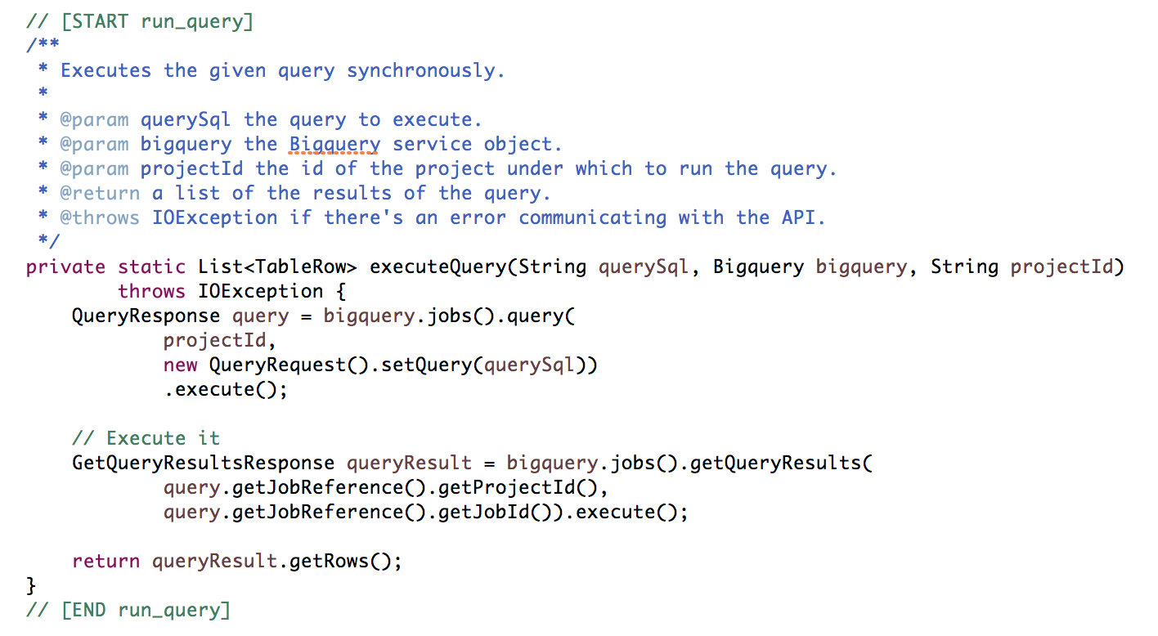
Query through RESTful API
Interacting with Google BigQuery using Java!

Slide 10
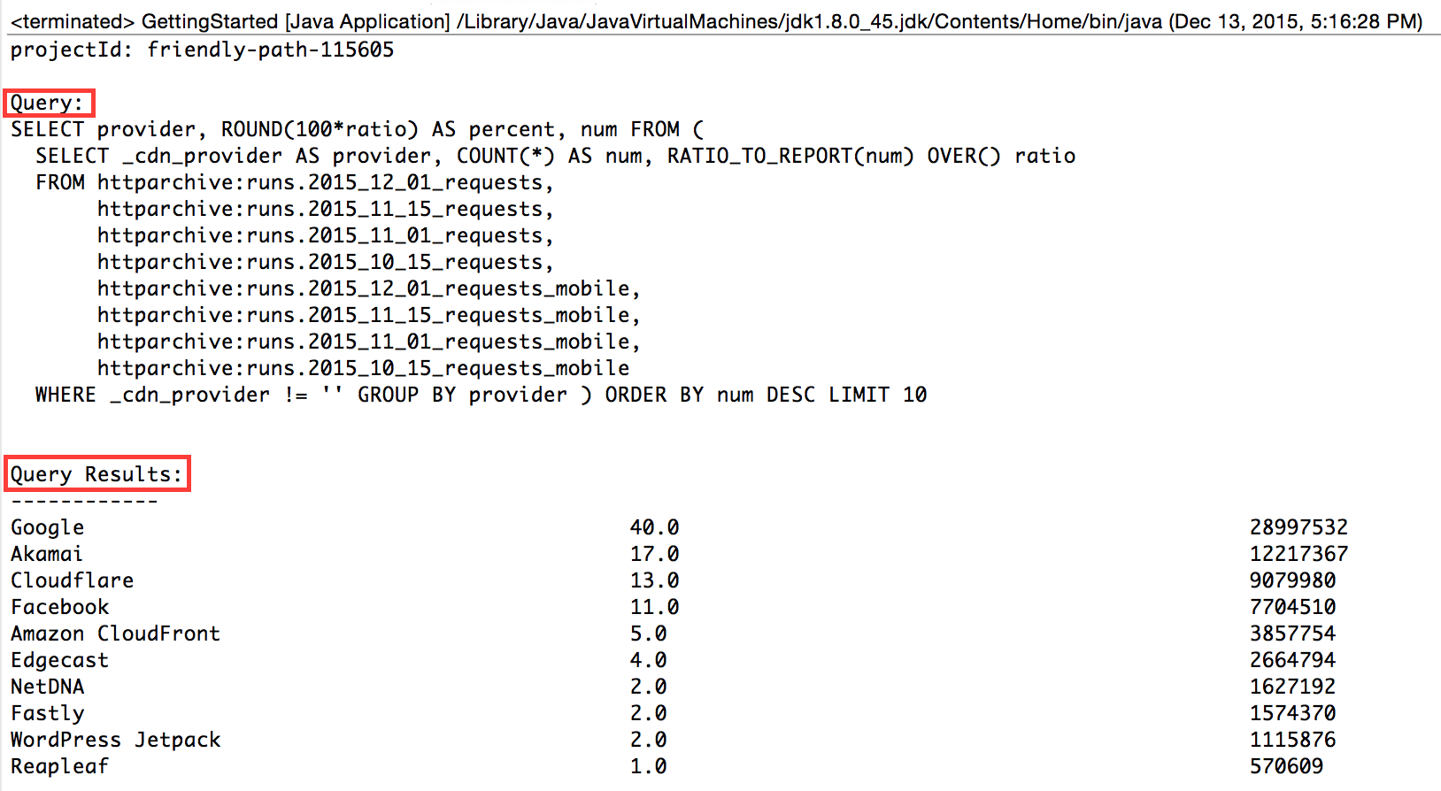
Query through RESTful API

Slide 11
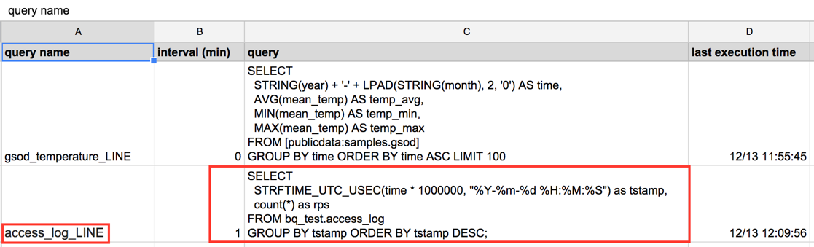
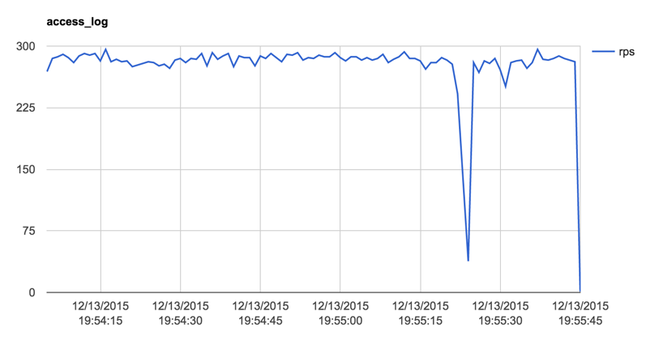
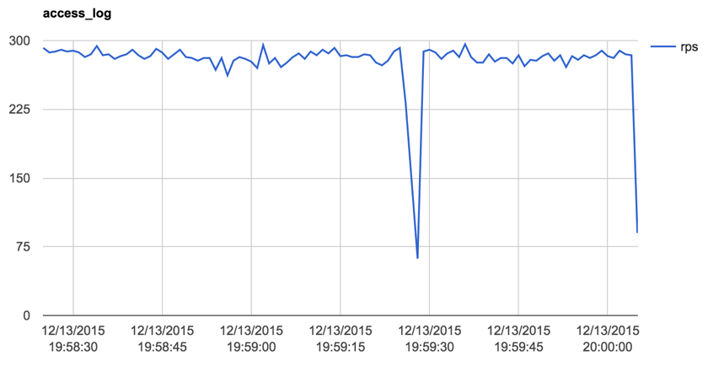
Use cases: Real-time log analysis

Slide 12
References
https://cloud.google.com/bigquery/what-is-bigquery
https://cloud.google.com/bigquery/third-party-tools
https://github.com/GoogleCloudPlatform/java-docs-samples/tree/master/bigquery/src/main/java/com/google/cloud/bigquery/samples
https://developers.google.com/resources/api-libraries/documentation/bigquery/v2/java/latest/
http://httparchive.org/interesting.php

Slide 13
Videos
Short video: https://youtu.be/LaEz-mcvIKk
Full video: https://youtu.be/_zN6Vjo29yU

