Slide 1
PenangAir
Simple Visual Explanation of All GAML Files
Notes:
Focus on WHAT and WHY, not code syntax.

Slide 2
Our Approach
Focus: WHAT each part does and WHY it exists.
Use real examples from PenangAir (real roads, real traffic counts).
Follow the story: Real Map → Traffic → Pollution → Visuals

Slide 3
Big Picture
PenangAir simulates traffic and air pollution on a REAL map of Penang.
It asks: 'If traffic increases, where might pollution hotspots appear?'
It is made of many smaller parts working together.
Main Idea: Traffic activity → Creates emissions → Leads to pollution → We see it on the map.

Slide 4
Key Concepts
AGENTS: Individual things that act (each vehicle is an 'agent').
AGENT-BASED MODEL (ABM): Many simple agents follow rules → Complex patterns appear.
GIS: Real maps (roads/buildings) instead of imaginary grid.
TIME-STEPPING: Simulation moves forward little by little (step-by step, second by second).
EMERGENCE: We don't 'draw' hotspots – they appear from traffic behaviour.

Slide 5
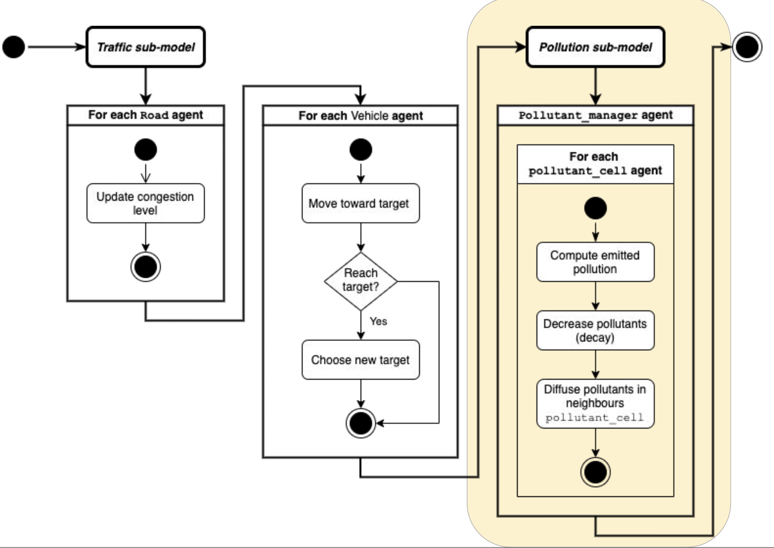
Flow chart of the models

Slide 6
The Cause–Effect Chain (Most Important)
REAL MAP (GIS)
↓
REAL TRAFFIC COUNTS (CSV) → Vehicles placed on roads
↓
VEHICLES MOVE (Traffic Flow)
↓
TRAFFIC ACTIVITY creates EMISSIONS
↓
EMISSIONS become AIR POLLUTION (spatial hotspots)
↓
WE SEE IT ON MAP + CHARTS (Visualization)

Slide 7
What to Look For When Running
1. Map loads first: See Penang roads/buildings appear.
2. Vehicles appear: Cars/bikes/buses/lorries placed on roads (realistic distribution).
3. Press Play: Vehicles start MOVING along roads.
4. Watch colours: Pollution layer changes colour over time (hotspots forming).
5. Watch chart: AQI line graph goes up/down as traffic changes.
6. Notice pattern: Busy roads/junctions often show higher pollution.

Slide 8
The 4 Main Groups of Files
1. CONTROL (Settings): global_vars.gaml – What rules/values to use
2. MAP & GIS (in main.gaml): Loads the real Penang map
3. SETUP & TIMING (Orchestration): PenangAir.gaml + main.gaml – Starts and runs everything
4. BEHAVIOURS (Agents): traffic, pollution, visualization – Who does what and what we see
5. INPUT DATA (includes/): Roads (shapefiles) + Traffic counts (traffic_counts.csv)

Slide 9
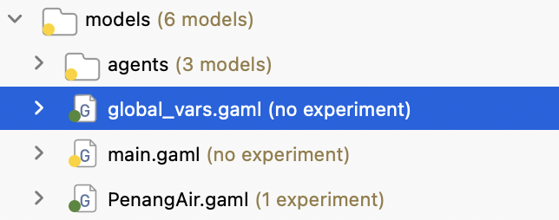
1. global_vars.gaml – The Control Panel
Analogy: Like a car's dashboard/settings (controls you can adjust).
Purpose: Keeps ALL numbers/settings in one central place.
Examples: How fast time runs, study area size, max vehicles, labels for charts.
WHY: Easy to test 'what-if' (change one number, whole model changes).
Key Idea: Separates SETTINGS from LOGIC.

Slide 10
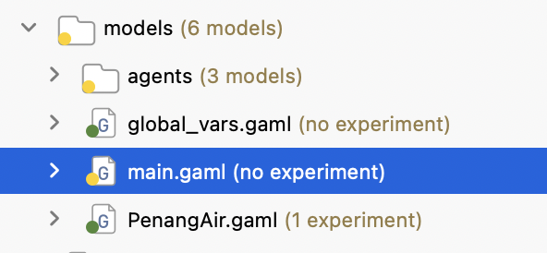
2. main.gaml – Loading the Real Map & GIS Data
Analogy: Loading a GIS Map of Penang before placing cars.
Reads real GIS map files (roads, buildings) from includes/ folder.
Creates the ROAD NETWORK (roads + intersections) that vehicles can travel on.
Defines the study area boundary (the area we are looking at).
Key Idea: Simulation happens on REAL geography, not a flat grid.

Slide 11
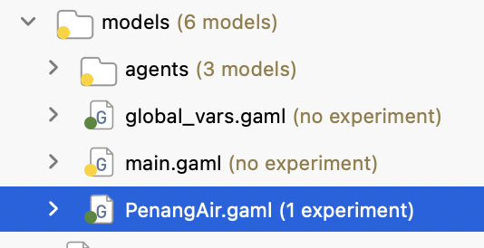
3. PenangAir.gaml – The Main Model File
Analogy: The 'master folder/conductor' that brings everyone together.
Connects all parts: settings + map + setup + agents.
Defines EXPERIMENTS – the different ways to run the model (interactive GUI).
This is the file you OPEN in GAMA to start the simulation.
Key Idea: The ENTRY POINT (starting door) to run everything.

Slide 12
4. main.gaml – Setup, Clean-Up & Timing
Analogy: Like setting up a road network + placing cars BEFORE pressing PLAY.
Runs ONCE at start (Initialisation). Then runs repeatedly over time.
Main Jobs: Centre map on study area, load roads/buildings, clean road network, create vehicles, keep time & AQI updated.
Key Idea: GETS EVERYTHING READY, then keeps the clock ticking.

Slide 13
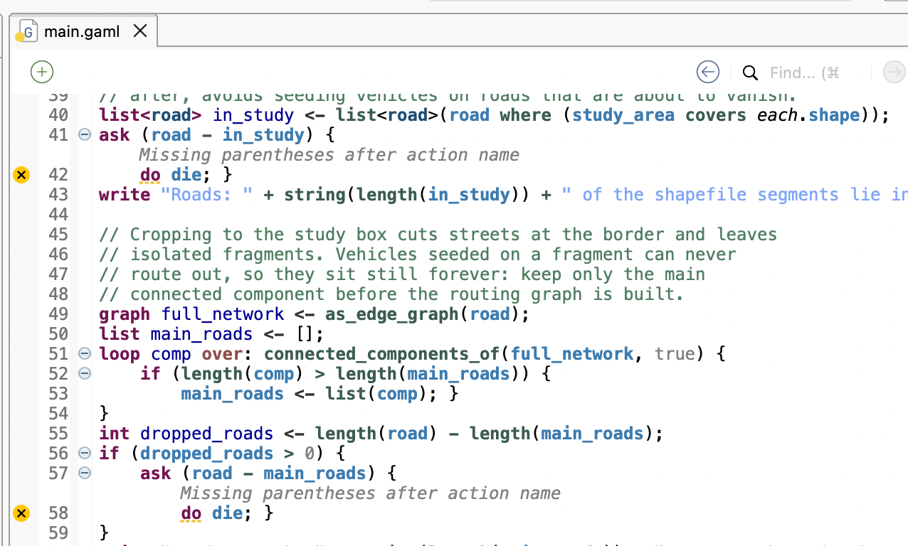
Important Step: Cleaning the Road Network
Problem: When we cut the map to our study area, some roads get CUT OFF and become 'islands' (disconnected).
Imagine: A small road piece with NO connection to the rest of the road network.
Vehicles placed there CANNOT move anywhere (stuck forever).
Solution: Find the BIGGEST connected road network, keep it. Remove small 'islands' (isolated fragments).
WHY: Keeps vehicles moving realistically on a connected road system.

Slide 14
5. The ON/OFF Switch: 'use_traffic_data'
Simple Question: Do we want to use REAL traffic data, or made-up traffic?
use_traffic_data = 1 → YES, use REAL traffic from traffic_counts.csv
use_traffic_data = 0 → NO, use a SMALL RANDOM default fleet (90 vehicles), scattered over all road types → much less traffic, weaker/diffuse pollution
It's just an ON/OFF switch (toggle). Set to 1 in the model. Normal mode = 1 (real CSV data); 0 = sparse random test fleet.
Key Idea: Easy way to choose realistic vs. simple traffic.

Slide 15
6. traffic_counts.csv – Real Traffic Survey Data
What it is: A spreadsheet of REAL traffic counts for Penang roads.
Contains ~2540 road entries with how many cars/buses/lorries/motorcycles pass.
Each row tells us: Road Name + Road Type + Length + Vehicle Counts (4 types).
Purpose: Makes the simulation start with REALISTIC traffic, not random guesses.
Key Idea: Input DATA (facts about Penang traffic).

Slide 16
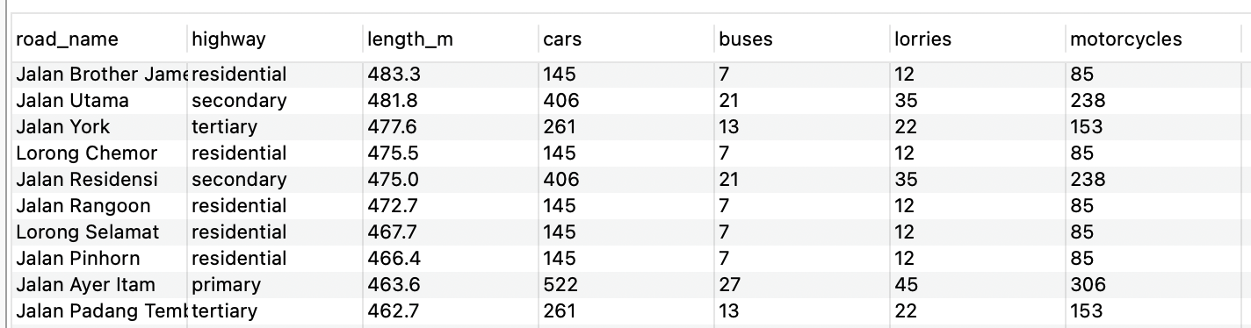
Understanding the CSV Columns
road_name: Name of the road (e.g. Jalan Masjid Negeri)
highway: Road TYPE (trunk, primary, secondary, tertiary, residential...)
length_m: How long the road is (in metres)
cars, buses, lorries, motorcycles: How MANY of each were counted
WHY road type matters: If a road has no name, we can still estimate by its TYPE.

Slide 17
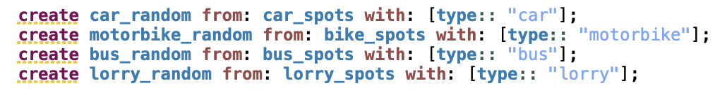
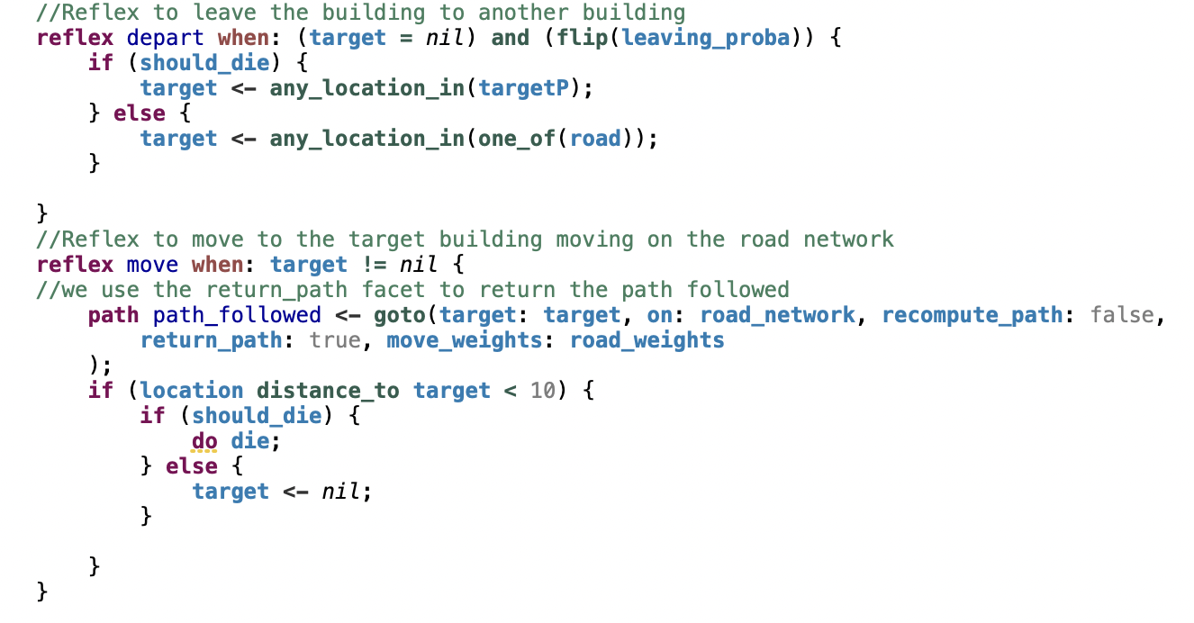
How Traffic Data Becomes Vehicles
STEP 1: Read traffic_counts.csv
STEP 2: For EACH road on the Penang map, decide: Use EXACT name match OR use AVERAGE by road type
STEP 3: Work out HOW MANY vehicles should be on that road segment
STEP 4: Create vehicle AGENTS (cars/bikes/buses/lorries) on those roads
STEP 5: Vehicles start moving on the road network

Slide 18
STEP 2 – Two Ways to Find Traffic Counts (Analogy: Phone Book)
OPTION A – EXACT MATCH (Preferred): Look up road by its EXACT name.
Analogy: Like looking up 'Jalan Masjid Negeri' in a phone book → get its exact numbers.
OPTION B – BY ROAD TYPE (Fallback): If NO name match, group by highway type.
Analogy: If unknown street name, use AVERAGE for all 'trunk' roads (or 'primary', etc.)
WHY: Some GIS road segments have missing names. This way ALL roads still get traffic (plausible, not zero).

Slide 19
Real Example: Exact Match vs Road-Type Average
EXAMPLE 1 – Exact Match: Road named 'Jalan Masjid Negeri' (trunk) in CSV has 638 cars, 33 buses, 55 lorries, 374 motorcycles → Use THESE exact numbers.
EXAMPLE 2 – No Name Match: An unnamed road segment is TYPE 'trunk' → Take AVERAGE of ALL trunk roads in CSV → Apply that average to this unnamed segment.
RULE: Try EXACT match FIRST. If no match → use ROAD TYPE average.
RESULT: Realistic where known, reasonable where unknown.

Slide 20
STEP 3 – From Traffic Counts to Vehicle Numbers
Traffic counts are 'how many pass per road' (survey numbers).
GIS splits roads into SHORT segments. We need how many vehicles to put on EACH segment.
We adjust based on: Segment LENGTH + Road TYPE SPEED (how fast vehicles travel).
Longer/slower roads can 'hold' more vehicles at a time than very short fast roads.
Simple Idea: Convert total counts → estimate vehicles present on that road segment at a given time.

Slide 21
Simple Example: Fractional Carry (Avoid Losing Vehicles)
Calculation gives decimals: e.g. 2.7 vehicles for a road segment.
We CANNOT create 0.7 of a vehicle agent – we can only create whole vehicles.
Solution: Create 2 vehicles on THIS segment, CARRY FORWARD 0.7 to the NEXT road segment.
Next segment does: its own calculation + 0.7 carried over.
WHY: If we just rounded DOWN (truncated) everywhere, we would LOSE many vehicles (especially on many short segments). Carrying remainders preserves the TOTAL fleet.

Slide 22
STEP 4 – Create Vehicle Agents on the Map
We now have a list of 'spots' (locations on roads) for each vehicle type (cars, motorcycles, buses, lorries).
Model creates ONE vehicle AGENT at each spot (car_random, motorbike_random, bus_random, lorry_random).
These are the INDIVIDUAL vehicles that will move in the simulation.
Scale & Cap: Can scale all by 'fleet_scale' (keeps same mix). Capped by 'max_vehicles' to keep it running smoothly (proportionally reduced to preserve mix).

Slide 23
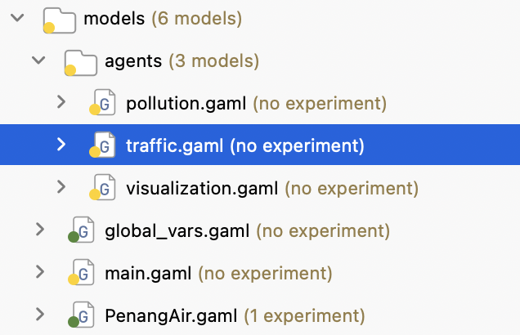
7. agents/traffic.gaml – The Vehicles That Move
Purpose: Defines how vehicles BEHAVE (move) on the road network.
Vehicles are AGENTS: Each car/bike/bus/lorry is an individual that follows rules.
Movement: Travel along roads (network-constrained), follow road paths, move step-by-step over time.
Speed depends on ROAD TYPE (trunk faster than residential, etc.)
Key Idea: This is the TRAFFIC LAYER – vehicles moving around Penang.

Slide 24
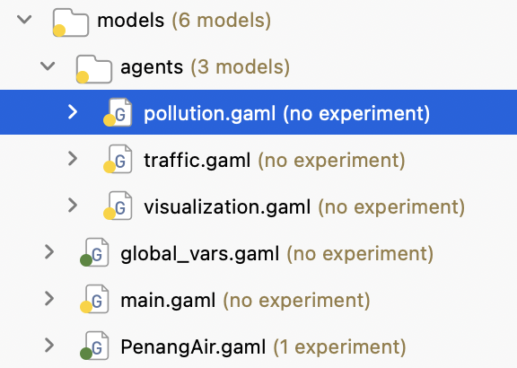
8. agents/pollution.gaml – From Traffic to Pollution
Purpose: Takes traffic ACTIVITY and turns it into AIR POLLUTION representation.
Core Chain: TRAFFIC ACTIVITY → EMISSIONS → POLLUTION
Where vehicles move (especially busy roads), pollution builds up/spreads.
Represented as a SPATIAL POLLUTION FIELD (pollution levels across the map area).
Creates POLLUTION HOTSPOTS (areas with higher pollution intensity).
Simplified & educational (focuses on cause–effect, not full atmospheric chemistry).

Slide 25
Pollution Hotspots – Simple Explanation
More traffic activity (more vehicles, busier roads) → More emissions in that area.
Pollution levels vary SPATIALLY (not same everywhere on map).
Busy junctions/roads tend to show HIGHER pollution (hotspots).
Over time, pollution levels CHANGE as traffic flows change.
This is shown as COLOUR GRADIENTS on the map (darker/warmer = higher pollution).

Slide 26
Emissions by Vehicle Type (per km)
Each vehicle emits pollutants as it travels. Per-km factors (published values):
Heat-map weight = (PM + NOx) x 3.0 x EMISSION_SCALE.
EMISSION_SCALE is the magnitude knob: lowered from 0.2 to 0.15 (about 25% less).
Electric vehicles emit only 10% of their class factor.
Vehicle | CO (g/km) | NOx (g/km) | SO2 (g/km) | PM (g/km)
motorbike | 3.62 | 0.3 | 0.03 | 0.1
car | 3.62 | 1.5 | 0.17 | 0.1
bus | 13.0 | 7.0 | 0.5 | 0.9
lorry | 15.0 | 9.0 | 0.6 | 1.0
Key idea: buses and lorries are the heavy polluters (PM+NOx sits ~an order of magnitude above a car). Lowering EMISSION_SCALE from 0.2 to 0.15 cuts every type by about 25%.

Slide 27
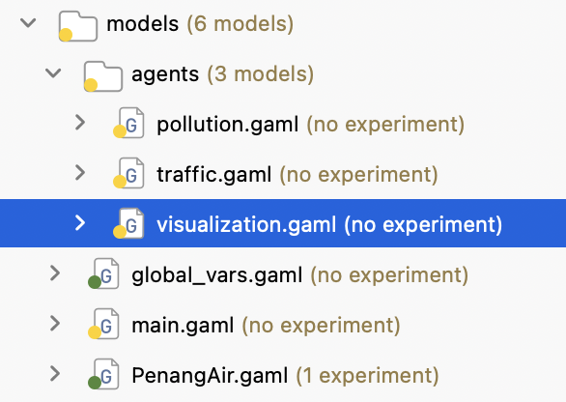
9. agents/visualization.gaml – What We See
Purpose: Turns numbers/agents into a VISUAL MAP + CHARTS (the GUI you see).
Shows: Penang map background, roads, buildings, vehicles moving, pollution layer (colours), study boundary.
Charts: AQI/pollution over TIME (line graph).
UI: Indicators (Time), progress bars (vehicle counts/mix).
Key Idea: Makes the invisible (pollution levels) VISIBLE on screen.

Slide 28
Buildings & Visuals (For Clarity)
Buildings loaded from shapefile to show urban area (city context).
Given small depth/varied textures to look nicer on map (visual only, not affecting simulation).
Helps us recognise areas (George Town/Penang urban layout).

Slide 29
Time & AQI (How We Track Changes Over Time)
Simulation runs STEP-BY-STEP (time passes in simulation).
Clock updates on screen (shows current simulation time).
AQI (Air Quality Indicator): Tracks MAXIMUM pollution level in the study area at intervals.
Plotted as a LINE GRAPH over time (shows trends: when does pollution go up/down?).
Key Idea: See HOW pollution changes over TIME, not just a single snapshot.

Slide 30
Simple Summary
PenangAir.gaml = Starts everything (entry point).
global_vars.gaml = The control panel (settings).
main.gaml = Loads GIS data, cleans roads, builds vehicles, runs the clock.
agents/ folder holds traffic, pollution, and visualization behaviours.
traffic_counts.csv = Real traffic numbers (input data).
traffic.gaml = Vehicles move on roads (traffic).
pollution.gaml = Traffic → creates pollution (impact).
visualization.gaml = Shows everything on screen (what we see).

Slide 31
Key Takeaway (In One Sentence)
PenangAir uses REAL traffic data on a REAL map of Penang to show, visually, how traffic can create air pollution hotspots over time.

Slide 32
Q&A
Thank You
Notes:
Open for questions.

