Slide 1
KMS Starfarm
Knowledge Management System for Agricultural KPI Analysis
AI-Powered Baseline Performance Tracking Across Value Chains

Slide 2
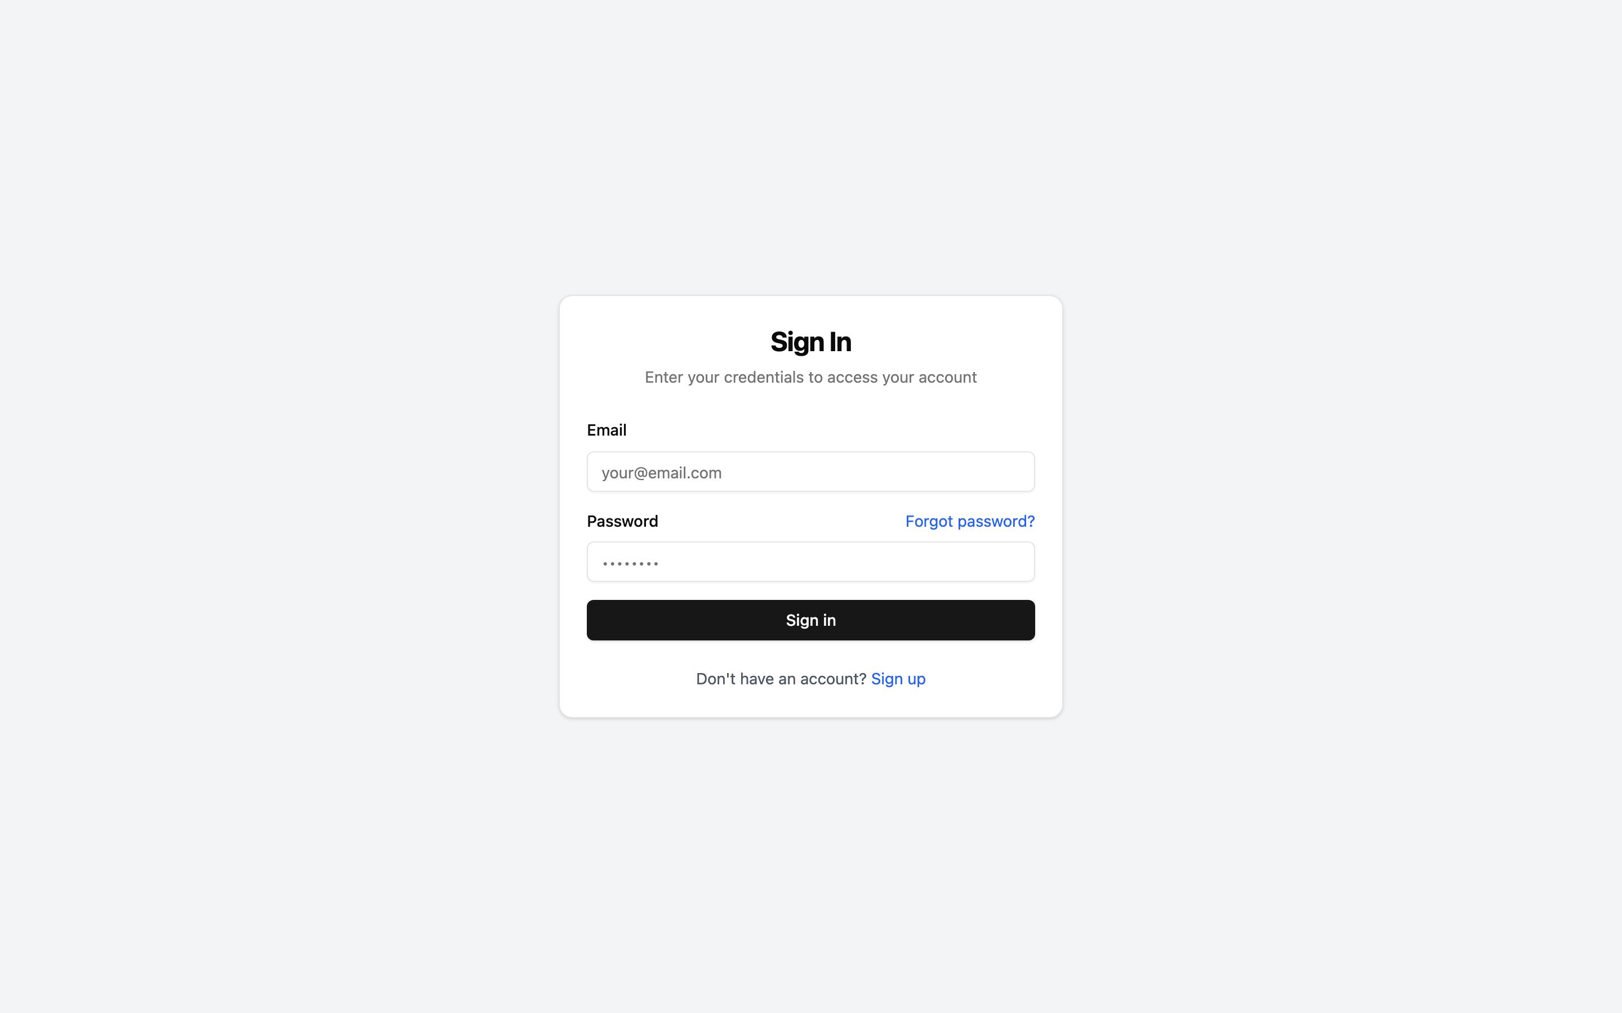
System Overview
Local-first architecture — no cloud dependency
Ollama LLM for AI-powered document analysis
FAISS vector store for semantic search
Supports PDF, DOCX, XLSX, TXT, CSV, images
Role-based access control (RBAC)
Organization & team management
Conversational RAG chat interface
Automatic KPI extraction from documents

Slide 3
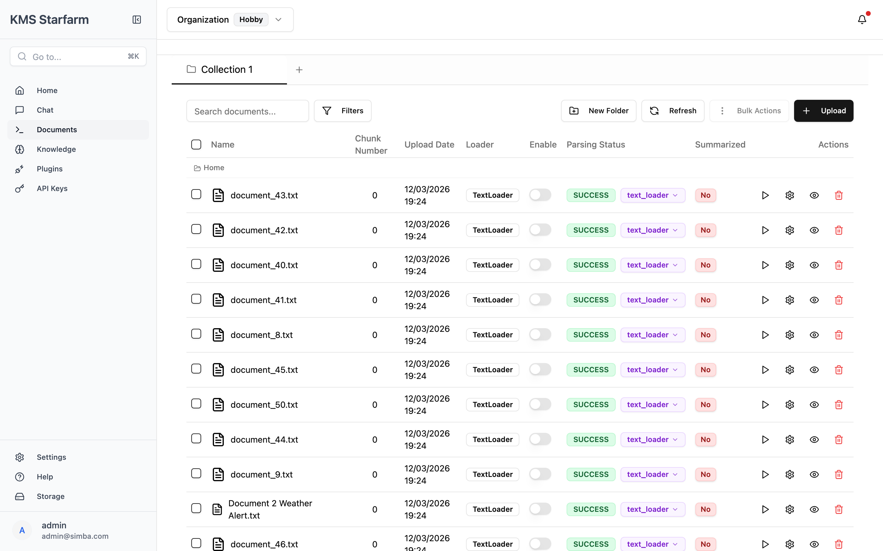
Document Management
Upload & organize agricultural reports
Auto-parse with Docling or Mistral OCR
Folder hierarchy with drag & drop
Bulk operations: parse, embed, delete
Enable/disable documents for KPI extraction
Document preview (PDF, Markdown, text)
Search across all documents
AI-powered summarization

Slide 4
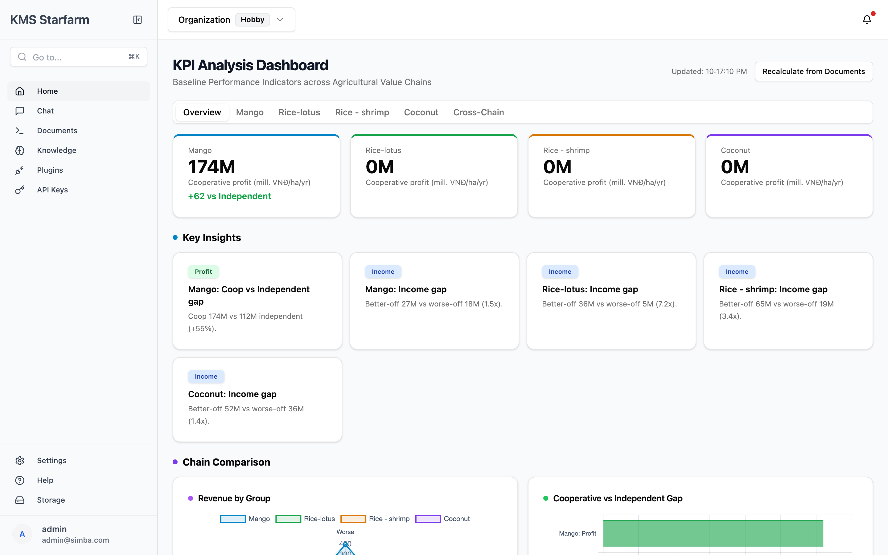
KPI Dashboard — Overview

Slide 5
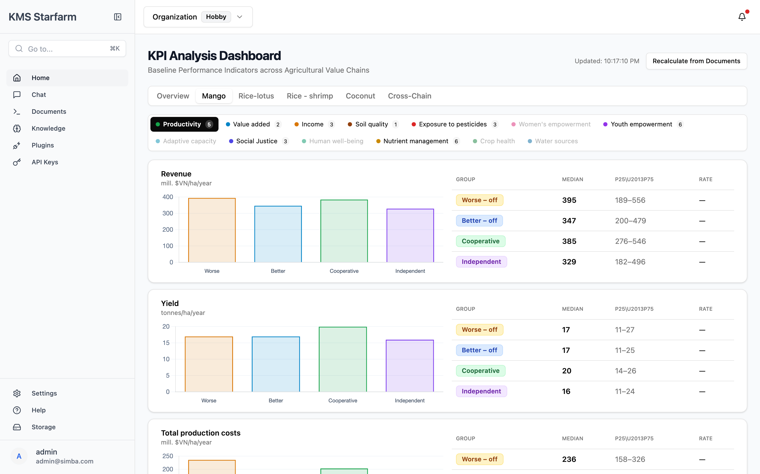
Value Chain Analysis — Mango
13 KPI categories displayed as tabs: Productivity, Value Added, Income, Soil Quality, Exposure to Pesticides, Women's Empowerment, Youth Empowerment, Adaptive Capacity, Social Justice, Human Well-being, Nutrient Management, Crop Health, Water Sources

Slide 6
AI-Powered KPI Extraction
Step 1
Upload agricultural documents (reports, surveys, field data)
Step 2
Parse & embed documents into vector store
Step 3
Click 'Recalculate from Documents' on dashboard
Step 4
LLM reads document content, understands meaning
Step 5
Extracts KPI data: indicators, values, groups
Step 6
Merges with baseline Excel data — preserves originals

Slide 7
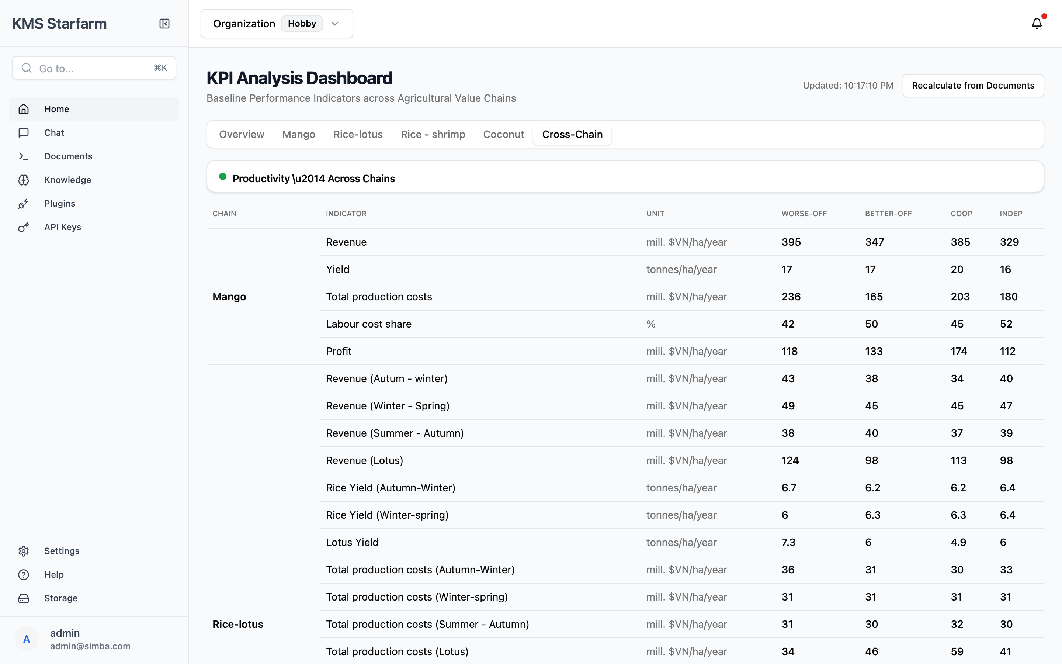
Cross-Chain Comparison
Compare KPIs across all 4 value chains: Mango, Rice-Lotus, Rice-Shrimp, Coconut See how Worse-off, Better-off, Cooperative, and Independent groups perform across chains.

Slide 8
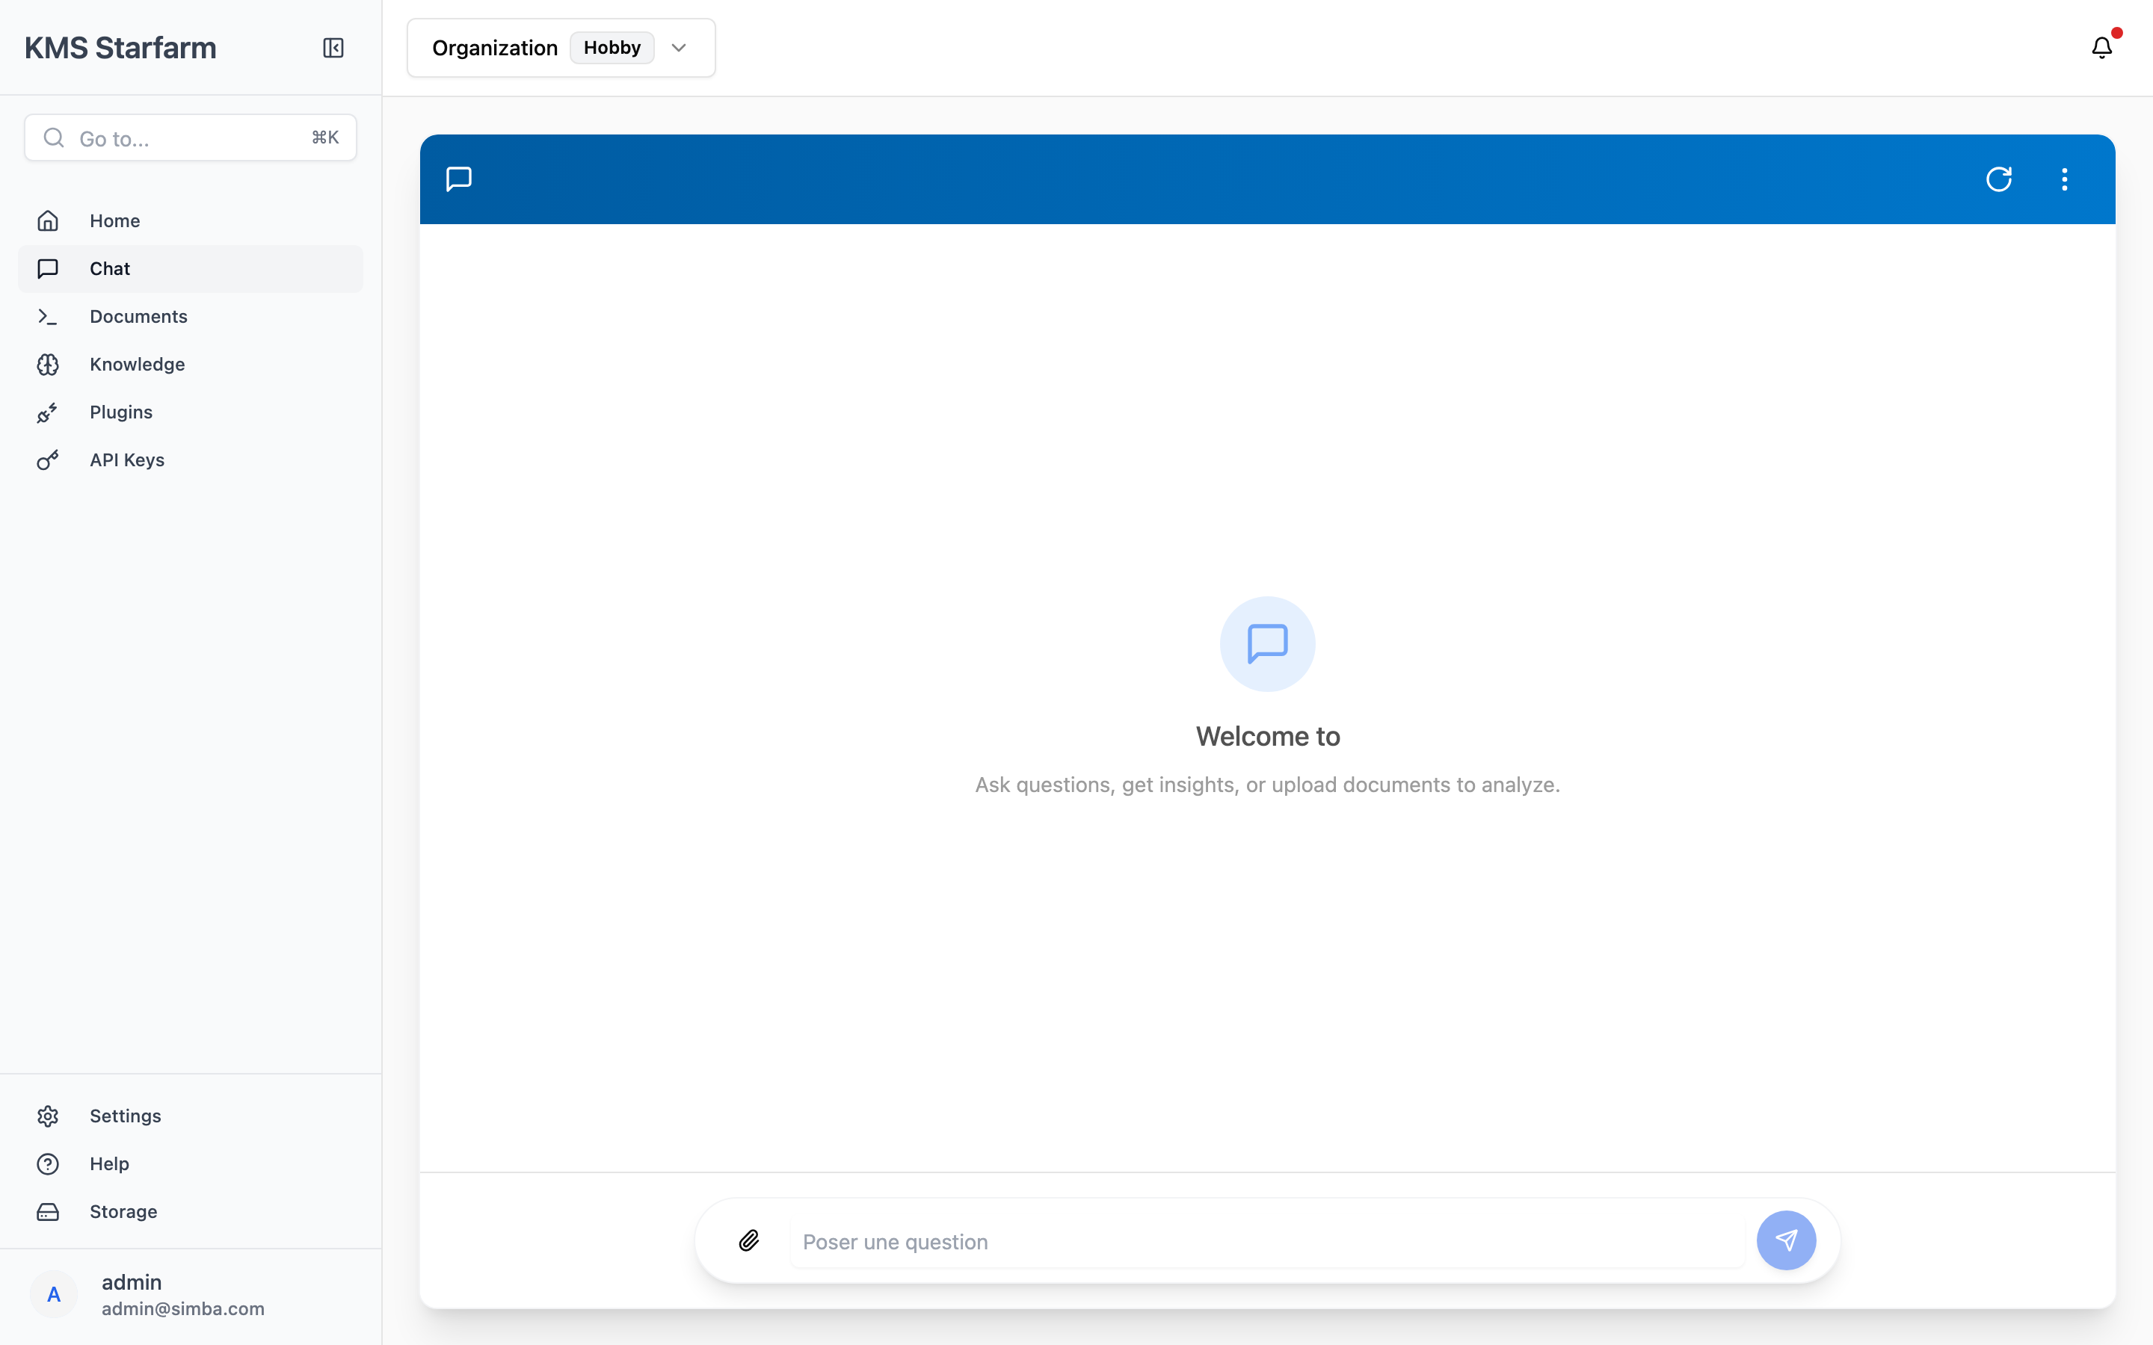
Conversational RAG Chat
Ask questions about your agricultural data
AI retrieves relevant documents via vector search
Streaming responses with source references
Upload documents directly from chat
Session persistence across page refreshes
Multiple retrieval strategies: semantic, keyword, hybrid

Slide 9
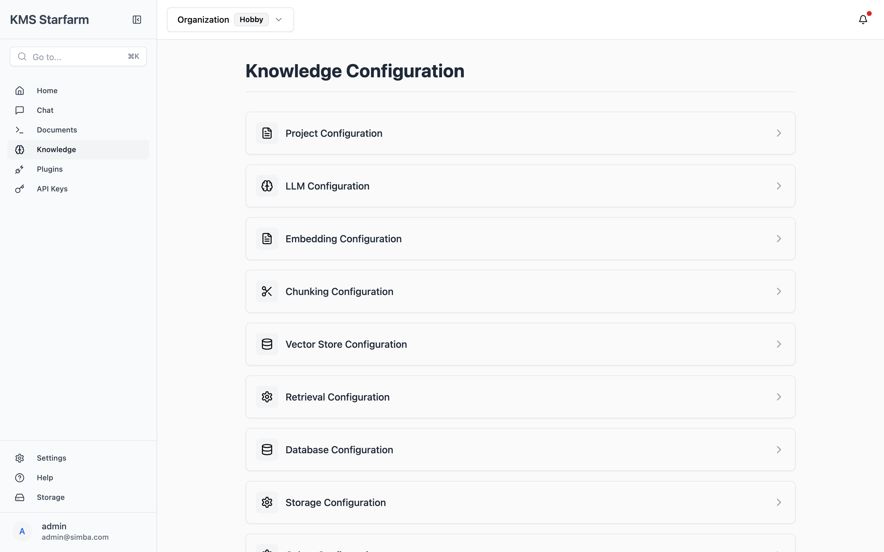
System Configuration
LLM Provider: Ollama (local inference)
Embedding: sentence-transformers/all-MiniLM-L6-v2
Vector Store: FAISS (local)
Database: LiteDB (local)
Task Queue: Celery + Redis
Parsing: Docling / Mistral OCR
All data stays on your machine

Slide 10
Architecture
Frontend
React + Vite + Tailwind CSS + shadcn/ui
Backend
FastAPI (Python) + Celery workers
LLM
Ollama (llama3.2 / qwen3.5) — local inference
Embeddings
HuggingFace sentence-transformers (local)
Vector Store
FAISS — fast similarity search
Database
LiteDB — lightweight document store
Task Queue
Redis + Celery — async parsing & summarization

Slide 11
Key Benefits
Local-first — all data and AI stay on your machine
AI-powered — automatic KPI extraction from any document format
Multi-chain analysis — Mango, Rice, Coconut value chains
Social inclusion — track across Worse-off, Cooperative, Independent groups
Conversational interface — ask questions, get answers from your data
Extensible — plugin architecture, REST API, SDK available
KMS Starfarm — Empowering Agricultural Knowledge Management

