Slide 1
Web App

Slide 2
Web Pages
Login screen, requiring user / password
Landing Page (navigation) to other charts/graphs
Price History (Product & Multiple products)
Promotions Overview (Product & Multiple products)
Assortiment Pie (Categories, nr of products)

Slide 3
Login Screen
Require user & password
No specific roles yet. Content is available for all users.

Slide 4
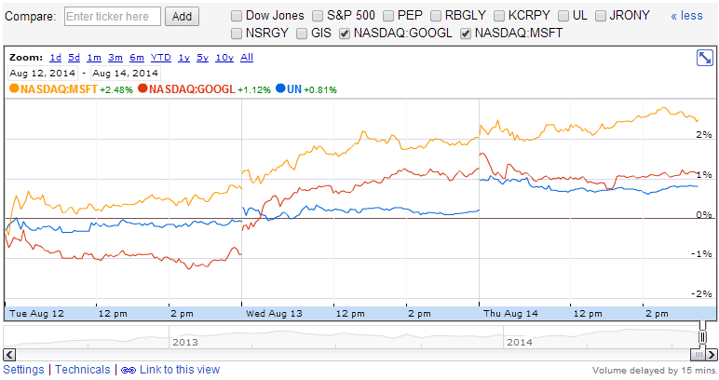
Price History - Page
Input: My SQLDatabase
With a prices table containing the price of a product for each dates
With a product table holding product details info
Output and user interactions
Ability to search through the product table with multiple criteria with the posibility to add filters after search results.
Productname search with free text
2 field with numeric value’s ( logical search criteria Between, higher etc)
Search on a 4 Level Hierarchy ( after Level 1 has been choosen, only the matching level 2’s should be shown in the search criteria
Graph should be similar as google finance

Slide 5
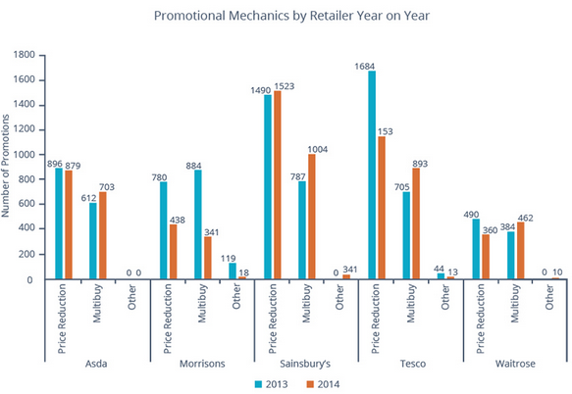
Promotions History - Page
Input: My SQLDatabase
With a prices table containing the prices and promotions of a product for each date
With a product table holding product details info
Category table Hierarchical (4 levels)
User interactions / Selection & Search Criteria
Ability to search through the product table with multiple criteria with the posibility to add filters after search results.
Productname search with free text
2 field with numeric value’s ( logical search criteria Between, higher etc)
Search on a 4 Level Hierarchy ( after Level 1 has been choosen, only the matching level 2’s should be shown in the search criteria
Graph should be like below

Slide 6
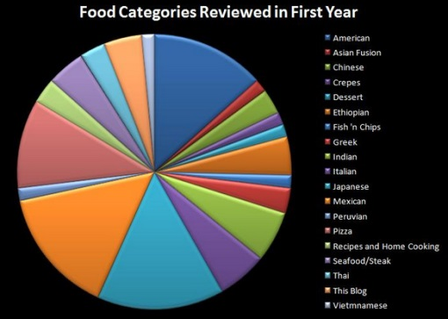

Assortiment Pie - Page
Input: My SQLDatabase
With a prices table containing the prices and promotions of a product for each date
With a product table holding product details info
Category table Hierarchical (4 levels)
User interactions / Selection & Search Criteria
Select collection by
Brands
Categories
Per RetailerS
Graph should be like below ( multiple graphs for different dates)
Nr of products in selected collection
Date 1
Date 2

