Slide 1
SPYFALL
GAME

Slide 2
MEET
THE
TEAM
“MEH”
Minho Park
sjp9635@gmail.com
mp52926
Elisha Kim
minjoy0321@gmail.com
tk25396
Harrison Nguyen
harrisonguyen.23@gmail.com
Hn6423

Slide 3
1
Strategy
Notes:
We separated logic for Spy and Non-Spy for our agent.

Slide 4
Goal: Deduce the location while avoiding suspicion.
Strategy:
Mixture of broad and specific questions to divert suspicion
Provide ambiguous but confident answers
- Included list of previously inferred locations in prompting
Question the most asked people to force others to ask least asked people
SPY

Slide 5
Goal: Identify the Spy without revealing the location.
Strategy:
Assign higher suspicion to vague, evasive, or hesitant answers.
Answer in general terms to avoid giving away the location
Ask everyone a question at least once then ask the most suspicious
Use specific questions for suspicious people, generic questions for others
NON-SPY

Slide 6
Goal: Protects the agent from prompt injection.
Strategy:
Sanitizes dangerous characters that can influence agent output.
Prompt the agent to not reveal their location or role until the end.
PROTECT

Slide 7
2
Performance

Slide 8
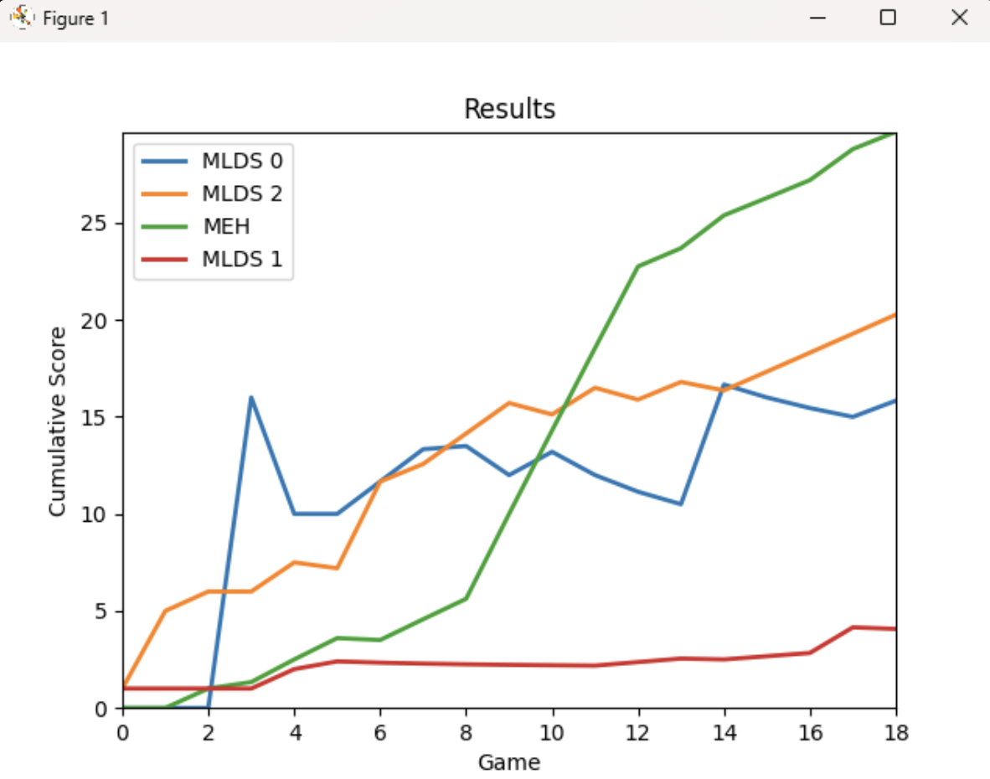
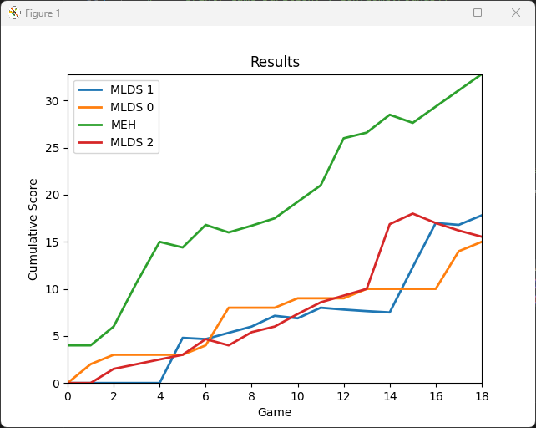
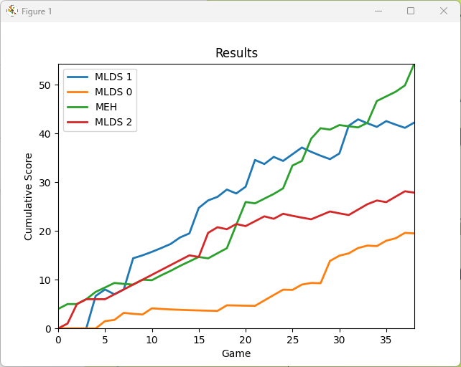
Performance Analysis of MEH Agent
Notes:
MEH consistently outperformed or competed well against other teams in most cases

Slide 9
THANKS
FOR
PLAYING

