Slide 1
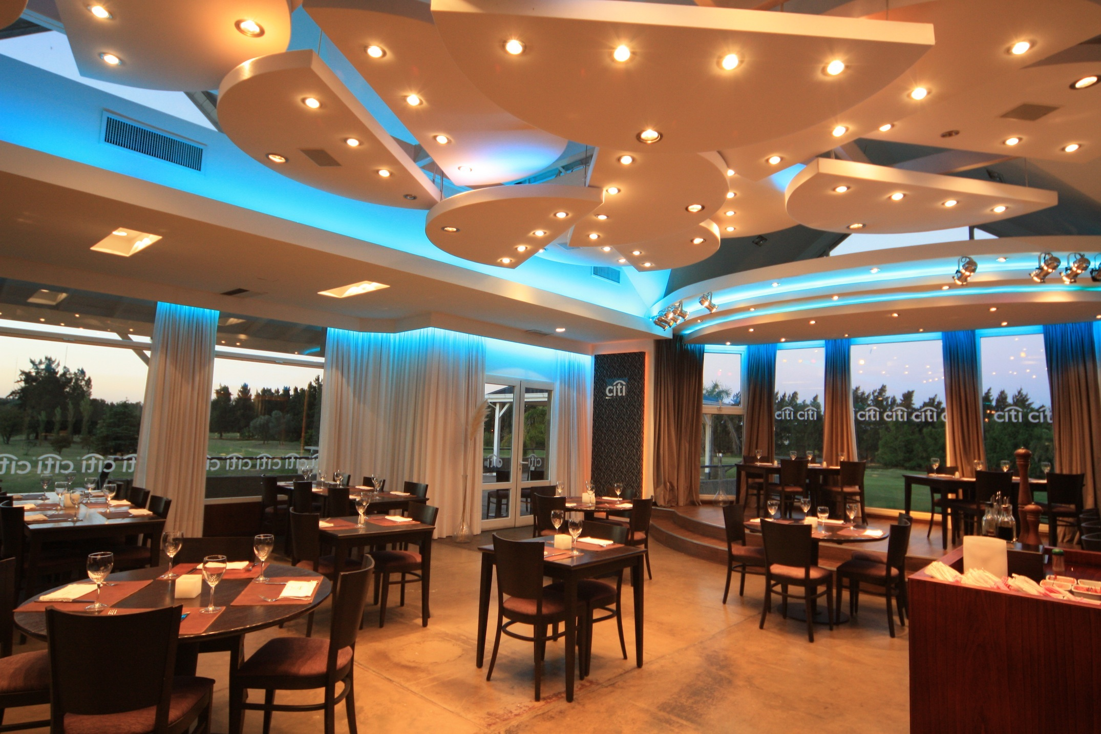
Restaurant Management

Slide 2
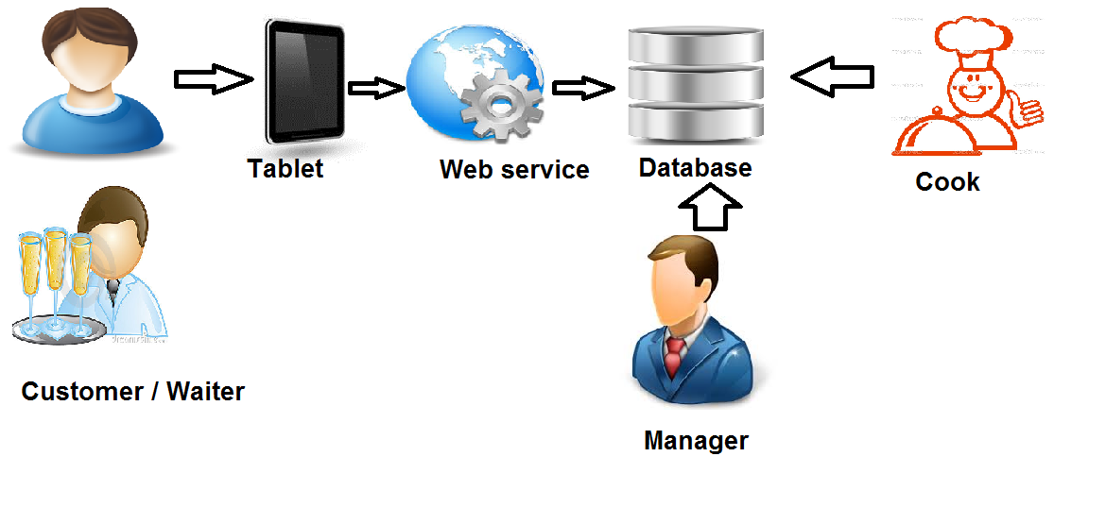

Slide 3
Tools for Development
Android Device:
Language : Java
Framework : Android SDK
Server side:
Language : Ruby / Javascript
Framework : Ruby on Rails
Source version control : Git
IDE : Eclipse / eMacs / vi
OS : Linux + Windows
Google.com

Slide 4
Issues
Database Design
Security
Data persistence

Slide 5
Thanks to
Pham Thi Thu Hoa
e-Order Team
Lai Duc Hung

